Slide 1

Systems Analysis and Design
Chapter 10: MVC model
Slides in this presentation contain hyperlinks. JAWS users should be able to get a list of links by using INSERT+F7
Notes:
If this PowerPoint presentation contains mathematical equations, you may need to check that your computer has the following installed:
1) MathType Plugin
2) Math Player (free versions available)
3) NVDA Reader (free versions available)

Slide 2
Learning Objectives
10.1 Definition
10.2 Different understanding of MVC
10.3 Types of MVC
10.4 Example of MVC in different technology

Slide 3
Definition (1 of 2)
MVC stands for Model-View-Controller (or 3-tier architecture)
The Model is the actual internal representation
The View (or a View) is a way of looking at or displaying the model
The Controller provides for user input and modification
These three components are usually implemented as separate classes

Slide 4
Definition (1 of 2)
MVC (or 3-tier) is known as:
Architecture
Pattern
Or Architectural Pattern
Trygve Reenskaug invented MVC
MVC were written when he was visiting a scientist at Xerox Palo Alto Research Laboratory (PARC) in 1978/79
At first, MVC was called “Thing Model View Editor” but rapidly changed it to “ Model View Controller”

Slide 5
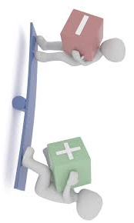
Pros and Cons
Advantages of MVC
MVC architecture will separate the user interface from business logic and business logic
Components are reusable.
Easy to maintain.
Different components of the application in MVC can be independently deployed and maintained.
This architecture helps to test components independently.
Disadvantages of MVC
The complexity is high.
Not suitable for small applications.
The inefficiency of data access in view.

Slide 6
The Model
Most programs are supposed to do work, not just be “another pretty face”
but there are some exceptions
useful programs existed long before GUIs
The Model is the part that does the work--it models the actual problem being solved
The Model should be independent of both the Controller and the View
But it provides services (methods) for them to use
Independence gives flexibility, robustness

Slide 7
The Controller
The Controller decides what the model is to do
Often, the user is put in control by means of a GUI
in this case, the GUI and the Controller are often the same
The Controller and the Model can almost always be separated (what to do versus how to do it)
The design of the Controller depends on the Model
The Model should not depend on the Controller

Slide 8
The View
Typically, the user has to be able to see, or view, what the program is doing
The View shows what the Model is doing
The View is a passive observer; it should not affect the model
The Model should be independent of the View, but (but it can provide access methods)
The View should not display what the Controller thinks is happening

Slide 9
Combining Controller and View
Sometimes the Controller and View are combined, especially in small programs
Combining the Controller and View is appropriate if they are very interdependent
The Model should still be independent
Never mix Model code with GUI code!

Slide 10
Learning Objectives
10.1 Definition
10.2 Different understanding of MVC
10.3 Types of MVC
10.4 Example of MVC in different technology

Slide 11
MVC Misunderstood
MVC is understood by different people in different ways
It is often misunderstood, but most software developers will say it is important; powerful
Lets start it right: MVC is a few patterns put together

Slide 12
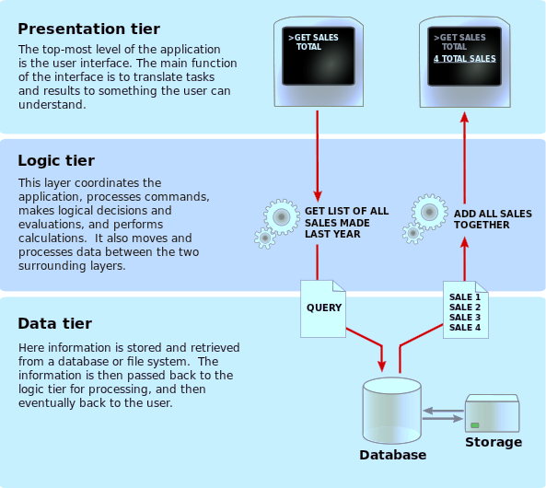
MVC: Different Understanding (1 of 3)
Separates representation of information from user interaction
Promotes:
Code Reusability
Separation of Concerns

Slide 13
MVC: Different Understanding (2 of 3)
VIEW
CONTROLLER
MODEL

Slide 14
Different understanding
MVC: Different Understanding (3 of 3)
CONTROLLER
VIEW
MODEL

Slide 15
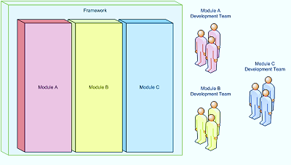
Code Reusability
Separation of Concerns
Application A
Application B
Improves code clarity and organization
Helps troubleshooting by isolating issues
Allows for multiple teams to develop simultaneously
Shortens development
Code Libraries
Design Patterns
Frameworks

Slide 16
Learning Objectives
10.1 Definition
10.2 Different understanding of MVC
10.3 Types of MVC
10.4 Example of MVC in different technology

Slide 17
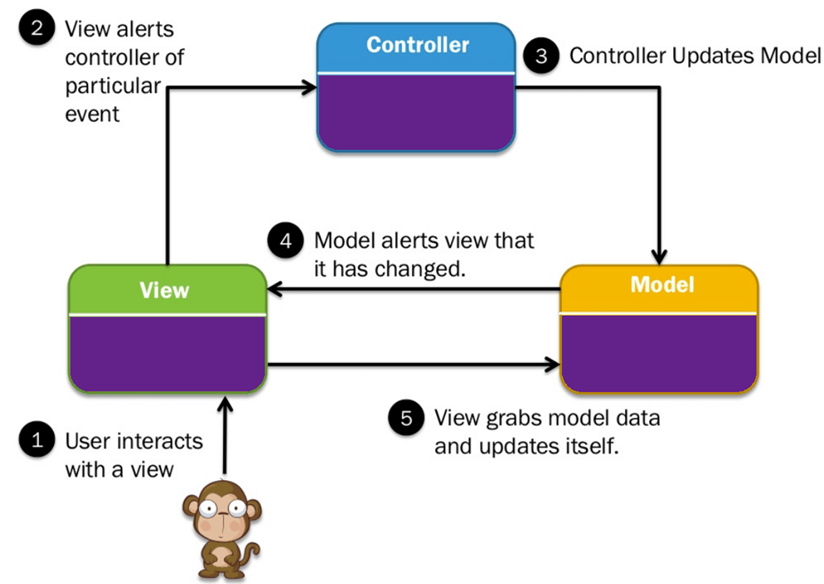
How MVC Work: 1st Type

Slide 18
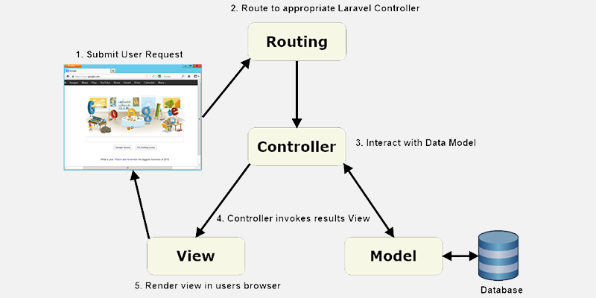
How MVC Work: 2nd Type

Slide 19
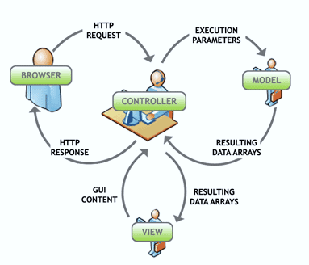
Execution Process
Controller – Mediates input and commands for the model or view
Model – Application data, business rules, logic, and functions.
View – Output and representation of data

Slide 20
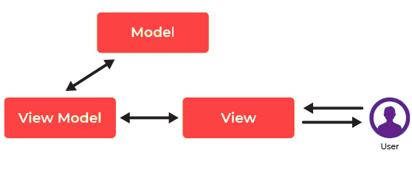
How MVC Work: MVVC Model
Instead of the controller of the MVC pattern, or the presenter of the MVP pattern, MVVM has a binder, which automates communication between the view and its bound properties in the view model
The view model has been described as a state of the data in the model
Notes:
Model:
Mô hình lưu trữ dữ liệu và logic liên quan. Nó đại diện cho dữ liệu đang được chuyển giữa các thành phần bộ điều khiển hoặc bất kỳ logic nghiệp vụ liên quan nào khác.
Ví dụ, một đối tượng Controller sẽ truy xuất thông tin học sinh từ cơ sở dữ liệu của trường. Nó thao tác dữ liệu và gửi nó trở lại cơ sở dữ liệu hoặc sử dụng nó để hiển thị cùng một dữ liệu.
View:
Chế độ xem là viết tắt của các thành phần giao diện người dùng như HTML, CSS, jQuery, v.v. Trong chế độ xem mẫu MVVC chịu trách nhiệm hiển thị dữ liệu nhận được từ Bộ điều khiển như một kết quả. Chế độ xem này cũng được chuyển đổi (các) Mô hình thành Giao diện người dùng (UI).
View Model:
View model có nhiệm vụ trình bày các hàm, lệnh, phương thức, hỗ trợ trạng thái của View. Nó cũng có trách nhiệm vận hành mô hình và kích hoạt các sự kiện trong Chế độ xem.

Slide 21
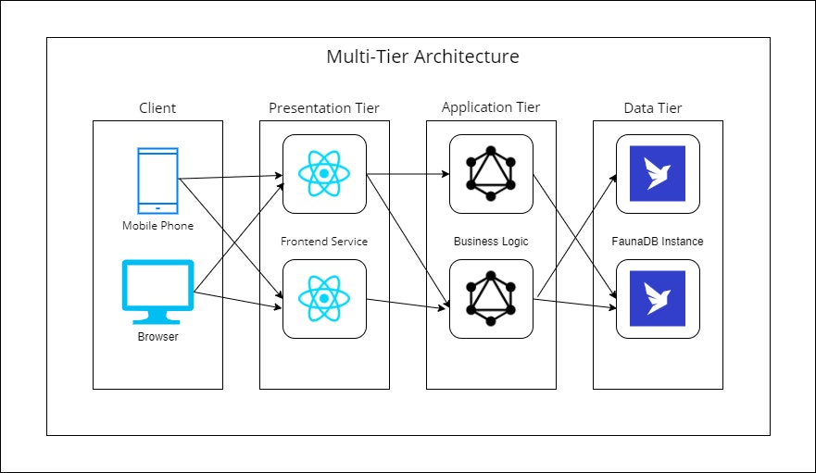
Improvement of MVC: Multitier architecture (or n-tier or multilayer)
Most common layers:
Client layer
Presentation layer
Application layer
Business layer
Integration layer
Data access layer
Service layer
Abstraction layer
Resource layer

Slide 22
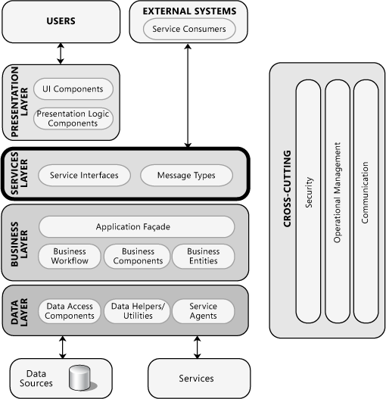
Microsoft Layered Application Architecture (1 of 2)
Layers are concerned with the logical division of components and functionality
Layers can be located on different tiers, or they may reside on the same tier

Slide 23
Microsoft Layered Application Architecture (2 of 2)
Design Steps for a Layered Structure:
Step 1 – Choose Your Layering Strategy
Step 2 – Determine the Layers You Require
Step 3 – Decide How to Distribute Layers and Components
Step 4 – Determine If You Need to Collapse Layers
Step 5 – Determine Rules for Interaction between Layers
Step 6 – Identify Cross Cutting Concerns
Step 7 – Define the Interfaces between Layers
Step 8 – Choose Your Deployment Strategy
Step 9 – Choose Communication Protocols

Slide 24
Learning Objectives
10.1 Definition
10.2 Different understanding of MVC
10.3 Types of MVC
10.4 Example of MVC in different technology

Slide 25
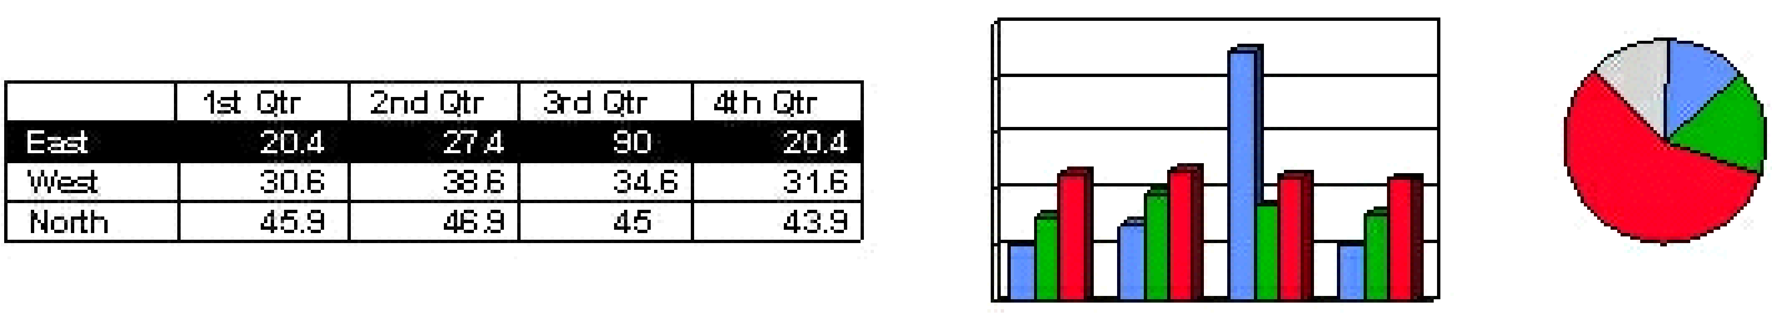
MVC: Example
Model:
float sales[3][4];
Controller:
Views:

Slide 26
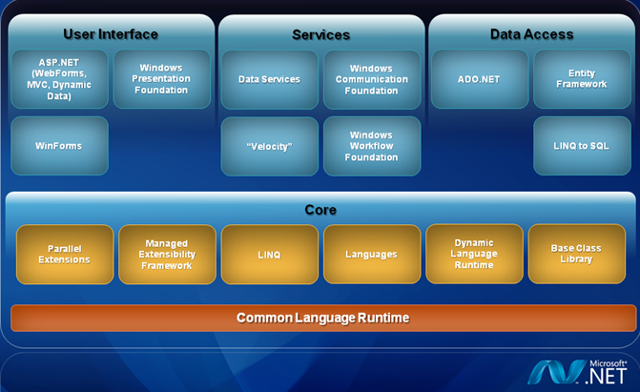
MVC: NET Framework
ASP.NET 4.0 Framework

Slide 27
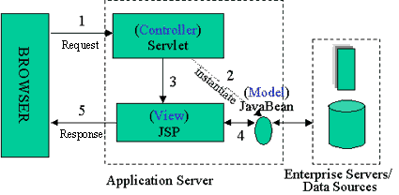
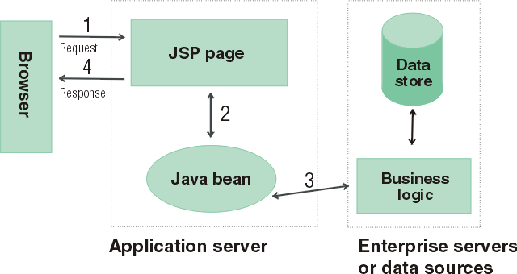
MVC: Java Server Pages
Model: Enterprise Beans with data in the DBMS
Controller: Servlets create beans, decide which JSP to return, do the bulk of the processing
View: The JSPs generated in the presentation layer (the browser)

Slide 28
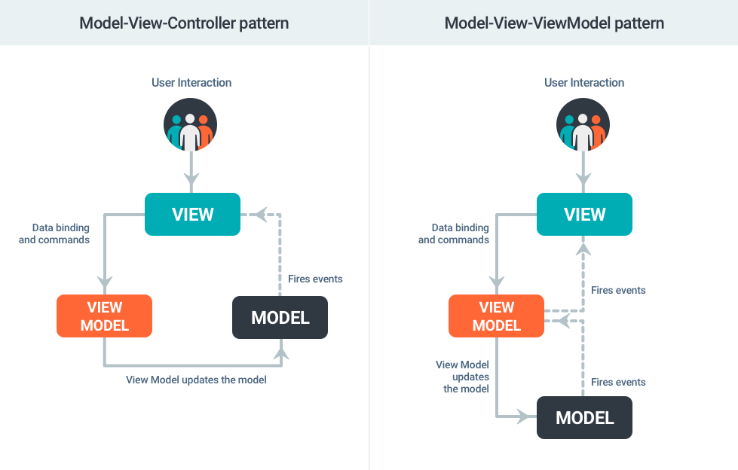
MVC: Android

Slide 29
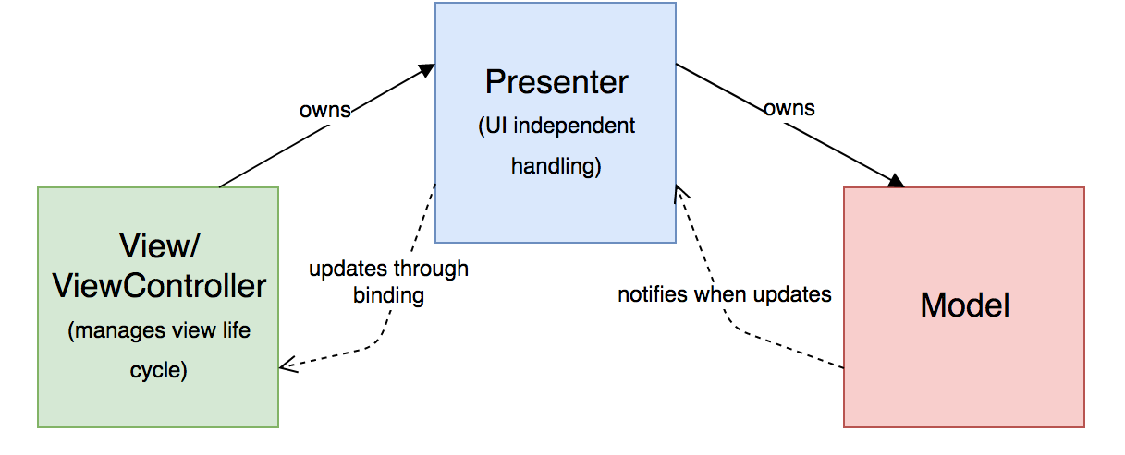
MVC: iOS
iOS has already recommended developers to follow MVC
Apple’s MVC is the modified version of the original MVC
But may fails for complex user interfaces

Slide 30
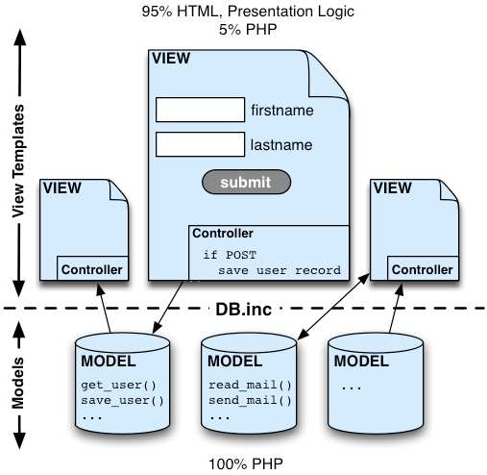
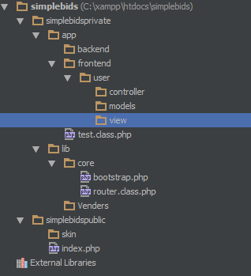
MVC: PHP

Slide 31
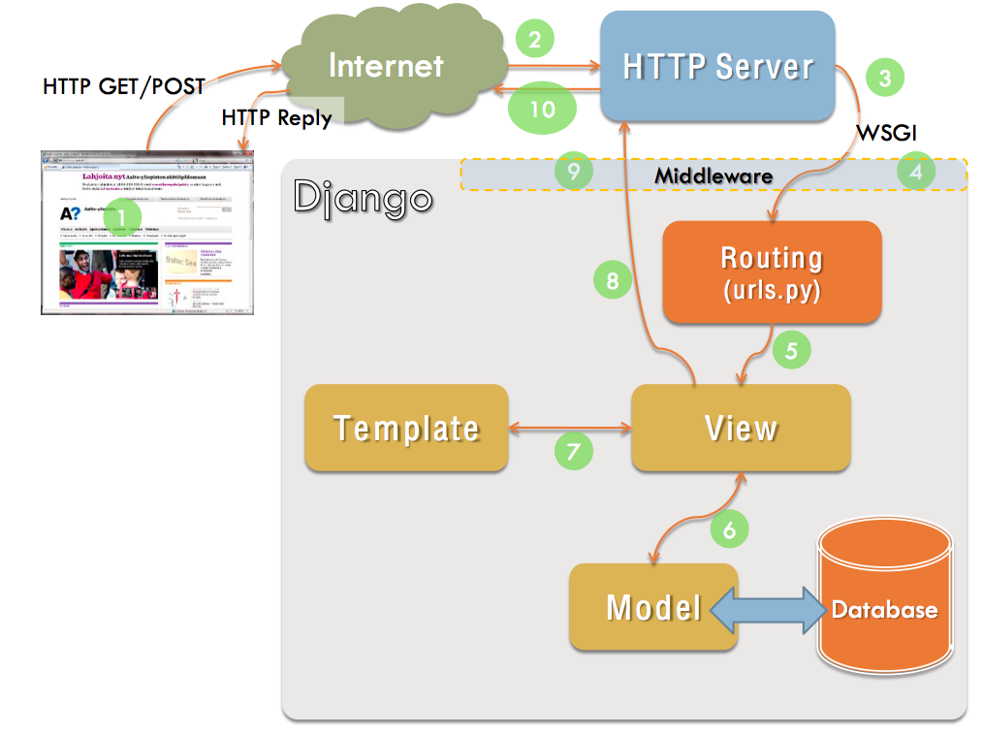
MVC: Python - Django

Slide 32
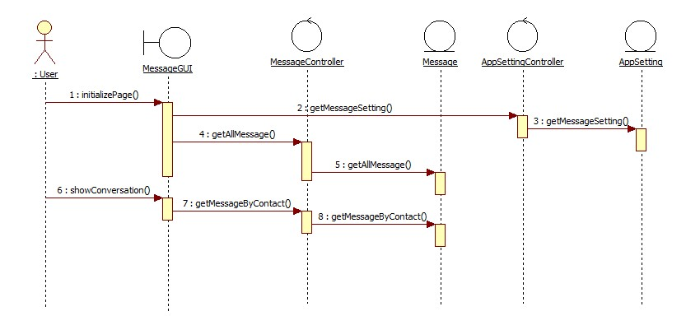
MVC: RUP
View: Boundary Controller: Controller Model: Entity

Slide 33
Key points
A Model does the “business logic”
It should be I/O free
Communication with the Model is via methods
This approach gives maximum flexibility in how the model is used
The Controller organizes the program and provides input (control) to the Model
The View displays what is going on in the model
It should never display what should be going on in the model
For example, if you ask to save a file, the View shouldn’t itself tell you that the file has been saved—it should tell you what the model reports
Especially in small programs, the Controller and View are often combined

Slide 34
The End
Give someone a program, you frustrate them for a day; teach them how to program, you frustrate them for a lifetime.
— David Leinweber

Slide 35

TIME TO WAKE UP

