Slide 1
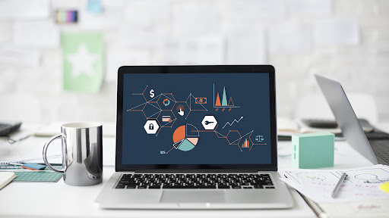
Systems Analysis and Design
Chapter 11: Software Reuse
Slides in this presentation contain hyperlinks. JAWS users should be able to get a list of links by using INSERT+F7
Notes:
If this PowerPoint presentation contains mathematical equations, you may need to check that your computer has the following installed:
1) MathType Plugin
2) Math Player (free versions available)
3) NVDA Reader (free versions available)

Slide 2
Learning Objectives
11.1 Definition
11.2 COTS product reuse
11.3 Component development for reuse
11.4 Function reuse

Slide 3

Definition (1 of 2)
In most engineering disciplines, systems are designed by composing existing components that have been used in other systems.
Software engineering has been more focused on original development but it is now recognized that to achieve better software, more quickly and at lower cost, we need to adopt a design process that is based on systematic software reuse.

Slide 4
Definition (1 of 2)
When you reuse program or design components, you have to follow the design decisions made by the original developer of the component
This may limit the opportunities for reuse
However, a more abstract form of reuse is concept reuse when a particular approach is described in an implementation independent way and an implementation is then developed
The two main approaches to concept reuse are:
Design patterns;
Generative programming.

Slide 5
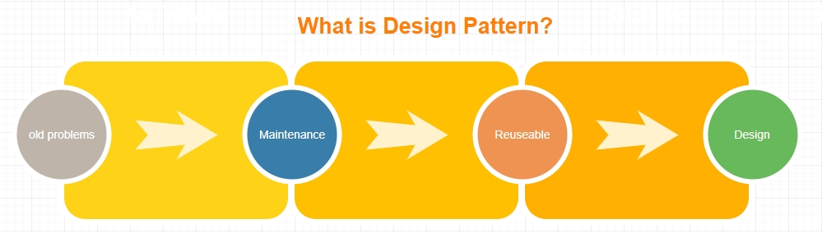
Design Patterns
A design pattern is a way of reusing abstract knowledge about a problem and its solution.
Description of the problem and the essence of its solution.
Should be sufficiently abstract to be reused in different settings.
Patterns often rely on object characteristics such as inheritance and polymorphism.

Slide 6
Generator-based Reuse
Program generators involve the reuse of standard patterns and algorithms.
These are embedded in the generator and parameterized by user commands. A program is then automatically generated.
Generator-based reuse is possible when domain abstractions and their mapping to executable code can be identified.
A domain specific language is used to compose and control these abstractions.

Slide 7
What can reuse? (1 of 3)
Application system reuse
The whole of an application system may be reused either by incorporating it without change into other systems (COTS reuse) or by developing application families
Component reuse
Components of an application from sub-systems to single objects may be reused
Object and function reuse
Software components that implement a single well-defined object or function may be reused

Slide 8
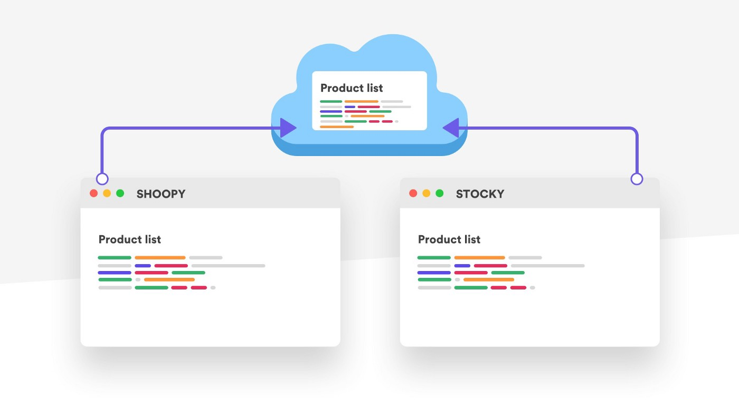
What can reuse? (2 of 3)
Another understanding:
Application system
Subsystem
Component
Module
Object
Function or Procedure

Slide 9
What can reuse? (3 of 3)
Reuse inside project:
Module
Object
Function
In another projects:
Application system
Subsystem
Component
Module
Object
Reusable classes
Subsystem A
Subsystem B
Module C
Module D
Project A
Project C
Project B

Slide 10
The Reuse Landscape (1 of 2)
Although reuse is often simply thought of as the reuse of system components, there are many different approaches to reuse that may be used.
Reuse is possible at a range of levels from simple functions to complete application systems.
The reuse landscape covers the range of possible reuse techniques.

Slide 11
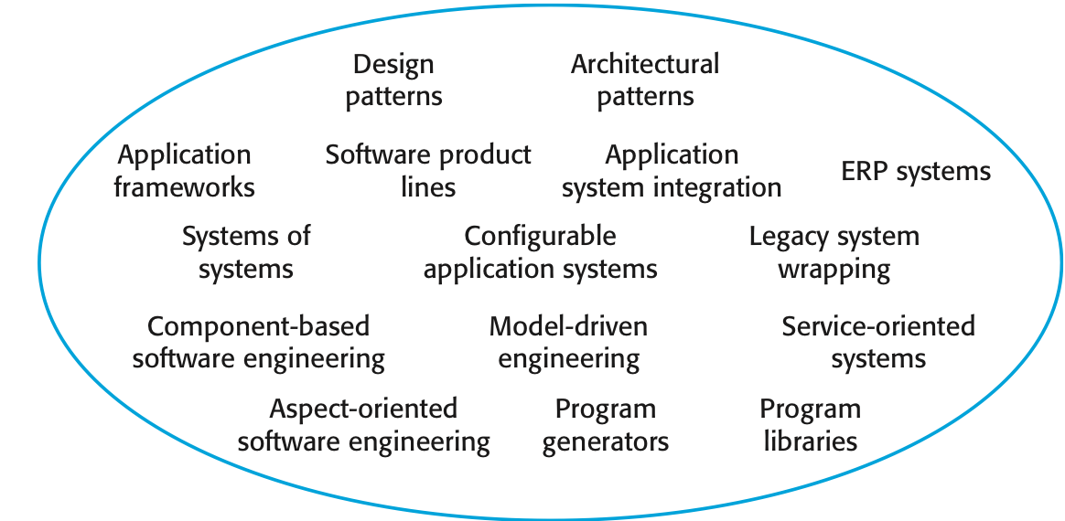
The Reuse Landscape (2 of 2)
Techniques of Reuse Landscape

Slide 12
Reuse: Pros and Cons
Problems:
Increased software (sw) maintenance costs
Lack of tool support
Not-invented-here syndrome
Difficult in creating and maintaining a component library
Finding and adapting reusable components
Benefits:
Increase software productivity, interoperability, more standardized
Shorten sw development time, develop sw with fewer people
Move personnel more easily from project to project
Reduce costs
Produce better quality sw and provide a powerful competitive advantage

Slide 13
Reuse Planning Factors
The development schedule for the software
The expected software lifetime
The background, skills and experience of the development team
The criticality of the software and its non-functional requirements
The application domain
The execution platform for the software

Slide 14
Reuse in High Level Programming Languages
Object codes (from different high-level programming languages) can be put together to make a library (.lib).
Binary codes are reusable as libraries on computers of the same architecture (compile-time sharing).
Libraries and object files on a computer are linked together to form an executable. (compile-time sharing of binary code).
A dynamically-linked library (.dll) can be shared by all programs on the same computer and by all the running processes on the same computer (run-time sharing).
Libraries (.lib and .dll) are machine-dependent

Slide 15
Learning Objectives
11.1 Definition
11.2 COTS product reuse
11.3 Component development for reuse
11.4 Function reuse

Slide 16
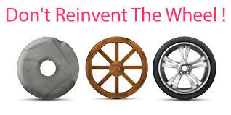
COTS Product Reuse
COTS - Commercial Off-The-Shelf systems
COTS systems are usually complete application systems that offer an API (Application Programming Interface)
Building large systems by integrating COTS systems is now a viable development strategy for some types of system such as E-commerce systems

Slide 17
COTS System Integration Problems
Lack of control over functionality and performance
COTS systems may be less effective than they appear
Problems with COTS system inter-operability
Different COTS systems may make different assumptions that means integration is difficult
No control over system evolution
COTS vendors not system users control evolution
Support from COTS vendors
COTS vendors may not offer support over the lifetime of the product

Slide 18
Learning Objectives
11.1 Definition
11.2 COTS product reuse
11.3 Component development for reuse
11.4 Function reuse

Slide 19
Component Development For Reuse
Components for reuse may be specially constructed by generalizing existing components
Component reusability
Should reflect stable domain abstractions
Should hide state representation
Should be as independent as possible
Should publish exceptions through the component interface
There is a trade-off between reusability and usability.
The more general the interface, the greater the reusability but it is then more complex and hence less usable

Slide 20
Reusable Components
The development cost of reusable components is higher than the cost of specific equivalents. This extra reusability enhancement cost should be an organization rather than a project cost
Generic components may be less space-efficient and may have longer execution times than their specific equivalents

Component without complex logic
REUSABLE

Component with complex logic
NOT REUSABLE

Slide 21
Reusability Enhancement
Name generalization
Names in a component may be modified so that they are not a direct reflection of a specific application entity
Operation generalization
Operations may be added to provide extra functionality and application specific operations may be removed
Exception generalization
Application specific exceptions are removed and exception management added to increase the robustness of the component
Component certification
Component is certified as reusable

Slide 22
Reusability Enhancement Process
Initial component
Name Generalization
Operation Generalization
Exception Generalization
Component Certification
Reuse component

Slide 23
Learning Objectives
11.1 Definition
11.2 COTS product reuse
11.3 Component development for reuse
11.4 Function reuse

Slide 24
Object & Function Reuse
Common technical functions which can be called from many others functions, e.g.:
Read/write Excel file
Validate number
Exception handling
Send email
Common business functions which can be used in another business processes, e.g. in Student Management System:
Get list of students
Get student’s information
Shared objects or share classes:
Header class, footer class
Constant variables, language packages

Slide 25
Code Library
Library of common functions
Library of module, component, subsystem
Project finish
Analyze which elements are reusable
Manage Code library
Add to Code library
New project
Decide which elements of Code library will be used
Maintain them

Slide 26
Key points
Advantages of reuse are lower costs, faster software development and lower risks.
Design patterns are high-level abstractions that document successful design solutions.
Program generators are also concerned with software reuse - the reusable concepts are embedded in a generator system.

Slide 27

TIME TO WAKE UP

