Slide 1
Usability - Learnability

Slide 2
Objective
- Review some design principles of learnability

Slide 3
Learnability
The ease that new users can begin effective interaction, achieve maximum performance.
Predictability
Synthesizability
Familiarity
Consistency
Generalizability

Slide 4
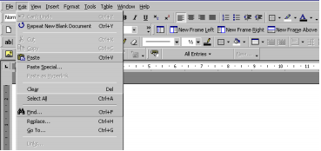
Predictability
- Predict + ability: Using knowledge of the interaction history, user easily determine the result of his future interaction with it.
Example:

Slide 5
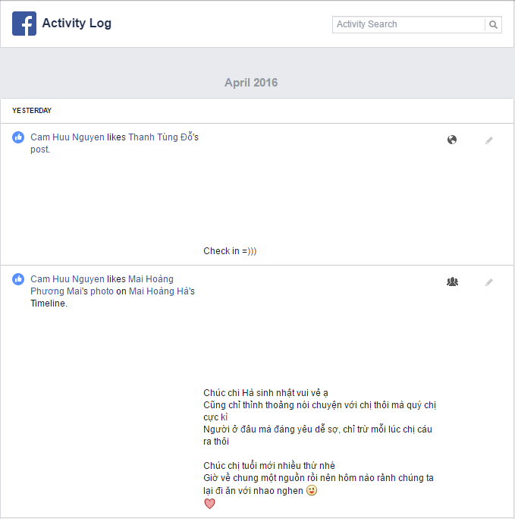

Synthesizability
Can access the effect of past action on current system state.

Slide 6
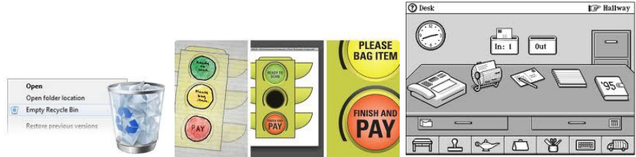
Familiarity
The extent to which a user's knowledge and experience in other real-world or computer-based domains can be applied when interacting with a new system

Slide 7
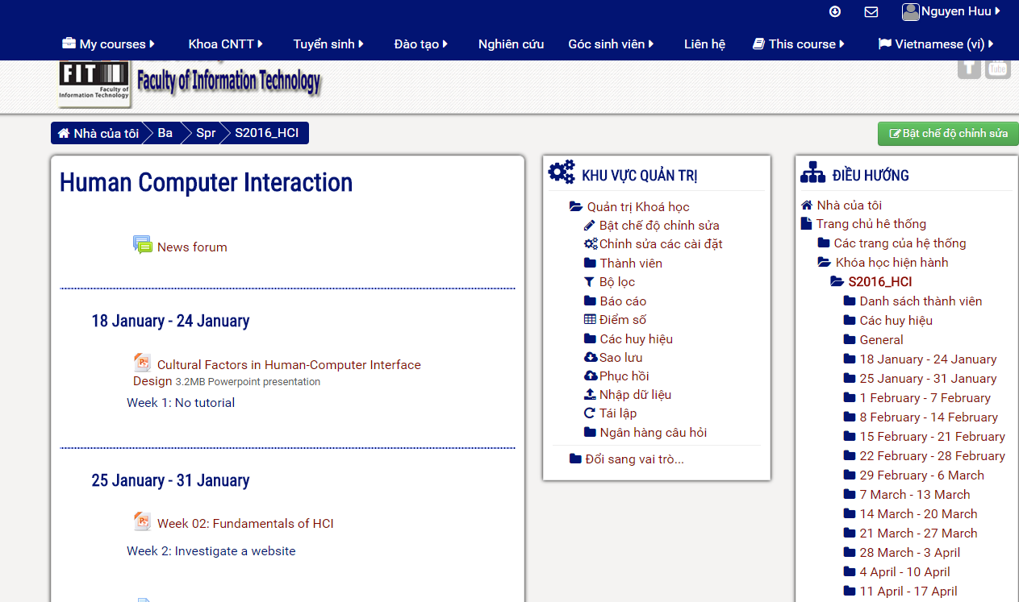
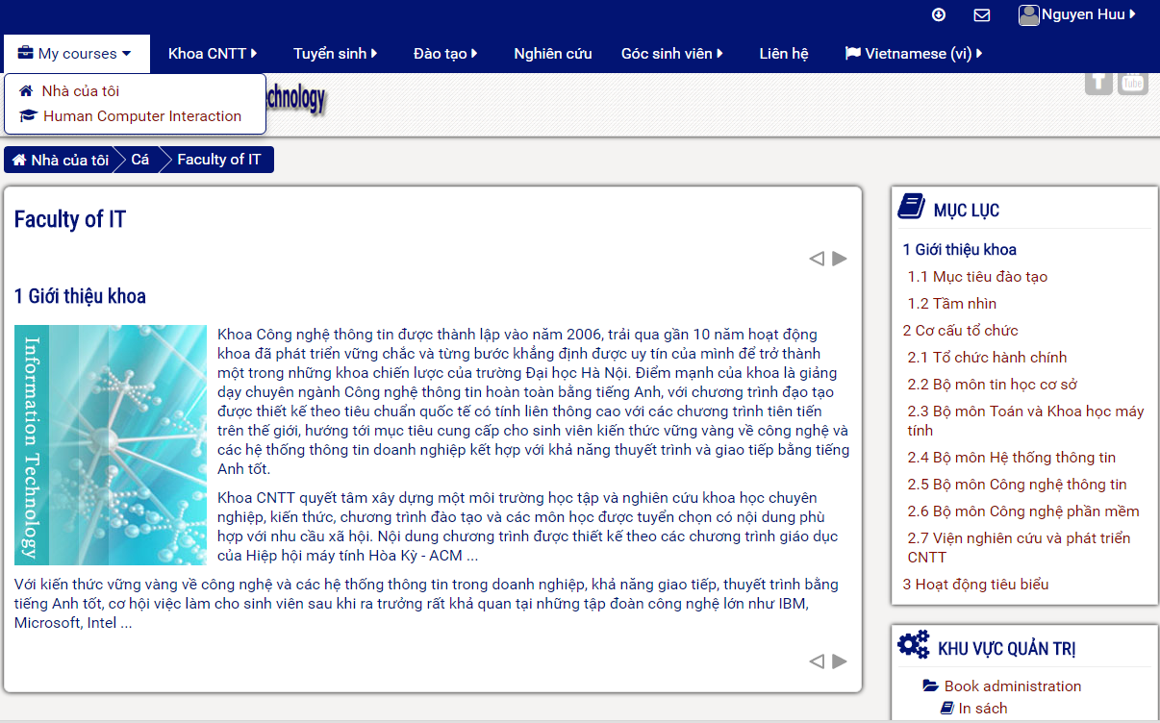
Consistency
Consistent : likeness in input/output behavior arising from similar situations or task objectives
When come to new system, without consistency principle, how can we navigate to corresponding action
Notes:
Examples: consistent patterns in layout; same short-cut keys for similar action; same placement for recurrent menu options. Always place the Quit command as the last item in the leftmost menu

Slide 8

Generalizability
Extending specific knowledge interaction within and across applications to other similar situations

