Slide 1
Learnability
Week 11

Slide 2
Objective
- Review some design principles of learnability
- Introduction to Basamiq Mockup.

Slide 3
Learnability
The ease that new users can begin effective interaction, achieve maximum performance.
Predictability
Synthesizability
Familiarity
Consistency
Generalizability

Slide 4
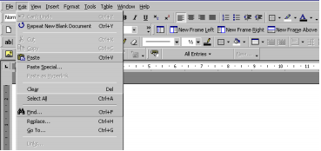
Predictability
- Predict + ability: Using knowledge of the interaction history, user easily determine the result of his future interaction with it.
Example:

Slide 5
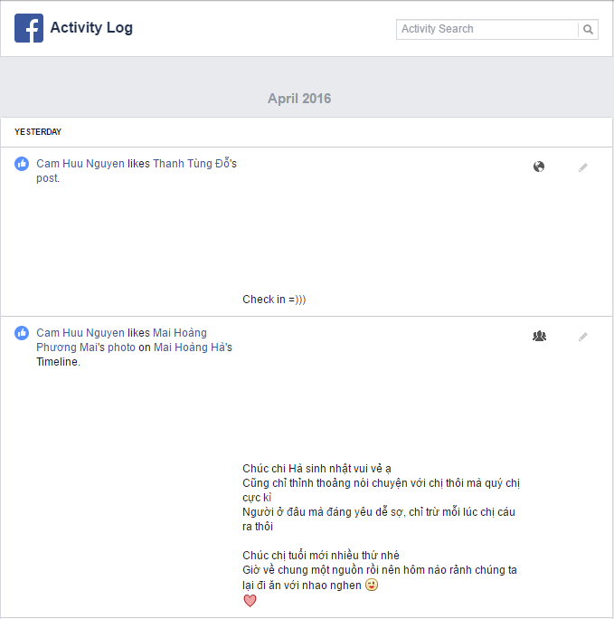

Synthesizability
Can access the effect of past action on current system state.

Slide 6
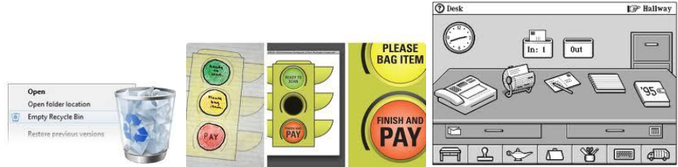
Familiarity
The extent to which a user's knowledge and experience in other real-world or computer-based domains can be applied when interacting with a new system

Slide 7
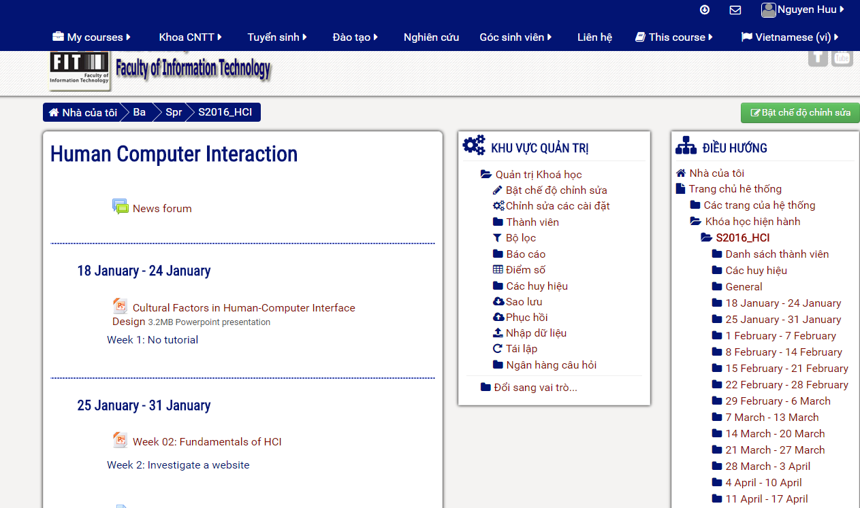
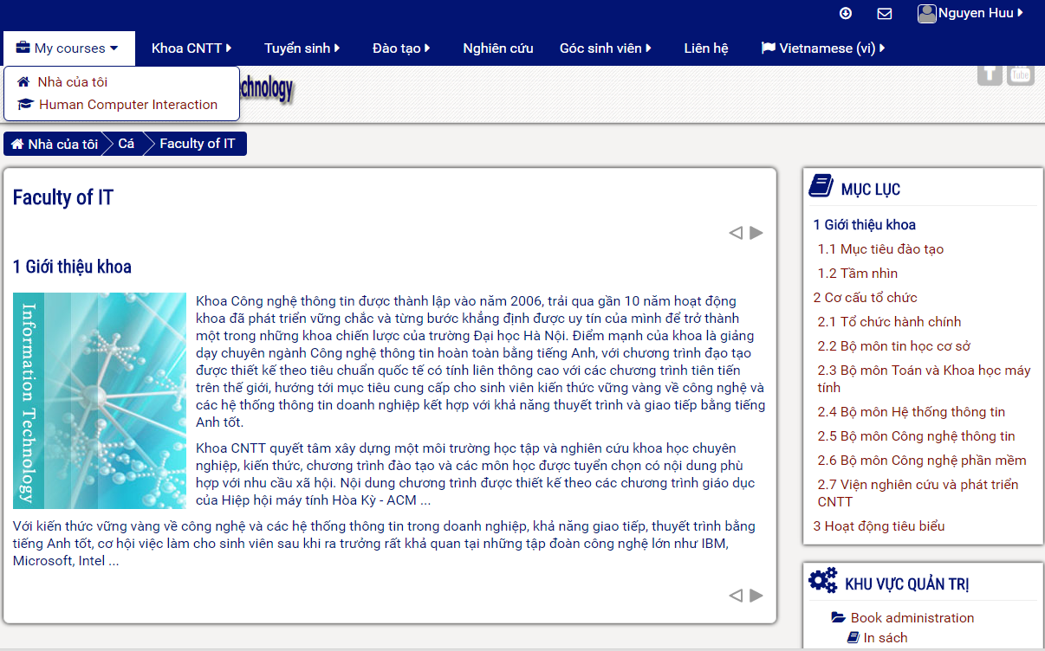
Consistency
Consistent : likeness in input/output behavior arising from similar situations or task objectives
When come to new system, without consistency principle, how can we navigate to corresponding action
Notes:
Examples: consistent patterns in layout; same short-cut keys for similar action; same placement for recurrent menu options. Always place the Quit command as the last item in the leftmost menu

Slide 8
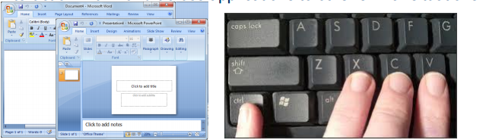
Generalizability
Extending specific knowledge interaction within and across applications to other similar situations

Slide 9
Flexibility
Week 12

Slide 10
Objective
- Review some design principles of flexibility

Slide 11
Flexibility
The multiplicity of ways the user and system exchange information.
Dialog initiative
Multithreading
Task migratibility
Substitutivity
Customizability

Slide 12
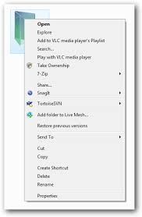
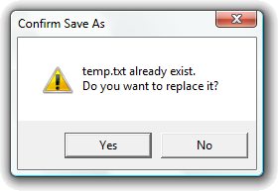
Dialog initiative
freedom from system imposed constraints on input dialogue
system vs. user pre-emptiveness: System/user initiates
dialog first
Example:

Slide 13
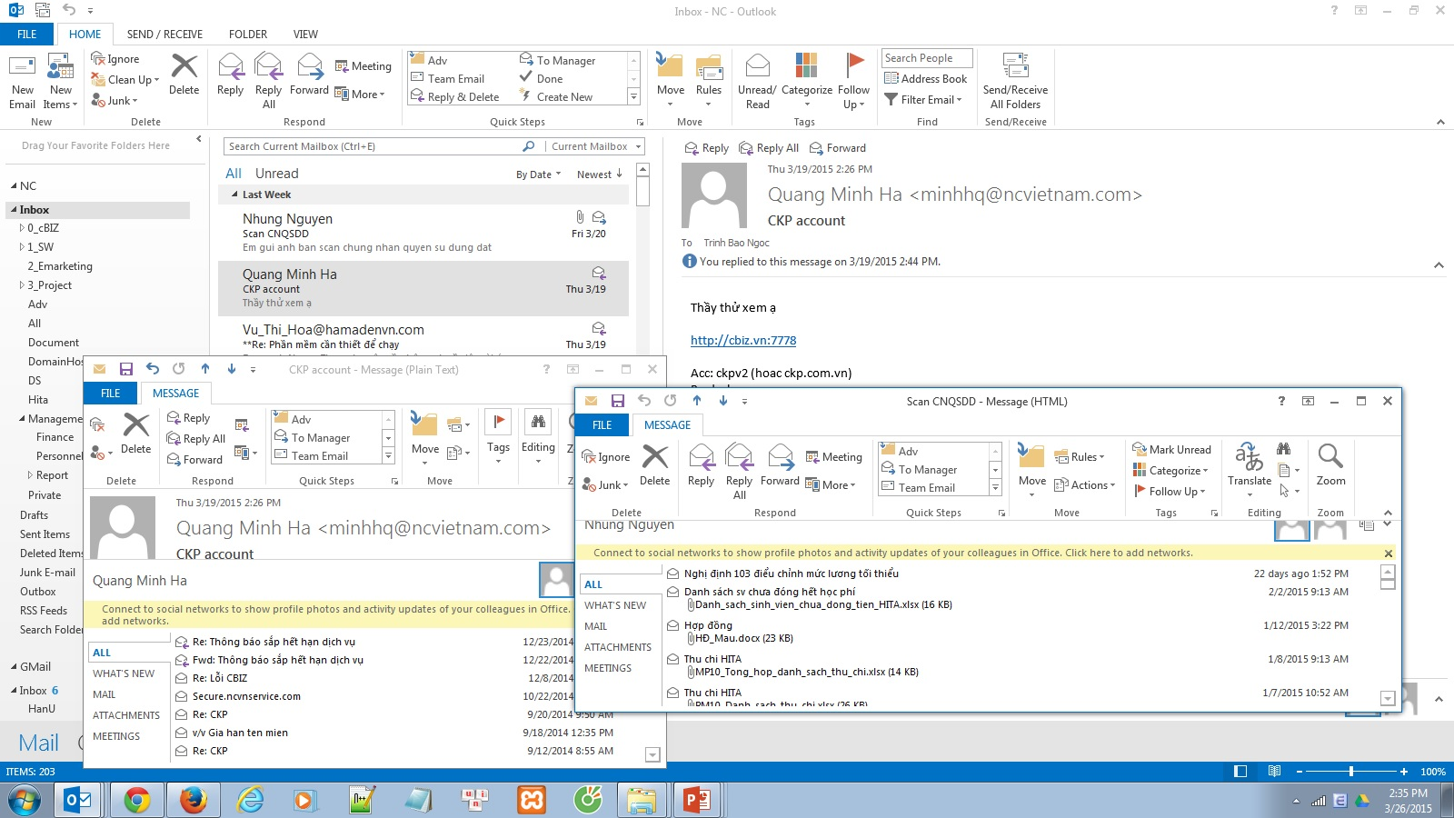
Multithreading
ability of system to support user interaction for more than one task at a time

Slide 14
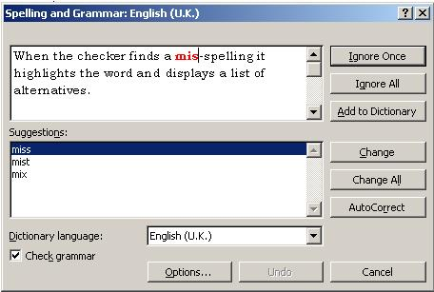
Task migratability
passing responsibility for task execution between user and system

Slide 15
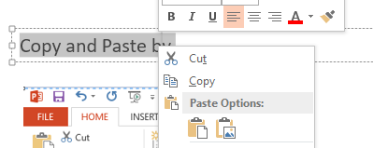
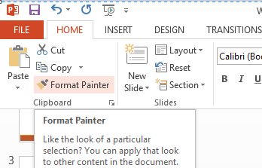
Substitutivity
Allowing equivalent values of input and output to be substituted for each other
Copy and Paste a text in PPTX by CTRL +C / CTRL+V

Slide 16
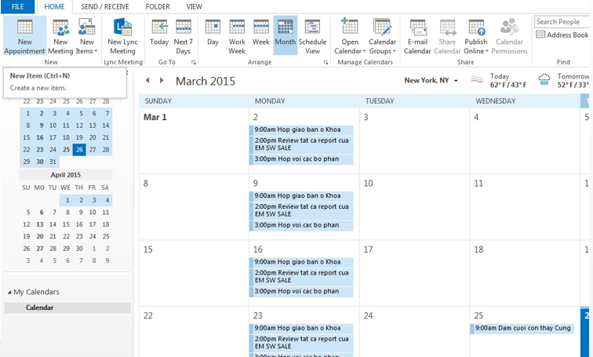
Customizability
modifiability of the user interface by user or system
Adaptivity & adaptability: System / user customizes user interface.

Slide 17
Robustness
W13

Slide 18
Outline
Understand robustness principles in human computer interaction

Slide 19
Robustness
Level of support provided for user to determine successful achievement and assess goals
Observability
Recoverability
Responsiveness
Task conformance

Slide 20
Observability
Evaluate system internal state based on interface representation. Often discussed in 5 other principles
Operation visibility: refers to how the user is shown the availability of operations that can be performed next
Browsability: Explore system state in a limited view provided at the interface.
Default: Assist user by giving default value (static/dynamically). Static: defined within the system or acquired at initialization. Dynamic: capture via user input and system load them as default.
Reachability: Navigate through observable state, whether the user can navigate from any given state to any other state
Persistence: deals with the duration of the effect of a communication act and the ability of the user to make use of that effect (sound/visual). For example, facebook “beep” notification => receive new notification
Visual

Slide 21
Example
Related to other principles learnt
Where am I? — immediate honesty with regard to system state
Where am I going? — operation predictability
Where have I been? — synthesisability
What can I do now? — predictability

Slide 22
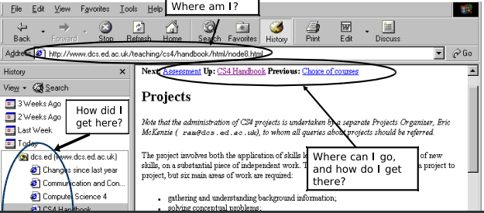

Slide 23
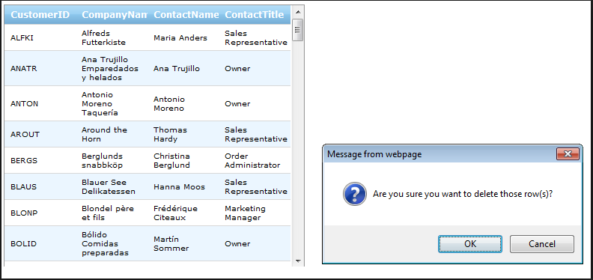
Recoverability
Ability to take corrective action when errors occur
Forward recoverability: Involves the acceptance of the current state and negotiation from that state towards the desired state. Involves prevention of error, engineered and initiate by system.

Slide 24

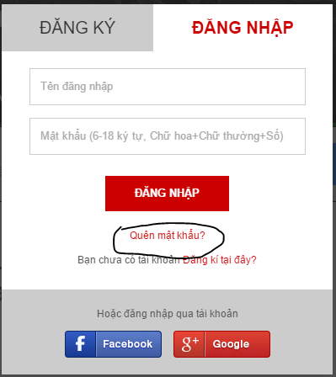

Backward recoverability: an attempt to undo the effects of previous interaction in order to return to a prior state before proceeding. Often initiate by user
Some applications

Slide 25
Characteristics
Reachability: User should be able to undo back to any point
user should be able to undo back to any point
Supported by reducing scope for making errors
avoid free-form input where possible, validate input immediately, allowing correction
… and ability of user to understand errors
error messages should be concise, informative, specific, constructive

Slide 26
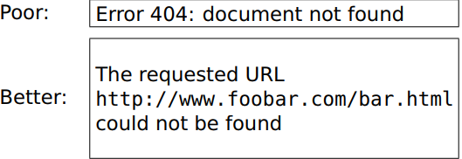

Slide 27
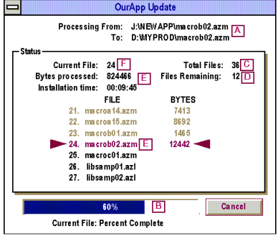
Responsiveness
Feedback should be commensurate (tương xứng) with action
If delay is inevitable, provide reassurance by time affordances.
A acceptance
B initiation and heartbeat
C progress
D scope and remainder
E exception
F progress and completion

Slide 28
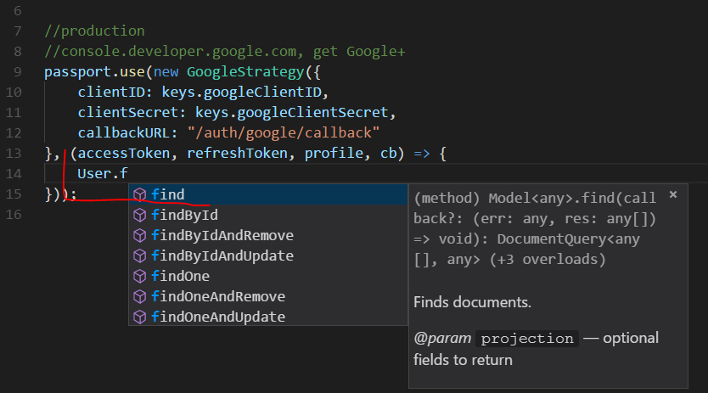
Task conformance
Degree to which system services support all tasks user wishes to perform in expected ways.

Slide 29
Reference
Dix, A. (1998). Human-computer interaction. London: Prentice Hall Europe.

