Slide 1
Topic 1:
Overview of Cryptography and Application
Vietnam National University Ho Chi Minh City, University of Science
Department of Information Technology
Assoc. Prof. Trần Minh Triết
PhD. Trương Toàn Thịnh

Slide 2
Introduction
Cryptography has been around for thousands of years.
For many centuries, the results of this field were mostly not applied in civilian areas of social life, but were mainly used in the military, political, and diplomatic fields. ...
Today, information encryption and security applications are being used more and more popularly in different fields around the world, from the fields of security, military, defense... to the fields of civil services such as e-commerce, banking, etc.

Slide 3
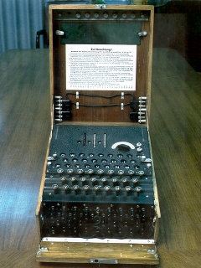
Cryptography
Cryptography is the science that studies mathematical techniques to provide information protection services.
W. Stallings (2003), Cryptography and Network Security: Principles and Practice, Third Edition, Prentice Hall
Terms:
  Cryptography
  Cryptanalysis
  Cryptology = Cryptography + Cryptanalysis
  Security
  Steganography

Slide 4
Cryptography???
Traditional understanding: keep the content of the exchange secret
Alice and Bob talk to each other while Eve tries to “eavesdrop”.
Alice
Bob
Eve

Slide 5
Some information problems
Confidentiality: ensuring information is kept confidential.
Integrity: ensures the integrity of information in communications or helps detect that information has been modified.
Authentication: authenticate the partners in the communication and authenticate the information content in the communication.
Non-repudiation: ensure that any partner in the system cannot deny responsibility for the action that he has taken

Slide 6
Authentication
Example:
  Bob waits Alice for “confirmation” until the working-time
  Need to make sure that Eve doesn't interfere to create fake “confirmations”
Two cases: online and offline
  Data origin authentication for offline
  Identification/Entity authentication for online
Alice
Bob
Eve

Slide 7
Integrity
Example:
  Bob needs to make sure he received exactly what Alice sent
  It is necessary to ensure that Eve does not intervene to correct the message that Alice sent to Bob
Integrity
Alice
Bob
Eve

Slide 8
Non-repudiation
Example:
  Bob receives a message that Alice sent
  Alice cannot "refute" not to send this message to Bob
Non-repudiation
Alice
Bob

Slide 9
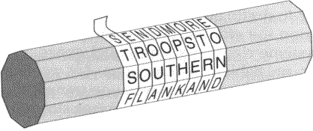
Brief history of the development of cryptography
Seals are used to seal important documents
Password is used to identify people in the organization…
L = 8
N = 32/L
Key
Plaintext
S | E | N | D | M | O | R | E
T | R | O | O | P | S | T | O
S | O | U | T | H | E | R | N
F | L | A | N | K | A | N | D
Ciphertext
https://asecuritysite.com/encryption/rust_scy

Slide 10
Ancient ciphers
Atbash method:
  Used in ancient Hebrew “בבל = ששך”
Caesar method:
  Anyone know this encryption rule to easily decrypt the message
ת | ש | ר | ק | צ | פ | ע | ס | נ | מ | ל | כ | י | ט | ח | ז | ו | ה | ד | ג | ב | א
א | ב | ג | ד | ה | ו | ז | ח | ט | י | כ | ל | מ | נ | ס | ע | פ | צ | ק | ר | ש | ת
A | B | C | … | X | Y | Z
D | E | F | … | A | B | C

Slide 11
Ancient ciphers
The Caesar method is a special case of the Shift Ciphers method.
Shift Cipher method: characters are rotated to K positions in the alphabet. K is considered the key for decryption
Both the Atbash and Shift Cipher methods are special cases of the general method used in antiquity: the “mono-alphabetic substitution cipher” method.
A | B | C | … | X | Y | Z
D | E | F | … | A | B | C

Slide 12

Ancient ciphers
Not all ancient coding methods used the substitution method.
First encoder: Spartan scytale (encryption stick)
Using this device, the letters in the message are not changed, but only the position of the messages appear (Transposition).
https://plus.maths.org/content/os/issue34/features/ekert/index

Slide 13
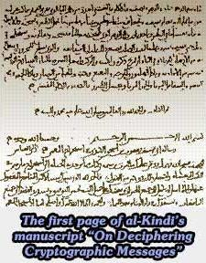
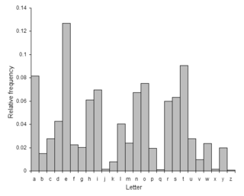
Ancient ciphers
According to recorded documents, the method of frequency analysis has been used since the 9th century
Coding in Europe had almost no development from antiquity to the 14th century!!!
https://plus.maths.org/content/os/issue34/features/ekert/index
https://en.wikipedia.org/wiki/Caesar_cipher

Slide 14
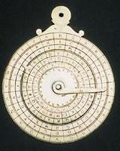
Renaissance ciphers
In Italy, as in other European countries, cryptography began to be developed again
Countries and cities began looking for experts in cryptography and code breaking to encrypt and decrypt messages.
The encryption method of this stage is usually “Poly-alphabetic substitution cipher”.
Many cryptographic tools are made and used

Slide 15
Renaissance ciphers
Multi-character substitution encoding can be viewed as using multiple consecutive single-character substitutions.
Usually use the Cipher Disk tool, or use the lookup table to help encrypt and decrypt
The main (classical) technique used to break the Multi-Character Replacement cipher system consists of 2 steps:
  Find out the length of the cycle
  Apply analytical techniques (for single-character substitution encoding) + information obtained from previous characters

Slide 16

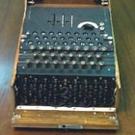
The 19th and early 20th centuries ciphers
Encryption was widely used during World War I
The development of radio waves and radios made communication in the military easier and more common.
Requires devices that support encryption and decryption => encoders are born
World War II: the war on science, including cryptography.
Enigma (Germany) cipher machine decrypted by British military
Japanese ‘Purple’ encoder decrypted by US military
Notes:
Cryptography in the 19th and 20th Centauries
Telegraph and Morse code revolutionize communications.
Many mechanical and electro-mechanical devices invented for encrypted communications.
Telegraphy and flags used in American civil war extensively, but relatively few interesting codes were used.

Slide 17
Cryptography system
A cryptosystem is a set of five (P, C, K, E, D) that satisfy the following conditions:
  Source set P is the finite set of all possible source messages to be encrypted
  Target set C is the finite set of all possible messages after encryption
  Key set K is a finite set of keys that can be used
  E and D are the encryption and decryption rules, respectively. For each k ∈ K, there exists an encryption rule e_{k} ∈ E and a decryption rule d_{k} ∈ D. Encryption rule e_{k}: P → C and decryption rule e_{k}: C → P are two functions satisfying d_{k}(e_{k}(x)) = x, ∀x ∈ P
Ensure that a message x encrypted with the encryption rule e_{k} can be correctly decrypted with the rule d_{k}

Slide 18
Cryptography system
Example of a cryptosystem:
  Let P = {m₁, m₂, m₃}, C = {c₁, c₂, c₃} ⇒ 3 × 2 × 1 = 6 bijections: P → C. So, we have K = {1, 2, 3, 4, 5, 6}
e₁
e₂
e₃
e₄
e₅
e₆
m₁
c₁
m₁
c₁
m₁
c₁
m₁
c₁
m₁
c₁
m₁
c₁
m₂
c₂
m₂
c₂
m₂
c₂
m₂
c₂
m₂
c₂
m₂
c₂
m₃
c₃
m₃
c₃
m₃
c₃
m₃
c₃
m₃
c₃
m₃
c₃
d₁
d₂
d₃
d₄
d₅
d₆
c₁
m₁
c₁
m₁
c₁
m₁
c₁
m₁
c₁
m₁
c₁
m₁
c₂
m₂
c₂
m₂
c₂
m₂
c₂
m₂
c₂
m₂
c₂
m₂
c₃
m₃
c₃
m₃
c₃
m₃
c₃
m₃
c₃
m₃
c₃
m₃

Slide 19




Symmetric cipher



Slide 20




Asymmetric cipher



Slide 21
Compare Symmetric & Asymmetric ciphers
Fast processing
Slow processing
Short key-length
Long key-length
Difficult to exchange keys
Easy to exchange keys

Slide 22
Design in the direction of cryptographic analysis
Determine the problem
Recommend solution
Bug!
Adjust the solution
Adjust the solution
Bug!
Use
Implement
Implement
Use
Bug!
Adjust the solution
…

Slide 23
Provable-Security approach
Determine the problem
Define
Scheme
Simplify the problem
Implement
Finish

Slide 24
Concept of Z_{m}
Z_{m} is a set of {0, 1, …, m-1}, equipped with addition operator (denote +) and multiplication operator (denote ×).
Addition and multiplication in Z_{m} are similar to Z, except for the result modulo m modulo m
Example:
  Assume we need compute in Z₁₆.
  In Z, we have 11 × 13 = 143
  Because 143 ≡ 15 (mod 16), so 11 × 13 = 15 in Z₁₆.

Slide 25
Properties of Z_{m}
Addition of Z_{m}
  Closure: ∀a, b ∈ Z_{m}, a + b ∈ Z_{m}
  Commutativity: ∀a, b ∈ Z_{m}, a + b = b + a
  Associativity: ∀a, b, c ∈ Z_{m}, (a + b) + c = a + (b + c)
  Z_{m} has a neutral element 0, ∀a, b ∈ Z_{m}, a + 0 = 0 + a = a
  For each a ∈ Z_{m}, there is an opposing element (m – a) ∈ Z_{m}
Multiplication of Z_{m}
  Closure: ∀a, b ∈ Z_{m}, a × b ∈ Z_{m}
  Commutativity: ∀a, b ∈ Z_{m}, a × b = b × a
  Associativity: ∀a, b, c ∈ Z_{m}, (a × b) × c = a × (b × c)
  Z_{m} has a unit element 1, ∀a, b ∈ Z_{m}, a × 1 = 1 × a = a
  Distribution of ‘×’ with ‘+’: ∀a, b, c ∈ Z_{m}, (a + b) × c = a × c + b × c

