Slide 1
Topic 2:
Symmetric Cipher
Vietnam National University Ho Chi Minh City, University of Science
Department of Information Technology
Assoc. Prof. Trần Minh Triết
PhD. Trương Toàn Thịnh

Slide 2
Introduction
Symmetric cryptosystem
  Conventional cryptosystem
  An encryption system in which the encryption and decryption processes both use the same key – secret key.
  The security of information depends on the security of the key.
Traditional methods use:
  Substitution: replace 1 word/character with another word/character
  Transposition: characters are changed their positions
Substitution/Transposition can be done with:
  Mono-alphabetic
  Poly-alphabetic

Slide 3




Symmetric cipher



Slide 4
Shift cipher
Shift Cipher:
  One of the oldest methods used for encryption
  The message is encrypted by rotating each character by k places in the alphabet
  The case with k = 3 is called the Caesar encryption method.
Let P = C = K = Z_{n}. For each k ∈ K we have:
  e_{k}(x) = x + k mod n and d_{k}(y) = y – k mod n, for x, y ∈ Z_{n}
  E = {e_{k}, k ∈ K} and D = {d_{k}, k ∈ K}
Properties:
  Simple
  Encryption and decryption processing is done quickly
  Key-space K = {0, 1, 2, …, n - 1} = Z_{n}
  Easily broken by trying every possible key

Slide 5
Shift cipher
Example: to encrypte a message represented by the letters A to Z (26 letters), we use Z₂₆.
  Encrypted messages are not secure and can be easily decrypted by trying one after another, 26 keys.
  On average, an encrypted message can be decrypted in about 26/2 = 13 tries.
Ciphertexts: JBCRCLQRWCRVNBJENBWRWN
Try k = 0, 1, 2, … 25
k = 0 | jbcrclqrwcrvnbjenbwrwn | k = 5 | ewxmxglmrxmqiweziwrmri
k = 1 | iabqbkpqvbqumaidmavqvm | k = 6 | dvwlwfklqwlphvdyhvqlqh
k = 2 | hzapajopuaptlzhclzupul | k = 7 | cuvkvejkpvkogucxgupkpg
k = 3 | gyzozinotzoskygbkytotk | k = 8 | btujudijoujnftbwftojof
k = 4 | fxynyhmnsynrjxfajxsnsj | k = 9 | astitchintimesavesnine

Slide 6
Substitution cipher
Substitution Cipher:
  Well-known and widely used encryption method for hundreds of years
  Encrypt the message by permuting the elements of the alphabet or, more generally, permuting the elements in the source set P.
Let P = C = Z_{n}, K are the sets of permutations of n elements 0, 1, …, n – 1. So, for each π ∈ K, a permutation of n elements 0, 1, …, n – 1. For each key π ∈ K, define:
  e_{π}(x) = π(x) and d_{π}(y) = π⁻¹(y), for x, y ∈ Z_{n}
  E = {e_{π}, π ∈ K} and D = {d_{π}, π ∈ K}
Properties:
  Simple, encryption and decryption are done quickly
  Key-space K has n! keys
  Overcoming the limitation of the Shift-Cipher method: It is impossible to attack by exhausting the key values ​​k ∈ K
Really secure???

Slide 7
Substitution cipher
AO VCO JO IBU RIBU
Attacks based on the occurrence of characters in the language
AO VCO JO IBU RIBU
?A H?A ?A ?NG ??NG
MA HOA VA UNG DUNG

Slide 8
Substitution cipher
Frequency analysis
  Character: E > T > R > N > I > O > A > S
  Digraph: TH > HE > IN > ER > RE > ON > AN > EN
  Trigraph: THE > AND > TIO > ATI > FOR > THA > TER > RES
L FDPH L VDZ L FRQTXHUHG
L FDPH L VDZ L FRQTXHUHG
i ?a?e i ?a? i ?????e?e?
i came i saw i conquered

Slide 9
Affine cipher
Let P = C = Z_{n}, K = {(a, b) ∈ Z_{n} × Z_{n}: gcd(a, n) = 1}. For each key k = (a, b) ∈ K, define:
  e_{k}(x) = (ax + b) mod n and d_{k}(y) = a⁻¹(y - b) mod n, for x, y ∈ Z_{n}
  E = {e_{k}, k ∈ K} and D = {d_{k}, k ∈ K}
For correct decrypt then e_{k} must be a bijection ⇒ gcd(a, n) = 1
Shift
Cipher
Substitution Cipher
Affine
Cipher

Slide 10
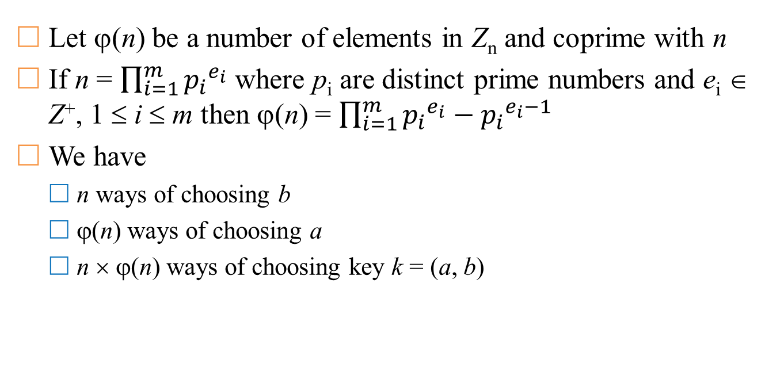
Affine cipher
Let ϕ(n) be a number of elements in Z_{n} and coprime with n
If n = $\prod_{i=1}^{m}{{p_{i}}^{e_{i}}}$ where p_{i} are distinct prime numbers and e_{i} ∈ Z⁺, 1 ≤ i ≤ m then ϕ(n) = $\prod_{i=1}^{m}{{p_{i}}^{e_{i}}}−{p_{i}}^{e_{i}−1}$
We have
  n ways of choosing b
  ϕ(n) ways of choosing a
  n × ϕ(n) ways of choosing key k = (a, b)

Slide 11
Euclide algorithm
Consider 2 prime numbers a and b (a > b) we have:
  a = q₀b + r₀ (0 < r₀ < b)
  b = q₁r₀ + r₁ (0 < r₁ < r₀)
  r₀ = q₂r₁ + r₂ (0 < r₂ < r₁)
  r₁ = q₃r₂ + r₃ (0 < r₃ < r₂)
  …
  r_{m-2} = q_{m-1}r_{m-1} + r_{m} (0 < r_{m} < r_{m-1})
  r_{m-1} = q_{m}r_{m} (0 = r_{m+1} < r_{m})
Easily see:
  gcd(a, b) = gcd(b, r₀) = gcd(r₀, r₁) = … = gcd(r_{m-1}, r_{m}) = r_{m}.
  Example: gcd(1071, 462) = gcd(462, 147) = gcd(147, 21) = 21
https://en.wikipedia.org/wiki/Euclidean_algorithm

Slide 12
Extended Euclide algorithm
Consider 2 prime numbers a and b, let’s build
  r₀ = a r₁ = b
  s₀ = 1 s₁ = 0
  t₀ = 0 t₁ = 1
So, we have:
  r₂ = r₀ – q₀r₁
  s₂ = s₀ – q₀s₁
  t₂ = t₀ – q₀t₁
  …
  r_{i+1} = r_{i-1} – q_{i}r_{i} (i ≥ 1)
  s_{i+1} = s_{i-1} – q_{i}s_{i}
  t_{i+1} = t_{i-1} – q_{i}t_{i}
Algorithm stops when r_{k+1} = 0 & r_{k} = gcd(a, b) = as_{k} + bt_{k}

Slide 13
Extended Euclide algorithm
Example a = r₀ = 240 and b = r₁ = 46
  Line 6 finds stop-condition r₆ = 0
  Result: gcd(240, 46) = 2 = -9 × 240 + 47 × 46
Note: gcd(a, b) = 1 = as + bt (a ⊥ b)
  If bt mod a ≅ 1 ⇒ t = b⁻¹ mod a
  If as mod b ≅ 1 ⇒ s = a⁻¹ mod b
i | q_{i−1} | r_{i} | s_{i} | t_{i}
0 |  | 240 | 1 | 0
1 |  | 46 | 0 | 1
2 | 240 / 46 = 5 | 240 − 5 × 46 = 10 | 1 − 5 × 0 = 1 | 0 − 5 × 1 = −5
3 | 46 / 10 = 4 | 46 − 4 × 10 = 6 | 0 − 4 × 1 = −4 | 1 − 4 × −5 = 21
4 | 10 / 6 = 1 | 10 − 1 × 6 = 4 | 1 − 1 × −4 = 5 | −5 − 1 × 21 = −26
5 | 6 / 4 = 1 | 6 − 1 × 4 = 2 | −4 − 1 × 5 = −9 | 21 − 1 × −26 = 47
6 | 4 / 2 = 2 | 4 − 2 × 2 = 0 | 5 − 2 × −9 = 23 | −26 − 2 × 47 = −120
https://en.wikipedia.org/wiki/Extended_Euclidean_algorithm

Slide 14
Vigenere cipher
Choose a positive integer m. Let P = C = K = (Z_{n})^{m}.
  K = {(k₁, k₂, …, k_{m}) ∈ (Z_{n})^{m}}
  For each key k = (k₁, k₂, …, k_{m}) ∈ K and ∀x, y ∈ (Z_{n})^{m}, define:
    e_{k}(x₁, x₂, …, x_{m}) = ((x₁ + k₁) mod n, (x₂ + k₂) mod n, …, (x_{m} + k_{m}) mod n)
    d_{k}(y₁, y₂, …, y_{m}) = ((y₁ - k₁) mod n, (y₂ - k₂) mod n, …, (y_{m} - k_{m}) mod n)
Subtitution cipher: for each key k, plain-text x ∈ P is mapped to only one y ∈C.
Vigenere cipher uses key with length m.
  Named after Blaise de Vigenere (Century 16)
  The Vigenere cipher can be viewed as consisting of m displacement ciphers that are applied alternately on a periodic basis.
  Key-space K of Vigenere cipher is n^{m}
  For example: n = 26, m = 5 then key-space has ~1.1 × 10⁷ keys

Slide 15
Vigenere cipher
Example: m = 6 and keyword CIPHER
Then, key k = (2, 8, 15, 7, 4, 17)
Let plaintexts: thiscryptosystemisnotsecure
t
h
i
s
c
r
y
p
t
o
s
y
s
t
e
m
i
s
19 | 7 | 8 | 18 | 2 | 17
2 | 8 | 15 | 7 | 4 | 17
21 | 15 | 23 | 25 | 6 | 8
24 | 15 | 19 | 14 | 18 | 24
2 | 8 | 15 | 7 | 4 | 17
0 | 23 | 8 | 21 | 22 | 15
18 | 19 | 4 | 12 | 8 | 18
2 | 8 | 15 | 7 | 4 | 17
20 | 1 | 19 | 19 | 12 | 9
n
o
t
s
e
c
u
r
e
13 | 14 | 19 | 18 | 4 | 2
2 | 8 | 15 | 7 | 4 | 17
15 | 22 | 8 | 25 | 8 | 19
20 | 17 | 4
2 | 8 | 15
22 | 25 | 19

Slide 16
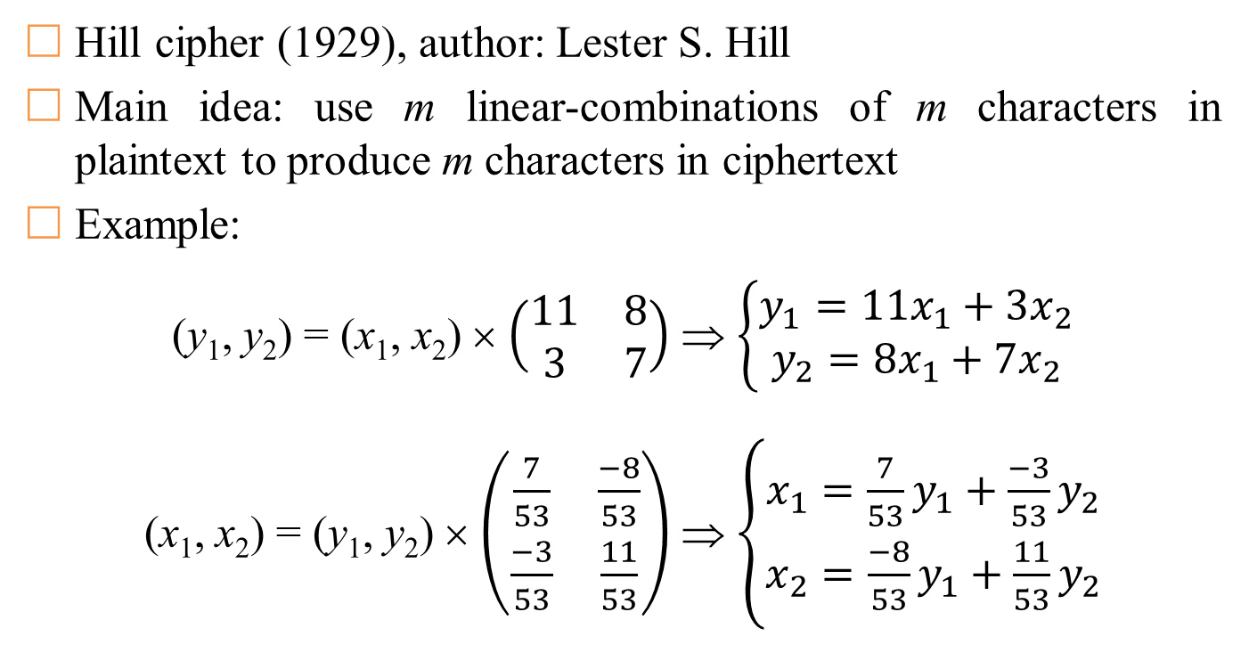
Hill cipher
Hill cipher (1929), author: Lester S. Hill
Main idea: use m linear-combinations of m characters in plaintext to produce m characters in ciphertext
Example:
(y₁, y₂) = (x₁, x₂) × $\left(\begin{matrix}11 & 8 \\ 3 & 7\end{matrix}\right)$ ⇒ $\left\{\begin{aligned}y_{1}=11x_{1}+3x_{2} \\ y_{2}=8x_{1}+7x_{2}\end{aligned}\right.$
(x₁, x₂) = (y₁, y₂) × $\left(\begin{matrix}\frac{7}{53} & \frac{−8}{53} \\ \frac{−3}{53} & \frac{11}{53}\end{matrix}\right)$ ⇒ $\left\{\begin{aligned}x_{1}=\frac{7}{53}y_{1}+\frac{−3}{53}y_{2} \\ x_{2}=\frac{−8}{53}y_{1}+\frac{11}{53}y_{2}\end{aligned}\right.$

Slide 17
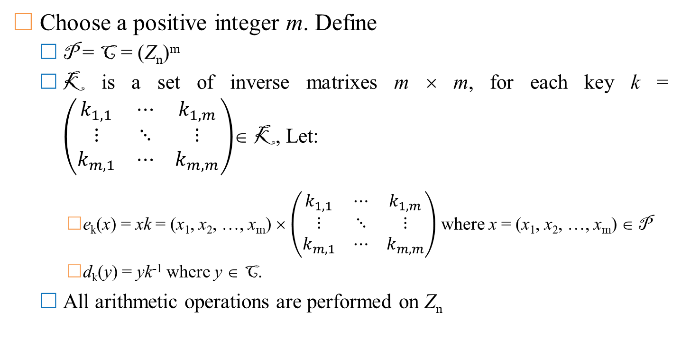
Hill cipher
Choose a positive integer m. Define
  P = C = (Z_{n})^{m}
  K is a set of inverse matrixes m × m, for each key k = $\left(\begin{matrix}k_{1,1} & ⋯ & k_{1,m} \\ ⋮ & ⋱ & ⋮ \\ k_{m,1} & ⋯ & k_{m,m}\end{matrix}\right)$∈ K, Let:
    e_{k}(x) = xk = (x₁, x₂, …, x_{m}) × $\left(\begin{matrix}k_{1,1} & ⋯ & k_{1,m} \\ ⋮ & ⋱ & ⋮ \\ k_{m,1} & ⋯ & k_{m,m}\end{matrix}\right)$ where x = (x₁, x₂, …, x_{m}) ∈ P
    d_{k}(y) = yk⁻¹ where y ∈ C.
  All arithmetic operations are performed on Z_{n}

Slide 18
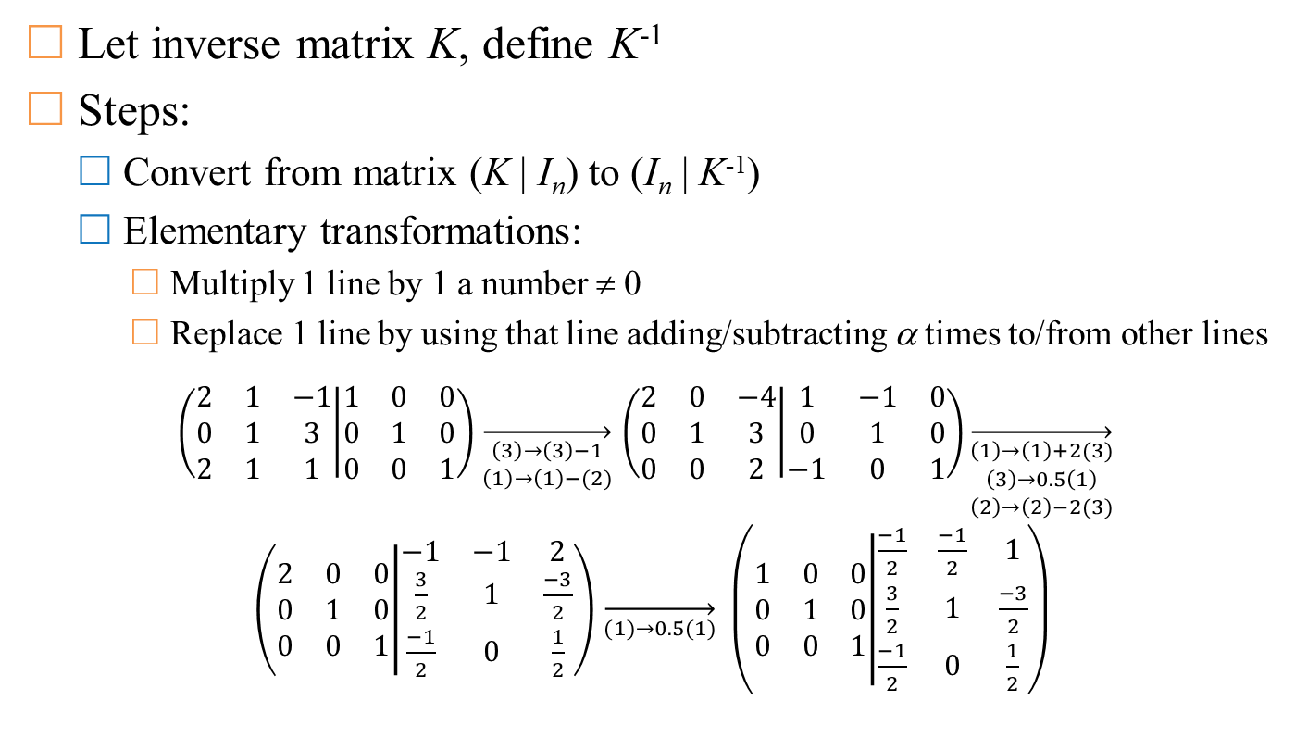
Inverse matrix
Let inverse matrix K, define K⁻¹
Steps:
  Convert from matrix (K | I_{n}) to (I_{n} | K⁻¹)
  Elementary transformations:
    Multiply 1 line by 1 a number ≠ 0
    Replace 1 line by using that line adding/subtracting α times to/from other lines
$\left(\begin{matrix}2 & 1 & −1 \\ 0 & 1 & 3 \\ 2 & 1 & 1\end{matrix} | \begin{matrix}1 & 0 & 0 \\ 0 & 1 & 0 \\ 0 & 0 & 1\end{matrix}\right)$ $\overset{→}{\begin{aligned}\left(3\right)→\left(3\right)−1 \\ \left(1\right)→\left(1\right)−(2)\end{aligned}}$ $\left(\begin{matrix}2 & 0 & −4 \\ 0 & 1 & 3 \\ 0 & 0 & 2\end{matrix} | \begin{matrix}1 & −1 & 0 \\ 0 & 1 & 0 \\ −1 & 0 & 1\end{matrix}\right)\overset{→}{\begin{aligned}\left(1\right)→\left(1\right)+2(3) \\ \left(3\right)→0.5\left(1\right) \\ \left(2\right)→\left(2\right)−2(3)\end{aligned}} \left(\begin{matrix}2 & 0 & 0 \\ 0 & 1 & 0 \\ 0 & 0 & 1\end{matrix} | \begin{matrix}−1 & −1 & 2 \\ \frac{3}{2} & 1 & \frac{−3}{2} \\ \frac{−1}{2} & 0 & \frac{1}{2}\end{matrix}\right)$ $\overset{→}{(1)→0.5(1)} \left(\begin{matrix}1 & 0 & 0 \\ 0 & 1 & 0 \\ 0 & 0 & 1\end{matrix} | \begin{matrix}\frac{−1}{2} & \frac{−1}{2} & 1 \\ \frac{3}{2} & 1 & \frac{−3}{2} \\ \frac{−1}{2} & 0 & \frac{1}{2}\end{matrix}\right)$

Slide 19
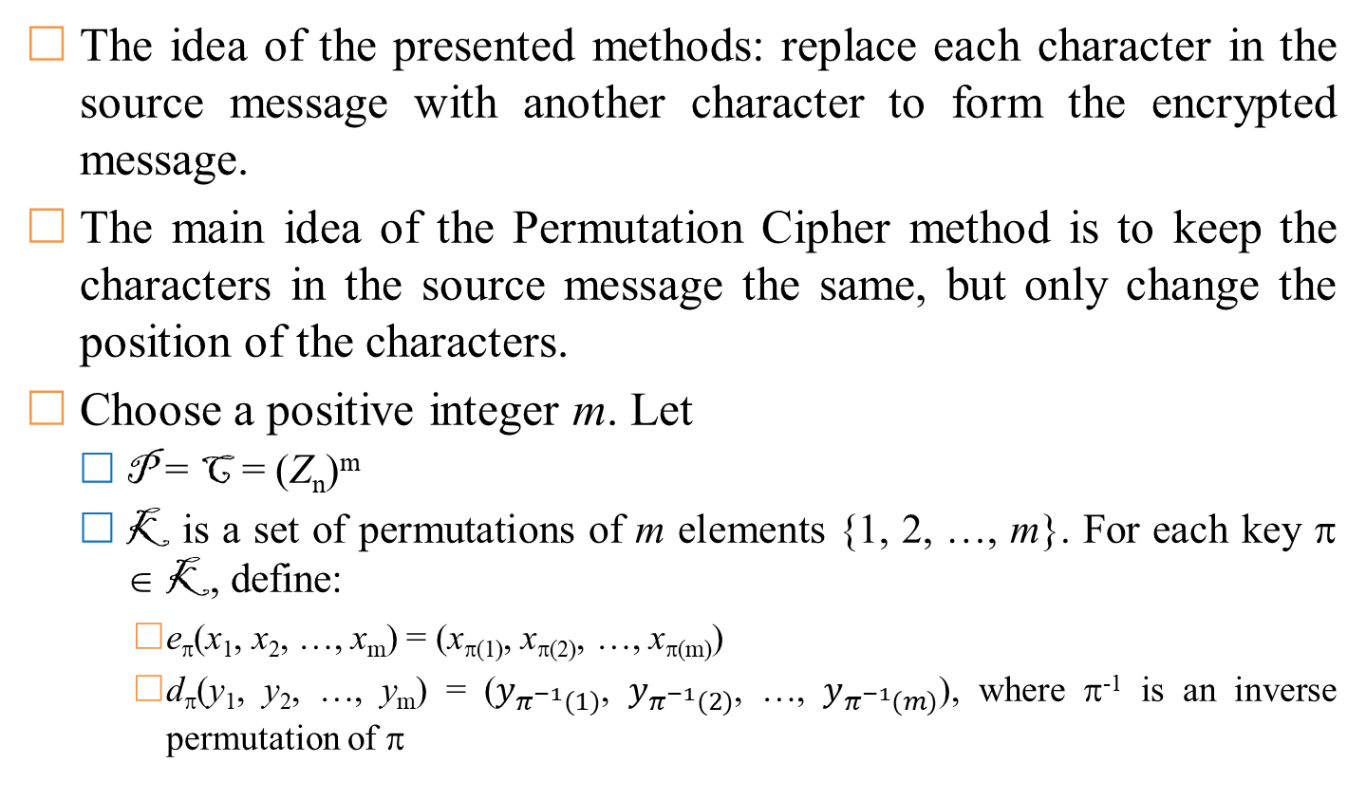
Permutation cipher
The idea of ​​the presented methods: replace each character in the source message with another character to form the encrypted message.
The main idea of ​​the Permutation Cipher method is to keep the characters in the source message the same, but only change the position of the characters.
Choose a positive integer m. Let
  P = C = (Z_{n})^{m}
  K is a set of permutations of m elements {1, 2, …, m}. For each key π ∈ K, define:
    e_{π}(x₁, x₂, …, x_{m}) = (x_{π(1)}, x_{π(2)}, …, x_{π(m)})
    d_{π}(y₁, y₂, …, y_{m}) = ($y_{π^{−1}(1)}$, $y_{π^{−1}(2)}$, …, $y_{π^{−1}(m)}$), where π⁻¹ is an inverse permutation of π

Slide 20
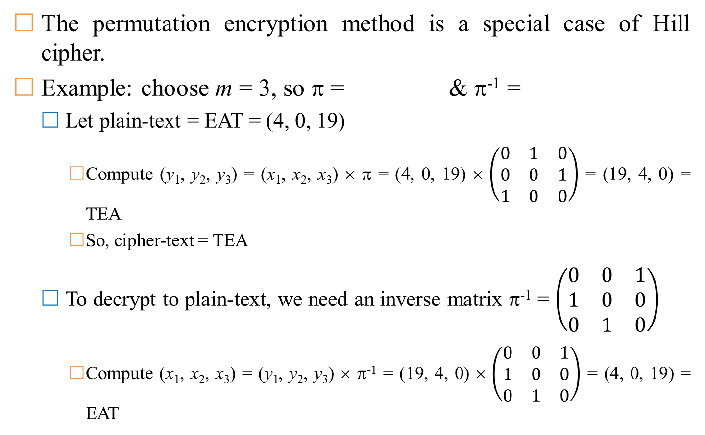
Permutation cipher
The permutation encryption method is a special case of Hill cipher.
Example: choose m = 3, so π = & π⁻¹ =
  Let plain-text = EAT = (4, 0, 19)
    Compute (y₁, y₂, y₃) = (x₁, x₂, x₃) × π = (4, 0, 19) × $\left(\begin{matrix}0 & 1 & 0 \\ 0 & 0 & 1 \\ 1 & 0 & 0\end{matrix}\right)$ = (19, 4, 0) = TEA
    So, cipher-text = TEA
  To decrypt to plain-text, we need an inverse matrix π⁻¹ = $\left(\begin{matrix}0 & 0 & 1 \\ 1 & 0 & 0 \\ 0 & 1 & 0\end{matrix}\right)$
    Compute (x₁, x₂, x₃) = (y₁, y₂, y₃) × π⁻¹ = (19, 4, 0) × $\left(\begin{matrix}0 & 0 & 1 \\ 1 & 0 & 0 \\ 0 & 1 & 0\end{matrix}\right)$ = (4, 0, 19) = EAT
1 | 2 | 3
3 | 1 | 2
1 | 2 | 3
2 | 3 | 1

Slide 21
Permutation cipher
Example: choose m = 6
  So π = & π⁻¹ =
  Assume plain-texts = shesellsseashellsbytheseashore
  So, cipher-texts = eeslshsalseslshblehsyeethraeos
1 | 2 | 3 | 4 | 5 | 6
3 | 5 | 1 | 6 | 4 | 2
1 | 2 | 3 | 4 | 5 | 6
3 | 6 | 1 | 5 | 2 | 4
s | h | e | s | e | l
e | e | s | l | s | h
l | s | s | e | a | s
s | a | l | s | e | s
h | e | l | l | s | b
l | s | h | b | l | e
y | t | h | e | s | e
h | s | y | e | e | t
a | s | h | o | r | e
h | r | a | e | o | s

