Slide 1
Topic 3:
Shannon theory
Vietnam National University Ho Chi Minh City, University of Science
Department of Information Technology
Assoc. Prof. Trần Minh Triết
PhD. Trương Toàn Thịnh

Slide 2
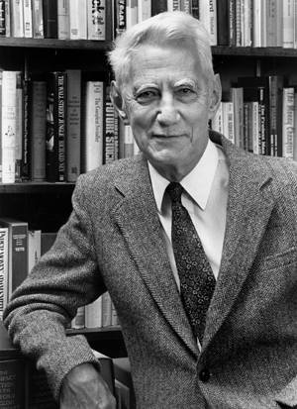
Contents
Introduction - Claude Shannon
Perfect security
Entropy
Combination of crypto-systems
Claude E. Shannon (1916-2001)
http://www.wisdom.weizmann.ac.il/~naor/COURSE/GiladTsur_YossiOren_ShannonSecrecy.ppt

Slide 3
Probability
Let X and Y be two random variables.
Definition:
  p(x) = p(X = x) is a probability of X receiving value x
  p(y) = p(Y = y) is a probability of Y receiving value y
  p(x | y) is a probability of X receiving value x if Y receives value y (conditional probability)
X and Y are independent random variables if only if p(x, y) = p(x) × p(y) for any value x of X and value y of Y

Slide 4

Probability
Example: consider tossing 2 dices
  We have result-space Ω = {(1,1),(1,2),(1,3),(1,4),(1,5),(1,6),
  (2,1),(2,2),(2,3),(2,4),(2,5),(2,6),
  (3,1),(3,2),(3,3),(3,4),(3,5),(3,6),
  (4,1),(4,2),(4,3),(4,4),(4,5),(4,6),
  (5,1),(5,2),(5,3),(5,4),(5,5),(5,6),
  (6,1),(6,2),(6,3),(6,4),(6,5),(6,6)}
  |Ω| = 36 elements, for w ∈ Ω
  Let X (based on Ω) be sum of two dices => X(w) ∈ {2, 3, 4, 5, 6, 7, 8, 9, 10, 11, 12}
Notation of mapping X: Ω → ℝ

Slide 5

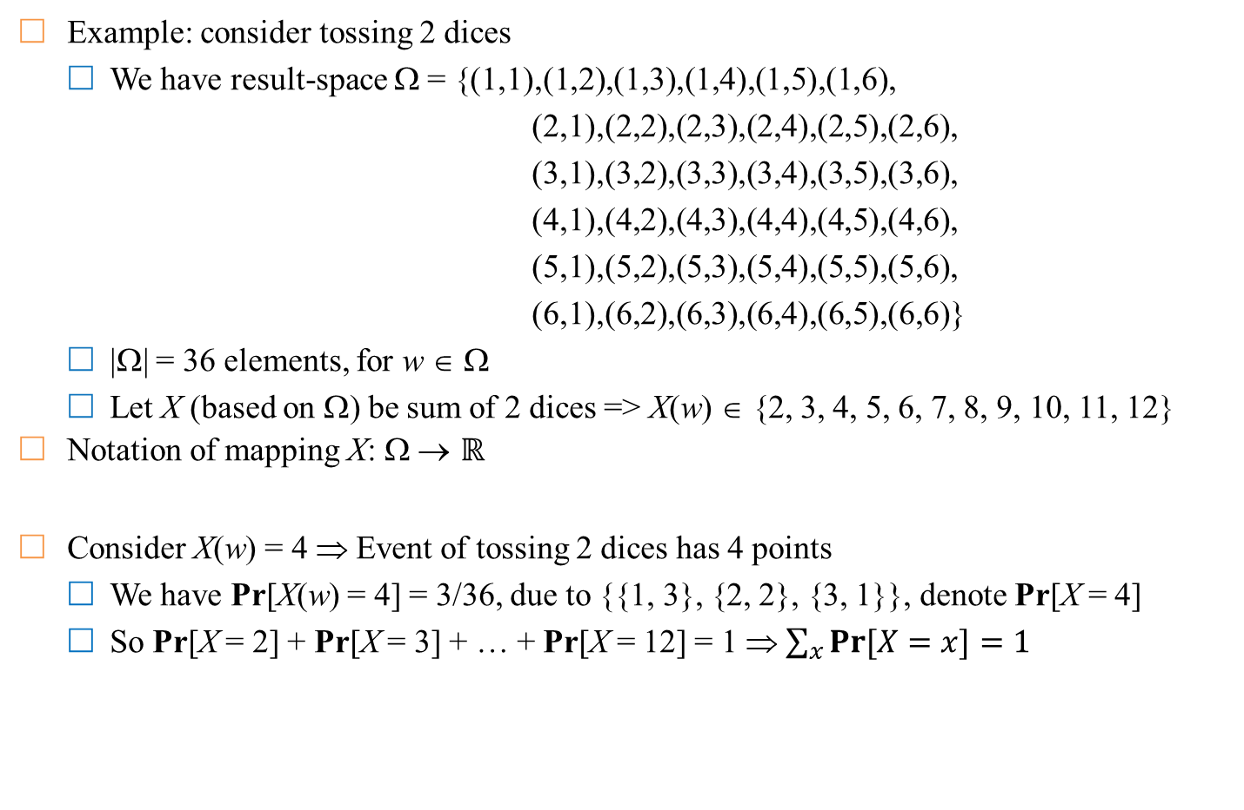
Probability
Example: consider tossing 2 dices
  We have result-space Ω = {(1,1),(1,2),(1,3),(1,4),(1,5),(1,6),
  (2,1),(2,2),(2,3),(2,4),(2,5),(2,6),
  (3,1),(3,2),(3,3),(3,4),(3,5),(3,6),
  (4,1),(4,2),(4,3),(4,4),(4,5),(4,6),
  (5,1),(5,2),(5,3),(5,4),(5,5),(5,6),
  (6,1),(6,2),(6,3),(6,4),(6,5),(6,6)}
  |Ω| = 36 elements, for w ∈ Ω
  Let X (based on Ω) be sum of 2 dices => X(w) ∈ {2, 3, 4, 5, 6, 7, 8, 9, 10, 11, 12}
Notation of mapping X: Ω → ℝ
Consider X(w) = 4 ⇒ Event of tossing 2 dices has 4 points
  We have Pr[X(w) = 4] = 3/36, due to {{1, 3}, {2, 2}, {3, 1}}, denote Pr[X = 4]
  So Pr[X = 2] + Pr[X = 3] + … + Pr[X = 12] = 1 ⇒ $\sum_{x}{Pr⁡[X=x]}=1$

Slide 6

Probability
Example: consider tossing 2 dices
  We have result-space Ω = {(1,1),(1,2),(1,3),(1,4),(1,5),(1,6),
  (2,1),(2,2),(2,3),(2,4),(2,5),(2,6),
  (3,1),(3,2),(3,3),(3,4),(3,5),(3,6),
  (4,1),(4,2),(4,3),(4,4),(4,5),(4,6),
  (5,1),(5,2),(5,3),(5,4),(5,5),(5,6),
  (6,1),(6,2),(6,3),(6,4),(6,5),(6,6)}
  |Ω| = 36 elements, for w ∈ Ω
  Let Y (based on Ω) be the result of tossing 2 dices with the same point => Y(w) ∈ {“2 same points”, “2 different points”}
  Should change “2 same points” to 1, & “2 different points” to 0 => Y(w) ∈ {0, 1}
Notation of mapping Y: Ω → ℝ

Slide 7

Probability
Example: consider tossing 2 dices
  We have result-space Ω = {(1,1),(1,2),(1,3),(1,4),(1,5),(1,6),
  (2,1),(2,2),(2,3),(2,4),(2,5),(2,6),
  (3,1),(3,2),(3,3),(3,4),(3,5),(3,6),
  (4,1),(4,2),(4,3),(4,4),(4,5),(4,6),
  (5,1),(5,2),(5,3),(5,4),(5,5),(5,6),
  (6,1),(6,2),(6,3),(6,4),(6,5),(6,6)}
  |Ω| = 36 elements, for w ∈ Ω
  Let Y (based on Ω) be the result of tossing 2 dices with the same point => Y(w) ∈ {“2 same points”, “2 different points”}
  Should change “2 same points” to 1, & “2 different points” to 0 => Y(w) ∈ {0, 1}
Notation of mapping Y: Ω → ℝ
Let Y(w) = 1 => Event of tossing 2 dices with the same point
  Pr[Y(w) = 1] = 6/36, due to 6 cases {{1, 1}, …, {6, 6}}
  So Pr[Y = 1] + Pr[Y = 0] = 1

Slide 8
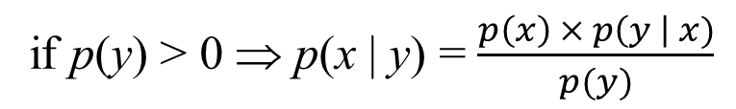
Bayes theorem
Let X and Y be two random variables
Bayes theorem
Corollary: X and Y are two independent ones ⇔ p(x | y) = p(x), ∀x, y
p(x, y) = p(x | y) × p(y) = p(y | x)× p(x)
Apriori
if p(y) > 0 ⇒ p(x | y) = $\frac{p\left(x\right) × p\left(y \right| x)}{p(y)}$
Aposteriori

Slide 9
Bayes theorem
Reconsider: example of tossing 2 dices
  We have result-space Ω = {(1,1),(1,2),(1,3),(1,4),(1,5),(1,6),
  …
  (6,1),(6,2),(6,3),(6,4),(6,5),(6,6)}
  |Ω| = 36 elements, for w ∈ Ω
  X: Sum of points of 2 dices => X(w) ∈ {2, 3, 4, …, 12}
  Y: 2 dices with the same point => Y(w) ∈ {0, 1}
Compute Pr[Y = 1|X = 4] (Probability of 4-point with 2 same faces)
  Pr[X = 4] = 3/36 => Pr[Y = 1|X = 4] = 1/3 due to {(1, 3), (2, 2), (3, 1)}
Compute Pr[X = 4|Y = 1] (Probability of 4-point with 2 same faces)
  Pr[Y = 1] = 6/36 => Pr[X = 4|Y = 1] = 1/6 due to {(1, 1), (2, 2), …, (6, 6)}
So Pr[Y = 1|X = 4] × Pr[X = 4] = Pr[X = 4|Y = 1] × Pr[Y = 1]

Slide 10
Context of cryptography
Some probabilistic notation for crypto-context
  p_{P} (x) : Probability of appearing plaintext x
  p_{K}(k) : Probability of choosing key k
  p_{C}(y) : Probability of ciphertext receiving value y
Note:
  Notations p_{P}, p_{K} and p_{C} are the probabilities for each distinct set
  It can be assumed that the key value k and the plaintext x are independent events
From the probability distribution of plaintext and key on the set P and K, we can determine the conditional probability distribution of plaintext ???

Slide 11
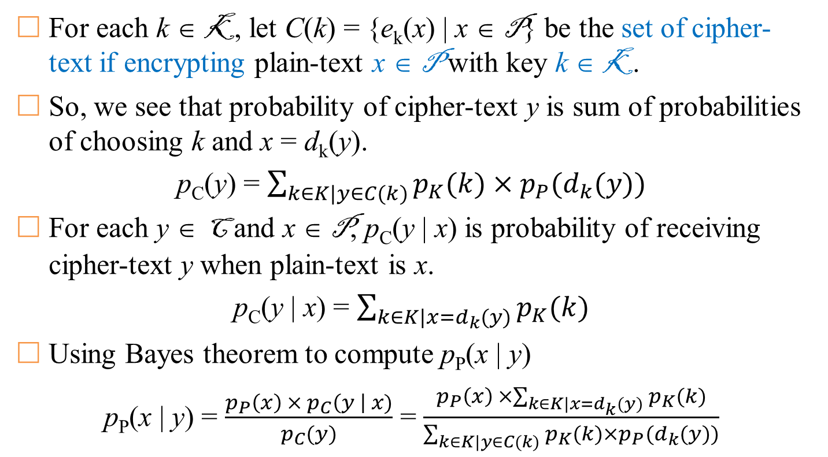
Context of cryptography
For each k ∈ K, let C(k) = {e_{k}(x) | x ∈ P} be the set of cipher-text if encrypting plain-text x ∈ P with key k ∈ K.
So, we see that probability of cipher-text y is sum of probabilities of choosing k and x = d_{k}(y).
p_{C}(y) = $\sum_{k∈K|y∈C(k)}{p_{K}(k)×p_{P}(d_{k}(y))}$
For each y ∈ C and x ∈ P, p_{C}(y | x) is probability of receiving cipher-text y when plain-text is x.
p_{C}(y | x) = $\sum_{k∈K|x=d_{k}(y)}{p_{K}(k)}$
Using Bayes theorem to compute p_{P}(x | y)
p_{P}(x | y) = $\frac{p_{P}\left(x\right) × p_{C}\left(y \right| x)}{p_{C}(y)}$ = $\frac{p_{P}\left(x\right) ×\sum_{k∈K|x=d_{k}(y)}{p_{K}(k)}}{\sum_{k∈K|y∈C(k)}{p_{K}(k)×p_{P}(d_{k}(y))}}$
Thực chất là xác suất chọn các khóa k

Slide 12
Example
Let P = {a, b} with p_{P}(a) = ¼, p_{P}(b) = ¾
Let K = {k₁, k₂, k₃} with p_{K}(k₁) = ½, p_{K}(k₂) = p_{K}(k₃) = ¼
Let C = {1, 2, 3, 4}
Let E be a set of encryption rules
  e_{k1}(a) = 1, e_{k1}(b) = 2
  e_{k2}(a) = 2, e_{k2}(b) = 3
  e_{k3}(a) = 3, e_{k3}(b) = 4
Let D be a set of decryption rules
  d_{k1}(1) = a, d_{k1}(2) = b
  d_{k2}(2) = a, d_{k2}(3) = b
  d_{k3}(3) = a, d_{k3}(4) = b
 | a | b
k₁ | 1 | 2
k₂ | 2 | 3
k₃ | 3 | 4
 | 1 | 2 | 3 | 4
k₁ | a | b
k₂ |  | a | b
k₃ |  |  | a | b

Slide 13
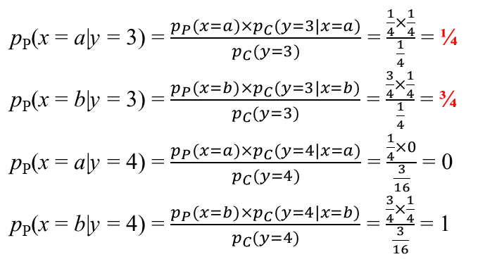
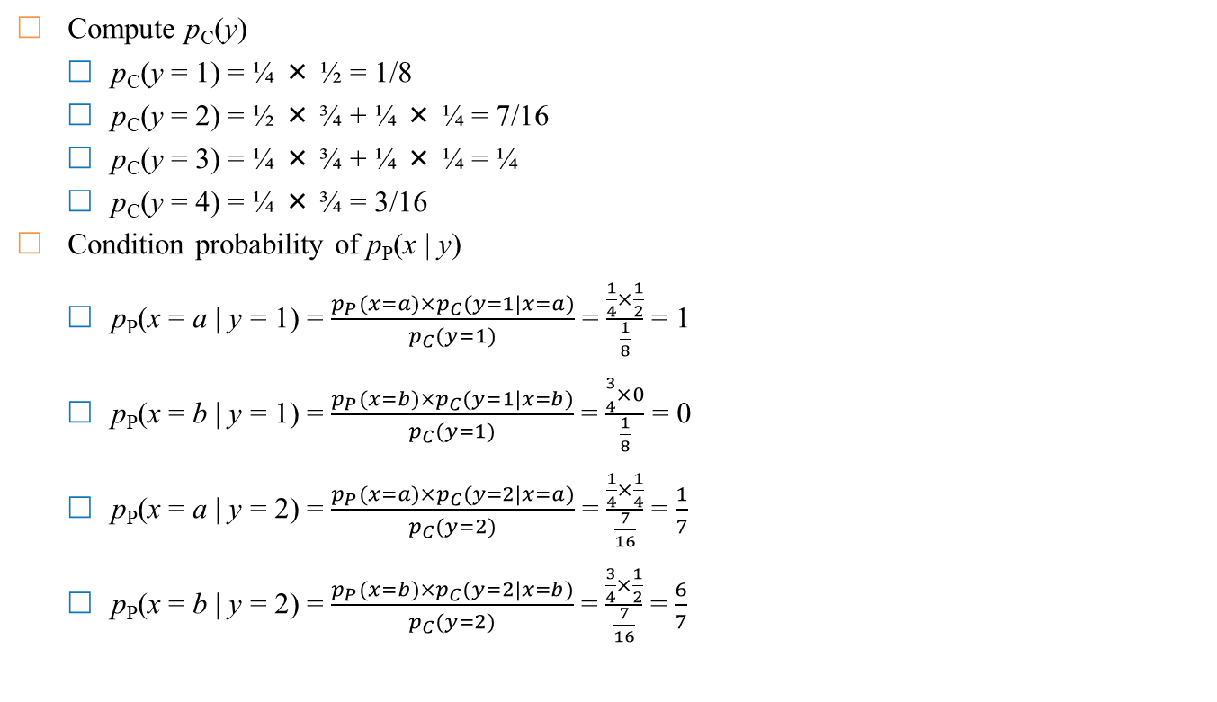
Example
Compute p_{C}(y)
  p_{C}(y = 1) = ¼ × ½ = 1/8
  p_{C}(y = 2) = ½ × ¾ + ¼ × ¼ = 7/16
  p_{C}(y = 3) = ¼ × ¾ + ¼ × ¼ = ¼
  p_{C}(y = 4) = ¼ × ¾ = 3/16
Condition probability of p_{P}(x | y)
  p_{P}(x = a | y = 1) = $\frac{p_{P}(x=a)×p_{C}(y=1|x=a)}{p_{C}(y=1)}$ = $\frac{\frac{1}{4}×\frac{1}{2}}{\frac{1}{8}}$ = 1
  p_{P}(x = b | y = 1) = $\frac{p_{P}(x=b)×p_{C}(y=1|x=b)}{p_{C}(y=1)}$ = $\frac{\frac{3}{4}×0}{\frac{1}{8}}$ = 0
  p_{P}(x = a | y = 2) = $\frac{p_{P}(x=a)×p_{C}(y=2|x=a)}{p_{C}(y=2)}$ = $\frac{\frac{1}{4}×\frac{1}{4}}{\frac{7}{16}}$ = $\frac{1}{7}$
  p_{P}(x = b | y = 2) = $\frac{p_{P}(x=b)×p_{C}(y=2|x=b)}{p_{C}(y=2)}$ = $\frac{\frac{3}{4}×\frac{1}{2}}{\frac{7}{16}}$ = $\frac{6}{7}$
 | a p_{P} = ¼ | b p_{P} = ¾
k₁ (p_{K} = ½) | 1 | 2
k₂ (p_{K} = ¼) | 2 | 3
k₃ (p_{K} = ¼) | 3 | 4
1
3
2
4

Slide 14
Perfect security
Perfectly secure?
Significance: The attacker gets nothing from the ciphertext
∀x ∈ P, ∀k ∈ K, p_{P}(x | c) = p_{P}(x), p_{K}(k | c) = p_{K}(k)
Evaluate Shift-cipher
  Assume 26 keys in Shift-cipher are randomly chosen with uniform probability (1/26)
  With set of plaintext having any probability distribution, Shift-cipher achieve perfect security???
  Let P = C = K = Z₂₆ = {0, 1, 2, …, 25}
  e_{k}(x) = (x + k) mod 26 and d_{k}(y) = (y – k) mod 26

Slide 15
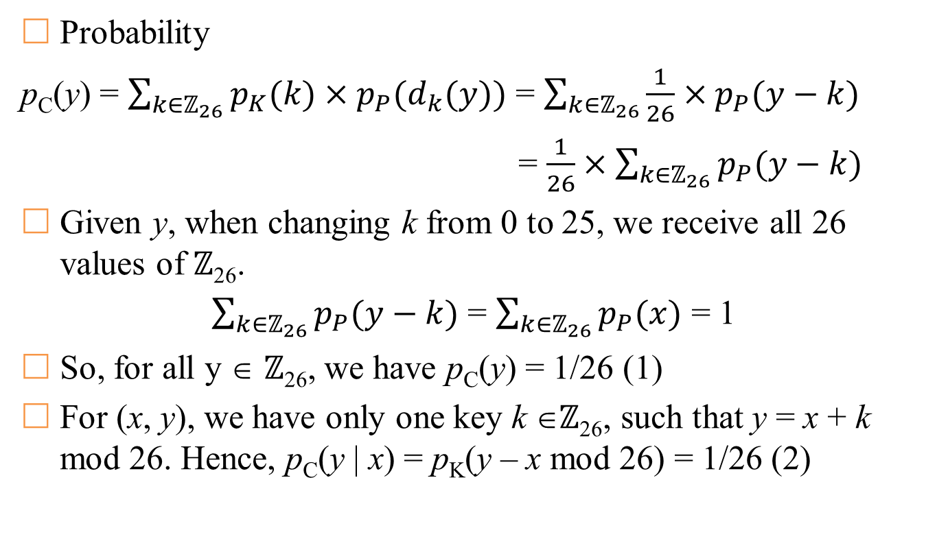
Perfect security (on Shift Cipher)
Probability
p_{C}(y) = $\sum_{k∈ℤ_{26}}{p_{K}(k)×p_{P}(d_{k}(y))}$ = $\sum_{k∈ℤ_{26}}{\frac{1}{26}×p_{P}(y−k)}$
= $\frac{1}{26}×\sum_{k∈ℤ_{26}}{p_{P}(y−k)}$
Given y, when changing k from 0 to 25, we receive all 26 values of ℤ₂₆.
$\sum_{k∈ℤ_{26}}{p_{P}(y−k)}$ = $\sum_{k∈ℤ_{26}}{p_{P}(x)}$ = 1
So, for all y ∈ ℤ₂₆, we have p_{C}(y) = 1/26 (1)
For (x, y), we have only one key k ∈ℤ₂₆, such that y = x + k mod 26. Hence, p_{C}(y | x) = p_{K}(y – x mod 26) = 1/26 (2)

Slide 16
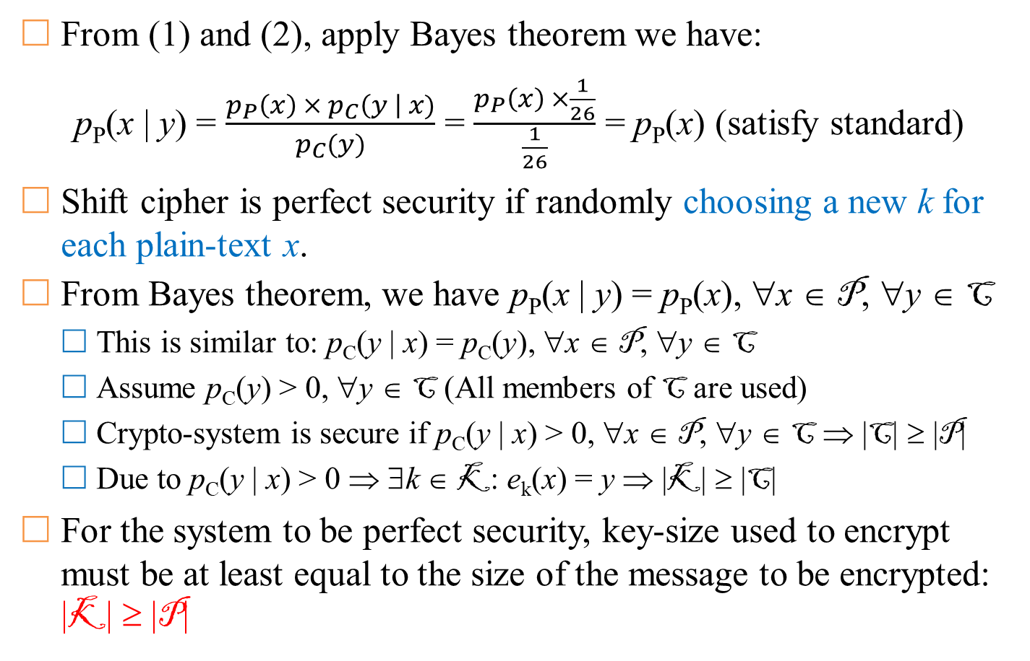
Perfect security (on Shift Cipher)
From (1) and (2), apply Bayes theorem we have:
p_{P}(x | y) = $\frac{p_{P}\left(x\right) × p_{C}\left(y \right| x)}{p_{C}(y)}$ = $\frac{p_{P}\left(x\right) ×\frac{1}{26}}{\frac{1}{26}}$ = p_{P}(x) (satisfy standard)
Shift cipher is perfect security if randomly choosing a new k for each plain-text x.
From Bayes theorem, we have p_{P}(x | y) = p_{P}(x), ∀x ∈ P, ∀y ∈ C
  This is similar to: p_{C}(y | x) = p_{C}(y), ∀x ∈ P, ∀y ∈ C
  Assume p_{C}(y) > 0, ∀y ∈ C (All members of C are used)
  Crypto-system is secure if p_{C}(y | x) > 0, ∀x ∈ P, ∀y ∈ C ⇒ |C| ≥ |P|
  Due to p_{C}(y | x) > 0 ⇒ ∃k ∈ K: e_{k}(x) = y ⇒ |K| ≥ |C|
For the system to be perfect security, key-size used to encrypt must be at least equal to the size of the message to be encrypted: |K| ≥ |P|

Slide 17
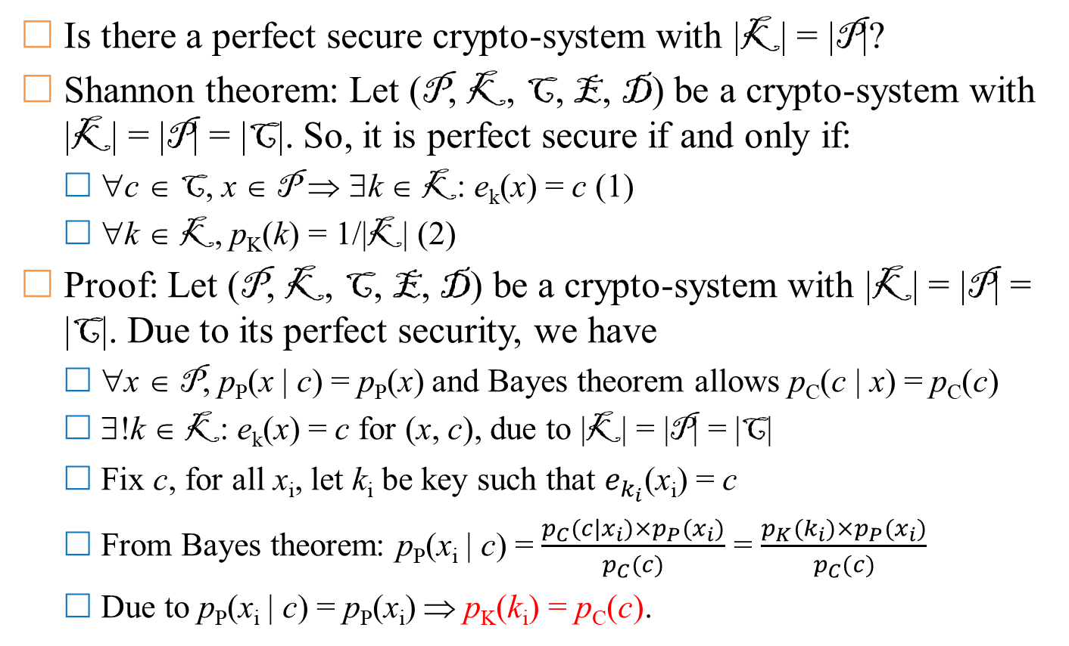
Vernam Cipher
Is there a perfect secure crypto-system with |K| = |P|?
Shannon theorem: Let (P, K, C, E, D) be a crypto-system with |K| = |P| = |C|. So, it is perfect secure if and only if:
  ∀c ∈ C, x ∈ P ⇒ ∃k ∈ K: e_{k}(x) = c (1)
  ∀k ∈ K, p_{K}(k) = 1/|K| (2)
Proof: Let (P, K, C, E, D) be a crypto-system with |K| = |P| = |C|. Due to its perfect security, we have
  ∀x ∈ P, p_{P}(x | c) = p_{P}(x) and Bayes theorem allows p_{C}(c | x) = p_{C}(c)
  ∃!k ∈ K: e_{k}(x) = c for (x, c), due to |K| = |P| = |C|
  Fix c, for all x_{i}, let k_{i} be key such that $e_{k_{i}}$(x_{i}) = c
  From Bayes theorem: p_{P}(x_{i} | c) = $\frac{p_{C}(c|x_{i})×p_{P}(x_{i})}{p_{C}(c)}$ = $\frac{p_{K}(k_{i})×p_{P}(x_{i})}{p_{C}(c)}$
  Due to p_{P}(x_{i} | c) = p_{P}(x_{i}) ⇒ p_{K}(k_{i}) = p_{C}(c).

Slide 18
Vernam Cipher
Gilbert Vernam (Bell Labs) proposed in 1919
  A key is a “long enough” random sequence of values. So, C = P ⊕ K
  This method is proven to be perfect security
  Limitation: the key is too long and cannot be reused
  Advantage: simple
Description:
  Let integer n ≥ 1, and P = C = K = (ℤ₂)^{n}. For each k ∈ (ℤ₂)^{n}, we let:
    e_{k}(x) = (x₁ + k₁, …, x_{n} + k_{n}) mod 2, where x = (x₁, …, x_{n}) and k = (k₁, …, k_{n}).
    d_{k}(y) = (y₁ + k₁, …, y_{n} + k_{n}) mod 2, where y = (y₁, …, y_{n})
Note: operator (+ mod 2) is ⊕-bit

Slide 19
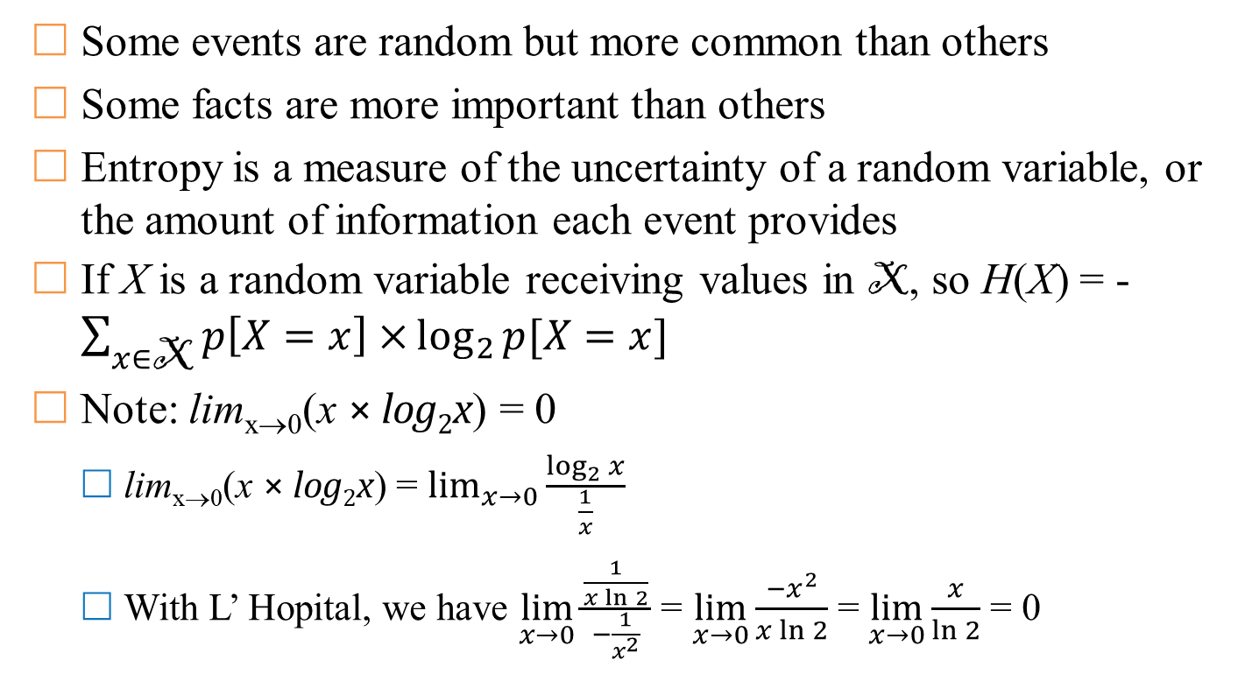
Informatic theory
Some events are random but more common than others
Some facts are more important than others
Entropy is a measure of the uncertainty of a random variable, or the amount of information each event provides
If X is a random variable receiving values in X, so H(X) = -$\sum_{x∈\text{X}}{p\left[X=x\right]×}\log_{2}{p[X=x]}$
Note: lim_{x→0}(x × log₂x) = 0
  lim_{x→0}(x × log₂x) = $\lim_{x→0}{\frac{\log_{2}{x}}{\frac{1}{x}}}$
  With L’ Hopital, we have $\lim_{x→0}{\frac{\frac{1}{x\ln{2}}}{−\frac{1}{x^{2}}}}$ = $\lim_{x→0}{\frac{{−x}^{2}}{x\ln{2}}}$ = $\lim_{x→0}{\frac{x}{\ln{2}}}$ = 0

Slide 20
Entropy and Huffman encoding
Recall the idea of Huffman encoding
Example: we have X = {a, b, c, d, e} with probabilities p(a) = .05, p(b) = .10, p(c) = .12, p(d) = .13 and p(e) = .60
a | b | c | d | e
.05 | .1 | .12 | .13 | .6
0 | 1
.15 |  | .12 | .13 | .6
 |  | 0 | 1
.15 |  | .25 |  | .6
0 |  | 1
.4 |  |  |  | .6
0 |  |  |  | 1
1
x | f(x)
a | 000
b | 001
c | 010
d | 011
e | 1
0
1
0
1
e
0
1
1
0
1
1
0
1
0
1
0
1
0
0
a
b
c
d
a
b
c
d
a
b
c
d
0.15
0.4
0.25
Huffman tree
Prefix-code

Slide 21
Entropy and Huffman encoding
Average length to transmit information for an event
l(f) = 0.05 × 3 + 0.1 × 3 + 0.12 × 3 + 0.13 × 3 + 0.6 × 1 = 1.8
Entropy:
H(X) = 0.05 × log₂(0.05) + 0.1 × log₂(0.1) + 0.12 × log₂(0.12)
+ 0.13 × log₂(0.13) + 0.6 × log₂(0.6)
= 1.7402
Result: H(X) ≤ l(f) ≤ H(X) + 1
‘a’
‘b’
‘c’
‘d’
‘e’
0.2161
0.3322
0.3671
0.3842
0.4422

Slide 22
Properties of Entropy
Basic properties
  H(X) ≥ 0, equality occurs if and only if the variable X is constant
  H(X) ≥ log₂|X|, equality occurs if and only if p(X = x) = 1/|X|
  H(X, Y) ≥ H(X) + H(Y), ‘=’ occurs ⇔ X & Y are independent distribution
  H(X|Y) ≥ H(X), equality occurs ⇔ X & Y are independent distribution
  Chain Rule: H(X, Y) = H(X|Y) + H(Y)
Entropy of components of crypto-system
  H(C|K) = H(P)
  H(C|P, K) = H(P|C, K) = 0
  H(P, K) = H(P) + H(K)
  H(C) ≥ H(P)
  H(C, P, K) = H(C, K) = H(P, K)
  H(K|C) = H(K) + H(P) - H(C) và H(K|C^{n}) = H(K) + H(P^{n}) - H(C^{n})
Notes:
H(C)>H(P) because the encryption is a deterministic, invertible function

Slide 23
Comments
There are 26! ≈10²⁶ encryption rule (substitution) for English text (includes normal characters)
Equivalent to 88-bit security ⇒ why is it easy to be attacked in practice?
Shannon: All approaches of mono-alphabetic cipher of English are easy to break if having 25 characters of cipher-text.

Slide 24
Language’s unicity distance
Spurious keys: if using shift-cipher, we have cipher-texts “WNAJW”
  There may be 5 and 22 to decrypt “RIVER” and “ARENA”
  One of them is wrong
Introduction of random variables
  Let P ∈ P ={a, b, …, z} (|P | = 26): set of characters
  Let P² ∈ P ²= {aa, …, zz} (|P ²| = 26²): set of digraphs
  …
  Let P^{n} ∈ P ^{n}= {a…a, …, z…z} (|P ²| = 26^{n}): set of n-graphs

Slide 25
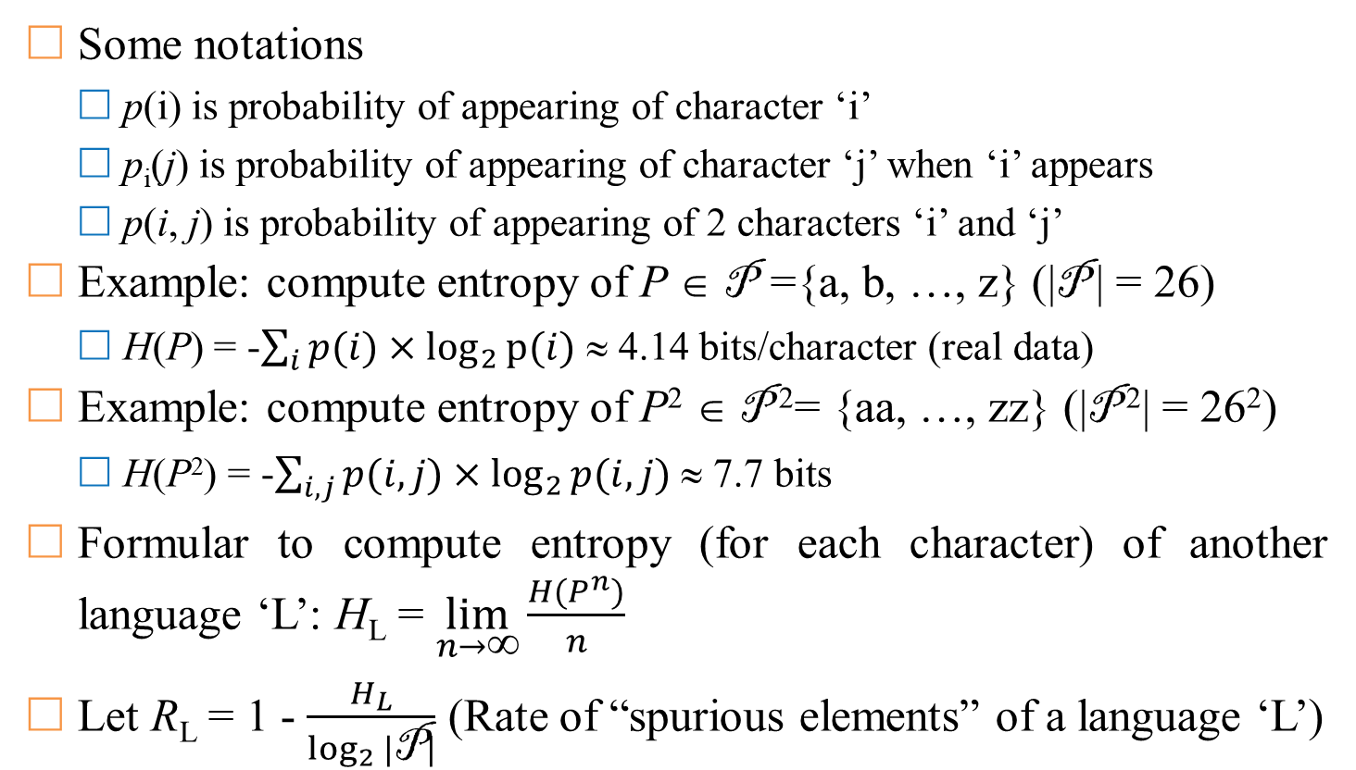
Language’s unicity distance
Some notations
  p(i) is probability of appearing of character ‘i’
  p_{i}(j) is probability of appearing of character ‘j’ when ‘i’ appears
  p(i, j) is probability of appearing of 2 characters ‘i’ and ‘j’
Example: compute entropy of P ∈ P ={a, b, …, z} (|P | = 26)
  H(P) = -$\sum_{i}{p(i)}×\log_{2}{p⁡(i)}$ ≈ 4.14 bits/character (real data)
Example: compute entropy of P² ∈ P ²= {aa, …, zz} (|P ²| = 26²)
  H(P²) = -$\sum_{i,j}{p(i,j)}×\log_{2}{p(i,j)}$ ≈ 7.7 bits
Formular to compute entropy (for each character) of another language ‘L’: H_{L} = $\lim_{n→∞}{\frac{H(P^{n})}{n}}$
Let R_{L} = 1 - $\frac{H_{L}}{\log_{2}{|\text{P}|}}$ (Rate of “spurious elements” of a language ‘L’)

Slide 26
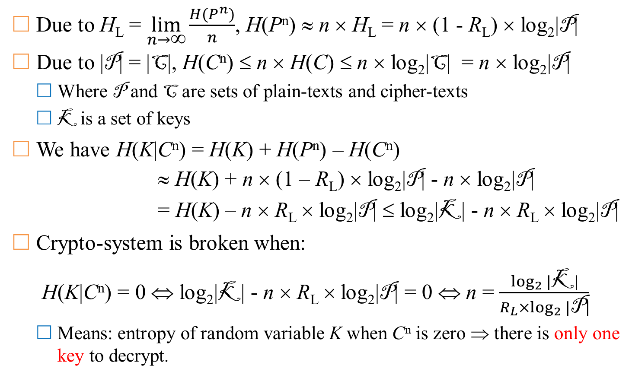
Language’s unicity distance
Due to H_{L} = $\lim_{n→∞}{\frac{H(P^{n})}{n}}$, H(P^{n}) ≈ n × H_{L} = n × (1 - R_{L}) × log₂|P|
Due to |P| = |C|, H(C^{n}) ≤ n × H(C) ≤ n × log₂|C| = n × log₂|P|
  Where P and C are sets of plain-texts and cipher-texts
  K is a set of keys
We have H(K|C^{n}) = H(K) + H(P^{n}) – H(C^{n})
≈ H(K) + n × (1 – R_{L}) × log₂|P| - n × log₂|P|
= H(K) – n × R_{L} × log₂|P| ≤ log₂|K| - n × R_{L} × log₂|P|
Crypto-system is broken when:
H(K|C^{n}) = 0 ⇔ log₂|K| - n × R_{L} × log₂|P| = 0 ⇔ n = $\frac{\log_{2}{|\text{K}|}}{R_{L}×\log_{2}{|\text{P}|}}$
  Means: entropy of random variable K when C^{n} is zero ⇒ there is only one key to decrypt.

Slide 27
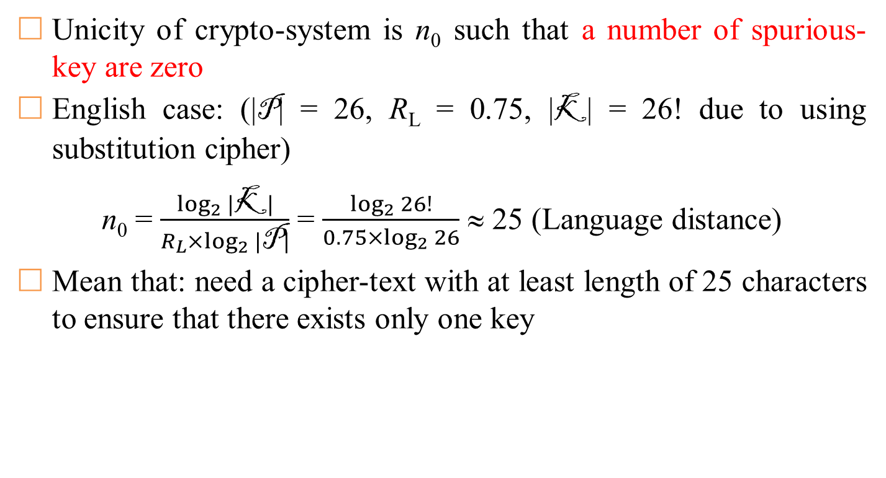
Language’s unicity distance
Unicity of crypto-system is n₀ such that a number of spurious-key are zero
English case: (|P| = 26, R_{L} = 0.75, |K| = 26! due to using substitution cipher)
n₀ = $\frac{\log_{2}{|\text{K}|}}{R_{L}×\log_{2}{|\text{P}|}}$ = $\frac{\log_{2}{26!}}{0.75×\log_{2}{26}}$ ≈ 25 (Language distance)
Mean that: need a cipher-text with at least length of 25 characters to ensure that there exists only one key

Slide 28
Comments
Data Compression
  Good compression – good encryption
  Good encryption – bad compression
Combination of encryption approaches
  “Weighted sum” of crypto-systems
    Create new crypto-systems from existing crypto-systems
    Choose 2 crypto-systems with the same message space, use system A with probability p, use system B with probability 1 – p.
  Product cipher: sequentially apply successive encryption algorithms

