Slide 1
Topic 7:
Digital signature
Vietnam National University Ho Chi Minh City, University of Science
Department of Information Technology
Assoc. Prof. Trần Minh Triết
PhD. Trương Toàn Thịnh

Slide 2
Contents
Introduction
RSA signature
DSA signature
One-time signature (Rabin method)
Notes:
Arbitrated signature schemes require a TTP for signature generation and verification, which results in computational generation and verification.
With added functionality such as blind, undeniable and fail-stop signature schemes

Slide 3
Introduction
Goals of digital signature:
  User authentication
  Data integrity
  Non-repudiation
Basic concepts:
  Digital signature: data string that allows to identify the origin/entity that generated a message.
  Algorithm for generating digital signatures: methods for generating digital signatures
  Digital signature strategy includes algorithm generating digital signature and algorithm verifying digital signature.
  Digital signature scheme = Digital signature generation algorithm + Digital signature verification algorithm

Slide 4
Introduction
Notations:
  M Message-space
  M_{S} Signed-message space
  S Signature-space
  R Map 1-1 from M to M_{S} (redundancy function)
  M_{R} Image of R
  R⁻¹ Inverse function of R
  h One-way function with a source set M
  M_{h} Hash-value space (h: M→ M_{h})

Slide 5
Introduction
Classification of digital signatures
Random
Restore
message
Determined
Signature
strategy
Random
Appendix
Determined

Slide 6
Introduction
s* = S_{A,k}(m_{h})
u = V_{A}(m_{h}, s*)
Signature strategies with appendix
  Signature accompanies original message (Ex: DSA, ElGamal, Schnorr…)
  Message (original) required for digital signature verification
  Use a cryptographic hash function (instead of a redundancy function)
M
M_{h}
S
h
S_{A,k}
m
m_{h}
s*
M_{h} × S
V_{A}
u ∈ {true, false}
Notes:
More commonly used

Slide 7
Introduction
s* = S_{A,k}(m_{h})
u = V_{A}(m_{h}, s*)
Requirements:
  For each k ∈ R, easy to compute S_{A,k}
  Easy to compute V_{A}
  Hard for those are not signer to find m ∈ M and s*∈ S such that V_{A}(m’, s*) = true, for m’ = h(m)
M
M_{h}
S
h
S_{A,k}
m
m_{h}
s*
M_{h} × S
V_{A}
u ∈ {true, false}

Slide 8
Introduction
A digital signature can allow the message to be recovered
M
M_{R}
S
R
S_{A,k}
m
m_{r}
s*
M_{S}
S
M_{R}
M
V_{A}
R⁻¹
s*
m_{r}
m

Slide 9
Introduction
Requirements:
  For each k ∈ R, easy to compute S_{A,k}
  easy to compute V_{A}
  Hard for (computationally infeasible) those are not A to find s* ∈ S such that V_{A}(s*) ∈ M_{R}
M
M_{h}
M_{R}
S
h
R
S_{A,k}
m
m_{h}
m_{r}
s*
M_{S}

Slide 10
Introduction
Levels of “Breaking” the e-signature strategy:
  Total Break: find an efficient way to “fake” a valid signature.
    Know private key?
    Do not know private-key but find an efficient way to create a valid signature.
  Selective forgery: Given a message, attacker can create a valid signature for this message.
  Existential forgery: can find and point to a message (maybe nonsense) but easy for attacker to create valid signature for this message.
Classification of attacks
  Key-only: attacker only know public-key
  Message attack
    Known-message attack: attacker has the signatures of a set of messages. Attacker knows contents of these messages but is not allowed to pre-choose these messages.
    Chosen-message attack: attacker has valid signatures of a set of selective messages (non-adaptive)
    Adaptive chosen-message attack: attacker can use signer as a “oracle”
Severity
Notes:
Total break can simply occur if the adversary finds an efficient algorithm that is functionally equivalent to the valid signing algorithm

Slide 11
RSA signature
Generate key n, p, q, e, d
Create signature
  Compute m_{r} = R(m)
  Compute s = m_{r}^{d} mod n
  Signature of m is s
Verify signature
  Receive public-key (n, e)
  Compute m_{r} = s^{e} mod n
  Verify m_{r} ∈ M_{r}
  Recover m = R⁻¹(m_{r})
Notes:
n, e are public, p q and d are private. d = e inverse mod phi(n)

Slide 12
RSA signature
Attack
  Factorize a large integer
  Possibility of multiple key pairs yielding the same signature
  Homomorphic property:
  E(x₁) × E(x₂) = x₁e× x₂e mod n = (x₁ × x₂)^{e} mod n = E(x₁ × x₂ mod n)
Re-blocking problem
Importance of redundancy function: ISO/IEC 9796
Efficiency (p, q are k-bit prime-numbers): cost of generating signature O(k³) and verifying signature O(k²)
Bandwidth
  Bandwidth depends on R.
  Example: ISO/IEC 9796 maps a k-bit message to a 2k-bit string in M_{S} with 2k-bit signature.
Notes:
For s1 and s2, we have that s1s2 is a signature for m1m2 given that m1m2 is an element of the image of the redundancy function. Thus it is important that our redundancy function is not multiplicative.
Various solutions to this problem, one effective solution is to ensure that each modulus is of a special form. Or have one set t bits for signing and one set t+1 bits for encrypting.
Where k is the number of bits in p and q.

Slide 13
DSA signature
Generating key:
  Choose 1 prime number q 160 bits
  Choose 0 ≤ t ≤ 8, choose 2^{511 + 64t} < p < 2^{512 + 64t} for q | p – 1
  Choose g in Z_{p}*, and α = g^{(p - 1) / q} mod p, α ≠ 1 (α is a primitive of sub-group with order q of Z_{p}*)
  Choose 1 ≤ a ≤ q - 1, compute y = αª mod p
  Public-key (p, q, α, y) and private-key a
Create signature:
  Randomly choose an integer k, 0 < k < q
  Compute r = (α^{k} mod p) mod q and k⁻¹ mod q
  Compute s = k⁻¹ × (h(m) + a × r) mod q
  Signature = (r, s)
Notes:
Two primes p and q. We are dealing with two groups, one Z*p and a subgroup of that of order q. Here alpha is a generator of that subgroup. Notice that the security of our key is based on the discrete logarithm problem.

Slide 14
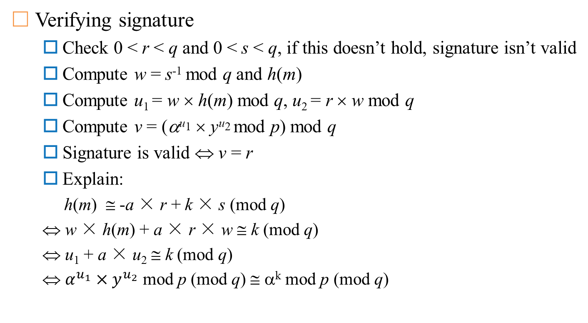
DSA signature
Verifying signature
  Check 0 < r < q and 0 < s < q, if this doesn’t hold, signature isn’t valid
  Compute w = s⁻¹ mod q and h(m)
  Compute u₁ = w × h(m) mod q, u₂ = r × w mod q
  Compute v = (α^{u1} × y^{u2} mod p) mod q
  Signature is valid ⇔ v = r
  Explain:
  h(m) ≅ -a × r + k × s (mod q)
  ⇔ w × h(m) + a × r × w ≅ k (mod q)
  ⇔ u₁ + a × u₂ ≅ k (mod q)
  ⇔ $α^{u_{1}}×y^{u_{2}}$ mod p (mod q) ≅ α^{k} mod p (mod q)

Slide 15
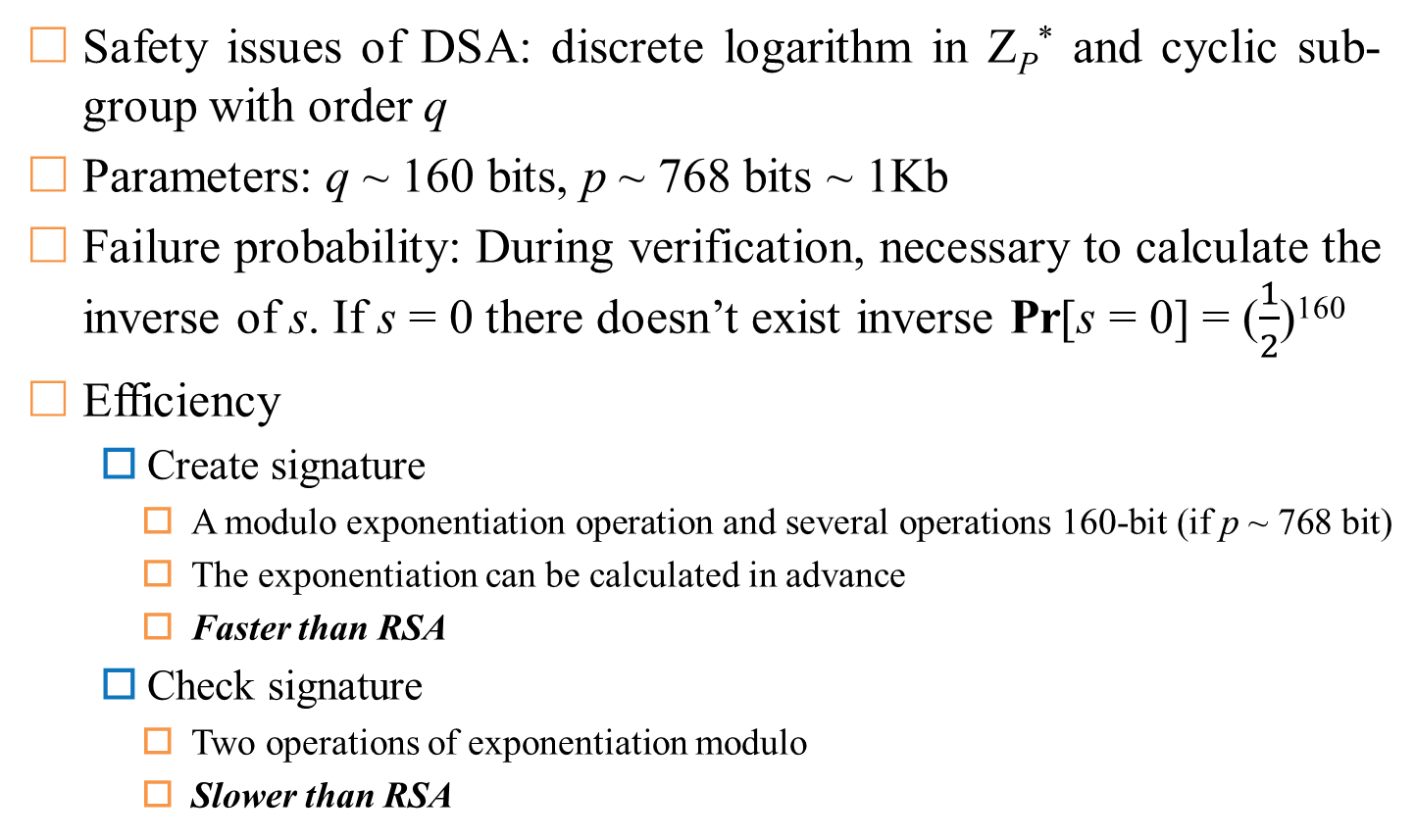
DSA signature
Safety issues of DSA: discrete logarithm in Z_{P}* and cyclic sub-group with order q
Parameters: q ~ 160 bits, p ~ 768 bits ~ 1Kb
Failure probability: During verification, necessary to calculate the inverse of s. If s = 0 there doesn’t exist inverse Pr[s = 0] = ($\frac{1}{2}$)¹⁶⁰
Efficiency
  Create signature
    A modulo exponentiation operation and several operations 160-bit (if p ~ 768 bit)
    The exponentiation can be calculated in advance
    Faster than RSA
  Check signature
    Two operations of exponentiation modulo
    Slower than RSA
Notes:
Note that Z*p we have the index-calculus methods such as coppersmiths algorithms which run in subexponential time. However, in the second group we are left with “square root” time with algorithms such as Pohlig Hellman
Verification requires the computation of s inverse, if s is zero then an inverse does not exist

Slide 16
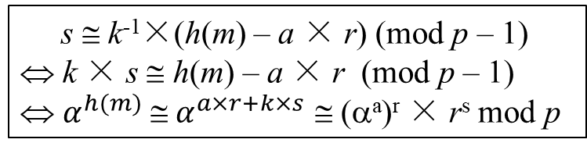
ElGamal signature
Generate key: p, q, α, a, y = αª mod p
  α is a primitive of Z*_{p}
  Public-key (p, α), private-key (a)
Create signature
  Randomly choose k, 1 ≤ k ≤ p - 1, gcd(k, p - 1) = 1
  Compute r = α^{k} mod p, k⁻¹ mod (p-1) and s = k⁻¹ × (h(m) - a × r) mod (p-1)
  Signature (r, s)
Check signature
  Check 1 ≤ r ≤ p – 1
  Compute v₁ = y^{r}× r^{s} mod p, h(m) and v₂ = α^{h(m)} mod p
  Signature is valid ⇔ v₁ = v₂
  s ≅ k⁻¹×(h(m) – a × r) (mod p – 1)
  ⇔ k × s ≅ h(m) – a × r (mod p – 1)
  ⇔ $α^{h(m)} \text{≅} α^{a×r+k×s}$ $\text{}$ (αª)^{r} × r^{s} mod p
Explain
Notes:
Here alpha is a generator of Z*p
p alpha and y are public and a is private key
Again, this is randomized as apposed to deterministic

Slide 17
ElGamal signature
Problems
  Value k must be distinguished for each signed message
    (s₁ - s₂) × k = (h(m₁) - h(m₂)) mod (p - 1)
    If gcd((s₁ - s₂), p - 1) = 1 then can determine the value k, and have private-key a
  If you don’t use the hash function, you may get an existential forgery
Efficiency
  Create signature
    An exponentiation operation modulo
    An operation that uses the Euclidean algorithm to compute the inverse
    Two multiplication operations modulo
  Check signature: three exponentiation operations modulo
Read more: Generalized ElGamal Signature
Notes:
If gcd((s1-s2),p-1)=1 then we can easily find k and from there we can find private key a
p. 255

Slide 18
One-time signature (Rabin method)
Definition: the signature strategy is used to sign up to one message
  If reused, can be hacked to create fake signatures.
  A new public key is required for each message to be signed
Most one-time signature strategies are characterized by very fast signature generation and verification
Create key: choose symmetric encryption algorithm E (ex: DES)
  Generating 2n random string k₁, k₂ ..., k_{2n} ∈ K, each has length of l
  Compute y_{i} = E_{ki}(M₀(i)), i ∈[1, 2n])
    M₀(i) is the binary representation of i filled with more bits 0 at the beginning to get the sequence l-bit
  Public key is (y₁, y₂, ... y_{2n}) and private key is (k₁, k₂, ... k_{2n})

Slide 19


One-time signature (Rabin method)
If there is a conflict, there is a need Trusted Third Party (TTP)
  Signer may deliberately deny having created the signature
  Verifier may deliberately not accept the signature
  …
Signer
Verifier
  Compute s_{i} = E_{ki}(h(m)), i ∈ [1, 2n]
  Signature (s₁, s₂, ..., s_{2n})
1
  {m, (s₁, ..., s_{2n})}
2
  Compute h(m)
  Randomly choose distinct n number of r_{j} ∈ [1, 2n]
  Need n keys k_{rj}, ∀j: 1 ≤ j ≤ n
3
  n keys k_{rj}, ∀j: 1 ≤ j ≤ n
  Check n keys y_{rj}?= E_{krj}(M₀(r_{j}))
  Check all s_{rj} = E_{krj}(h(m))
4
  {Accept or reject}
Notes:
Here note that we are using n or half of 2n, the original number of keys

Slide 20


One-time signature (Rabin method)
Context: Signer refuse to generate signature provided by Verifier
Signer
TTP
  {k₁, ..., k_{2n}}
  {m, (s₁, ..., s_{2n})}
Verifier
Check private-key {k₁, k₂, …, k_{2n}}
1
If this doesn’t hold, TTP judge Verifer thắng
2
Compute u_{i} = $E_{k_{i}}$(h(m)), 1 ≤ i ≤ 2n
If there are at most n quantities u_{i} = s_{i}
3
There are at least n + 1 quantities u_{i} = s_{i}
Fake signature (Signer thắng)
Real signature (Verifier thắng)
Notes:
B cannot provide more than n encrypted values because it does not have another key or find a collision in the hash function
A would need to find n values such that ui equals si and hope that B chooses these values.

