Slide 1

Topic 9:
Hash function & MAC
Vietnam National University Ho Chi Minh City, University of Science
Department of Information Technology
Assoc. Prof. Trần Minh Triết
PhD. Trương Toàn Thịnh

Slide 2
Contents
Introduction
Properties of hash function
Classification of cryptographic hash function
Some popular hash function architectures
MD5 hash function
SHA hash functions
MAC and HMAC
Notes:
Arbitrated signature schemes require a TTP for signature generation and verification, which results in computational generation and verification.
With added functionality such as blind, undeniable and fail-stop signature schemes

Slide 3
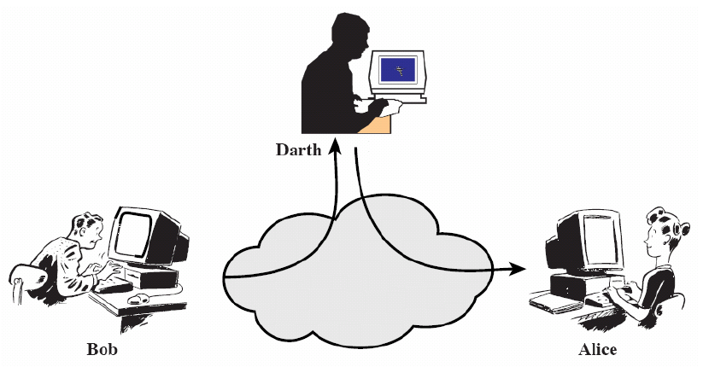
Introduction

Slide 4
Integrity and secrecy
Integrity: the attacker cannot intervene to edit the message content
Encryption is only intended to ensure confidentiality, not to help ensure information integrity
An attacker can modify the encrypted message without knowing the actual content of the message
Example:
  In an online auction, it is possible to change a competitor’s bid without knowing the actual content of the bid

Slide 5
Main ideas of hash function
H is a lossy compression function
Collision: H(x) = H(x’) for x ≠ x’
H can apply on data of almost any size
  Result of H is a n-bit string (fixed n) “looks random”
  Easy to compute H(x) for any x
  H is one-way function and secure against to “collision”
x₁
x₂
Message
y₁
x₃
Digest message
y₂
Bit strings of any length!
Fixed length bit string

Slide 6
One-wayness
The function H is difficult to reverse transform
  Given random bit string y ∈ {0, 1}^{n}, hard to find bit string x such that H(x) = y
Example: brute-force for each value x, check if H(x) = y for SHA-1 producing a 160-bit string
  Assume the hardware allows it to be done 2³⁴ computations/s
  Can perform 2⁵⁹ computations/year
  Need 2¹⁰¹ (~10³⁰) years to reverse transform SHA-1 with given random value y

Slide 7
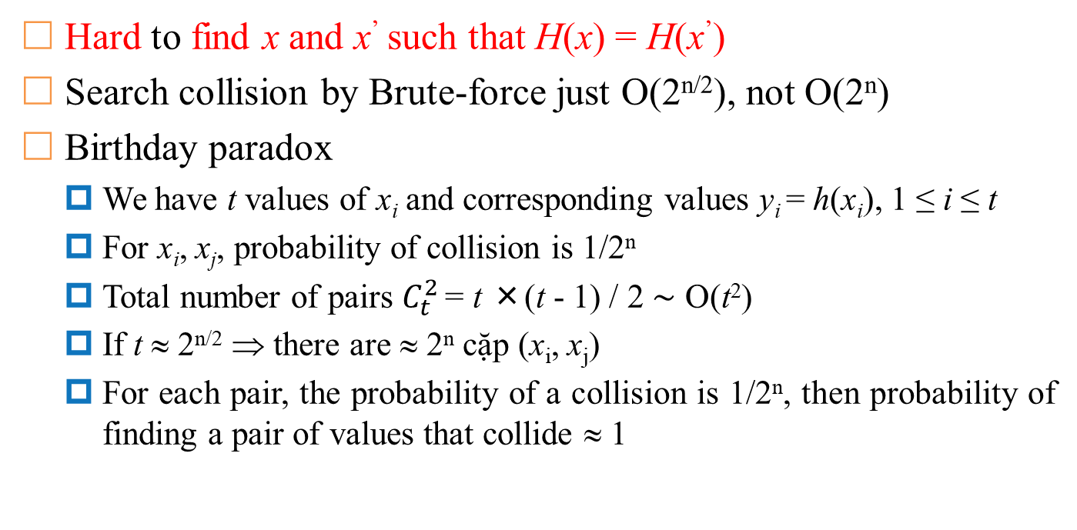
Safety against collisions
Hard to find x and x’ such that H(x) = H(x’)
Search collision by Brute-force just O(2^{n/2}), not O(2^{n})
Birthday paradox
  We have t values of x_{i} and corresponding values y_{i} = h(x_{i}), 1 ≤ i ≤ t
  For x_{i}, x_{j}, probability of collision is 1/2^{n}
  Total number of pairs $C_{t}^{2}$ = t ×(t - 1) / 2 ∼ O(t²)
  If t ≈ 2^{n/2} ⇒ there are ≈ 2^{n} cặp (x_{i}, x_{j})
  For each pair, the probability of a collision is 1/2^{n}, then probability of finding a pair of values ​​that collide ≈ 1

Slide 8
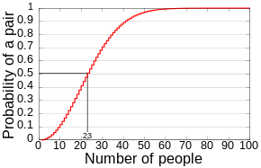
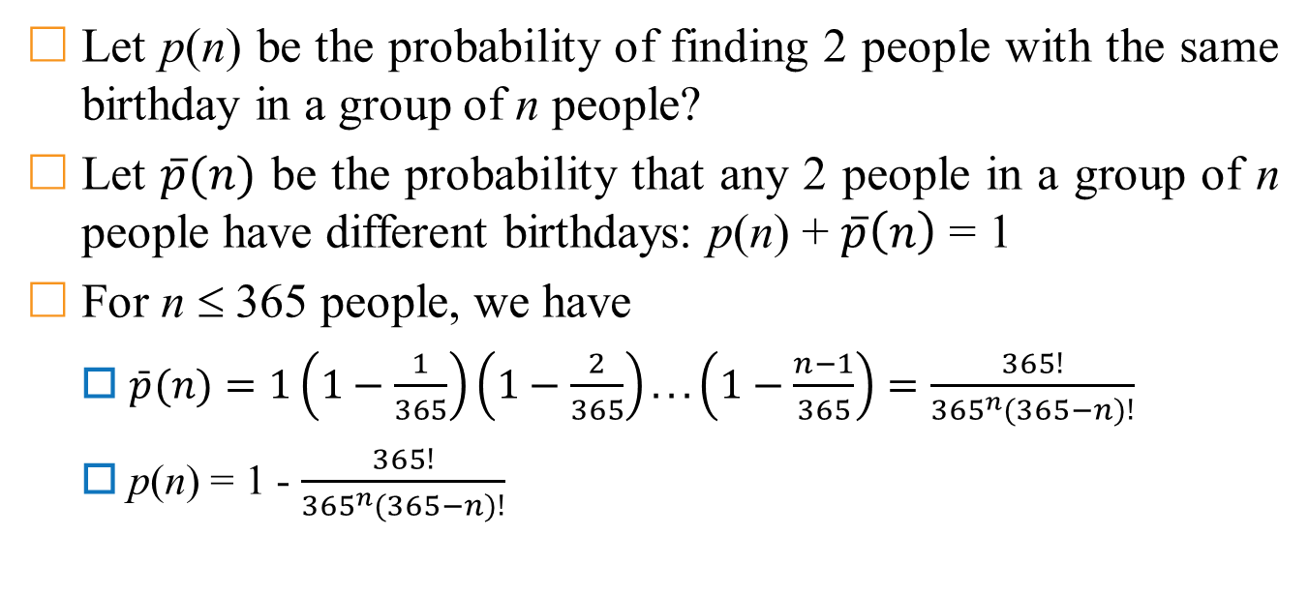
Birthday Paradox
Let p(n) be the probability of finding 2 people with the same birthday in a group of n people?
Let $\overline{p}(n)$ be the probability that any 2 people in a group of n people have different birthdays: p(n) + $\overline{p}\left(n\right)$ = 1
For n ≤ 365 people, we have
  $\bar{p}(n)=1\left(1−\frac{1}{365}\right)\left(1−\frac{2}{365}\right)...\left(1−\frac{n−1}{365}\right)=\frac{365!}{365^{n}(365−n)!}$
  p(n) = 1 - $\frac{365!}{365^{n}(365−n)!}$
https://en.wikipedia.org/wiki/Birthday_problem

Slide 9
Safe from "weak" collisions
Weak Collision Resistance
Given a randomly chosen bit string x, hard to find x’ such that H(x) = H(x’)
The attacker must find a value that collides with a given x value. This is harder to find a pair of x and x’ colliding each other.
Brute-force attack: O(2^{n})
Comment: safety against “weak” collisions does not guarantee safety against collisions

Slide 10
Properties of the hash function
Safe against “preimage” attacks
  Preimage resistance or one-wayness
  Given y, hard to find x such that H(x) = y
Safety against collisions
  Collision resistance
  Hard to find 2 distinct values x and x’ such that H(x’) = H(x)
Safe against “second preimage” attack
  2nd preimage resistance or weak collision resistance
  Given x and y = H(x), hard to find x’ ≠ x such that H(x’) = y

Slide 11
Classification of cryptographic hash function
Cryptographic
Hash Functions
Not use key
Message Authentication Codes
(MAC)
Manipulation Detection Codes
(MDC)
Use key
One-Way
Hash Functions
(OWHF)
Collision Resistant Hash Functions
(CRHF)

Slide 12
Merkle-Damgård architecture
Authors: Ralph Merkle, Ivan Damgård
Most hash functions use this structure
Example: SHA-1, MD5
Block
1
Block
2
Block
n
Length
padding
IV
f
f
f
f
Finali-
sation
Hash

Slide 13

Matyas-Meyer-Oseas architecture
m_{i}
Architecture “dual” with architecture Davies-Mayer
At the 1st block (i = 1), need using initial value H₀
If function E uses key and block with different sizes, function g need converting H_{i-1} to key suitable for function E
H_{i – 1}
g
E
⊕
H_{i}
H_{i} = E_{g (H )} (m_{i}) ⊕ m_{i}
_{i-1}

Slide 14
Davies-Meyer architecture
H_{i – 1}
Architecture “dual” with architecture Matyas-Meyer-Oseas
At the 1st block (i = 1), need using initial value H₀
If function E is not safe, then applying method of fixed-point attack to attack corresponding hash function
m_{i}
E
⊕
H_{i}
H_{i} = E (H_{i –1}) ⊕ H_{i –1}
m_{i}

Slide 15
Miyaguchi-Preneel architecture
m_{i}
Expansion of architecture Matyas-Meyer-Oseas
At the 1st block (i = 1), need using initial value H₀
If function E uses key and block with different sizes, then function g need converting H_{i-1} to key suitable for function E
H_{i – 1}
g
E
⊕
H_{i}
H_{i} = E_{g (H )} (m_{i}) ⊕H_{i-1} ⊕ m_{i}
_{i -1}

Slide 16
Message-Digest algorithm (MD5)
Message Digest 4 hash proposed by Rivest in 1990. In 1991, improved version called MD5 was proposed.
Notes:
  Little-endian value, for example of a 32-bit integer 0x0A0B0C0D
  Big-endian value, for example of 32-bit integer 0x0A0B0C0D
32-bit integer
0A0B0C0D
Memory
0D
a
0C
a + 1
0B
a + 2
0A
a + 3
Memory
0A0B0C0D
32-bit integer
a
0A
a + 1
0B
a + 2
0C
a + 3
0D
https://en.wikipedia.org/wiki/Endianness

Slide 17
Message-Digest algorithm (MD5)
Steps in algorithm:
  Declare: int i, s[64], K[64] //32-bit variables & mod 2³² when computing
  Define values ​​for left rotation coefficient R[i] of each cycle:
    s[0..15] = {7, 12, 17, 22, 7, 12, 17, 22, 7, 12, 17, 22, 7, 12, 17, 22}
    s[16..31] = {5, 9, 14, 20, 5, 9, 14, 20, 5, 9, 14, 20, 5, 9, 14, 20}
    s[32..47] = {4, 11, 16, 23, 4, 11, 16, 23, 4, 11, 16, 23, 4, 11, 16, 23}
    s[48..63] = {6, 10, 15, 21, 6, 10, 15, 21, 6, 10, 15, 21, 6, 10, 15, 21}
  Initialize variables:
    a₀ = 0x67452301
    b₀ = 0xEFCDAB89
    c₀ = 0x98BADCFE
    d₀ = 0x10325476

Slide 18
Message-Digest algorithm (MD5)
Steps in algorithm:
  Compute constants K[i] using below loop:
    for i from 0 to 63 { K[i] = floor(abs(sin(i + 1)) × 2³²}*
  Pre-processing:
    Add bit 1 at the end of the message
    Add k bit 0 such that length of message congruent 448 (mod 512)
    Add 64 bits to represent the length of original message (little-endian stored value)
M
1
0…0
m
m bit
1 bit
k bit
64 bit
Multiples of 512
*Can compute offline

Slide 19
Message-Digest algorithm (MD5)
Example of pre-processing step:
  Assume input-data is a string m = “hello world”
  Convert m to ASCII code:
    01101000 01100101 01101100 01101100 01101111 00100000 01110111 01101111 01110010 01101100 01100100
  Due to |m| = 88 bits ⇒ need more 360 bits to satisfy 448 mod 512 ≅ 448 bits ⇒ add one bit ‘1’ and 359 bit ‘0’
  Convert 88 bits to binary form:
    0000000000000000000000000000000000000000000000000000000001011000
  So, we have m after padded: (|m| = 512 bits):
01101000 | 01100101 | 01101100 | 01101100 | 01101111 | 00100000 | 01110111 | 01101111 | 01110010 | 01101100 | 01100100
10000000 | 00000000 | 00000000 | 00000000 | 00000000 | 00000000 | 00000000 | 00000000 | 00000000 | 00000000 | 00000000
00000000 | 00000000 | 00000000 | 00000000 | 00000000 | 00000000 | 00000000 | 00000000 | 00000000 | 00000000 | 00000000
00000000 | 00000000 | 00000000 | 00000000 | 00000000 | 00000000 | 00000000 | 00000000 | 00000000 | 00000000 | 00000000
00000000 | 00000000 | 00000000 | 00000000 | 00000000 | 00000000 | 00000000 | 00000000 | 00000000 | 00000000 | 00000000
00000000 | 00000000 | 00000000 | 00000000 | 00000000 | 00000000 | 00000000 | 00000000 | 01011000

Slide 20
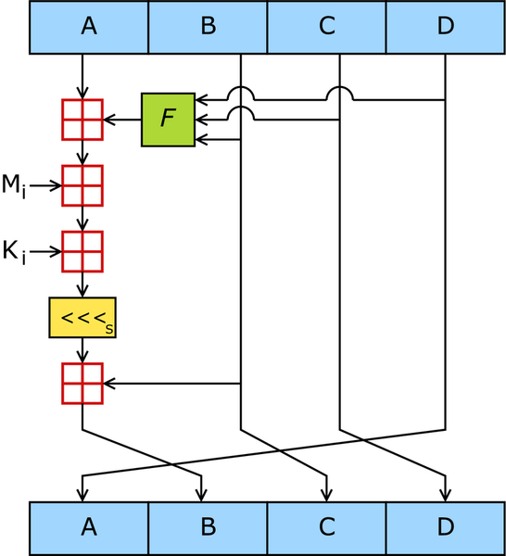
Message-Digest algorithm (MD5)
Steps in algorithm:
  Divide message (padded m) into 512-bit blocks
    For each 512-bit block (ex: q^{th} block)
      Divide into 16 words (little-endian 32-bit word) w[0..15]
      Create 4 variables A = a₀, B = b₀, C = c₀, D = d₀
      Start 64 cycles processing A, B, C, D
      a₀ += A, b₀ += B, c₀ += C, d₀ += D
  Final digest message: a₀ | b₀ | c₀ | d₀
  Example of describing one cycle from 64 cycles
    A, B, C, D are 4 words (32 bits) of a state
    F is non-linear function (changed with i^{th} cycle)
    <<<_{s} is left-rotate s positions taken from s[64]
    ⊞ add modulo 2³².
    K_{i} is a constant from K[64]
  Describe one cycle in 64 cycles
https://en.wikipedia.org/wiki/MD5

Slide 21
Processing cycle of MD5
Pseudo-code of 64 cycles
  for i from 0 to 63
    int f, g
    if 0 ≤ i ≤ 15 then { f = (B ∧ C) ∨ ((¬ B) ∧ D); g = i }
    if 16 ≤ i ≤ 31 then { f = (D ∧ B) ∨ ((¬ D) ∧ C) ; g = (5×i + 1) mod 16 }
    if 32 ≤ i ≤ 47 then { f = B ⊕ C ⊕ D; g = (3×i + 5) mod 16 }
    if 48 ≤ i ≤ 63 then { f = C ⊕ (B ∨ (¬ D)); g = (7×i) mod 16 }
    f = f + A + K[i] + M[g]
    A = D; D = C; C = B; B = B + (f <<<_{s[i]}) // f left-rotates s[i] positions
Test-vector:
  MD5(“”) = d41d8cd98f00b204e9800998ecf8427e
  MD5(“fit.hcmus”) = 22227c3065cbf40733e9a11ffa07124a

Slide 22
Secure Hash Algorithm 1 (SHA-1)
The Secure Hash Standard (SHS or SHA1) method developed by NIST and NSA was published in the Federal Register on January 31, 1992, and then officially became the standard method on May 13, 1993..
Messages are processed in 512-bit blocks
Digested message 160-bit length
Steps in algorithm
  Initialize variables:
    h₀ = 0x67452301
    h₁ = 0xEFCDAB89
    h₂ = 0x98BADCFE
    h₃ = 0x10325476
    h₄ = 0xC3D2E1F0

Slide 23
Secure Hash Algorithm 1 (SHA-1)
Steps in algorithm
  Pre-processing data:
    Add bit 1 at the end of the message
    Add k bits ‘0’ such that the length of message ≅ 448 (mod 512)
    Add 64 bits to represents the length of the original message (value stored in big-endian format)
M
1
0…0
m
m bits
1 bit
k bits
64 bits
Multiples of 512

Slide 24
Secure Hash Algorithm 1 (SHA-1)
Example of pre-processing step:
  Assume input-data is a string m = “hello”
  Convert m to ASCII code:
    01101000 01100101 01101100 01101100 01101111
  Due to |m| = 40 bits ⇒ need more 408 bits to satisfy 448 mod 512 ≅ 448 bits ⇒ add one bit ‘1’ and 407 bits ‘0’
  Convert 40 bits to binary form (stand for 64 bits = 2-word)
    0000000000000000000000000000000000000000000000000000000000101000
  So, m after padded: (|m| = 512 bits, sixteen 32-bit words):
01101000 | 01100101 | 01101100 | 01101100 | 01101111 | 10000000 | 00000000 | 00000000 | 00000000 | 00000000 | 00000000
00000000 | 00000000 | 00000000 | 00000000 | 00000000 | 00000000 | 00000000 | 00000000 | 00000000 | 00000000 | 00000000
00000000 | 00000000 | 00000000 | 00000000 | 00000000 | 00000000 | 00000000 | 00000000 | 00000000 | 00000000 | 00000000
00000000 | 00000000 | 00000000 | 00000000 | 00000000 | 00000000 | 00000000 | 00000000 | 00000000 | 00000000 | 00000000
00000000 | 00000000 | 00000000 | 00000000 | 00000000 | 00000000 | 00000000 | 00000000 | 00000000 | 00000000 | 00000000
00000000 | 00000000 | 00000000 | 00000000 | 00000000 | 00000000 | 00000000 | 00000000 | 00101000

Slide 25
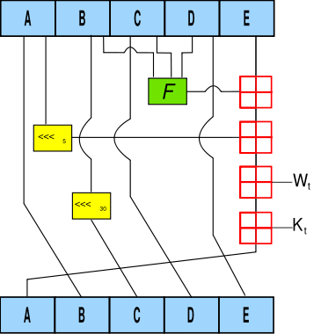
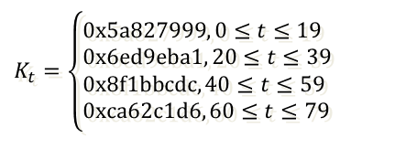
Secure Hash Algorithm 1 (SHA-1)
Steps in algorithm
  Divide message (padded m) into 512-bit blocks
    For each 512-bit block:
      Divide into 16 words (32 bits, big-endian) w[0..15]
      for i from 16 to 79 // Extend 16 words (32 bits) to 80 words (32 bits)
        w[i] = (w[i-3] ⊕ w[i-8] ⊕ w[i-14] ⊕ w[i-16]) <<< 1 (16 ≤ i < 80)
      A = h₀, B = h₁, C = h₂, D = h₃, E = h₄
      Start 80 cycles processing
      h₀ += A, h₁ += B, h₂ += C, h₃ += D, h₄ += E
  Result = h₀ | h₁ | h₂ | h₃ | h₄
  For example, describing one cycle in 80 cycles
    t is an ordinal number of the cycle (0 ≤ t ≤ 79)
    A, B, C, D, E are 5 words (32 bits) of a state
    F is a non-linear function (changed with cycle)
    <<< n is a left-rotate n positions
    ⊞ add modulo 232.
    K_{t} is a constant following ⇒
$$K_{t}=\left\{\begin{aligned}&0x5a827999, 0≤t≤19 \\ &0x6ed9eba1, 20≤t≤39 \\ &0x8f1bbcdc,40≤t≤59 \\ &0xca62c1d6, 60≤t≤79\end{aligned}\right.$$
  Describe one cycle in 80 cycles
https://en.wikipedia.org/wiki/SHA-1

Slide 26
Processing cycle of SHA-1
Pseudo-code of 80 cycles
  for i from 0 to 79
    if 0 ≤ i ≤ 19 then { f = (B ∧ C) ∨ ((¬B) ∧ D); K = 0x5A827999 }
    if 20 ≤ i ≤ 39 then { f = B ⊕ C ⊕ D; K = 0x6ED9EBA1 }
    if 40 ≤ i ≤ 59 then { f = (B ∧ C) ∨ (B ∧ D) ∨ (C ∧ D); K = 0x8F1BBCDC }
    if 60 ≤ i ≤ 79 then { f = B ⊕ C ⊕ D; K = 0xCA62C1D6 }
    temp = (A <<< 5) + f + E + K + w[i]
    E = D; D = C; C = B <<< 30
    B = A
    A = temp
Test-vector:
  SHA-1(“”) = da39a3ee5e6b4b0d3255bfef95601890afd80709
  SHA-1(“fit.hcmus”) = 86cb71d2190be898de94356d59e5f0138f8d8496

Slide 27

A group of SHA hash functions
011010011101
2015
2001
SHA3-224
SHA-256
2001
SHA-384
2015
SHA3-256
2012
2015
1994
2004
SHA-512/256
SHA3-384
SHA-1
SHA-224
2015
SHAKE256
1993
2001
2012
SHA-0
SHA-512
SHA-512/224
2015
SHA3-512
2015
SHAKE128
Secure Hash Standard

Slide 28
SHA algorithms
Algorithm | Result (bit) | State (bit) | Block (bit) | Maximum message (bit) | Cycle | Operation | Collision
SHA-0 | 160 | 160 | 512 | 2⁶⁴ − 1 | 80 | +, and, or, xor, rotl | Yes
SHA-1 |  |  |  |  |  |  | 2⁶³ operations
SHA-256/224 | 256/224 | 256 |  |  | 64 | +, and, or, xor, shr, rotr | No
SHA-512/384 | 512/384 | 512 | 1024 | 2¹²⁸ − 1 | 80
SHA3-224/256/384/512 | 224/256/384/512 | 1600 | 1152/1088/832/576 | No limit | 24 | and, xor, rot, not
SHAKE-128/256 | Tùy ý |  | 1344/1088

Slide 29


Message authentication code (MAC)
Purpose: determine the origin of information (digital signature)
  Generate MAC & check MAC shared secret key
  The sender & receiver must agree on the secret key in advance
  Does not support non-repudiation
  The MAC can be generated from a cryptographic hash function (HMAC) or from a block cipher (OMAC, CBC-MAC, PMAC).
MESSAGE
MESSAGE
Sender
MESSAGE
MAC Algorithm
Receiver
MAC Algorithm
MAC
MAC
?=
MAC
MAC
Decision: if same then authentic and integrity checked else something is wrong

Slide 30
Keyed-hash message authentication code
HMAC(K, m)
  Pseudo-code:
  function HMAC(K, m)
    opad = [0x5c × blocksize]
    ipad = [0x36 × blocksize]
    if (length(K) > blocksize) then
    K = hash(K)
    end if
    for i from 0 to length(K) step 1
    ipad[i] ^= K[i]
    opad[i] ^= K[i]
    end for
    return hash(opad || hash(ipad || m))
K
m
⊕
ipad
⊕
+
opad
output
h
+
HMAC_{K}(m) = h((K ⊕ opad) || h((K ⊕ ipad) || m))
0x5c5c5c…5c5c
0x363636…3636
Mihir Bellare, Ran Canetti, Hugo Krawczyk (1996 )

Slide 31
CBC-MAC
See more:
  How to attack?
  Reference: CMAC
m₁
m₂
m_{n}
0
⊕
⊕
…
⊕
k
E
k
E
k
E
result
Example DES or AES

