Slide 1
Topic 10:
Secured Socket Layer
Vietnam National University Ho Chi Minh City, University of Science
Department of Information Technology
Assoc. Prof. Trần Minh Triết
PhD. Trương Toàn Thịnh

Slide 2
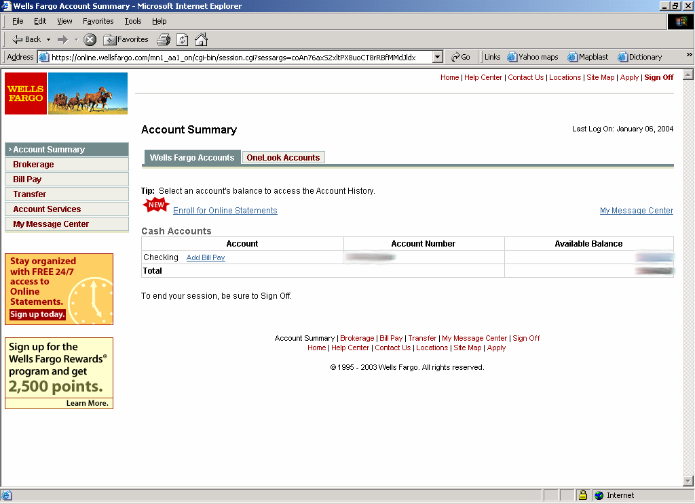
SSL / TLS in daily life?

Slide 3
The evolution of the protocol
SSL 1.0
  Internal research in Netscape (~early 1994?)
  “Lost in the mists of time”
  Main author: Taher Elgamal
SSL 2.0
  Netscape published on 11/1994
  There are still a few problems
  Expired on 2011 (RFC 6176)
SSL 3.0
  Published in RFC 6101
  Netscape and Paul Kocher designed (11/1996)
  Expired on 6/2015 (RFC 7568)
https://datatracker.ietf.org/doc/html/rfc6101

Slide 4
The evolution of the protocol
TLS 1.0 và TLS 1.1
  Internet standards based on SSL 3.0 (01/1999)
  Incompatible works with SSL 3.0
  Expired on ~ 3/2020
  TLS 1.1 updated from TLS 1.0
  TLS 1.0 published in RFC 2246 and TLS 1.1 in RFC 4346
TLS 1.2
  Updated from TLS 1.1
  Currently in use
  Published in RFC 5246
TLS 1.3
  Updated from TLS 1.2
  Used by some libraries, browsers and software
  Published in RFC 8446
https://datatracker.ietf.org/doc/html/rfc5246

Slide 5
Some limitations in SSL 2.0
Key length is too short
  In weakened modes before being released to the public, SSL 2.0 has narrowed the key length for authentication to 40 bits.
Generate weak MAC
Vulnerable to integrity attack
  SSL 2.0 adds bytes (padding) to the MAC in block cipher modes, but has no control over padding length validation. This makes it possible for an attacker to delete some bytes at the end of the message.
Ciphersuite rollback attack
  An attacker can modify the “ClientHello” message to “trick” the server into choosing an old version or a weak algorithm

Slide 6
Basics of TLS (TLS Handshake Protocol)
TLS consists of two protocols:
  Handshake protocol: use asymmetric encryption to establish a shared secret key between client and server
    Include Client and Server
    Negotiate protocol version and the set of cryptographic algorithms to be used
      Compatibility & interoperability between different implementations of the general protocol
    Authenticate client and server (optional)
      Use an e-certificate to know the partner's public key and confirm each other's identity
    Use public key to establish public-secret
  Record protocol: Use the secret key established in the handshake protocol to protect communication between client and server

Slide 7



Structure of Handshake protocol (in general)
Client
ClientHello
Server
1
ServerHello,
[Certificate],
[ServerKeyExchange],
[CertificateRequest],
ServerHelloDone
2
3
3
4
5
6
[Certificate],
ClientKeyExchange,
[CertificateVerify]
Finished
7
8
Switch to the negotiated encryption algorithm
9
Switch to the negotiated encryption algorithm
Finished
10

Slide 8

ClientHello
Client
Server
1
ClientHello
Client reports (data NOT encrypted):
Version of in-use protocol
Supported encryption algorithms

Slide 9
ClientHello
4 bytes timestamp, 28 bytes random value
session_id:
  ≠ 0 for new connection of existing session
  = 0 for new connection of new session
client_version: maximum version value
cipher_suites: Ordered list of supported client algorithms
compression_methods: an ordered list of compression algorithms that the client supports
Highest version of the protocol supported by the client
struct {
TimeStamp timestamp;
ProtocolVersion client_version;
Random random;
SessionID session_id;
CipherSuite cipher_suites;
CompressionMethod compression_methods;
} ClientHello
Session id (if the client wants to resume an old session)
Client-supported cryptographic algorithms (e.g., RSA or Diffie-Hellman)

Slide 10
ServerHello
Client
Server
1
C, Version_{c}, suite_{c}, N_{c}
ServerHello
2
Server responds (data NOT encrypted):
Highest version supported by server and client
The strongest set of cryptographic algorithms supported by the client

Slide 11
ServerHello
The structure consists of
  32 bytes random value
  session_id: new value or old value reused
  version: min{version_{client supports}, version_{maximum server supports}}
  cipher_suite list: list of selected algorithms (select only one algorithm in each category)
  compression list: Select only from client-supported compression algorithms
  Key exchange method
    RSA: need to certify the recipient's public key
    Fixed DH: Both parties must have a public-key certificate
    Ephemeral DH: Both sides need the key to sign and certify the public-key
    Anonymous DH: don’t validate DH key, man-in-the-middle attack possible
    Fortezza: rarely used

Slide 12
ServerHello
CipherAlgorithm
  RC4, RC2, DES, 3DES, DES40, IDEA, Fortezza
MACAlgorithm
  MD5 or SHA-1
CipherType
  stream or block
IsExportable: true or false
HashSize
  0, 16 or 20 bytes
Key Material: used to generate a write-key
IV Size: size of IV in CBC

Slide 13
ServerKeyExchange
Client
Server
1
C, Version_{c}, suite_{c}, N_{c}
Version_{s}, suite_{s}, N_{s},
2
ServerKeyExchange
3
Server sends its certificate of public-key (RSA or Diffie-Hellman, depending on the selected set of algorithms)

Slide 14
ServerKeyExchange
No need for RSA and Fixed DH
Needed with Anonymous DH, Ephemeral DH
Use with RSA if the server only has a key for signing. The server then sends a temporary public key (RSA) to the client
Message ServerKeyExchange:
  Signed by server
  Signature on hash value of:
    ClientHello.random, ServerHello.random
    Parameter of Server Key Exchange

Slide 15
ClientKeyExchange
Client
Server
1
C, Version_{c}, suite_{c}, N_{c}
Version_{s}, suite_{s}, N_{s},
2
sig_{ca}(S,K_{s}),
3
“ServerHelloDone”
4

Slide 16
ClientKeyExchange
Client
Server
1
C, Version_{c}, suite_{c}, N_{c}
Version_{s}, suite_{s}, N_{s},
2
sig_{ca}(S,K_{s}),
3
“ServerHelloDone”
4
5
ClientKeyExchange
Client generates a secret-key (encrypted with the server's public-key) and sends it to the server

Slide 17
ClientKeyExchange
Structure
struct {
select (KeyExchangeAlgorithm) {
case rsa: EncryptedPreMasterSecret;
case diffie_hellman: ClientDiffieHellmanPublic;
} exchange_keys
} ClientKeyExchange
struct {
ProtocolVersion client_version;
opaque random[46];
} PreMasterSecret
RSA or Diffie-Hellman key exchange algorithm
Client-side protocol version

Slide 18
“Core” SSL
Client
Server
1
C, Version_{c}, suite_{c}, N_{c}
Version_{s}, suite_{s}, N_{s},
2
sig_{ca}(S,K_{s}),
3
“ServerHelloDone”
4
5
{Secret_{c}}_{Ks}
If the protocol is correct, from now on, C and S share a common secret key
Switch to using key
deduced from secret_{c}
Switch to using key
deduced from secret_{c}

Slide 19
States of Client and Server
Client state
Server state
ClientHello
M_SLEEP
M_CLIENT_HELLO
ServerHello
M_SERVER_HELLO
M_SEND_KEY
ServerKeyExchange
M_SERVER_KEY
M_CLIENT_KEY
M_SEND_KEY
M_DONE
ClientKeyExchange

Slide 20
Main part of SSL 3.0
Client
Server
1
C, Version_{c} = 3.0, suite_{c}, N_{c}
Version_{s} = 3.0, suite_{s}, N_{s},
2
sig_{ca}(S,K_{s}),
3
“ServerHelloDone”
4
5
{Secret_{c}}_{Ks}
If the protocol is correct, from now on,
C and S share the common secret key
Switch to using key
deduced from secret_{c}
Switch to using key
deduced from secret_{c}

Slide 21
Mis-choose old version!
Client
Server
1
C, Version_{c} = 2.0, suite_{c}, N_{c}
Version_{s} = 2.0, suite_{s}, N_{s},
2
sig_{ca}(S,K_{s}),
3
“ServerHelloDone”
4
5
{Secret_{c}}_{Ks}
The server was "tricked" and decided to
establish communication
between S and C using the old version

Slide 22
Adjust SSL
Client
Server
1
C, Version_{c} = 3.0, suite_{c}, N_{c}
Version_{s} = 3.0, suite_{s}, N_{s},
2
sig_{ca}(S,K_{s}),
3
“ServerHelloDone”
4
5
{Version_{c},Secret_{c}}_{Ks}
If the protocol is correct, from now on,
C and S share the common secret key
Prevent attack
with old version
Added version check
matches the information in ClientHello
Switch to using key
deduced from secret_{c}
Switch to using key
deduced from secret_{c}

Slide 23
Summary
A = basic protocol
C = A + certificate of public key
  Authentication for client and server
E = C + confirmation message (Finished)
  Prevent attacks from “tricking” the server to choose the old version or weak algorithms
F = E + nonse
  Prevent replay attack

Slide 24
Anomaly detection with Finished
Change
Client
… Suite_{C} …
Server
Change
… Suite_{S} …
…
Switch to sharing algorithms
X
X
Finished
Finished
data
data

Slide 25
Example: Version Rollback Attack
SSL 2.0 Finish message “forgot” with version information
Client
Server
SessionId, Ver_{C}= 2.0, N_{C}, ...
Ver_{S}= 2.0, N_{S}, ...
X
X
Finished
Finished
{ N_{S} } SecretKey
{ N_{C} } SecretKey
data
data

Slide 26
Server Authentication
Need to use certificate X.509 v3 in case of using RSA, Fixed DH, Ephemeral DH
Client
Server
1
ClientHello
ServerHello
2
Certificate
3
“ServerHelloDone”
4
5
ClientKeyExchange
6
[ChangeCipherSpec]
7
Finished
[ChangeCipherSpec]
8
Finished
9

Slide 27
Server & Client Authentication
1
ClientHello
Client
ServerHello
2
Server
Certificate
3
CertificateRequest
4
“ServerHelloDone”
5
6
Certificate
7
ClientKeyExchange
8
CertificateVerify
9
[ChangeCipherSpec]
10
Finished
[ChangeCipherSpec]
11
Finished
12

