Slide 1

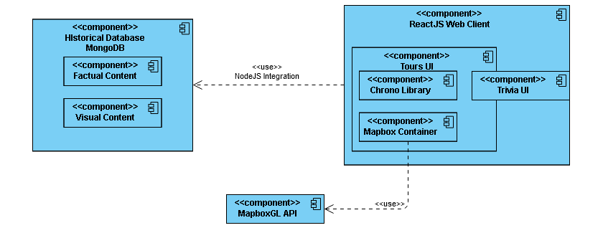
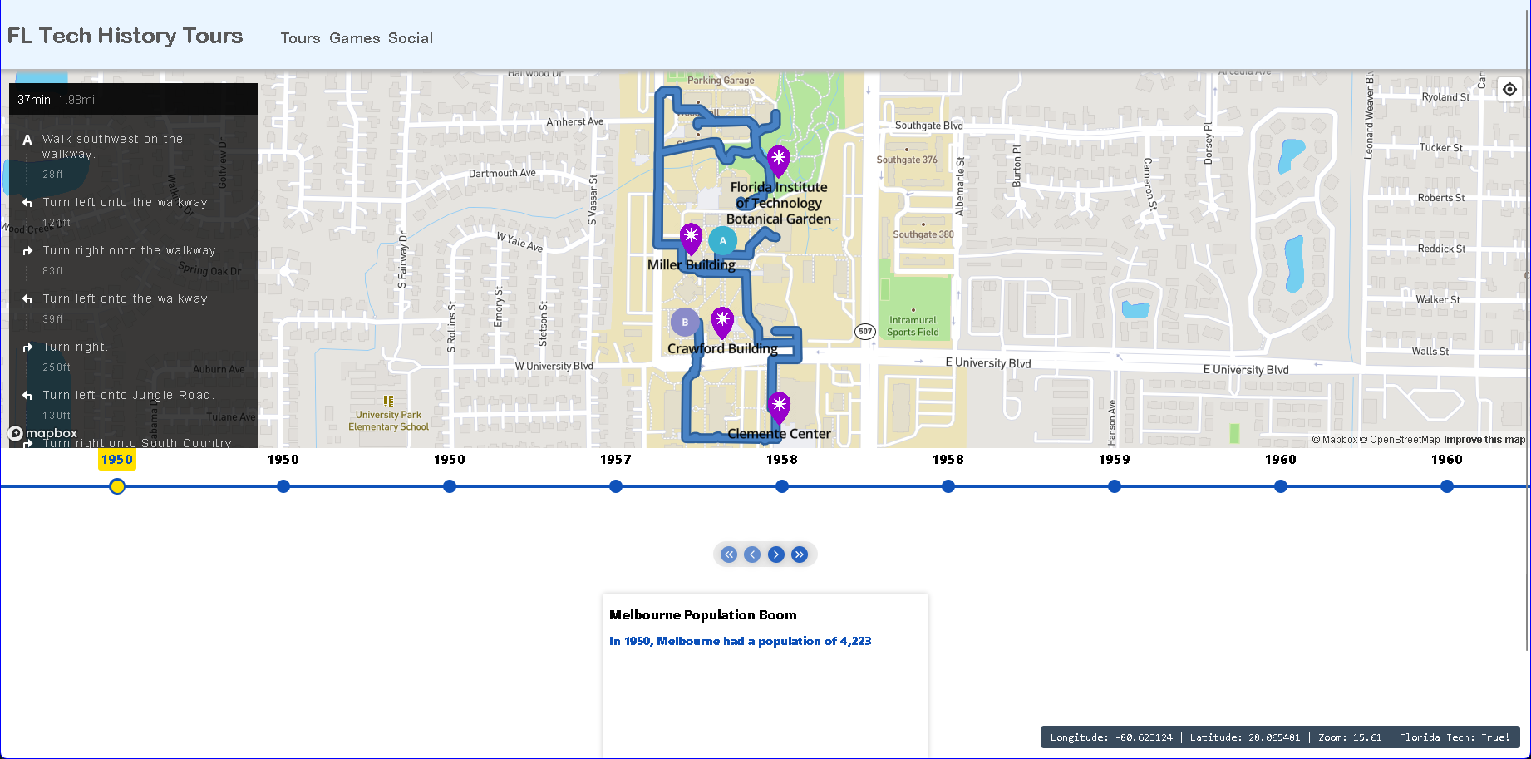
Florida Tech History Tours
Tyler Zars, Grant Butler, Cameron Miskell, Matthew Tokarski
Faculty Advisor(s): Dr. Fitzroy Nembhard, Dept. of Computer Science, Florida Institute of Technology
Motivation
Design
With the over 60 years of history behind Florida Tech, all the factoids that have been kept and passed down are displayed largely in a single room in the library. The goal of this project is to ensure that others can learn about the much broader history of Florida Tech while experiencing the university itself. The vast history of Florida Tech isn’t known with just small plaques attached to buildings and statues scatted across the campus. This web application allows for users to find historical sites on campus and navigate to them accordingly to learn about places they find interesting.
FIgure 1: System Architecture Diagram
Goals
Allow students, staff, and visitors to access and explore the history of Florida Tech’s campus
Provide students, staff, and visitors around campus to experience and see historical sites with predefined guided tours
Give students, staff, and visitors the ability to test their knowledge of campus with various interactive games.
Figure 2: Graphical User Interface (GUI)
Methods
Our application utilizes Node JS to provide the user with a static website that makes API calls to Mapbox for the map and any routing on the tours. We compiled a list of historical facts by working with the archivist on campus, historical books written about the campus, and general facts and tidbits found throughout the campus and it’s website. This information was compiled together with geofenced coordinates of all the locations on campus that allow for us to tag buildings and provide users with a way to navigate between them. This all combines in the web application allowing for full tours of the campus with historical facts show.
Results
Conclusion & Future Ideas
From the work over two semesters we have produced an interactive web application with three static tours and the option to set additional waypoints. The application can consistently load and be fully interactable within three seconds. We discuss 58 facts from the first 40+ years of Florida Tech in a timeline format. The application provides users with interesting information based off their location within 75 feet of their current location.
This application is a good introductory experience for campus goers to learn about the rich history of Florida Tech. This application provides a way for users to connect with the past while learning in the present. In the future, more facts and tours can be added to allow for new and old members of campus alike to celebrate our universities history.

