Slide 1
Parallel Computing (III) 多執行緒 (Multithreaded Programming)
Cheng-Hung Lin

Slide 2
Multicore Programming
Multicore or multiprocessor systems putting pressure on programmers, challenges include:
Dividing activities
Balance
Data splitting
Data dependency
Testing and debugging
Parallelism implies a system can perform more than one task simultaneously
Concurrency supports more than one task making progress
Single processor / core, scheduler providing concurrency
Types of parallelism
Data parallelism – distributes subsets of the same data across multiple cores, same operation on each
Task parallelism – distributing threads across cores, each thread performing unique operation

Slide 3
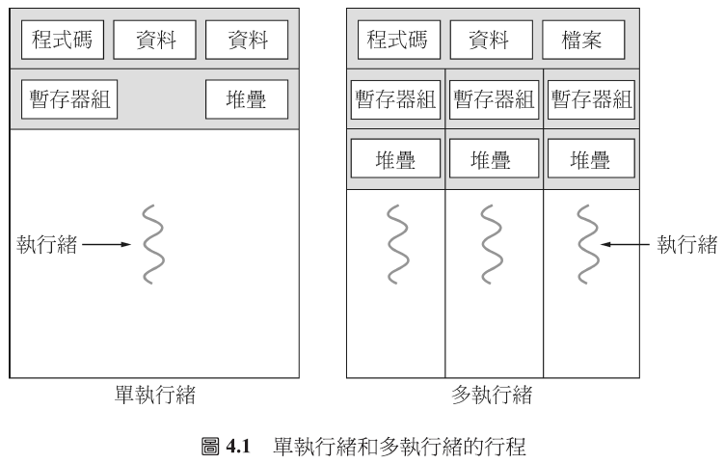
執行緒(Thread)
執行緒(Thread)是 CPU使用時的一個基本單位，它是由一個執行緒ID、程式計數器、一組暫存器，以及一個堆疊空間所組成。

Slide 4
Difference between creating a process and a thread
Process A
Stack
Heap
BSS
Data
Code
Thread A
Stack
Heap
BSS
Data
Code
Pthread_create()
Fork()
Process B
Stack
Heap
BSS
Data
Code
Thread B
Stack
Process A and Process B do not share resources.
Thread B only applies its own stack memory.
Thread B shares code, data, BSS, heap, files with thread A.

Slide 5
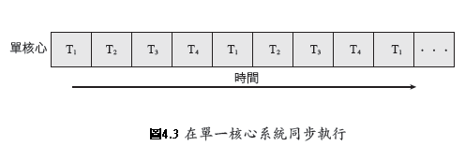
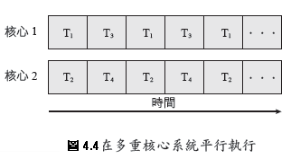
多核心程式的挑戰
在位多核心系統編寫程式中目前的挑戰有以下五個領域：
切割活動(Dividing activities)： 檢查應用程式來找出可以被切割成個別的、同時發生的任務，因此可以在個別的核心上平行地執行。
平衡(Balance)： 當識別任務可以平行地執行時，程式員也必須保證任務執行為相等的工作。
資料分裂(Data splitting)： 正如同應用程式被分割成個別的任務，藉由任務來存取和運用的資料必須被分割到個別的核心上執行。
資料相依性(Data dependency)： 藉由任務存取的資料必須在兩個或多個任務之間檢查其相依性。在一個任務依靠另一個任務的情況下，程式員必須確認任務的執行與資料的相依性是同步的。
測試與除錯(Testing and debugging)：當一個程式在多核心上平行地執行時，有許多不同的執行路徑。測試和除錯這類同步的程式原來就比測試和除錯單一執行緒的應用程式更加困難。

Slide 6
Difference of functions
Functions | Thread | Process
Create | pthread_create | fork, vfork
Exit | pthread_exit | exit
Wait | pthread_join | wait, waitpid
Cancel/Terminate | pthread_cancel | abort
Read ID | pthread_self | getpid
Scheduling | SCHED_OTHER, SCHED_FIFO, SCHED_RR | SCHED_OTHER, SCHED_FIFO, SCHED_RR
communication | Message, mutex | Shared memory, pipe, message passing

Slide 7
User Threads and Kernel Threads
User threads - management done by user-level threads library
Three primary thread libraries:
POSIX Pthreads
Win32 threads
Java threads
Kernel threads - Supported by the Kernel
Examples – virtually all general purpose operating systems, including:
Windows
Solaris
Linux
Tru64 UNIX
Mac OS X

Slide 8
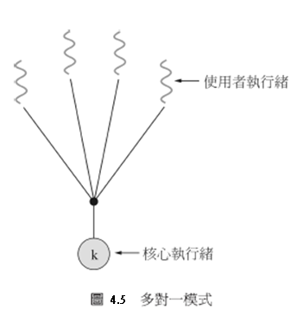
多執行緒模式
多對一模式(Many-to-one model)
Many user-level threads mapped to a single kernel thread
One thread blocking causes all to block
Multiple threads may not run in parallel on muticore system because only one may be in kernel at a time
Few systems currently use this model because it cannot take advantage of multiple processing cores.
Examples:
Solaris Green Threads
GNU Portable Threads

Slide 9
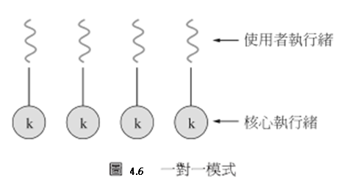
一對一模式(One-to-One)
Map each user thread to a kernel thread
Creating a user-level thread requires creating a kernel thread
Supporting multiprocessors
The number of threads is restricted due to the overhead of creating kernel threads.
Examples
Windows NT/XP/2000
Linux
Solaris 9 and later

Slide 10
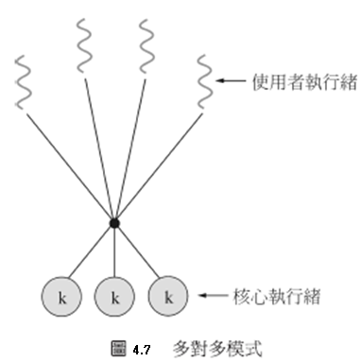
多對多模式(Many-to-Many)
Multiplexes many user-level threads to a smaller of equal number of kernel threads
The number of kernel threads may be specific to a particular application or a particular machine.
Solaris prior to version 9
Windows NT/2000 with the ThreadFiber package

Slide 11
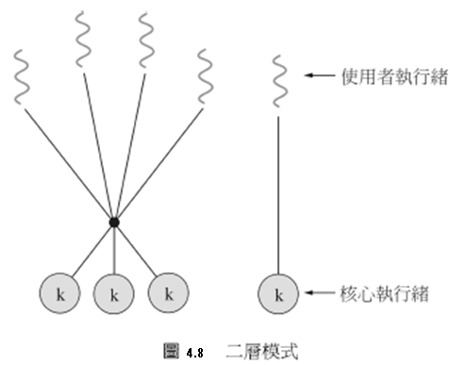
Two-level Model
Similar to M:M, except that it allows a user thread to be bound to a kernel thread
Examples
IRIX
HP-UX
Tru64 UNIX
Solaris 8 and earlier

Slide 12
執行緒的函式庫
Thread library provides programmer with API for creating and managing threads
Two primary ways of implementing
Library entirely in user space with no kernel support
Kernel-level library supported by the OS

Slide 13
執行緒程式庫(Thread Libraries)
4.3.1 Pthreads
Pthreads依據POSIX以 (IEEE1003.1c)標準定義執行緒產生和同步的API。
Pthreads是執行緒行為的規格，而非製作。作業系統設計者可以用任何他們期望的方式製作此規格。
4.3.2 Win32執行緒
使用Win32執行緒程式庫產生執行的技巧與Pthreads技巧，在許多方面很相似。當使用Win32API時，必須含有windows.h的標題檔。
4.3.3 Java執行緒
執行緒是在Java程式、Java語言和JavaAPI中程式執行的基本模式，Java的API提供執行緒的產生與管理一組豈富的特性。所有Java程式至少包含一個單一執行緒控制，即使只包含一個main()方法的Java程式也是以一個單一執行緒在JVM下執行。

Slide 14
Pthreads
May be provided either as user-level or kernel-level
A POSIX standard (IEEE 1003.1c) API for thread creation and synchronization
Specification, not implementation
API specifies behavior of the thread library, implementation is up to development of the library
Common in UNIX operating systems (Solaris, Linux, Mac OS X)

Slide 15
Preliminaries
Include pthread.h in the main file
Compile program with –lpthread
gcc –o test test.c –lpthread
may not report compilation errors otherwise but calls will fail
Good idea to check return values on common functions

Slide 16
pthread_attr_init
#include <pthread.h>
int pthread_attr_init(pthread_attr_t *attr);
以內定(default)的屬性初始化執行緒的屬性
若成功返回0，若失敗返回-1。
用pthread_attr_destroy對其去除初始化 int pthread_attr_destroy(pthread_attr_t*attr);

Slide 17
執行緒屬性
POSIX定義的執行緒屬性有：可分離狀態(detachstate)、 執行緒堆疊大小(stacksize)、執行緒堆疊地址(stackaddr)、作用域（scope）、繼承排程(inheritsched)、 排程策略(schedpolicy)和排程引數(schedparam)。 有些系統並不支援所有這些屬性，使用前注意檢視系統文件。
但是所有Pthread系統都支援detachstate屬性，該屬性可以是PTHREAD_CREATE_JOINABLE或PTHREAD_CREATE_DETACHED，預設的是joinable的。擁有joinable屬性的執行緒可以被另外一個執行緒等待，同時還可以獲得執行緒的返回值，然後被回收。而detached的執行緒結束時，使用的資源立馬就會釋放，不用其他執行緒等待。

Slide 18
執行緒的相關API
pthread_create()：建立一個執行緒
pthread_exit()：終止當前執行緒
pthread_cancel()：中斷另外一個執行緒的執行
pthread_join()：阻塞當前的執行緒，直到另外一個執行緒執行結束
pthread_attr_init()：初始化執行緒的屬性
pthread_attr_setdetachstate()：設定脫離狀態的屬性（決定這個執行緒在終止時是否可以被結合）
pthread_attr_getdetachstate()：獲取脫離狀態的屬性
pthread_attr_destroy()：刪除執行緒的屬性
pthread_kill()：向執行緒傳送一個訊號

Slide 19
Creating a thread: pthread_create
int pthread_create( pthread_t *thread, pthread_attr_t *attr, void *(*thread_function)(void *), void *arg );
first argument – pointer to the identifier of the created thread
second argument – thread attributes
third argument – pointer to the function the thread will execute
fourth argument – the argument of the executed function (usually a struct)
returns 0 for success

Slide 20
Waiting for the threads to finish: pthread_join
int pthread_join( pthread_t thread, void **thread_return )
main thread will wait for daughter thread thread to finish
first argument – the thread to wait for
second argument – pointer to a pointer to the return value from the thread
returns 0 for success
threads should always be joined; otherwise, a thread might keep on running even when the main thread has already terminated

Slide 21
Exiting a Thread
pthreads exist in user space and are seen by the kernel as a single process
if one issues and exit() system call, all the threads are terminated by the OS
if the main() function exits, all of the other threads are terminated
To have a thread exit, use pthread_exit()
Prototype:
void pthread_exit(void *status);
status: the exit status of the thread – passed to the status variable in the pthread_join() function of a thread waiting for this one

Slide 22
Pthreads Example
#include <pthread.h>
#include <stdio.h>
int sum; /* this data is shared by the thread(s) */
void *runner(void *param); /* the thread */
int main(int argc, char *argv[]){
pthread_t tid; /* the thread identifier */
pthread_attr_t attr; /* set of attributes for the thread */
if (argc != 2) {
fprintf(stderr,"usage: a.out <integer value>\n");
/*exit(1);*/
return -1;
}
if (atoi(argv[1]) < 0) {
fprintf(stderr,"Argument %d must be non-negative\n",atoi(argv[1]));
/*exit(1);*/
return -1;
}

Slide 23
pthread_attr_init(&attr); /* get the default attributes */
pthread_create(&tid,&attr,runner,argv[1]); /* create the thread */
pthread_join(tid,NULL); /* now wait for the thread to exit */
printf("sum = %d\n",sum);
}
// The thread will begin control in this function
void *runner(void *param)
{
int i, upper = atoi(param);
sum = 0;
if (upper > 0) {
for (i = 1; i <= upper; i++)
sum += i;
}
pthread_exit(0);
}
Thread shares global variables

Slide 24
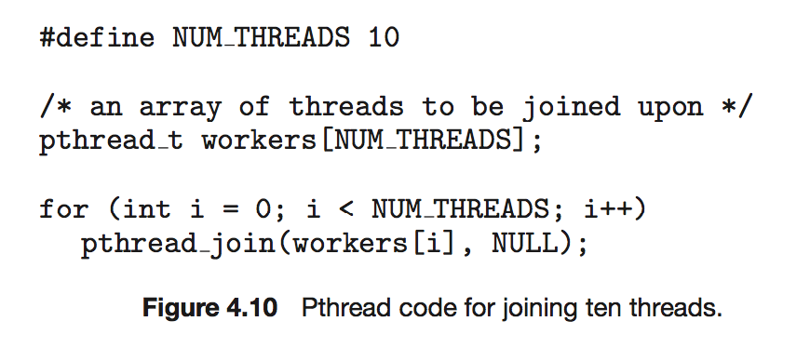
Pthreads Code for Joining 10 Threads

Slide 25
Quiz 1
else if (pid > 0) { /* parent process */
wait(NULL);
printf("PARENT: value = %d\n",value);
}
}
/**
* The thread will begin control in this function
*/
void *runner(void *param)
{
value = 5;
pthread_exit(0);
}
#include <pthread.h>
#include <stdio.h>
#include <sys/types.h>
#include <unistd.h>
#include <wait.h>
int value = 0; /* this data is shared by the thread(s) */
void *runner(void *param); /* the thread */
int main(int argc, char *argv[])
{
pid_t pid;
pthread_t tid; /* the thread identifier */
pthread_attr_t attr; /* set of attributes for the thread */
pid = fork();
if (pid == 0) { /* child process */
pthread_attr_init(&attr); /* get the default attributes */
pthread_create(&tid,&attr,runner,argv[1]); /* create the thread */
pthread_join(tid,NULL); /* now wait for the thread to exit */
printf("CHILD: value = %d\n",value);
}

Slide 26
Quiz 1 Answer
else if (pid > 0) { /* parent process */
wait(NULL);
printf("PARENT: value = %d\n",value);
}
}
/**
* The thread will begin control in this function
*/
void *runner(void *param)
{
value = 5;
pthread_exit(0);
}
#include <pthread.h>
#include <stdio.h>
#include <sys/types.h>
#include <unistd.h>
#include <wait.h>
int value = 0; /* this data is shared by the thread(s) */
void *runner(void *param); /* the thread */
int main(int argc, char *argv[])
{
pid_t pid;
pthread_t tid; /* the thread identifier */
pthread_attr_t attr; /* set of attributes for the thread */
pid = fork();
if (pid == 0) { /* child process */
pthread_attr_init(&attr); /* get the default attributes */
pthread_create(&tid,&attr,runner,argv[1]); /* create the thread */
pthread_join(tid,NULL); /* now wait for the thread to exit */
printf("CHILD: value = %d\n",value);
}
$ ./quiz1
CHILD: value = 5
PARENT: value = 0

Slide 27
Problem: vector addition using pthread
#include <pthread.h>
#include <stdio.h>
#include <stdlib.h>
#define N 100
int A[N];
int B[N];
int C[N];
int goldenC[N];
void *runner(void *param); /* the thread */
int main(int argc, char *argv[]) {
int i, j, k, *pos;
pthread_t tid[N]; //Thread ID
pthread_attr_t attr[N]; //Set of thread attributes
struct timespec t_start, t_end;
double elapsedTime;
for(i = 0; i < N; i++) {
A[i] = rand()%100;
B[i] = rand()%100;
}
// start time
clock_gettime( CLOCK_REALTIME, &t_start);
for(i = 0; i < N; i++) {
//Assign a row and column for each thread
pos = (int*)malloc(sizeof(int));
*pos = i;
pthread_attr_init(&attr[i]);
pthread_create(&tid[i],&attr[i],runner,pos);
}

Slide 28
int pass = 1;
for(i = 0; i < N; i++) {
if(goldenC[i] != C[i]){
pass = 0;
}
}
if(pass==1)
printf("Test pass!\n");
else
printf("Test fail!\n");
return 0;
}
for(i = 0; i < N; i++) {
pthread_join(tid[i], NULL);
}
// stop time
clock_gettime( CLOCK_REALTIME, &t_end);
// compute and print the elapsed time in millisec
elapsedTime = (t_end.tv_sec - t_start.tv_sec) * 1000.0;
elapsedTime += (t_end.tv_nsec - t_start.tv_nsec) / 1000000.0;
printf("Parallel elapsedTime: %lf ms\n", elapsedTime);
//Print out the resulting matrix
// start time
clock_gettime( CLOCK_REALTIME, &t_start);
for(i = 0; i < N; i++) {
goldenC[i] = A[i] + B[i];
}
// stop time
clock_gettime( CLOCK_REALTIME, &t_end);
// compute and print the elapsed time in millisec
elapsedTime = (t_end.tv_sec - t_start.tv_sec) * 1000.0;
elapsedTime += (t_end.tv_nsec - t_start.tv_nsec) / 1000000.0;
printf("Sequential elapsedTime: %lf ms\n", elapsedTime);
//The thread will begin control in this function
void *runner(void *param) {
int *pos = param;
int i;
C[*pos] = A[*pos] + B[*pos];
pthread_exit(0);
}

Slide 29
Homework
Change N to 1000000
Create 4 threads
Each thread performs addition on 1000000/4 elements.

Slide 30
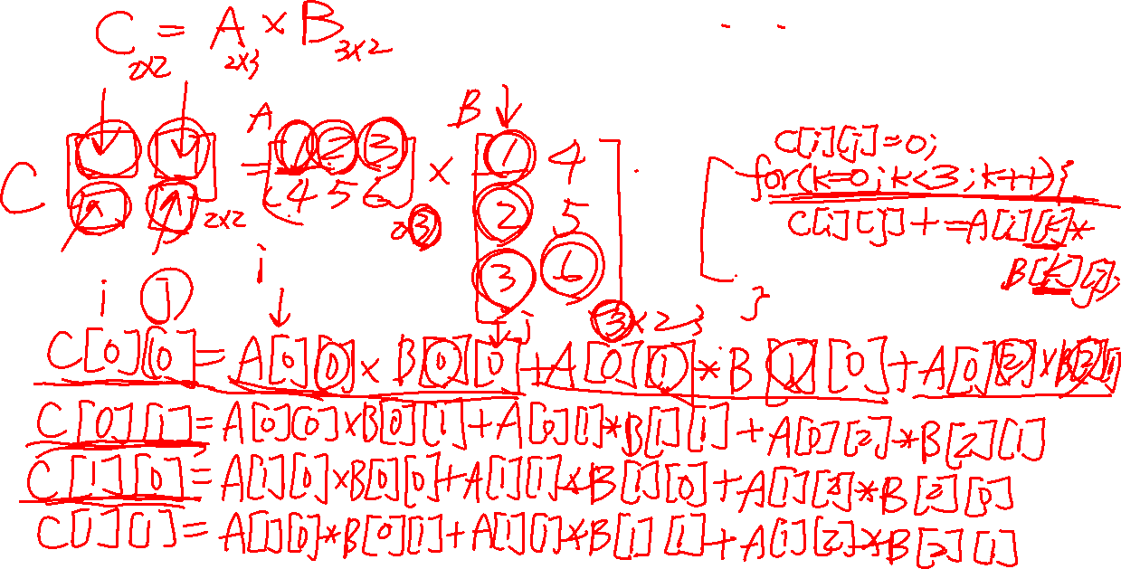

Slide 31
Matrix multiplication
#include <pthread.h>
#include <stdio.h>
#include <stdlib.h>
#define N 100
int A [N][N];
int B [N][N];
int C [N][N];
int goldenC [N][N];
struct v {
int i; /* row */
int j; /* column */
};
void *runner(void *param); /* the thread */
int main(int argc, char *argv[]) {
int i, j, k;
pthread_t tid[N][N]; //Thread ID
pthread_attr_t attr[N][N]; //Set of thread attributes
struct timespec t_start, t_end;
double sequentialelapsedTime;
double parallelelapsedTime;
for(i = 0; i < N; i++) {
for(j = 0; j < N; j++) {
A[i][j] = rand()%100;
B[i][j] = rand()%100;
}
}

Slide 32
// start time
clock_gettime( CLOCK_REALTIME, &t_start);
for(i = 0; i < N; i++) {
for(j = 0; j < N; j++) {
//Assign a row and column for each thread
struct v *data = (struct v *) malloc(sizeof(struct v));
data->i = i;
data->j = j;
//Get the default attributes
pthread_attr_init(&attr[i][j]);
//Create the thread
pthread_create(&tid[i][j],&attr[i][j],runner,data);
}
}
for(i = 0; i < N; i++) {
for(j = 0; j < N; j++) {
pthread_join(tid[i][j], NULL);
}
}
// stop time
clock_gettime( CLOCK_REALTIME, &t_end);
void *runner(void *param) {
struct v *data = param;
int k, sum = 0;
for(k = 0; k< N; n++){
sum += A[data->i][k] * B[k][data->j];
}
C[data->i][data->j] = sum;
pthread_exit(0);
}
// compute and print the elapsed time in millisec
parallelelapsedTime = (t_end.tv_sec - t_start.tv_sec) * 1000.0;
parallelelapsedTime += (t_end.tv_nsec - t_start.tv_nsec) / 1000000.0;
printf("Parallel elapsedTime: %lf ms\n", parallelelapsedTime);

Slide 33
// start time
clock_gettime( CLOCK_REALTIME, &t_start);
for(i = 0; i < N; i++) {
for(j = 0; j < N; j++) {
for(k=0; k< N; k++){
goldenC[i][j]+=A[i][k] * B[k][j];
}
}
}
// stop time
clock_gettime( CLOCK_REALTIME, &t_end);
// compute and print the elapsed time in millisec
sequentialelapsedTime = (t_end.tv_sec - t_start.tv_sec) * 1000.0;
sequentialelapsedTime += (t_end.tv_nsec - t_start.tv_nsec) / 1000000.0;
printf("sequential elapsedTime: %lf ms\n", sequentialelapsedTime);
printf("Speedup %.2lf\n", sequentialelapsedTime/parallelelapsedTime);

Slide 34
int pass = 1;
for(i = 0; i < N; i++) {
for(j = 0; j < N; j++) {
if(goldenC[i][j]!=C[i][j]){
pass = 0;
}
}
}
if(pass==1)
printf("Test pass!\n");
return 0;
}

Slide 35
Problem
Too many threads
Reading B matrix is inefficient
Transpose B would be better

Slide 36
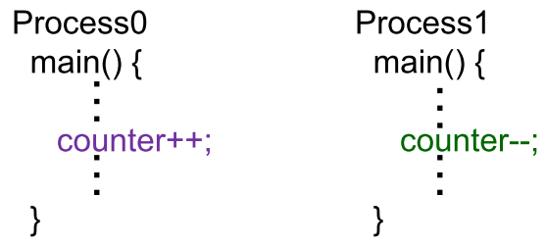
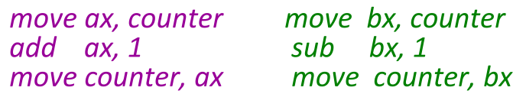
Synchronization Problem
Assume variable “counter” is shared by processes.
The statement “counter++” & “counter--”may be implemented in machine language as:

Slide 37
Instruction Interleaving
Instruction Interleaving
producer: move ax, counter → ax = 5
producer: add ax, 1 → ax = 6
context switch
consumer: move bx, counter → bx = 5
consumer: sub bx, 1 → bx = 4
context switch
producer: move counter, ax → counter = 6
context switch
consumer: move counter, bx → counter = 4
The value of counter may be either 4, 5, or 6
The ONLY correct result is 5!

Slide 38
Thread-Safe Routines
System calls or library routines are called “Thread-Safe” if they can be called from multiple threads simultaneously and always produce correct results

Slide 39
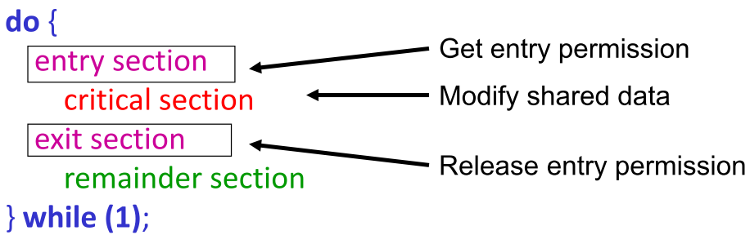
Critical Section & Mutual Exclusion
Critical Section is a piece of code that can only be accessed by one process/thread at a time
Mutual exclusion is the problem to insure only one process/thread can be in a critical section
E.g.: The design of entry section & exit section provides mutual exclusion for the critical section

Slide 40
Critical section problem
多個程序同時對共享資料(shared data )進行存取可能會造成資料不一致(data inconsistency)
為保持資料的一致性，必須確保合作程序的執行順序
假設生產者/消費者問題中，共用一個緩衝(buffer)。透過一個變數count來記錄這個緩衝的使用數量。其中count初始化為0。當生產者生產一個資料時，count加一，相反的當消費者消費一個資料時，count減一。

Slide 41
Producer
while (true) {
/* produce an item and put in nextProduced */
while (count == BUFFER_SIZE); // do nothing
buffer [in] = nextProduced;
in = (in + 1) % BUFFER_SIZE;
count++;
}

Slide 42
Consumer
while (true) {
while (count == 0); // do nothing
nextConsumed = buffer[out];
out = (out + 1) % BUFFER_SIZE;
count--;
/* consume the item in nextConsumed
}

Slide 43
這個不正確的狀態是因為允許兩個行程並行處理這個 counter變數。像這種數個行程同時存取和處理相同資料的情況，而且執行的結果取決於存取時的特殊順序，就叫競爭情況 (race condition)。

Slide 44
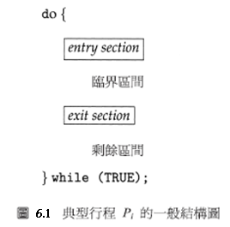
Solution to critical section problem
解決critical section problem的方案必須滿足下面三個要求
互斥(mutual exclusion):如果行程Pi正在臨界區(critical section)間內執行，則其它的行程不能在其臨界區間內執行。
進行(Progress):如果沒有行程在臨界區間內執行，同時某一行程想要進入臨界區間，那麼只有那些不在剩餘區間執行的行程才能加入決定誰將在下一次進入臨界區間，並且這個選擇不得無限期地延遲下去。
限制住的等待(bound waiting):在一個行程已經要求進入臨界區間，而此要求尚未被答應之前，允許其它的行程進入臨界區間的次數有一個限制。

Slide 45
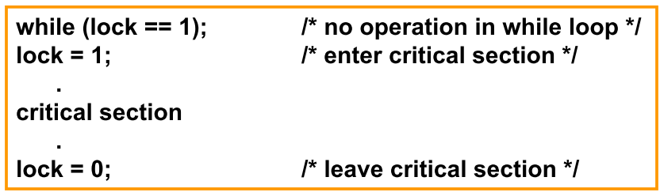
Locks
Lock: the simplest mechanism for ensuring mutual exclusion of critical section
Spinlock is one of the implementation:
Locks are implemented in Pthreads by a special type of variables “mutex”
Mutex is abbreviation of “mutual exclusion”

Slide 46
Mutex Locks
do {
acquire lock
critical section
release lock
remainder section
} while (true);
acquire(){
while(!available);//busy wait
available = false;
}
release(){
available = true;
}

Slide 47
Mutex Locks
OS designers build software tools to solve critical section problem
Simplest is mutex lock
要進入critical section先透過acquire() 取得 lock 之後再透過release() 釋放lock
利用布林變數指示lock 可用還是不可用
acquire() and release() 必須是原子化(atomic)
通常用hardware atomic instructions實現
But this solution requires busy waiting
This lock therefore called a spinlock

Slide 48
Pthread Lock/Mutex Routines
To use mutex, it must be a global variable declared as of type pthread_mutex_t and initialized with pthread_mutex_init() or PTHREAD_MUTEX_INITIALIZER;
A mutex is destroyed with pthread_mutex_destory()
A critical section can then be protected using pthread_mutex_lock() and pthread_mutex_unlock()

Slide 49
Mutex Locks
A Mutex lock is created like a normal variable
pthread_mutex_t mutex;
Mutexes must be initialized before being used
a mutex can only be initialized once
prototype:
int pthread_mutex_init(pthread_mutex_t *mp, const pthread_mutexattr_t *mattr);
mp: a pointer to the mutex lock to be initialized
mattr: attributes of the mutex – usually NULL
Example
/* pthread_mutex_t mutex = PTHREAD_MUTEX_INITIALIZER; */
pthread_mutex_t mutex;
pthread_mutex_init(&mutex, NULL);

Slide 50
Linux的同步
Linux在2．6版之前是一個不可搶先的核心，也就是行程在核心模式執行是不可搶先，甚至如果一個較高優先的權行程可以執行時。然而，現在 Linux完全可以搶先，所以當任務正在核心執行時是可以搶先的。
Pthreads的同步
Threads API在執行緒同步提供mutex locks、 condition variables和read-write locks。這一個API對電腦程式設計師是可用的以及不是任何特別核心的一部份。 mutex locks呈現使用Pthreads的基本同步技術。 mutex locks用來保護臨界區間的程式碼,也就是執行緒在進入臨界區間前獲得鎖，然後在離開臨界區間將鎖釋放。

Slide 51
Locking a Mutex
To insure mutual exclusion to a critical section, a thread should lock a mutex
when locking function is called, it does not return until the current thread owns the lock
if the mutex is already locked, calling thread blocks
if multiple threads try to gain lock at the same time, the return order is based on priority of the threads
higher priorities return first
no guarantees about ordering between same priority threads
prototype:
int pthread_mutex_lock(pthread_mutex_t *mp);
mp: mutex to lock

Slide 52
Unlocking a Mutex
When a thread is finished within the critical section, it needs to release the mutex
calling the unlock function releases the lock
then, any threads waiting for the lock compete to get it
very important to remember to release mutex
prototype:
int pthread_mutex_unlock(pthread_mutex_t *mp);
mp: mutex to unlock

Slide 53
Pthreads Synchronization
#include <pthread.h>
pthread_mutex_t mutex;
/*create the mutex lock*/
pthread_mutex_init(&mutex, NULL);
/*acquire the mutex lock*/
pthread_mutex_lock(&mutex);
/* critical section*/
/*release the mutex lock*/
pthread_mutex_unlock(&mutex);

Slide 54
Example
#include <stdio.h>
#include <pthread.h>
pthread_mutex_t mutex = PTHREAD_MUTEX_INITIALIZER;
int count;
void * thread_run(void *arg){
int i;
pthread_mutex_lock(&mutex);
for (i = 0; i < 3; i++) {
printf("[%ld]value of count: %d\n", pthread_self(), ++count);
}
pthread_mutex_unlock(&mutex);
return 0;
}
Critical Section

Slide 55
int main(int argc, char *argv[]){
pthread_t thread1, thread2, thread3, thread4;
pthread_create(&thread1, NULL, thread_run, 0);
pthread_create(&thread2, NULL, thread_run, 0);
pthread_create(&thread3, NULL, thread_run, 0);
pthread_create(&thread4, NULL, thread_run, 0);
printf("thread1 id: %ld\n", thread1);
printf("thread2 id: %ld\n", thread2);
printf("thread3 id: %ld\n", thread3);
printf("thread4 id: %ld\n", thread4);
pthread_join(thread1, 0);
pthread_join(thread2, 0);
pthread_join(thread3, 0);
pthread_join(thread4, 0);
pthread_mutex_destroy(&mutex);
return 0;
}
$ ./mutex1
[139816833672960]value of count: 1
[139816833672960]value of count: 2
[139816833672960]value of count: 3
thread1 id: 139816833672960
thread2 id: 139816825280256
thread3 id: 139816816887552
thread4 id: 139816687630080
[139816687630080]value of count: 4
[139816687630080]value of count: 5
[139816687630080]value of count: 6
[139816816887552]value of count: 7
[139816816887552]value of count: 8
[139816816887552]value of count: 9
[139816825280256]value of count: 10
[139816825280256]value of count: 11
[139816825280256]value of count: 12

Slide 56
如果拿掉mutex lock會如何?

Slide 57
Example of Race condition
#include <stdio.h>
#include <stdlib.h>
#include <pthread.h>
void *thread(void *param);
int count = 0;
#define N 10000
int main(int argc, char *argv[])
{
int i;
pthread_t tid[N];
pthread_attr_t attr[N];
//Create N threads
for(i = 0; i < N; i++){
pthread_attr_init(&attr[i]);
pthread_create(&tid[i], &attr[i], thread, NULL);
}
for(i = 0; i < N; i++){
pthread_join(tid[i], NULL);
}
printf("count is %d\n", count);
return 0;
}
void *thread(void *param)
{
count++;
}

Slide 58
Solution using Mutex lock
#include <stdio.h>
#include <stdlib.h>
#include <pthread.h>
#include <semaphore.h>
void *thread(void *param);
int count = 0;
pthread_mutex_t mutex;
#define N 10000
int main(int argc, char *argv[]){
int i;
pthread_t tid[N];
pthread_attr_t attr[N];
pthread_mutex_init(&mutex, NULL);
//Create N threads
for(i = 0; i < N; i++){
pthread_attr_init(&attr[i]);
pthread_create(&tid[i], &attr[i], thread, NULL);
}
for(i = 0; i < N; i++){
pthread_join(tid[i], NULL);
}
printf("count is %d\n", count);
return 0;
}
void *thread(void *param)
{
//acquire the mutex lock
pthread_mutex_lock(&mutex);
count++;
//release the mutex lock
pthread_mutex_unlock(&mutex);
}

Slide 59
Example
void consumer(char* buf) {
for(;;) {
while(count == 0);
pthread_mutex_lock(&bufLock);
printf("output buffer:");
printf("%c\n", buf[count-1]);
count--;
pthread_mutex_unlock(&bufLock);
}
}
int main() {
char buffer[MAX_SIZE];
pthread_t p;
count = 0;
pthread_mutex_init(&bufLock, NULL);
pthread_create(&p, NULL, (void*)producer, buffer);
consume(buffer);
return 0;
}
#include <stdio.h>
#include <pthread.h>
#define MAX_SIZE 5
pthread_mutex_t bufLock;
int count;
void producer(char* buf) {
for(;;) {
while(count == MAX_SIZE);
pthread_mutex_lock(&bufLock);
printf("enter a char:");
buf[count] = getchar();
getchar();
count++;
pthread_mutex_unlock(&bufLock);
}
}

Slide 60
死結(Deadlock)

Slide 61
Deadlock example
void *proc2(){
printf(“\nThis is proc2 using rs2\n”);
pthread_mutex_lock(&lock2);
usleep(200);
printf( “\np2 trying to get rs1...\n”);
pthread_mutex_lock(&lock1);
test--;
printf(“Test: %d\n”, test);
printf(“\nproc2 got rs1!!\n”);
pthread_mutex_unlock(&lock1);
pthread_mutex_unlock(&lock2);
return 0;
}
#include<pthread.h>
#include<stdio.h>
#include<stdlib.h>
#include <unistd.h>
pthread_mutex_t lock1 = PTHREAD_MUTEX_INITIALIZER;
pthread_mutex_t lock2 = PTHREAD_MUTEX_INITIALIZER;
int test=0;
void *proc1(){
printf(“\nThis is proc1 using rs1\n”);
pthread_mutex_lock(&lock1);
usleep(200);//200 micro seconds
printf("\np1 trying to get rs2...\n");
pthread_mutex_lock(&lock2);
test++;
printf(“Test: %d\n”, test);
printf(“\nproc1 got rs2!!\n”);
pthread_mutex_unlock(&lock2);
pthread_mutex_unlock(&lock1);
return 0;
}

Slide 62
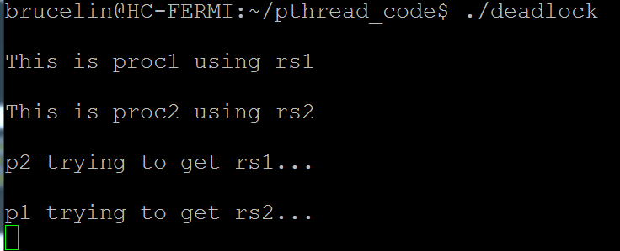
int main(){
pthread_t t1,t2;
pthread_create(&t1,NULL, proc1 , NULL);
pthread_create(&t2,NULL, proc2 , NULL);
pthread_join(t1,NULL);
pthread_join(t2,NULL);
// will never arrive here
pthread_mutex_destroy(&lock1);
pthread_mutex_destroy(&lock2);
}

Slide 63
Semaphore
A tool to generalize the synchronization problem
Deadlock may occur if not use appropriately !
More specifically…
a record of how many units of a particular resource are available
If #record = 1 → binary semaphore, mutex lock
If #record > 1 →counting semaphore
accessed only through 2 atomic operations: wait & signal
Spinlock implementation:
Semaphore is an integer variable
wait (S) {
while (S <= 0) ;
S--;
}
signal (S) {
S++;
}

Slide 64
Semaphore Example
shared data:
semaphore S ; // initially S = 1
Process Pi:
do {
wait (S) ;
critical section
signal (S);
remainder section
} while (1) ;

Slide 65
POSIX Semaphore
pthreads allows the specific creation of semaphores
can do increments and decrements of semaphore value
semaphore can be initialized to any value
thread blocks if semaphore value is less than or equal to zero when a decrement is attempted
as soon as semaphore value is greater than zero, one of the blocked threads wakes up and continues
no guarantees as to which thread this might be

Slide 66
POSIX Semaphore
#include <semaphore.h>
sem_t sem;
/*create a semaphore and initialized to 1 */
sem_init(&sem, 0, 1);
/*acquire the semaphore*/
sem_wait(&sem);
/*critical section*/
/*release the semaphore*/
sem_post(&sem);
POSIX Semaphore routines:
sem_init(sem_t *sem, int pshared, unsigned int value)
sem_wait(sem_t *sem)
sem_post(sem_t *sem)
sem_getvalue(sem_t *sem, int *valptr)
sem_destory(sem_t *sem)

Slide 67
Creating Semaphores
Semaphores are created like other variables
sem_t semaphore;
Semaphores must be initialized
Prototype:
int sem_init(sem_t *sem, int pshared, unsigned int value);
sem: the semaphore value to initialize
pshared: share semaphore across processes – usually 0
value: the initial value of the semaphore

Slide 68
Decrementing a Semaphore
Prototype:
int sem_wait(sem_t *sem);
sem: semaphore to try and decrement
If the semaphore value is greater than 0, the sem_wait call return immediately
otherwise it blocks the calling thread until the value becomes greater than 0

Slide 69
Incrementing a Semaphore
Prototype:
int sem_post(sem_t *sem);
sem: the semaphore to imcrement
Increments the value of the semaphore by 1
if any threads are blocked on the semaphore, they will be unblocked

Slide 70
Example I
void consumer(char* buf) {
int out = 0;
for(;;) {
sem_wait(&full);
printf("%c\n", buf[out]);
out = (out + 1) % MAX_SIZE;
sem_post(&empty);
}
}
int main() {
char buffer[MAX_SIZE];
pthread_t p;
sem_init(&empty, 0, MAX_SIZE);
sem_init(&full, 0, 0);
pthread_create(&p, NULL, (void*)producer, buffer);
consumer(buffer);
return 0;
}
#include <stdio.h>
#include <semaphore.h>
#include <pthread.h>
#define MAX_SIZE 5
sem_t empty, full;
void producer(char* buf) {
int in = 0;
for(;;) {
sem_wait(&empty);
buf[in] = getchar();
getchar();
in = (in + 1) % MAX_SIZE;
sem_post(&full);
}
}

Slide 71
Example II
#include <stdio.h>
#include <pthread.h>
#include <unistd.h>
#include <semaphore.h>
sem_t semaphore;
int counter = 0;
void* child() {
for(int i = 0;i < 5;++i) {
sem_wait(&semaphore);
printf("Counter = %d\n", ++counter);
sleep(1);
}
pthread_exit(NULL);
}
int main(void) {
sem_init(&semaphore, 0, 0);
pthread_t t;
pthread_create(&t, NULL, child, NULL);
printf("Post 2 jobs.\n");
sem_post(&semaphore);
sem_post(&semaphore);
sleep(4);
printf("Post 3 jobs.\n");
sem_post(&semaphore);
sem_post(&semaphore);
sem_post(&semaphore);
pthread_join(t, NULL);
return 0;
}
Notes:
如果我們現在有兩個執行緒，分別負責一份工作的前半段與後半段，也就是說第一個執行緒會把它處理好的資料，發包給第二個執行緒繼續處理，而兩個執行緒的處理速度有可能不同，這種狀況我們就可以使用旗標（Semaphore）的方式來串接。
旗標本身就是一個計數器，也就是紀錄目前尚未處理的工作數量，我們可以使用 sem_wait 來判斷是否有尚未處理的工作，當工作數量大於 0 時，sem_wait 就會讓執行緒進入處理，並且把工作數量遞減 1，而如果工作數量為 0 的時候，則會讓執行緒等待，直到有新的工作來臨時，才讓執行緒進入。
另外在產生工作的執行緒中，可以使用 sem_post 放入新的工作（也就讓將計數器遞增 1），這樣就可以將多個執行緒串接起來處理大型的工作流程。
在這個程式中，主執行緒負責派送工作，工作有時候多、有時候少，而子執行緒則是以每秒處理一個工作的速度，消化接收到的工作。
旗標在使用前要先以 sem_init 初始化，其第二個參數是指定是否要讓其他的行程（process）共用旗標，這裡我們是單一行程、多執行緒的程式，所以第二個參數設定為 0 即可；第三個參數則是設定旗標的初始值。
旗標本身只是紀錄工作的數量，並且控制執行緒的執行，並沒有負責資料的配送，通常我們可以自己實做一個資料佇列（queue），配合旗標來計算索引，讓子執行緒從佇列中取得資料進行處理。

Slide 72
Parting Notes
Very important to get all the ordering right
one simple mistake can lead to problems
no progress
mutual exclusion violation
Comparing primitives
Using mutual exclusion with CV’s is faster than using semaphores
Sometimes semaphores are intuitively simpler

Slide 73
Semaphore Drawback
Although semaphores provide a convenient and effective synchronization mechanism, its correctness is depending on the programmer
All processes access a shared data object must execute wait() and signal() in the right order and right place

Slide 74
Condition Variables (CV)
CV represent some condition that a thread can:
Wait on, until the condition occurs; or
Notify other waiting threads that the condition has occurred
Three operations on condition variables:
wait() --- Block until another thread calls signal() or broadcast() on the CV
signal() --- Wake up one thread waiting on the CV
broadcast() --- Wake up all threads waiting on the CV
In Pthread, CV type is a pthread_cond_t
Use pthread_cond_init((&theCV, NULL) to initialize
pthread_cond_wait (&theCV, &somelock)
pthread_cond_signal (&theCV)
pthread_cond_broadcast (&theCV)
Notes:
條件變量是利用線程間共享的全局變量進行同步的一種機制，主要包括兩個動作：一個線程等待"條件變量的條件成立"而掛起；另一個線程使"條件成立"（給出條件成立信號）。為了防止競爭，條件變量的使用總是和一個互斥鎖結合在一起。

Slide 75
Condition Variables (CV)
Notice in the previous example a spin-lock was used
wait for a condition to be true
the buffer to be full or empty
spin-locks require CPU time to run
waste of cycles
Condition variables allow a thread to block until a specific condition becomes true
recall that a blocked process cannot be run
doesn’t waste CPU cycles
blocked thread goes to wait queue for condition
When the condition becomes true, some other thread signals the blocked thread(s)

Slide 76
Condition Variables (CV)
A CV is created like a normal variable
pthread_cond_t cond;
CVs must be initialized before being used
a CV can only be initialized once
prototype:
int pthread_cond_init(pthread_cond_t *cv, const pthread_condattr_t *cattr);
cv: a pointer to the conditon variable to be initialized
cattr: attributes of the condition variable – usually NULL
pthread_cond_init(&cond, NULL);
pthread_cond_t cond = PTHREAD_COND_INITIALIZER;

Slide 77
Blocking on CV
A wait call is used to block a thread on a CV
puts the thread on a wait queue until it gets a signal that the condition is true
even after signal, condition may still not be true!
blocked thread does not compete for CPU
the wait call should occur under the protection of a mutex
this mutex is automatically released by the wait call
the mutex is automatically reclaimed on return from wait call
prototype:
int pthread_cond_wait(pthread_cond_t *cv, pthread_mutex_t *mutex);
cv: condition variable to block on
mutex: the mutex to release while waiting

Slide 78
Signaling a Condition
A signal call is used to “wake up” a single thread waiting on a condition
multiple threads may be waiting and there is no guarantee as to which one wakes up first
thread to wake up does not actually wake until the lock indicated by the wait call becomes available
condition thread was waiting for may not be true when the thread actually gets to run again
should always do a wait call inside of a while loop
if no waiters on a condition, signaling has no effect
prototype:
int pthread_cond_signal(pthread_cond_t *cv);
cv: condition variable to signal on

Slide 79
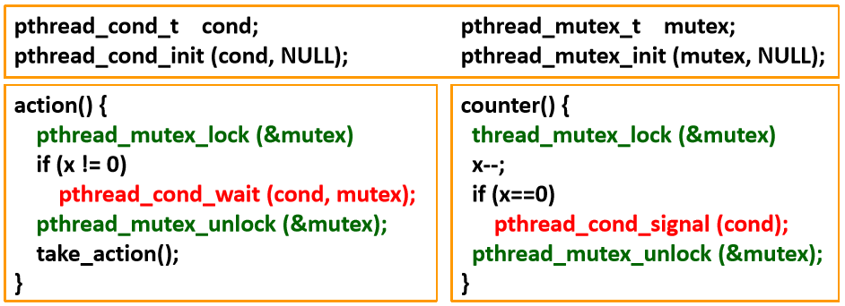
Using Condition Variable
Example:
The left thread is designed to take action when x=0
Another thread is responsible for decrementing the counter
All condition variable operation MUST be performed while a mutex is locked!!!
Why is the lock necessary?

Slide 80
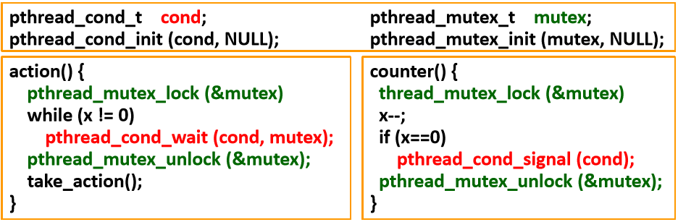
Using Condition Variable
Because event counter “x” is a SHARED variable
If no lock on thread action()…
Wait after any thread (i.e. not counter) sets “x” to 0
If no lock on thread counter()…
No guarantee that decrement and test of “x” is atomic
Requiring CV operations to be done while holding a lock prevents a lot of common programming mistakes

Slide 81
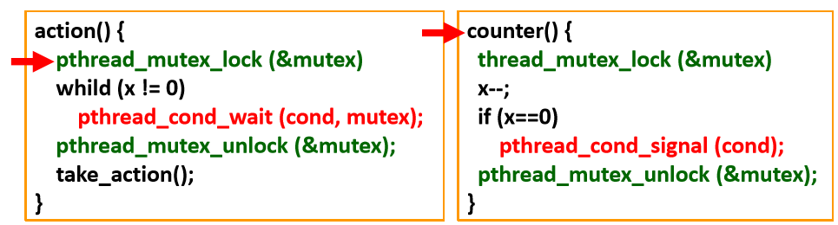
Using Condition Variable
What really happens…
1. Lock mutex

Slide 82
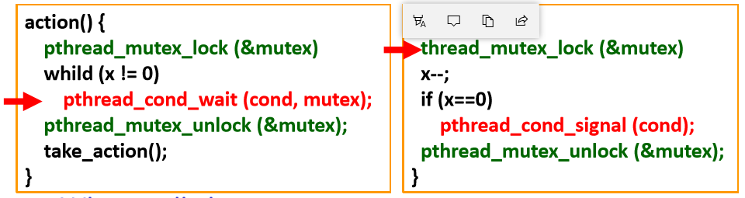
Using Condition Variable
What really happens…
1. Lock mutex
2. Wait()
1. Put the thread into sleep(into waiting queue) & releases the lock(mutex)
1. Lock mutex

Slide 83
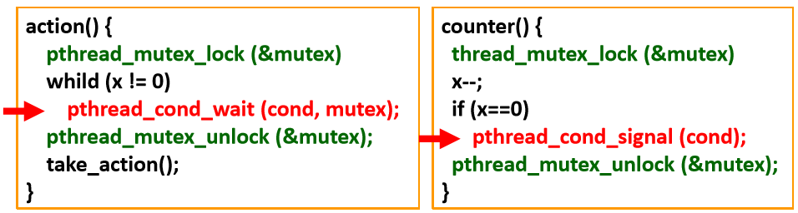
Using Condition Variable
What really happens…
1. Lock mutex
2. Wait()
1. Put the thread into sleep & releases the lock
2. Waked up, but the thread is locked
Lock mutex
Signal()

Slide 84
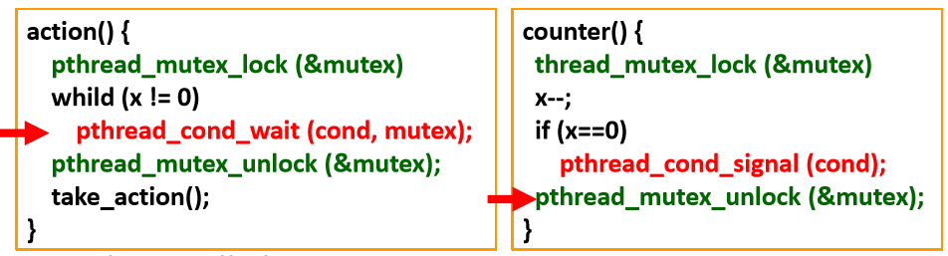
Using Condition Variable
What really happens…
1. Lock mutex
2. Wait()
1. Put the thread into sleep & releases the lock
2. Waked up, but the thread is locked
3. Re-acquire lock and resume execution
Lock mutex
Signal()
Releases the lock

Slide 85
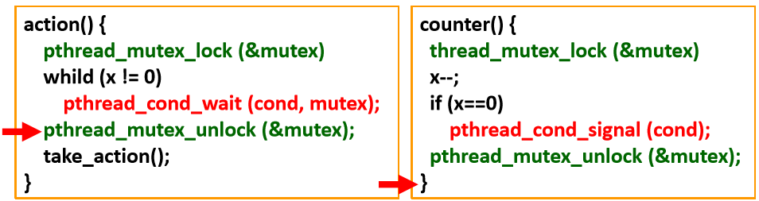
Using Condition Variable
What really happens…
1. Lock mutex
2. Wait()
1. Put the thread into sleep & releases the lock
2. Waked up, but the thread is locked
3. Re-acquire lock and resume execution
3. Release the lock
Lock mutex
Signal()
Releases the lock

Slide 86
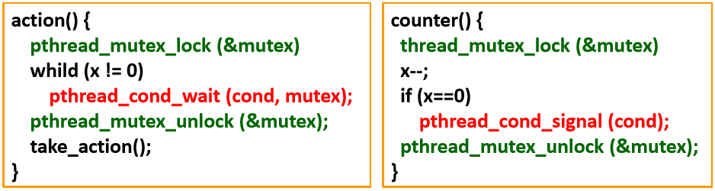
Using Condition Variable
What really happens…
1. Lock mutex
2. Wait()
1. Put the thread into sleep & releases the lock
2. Waked up, but the thread is locked
3. Re-acquire lock and resume execution
3. Release the lock
Lock mutex
Signal()
Releases the lock
Another reason why condition variable op. MUST within mutex lock

Slide 87
Example 1
void counter(void) {
pthread_mutex_lock(&mutex);
while(x!=0){
x--;
printf("x:%d\n",x);
}
if(x==0){
pthread_cond_signal(&cond);
}
pthread_mutex_unlock(&mutex);
printf("counter release!\n");
}
$ ./cv
x:4
x:3
x:2
x:1
x:0
counter release!
Take action!
#include <stdio.h>
#include <pthread.h>
pthread_mutex_t mutex;
pthread_cond_t cond;
int x = 5;
void action(void) {
pthread_mutex_lock(&mutex);
if(x!=0){
pthread_cond_wait(&cond, &mutex);
}
pthread_mutex_unlock(&mutex);
printf("Take action!\n");
}
int main() {
pthread_mutex_init(&mutex, NULL);
pthread_cond_init(&cond, NULL);
pthread_t p;
pthread_create(&p, NULL, (void*)counter, NULL);
action();
return 0;
}

Slide 88
Example 2
void consumer(char* buf) {
for(;;) {
pthread_mutex_lock(&lock);
while(count == 0)
pthread_cond_wait(&notEmpty, &lock);
printf("output buffer:");
printf("%c\n", buf[count-1]);
count--;
pthread_cond_signal(&notFull);
pthread_mutex_unlock(&lock);
}
}
#include <stdio.h>
#include <pthread.h>
#define MAX_SIZE 5
pthread_mutex_t lock;
pthread_cond_t notFull, notEmpty;
int count;
void producer(char* buf) {
for(;;) {
sleep(1);//let consumert to get mutex
pthread_mutex_lock(&lock);
while(count == MAX_SIZE)
pthread_cond_wait(&notFull, &lock);
printf("enter a char:");
buf[count] = getchar();
getchar();
count++;
pthread_cond_signal(&notEmpty);
pthread_mutex_unlock(&lock);
}
}
int main() {
char buffer[MAX_SIZE];
pthread_t p;
count = 0;
pthread_mutex_init(&lock, NULL);
pthread_cond_init(&notFull, NULL);
pthread_cond_init(&notEmpty, NULL);
pthread_create(&p, NULL, (void*)producer, buffer);
consumer(buffer);
return 0;
}

Slide 89
隱性線程(Implicit Threading)
隨著線程數量的增加，顯式線程(explicit threads)的編程正確性更加困難
隱性線程(Implicit Threading)由編譯器和運行時庫(run-time libraries ) 創建和管理線程，而不是由程序員
Three methods explored
Thread Pools
OpenMP
Grand Central Dispatch
Other methods include Microsoft Threading Building Blocks (TBB), java.util.concurrent package

