Slide 1
Parallel Computing (IV) Shared-Memory Programming model: openMP
Cheng-Hung Lin

Slide 2
OpenMP Outline
Parallel Region Construct
Parallel Directive
Working-Sharing Construct
DO/for Directive
SECTIONS Directive
SINGLE Directive
Synchronization Construct
Date Scope Attribute Clauses
Run-Time Library Routines

Slide 3
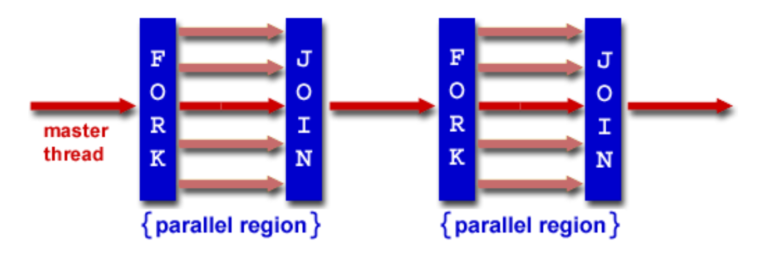
What is OpenMp?
OpenMp(Open Multi-Processing)是一種利用thread進行平行化處理，進而加快程式處理的速度的函式庫，可跨平台使用。
程式語言:C,C++,Fortran
OpenMp會在進入parallel region將master thread複製好幾份放到記憶體內同時執行(從parallel region開始的地方執行)，最後離開parallel region的時候會等待所有thread執行完畢後再繼續執行master thread的程式

Slide 4
OpenMp教學
首先設定預設的thread數量，當程式碼中沒有指定thread數量時則會使用預設或是以Logical CPU當作預設值，這邊先預設thread數量為2
$ export OMP_NUM_THREADS=2
OpenMp使用語法 : #pragma omp <directive> [clause[[,] clause] …]
OpenMp基本Function
omp_get_thread_num() 取得目前thread的id
omp_set_num_threads(n) 在程式中設定thread的數量
omp_get _num_threads()取得使用中thread的數量
omp_set_schedule()設定schedule的方法

Slide 5
OpenMP
Set of compiler directives and an API for C, C++, FORTRAN
Provides support for parallel programming in shared-memory environments
Identifies parallel regions – blocks of code that can run in parallel
#pragma omp parallel
Create as many threads as there are cores
#pragma omp parallel for
for(i=0; i<N; i++) {
c[i] = a[i] + b[i];
}

Slide 6
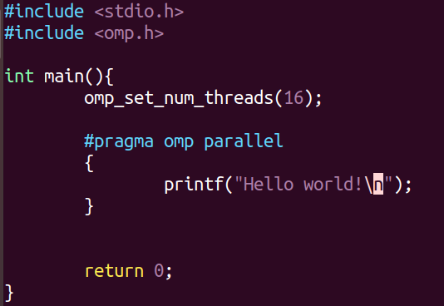
#pragma omp parallel

Slide 7
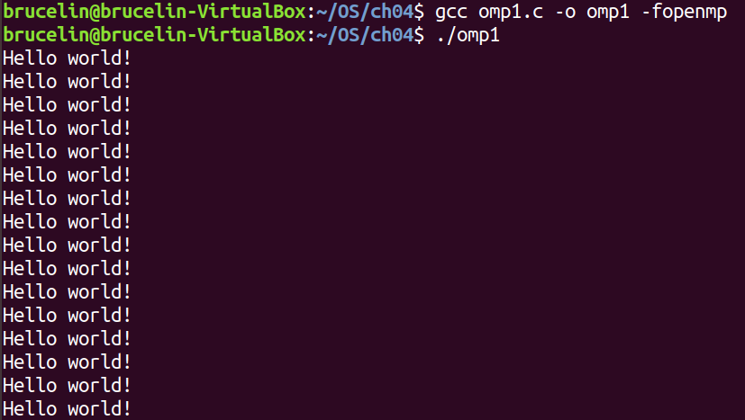

Slide 8
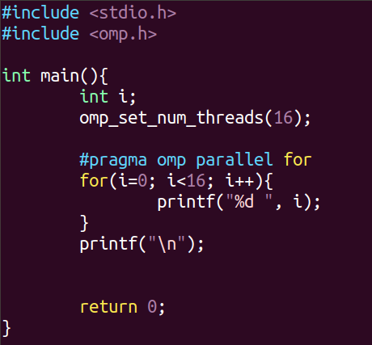

#pragma omp parallel for

Slide 9
Omp 用法
#pragma omp directive [clause]
parallel
for
#pragma omp parallel for
for( int i = 0; i < 10; ++ i )
Test( i );
#pragma omp parallel
{
#pragma omp for
for( int i = 0; i < 10; ++ i )
Test( i );
}

Slide 10
directive
directive | function
parallel | 代表接下來的程式區塊將被平行化。
for | 用在 for 迴圈之前，會將迴圈平行化處理。（註：迴圈的 index 只能是 int）
master | 指定由主執行緒來執行接下來的程式。
ordered | 指定接下來被程式，在被平行化的 for 迴圈將依序的執行。
atomic | 這個指令的目的在於避免變數被同時修改而造成計算結果錯誤。
barrier | 等待，直到所有的執行緒都執行到 barrier。用來同步化。

Slide 11
directive
directive | function
Sections | 將接下來的 section 平行化處理。
Single | 之後的程式將只會在一個執行緒執行，不會被平行化。
threadprivate | 定義一個變數是一個線程私有
critical | 強制接下來的程式區塊為關鍵區(critical section)，一次只會被一個執行緒執行。
flush | Specifies that all threads have the same view of memory for all shared objects.

Slide 12
clause
clause | functions
copyin | 讓 threadprivate 的變數的值和主執行緒的值相同。
copyprivate | 將不同執行緒中的變數共用。
default | 設定平行化時對變數處理方式的預設值。
firstprivate | 讓每個執行緒中，都有一份變數的複本，以免互相干擾；而起始值則會是開始平行化之前的變數值。

Slide 13
clause
clause | functions
if | 判斷條件，可以用來決定是否要平行化。
lastprivate | 讓每個執行緒中，都有一份變數的複本，以免互相干擾；而在所有平行化的執行緒都結束後，會把最後的值，寫回主執行緒。
nowait | 忽略 barrier（等待）。
num_threads | 設定平行化時執行緒的數量。

Slide 14
clause
clause | functions
ordered | 使用於 for，可以在將迴圈平行化的時候，將程式中有標記 directive ordered 的部份依序執行。
private | 定義變數為私有變數，讓每個執行緒中，都有一份變數的複本，以免互相干擾。
reduction | 對各執行緒的變數，直行指定的運算元來合併寫回主執行緒。
schedule | 設定 for 迴圈的平行化方法；有 dynamic、guided、runtime、static 四種方法。
shared | 將變數設定為所有執行緒共用。

Slide 15
Find the error
for(i=0; i<N; i++){
temp = A[i];
A[i] = B[i];
B[i] = temp;
}
#pragma omp parallel for
for(i=0; i<N; i++){
temp = AA[i];
AA[i] = BB[i];
BB[i] = temp;
}
for(i=0; i<N; i++){
if(A[i] != AA[i] || B[i]!=BB[i])
break;
}
if(i==N)
printf("Test pass!!!\n");
else
printf("Test failure\n");
return 0;
}
#include <stdio.h>
#include <stdlib.h>
#include <omp.h>
#include <time.h>
#define N 16
int main(){
int i;
int temp;
int A[N], B[N], AA[N], BB[N];
for(i=0; i<N; i++){
A[i] = rand() % 256;
B[i] = rand() % 256;
AA[i] = A[i];
BB[i] = B[i];
}

Slide 16
Solution
for(i=0; i<N; i++){
temp = A[i];
A[i] = B[i];
B[i] = temp;
}
#pragma omp parallel for private(temp)
for(i=0; i<N; i++){
temp = AA[i];
AA[i] = BB[i];
BB[i] = temp;
}
for(i=0; i<N; i++){
if(A[i] != AA[i] || B[i]!=BB[i])
break;
}
if(i==N)
printf("Test pass!!!\n");
else
printf("Test failure\n");
return 0;
}
#include <stdio.h>
#include <stdlib.h>
#include <omp.h>
#include <time.h>
#define N 16
int main(){
int i;
int temp;
int A[N], B[N], AA[N], BB[N];
for(i=0; i<N; i++){
A[i] = rand() % 256;
B[i] = rand() % 256;
AA[i] = A[i];
BB[i] = B[i];
}

Slide 17
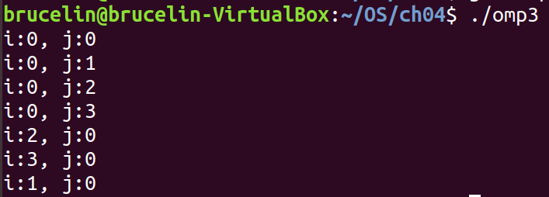
Find the error
#include <stdio.h>
#include <omp.h>
#define N 4
int main(){
int i, j;
#pragma omp parallel for
for(i=0; i<N; i++){
for(j=0; j<N; j++){
printf("i:%d, j:%d\n", i, j);
}
}
return 0;
}

Slide 18
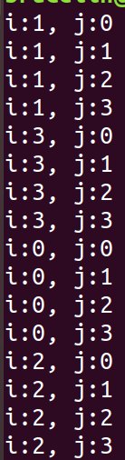
Solution
#include <stdio.h>
#include <omp.h>
#define N 4
int main(){
int i, j;
#pragma omp parallel for private( j)
for(i=0; i<N; i++){
for(j=0; j<N; j++){
printf("i:%d, j:%d\n", i, j);
}
}
return 0;
}
parallelize only the outer loop

Slide 19
平行內外迴圈
#include <stdio.h>
#include <omp.h>
#define N 4
int main(){
int i, j;
#pragma omp parallel for collapse(2)
for(i=0; i<N; i++){
for(j=0; j<N; j++){
printf("i:%d, j:%d\n", i, j);
}
}
return 0;
}

Slide 20
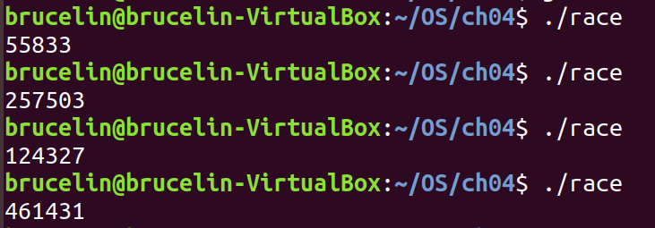
Find the bug
#include <stdio.h>
#include <omp.h>
#define N 1000
int main(){
int i, sum = 0;
#pragma omp parallel for
for(i=1; i<=N; i++){
sum += i;
}
printf("%d\n", sum);
return 0;
}

Slide 21
Solution
#include <stdio.h>
#include <omp.h>
#define N 1000
int main(){
int i, sum = 0;
#pragma omp parallel for
for(i=1; i<=N; i++){
#pragma omp atomic
sum += i;
}
printf("%d\n", sum);
return 0;
}

Slide 22
Solution II
#include <stdio.h>
#include <omp.h>
#define N 1000
int main(){
int i, sum = 0;
#pragma omp parallel for reduction(+:sum)
for(i=1; i<=N; i++){
sum += i;
}
printf("%d\n", sum);
return 0;
}

Slide 23
Compare the performance of atomic and reduction
Please compare the performance of atomic add and reduction Add.
int a[1000000]
for(i=0; i<1000000; i++)
a[i] = i;
for(i=0; i<1000000; i++)
sum = sum + a[i];

Slide 24
Example1:利用parallel進行程式的平行化
$ ./program1
Thread 0 Hello World
Thread 1 Hello World
Thread 3 Hello World
Thread 7 Hello World
Thread 4 Hello World
Thread 5 Hello World
Thread 2 Hello World
Thread 6 Hello World
#include<omp.h> #include<stdio.h>
int main(int argc,char* argv[]){ #pragma omp parallel { printf("Thread %d Hello World \n",omp_get_thread_num()); } }
編譯與執行:-fopenmp 用來載入libgomp這個動態函式庫
$ gcc -fopenmp example.c $ ./a.out

Slide 25
Example2:for迴圈平行化
因為是平行化處理所以跑出來的結果不一定照順序​
#include<omp.h> #include<stdio.h>
int main(){
#pragma omp parallel { #pragma omp for for(int i=0;i<16;i++) { printf("thread %d : loop %d\n",omp_get_thread_num(),i); } } return 0; }
$ ./example2
Thread 0: loop:0
Thread 0: loop:1
Thread 4: loop:8
Thread 3: loop:6
Thread 3: loop:7
Thread 1: loop:2
Thread 1: loop:3
Thread 5: loop:10
Thread 5: loop:11
Thread 4: loop:9
Thread 2: loop:4
Thread 2: loop:5
Thread 7: loop:14
Thread 7: loop:15
Thread 6: loop:12
Thread 6: loop:13

Slide 26
Example3:parallel sections
#include <stdio.h>
#include <stdlib.h>
#include <omp.h>
int main(){
omp_set_num_threads(4);
#pragma omp parallel sections
{
#pragma omp section
{
for(int i=0;i<100000;++i);
printf("thread %d, first section\n",omp_get_thread_num());
}
#pragma omp section
{
printf("thread %d, second section\n",omp_get_thread_num());
}
#pragma omp section
{
printf("thread %d, third section\n",omp_get_thread_num());
}
#pragma omp section
{
printf("thread %d, fourth section\n",omp_get_thread_num());
}
}
return 0;
}
因為第1個section跑比較久所以最後才顯示出來​
$ ./example3
thread 0, third section
thread 3, fourth section
thread 2, second section
thread 1, first section
$ ./example3
thread 1, second section
thread 3, fourth section
thread 2, third section
thread 0, first section

Slide 27
Example4: single 只跑一次，master 只讓master thread跑
int main(){
int i, j;
#pragma omp parallel num_threads(4)
{
#pragma omp for
for(i=0; i<4; i++){
for(j=0; j<100000; j++);
printf("thread %d:%d\n", omp_get_thread_num(), i);
}
printf("thread %d: four times\n", omp_get_thread_num());
#pragma omp single
{
printf("thread %d, one times\n", omp_get_thread_num());
}
#pragma omp master
{
printf("thread %d, master\n", omp_get_thread_num());
}
}
return 0;
}
被single包含的程式只執行一次，被master包含的程式只會讓master執行​
$ ./example4
thread 1:1
thread 3:3
thread 0:0
thread 2:2
thread 1: four times
thread 1, one times
thread 3: four times
thread 0: four times
thread 2: four times
thread 0, master

Slide 28
Example5: private
左邊因為共用變數j而導致迴圈沒跑滿25圈，右邊因為把j複製多份所以沒這問題​
$ ./example5
thread 3 : 15 loop
thread 3 : 16 loop
thread 3 : 17 loop
thread 3 : 18 loop
thread 3 : 19 loop
thread 4 : 20 loop
thread 1 : 5 loop
thread 0 : 0 loop
thread 2 : 10 loop
--------------
thread 2 : 10 loop
thread 4 : 20 loop
thread 1 : 5 loop
thread 2 : 11 loop
thread 1 : 6 loop
thread 2 : 12 loop
thread 3 : 15 loop
thread 3 : 16 loop
thread 3 : 17 loop
thread 3 : 18 loop
thread 3 : 19 loop
thread 4 : 21 loop
thread 4 : 22 loop
thread 4 : 23 loop
thread 4 : 24 loop
thread 1 : 7 loop
thread 1 : 8 loop
thread 1 : 9 loop
thread 0 : 0 loop
thread 2 : 13 loop
thread 2 : 14 loop
thread 0 : 1 loop
thread 0 : 2 loop
thread 0 : 3 loop
thread 0 : 4 loop
被private包含的變數再跑平行運算時，每個thread會自己複製一份不會共用同一份變數
#include<omp.h>​ #include<stdio.h>​ #include<stdlib.h>
int main()​{​ int i,j;
#pragma omp parallel for​ for(i=0;i<5;i++)​ for(j=0;j<5;j++)​{​ printf("thread %d : %d loop\n",omp_get_thread_num(),i*5+j);​ }​ printf("--------------------------------------------------------\n");​ #pragma omp parallel for private(j)​ for(i=0;i<5;i++)​ for(j=0;j<5;j++)​{​ printf("thread %d : %d loop\n",omp_get_thread_num(),i*5+j);​ }​ }​

Slide 29
Example6:firstprivate 和lastprivate
firstprivate 和private差不多只是在複製時也會複製初始值，lastprivate則是會在最後將複製出來的值丟回到本尊
thread 0 : count -4
thread 0 : count -3
thread 0 : count -2
thread 1 : count -4
thread 1 : count -3
Final count: -3
#include <stdio.h>
#include <omp.h>
int main(){
int i;
int count = -5;
#pragma omp parallel for firstprivate(count) lastprivate(count) num_threads(2) for(i=0; i<5; i++){
count++;
printf("thread %d : count %d\n",omp_get_thread_num(),count);
}
printf("Final count: %d\n", count);
return 0;
}

Slide 30
Example7: atomic
atomic是為了保證變數在做計算時不被其他thread跟改到而導致計算出的東西有錯誤(race condition)
如果沒有加atomic跑出來的數字會是低於5,000,000，加了atomic可以保證變數做運算時不會被其他thread給更改到數字
另外j必須設成private
#include <stdio.h>
#include <omp.h>
int main(){
int sum = 0;
int i, j;
#pragma omp parallel for
for(i=0; i<1000; i++){
for(j=0; j<5000; j++){
sum += 1;
}
}
printf("sum: %d\n", sum);
return 0;
}
#include <stdio.h>
#include <omp.h>
int main(){
int i, j;
int sum = 0;
#pragma omp parallel for private(j)
for(i=0; i<1000; i++){
for(j=0; j<50000; j++){
sum += 1;
}
}
printf("sum: %d\n", sum);
return 0;
}
$ ./example7
sum: 10333106
./example7
sum: 6997785

Slide 31
Example7: atomic
#include <stdio.h>
#include <omp.h>
int main(){
int i, j;
int sum = 0;
#pragma omp parallel for private(j)
for(i=0; i<1000; i++){
for(j=0; j<50000; j++){
#pragma omp atomic
sum += 1;
}
}
printf("sum: %d\n", sum);
return 0;
}
$ ./example7
sum: 50000000

Slide 32
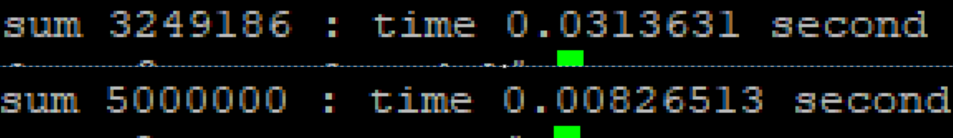
Example8:reduction
Reduction目的和上面很像，他是將每個sum依照thread各別複製一份出來後最後join時將所有sum相加就不會導致錯誤發生
但是只可以接受+、*、-、&...等運算符號
#include<omp.h> #include<stdio.h> #include<stdlib.h>
int main(){ int sum = 0; double start = omp_get_wtime(); #pragma omp parallel for reduction(+:sum) private(j) for(int i=0;i<1000;i++){ for(int j=0;j<5000;j++){ sum+=1; }
}
printf("sum %d : time %4g second\n",sum,omp_get_wtime()-start); }
如果沒有加reduction出來的數字會因為race condition而有錯誤

Slide 33
Please compare atomic add and reduction add
請比較一下example 7 與 example 8的效能

Slide 34
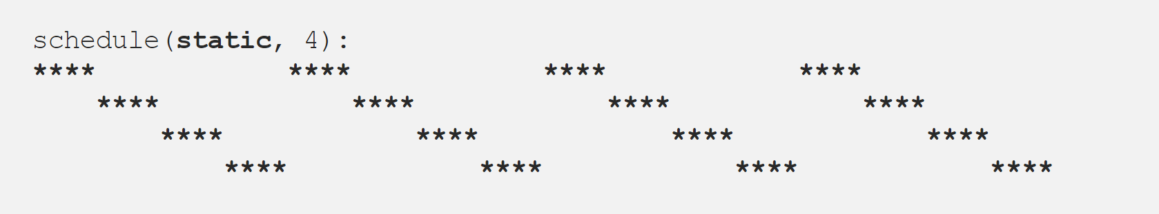
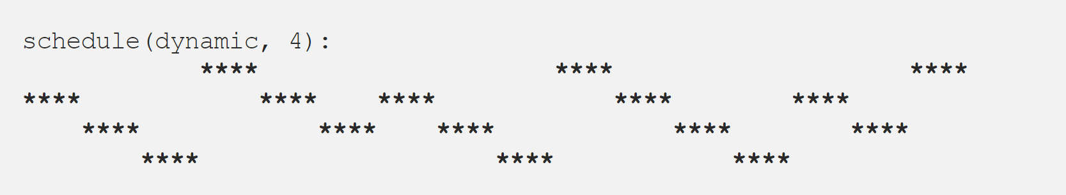
Example9:schedule
schedule分成4種static, dynamic, guided, runtime, auto
static:將迴圈每n個分一組，依照thread順序輪流給每個thread執行，當跑過一輪後再從第一個thread開始輪流跑
dynamic:將迴圈每n個分一組，隨機分配給thread執行

Slide 35
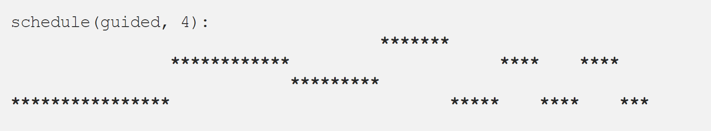
Example9:schedule
guided:剛開始會依照thread數量下去切，如果迴圈有64個，thread有4個，那一開始第一組的數量則是64/4=16，依序往後每組數量會遞減，收縮到n個一組，如剩下的數量不夠n個則剩下的全部變成1組
runtime:先不指定方法等到要執行時會依照系統變數OMP_SCHEDULE或omp_set_schedule做設定
schedule(runtime):
auto:由系統幫忙處理
schedule(auto):

Slide 36
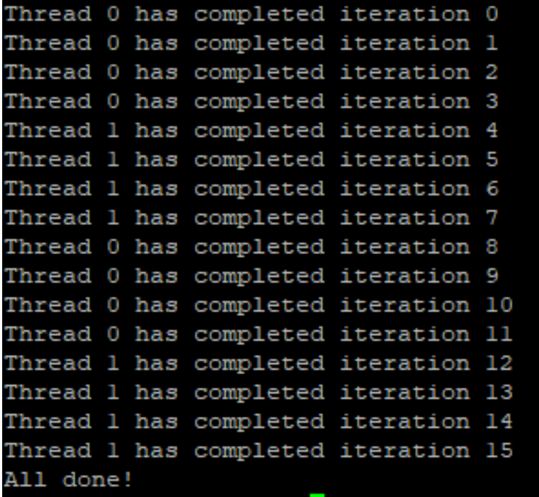
schedule(static,4)範例
將迴圈每4個一組下去跑，每次跑的thread都會照順序，thread0先跑在換thread1，依此類推
#include<omp.h> #include<stdio.h> #include<stdlib.h> #include<unistd.h> int main(){ #pragma omp parallel for schedule(static,4) num_threads(2) ordered for(int i=0;i<16;i++){ #pragma omp ordered printf("Thread %d has completed iteration %d\n",omp_get_thread_num(),i); }
printf("All done!\n");
return 0;
}

Slide 37
Static schedule example (I)
總共有8個threads
Total 16的iterations平分給8個threads
Thread 7: loop 14
Thread 7: loop 15
Thread 5: loop 10
Thread 0: loop 0
Thread 0: loop 1
Thread 2: loop 4
Thread 2: loop 5
Thread 1: loop 2
Thread 1: loop 3
Thread 5: loop 11
Thread 4: loop 8
Thread 4: loop 9
Thread 6: loop 12
Thread 6: loop 13
Thread 3: loop 6
Thread 3: loop 7
#include <stdio.h>
#include <omp.h>
int main(){
int i;
#pragma omp parallel
{
#pragma omp for schedule(static)
for(i=0; i<16; i++){
printf("Thread %d: loop %d\n", omp_get_thread_num(), i);
}
}
return 0;
}

Slide 38
Static schedule example (II)
每個thread負責4個iterations
Total 16的iterations平分給4個threads
Thread 3: loop 12
Thread 3: loop 13
Thread 3: loop 14
Thread 3: loop 15
Thread 1: loop 4
Thread 1: loop 5
Thread 1: loop 6
Thread 1: loop 7
Thread 0: loop 0
Thread 0: loop 1
Thread 0: loop 2
Thread 0: loop 3
Thread 2: loop 8
Thread 2: loop 9
Thread 2: loop 10
Thread 2: loop 11
#include <stdio.h>
#include <omp.h>
int main(){
int i;
#pragma omp parallel
{
#pragma omp for schedule(static, 4)
for(i=0; i<16; i++){
printf("Thread %d: loop %d\n", omp_get_thread_num(), i);
}
}
return 0;
}

Slide 39
Dynamic schedule example (I)
動態分派iterations 給沒事的thread
#include <stdio.h>
#include <omp.h>
int main(){
int i;
#pragma omp parallel
{
#pragma omp for schedule(dynamic)
for(i=0; i<16; i++){
printf("Thread %d: loop %d\n", omp_get_thread_num(), i);
}
}
return 0;
}
Thread 2: loop 0
Thread 2: loop 8
Thread 2: loop 9
Thread 2: loop 10
Thread 2: loop 11
Thread 2: loop 12
Thread 2: loop 13
Thread 2: loop 14
Thread 2: loop 15
Thread 6: loop 1
Thread 5: loop 2
Thread 1: loop 5
Thread 7: loop 3
Thread 0: loop 4
Thread 3: loop 6
Thread 4: loop 7

Slide 40
Dynamic schedule example (II)
動態分派iterations 給沒事的thread，每個thread負責4個iterations.
#include <stdio.h>
#include <omp.h>
int main(){
int i;
#pragma omp parallel
{
#pragma omp for schedule(dynamic, 4)
for(i=0; i<16; i++){
printf("Thread %d: loop %d\n", omp_get_thread_num(), i);
}
}
return 0;
}
Thread 3: loop 0
Thread 3: loop 1
Thread 3: loop 2
Thread 3: loop 3
Thread 7: loop 8
Thread 7: loop 9
Thread 7: loop 10
Thread 7: loop 11
Thread 1: loop 4
Thread 1: loop 5
Thread 1: loop 6
Thread 1: loop 7
Thread 5: loop 12
Thread 5: loop 13
Thread 5: loop 14
Thread 5: loop 15

Slide 41
Guided example
Thread 1: loop 0
Thread 1: loop 1
Thread 1: loop 2
Thread 0: loop 22
Thread 0: loop 23
Thread 0: loop 24
Thread 0: loop 25
Thread 0: loop 26
Thread 0: loop 27
Thread 0: loop 44
Thread 0: loop 45
Thread 0: loop 46
Thread 0: loop 47
Thread 0: loop 48
Thread 0: loop 49
Thread 0: loop 50
Thread 0: loop 51
Thread 0: loop 52
Thread 0: loop 53
Thread 0: loop 54
Thread 0: loop 55
Thread 0: loop 56
Thread 0: loop 57
Thread 0: loop 58
Thread 0: loop 59
Thread 0: loop 60
Thread 0: loop 61
Thread 0: loop 62
Thread 0: loop 63
Thread 3: loop 15
Thread 3: loop 16
Thread 3: loop 17
Thread 3: loop 18
Thread 3: loop 19
Thread 3: loop 20
Thread 3: loop 21
Thread 6: loop 33
Thread 6: loop 34
Thread 6: loop 35
Thread 6: loop 36
Thread 1: loop 3
Thread 1: loop 4
Thread 1: loop 5
Thread 1: loop 6
Thread 1: loop 7
Thread 7: loop 8
Thread 7: loop 9
Thread 7: loop 10
Thread 4: loop 28
Thread 4: loop 29
Thread 4: loop 30
Thread 4: loop 31
Thread 4: loop 32
Thread 7: loop 11
Thread 7: loop 12
Thread 7: loop 13
Thread 7: loop 14
Thread 2: loop 41
Thread 2: loop 42
Thread 2: loop 43
Thread 5: loop 37
Thread 5: loop 38
Thread 5: loop 39
Thread 5: loop 40
guided 的 chunk 切割方法和 static、dynamic 不一樣；他會以「遞減」的數目，來分割出 chunk。而 chunk 的分配方式，則是和 dynamic 一樣是動態的分配。而遞減的方式，大約會以指數的方式遞減到指定的 chunk_size。
#include <stdio.h>
#include <omp.h>
int main(){
int i;
#pragma omp parallel num_threads(8)
{
#pragma omp for schedule(guided)
for(i=0; i<64; i++){
printf("Thread %d: loop %d\n", omp_get_thread_num(), i);
}
}
return 0;
}

Slide 42
Parallel Region Constructs --- Parallel Directive
Limitations:
A parallel region must be a structured block that does not span multiple routines or code files
It is illegal to branch (goto) into or out of a parallel region, but you could call other functions within a parallel region

Slide 43
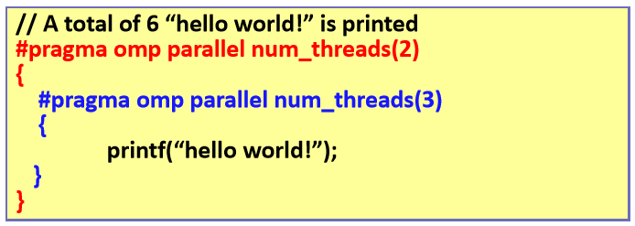
Nested Parallel Region
check if nested parallel regions are enabled
omp_get_nested ()
To disable/enable nested parallel regions:
omp_set_nested (bool)
Setting of the OMP_NESTED environment variable
If nested is not supported or enabled:
Only one thread is created for the nested parallel region code

Slide 44
Example 9: nested parallel region
#include <stdio.h>
#include <omp.h>
int main(){
if(!omp_get_nested()){
omp_set_nested(1);
}
#pragma omp parallel num_threads(2)
{
#pragma omp parallel num_threads(3)
{
printf("Thread %d: hello world!\n", omp_get_thread_num());
}
}
return 0;
}
Thread 2: hello world!
Thread 0: hello world!
Thread 2: hello world!
Thread 0: hello world!
Thread 1: hello world!
Thread 1: hello world!

Slide 45
OpenMP Outline
Synchronization Construct
Date Scope Attribute Clauses
Run-Time Library Routines

Slide 46
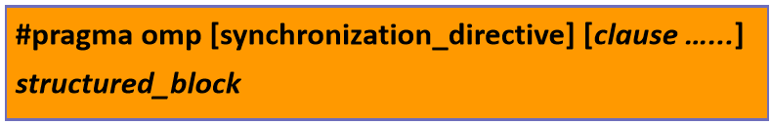
Synchronization Constructs
For synchronization purpose among threads
Synchronization Directives
master: only executed by the master thread
No implicit barrier at the end
More efficient than SINGLE directive
critical: must be executed by only one thread at a time
Threads will be blocked until the critical section is clear
barrier: blocked until all threads reach the call
atomic: memory location must be updated atomically provide a mini-critical section

Slide 47
Example 10: critical
#include <stdio.h>
#include <stdlib.h>
#include <omp.h>
int main(){
int sum = 0;
int i, j;
double start;
start = omp_get_wtime();
#pragma omp parallel for private(j)
for(i=0; i<10000; i++){
for(j=0; j<50000; j++){
#pragma omp critical
{
sum += 1;
}
}
}
printf("reduction sum: %d: time %4g second\n", sum, omp_get_wtime()-start);
return 0;
}

Slide 48
Compare reduction, atomic, and critical
Compare the results of example 7, 8, and 10

Slide 49
LOCK OpenMP Routine
void omp_init_lock(omp_lock_t *lock)
Initializes a lock associated with the lock variable
void omp_destroy_lock(omp_lock_t *lock)
Disassociates the given lock variable from any locks
void omp_set_lock(omp_lock_t *lock)
Force the thread to wait until the specified lock is available
void omp_unset_lock(omp_lock_t *lock)
Releases the lock from the executing subroutine
int omp_test_lock(omp_lock_t *lock)
Attempts to set a lock, but does NOT block if unavailable

Slide 50
Example 11: lock vs critical
#include <stdio.h>
#include <stdlib.h>
#include <omp.h>
int main(){
int sum = 0;
omp_lock_t lock;
omp_init_lock(&lock);
#pragma omp parallel
{
omp_set_lock(&lock);
sum += 1;
omp_unset_lock(&lock);
}
omp_destroy_lock(&lock);
printf("reduction sum: %d\n", sum);
return 0;
}
#include <stdio.h>
#include <stdlib.h>
#include <omp.h>
int main(){
int sum = 0;
#pragma omp parallel
{
#pragma omp critical
sum += 1;
}
printf("critcal sum: %d\n", sum);
return 0;
}

Slide 51
Example & Comparison
Advantage of using critical over lock:
no need to declare, initialize and destroy a lock
you always have explicit control over where your critical section ends
Less overhead with compiler assist
omp_lock_t lock;
omp_init_lock(&lock);
#pragma omp parallel
{
omp_set_lock(&lock);
sum += 1;
omp_unset_lock(&lock);
}
omp_destroy_lock(&lock);
#pragma omp parallel
{
#pragma omp critical
sum += 1;
}

Slide 52
OpenMP Outline
Parallel Region Construct
Parallel Directive
Working-Sharing Construct
DO/for Directive
SECTIONS Directive
SINGLE Directive
Synchronization Construct
Date Scope Attribute Clauses
Run-Time Library Routines

Slide 53
OpenMP Date Scope
OpenMP is based on shared memory programming model
Most variables are shared by default
Global shared variables:
File scope variables, static
Private non-shared variables:
Loop index variables 迴圈索引的變數
Stack variables in subroutines called from parallel regions
Data scope can be explicitly defined by clauses…
PRIVATE , SHARED, FIRSTPRIVATE, LASTPRIVATE
DEFAULT, REDUCTION, COPYIN

Slide 54
Date Scope Attribute Clauses
PRIVATE (var_list):
Declares variables in its list to be private to each thread; variable value is NOT initialized & will not be maintained outside the parallel region
SHARED (var_list):
Declares variables in its list to be shared among all threads
By default, all variables in the work sharing region are shared except the loop iteration counter.
FIRSTPRIVATE (var_list):
Same as PRIVATE clause, but the variable is INITIALIZED according to the value of their original objects prior to entry into the parallel region
LASTPRIVATE (var_list)
Same as PRIVATE clause, with a copy from the LAST loop iteration or section to the original variable object

Slide 55
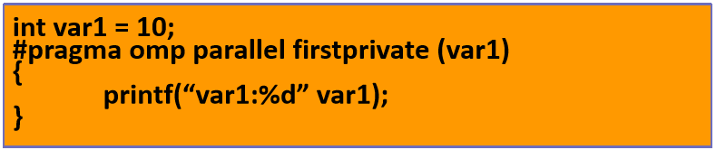
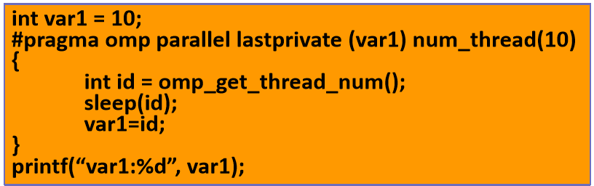
Examples
firstprivate (var_list)
lastprivate (var_list)

Slide 56
Date Scope Attribute Clauses
DEFAULT (PRIVATE | FIRSTPRIVATE | SHARED | NONE)
Allows the user to specify a default scope for ALL variables in the parallel region
COPYIN (var_list)
Assigning the same variable value based on the instance from the master thread
COPYPRIVATE (var_list)
Broadcast values acquired by a single thread directly to all instances in the other thread
Associated with the SINGLE directive
REDUCTION (operator: var_list)
A private copy for each list variable is created for each thread
Performs a reduction on all variable instances
Write the final result to the global shared copy

Slide 57
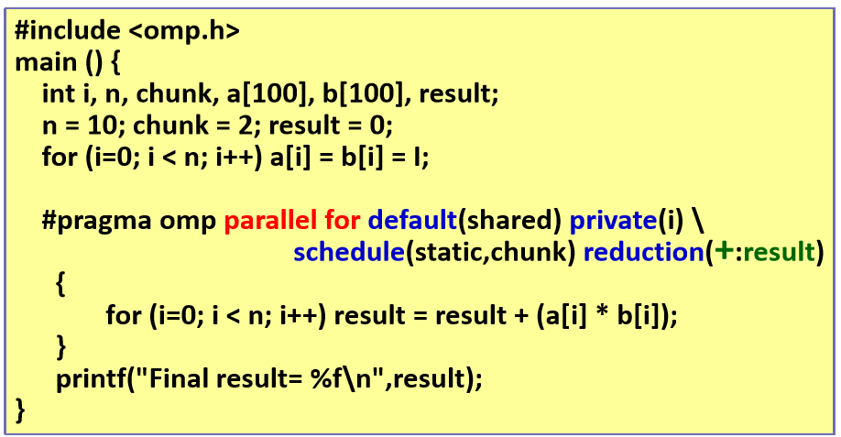
Reduction Clause Example
Reduction operators: +, *, &, |, ^, &&, ||

Slide 58
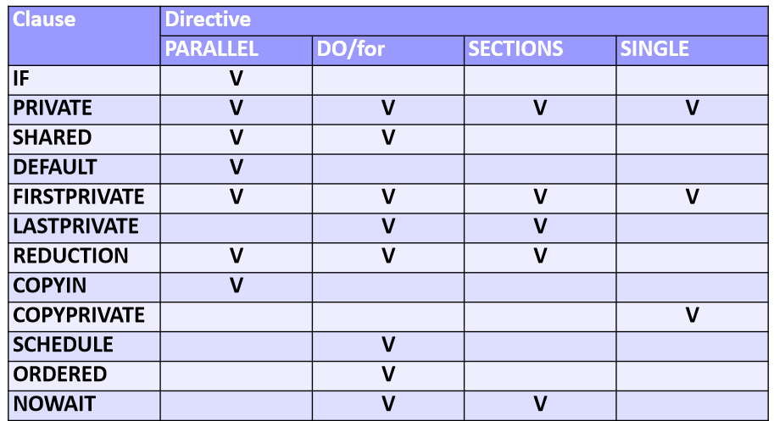
OpenMP Clause Summary
Synchronization Directives DO NOT accept clauses

