Slide 1


CPD-X Test Station Introduction
FIT Hon Teng Limited
鴻騰六零八八精密科技股份有限公司
2026/1/12
© All rights reserved by FIT Hon Teng Limited. Storage, reproduction, printing, distribution or disclosure to any third party is strictly prohibited.

Slide 2
E&F SW Authentication
SW Planning
Off-line Mode
Audit Mode
Normal Mode
1. Verify & Plan ERS/DFM
2. Simulate test Item & communication
3. Extend Design Features
4. Let vendor preparing self-test program (Case QT)
5. Integrate test item of overlay ,e.g. Atlas /Python/Swift
1.Certificate Holder & Fixture condition with DFM
2.Run overlay and
remove CB/UOP functions
3. SW team needs finishing 50up loop or GRR test
1.Test Vendor’s Holder & Fixture & overlay before P1 build
2.Put overlay on GHDS, remove CB/UOP
3. Need uploading test result to Insight
4. Don’t write the calibration value on acoustic station
1.Receive test data between P1 to EVT build ,calculate the Retest Rate & Fair Rate on TIL report
2.Add CB/UOP items
3.Need uploading test result to Insight
4.Modify overlay to decrease retest rate & test time
Case QT/WLC
Bud QT

Slide 3
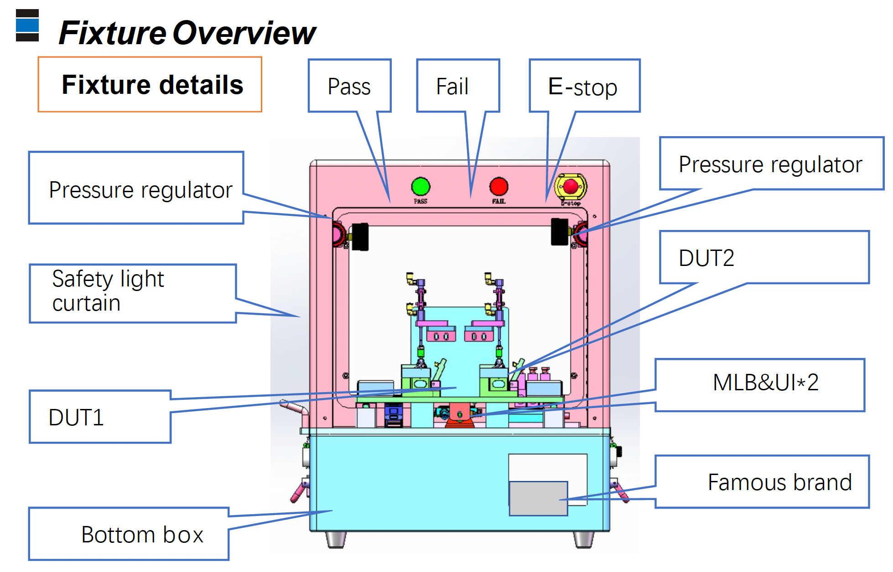
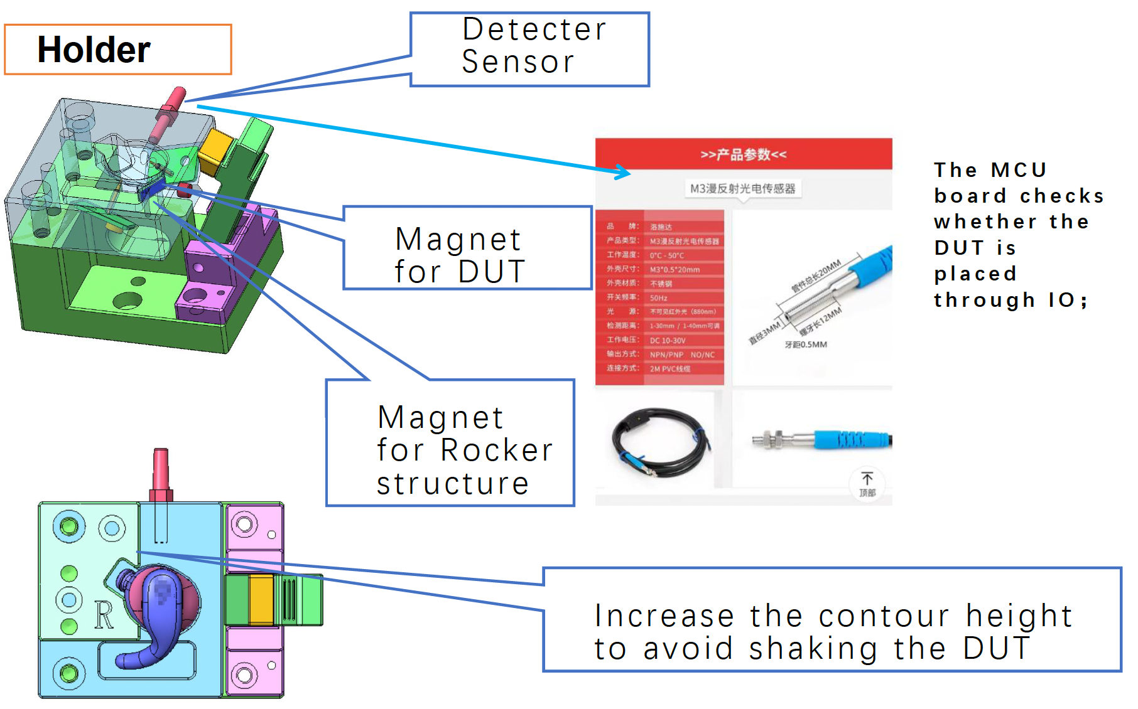
Bud QT Station Introduction
Test Model:B494b Vendor : 星禾宏泰/泰諾嘉
Objective :
Write and upload DUT information (FATP SN, FATP CFG, battery information)
Check Locust Connectivity
Check BUCK/LDO Function
Check Kessel & IMU Connectivity
Check battery status
Check button status
Brief introduction of main equipment :
B494b system test fixture
Control board module
Cylinder module for DUT in /out and 1~3 button test
Dut holder
Testing principle :
Mac Mini communicates with DUT through grass ninja / B495 MLB, read and write DUT’s information.
Check the status of the Buck/LDO by reading the parameters of the corresponding test points.
Read the chip information by sending a command to check the connectivity of the chip.
Send commands to check DUT battery charger status.
Use the cylinder to create the state of pressing and releasing to verify the function of the button.

Slide 4
Terminology
Test Items | Description
Bud Charging On | 設定Charging On
Get Case Version | 讀取Case FW/HW version
Button Test | 降下、上拉圓柱棒來做按鈕按壓測試
Read Bud SN | 讀取Bud MLB/FATP SN
Chack Battery Status | 檢查電池資訊
Read BUCK and LDO | 讀取 BUCK and LDO 1/2/3
Quiescent Current | 自用電流
Check Status and Syscfg | 檢查Kessel Type/RevID/Bud FW Version, Syscfg ACRT/SCRT
Check HWID/ECID | 檢查HWID/ECID
Read VBATT | 讀取電池電壓
IMU Test | 慣性量測單元/加速度計/陀螺儀
Check OTP Locked | OTP鎖定
Enable UVP | 啟動UVP
Check Bud Link | 檢查Bud Link (此時以先Close Tunnel)
Notes:
BUCK 是一種開關式降壓轉換器，也常叫降壓型 DC to DC。 LDO 是低壓差線性穩壓器，Linear Regulator 的一種。
Quiescent Current（常寫 Iq）是指電源 IC 在「沒有帶負載或負載很小」時，為了讓自己維持運作所消耗的那個電流，也就是它的自用電流。
「讀取 VBATT」通常就是指去量測或取得裝置的電池端電壓，也就是電池正極那條電源軌的電壓值。
OTP（One Time Programmable）是一種只能寫入一次或只能從 0 改成 1 的非揮發性儲存區，常見形式是 eFuse 或 OTP memory。
UVP（Under Voltage Protection 或 Under Voltage Lockout，常縮寫 UVLO）是在電壓太低時採取保護動作，避免系統在低電壓下不穩定運作或損壞。

Slide 5
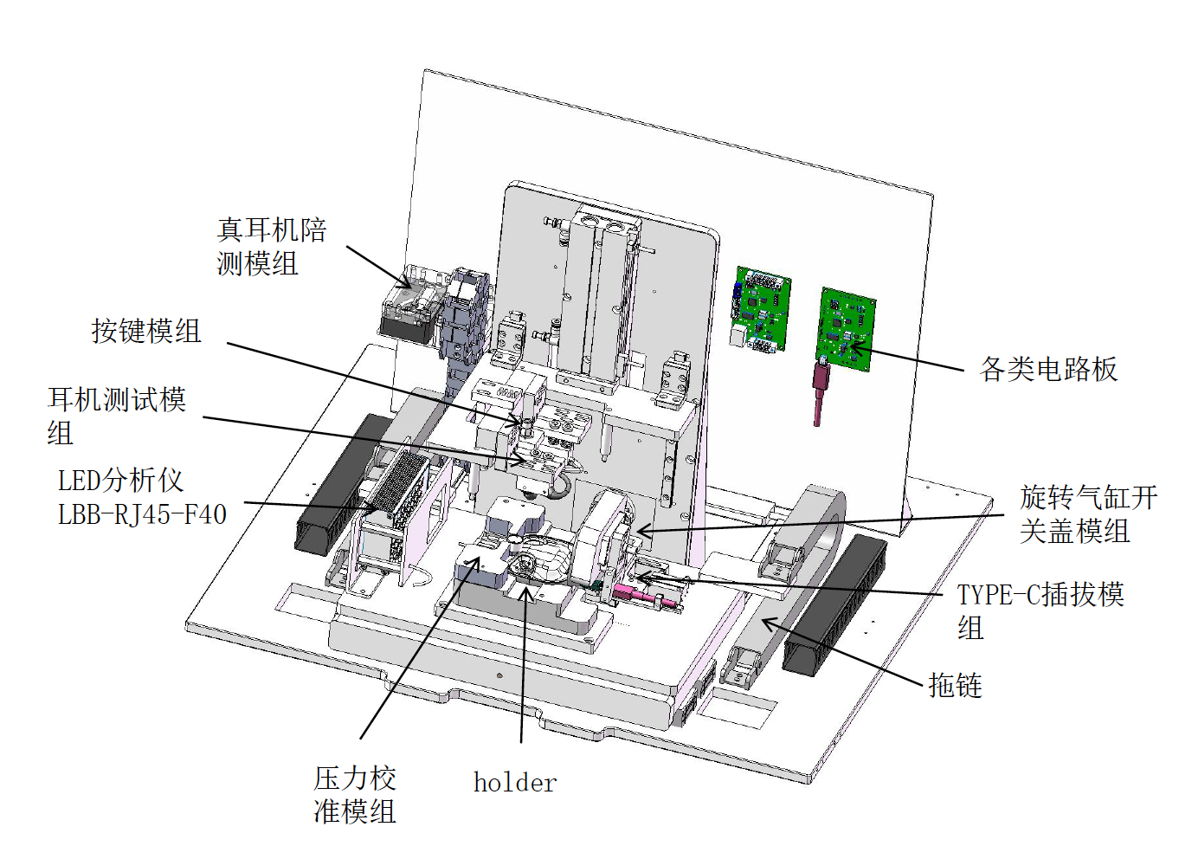
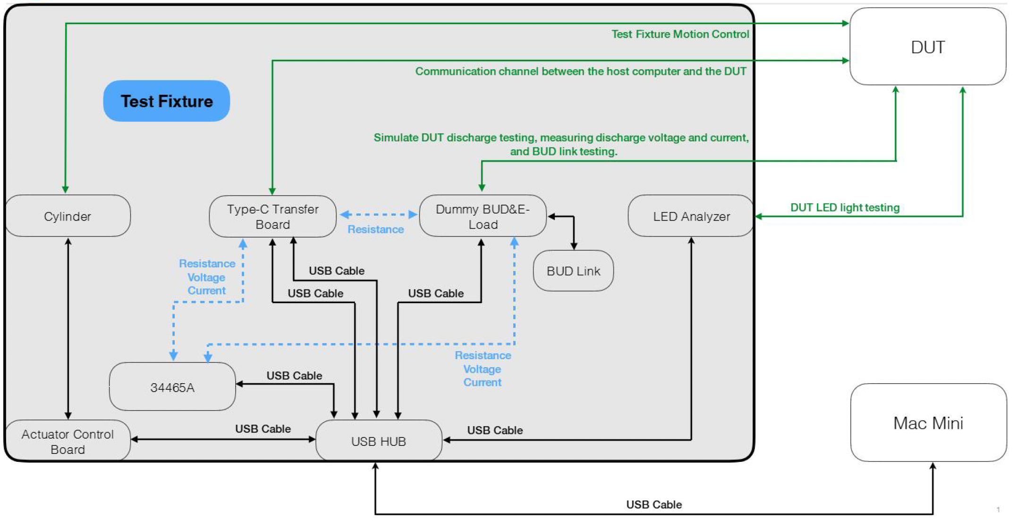
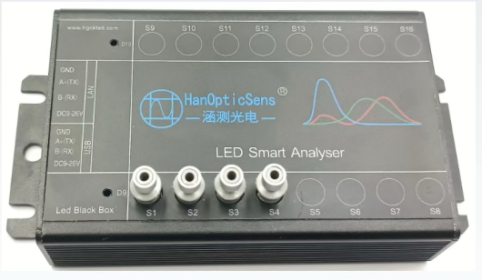
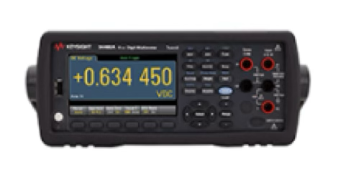
Case QT Station Introduction
Test Model:B499 Vendor : 東方恆越/上海盤雲
Objective: (test coverage)
Test Case GND DCR.
Write and Read Case information (FATP SN, FATP CFG, FW version, HWID, BTID)
Check Case battery charger status and FuelGauge calibration information.
Check Case signal indicate LED and button status.
Test Case ship mode Enter & Exit.
Test the voltage and current of Case output 5V under no-load/loaded conditions.
Test the connectivity between Case and Bud.
Check Case lid status.
Brief introduction of main equipment
Teye-C auto insertion module.
Pusher /Puller module(東方恆越).
Control Box module.
Sliding in and out module.
Holder with DUT module.
LED Analyzer.
DMM.
Testing principle
Use DMM through dummy bud to measure GND DCR from Type-C to BUD_L/R_NEG.
Mac Mini communicates with Case through Type-C cable, send commands to read and write Case information (FATP SN, FATP CFG, FW version, HWID, BTID).
Send commands check Case battery charger status and FuelGauge calibration information.
Use an LED analyzer to measure the X/Y color coordinates, brightness, and wavelength of the signal lights in the Case when they emit red and white light. Use the cylinder to create the state of pressing and releasing to verify the function of the button.
Send command to put the Case into ship mode, disconnect and reconnect VBUS voltage to exit ship mode.
Send command to the L/R POS point output 5V of the Case, and measure the voltage and current when loaded with 100mA and 0mA.
Connect to B498 bud t and send a command to read TX and RX values to check the communication function between Case and bud.
Use the cylinder to create the state of opening and closing to verify the function of the Case lid.
Notes:
B499 Case Quick Test :
測試涵蓋 Case 電源、通訊、機構與指示功能，確保產品具備完整功能性與可靠度。
測試目標（Test Coverage）：
量測 Case GND DCR
讀寫 Case 基本資訊（FATP SN、FATP CFG、FW Version、HWID、BTID）
檢查 Case 電池充電器狀態與 Fuel Gauge 校正資訊
驗證 Case 指示燈（LED）與按鍵功能
驗證 Case Ship Mode 進入與退出
驗證 Case 5V 輸出電壓與電流（無負載／有負載條件）
驗證 Case 與 Bud 之間的通訊連線
驗證 Case 上蓋（Lid）開關狀態
主要設備：
Type-C 自動插拔模組
推／拉模組（東方恆越）
Control Box 模組
滑入／滑出模組
含 DUT 的治具模組
LED 分析儀
數位電錶（DMM）
測試原理（Testing Principle）：
透過 Dummy Bud 搭配 DMM 量測 Type-C GND 至 BUD_L / BUD_R NEG 的 GND DCR
Mac Mini 透過 Type-C 與 Case 通訊 進行 Case 資訊讀寫（FATP SN、FATP CFG、FW Version、HWID、BTID）
發送指令檢查
電池充電器狀態
Fuel Gauge 校正資訊
使用 LED 分析儀量測 Case 指示燈
X / Y 色座標
亮度
波長（紅光 / 白光）
透過氣缸模擬按鍵
按下 / 釋放狀態
驗證按鍵功能
發送指令使 Case 進入 Ship Mode 透過斷開並重新接上 VBUS 退出 Ship Mode
發送指令使 Case 於 L / R POS 輸出 5V 於 0 mA 與 100 mA 負載條件下量測電壓與電流
透過 Dummy Bud 連接 Bud 讀取 TX / RX 數值，驗證 Case 與 Bud 通訊功能
透過氣缸模擬開蓋 / 關蓋 驗證 Case Lid 狀態偵測功能

Slide 6
Terminology
Case QT - SW test flowchart(Online)：
Scan SN
DCR(DMM)
Control Bit
System info
Discharge (DMM)
Ship Mode
Button
LED Analysis (DMM)
Fuel Gauge
Charge
(DMM)
E-load
Bud Link
Lid Status
Control Bit
Reset

Slide 7
Terminology
Case QT - SW test flowchart：
Scan SN
DCR(DMM)
System info
Discharge (DMM)
Charge
(DMM)
E-load
Ship Mode
Button
LED Analysis (DMM)
Fuel Gauge
Bud Link
Lid Status
Reset

Slide 8
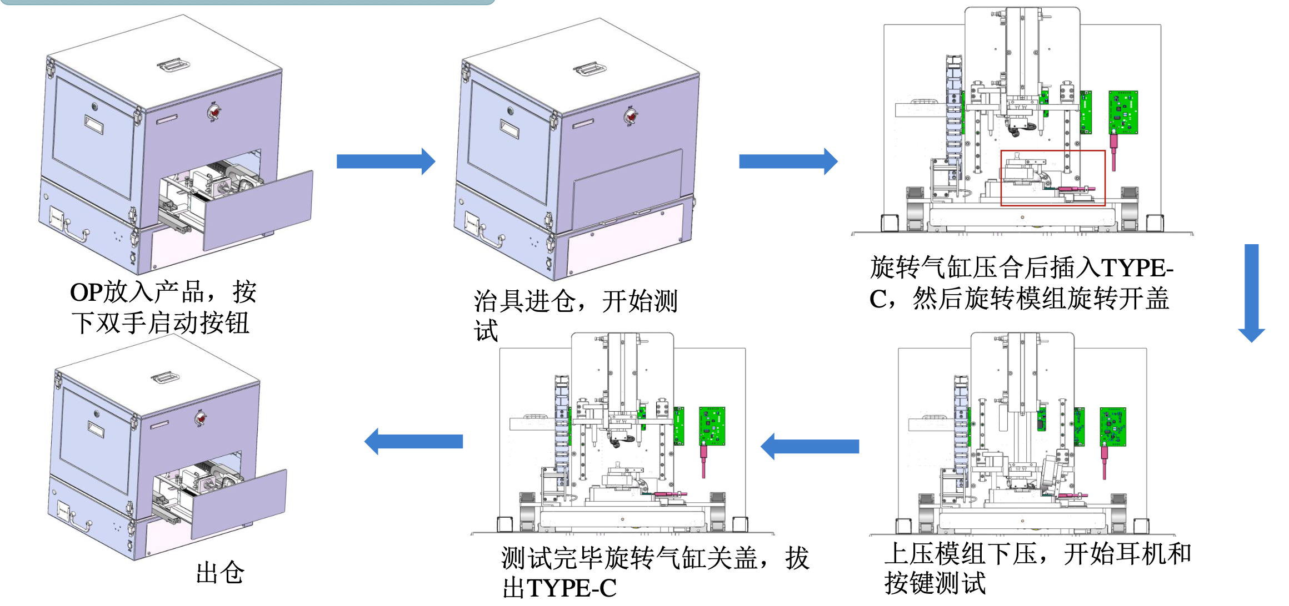
Terminology
Case QT - test flowchart：

Slide 9
Terminology
Test Items | Description
DCR | Measure GND DCR from Type-C to BUD_L/R_NEG
DUTPowerON | Open DUT communication channel
Bootmode | Set the Bootmode 2 to facilitate subsequent testing.
PowerMux | Read GPIO Data
BatteryDisChargeStatus | Verify voltage, current, SOC, and temp when the Case charger disable
BatteryChargeStatus | Verify voltage, current, SOC, and temp when the Case charger enable
Info | Check battery and FuelGauge calibration information
Brightness | Measure the Case LED parameters under red and white light conditions
GPIOCheck_Button_(Status) | Verify the ststus of the button under the state of pressing and releasing
OVP | Verify that the VBUS voltage is normal when OVP is disabled
Transition | Test Case ship mode Enter & Exit
Constant | Measure the output voltage & current at the L/R POS under load conditions
ConnectivityTest_BuddyLink(Right/Left) | Check the communication function between Case and bud
LidStatusCheck | Check Case lid status
Notes:
DCR：透過Dummy bud ，量測Type-C 端到 BUD 左／右負極（BUD_L/R_NEG）的接地直流電阻（GND DCR）
DUTPowerON：控制TypeC板 打開DUT通信通道（USB）
Bootmode：設定為 Bootmode 2 並確認設定成功 以方便後續測試. (mode 2 SMT 工廠線（裸板 MLB）測試用 最高效能 / 高功耗)
PowerMux：讀取GPIO 晶片資料
Battery（Dis / Charge）Status：驗證充電盒在充電和未充電下的電壓、電流、電量和溫度
Info：確認電池狀態與電量記晶片的校準資訊並重新設定
Brightness：量測充電盒的LED指示燈在無光、白光、紅光等情況下的各項參數（光強度）
GPIOCheck_Button_(Status)：指令控制汽缸下壓按鈕並確認按鈕狀態
OVP：驗證VBUS在過壓保護（OVP）開啟的狀態下電壓值在正常區間
Transition：測試充電盒進入ship mode功能後退出（斷連後重新連結）
Constant：量測左右耳 POS端 在有/無電子負載時的輸出電壓和電流 （確認 Case 的 5V 電源輸出功能正常）
ConnectivityTest_BuddyLink(Right/Left)：確認左右真耳與充電盒的通訊狀態（bud detect L/R）、發送指令讀取 TX 與 RX 確認通訊功能（bud link test L/R）
LidStatusCheck：透過dev lid get 讀取確認充電盒的開關蓋狀況 (Open/Close)

Slide 10
Terminology
Test Items | Description
scan_sn | Read and verify the SN
CloseDoor | Close the fixture door
DeviceReset | Reset the dummy board and Type-C board
TypeC_In | Insert the Type-C module
Press_DUT | Open the lid and press down to secure the DUT
DCR | Measure GND DCR from Type-C to BUD_L/R_NEG
DUTPowerON | Open DUT communication channel
ResetDUT | Find DUT USB port and reset
CleanDUTPort | Use UART to send a command and verify the DUT port communication
Bootmode | Set the Bootmode 2 to facilitate subsequent testing
MLBSN | Read and verify the MLBSN
SNWrite_SrNm | Read the SN and Write FGSN
SrNm | Read the SN and FGSN and verify that they match
Notes:
DCR：透過Dummy bud ，量測Type-C 端到 BUD 左／右負極（BUD_L/R_NEG）的接地直流電阻（GND DCR）
DUTPowerON：控制TypeC板 打開DUT通信通道（USB）
Bootmode：設定為 Bootmode 2 並確認設定成功 以方便後續測試. (mode 2 SMT 工廠線（裸板 MLB）測試用 最高效能 / 高功耗)
MLBSN：讀取驗證MLBSN
SNWrite_SrNm：讀取ＳＮ並寫入ＦＧＳＮ
SrNm：驗證ＳＮ和ＦＧＳＮ是否匹配

Slide 11
Terminology
Test Items | Description
BoardID | Read and verify the HWID and PID
FW | Read and verify the FW version
BTID | Read and verify the BTID
USB | Get the USB information (Product / Vendor ID)
PowerMux | Read GPIO Data
BatteryDisChargeStatus | Verify voltage, current, SOC, and temp when the Case charger disable
BatteryChargeStatus | Verify voltage, current, SOC, and temp when the Case charger enable
Info | Check battery and FuelGauge calibration information
Brightness | Measure the Case LED parameters under red and white light conditions
GPIOCheck_Button_(Status) | Verify the ststus of the button under the state of pressing and releasing
OVP | Verify that the VBUS voltage is normal when OVP is disabled
Reset | Verify the DUT reset behavior upon VBUS removal
Transition | Test Case ship mode Enter & Exit
Constant | Measure the output voltage & current at the L/R POS under load conditions
Notes:
BoardID：寫入HWID 和 PID
FW：讀取驗證ＦＷ版本
BTID：讀取驗證BTID
USB：獲取USB information （Product / Vendor ID）
PowerMux：讀取GPIO 晶片資料
Battery（Dis / Charge）Status：驗證充電盒在充電和未充電下的電壓、電流、電量和溫度
Info：確認電池狀態與電量記晶片的校準資訊並重新設定
Brightness：量測充電盒的LED指示燈在無光、白光、紅光等情況下的各項參數（光強度）
GPIOCheck_Button_(Status)：指令控制汽缸下壓按鈕並確認按鈕狀態
OVP：驗證VBUS在過壓保護（OVP）開啟的狀態下電壓值在正常區間
Reset:驗證 DUT 在 VBUS 移除情況下是否能正常執行 reset 功能
Transition：測試充電盒進入ship mode功能後退出（斷連後重新連結）
Constant：量測左右耳 POS端 在有/無電子負載時的輸出電壓和電流 （確認 Case 的 5V 電源輸出功能正常）
ConnectivityTest_PARROT：驗證 DUT 是否能正確連線到 PARROT 裝置

Slide 12
Terminology
Test Items | Description
DummyReset | Reset the Dummy board
ConnectivityTest_PARROT | Verify the connectivity between the DUT and the PARROT device
OpenBudlinkChannel | Open the dummy board budlink channel
ConnectivityTest_BuddyLink(Right/Left) | Check the communication function between Case and bud
CloseBudlinkChannel | Close the dummy board budlink channel
Release_DUT | Raise the dummy-bud pressing module to release the DUT fixture
LidStatusCheck | Check Case lid status
SystemReset | Reset the DUT device
Teardown
FixtureReset | Reset the fixture to ensure it returns to the initial position
cleanSN | Clear the DUT's SN to allow reprogramming or retesting.
Notes:
（Open/Close）BudlinkChannel:開啟or關閉dummy board budlink通道
ConnectivityTest_BuddyLink(Right/Left)：確認左右真耳與充電盒的通訊狀態（bud detect L/R）、發送指令讀取 TX 與 RX 確認通訊功能（bud link test L/R）
Release_DUT：升起假耳模組釋放DUT裝置
LidStatusCheck：透過dev lid get 讀取確認充電盒的開關蓋狀況 (Open/Close)
SystemReset：測試結束 重置ＤＵＴ
FixtureReset：復位治具確保回到初始位置
cleanSN：清除 DUT SN，以便重新寫入或重新測試

Slide 13
Terminology
Cylinder Board Command :
Functions | Command | Return | Notes
開始測試 |  | START | 按下左右按鈕，且氣壓缸有正確吸取時才發送 START
進出汽缸工作位(入) | cylinder1 front | cylinder1 front[ok] | 先關蓋汽缸動作(cylinder3 front)，再進入汽缸工作位
進出汽缸初始位(外) | cylinder1 back | cylinder1 back[ok] | 初始位後，底部真空吸關(cylinder6 back)
Type-C汽缸動作 | cylinder2 front | cylinder2 front[ok]
Type-C汽缸復位 | cylinder2 back | cylinder2 back[ok]
關蓋汽缸動作 | cylinder3 front | cylinder3 front[ok]
關蓋汽缸復位 | cylinder3 back | cylinder3 back[ok] | 開蓋真空吸開後復位
開關蓋狀態判定 | Check DUT | DUT[n] | DUT[0]代表關蓋、DUT[1]代表開蓋
假耳下壓汽缸動作 | cylinder4 front | cylinder4 front[ok]
假耳汽缸復位 | cylinder4 back | cylinder4 back[ok]
按鍵汽缸動作 | cylinder5 front | cylinder5 front[ok]
按鍵汽缸復位 | cylinder5 back | cylinder5 back[ok]
底部真空吸開 | cylinder6 front | cylinder6 front[ok] | 綁在cylinder1 front前
底部真空吸關 | cylinder6 back | cylinder6 back[ok] | 綁在cylinder1 back後
開蓋真空吸開 | cylinder9 front | cylinder9 front[ok] | 新設計
開蓋真空吸關 | cylinder9 back | cylinder9 back[ok] | 新設計
測試成功 | Pass | Pass OK | 測試成功燈號
測試失敗 | Fail | Fail OK | 測試失敗燈號
reset | reset | Reset OK\r\n | 全部動作復位
help | help |  | Command list

Slide 14
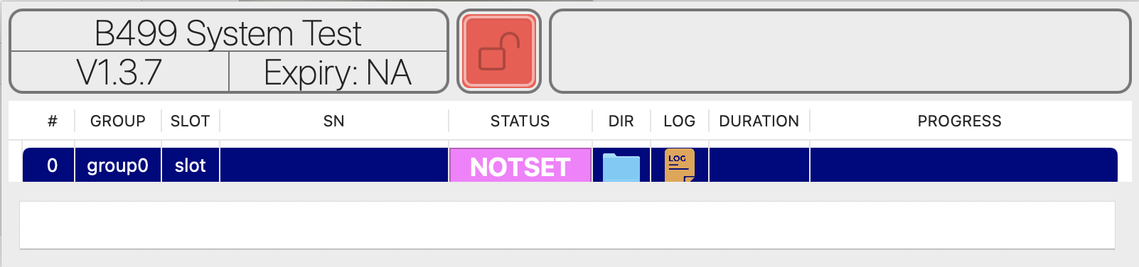
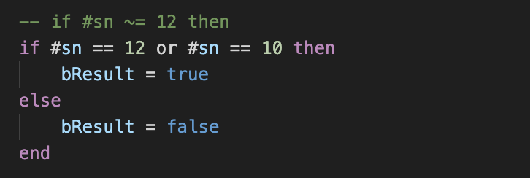
Terminology
scan_sn：
Read and verify the SN
Use TPInterview Plugin to get the SN
SN length must be 12 or 10

Slide 15
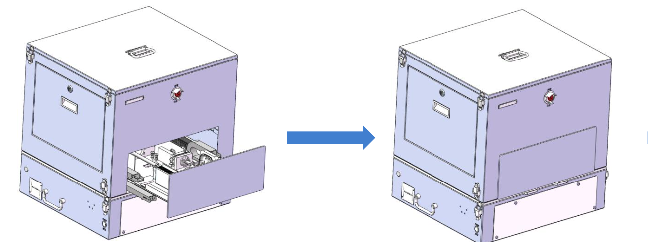
Terminology
CloseDoor：
Close the fixture door
Command：
Test item | cylinder command | Description
CloseDoor | cylinder1 front | 進入工作位（先關蓋）

Slide 16
Terminology
DeviceReset：
Reset the dummy board and Type-C board
Command：
Test item |  | Type-C command | Description | Dummy command | Description
DeviceReset | 1 | reset | 復位 | reset | 復位

Slide 17
Terminology
TypeC_In：
Insert the Type-C module
Command：
Test item | cylinder command | Description
TypeC_In | cylinder2 front | 進入工作位（先關蓋）

Slide 18
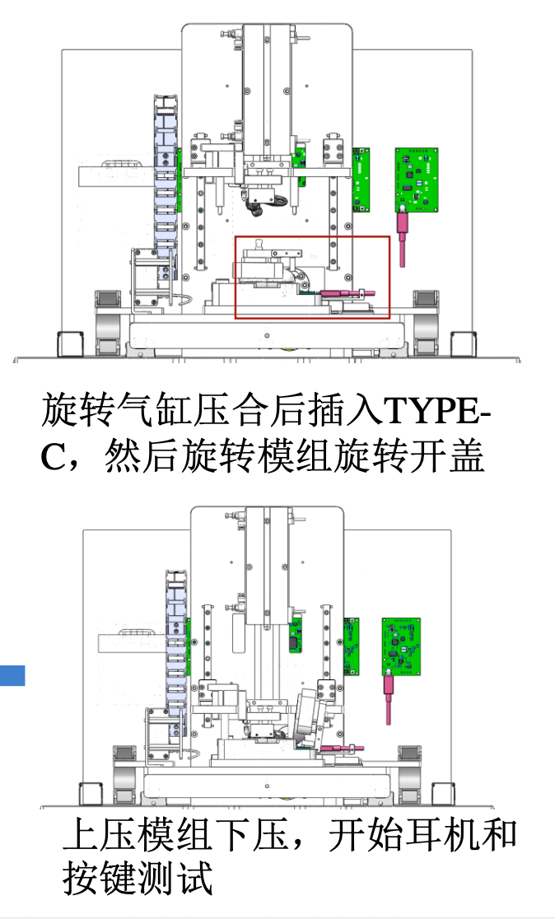
Terminology
Press_DUT：
Open the lid and press down to secure the DUT
Command：
Test item |  | cylinder command | Description
Press_DUT | 1 | cylinder3 back | 關蓋汽缸復位(開蓋)
 | 2 | Check DUT | 開關蓋狀態判定
 | 3 | cylinder4 front | 假耳下壓動作

Slide 19
Terminology
DCR：
Measure GND DCR from Type-C to BUD_L/R_NEG
Command：
Test item |  | Type-C cmd | Description | Dummy cmd | Description | shell cmd | Description | Cylinder cmd | Description
DCR (Left /Right) | 1 | test_vbus_contact_resistance_on | 打開通道,DMM獲取內阻
 | 2 |  |  | test_(L/R)_contact_resistance_on | 打開通道,DMM獲取內阻
 | 3 |  |  |  |  | DMM.py | 量測DCR(1st)
 | 4 |  |  |  |  |  |  | cylinder4 back | 假耳上抬
 | 5 |  |  |  |  |  |  | cylinder4 front | 假耳下壓
 | 6 |  |  |  |  | DMM.py | 量測DCR(2nd)
 | 7 |  |  | test_(L/R)_contact_resistance_off | 測試完成,關閉通道
 | 8 | test_vbus_contact_resistance_off | 測試完成,關閉通道
Notes:
DCR：透過Dummy bud ，量測Type-C 端到 BUD 左／右負極（BUD_L/R_NEG）的接地直流電阻（GND DCR）
每一邊假耳量測兩次ＤＣＲ

Slide 20
Terminology
DUTPowerON：
Open DUT communication channel
Command：
Test item |  | Type-C command | Description | Dummy command | Description
DUTPowerON | 1 | PC_MODE_ON | 打開DUT通信通道（USB）
 | 2 | vbus[1][5] | 設定外接電源5v
Notes:
DUTPowerON：控制TypeC板 打開DUT通信通道（USB）

Slide 21
Terminology
ResetDUT：
Find DUT USB port and reset
Command：
Test item |  | Shell command | Description | DUT_USB command | Description | DUT command | Description
ResetDUT | 1 | find /dev/cu.usbmodem* | macOS 找 DUT serial port
 | 2 |  |  | \n
 | 3 |  |  | ft reset\n | 重置DUT
 | 4 |  |  |  |  | ft fw ver | 當回應是亂碼才執行
若連接失敗，執行以下指令
Test item |  | cylinder command | Description
ResetDUT | 1 | cylinder2 back | Type-C汽缸復位
 | 2 | cylinder2 front | Type-C汽缸動作
Retry 最多 3次
Notes:
自動尋找 DUT 的 USB port，透過 UART 下 reset 指令確認 DUT 回應，若失敗就控制治Type-C插拔重新嘗試
希望下 reset 指令後 DUT 回應 Powerbeats字串
若回應為亂碼 則對ＤＵＴ再下ft fw ver 取得 version 以確保ＤＵＴ重啟無問題

Slide 22
Terminology
CleanDUTPort：
Use UART to send a command and verify the DUT port communication
Command：
Test item |  | DUT command | Description
CleanDUTPort | 1 | ft fw ver | 透過回傳，確保連線是正常的
Notes:
透過 UART 發送指令讀取 FW version，以清空並確認 DUT USB port 通訊狀態是否正常

Slide 23
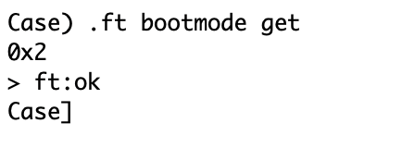
Terminology
Bootmode：
Set the Bootmode 2 to facilitate subsequent testing
Command：
Test item |  | DUT command | Description
Bootmode | 1 | ft bootmode set 2 | 設定bootmode為2(SMT 工廠模式)
 | 2 | ft bootmode get | 獲取bootmode,檢查設定是否成功
Get Bootmode 2
Notes:
Bootmode：設定為 Bootmode 2 並確認設定成功 以方便後續測試. (mode 2 SMT 工廠線（裸板 MLB）測試用 最高效能 / 高功耗)

Slide 24
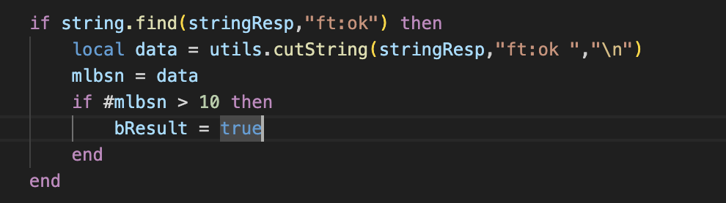
Terminology
MLBSN：
Read and verify the MLBSN
Command：
Test item |  | DUT command | Description
MLBSN | 1 | ft sn read mlb | 讀取mlbsn
確認回傳字串並驗證mlbsn
Notes:
MLBSN：讀取驗證MLBSN

Slide 25
Terminology
SNWrite_SrNm：
Read the SN and Write FGSN
Command：
Test item |  | DUT command | Description
SNWrite_SrNm | 1 | ft sn read system | 讀取盒子sn 確認是否與掃描的sn相同
 | 2 | ft sn write system | 若盒子無sn 則寫入掃描時的sn
＃在傳送指令前會先確認sn有值才開始
Notes:
SNWrite_SrNm：讀取ＳＮ並寫入ＦＧＳＮ

Slide 26
Terminology
SrNm：
Read the SN and FGSN and verify that they match
Command：
Test item |  | DUT command | Description
SrNm | 1 | ft sn read system | 讀取FGSN
Notes:
SrNm：驗證ＳＮ和ＦＧＳＮ是否匹配

Slide 27
Terminology
BoardID：
Read and verify the HWID and PID
Command：
Test item |  | DUT command | Description
BoardID | 1 | ft hw ver | 讀取硬體版本
 | 2 | adc read pid | 讀取硬體識別電壓
Notes:
BoardID：讀取驗證HWID 和 PID

Slide 28
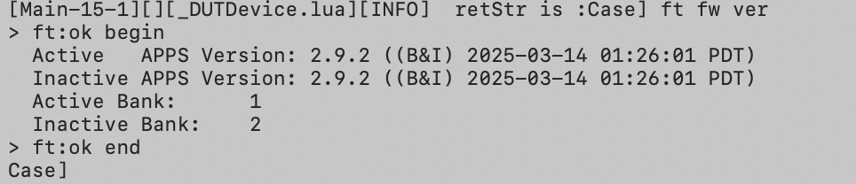
Terminology
FW：
Read and verify the FW version
Command：
Test item |  | DUT command | Description
FW | 1 | ft fw ver | 讀取韌體版本
讀取驗證FW active 和 inactive version
Notes:
FW：讀取驗證雙韌體區（Active / Inactive）的 FW 版本

Slide 29
Terminology
BTID：
Read and verify the BTID
Command：
Test item |  | DUT command | Description
BTID | 1 | ft btid read | 讀取bitd
 | 2 | ft btid write 1 | 若沒讀取到btid才寫入
 | 3 | ft btid read | 驗證bitd
Notes:
BTID：讀取驗證BTID

Slide 30
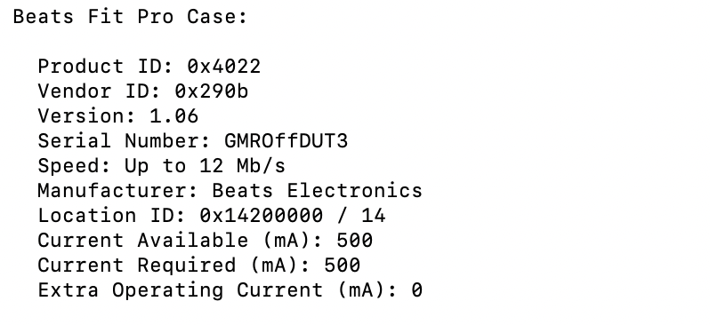
Terminology
USB：
Get the USB information (Product / Vendor ID)
Command：
Test item |  | shell command | Description
USB | 1 | system_profiler SPUSBDataType | 取得USB 裝置的詳細資訊
讀取驗證Product / Vendor ID
Notes:
USB：獲取USB information （Product / Vendor ID）

Slide 31
Terminology
PowerMux：
Read GPIO data
Command：
Test item |  | DUT command | Description
PowerMux | 1 | gpio get A 9 | 讀取GPIO 晶片資料
Notes:
PowerMux：讀取GPIO 晶片資料

Slide 32
Terminology
Battery( DisCharge / Charge )Status：
Verify voltage, current, SOC, and temp when the case charger ( disable / enable )
Command：
Test item |  | DUT command | Description | Type-C command | Description
BatteryDisChargeStatus | 1 | charger disable | 關閉充電功能
BatteryChargeStatus | 1 | charger enable | 開啟充電功能
Battery(DisCharge/Charge)Status | 2 | charger regdump | 讀取充電晶片暫存器值
 | 3 | gg info | 確認電池各項資訊
 | 4 |  |  | getvoltage | 獲取電壓
 | 5 |  |  | getcurrent | 獲取電流
 | 6 | charger vbus status | 確認vbus狀態
 | 7 | charger adc read vbus | 讀取 VBUS 電壓
 | 8 | charger adc read ibus | 讀取 VBUS 電流
 | 9 | charger adc read vbat | 讀取 充電盒電池端電壓
 | 10 | charger adc read ibat | 讀取 充電盒電池充放電電流
 | 11 | ft temperature get | 檢查MCU溫度
 | 12 | charger adc read TDIE | 檢查電池溫度
Notes:
Battery（Dis / Charge）Status：驗證充電盒在充電和未充電下的電壓、電流、電量和溫度

Slide 33
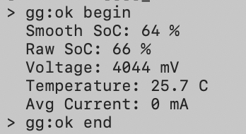
Terminology
Info：
Check battery and fuel gauge calibration information
Command：
Test item |  | DUT command | Description
Info | 1 | gg unseal | 解除fuel gauge校正值鎖定
 | 2 | gg cal info | 取得fuel gauge校正值資訊
 | 3 | gg info | 確認電池各項資訊
 | 4 | gg cc_offset_cal | 設定fuel gauge校正值
 | 5 | gg seal | 鎖定fuel gauge校正值
 | 6 | gg reset | reset
gg info
Notes:
Info：確認電池狀態與電量記晶片的校準資訊並重新設定

Slide 34
Terminology
Brightness：
Measure the case LED parameters under red and white light conditions
Command：
Test item |  | DUT command | Description | LED command | Description | Type-C command | Description
Brightness | 1 | dev vbus enable | 開啟vbus供電
 | 2 | charger disable | 關閉充電功能
 | 3 | pwm unset | 關閉盒子燈
 | 4 |  |  |  |  | getcurrent | 獲取LED無光vbus電流
 | 5 |  |  | :001w_target_type01-01=0 | 設定LED分析儀測白光
 | 6 |  |  | :001w_offset_en01-01=1 | 設定白光校正補償
 | 7 |  |  | :001r_chroma01-01 | 讀取數值（無光）
 | 8 | PWM set white 1000 | 設定盒子白光
 | 9 |  |  |  |  | getcurrent | 獲取LED白光vbus電流
 | 10 |  |  | :001r_chroma01-01 | 讀取數值（白光）
 | 11 | pwm unset | 關閉盒子燈
 | 12 | PWM set red 1000 | 設定盒子紅光
 | 13 |  |  | :001w_target_type01-01=11 | 設定LED分析儀測紅光
 | 14 |  |  | :001w_offset_en01-01=2 | 設定紅光校正補償
 | 15 |  |  |  |  | getcurrent | 獲取LED紅光vbus電流
 | 16 |  |  | :001r_chroma01-01 | 讀取數值（紅光）
 | 17 | pwm unset | 關閉盒子燈
Notes:
Brightness：量測充電盒的LED指示燈在無光、白光、紅光等情況下的各項參數（光強度）

Slide 35
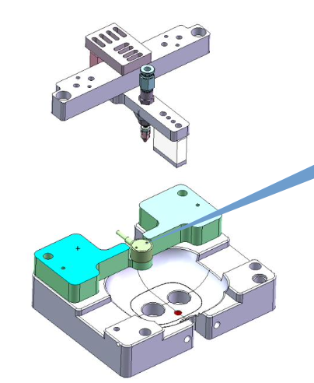
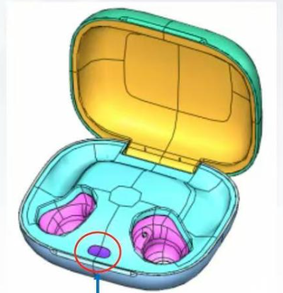
Terminology
GPIOCheck_Button_(Initial / Pressed / Released)：
Verify the status of the button under the state of pressing and releasing
Command：
Test item |  | DUT command | Description | cylinder command | Description
GPIOCheck_Button_Initial | 1 | dev btn get | 讀取按鍵狀態（釋放）
GPIOCheck_Button_Pressed | 1 |  |  | cylinder5 front | 按鍵汽缸往前按壓
 | 2 | dev btn get | 讀取按鍵狀態（按壓）
GPIOCheck_Button_Released | 1 |  |  | cylinder5 back | 按鍵汽缸往後鬆開
 | 2 | dev btn get | 讀取按鍵狀態（釋放）
Notes:
GPIOCheck_Button_(Status)：指令控制汽缸下壓按鈕並確認按鈕狀態

Slide 36
Terminology
OVP (Over Voltage Protection)：
Verify that the VBUS voltage is normal when OVP is disabled
Command：
Test item |  | DUT command | Description
OVP | 1 | dev vbus disable | 關閉過壓保護
 | 2 | dev vbus get | 檢查vbus電壓
Notes:
OVP：驗證VBUS在過壓保護（OVP）開啟的狀態下電壓值在正常區間

Slide 37
Terminology
Transition：
Test case ship mode Enter & Exit
Command：
Test item |  | DUT command | Description | Type-C command | Description
Transition | 1 |  |  | vbus[1][5] | 設定外接電源5v
 | 2 | dev powermode set standby | 設定充電盒休眠模式
 | 3 |  |  | vbus[1][0] | 設定外接電源0v (斷連)
 | 4 |  |  | vbus[1][5] | 設定外接電源5v (重連，離開休眠)
Notes:
Transition：測試充電盒進入ship mode功能後退出（斷連後重新連結）

Slide 38
Terminology
Constant：
Measure the output voltage & current at the bud L/R POS under (no/ load) conditions
Command：
Test item |  | DUT command | Description | Dummy command | Description
Constant | 1 | charger disable | 關閉充電功能
 | 2 | dev vbus disable | 停用5v外部電源
 | 3 | dev vbus get | 確認停用vbus
 | 4 | charger boost enable | 啟用 Boost Mode升壓供電
 | 5 | charger boostv set 5000 | 設定 Boost 輸出電壓5Ｖ
 | 6 | bud mgr disable | 停用 bud的管理
 | 7 | bud chg set left on | 打開 左耳充電路徑
 | 8 | bud chg set right on | 打開 右耳充電路徑
 | 9 |  |  | set_left_eload[0] | 設定 左耳電子負載電流 0mA
 | 10 |  |  | set_right_eload[0] | 設定 右耳電子負載電流 0mA
 | 11 |  |  | left_eload_ch_on | 打開左耳Eload通道
 | 12 |  |  | right_eload_ch_on | 打開右耳Eload通道
 | 13 |  |  | set_left_eload[100] | 設定 左耳電子負載電流 100mA
Notes:
Constant：量測左右耳 POS端 在有/無電子負載時的輸出電壓和電流 （確認 Case 的 5V 電源輸出功能正常）
切斷外部 USB 充電影響
關掉 charger 正常充電模式
改用 Case 內部電池升壓（boost）產生 5V
驗證 Case 在「沒插線」時，是否能正確輸出 5V（給 Bud / POS / Test pin）
電子負載精準模擬耳機充電電流，驗證 Case 在負載變化下5V輸出是否可靠

Slide 39
Terminology
Constant：
Measure the output voltage & current at the bud L/R POS under load conditions
Command：
Test item |  | DUT command | Description | Dummy command | Description
Constant | 14 |  |  | set_right_eload[100] | 設定 右耳電子負載電流 100mA
 | 15 |  |  | get_left_pos_voltage | 讀取 左耳 Bud Pogo pin 電壓
 | 16 |  |  | get_left_eload_current | 讀取 左耳電子負載實際的電流
 | 17 |  |  | get_right_pos_voltage | 讀取 右耳 Bud Pogo pin 電壓
 | 18 |  |  | get_right_eload_current | 讀取 右耳電子負載實際的電流
 | 19 | gg info | 取得電池各項資訊
 | 20 |  |  | set_left_eload[0] | 設定 左耳電子負載電流 0mA
 | 21 |  |  | set_right_eload[0] | 設定 右耳電子負載電流 0mA
 | 22 |  |  | get_left_pos_voltage | 讀取 左耳 Bud Pogo pin 電壓
 | 23 |  |  | get_right_pos_voltage | 讀取 右耳 Bud Pogo pin 電壓
 | 24 | gg info | 確認電池各項資訊
 | 25 |  |  | （Left / Right）_eload_ch_off | 關閉左右耳Eload通道
 | 26 | dev vbus enable | 重新啟用5v外部電源
 | 27 | dev vbus get | 確認啟用vbus
Notes:
Constant：量測左右耳 POS端 在有/無電子負載時的輸出電壓和電流 （確認 Case 的 5V 電源輸出功能正常）
切斷外部 USB 充電影響
關掉 charger 正常充電模式
改用 Case 內部電池升壓（boost）產生 5V
驗證 Case 在「沒插線」時，是否能正確輸出 5V（給 Bud / POS / Test pin）
電子負載精準模擬耳機充電電流，驗證 Case 在負載變化下5V輸出是否可靠

Slide 40
Terminology
ConnectivityTest_PARROT：
Verify the connectivity between the DUT and the PARROT device
Command：
Test item |  | DUT command | Description
ConnectivityTest_PARROT | 1 | I2c scan i2c1 | 在 i2c1 bus 上掃描所有裝置位址
Notes:
ConnectivityTest_PARROT：驗證 DUT 是否能正確連線到 PARROT 裝置

Slide 41
Terminology
OpenBudlinkChannel ＆ CloseBudlinkChannel：
Reset the fixture to ensure it returns to the initial position
Clear the DUT's SN to allow reprogramming or retesting.
Command：
Test item |  | Dummy command | Description
OpenBudlinkChannel | 1 | right_budlink_ch_on | 打開右耳連接通道
 | 2 | left_budlink_ch_on | 打開左耳連接通道
CloseBudlinkChannel | 1 | right_budlink_ch_off | 關閉右耳連接通道
 | 2 | left_budlink_ch_off | 關閉左耳連接通道

Slide 42

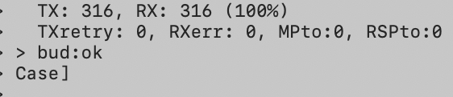
Terminology
ConnectivityTest_BuddyLink(Right/Left)：
Check the communication function between case and bud
Command：
Test item |  | DUT command | Description
ConnectivityTest_BuddyLink(Right/Left) | 1 | ft reset | reset系統
 | 2 | dbg set all none | Debug 相關設定設為無
 | 3 | bud mgr disable (left/right) | 停用（L/R）Bud的管理
 | 4 | bud detect (left/right) | 偵測（L/R）Bud
 | 5 | bud mgr enable (left/right) | 啟用（L/R）Bud的管理
 | 6 | bud state get (left/right) | 獲取（L/R）Bud目前狀態
 | 7 | bud link test (left/right) | 測試（L/R）Bud連線功能
bud detect
bud link test
Notes:
ConnectivityTest_BuddyLink(Right/Left)：確認左右真耳與充電盒的通訊狀態（bud detect L/R）、發送指令讀取 TX 與 RX 確認通訊功能（bud link test L/R）
dbg set all none：關閉所有 Debug log ，避免 log 影響測試穩定性
bud mgr disable：暫停該側 Bud 的管理
bud detect：主動偵測
bud mgr enable：恢復該側 Bud 的完整管理，開始通訊
bud link test ：執行 通訊測試，驗證能回應、資料通

Slide 43
Terminology
Release_DUT：
Raise the dummy-bud pressing module to release the DUT fixture
Command：
Test item |  | cylinder command | Description
Release_DUT | 1 | cylinder4 back | 假耳汽缸上抬
Notes:
Release_DUT：升起假耳模組釋放DUT裝置

Slide 44
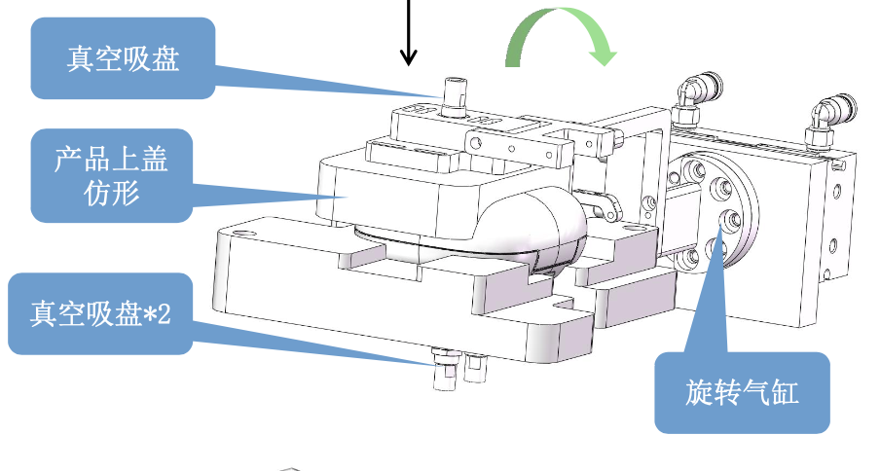
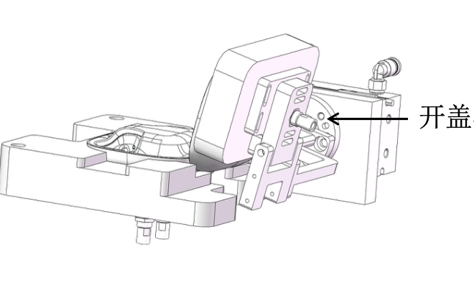
Terminology
LidStatusCheck：
Close the lid and Check case lid status
Command：
Test item |  | DUT command | Description | cylinder command | Description
LidStatusCheck | 1 | dev lid get | 讀取盒子開關蓋狀態(開)
 | 2 |  |  | cylinder3 front | 關蓋汽缸往前（關）
 | 3 |  |  | cylinder3 back | 關蓋汽缸往後（動作收回）
 | 4 | dev lid get | 讀取盒子開關蓋狀態(關)
Notes:
LidStatusCheck：透過dev lid get 讀取確認充電盒的開關蓋狀況 (Open/Close)

Slide 45
Terminology
SystemReset：
Reset the DUT device
Command：
Test item |  | DUT command | Description
SystemReset | 1 | ft reset | 重置待測裝置
Notes:
SystemReset：測試結束 重置ＤＵＴ

Slide 46
Terminology
Teardown - FixtureReset ＆ cleanSN：
Reset the fixture to ensure it returns to the initial position
Clear the DUT's SN to allow reprogramming or retesting.
Command：
Test item |  | Type-C command | Description | Dummy command | Description | cylinder command | Description
FixtureReset | 1 | reset | 復位 | reset | 復位
 | 2 |  |  |  |  | cylinder4 back | 假耳汽缸上抬
 | 3 |  |  |  |  | cylinder2 back | Type-C復位
 | 4 |  |  |  |  | reset | 全汽缸復位
cleanSN | 1 | TPinterview clear SN
Notes:
FixtureReset：復位治具確保回到初始位置
cleanSN：清除 DUT SN，以便重新寫入或重新測試

Slide 47
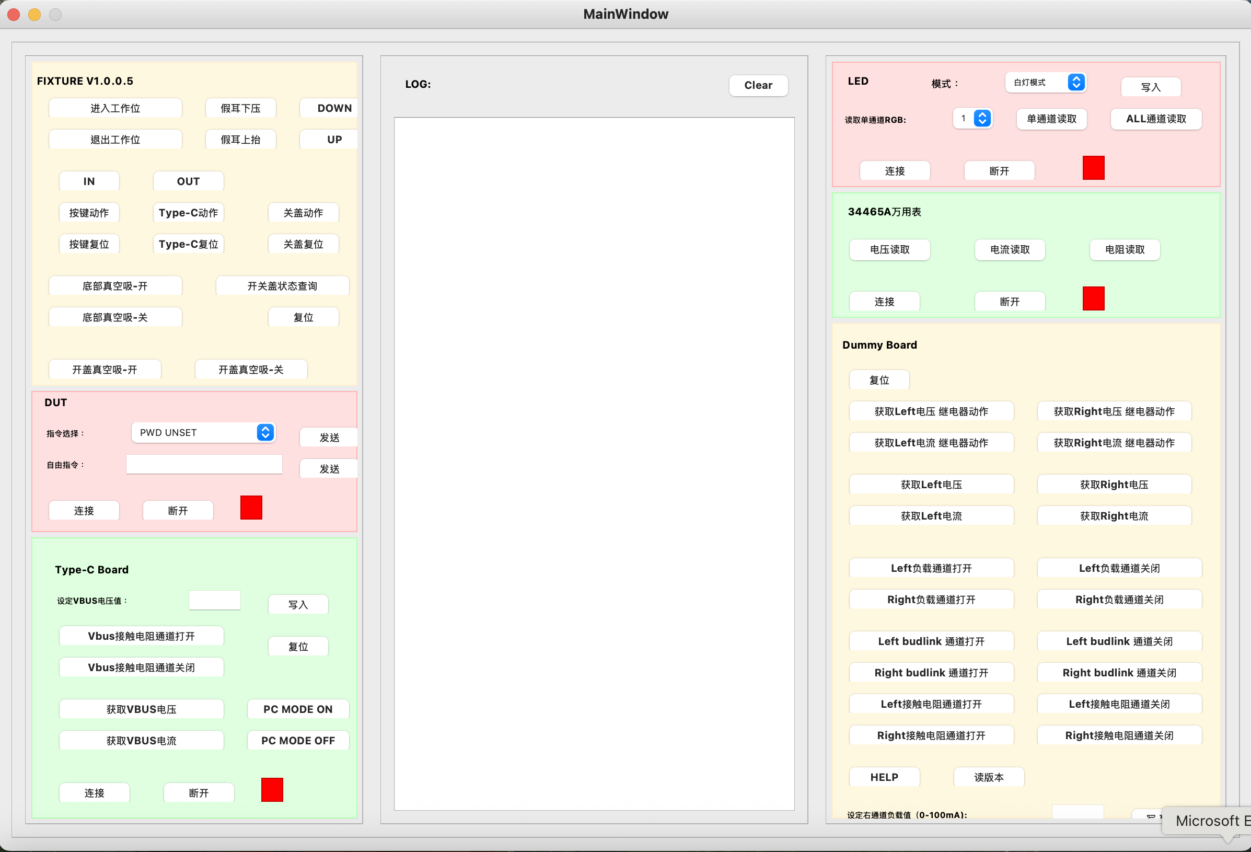
Terminology
Case QT - Debug Tool
介面顯示治具各模組連結狀態，並提供模組對應之功能，以供調適
1. Fixture 2. DUT 3. Type-C Board 4. LED Analysis 5. DMM-34465A 6. Dummy Board 7. Log display
1
7
4
5
6
2
3

Slide 48
Terminology
Functions | Command
進入工作位（先關蓋） | cylinder1 front
退出工作位（後關下真空） | cylinder1 back
Type-C動作 | cylinder2 front
Type-C復位 | cylinder2 back
關蓋動作 | cylinder3 front
關蓋復位 | cylinder3 back
開關蓋狀態查詢 | Check DUT
假耳下壓動作 | cylinder4 front
假耳上抬動作 | cylinder4 back
按鍵動作 | cylinder5 front
按鍵復位 | cylinder5 back
底部真空吸-開 | cylinder6 front
底部真空吸-關 | cylinder6 back
開蓋真空吸-開 | cylinder9 front
開蓋真空吸-關 | cylinder9 back
ＩＮ（僅進入工作位 不吸氣） | ＩＮ
ＯＵＴ（僅退出工作位） | ＯＵＴ
ＤＯＷＮ | 同假耳下壓
ＵＰ | 同假耳上抬
復位 | reset
Case QT - Debug Tool - Fixture
測試執行順序：
進入工作位 -> Type-C動作 ->關蓋復位(開蓋) -> 假耳下壓動作 -> 按鍵動作 -> 按鍵復位 ->假耳上抬動作 ->關蓋動作
->假耳上抬動作(Teardown) -> Type-C復位(Teardown) ->復位

Slide 49
Terminology
Case QT - Debug Tool - DUT
Command | functions
pwm unset | 關閉盒子燈
PWM set white 1000 | 設定盒子白光
PWM set red 1000 | 設定盒子紅光
Read MLB SN | 非正式Case指令，對應指令參考Case QT设备继电器及气缸指令说明-V1.0 20251222.pdf
Read FG SN
Read BTID
Read DUT HW ID
Read DUT FW
Read DUT PID
GG INFO
GG CAL INFO
GG RESET
READ BUTTON STATUS
FT RESET
預設

Slide 50
Terminology
Case QT - Debug Tool – Type-C Board
Functions | Command | Note
設定vbus電壓值 | vbus[1][m] | m電壓值(0 / 5)Ｖ
Vbus接觸電阻通道打開 | test_vbus_contact_resistance_on
Vbus接觸電阻通道關閉 | test_vbus_contact_resistance_off
獲取vbus電壓 | getvoltage
獲取vbus電流 | getcurrent
PC MODE ON | PC_MODE_ON | 開啟DUT USB通訊
PC MODE OFF | PC_MODE_OFF | 調適用指令
復位 | reset

Slide 51
Terminology
Case QT - Debug Tool – LED Analysis
Functions | Command | Note
白燈模式 | :001w_target_type01-01=0 | 設定LED分析儀測白光
 | :001w_offset_en01-01=1 | 設定白光校正補償
紅燈模式 | :001w_target_type01-01=11 | 設定LED分析儀測紅光
 | :001w_offset_en01-01=2 | 設定紅光校正補償
獲取單通道RGB | :001r_chroma01-01 | 使用LED分析儀通道口，預設1
ALL通道獲取 |  | 全通道讀取

Slide 52
Terminology
Case QT - Debug Tool – DMM
Functions | Command | Note
電壓讀取 | Use DMM.py
電流讀取
電阻讀取 |  | 測DCR

Slide 53
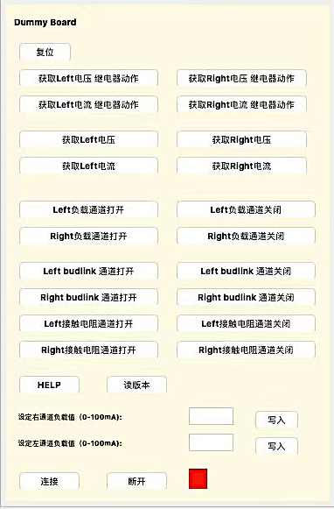
Terminology
Case QT - Debug Tool – Dummy board
Functions | Command | Note
（L/R）電壓繼電器動作 | get_(L/R)_pos_voltage_relay | 調適用指令
（L/R）電流繼電器動作 | get_(L/R)_eload_current_relay | 調適用指令
獲取（L/R）電壓 | get_(L/R)_pos_voltage
獲取（L/R）電流 | get_(L/R)_eload_current
（L/R）負載通道打開 | (L/R)_eload_ch_on
（L/R）負載通道關閉 | (L/R)_eload_ch_off
（L/R）budlink通道打開 | (L/R)_budlink_ch_on
（L/R）budlink通道關閉 | (L/R)_budlink_ch_off
（L/R）接觸電阻通道打開 | test_(L/R)_contact_resistance_on
（L/R）接觸電阻通道關閉 | test_(L/R)_contact_resistance_off
設定（L/R）通道負載值 | set_(L/R)_eload[n] | n負載值(0/100)mA
💡: (L/R)代表(left / right)

Slide 54
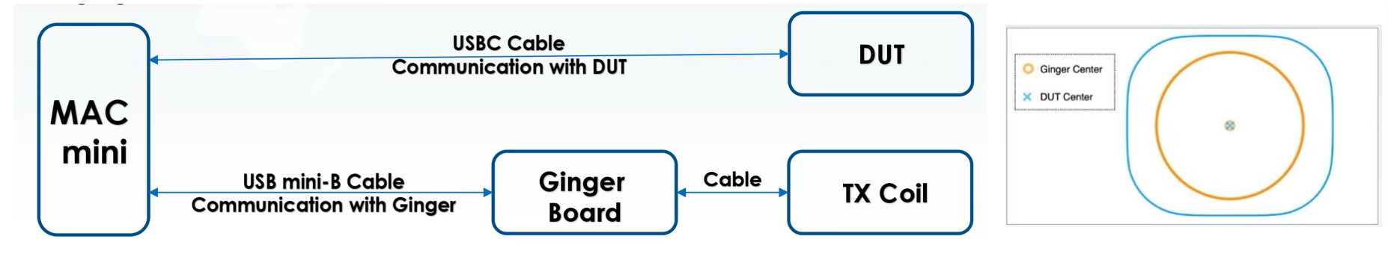
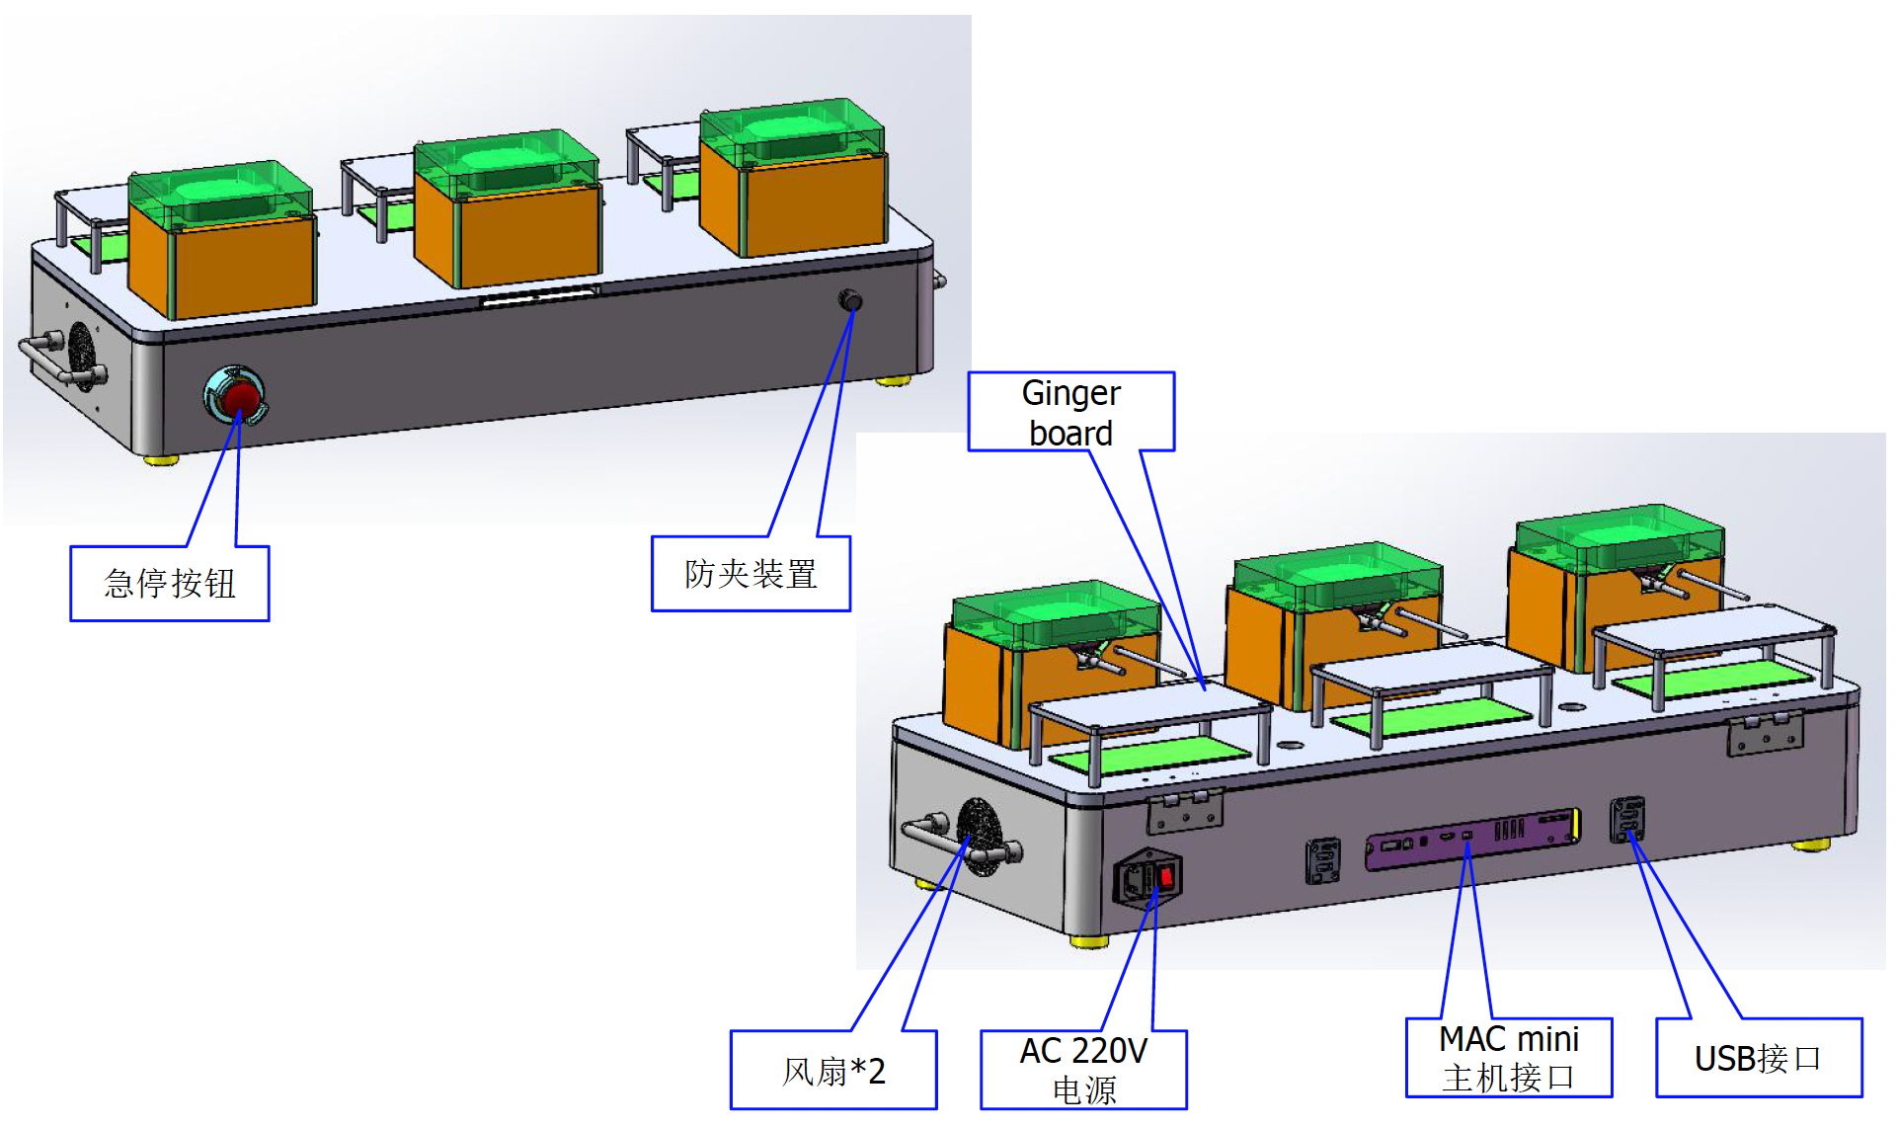
Wireless Charger Station Introduction
Test Model:B499 Vendor : 燦華
Objective: (test coverage)
The purpose of this station is to test the wireless power transfer (WPT) of Bootmode 2 case
Detect the test parameters of DUT at charging current of 40mA,120mA, 240mA, 360mA, 440mA and 480mA
Brief introduction of main equipment
Wireless charging fixture（3up）
Data Dependency tech , increase TT efficiency to 21.6%
WASP(coil) and Ginger board : Composition TX simulator
Testing principle
Overview of Overlay Testing Principle: WASP (coil) and Ginger board open TX mode and set a fixed TX frequency.
Set wireless charging mode for DUT, set different charging currents(40ma~480ma), and read wireless charging test parameters for DUT.
Operation steps: OP connects the DUT to type-c, then places the DUT in the holder, and then places the pressure block on the holder to fix the DUT. Overlay begins testing, and after testing is complete, remove the DUT from the holder
Main parameters of DUT wireless charging test: charger ADC value; gg info(voltage, current); wlchgr info(VRECT, ICUR)；ginger power; Power Transfer Efficiency.
Notes:
此測試站為無線充電站
本站點用於測試產品在 Bootmode 2 情境下的 無限功率轉換(WPT)的無線充電功能。
測試將於多組充電電流條件下進行，包含 40mA、120mA、240mA、360mA、440mA 與 480mA，以確認 DUT 在各電流段的測試參數與表現是否符合預期
接著我們為此測試站所帶來的效益是：
無線充電治具擴充至3穴
透過平行化處理的方式，將測試時間減少約21%
WASP（線圈）與 Ginger 板組合，作為 TX 模擬器使用
一、測試原理概述（Testing Principle）
本測試採用 WASP（coil）搭配 Ginger board 組成之 TX 模擬器。
測試時由 Ginger board 啟動 TX mode，並設定固定的 TX 頻率。
DUT 進入無線充電模式後，依序設定不同充電電流條件（40 mA～480 mA），並讀取 DUT 之無線充電相關測試參數，以評估其表現。
二、操作流程（Operation Steps）
操作者（OP）先將 DUT 以 Type-C 進行插入
接著將 DUT 放置於治具（holder）中，並使用上方放置壓塊用以固定 DUT 位置。
下位機將發送啟動指令啟動 Overlay 測試流程，系統自動進行無線充電測試。
測試完成後，取出 DUT，結束測試。
三、無線充電測試主要量測項目（Main Test Parameters）
數位轉類比充電數值
產品電池資訊（電壓、電流）
無線充電模組資訊（VRECT、ICUR）
Ginger power（TX 輸出功率）
Power Transfer Efficiency（電源轉換效率）

Slide 55
Terminology
Ginger_Set_TX | Set Ginger Board to TX Mode
Ginger_Set_coil_off | Disable TX coil output on the Ginger Board
Ginger_Get_dc_power | Measure DC input power when TX coil is disabled
Charger_enable | Enable the DUT charger on
Charger_Set_limits | Set and verify charger limit type to voltage mode
Charger_Set_Topoff_limits | Set and verify charger top-off voltage limits
PowerTransfer_BatCharging_40mA | Set case current, enable coil, verify wireless charger, read charger & battery info
Notes:
講一下流程

Slide 56
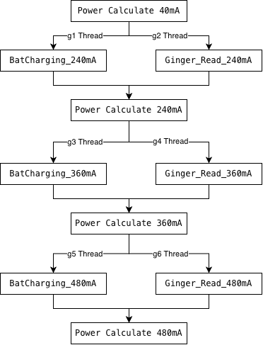
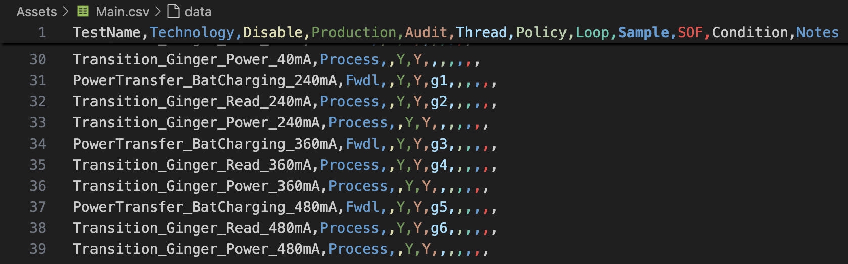
Terminology
PowerTransfer_BatCharging_240 / 360 / 480 mA | Set case current and read wireless charger & battery info
Transition_Ginger_Read_240 / 360 / 480 mA | Read inverter DC input Power / Voltage/ Current
Transition_Ginger_Power_240 / 360 / 480 mA | Calculate Ginger board input power and verify transfer efficiency
Start Parallel Thread
Join Thread Point
Notes:
講一下流程

Slide 57
Terminology
SetChargerParams | Set and verify charger top-off parameters
Set_Bud_Voltage | Set and verify bud top-off voltage limits
Notes:
講一下流程

Slide 58

Foxconn Interconnect Technology Limited (Incorporated in the Cayman Islands and carrying on business in Hong Kong as FIT Hon Teng Limited)

