Slide 1

Fit-Forge Fitness Platform
Kubernetes Microservices Architecture
Production-ready container orchestration for scalable fitness services

Slide 2



Why Microservices + Kubernetes
Scalability
Modularity
Reliability
Independent service scaling based on demand
Decoupled services enable agile development
Self-healing pods ensure uptime
Overcoming monolithic architecture limitations through containerized microservices

Slide 3
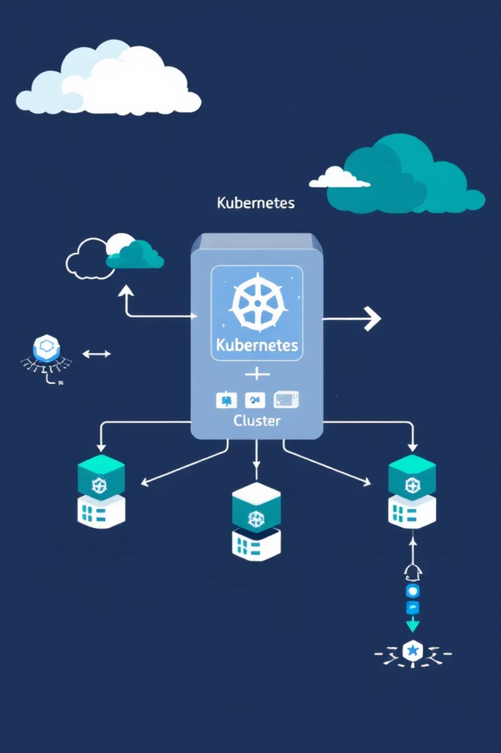
System Architecture Overview
Microservices
Infrastructure
Frontend, Auth, User services
AI Agent, Nutrition, Workout services
Progress tracking service
1 Master Node, 2 Worker Nodes
HAProxy external load balancer
Kubernetes Gateway routing

Slide 4
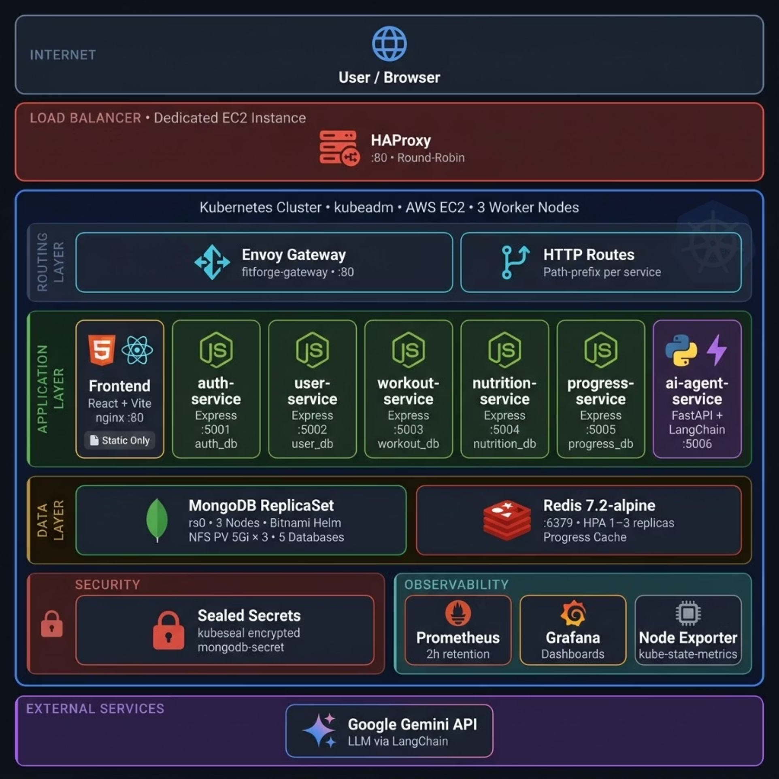

Slide 5
Request Flow: User Authentication
01
02
03
Initial Request
Gateway Routing
Authentication
User → HAProxy external load balancer
Path-based routing to auth-service
Token validation and user lookup
04
05
Data Query
Response Return
MongoDB user document retrieval
Authenticated response to client

Slide 6
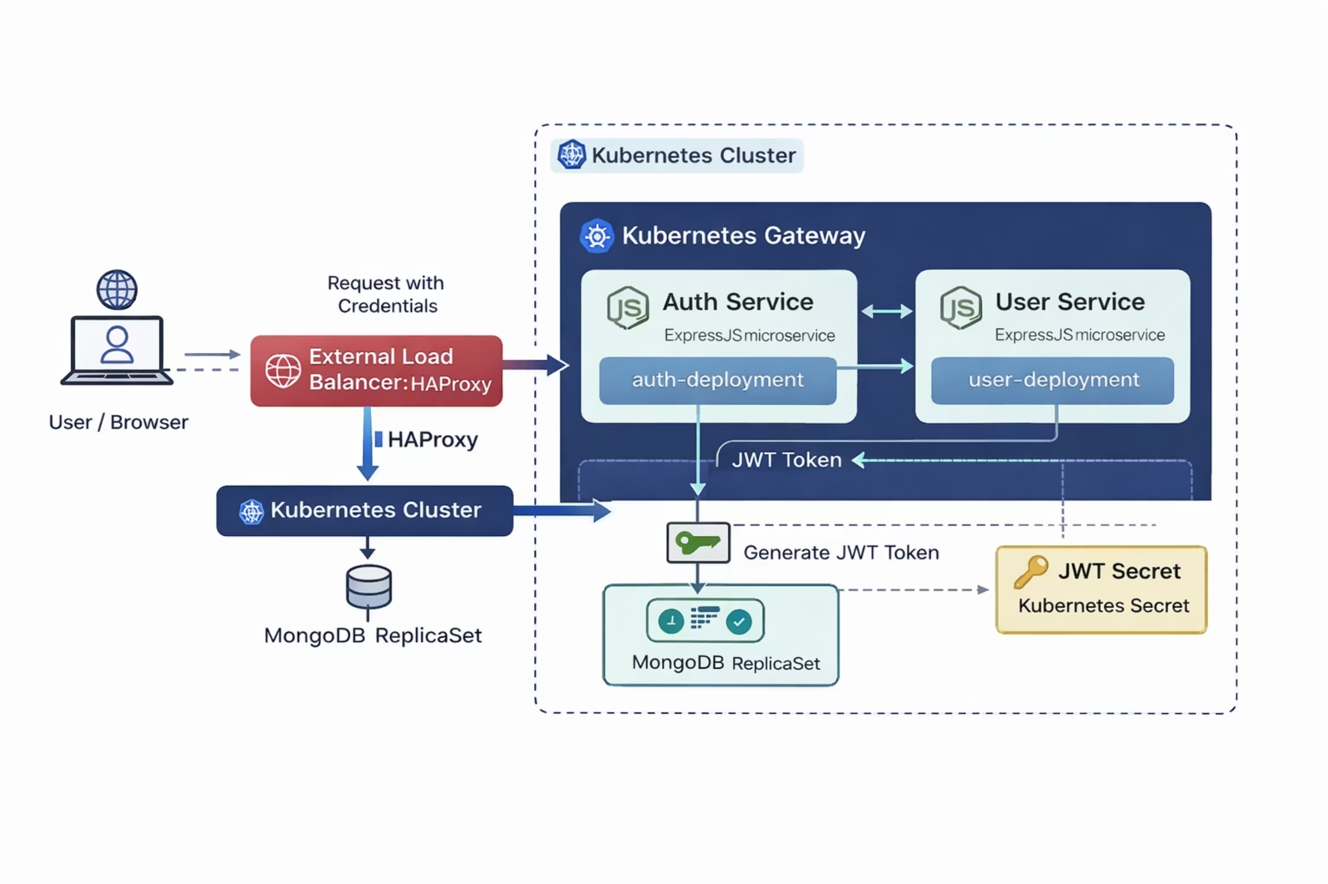

Slide 7




Networking Architecture
User Request
HAProxy
Client initiates connection
External load balancing
Kubernetes Gateway
Target Service
Path-based routing
Service discovery

Slide 8
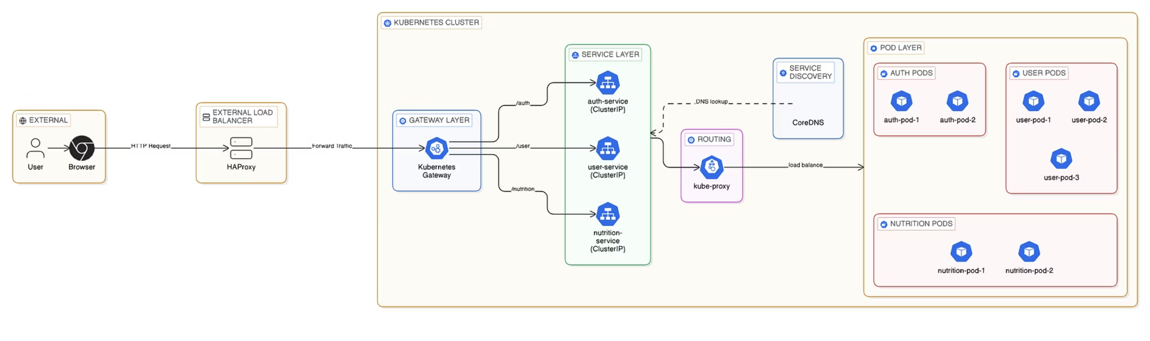

Slide 9
Security & DevOps Pipeline
Kubernetes Secrets
Trivy Image Scanning
Encrypted credential storage for database passwords and API keys
Automated vulnerability scanning during Docker build process
Image Registry
Centralized container image storage with version tagging

Slide 10
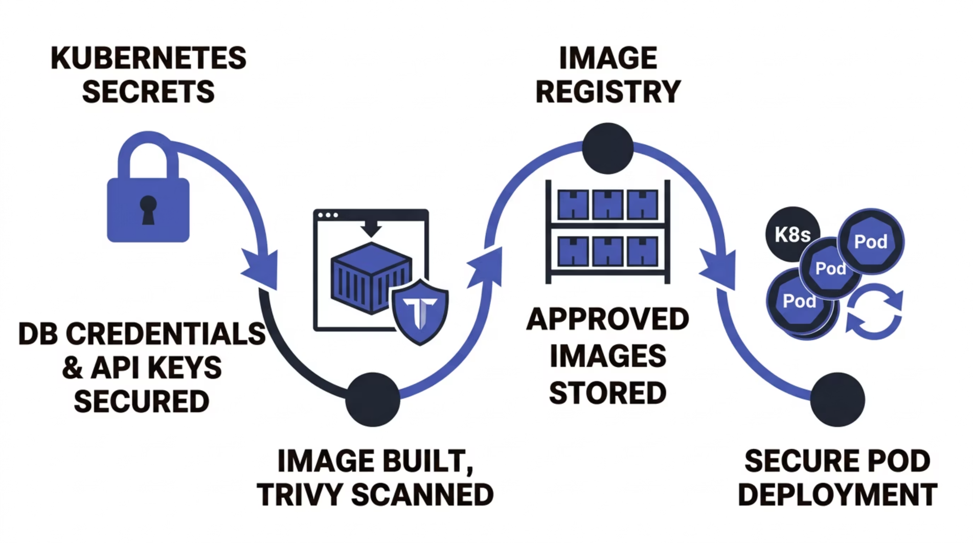


Slide 11

Scaling & Reliability Features
Horizontal Pod Autoscaler
Automatic replica adjustment based on CPU/memory metrics
Liveness Probes
Health checks restart unhealthy containers
Readiness Probes
Traffic routing only to ready pods
Rolling Updates
Zero-downtime deployments with gradual rollout

Slide 12
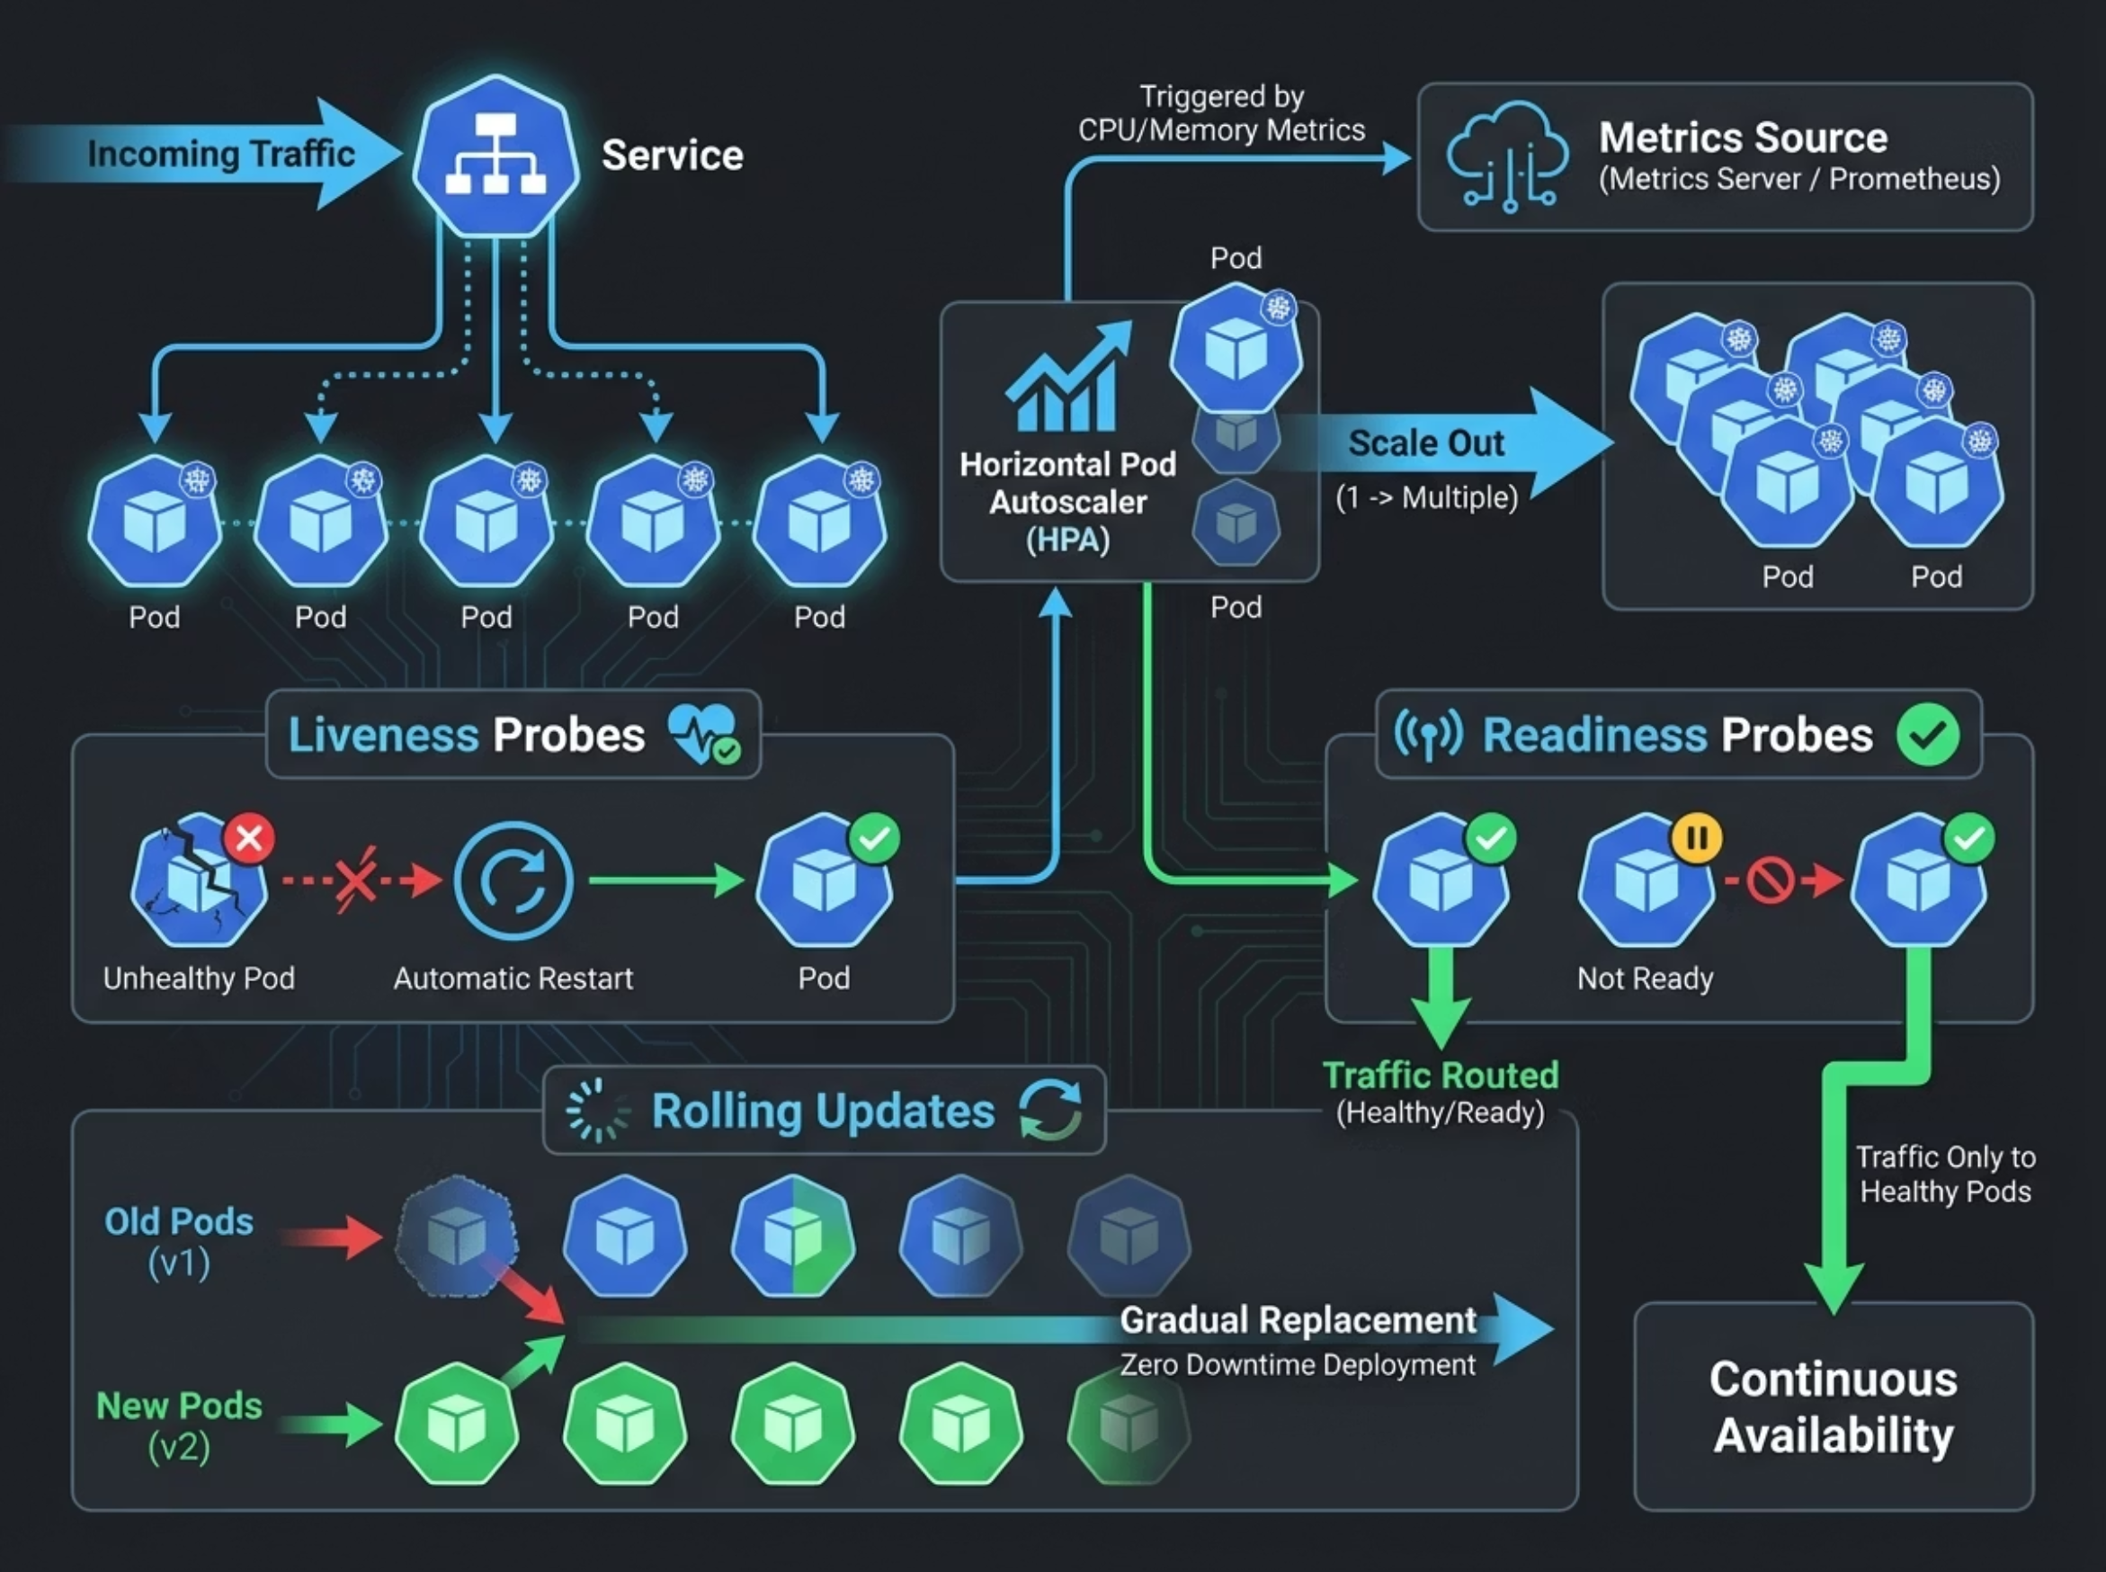

Slide 13

Data Layer Architecture
MongoDB StatefulSet
Redis Caching
Single MongoDB instance via mongo-service StatefulSet
Redis StatefulSet for high-speed data access
Persistent storage with PVC
Structured document storage
ACID transaction support
Session management
Query result caching
Rate limiting counters

Slide 14
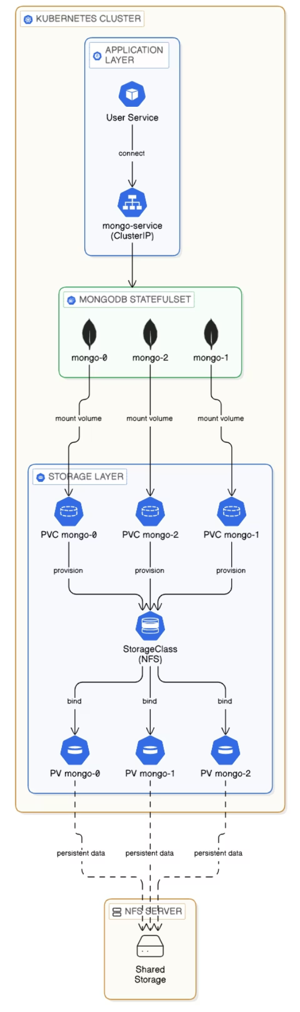

Slide 15
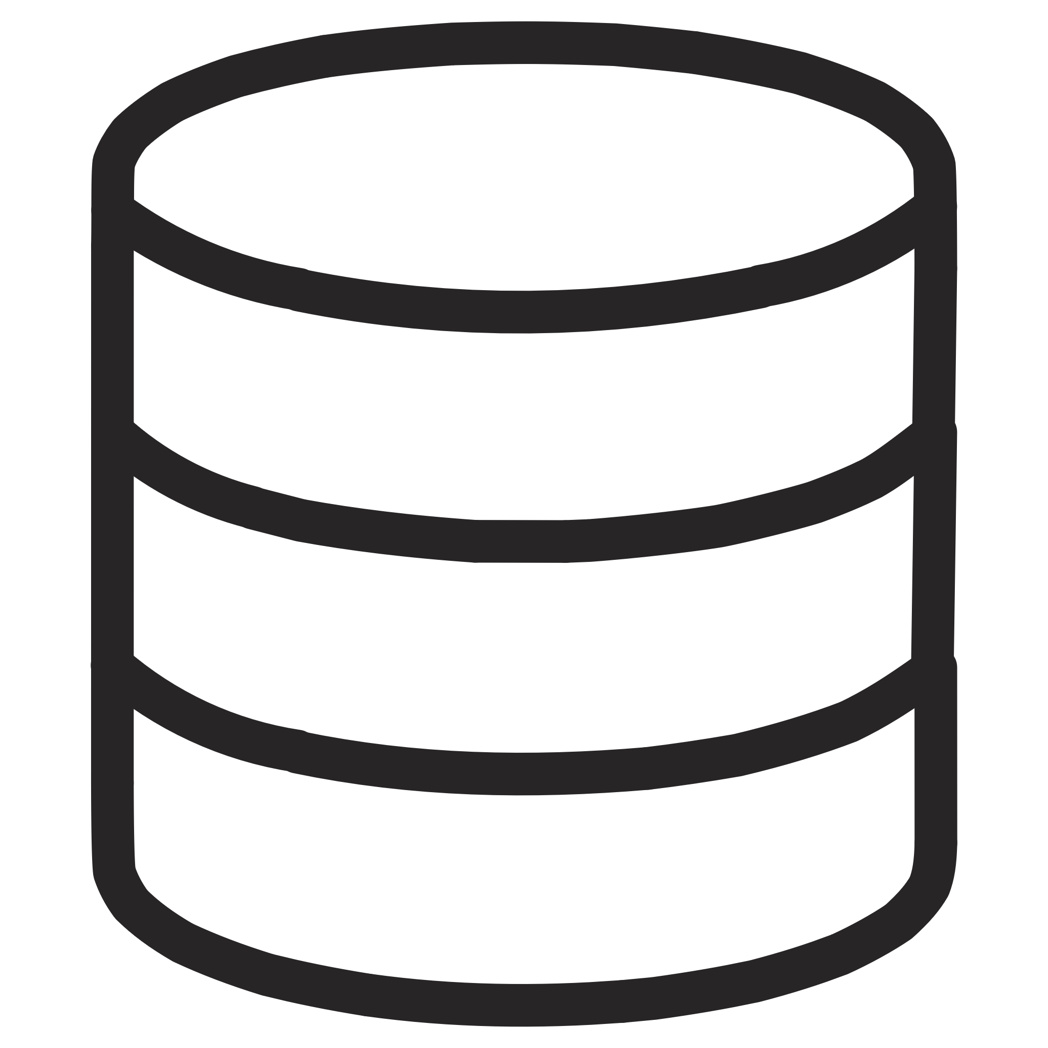



Storage: PVC + NFS Integration
PersistentVolume Claim
Pod Request
Kubernetes binds PVC to available PV
Container requests persistent storage via PVC
NFS Backend
StorageClass Provisioning
Network File System provides shared storage backend
Dynamic volume creation with StorageClass parameters

Slide 16


Monitoring
Prometheus Metrics
Grafana Dashboards
Centralized metrics collection for all services, nodes, and infrastructure components
Visualize performance metrics, request rates, error rates, and system health

Slide 17
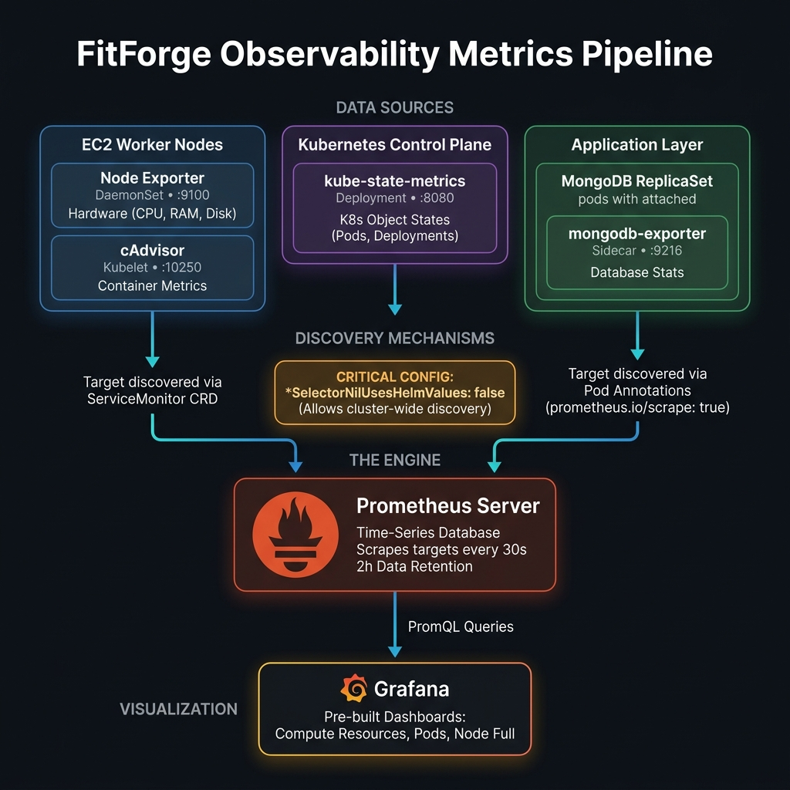

Slide 18
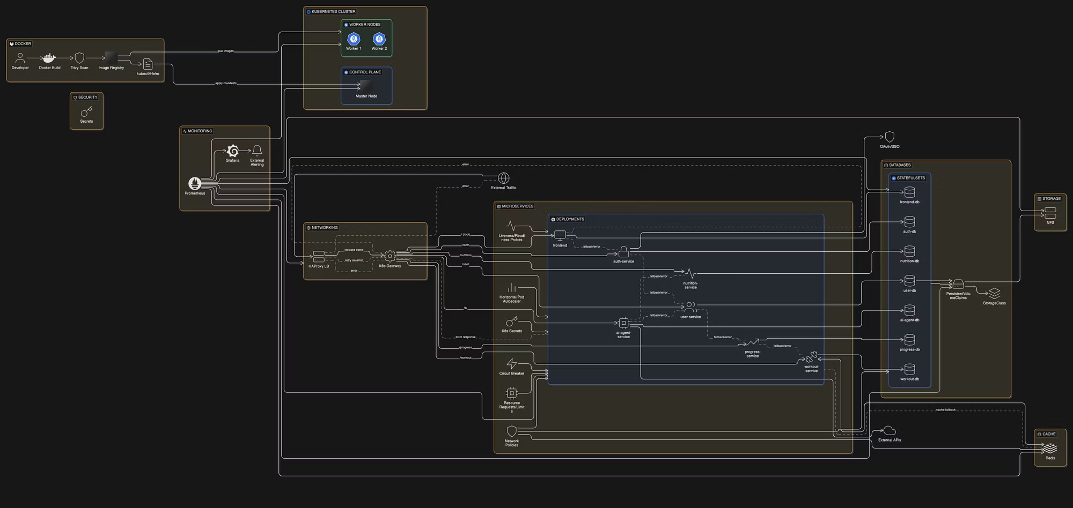

Slide 19
Thank You

