Slide 1
Sales Operations
KPI Reporting & Analytics Dashboard
Automated ETL Pipeline | Statistical Analysis | Executive Reporting
$7.9M
39.2%
14.1%
7
Total Revenue
Avg Win Rate
Avg Quota Attainment
Territories Tracked
Period: Jan 2023 – Dec 2024 | Data Source: CRM + ERP + Marketing DB

Slide 2
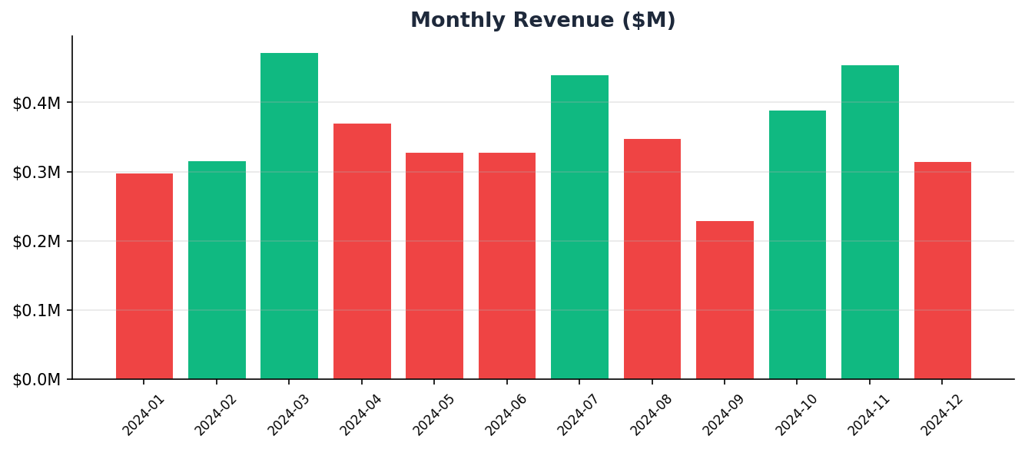
Monthly Revenue Performance
+14.2%
Avg MoM Growth

Slide 3
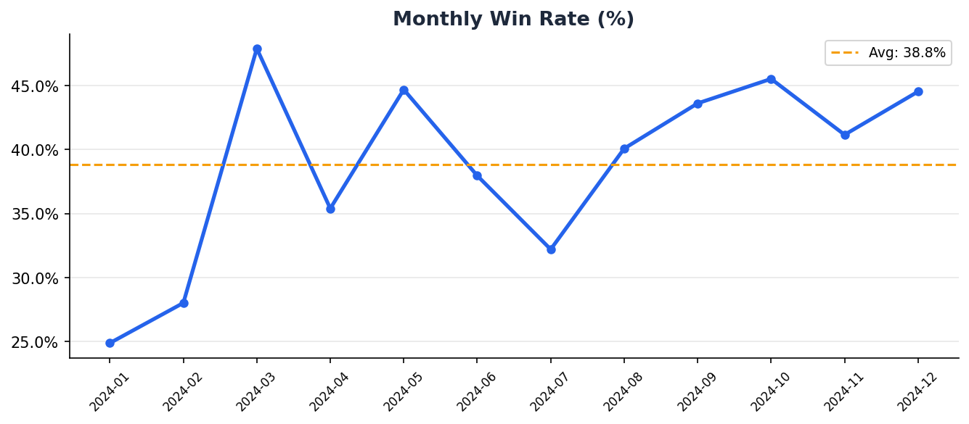
Win Rate Analysis
Top Performer
Castillo
54.4% win rate

Slide 4
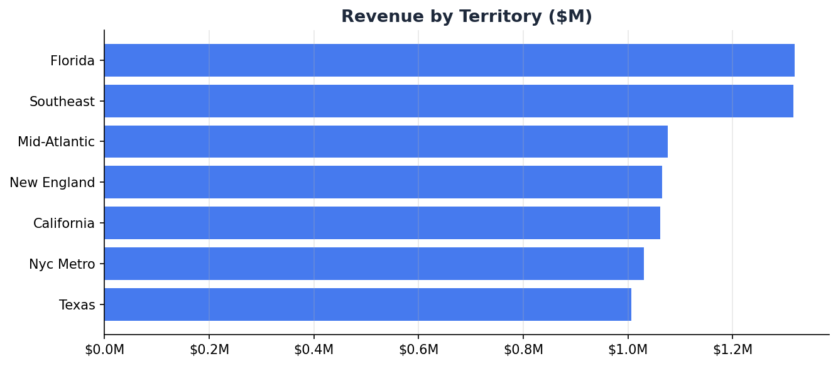
Territory Performance

Slide 5
Key Findings & Recommendations
Win Rate
Average 39.2% — exceeds industry benchmark of 25–30%.
Quota Attainment
Team avg 14.1% — focus coaching on reps below 80%.
Forecast Accuracy
Avg MAPE 10.7% — refine inputs for outlier months.
Sales Cycle
Avg 66 days — identify bottlenecks in Proposal stage.

