Slide 1

Amit Kumar Singh
ITBrainShapers

Slide 2
MVC
Model
  Data layer
View
  Presentation layer
Controller
  Logic layer

Slide 3

Typical Flow
2
Script
Database
Client
4
1
3

Slide 4
MVC Flow
MVC can vary depending on the framework with which you’re working, but generally it works as follows
1. The client sends a page request to the application, either by typing a URL or by clicking a link of some kind. By convention, a typical URL is usually structured like this:
http://{Domain}.com/{Application}/{Controller}/{Action}/{Parameter 1, etc.}
2. The dispatcher script parses the URL structure and determines which controller to execute. It also passes along any actions and parameters to the controller.

Slide 5
3. The function in the controller may need to handle more data than just the parameters forwarded by the dispatcher. It will send database requests to the model script.
4. The model script determines how to interact with the database using the requests submitted by the controller. It may run queries with the database and do all sorts of handy data-sorting instructions.
5. Once the model has pulled any data from or sent data to the database, it returns its output to the controller.

Slide 6
Continue..
6. The controller processes the data and outputs to the view file.
7. The view adds any design or display data to the controller output and sends its output to the client’s browser

Slide 7

WEB SERVER
request for /tasks/index
Response
1
Request
7
TasksController
Layout
{tasks_controller.php}
{tasks.thtml}
Index
Method
ToDo
Method
Tasks
Index
View
2
Index Method Called
5
Index View selected
Done
Method
Undo
Method
View combined with layout
6
Tasks
Index
View
Tasks
Index
View
Views
{index.thtml
todo.thtml
done.thtml}
3
Data Requested
Data returned
4
Model Task {task.php}
DATABASE
Table tasks

Slide 8
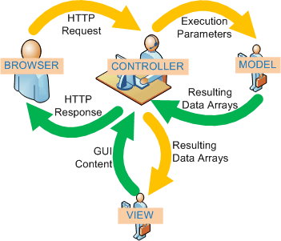
MVC FLOW

Slide 9
CakePHP
A framework for developing applications in PHP
Inspired by Ruby on Rails
Follows MVC design pattern
Convention over configuration

Slide 10
CakePHP follows the MVC software design pattern. Programming using MVC separates your application into three main parts:
The Model represents the application data
The View renders a presentation of model data
The Controller handles and routes requests made by the client

Slide 11
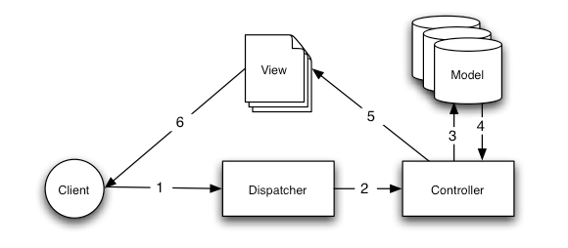
Typical Flow Of CakePHP

Slide 12
CakePHP (or, for short, Cake) is a framework, not a set of libraries, even though it contains dozens of functions and methods that simplify web development much like libraries do.
The benefit of using MVC to develop web sites is that repeated functions or tasks can be separated, thus allowing for quicker edits.

Slide 13
CRUD Operations and the Bake Script
  CRUD operations: create, read, update, and delete
  Stop writing each CRUD operation by hand,.
  Use prebuilt classes provided to do that.
  Cake includes the Bake script, a handy command-line tool that generates editable CRUD code based on your database schema and customized parameters.
Scaffolding
  it figures out how some standard interface views should work with your database and outputs the HTML forms, all without you having to write one bit of HTML.

Slide 14
Helpers
  Cake comes with standard HTML, Ajax, and JavaScript helpers that make creating views much easier
Customizable Elements
  You can customize each of Cake’s features to fit your application. For example, you can bring FCKeditor, the popular WYSIWYG editor for web browsers, into Cake as a plug-in.
  Using customized helpers, you can bring all the functionality of FCKeditor into your Cake application and actually trim out extra lines of PHP code to get it working.

Slide 15
Other Features
Cake offers, its repository of other powerful resources such as built-in validation
access control lists (ACLs)
data sanitization(Data Sanitization is the process of making sensitive information in non-production databases safe for wider visibility.)
security and session handling components
view caching

Slide 16
CakePHP Framework
app/
  config/
  controllers/
  models/
  plugins/
  tmp/
  vendors/
  views/
  webroot/
cake/
  config/
  docs/
  libs/
vendors/

Slide 17
The app folder will be where you work your magic: it’s where your application’s files will be placed.
The cake folder is where we’ve worked our magic. Make a personal commitment not to edit files in this folder. We can’t help you if you’ve modified the core.
Finally, the vendors folder is where you’ll place third-party PHP libraries you need to use with your CakePHP applications.

Slide 18
Folder | What it Contains
config | Holds the (few) configuration files CakePHP uses. Database connection details, bootstrapping, core configuration files and more should be stored here.
controllers | Contains your application’s controllers and their components.
locale | Stores string files for internationalization.
models | Contains your application’s models, behaviors, and datasources.
plugins | Contains plugin packages.

Slide 19
tmp | This is where CakePHP stores temporary data. The actual data it stores depends on how you have CakePHP configured, but this folder is usually used to store model descriptions, logs, and sometimes session information. Make sure that this folder exists and that it is writable, otherwise the performance of your application will be severely impacted. In debug mode, CakePHP will warn you if it is not the case.
vendors | Any third-party classes or libraries should be placed here. Doing so makes them easy to access using the App::import('vendor', 'name') function. Keen observers will note that this seems redundant, as there is also a vendors folder at the top level of our directory structure. We'll get into the differences between the two when we discuss managing multiple applications and more complex system setups.
views | Presentational files are placed here: elements, error pages, helpers, layouts, and view files.
webroot | In a production setup, this folder should serve as the document root for your application. Folders here also serve as holding places for CSS stylesheets, images, and JavaScript files.

Slide 20
Controller Extension
A Component is a class that aids in controller logic. If you have some logic you want to share between controllers (or applications), a component is usually a good fit.
Controllers are also fitted with callbacks.

Slide 21
View Extension
A Helper is a class that aids in view logic. Much like a component used among controllers, helpers allow presentational logic to be accessed and shared between views.
One of the core helpers, AjaxHelper, makes Ajax requests within views much easier.

Slide 22
Model Extension
Behaviors work as ways to add common functionality between models.
models are featured with callbacks as well:
beforeFind()
afterFind()
beforeValidate()
beforeSave()
afterSave()
beforeDelete()
afterDelete()

Slide 23
Callbacks available include:
beforeFilter(), executed before any controller action logic
beforeRender(), executed after controller logic, but before the view is rendered
afterFilter(), executed after all controller logic, including the view render. There may be no difference between afterRender() and afterFilter() unless you’ve manually made a call to render() in your controller action and have included some logic after that call.

Slide 24
Application Extension
Controllers, helpers and models each have a parent class you can use to define application-wide changes.
AppController (located at /app/app_controller.php),
AppHelper (located at /app/app_helper.php) and
AppModel (located at /app/app_model.php)
are great places to put methods you want to share between all controllers, helpers or models.

Slide 25
Convention Over Configuration
File and ClassName Convention
In general, filenames are underscored while classnames are CamelCased. So if you have a class MyStudentClass, then in Cake, the file should be named my_student_class.php.

Slide 26
Model and Database Convention
Model classnames are singular and CamelCased.
Ex:-Person, BigPerson, and ReallyBigPerson
Table names corresponding to CakePHP models are plural and underscored.
The underlying tables for the above mentioned models would be people, big_people, and really_big_people, respectively.

Slide 27
Controller Convention
Controller classnames are plural, CamelCased, and end in Controller.
PeopleController and LatestArticlesController are both examples of conventional controller names.

Slide 28
Continue..
he first method you write for a controller might be the index() method.
When a request specifies a controller but not an action, the default CakePHP behavior is to execute the index() method of that controller.

Slide 29
View convention
View template files are named after the controller functions they display, in an underscored form. The getReady() function of the PeopleController class will look for a view template in /app/views/people/get_ready.ctp.

Slide 30
Example
Here’s a final example that ties the conventions
Database table: "people"
Model class: "Person", found at /app/models/person.php
Controller class: "PeopleController", found at /app/controllers/people_controller.php
View template, found at /app/views/people/index.ctp

Slide 31
Flow
CakePHP knows that a request to http://example.com/people/ maps to a call on the index() function of the PeopleController, where the Person model is automatically available (and automatically tied to the ‘people’ table in the database), and renders to a file.
None of these relationships have been configured by any means other than by creating classes and files that you’d need to create anyway.

Slide 32
Naming conventions
http://book.cakephp.org/view/328/Cake-Conventions
Table names: “notes”, “my_notes”
Model: “mynote.php”->“MyNote”
Controller: “my_notes_controller.php”-> “MyNotesController”
Views named after actions, organised in folders according to the related controller:
  views/my_notes/index.thtml
  views/my_notes/add.thtml

Slide 33
table name -students
Model
class Student save as student.php
controller
class StudentsController -students_controller.php
view
Create one folder in views folder named as controller name
foldername =students
view file extendsion must be .ctp or .thtml

Slide 34
Paths + parameters
Cake uses url to pass parameters
Apache mod_rewrite converts url into scriptname and parameters
http://www.example.com /controllername/action/param1/param2/…
Uses paths to figure out views
Views stored in “controllername” folder

Slide 35
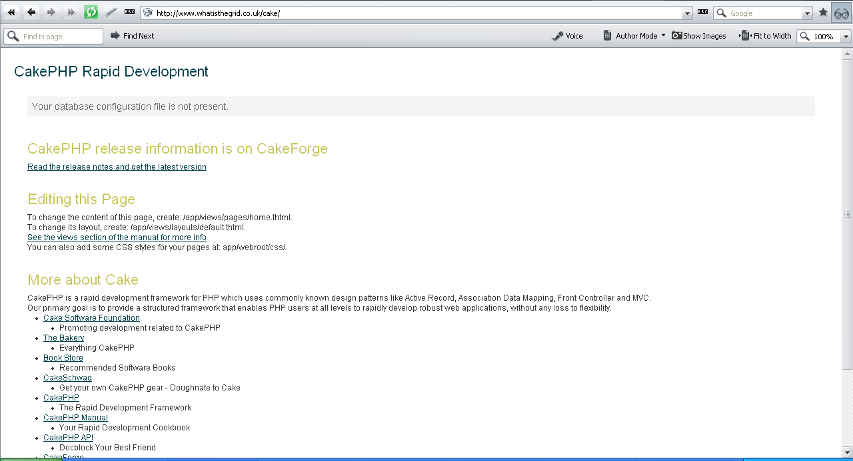

Slide 36
OOP in PHP
Limited support in PHP <5
Much better support in PHP >=5
Simpler than Java OOP
class SomeClass {
  function func() {
  ….
  }
  }
  SomeClass s = new someClass();
  s->func();

Slide 37
Hello world… again
Remember application is separated into model / view / controller
Model:
<?php
/* /app/model/hello.php */
class Hello extends AppModel {
var $name = 'Hello';
var $useTable = false;
}
?>

Slide 38
Hello world… again
View:
<!--
/* /app/views/index.thtml */
-->
<hr size=1/>
<h1><?php echo $data ?></h1>
<hr size=1/>

Slide 39
Controller:
<?php
/* app/controller/hello_controller.php */
class HelloController extends AppController {
var $name = "Hello";
var $uses = 'Hello';
function index() {
$data = 'Hello world!';
$this->set('data', $data);
}
}
?>

Slide 40
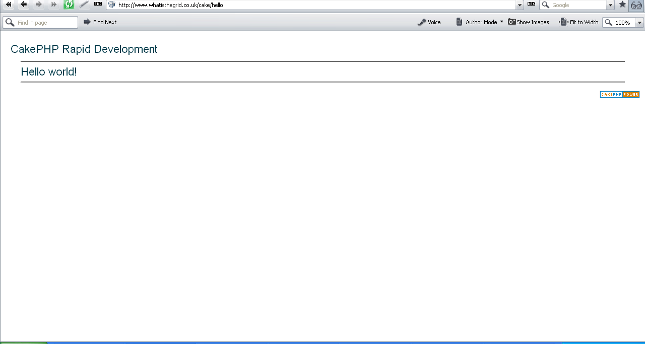

Slide 41
Simple DB table app
An online contact list
We want to add, edit, view and delete names and phone numbers
Uses a single table

Slide 42
Model
Add table to DB:
CREATE TABLE cake_contacts (
id INT UNSIGNED AUTO_INCREMENT PRIMARY KEY,
name VARCHAR(50),
number VARCHAR(50),
created DATETIME DEFAULT NULL,
modified DATETIME DEFAULT NULL
);

Slide 43
Model
Add a script called contact.php to models/
<?php
class Contact extends AppModel
{
var $name = ‘Contact';
}
?>

Slide 44
View
views/contacts/index.thtml
  <h1>Contact list</h1>
  <p>
  <?php echo $html->link('Add Contact', 'contacts/add') ?>
  </p>
  <table>
  <tr>
  <th>Id</th>
  <th>Name</th>
  <th>Number</th>
  </tr>

Slide 45
View
views/contacts/index.thtml cntd…
  <?php foreach ($contacts as $contact): ?>
  <tr>
  <td><?php echo $contact['Contact']['id']; ?></td>
  <td>
  <?php
  echo $html->link($contact['Contact'][name'],
  "contacts/view/{$contact['Contact']['id']}")?>
  [<?php echo $html->link('Edit',
  "contacts/edit/{$contact['Contact']['id']}")?>,
  <?php echo $html->link('Delete',
  "contacts/delete/{$contact['Contact']['id']}",
  null, 'Sure?')?>]
  </td>
  <td><?php echo $contact['Contact']['created']; ?>
  </td>
  </tr>
  <?php endforeach; ?>
  </table>

Slide 46
View
views/contacts/view.thtml
  <h1><?php echo $data['Contact']['name']?></h1>
  <p><small>
  Created: <?php echo $data['Contact']['created']?>
  </small></p>
  <p><?php echo $data['Contact']['number']?></p>

Slide 47
View
views/contacts/add.thtml
  <h1>Add Contact</h1>
  <form action="<?php echo $html->url("contacts/add"); ?>" method="post">
  <p>Name:
  <?php echo $html->input('Contact/name', array('size' => '40')) ?>
  </p>
  <p>Number:
  <?php echo $html->input('Contact/number', array('size' => '40')) ?>
  </p>
  <p><?php echo $html->submit('Save') ?>
  </p>
  </form>

Slide 48
View
views/contacts/edit.thtml
  <h1>Edit Contact</h1>
  <form action="<?php echo $html->url('/contacts/edit')?>" method="post">
  <?php echo $html->hidden('Contact/id'); ?>
  <p>Name:
  <?php echo $html->input('Contact/name',
  array('size' => '40')) ?>
  </p>
  <p>Number:
  <?php echo $html->input('Contact/number',
  array('size' => '40')) ?>
  </p>
  <p>
  <?php echo $html->submit('Save') ?>
  </p>
  </form>

Slide 49
Controller
/app/controllers/notes_controller.php:
<?php
class ContactsController extends AppController
{
var $name = 'Contacts';
function index() {
$this->set('contacts', $this->Contact->findAll());
}
function view($id) {
$this->Contact->id = $id;
$this->set('data', $this->Contact->read());
}

Slide 50
Controller
/app/controllers/notes_controller.php:
function add() {
if (!empty($this->data['Contact'])) {
if($this->Contact->save($this->data['Contact'])) {
$this->flash('Your contact has been added.',
‘/contacts/');
}
}
}
function delete($id) {
if ($this->Contact->del($id)) {
$this->flash('The contact with id: '.$id.' has been deleted.', ‘/contacts/');
}
}

Slide 51
Controller
/app/controllers/notes_controller.php:
function edit($id = null) {
if (empty($this->data['Contact'])) {
$this->Contact->id = $id;
$this->data = $this->Contact->read();
} else {
if($this->Contact->save($this->data['Contact'])) {
$this->flash('Your contact has been updated.',‘/contacts/');
}
}
}
}
?>

Slide 52
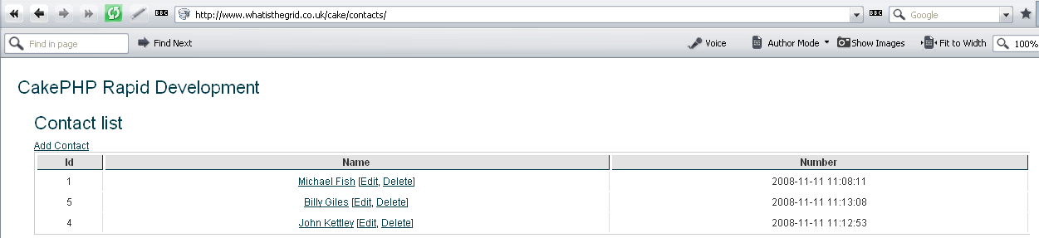
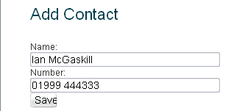

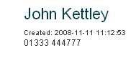
Resulting application
…../cake/contacts/add
…../cake/contacts/edit/1
…../cake/contacts/view/4

Slide 53
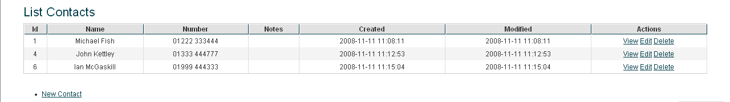
Other benefits
Bake script – command line script generator
Uses LAMP common web platform
  (Linux, Apache, MySQL and PHP)
Helpers for HTML, Forms, Pagination, AJAX, Javascript, XML, RSS
Scaffolding (no need for views)
  Create controller with var $scaffold;

Slide 54
Disadvantages
Mainly due to the limitations of PHP
  Clumsy OOP
  Access data through arrays not classes (which RoR does) – more code in view
Create tables in separate SQL
Not well documented yet

