Slide 1
Digital Arts Spring 2018 Midterm Project The July 7 Meet
117270910003 Ding Yi

Slide 2
Project: The July 7 Meet
Idea
Inspired by an ancient Chinese love story, The Cowherd and the Girl Weaver
Qixijie, the Chinese Valentine’s Day on July 7 (Chinese lunar calendar), is actually formed from this story
Designed the projects in 7 steps

Slide 3
Project: The July 7 Meet
Schedule
Day 0: Design and prepare the materials
Day 1: Set the Galaxy
Day 2: Insert images the Cowherd and the Girl Weaver
Day 3: Put in the text “Day: XXX”
Day 4: Make the Cowherd and the Girl Weaver move
Day 5: Check the collisions of the Cowherd and the Girl Weaver
Day 6: Set the countdown
Day 7: Set the appearance of the image They Meet

Slide 4
Project: The July 7 Meet
Story
The Cowherd lived in a struggling life with an old ox
One day, informed by the ox, the cowherd went to a secret pond where the beautiful daughters of the Emperor of Heaven bathed
If the cowherd stole one of their clothes, the girl would be unable to escape and become his wife
The girl happened to be the most beautiful daughter of the Emperor of Heaven
They fell in love with each other, and soon had two babies
However, when the Queen Mother knew that, they were separated by the Galaxy
Their sadness made the Queen Mother felt guilty, so she agreed to let them see each other on July 7 on the lunar calendar each year

Slide 5


1
Day: 0
3
6
2&4
&5
2&4
&5

Slide 6
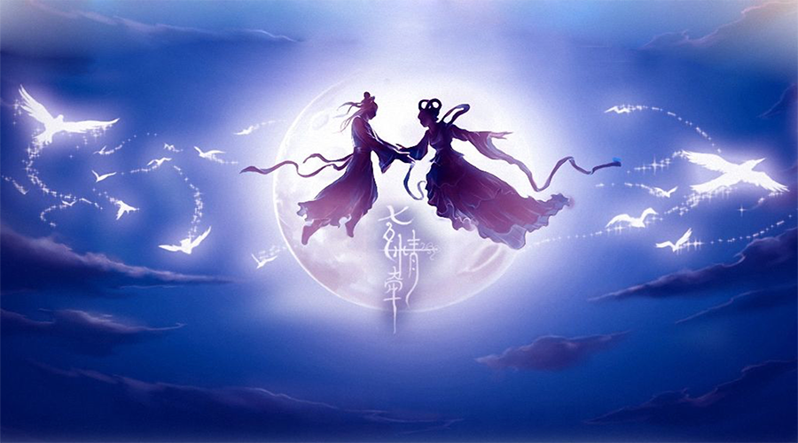
7

Slide 7
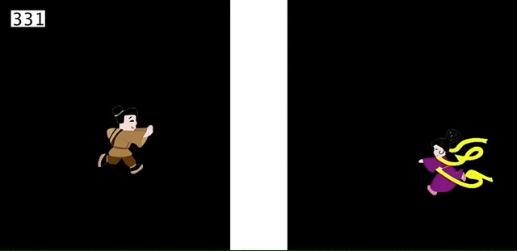
Project: The July 7 Meet
Recording

Slide 8
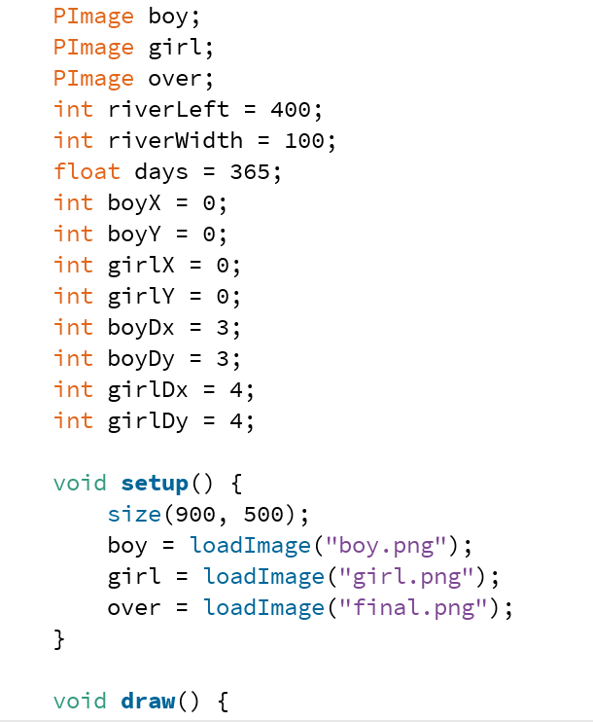
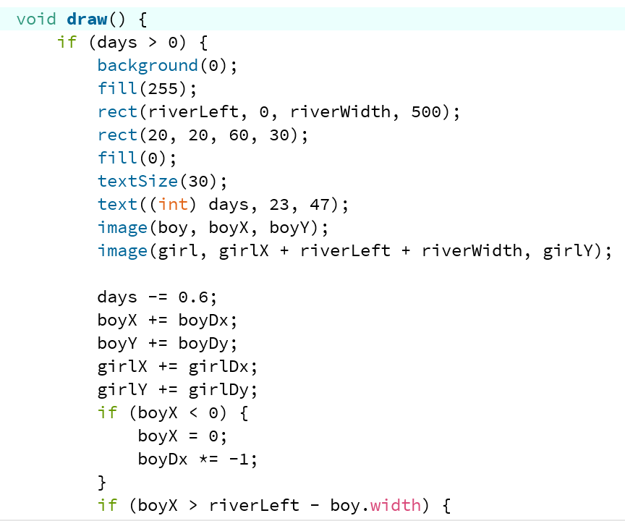
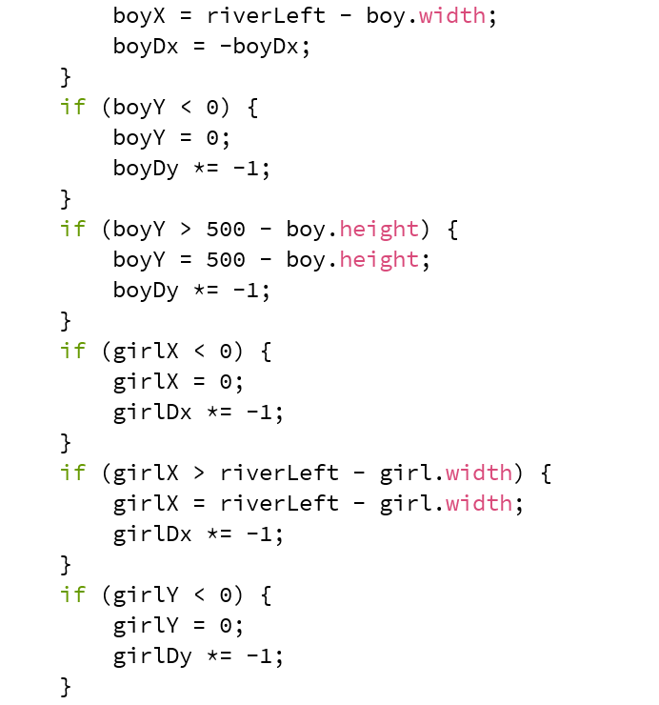
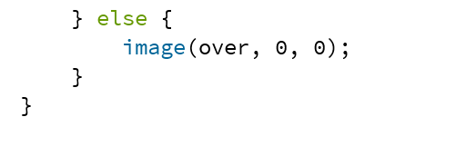
Project: The July 7 Meet
Coding

