Slide 1
TECHNICAL PORTFOLIO & RESEARCH SHOWCASE
FITRA NURMAYADI
Computer & Embedded Systems Engineer
CORE ENGINEERING DISCIPLINES
• 1. Edge AI & Hardware Benchmarking (Hailo-8L, Jetson Orin Nano, On-Chip INT8 LLMs)
• 2. Robotics & Autonomous Control (6-DOF Kinematics, Dynamic Inverted Pendulums, BLDC)
• 3. Reinforcement Learning & Simulation (PyBullet 6-DOF VTVL, MuJoCo, PPO/SAC/TD3)
• 4. Embedded Systems & Custom Hardware (ESP32-S3/C3, FreeRTOS, LoRa, CAN-Bus, KiCad PCBs)
🌐 fitranurmayadi.github.io | 💻 github.com/fitranurmayadi

Slide 2
CORE COMPETENCIES
Engineering Overview & Technical Architecture
Bridging on-device intelligence, high-frequency dynamic control, and custom PCB hardware.
Edge AI & NPU Benchmarking
Robotics & Autonomous Systems
RL & Physics Simulation
Custom Hardware & IoT
• Empirical benchmarking across SBCs & NPUs
• Hailo-8L (13 TOPS), Jetson Orin Nano, RK3588
• 1.84M INT8 Generative LLM on ESP32-S3
• Flash-mapped RAG & Vector Embeddings
• Inference latency, wattage & thermal profiling
• 3-DOF Manipulator with YOLOv11 Visual Sorting
• Inverse Kinematics & coordinate transformation
• Two-Wheeled Self-Balancing Robot (BLDC)
• High-speed optical quadrature velocity loops
• FreeRTOS dual-core multitasking control loops
• PyBullet 6-DOF Falcon 9 VTVL Simulator
• Aerodynamic crosswinds & TVC gimbal dynamics
• Deep RL algorithms: PPO, SAC, TD3, DDPG
• MuJoCo dynamic balancing environments
• Sim-to-Real policy transfer & ONNX deployment
• KiCad 2-layer PCB layout & component assembly
• ideaSTEAM XB1: ESP32 development board
• Automotive ISO 11898 CAN-Bus telemetry
• Long-range solar LoRa wireless sensor networks
• Industrial power & environmental telemetry

Slide 3

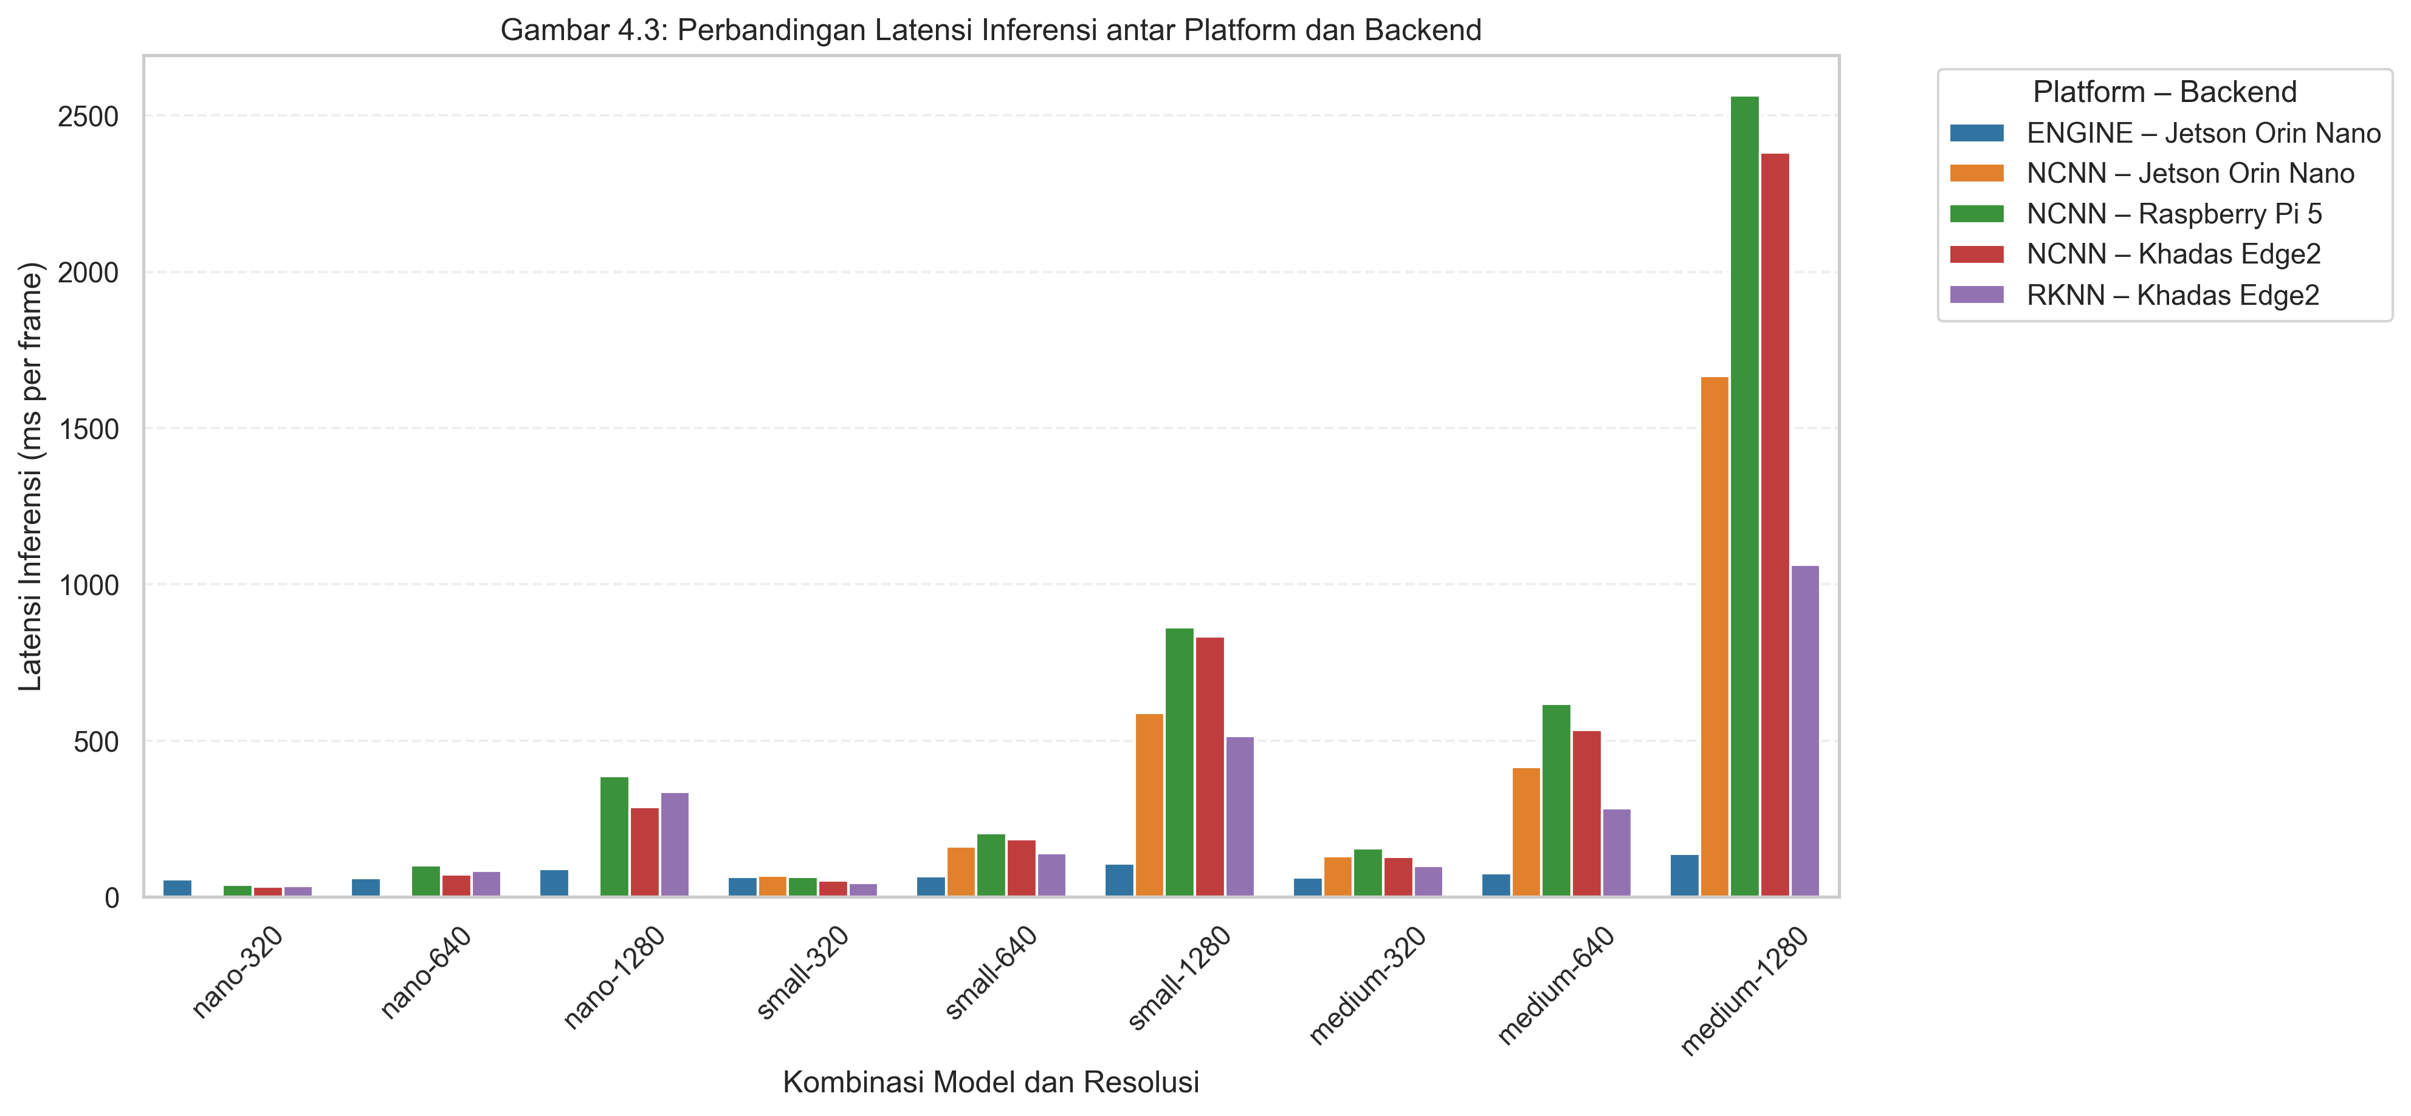
FLAGSHIP RESEARCH · MASTER'S THESIS
YOLO11-OBB SBC & Edge NPU Benchmark Suite
Empirical cross-platform evaluation of oriented object detection on edge silicon.
RESEARCH HIGHLIGHTS & ARCHITECTURE
▶ Evaluated Hardware Platforms:
Raspberry Pi 5 (Cortex-A76), Raspberry Pi AI Kit with Hailo-8L NPU (13 TOPS via PCIe Gen2), NVIDIA Jetson Orin Nano (40 TOPS GPU/NVDLA), and Khadas Edge 2 (RK3588S, 6 TOPS NPU).
▶ Model & Workload:
YOLO11-OBB (Oriented Bounding Box) for aerial and arbitrary-oriented target detection, converted across native runtime backends: Hailo HEF, TensorRT, RKNN, ONNX.
▶ Multi-Metric Empirical Suite:
Evaluated inference latency (ms), frame throughput (FPS), active power draw (Watts via hardware USB power meter), Joules-per-frame energy cost, and thermal throttling under continuous 15-minute load.
▶ Key Conclusion:
Dedicated NPUs (Hailo-8L & RK3588) provide up to 5.4x higher energy efficiency (FPS/Watt) compared to standard host CPU inference while maintaining sub-20ms inference latency.

Slide 4
EDGE AI & EMBEDDED INTELLIGENCE
ESP32 Micro-LM: 1.84M On-Chip Generative Language Model
100% disconnected on-device token generation with flash-mapped RAG on ESP32-S3.
HARDWARE CONSTRAINTS
• SoC Target: ESP32-S3 (Dual-Core Xtensa LX7 @ 240 MHz)
• Octal PSRAM: 8MB high-speed memory for KV-cache and intermediate activations
• SPI Flash: 16MB mapped via MMU for zero-copy weight execution
• Power Envelope: 3.3V, < 240mA active consumption
• Firmware Framework: Pure ESP-IDF (C++) with FreeRTOS dual-core task affinity
QUANTIZATION & PIPELINE
• Parameter Scale: 1.84M parameters customized for domain-specific telemetry queries
• INT8 W8A32 Quantization: Weights stored as signed 8-bit integers, 32-bit accumulators to prevent overflow
• Dual-Core Pipelining: Core 0 handles token decoding & attention compute; Core 1 handles stream buffering & UART/OLED display
• SIMD Acceleration: Utilizing Xtensa PIE (Processor Instruction Extension) for vector dot-product acceleration
FLASH RAG & BENEFITS
• Flash-Mapped Vector Index: Knowledge base encoded into compact INT8 embeddings in flash memory partition
• Zero Cloud Dependency: Operates completely offline in air-gapped industrial, defense, or wilderness environments
• Zero Subscription / API Cost: No OpenAI or cloud vendor lock-in
• Sub-Millisecond Retrieval: Cosine similarity search over sensor datasheets and device error codes
• Immediate Privacy: Raw data never leaves local chip boundary

Slide 5
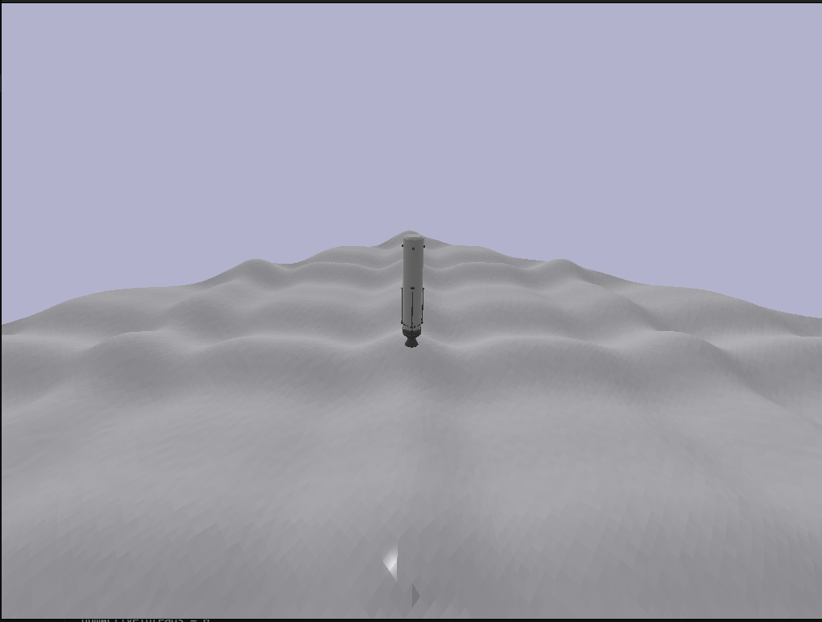
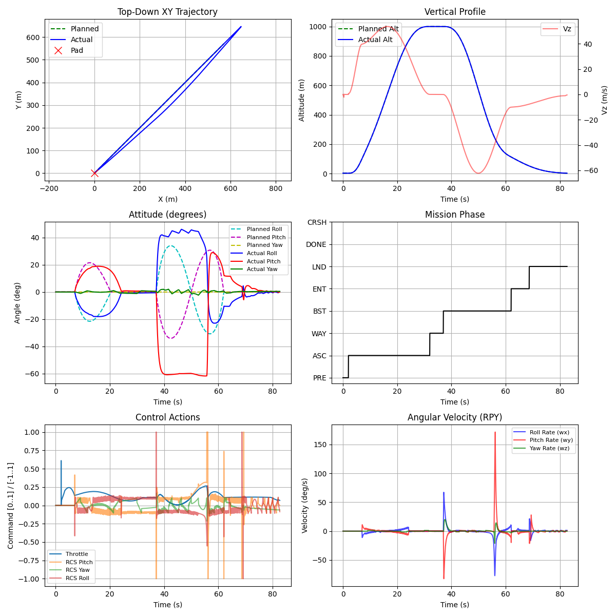
PHYSICS SIMULATION & REINFORCEMENT LEARNING
RocketLander3D: 6-DOF Falcon 9 VTVL Flight Simulation & RL
Continuous 6-DOF rocketry flight simulator with thrust vectoring & aerodynamic crosswinds.
DYNAMICS & CONTROL POLICY
▶ High-Fidelity 6-DOF Physics:
Modeled in PyBullet & Farama Gymnasium. Accounts for variable mass depletion as propellant burns, changing center of mass (CoM), and moment of inertia tensor over time.
▶ Actuation & Aerodynamics:
Simulates Thrust Vector Control (TVC) 2-axis engine gimbal deflection (+/- 15 deg), cold gas thruster attitude control, dynamic atmospheric crosswinds, and landing leg ground contact mechanics.
▶ Reinforcement Learning Algorithms:
Trained continuous action-space neural policies: Proximal Policy Optimization (PPO) and Soft Actor-Critic (SAC) against reward formulations prioritizing fuel conservation, upright attitude, and touchdown velocity < 1.0 m/s.
▶ Baseline Benchmarking:
Compared RL policy convergence against classical Cascaded PID and LQR controllers under turbulent wind shear.

Slide 6
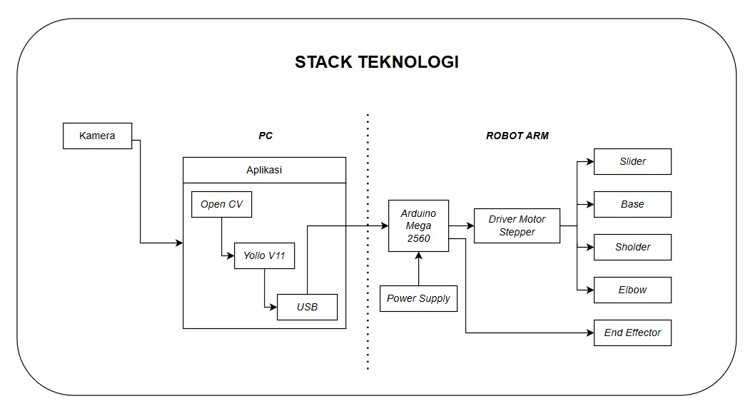
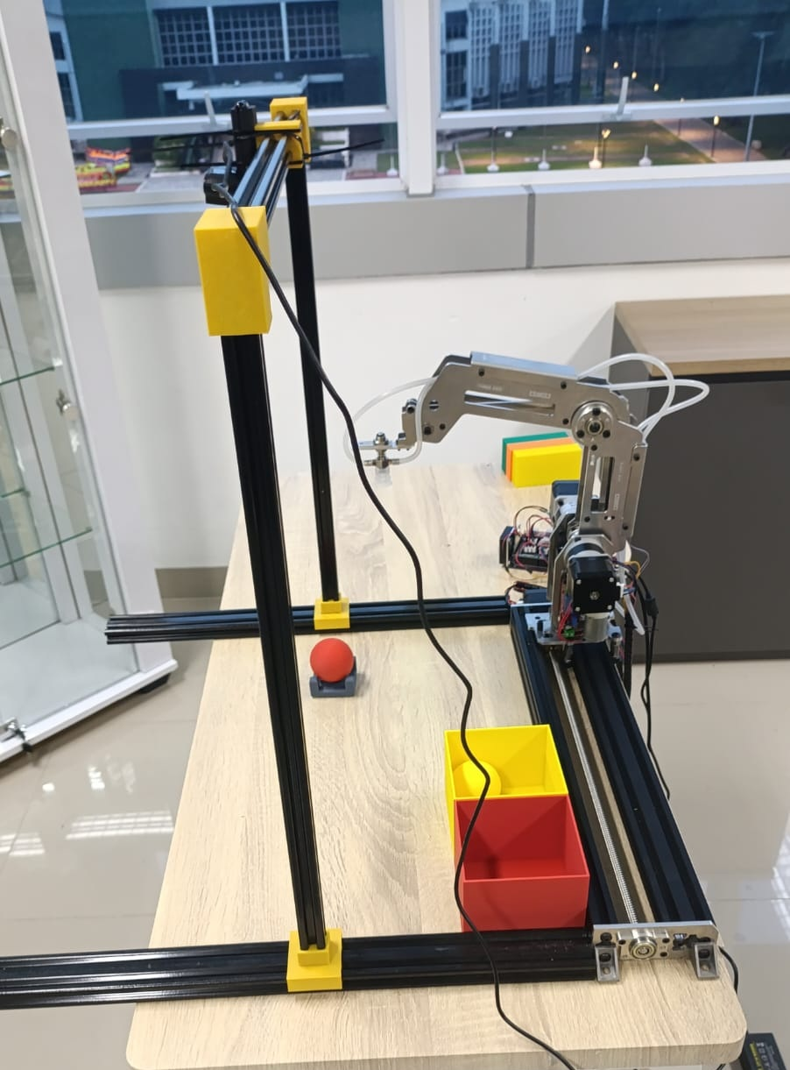
ROBOTICS & COMPUTER VISION
3-DOF Robotic Arm with YOLOv11 Visual Sorting
Integration of real-time machine vision, inverse kinematics, and multi-servo actuation.
HARDWARE & VISION PIPELINE
▶ Robotic Manipulator Hardware:
Heavy-duty aluminum alloy chassis with 3 degrees of freedom plus end-effector gripper. Powered by high-torque metal-gear servos (MG996R / DS3218) driven by a dedicated 16-channel PCA9685 I2C PWM driver.
▶ Vision Pipeline (YOLOv11):
Overhead camera stream processed via YOLOv11 inference for real-time item classification and bounding box localization.
▶ Spatial Coordinate Mapping:
Calibrated OpenCV homography and perspective transformation mapping 2D image pixel coordinates (u, v) into physical millimeter coordinates (X, Y, Z) on the conveyor sorting plane.
▶ Inverse Kinematics Solver:
Geometric and trigonometric IK solver executing on the embedded controller, converting target (X, Y, Z) coordinates into precise joint angles (theta_1, theta_2, theta_3) with trajectory smoothing.

Slide 7
ROBOTICS & CONTROL SYSTEMS
Robotics & Dynamic Control Highlights
High-frequency embedded balance loops, competitive robotics, and kinematic platforms.
TWSBR Nidec 24H BLDC Hardware
• Dynamic inverted-pendulum balancing robot
• Dual Nidec 24H brushless DC motors with optical quadrature encoders
• MPU6050 6-axis IMU complementary sensor fusion filter
• High-frequency FreeRTOS dual-core balance loop
• Live WiFi / OSC telemetry for state debugging
Competition Line Follower Robot
• 7-channel front phototransistor array with LM339 comparators
• High-RPM coreless DC motors with magnetic hall encoders
• Non-volatile EEPROM calibration for on-track PID tuning
• Dynamic cornering braking & acceleration feedforward
Wi-Fi Combat Sumo Robot
• High-torque differential drive combat platform on ESP32
• On-board asynchronous web server (ESPAsyncWebServer)
• Zero-latency responsive touch GUI with dual fader controls
• SoftAP local wireless network with failsafe timeout
Quadruped Spider & Myo EMG Arm
• 8-DOF spider robot with parametric gait kinematics
• Myo EMG armband decoding muscle biopotential signals
• Prosthetic hand teleoperation via gesture classification
• Smooth servo interpolation avoiding high current spikes

Slide 8
RL ALGORITHMS & DYNAMICS
Reinforcement Learning & Physics Simulation
Evaluating continuous control algorithms in rigorous physics simulation engines.
twsbr-rl: Inverted Pendulum RL Benchmark
▶ Simulated Physics Engines:
Implemented across both MuJoCo and PyBullet for high-speed parallel rollouts.
▶ Continuous Deep RL Benchmark:
Benchmarked Soft Actor-Critic (SAC), Proximal Policy Optimization (PPO), and Twin Delayed DDPG (TD3) under random impulse disturbances.
▶ Baseline Comparison:
Evaluated against analytical Linear Quadratic Regulator (LQR) and Cascaded PID controllers.
▶ Observation & Reward Space:
Includes tilt angle (theta), angular velocity (theta_dot), cart position (x), linear velocity (x_dot), and motor torque penalization.
▶ Edge Deployment Pipeline:
Trained policy networks exported to ONNX format for on-device inference on embedded ARM/ESP32 microcontrollers.
LunarLander3D & Sim-to-Real Methodologies
▶ 3D Continuous Low-Gravity Control:
Gymnasium environment simulating descent, attitude orientation, thruster throttling, and leg contact in lunar gravity (1.62 m/s²).
▶ Domain Randomization:
Perturbing friction coefficients, ground slope, sensor noise, and engine response lag during training to prevent overfitting.
▶ Multi-Objective Reward Engineering:
Balancing soft landing speed (< 0.5 m/s), low fuel expenditure, vertical alignment, and landing pad touchdown accuracy.
▶ Sim-to-Real Readiness:
Quantizing observation tensors to fixed-point / INT8, ensuring real-time inference latency fits within hardware micro-loop budgets (< 5ms).

Slide 9
EMBEDDED SYSTEMS & HARDWARE CODESIGN
Custom Embedded Hardware, IoT & PCB Engineering
Production-grade microcontrollers, custom PCBs, CAN-bus networks, and wireless telemetry.
ideaSTEAM XB1: Custom ESP32 Dev Board
• Designed 2-layer PCB in KiCad with USB-C CP2102 auto-flasher
• High-efficiency LDO regulator circuit with reverse polarity protection
• Breadboard-friendly standardized 0.1" breakout headers
• Tested and deployed for educational STEM & robotics prototyping
Electric Vehicle (EV) CAN-Bus Telemetry
• Automotive ISO 11898 standard implementation via MCP2515 transceiver
• Real-time battery pack thermals, cell voltages, and motor RPM telemetry
• High-reliability differential signaling rejecting EMI/noise
• Local TFT dashboard visualization and alert trigger thresholds
ESP32-C3 RISC-V AC Power Monitoring
• Isolated AC power meter via PZEM-004T optical UART isolation
• Monitors active power (W), voltage, current (A), energy (kWh), and frequency
• MQTT message broker telemetry published to InfluxDB and Grafana
• ESP32-C3 single-core RISC-V with WiFi & BLE 5.0
Solar Long-Range LoRa Agricultural System
• Semtech SX1278 433 MHz LoRa transceiver with +20 dBm PA
• Deep sleep current < 15 uA powered by solar LiFePO4 battery management
• Multi-sensor array: soil moisture, air temperature, relative humidity, light
• Range > 5 km non-line-of-sight telemetry in remote farm fields

Slide 10
APPLIED IOT SYSTEMS
Industrial & Environmental IoT Deployments
Real-world telemetry solutions operating in aquacultural, agricultural, and residential facilities.
Biofloc Fish Pond Automation
• Real-time dissolved oxygen (DO), pH, temperature, and water level monitoring
• Automated aerator motor control relays with hysteresis thresholds
• GSM/GPRS and Wi-Fi dual-fallback telemetry alerting farm managers
Vertical Hydroponic & Nutrient Control
• Total Dissolved Solids (TDS) and Electrical Conductivity (EC) feedback loops
• Peristaltic dosing pumps for precision pH up/down and nutrient A/B injection
• Cyclic irrigation scheduler maintaining root oxygenation
Low-Power Weather Parameter Station
• Barometric pressure (BME280), wind speed anemometer, rainfall tipping bucket
• Ultra-low-power battery telemetry transmitting via LoRa / MQTT
• Tested under tropical outdoor climate conditions for continuous operations
Automated Mushroom Cultivation Environment
• Ultrasonic mist humidifiers and exhaust fan ventilation control
• High-humidity capacitive sensors preventing spore saturation
• Dual-relay actuation maintaining strict 85-95% RH microclimate

Slide 11
ENGINEERING CAPABILITIES
End-to-End Technology & Tooling Stack
Full vertical integration from schematic capture and board layout to deep learning & cloud.
HARDWARE & FIRMWARE
• Microcontrollers: ESP32, ESP32-S3, ESP32-C3 RISC-V, STM32, Arduino
• OS & Frameworks: ESP-IDF, FreeRTOS, STM32 HAL, PlatformIO
• Protocols: CAN-Bus (ISO 11898), LoRa, I2C, SPI, UART, Modbus RS485
• EDA / CAD: KiCad (schematic & multi-layer layout), Fusion 360 (CAD/STL)
EDGE AI & MACHINE LEARNING
• Frameworks: PyTorch, TensorFlow Lite for Microcontrollers (TFLM)
• Edge Runtimes: Hailo Dataflow Compiler (HEF), NVIDIA TensorRT, RKNN-Toolkit2
• Computer Vision: YOLO11-OBB, YOLOv8, OpenCV, Homography / Calibration
• Quantization: INT8 W8A32, PTQ (Post-Training Quantization), Flash RAG
SIMULATION & CONTROL
• Physics Engines: MuJoCo, PyBullet, Farama Gymnasium
• RL Algorithms: Stable-Baselines3 (SAC, PPO, TD3, DDPG, A2C)
• Control Theory: LQR (Linear Quadratic Regulator), Cascaded PID, State-Space
• Export Formats: ONNX runtime, C++ embedded inference deployment
SYSTEMS, DEVOPS & TELEMETRY
• Languages: Python, C/C++, JavaScript, Bash, SQL
• IoT & Telemetry: MQTT, WebSockets, OSC, REST API, ESPAsyncWebServer
• Data & Monitoring: InfluxDB, Grafana, Node-RED, Linux / Docker
• Version Control & CI/CD: Git, GitHub, Automated testing & documentation

Slide 12
PUBLIC CODEBASES
Open Source Project Index & GitHub Repositories
Well-documented, verifiable engineering repositories available on GitHub.
github.com/fitranurmayadi/obb-sbc-benchmark
Master's Thesis: Cross-platform YOLO11-OBB benchmark on Hailo-8L, Jetson, Khadas (Python, TensorRT, HEF)
github.com/fitranurmayadi/line-follower
High-speed line follower with on-track EEPROM PID auto-calibration (C++, PWM, Hardware Encoders)
github.com/fitranurmayadi/esp32-microlm
100% on-device 1.84M INT8 generative language model & flash RAG on ESP32-S3 (C++, ESP-IDF, FreeRTOS)
github.com/fitranurmayadi/S2SProject
On-chip Genetic Algorithm PID auto-tuning on dual-core ESP32-S3 (C++, GA, Embedded Optimization)
github.com/fitranurmayadi/rocketlander3d
6-DOF Falcon 9 VTVL flight simulator with thrust vector control and deep RL (Python, PyBullet, Gymnasium)
github.com/fitranurmayadi/weather-stations-lora-mqtt
Solar-powered long-range multi-sensor meteorological station (C++, LoRa, Deep Sleep)
github.com/fitranurmayadi/twsbr-rl
MuJoCo/PyBullet simulation environment & RL balance benchmark with ONNX export (Python, MuJoCo, SB3)
github.com/fitranurmayadi/waterflow-monitoring-mqtt
Precision Hall-effect fluid dynamics telemetry with MQTT alerting (C++, Pulse Counter, FreeRTOS)
github.com/fitranurmayadi/ESP32C3-PowerMonitoring
AC energy monitoring via PZEM-004T optical UART and MQTT telemetry (C++, ESP32-C3, MQTT)
github.com/fitranurmayadi/muse-myo-arduino-js
EMG biopotential classification and robotic hand teleoperation (C++, JavaScript, Web Bluetooth)

Slide 13
ENGINEERING PHILOSOPHY & SUMMARY
Committed to rigorous, first-principles engineering across the full hardware-software stack. Whether deploying INT8 quantized neural networks to resource-constrained microcontrollers, modeling 6-DOF dynamic physics environments, or routing impedance-controlled PCBs in KiCad, the objective remains clear: high reliability, verifiable benchmarks, and zero unnecessary fluff.
CONNECT & COLLABORATE
Portfolio Website: https://fitranurmayadi.github.io
GitHub Profile: https://github.com/fitranurmayadi
Primary Disciplines: Edge AI Acceleration · Embedded Systems · Robotics & Dynamics · Physics Simulation

