Slide 1

Mini Project on
Comparison of Shopping Websites and
Trend Analyzer
*Only for Smart-Phones
And Smart-T.V.
Under guidance of
Dr. O.P. Vyas.
Submitted By-
Gaurav Gupta (RIT2012018)
Harshit Gupta (RIT2012048)
Kamal Soni (RIT2012076)
Nakshatra Maheshwari (RIT2012074)
Shashank Sharma (RIT2012075)
Shweta Choudhary (RIT2012025)

Slide 2
Contents
Introduction-What is our project ?
Working Steps and Future Scope.
Activity Time Chart
References

Slide 3
What is our project?
Introduction- Shopping comparison trend analyzer
Need-There is probably no need to say that there is too much information on the Web nowadays. Search engines help us a little bit. What is better is to have something interesting recommended to us automatically without asking.
Possible Solutions-pricedekho.com,junglee.com,buyhatke.com
THEN WHY OUR PROJECT-
User ratings are not preferred.
Do not take specifications matching into account(based only on price).

Slide 4
work steps
Data Scraping
Data Cleaning
Database Mangement
Matrix Factorization
Conclusion-Limitation,future Scope

Slide 5

DATA SCRAPPING
Web crawler?
Web scrapper?
Scrapper used: Scrapy.
Selenium-pre step to Scrapy.
But Why Scrapy?
Intermediate action.
Demonstration at the end

Slide 6
DATA CLEANING
Data is not always clean
Noise Removal
Data needs to be GENERALISED
Making Data ready -> from scrapy to create database
Use of string processing

Slide 7
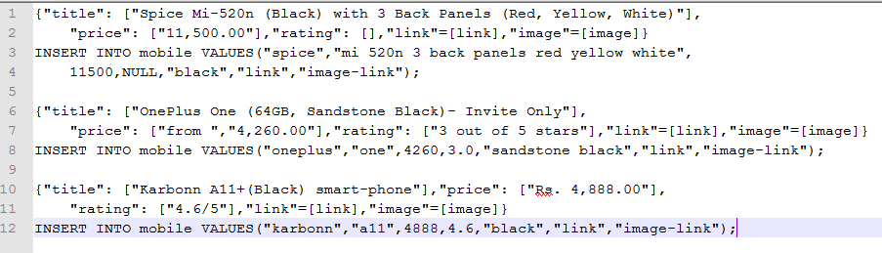
DATA CLEANING(contd…)

Slide 8
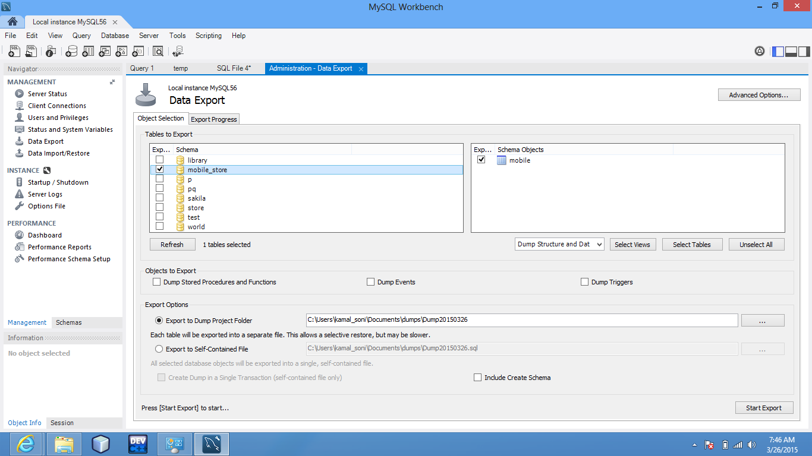
DATABASE MANAGEMENT
From Clean data to database
MYSQL
PROBLEMS?
Very large data
Redundant data
Solution-Normalization

Slide 9
Matrix Factorization
After normalization we have a bigger issue to solve ‘missing values’ .
Fill missing values(ratings) by approaches like matrix factorization .
Basic idea behind matrix factorization is that a matrix with higher rank could be converted into ranks of smaller one .
Where P and Q are matrix of smaller ranks and with the help of these two one can find the missing value.
R’ matrix will have our predicted rating values.

Slide 10
Matrix Factorization(contd…)
 | D1 | D2 | D3 | D4
U1 | 5 | 3 | - | 1
U2 | 4 | - | - | 1
U3 | 1 | 1 | - | 5
U4 | 1 | - | - | 4
U5 | - | 1 | 5 | 4
 | D1 | D2 | D3 | D4
U1 | 4.97 | 2.98 | 2.18 | 0.98
U2 | 3.97 | 2.40 | 1.97 | 0.99
U3 | 1.02 | 0.93 | 5.32 | 4.93
U4 | 1.00 | 0.85 | 4.59 | 3.93
U5 | 1.36 | 1.07 | 4.89 | 4.12

Slide 11
Activity Time chart
Before Mid-Semester
After Mid-Semester
Learning Scrapy, Selenium, Data Cleansing,etc.
Creation of Scrapy scripts.
Data Cleansing.
Database Schema
Representation Web Interface
Levenshtein distance algorithm for comparing description.
Regular Extraction of data at certain intervals.
Matrix Factorization Algorithm.
Database Normalization.
Pattern Analysis in Large Data.
Rate Increase/Decrease Prediction.

Slide 12
Conclusion
Drawbacks:
In this dynamic world, websites keeps changing.
Large database required.
Noise is never completely removed.
High Speed Internet (Time threshold needs to be heuristic).
Project at a glance – Summarization.
Future Scope
Great success if worked upon large number of websites.

Slide 13
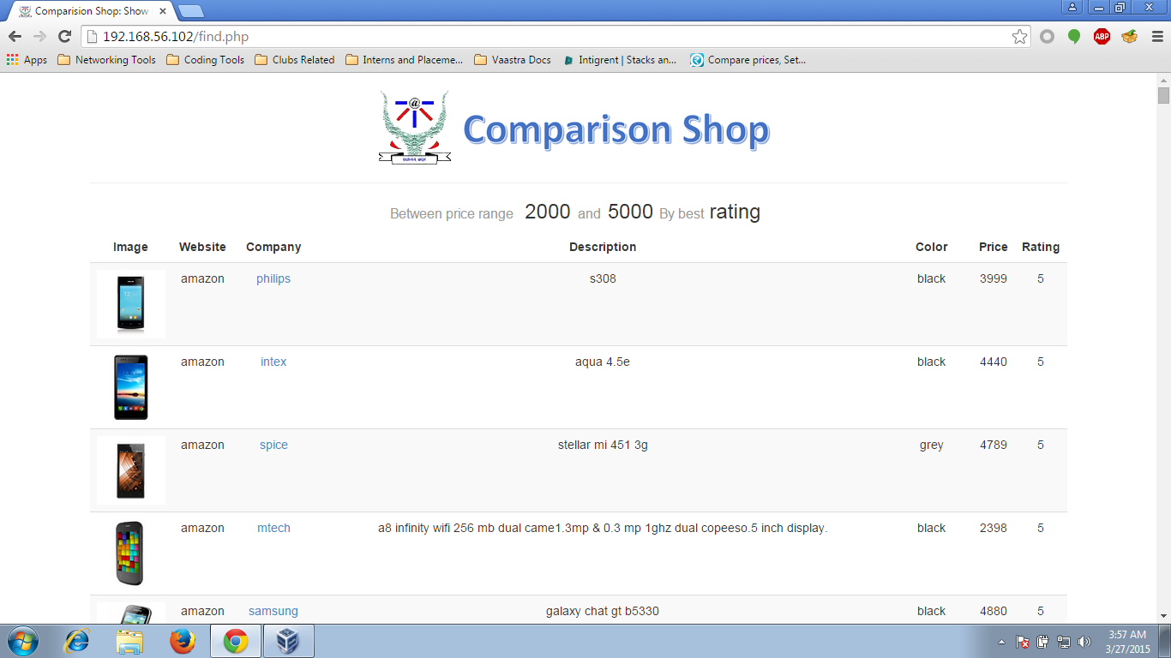
Demonstration

Slide 14
Suggestion
&
Questions (if any)

