Slide 1
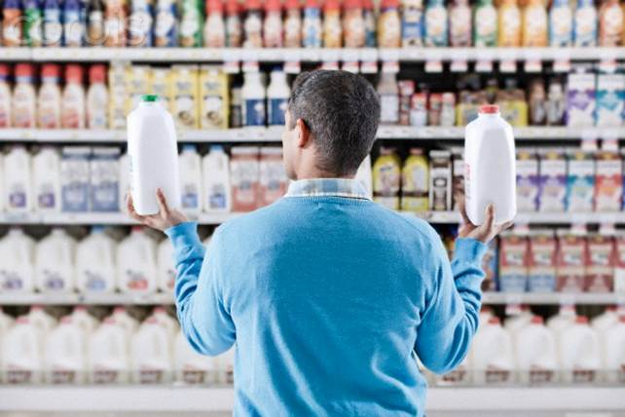
Mini Project on
Shopping Comparison Trend Analyzer
Under guidance of
Dr. O.P. Vyas.
Submitted By-
Gaurav Gupta (RIT2012018)
Harshit Gupta (RIT2012048)
Kamal Soni (RIT2012076)
Nakshatra Maheshwari (RIT2012074)
Shashank Sharma (RIT2012075)
Shweta Choudhary (RIT2012025)

Slide 2
Contents
Introduction to the team and their roles.
Introduction-What is our project ?
Working Steps and Future Scope.
Activity Time Chart
References

Slide 3
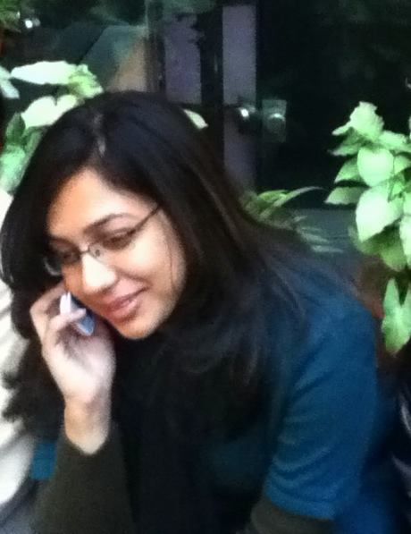





Team Members and Their Roles
Shweta:
Scrapy
Nakshatra:
Extraction of Data
Gaurav:
Data Cleansing
Shashank :
Algorithms
Kamal:
Database
Harshit:
Representation
& Interface

Slide 4
What is our project?
Introduction- Shopping comparison trend analyzer
Need-There is probably no need to say that there is too much information on the Web nowadays. Search engines help us a little bit. What is better is to have something interesting recommended to us automatically without asking.
Possible Solutions-pricedekho.com,junglee.com,buyhatke.com
THEN WHY OUR PROJECT-
User ratings are not preferred.
Do not take specifications matching into account(based only on price).

Slide 5
work steps
Data Scraping
Data Cleaning
Database Mangement
Matrix Factorization
Conclusion-Limitation,future Scope

Slide 6

DATA SCRAPPING
Web crawler?
Web scrapper?
Scrapper used: Scrapy.
Selenium-pre step to Scrapy.
But Why Scrapy?
Intermediate action.
Demonstration at the end

Slide 7
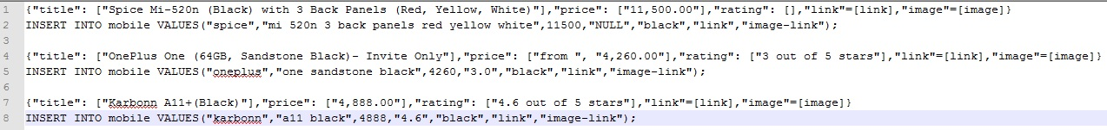
DATA CLEANING
Data is not always clean
Noise Removal
Data needs to be GENERALISED.
Making Data ready -> from scrapy to create database.

Slide 8
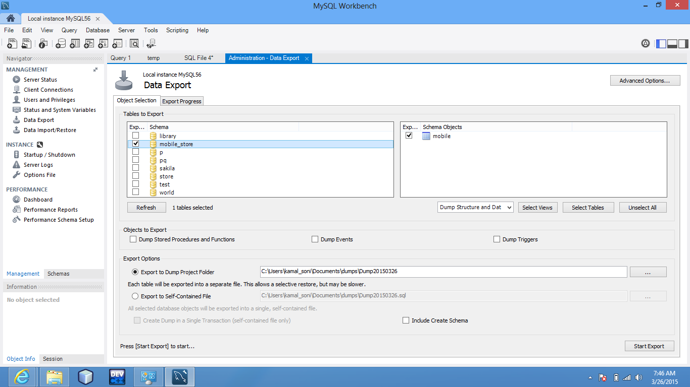
DATABASE MANAGEMENT
From Clean data to database
MYSQL
PROBLEMS?
Very large data
Redundant data
Solution-Normalization

Slide 9
Matrix Factorization
 | D1 | D2 | D3 | D4
U1 | 5 | 3 | - | 1
U2 | 4 | - | - | 1
U3 | 1 | 1 | - | 5
U4 | 1 | - | - | 4
U5 | - | 1 | 5 | 4
 | D1 | D2 | D3 | D4
U1 | 4.97 | 2.98 | 2.18 | 0.98
U2 | 3.97 | 2.40 | 1.97 | 0.99
U3 | 1.02 | 0.93 | 5.32 | 4.93
U4 | 1.00 | 0.85 | 4.59 | 3.93
U5 | 1.36 | 1.07 | 4.89 | 4.12

Slide 10
Activity Time chart
Before Mid-Semester
After Mid-Semester
Creation of Scrapy scripts.
Data Cleansing.
Levenshtein distance Algorithm for comparing description.
Database Schema
Representation Web Interface
Regular Extraction of data at certain intervals.
Matrix Factorization Algorithm.
Database Normalization.
Pattern Analysis in Large Data.
Rate Increase/Decrease Prediction.

Slide 11
Conclusion
Drawbacks:
In this dynamic world, websites keeps changing.
Large database required.
Noise is never completely removed.
High Speed Internet (Time threshold needs to be heuristic).
Project at a glance – Summarization.
Future Scope
Great success if worked upon large number of websites.

Slide 12
Demonstration

Slide 13
Suggestion
&
Questions (if any)

