Slide 1
Learn Amhariga "ኣማርኟ" Language
By Fitsum Woldemariam

Slide 2
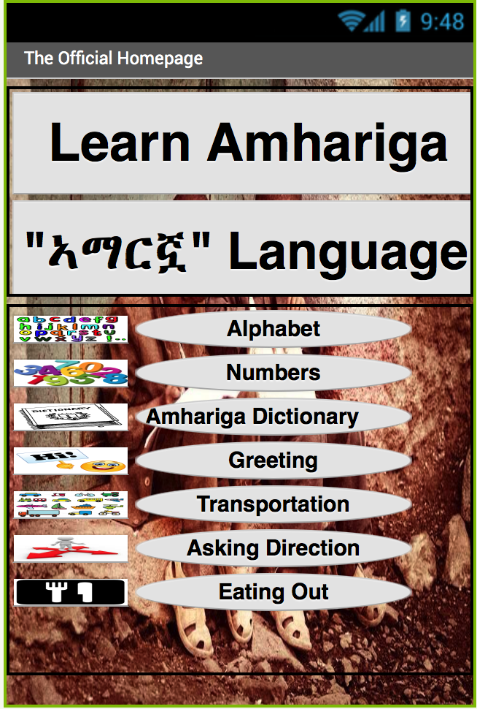
Homepage

Slide 3
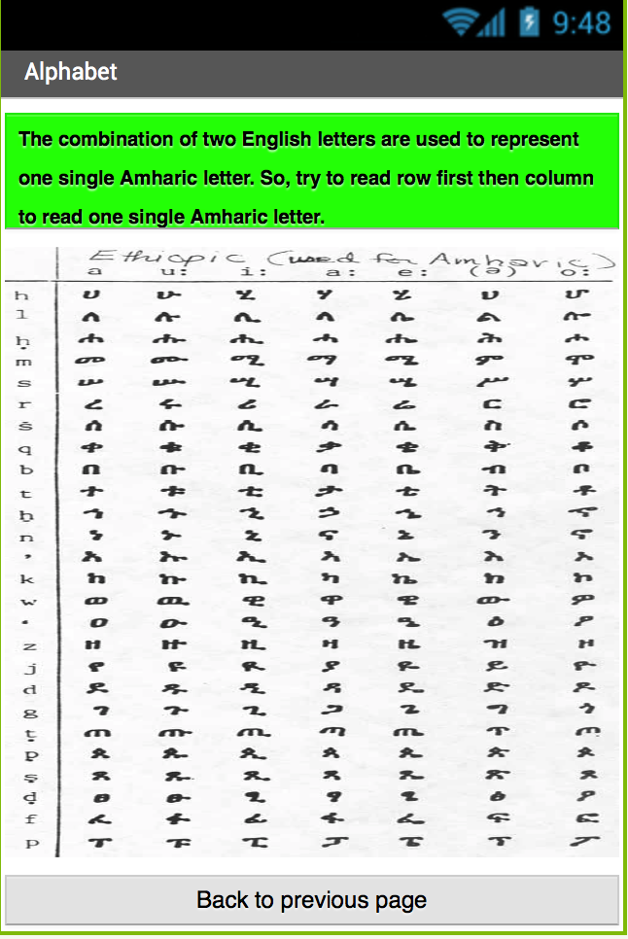
alphabet

Slide 4
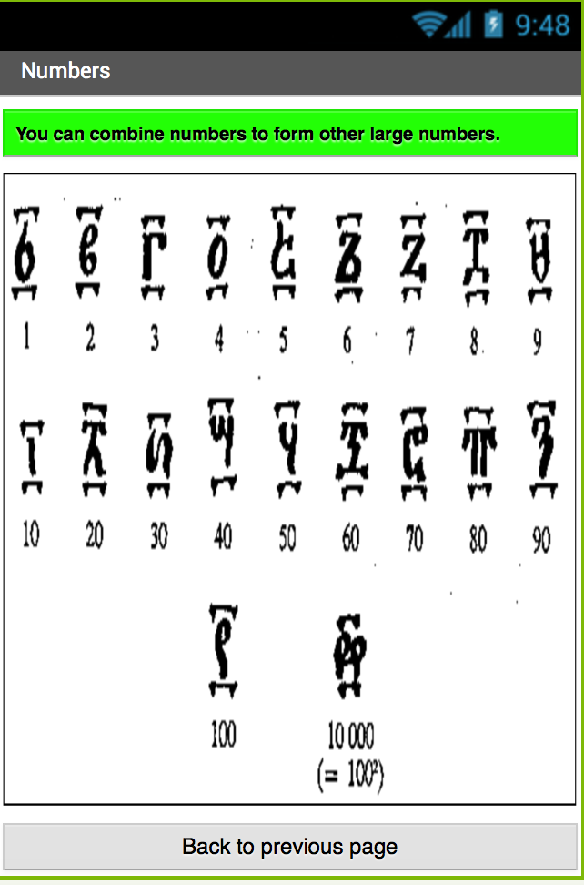
Numbers

Slide 5
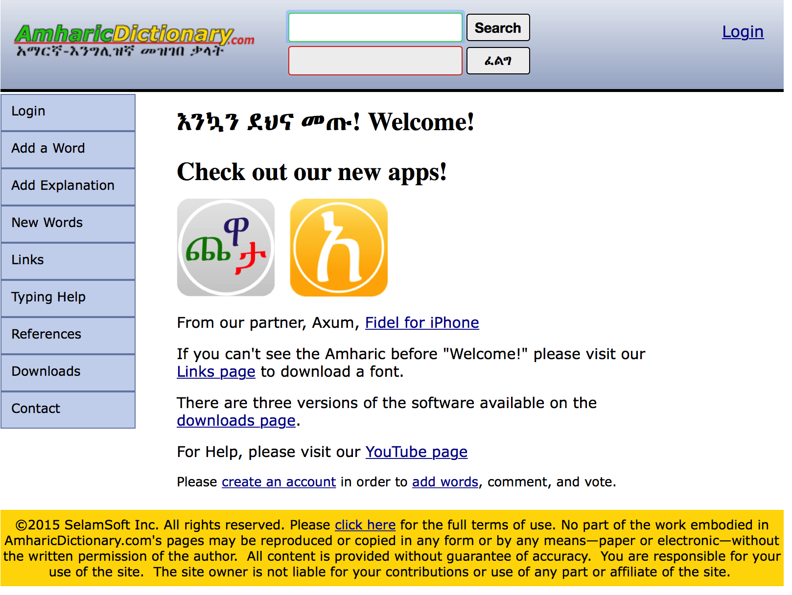
Amhariga Dictionary

Slide 6
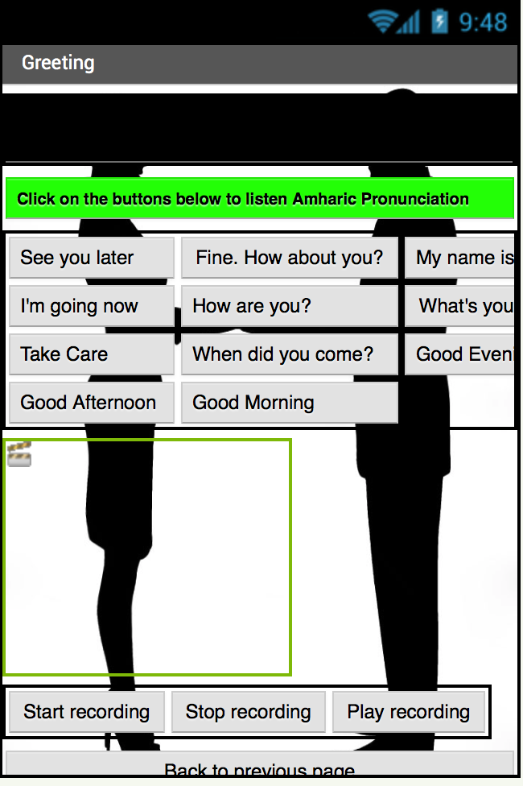
Greeting

Slide 7
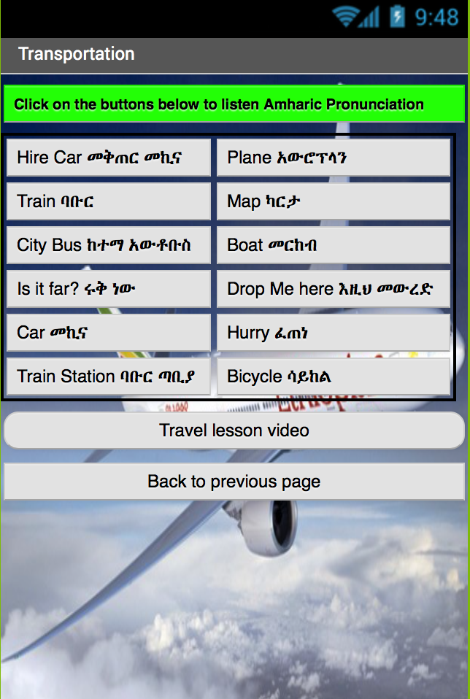
Transportation

Slide 8
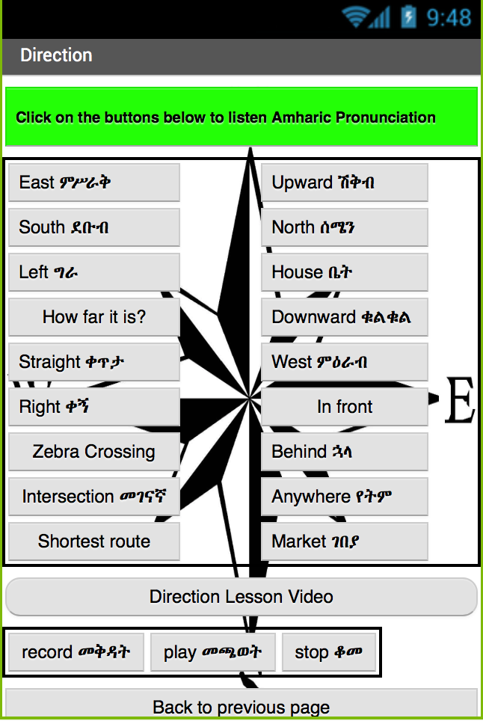
Asking direction

Slide 9
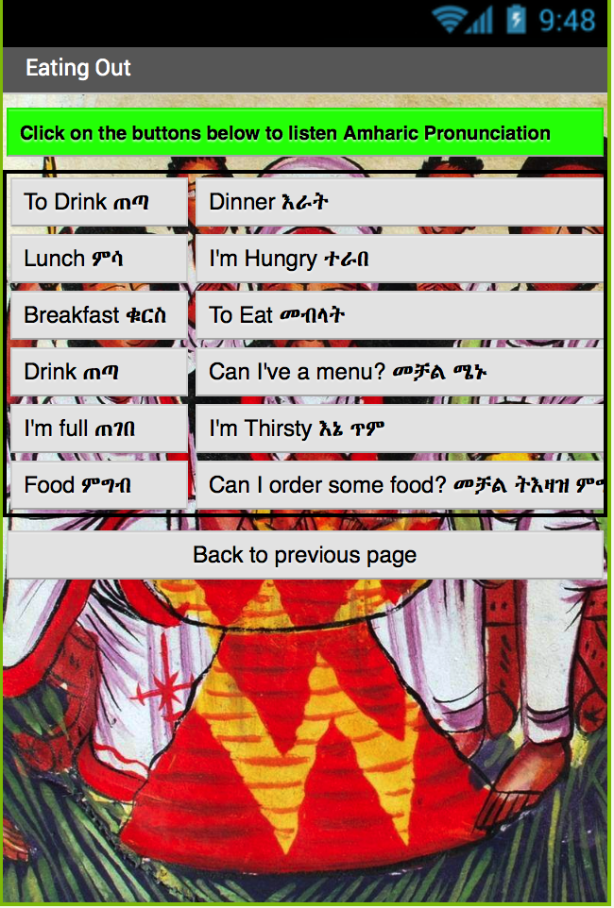
Eating out

