Slide 1
Lecture Activity: Brain Cancer
Oleh Kozynets, Fakrul Islam Tushar

Slide 2
Outline
Brain and Other Nervous System Cancer
CAD for Brain Cancer
Segmentation
Previous Studies, Deep Learning
DeepMedic
Dense Training
Deeper Network
Multi-Scale Pathway
Model Analysis
Results
Conclusion
Notes:
We start from general information about brain cancer and continue by taking closer look at selected CAD approach.

Slide 3
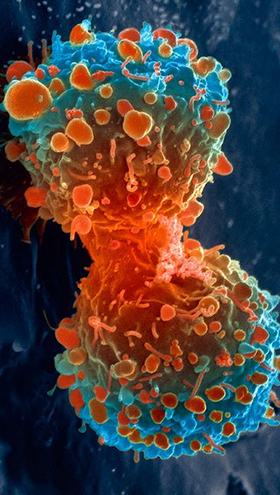
1.Brain and Other Nervous System Cancer
Cancers are diseases characterized by unstoppable growth and spreading of the body’s cells
5 years survival rate is 33.2%
Most frequently diagnosed among people aged 55-64
https://seer.cancer.gov/statfacts/html/brain.html
Image by the US National Institutes of Health
Notes:
Cancers are diseases characterized by unstoppable growth and spreading of the body’s cells, they can be categorized by their location in the patient’s body. Typically, brain cancer and other nervous system cancer are considered together.
This is one of the most fatal types of cancer. 33.2% of people survive for more than 5 years after being diagnosed with brain and other nervous system cancer. This type of cancer is most frequently diagnosed among people aged 55-64.
The data were taken from the National Cancer Institute of the US.

Slide 4
1.Brain and Other Nervous System Cancer
https://seer.cancer.gov/statfacts/html/brain.html
Notes:
Compared to other cancers, brain and other nervous system cancer is relatively rare, accounting for around 1.4% (23,880) of new cancer cases in the US in 2018.

Slide 5
1.Brain and Other Nervous System Cancer
https://seer.cancer.gov/statfacts/html/brain.html
Notes:
2.8% (16,830) of cancer deaths were due to this type of cancer.

Slide 6
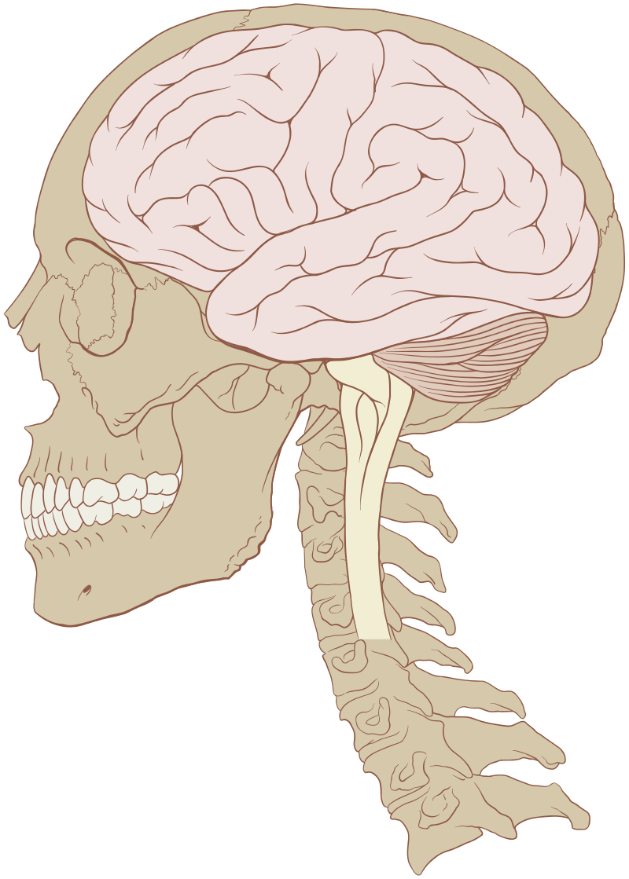
1.Brain and Other Nervous System Cancer
150 different brain tumors
Primary and metastatic brain tumors
Low (I, II) and high (III, IV) grade tumors according to WHO
https://www.aans.org/Patients/Neurosurgical-Conditions-and-Treatments/Brain-Tumors
Image by Patrick J. Lynch, medical illustrator
Notes:
The tumors may be either benign (not cancer) or malignant (tissue mass formed by cancerous cells). Unlike most benign tumors elsewhere in the body, benign brain tumors can be life threatening. There are 150 types of brain and spinal cord tumors. Tumors that start in the brain are called Primary brain tumors. Often, tumors found in the brain had started somewhere else in the body and spread to one or more parts of the brain. Such tumors are called Metastatic brain tumors.
According to the World Health Organization tumor malignancy or benignity can be graded as Low or High, based on how abnormal the cancer cells look under a microscope and how quickly the tumor is likely to grow and spread.
Information is taken from the American Association of Neurological Surgeons (AANS) website.

Slide 7
1.Brain and Other Nervous System Cancer
https://www.aans.org/Patients/Neurosurgical-Conditions-and-Treatments/Brain-Tumors
Notes:
The most common benign tumors are Meningiomas. They originate from the meninges, the membrane-like structures that surround the brain and spinal cord, they account for 10-15% of tumors.
Gliomas are the most prevalent type (78%) of malignant brain tumors, accounting for 30% of all brain tumors. They arise from the supporting cells of the brain, called the glia.
Information is taken from the American Association of Neurological Surgeons (AANS) website.

Slide 8
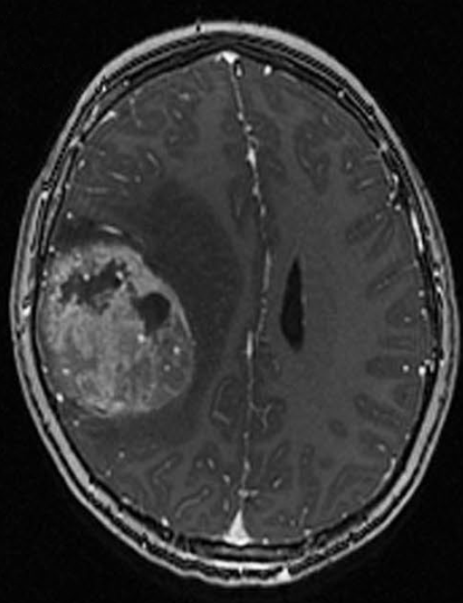
1.Brain and Other Nervous System Cancer
T2 and FLAIR MRI
T1-weighted post-Gadolinium MRI
Perfusion MRI
Diffusion MRI
Epithelioid glioblastoma (Ep-GBM)
Grade IV, WHO
[D. H. Louis et al.] WHO classification of tumours of the central nervous system WHO/IARC., Lyon, France, Tech. Rep., 2007.
Notes:
In the case of brain cancer, MRI is considered as the standard technique, due to its good soft tissue contrast and widely availability. For finding tumor-induced tissue changes, doctors use T2 and FLAIR MRI (highlighting differences in tissue water relaxational properties), post-Gadolinium T1 MRI (showing pathological intratumoral take-up of contrast agents), perfusion and diffusion MRI (blood flow and local water diffusion) etc.
Epithelioid glioblastomas (Ep-GBM), which is a variant of glioblastoma (a malignant glioma, IVth grade), is presented on this post-contrast T1-weighted MRI.

Slide 9
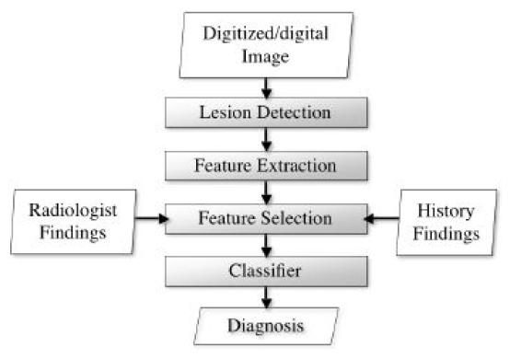
2.CAD for Brain Cancer
MAIA CAD course
Notes:
The traditional workflow of a CAD (computer aided system for detection and diagnosis) follows the steps that radiologists do when issuing a diagnosis. You have probably seen it during our CAD course. As a result of a small research we performed, we found that most of recent research papers on brain tumors focus on the Lesion Detection stage. Typically, the lesion detection stage consists of image segmentation and defining a region of interest.

Slide 10
3.Brain Tumor Segmentation
Segmentation
Shape
Size
Location
Metabolism
Notes:
Why segmentation is important?
Segmentation of medical images provide valuable information about shape, size, location and metabolism of brain tumors; such information is important for planning of treatment strategies, monitoring of a disease progression and prediction of patient’s outcome.
Manual segmentation is a very time-consuming procedure, since brain tumors have highly irregular shape and vary significantly in their sizes.

Slide 11
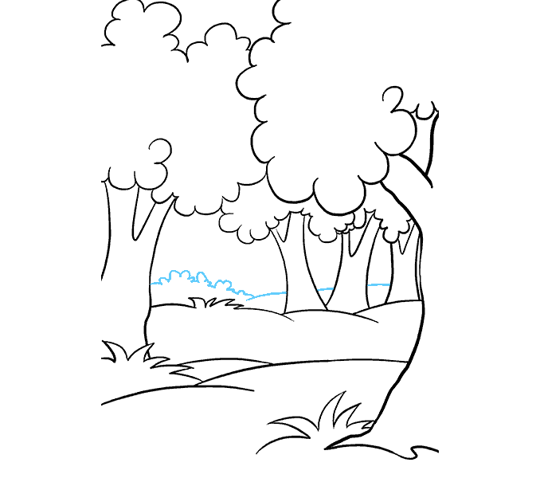
4.Previous Studies
No training data required:
Image registration
Image synthesis
Saliency based-method
Machine learning methods:
Random Forests et al. (RF and atlas-based, RF and RMF)
Deep Learning
[K. Kamnitsas et al. 2017] Efficient multi-scale 3D CNN with fully connected CRF for
accurate brain lesion segmentation. Medical Image Analysis 36 (2017) 61–78
Notes:
Numerous methods for automatic brain lesion segmentation were proposed before.
The first big group of methods tackles segmentation task as an abnormality detection problem, they do not require training data and are more suitable for lesion detection than precise segmentation. Among those are: Image registration (comparison of healthy and affected brains, atlas-based), Image synthesis (create/synthesize pseudo-healthy images, that can by used in comparison), Saliency based-method (exploits brain asymmetries in pathological cases).
Another group uses machine learning approach. Among the most successful machine learning methods were Random Forests et al. , + Random Markov Fields (RMF). Their modelling capabilities still have significant limitations in comparison to recently introduced deep learning-based methods.

Slide 12
4.PS: Deep Learning
2D CNNS
Use neural network build for image processing
3D brain scan is achieved by processing each 2D slice independently
3D CNNS
Use 3D convolutions
Increased number of parameters and significant memory and computational requirements
[K. Kamnitsas et al. 2017] Efficient multi-scale 3D CNN with fully connected CRF for accurate brain lesion segmentation. Medical Image Analysis 36 (2017) 61–78
All images in the following slides are taken from this article.
Notes:
Deep Learning for automatic brain lesion segmentation. We can segment 3D brain in different ways.
2D CNNs, which have been used extensively in computer vision applications on natural images. Here, the segmentation of a 3D brain scan is achieved by processing each 2D slice independently, which is arguably a non-optimal use of the volumetric medical image data. Despite the simplicity in the architecture, the promising results obtained by these methods indicate the potential of CNNs.
To incorporate 3D contextual information 3D CNNs are used. They utilize 3D convolution, as a result have more parameters and significant memory and computational power requirements.

Slide 13
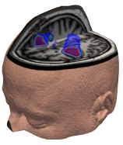
5.DeepMedic
11-layers deep 3D CNN for brain tumors segmentation
Proposed by Konstantinos Kamnitsas et al. in 2017
It was written in Python, using TensorFlow/Theano, NiBabel, NumPy et al.
Among top-performers on the BRATS 2016 challenge
BRATS 2017 challenge winners (DeepMedic, FCN, U-Net)
Notes:
We decided to consider deep learning methods for automatic brain lesion segmentation. We selected a dual pathway, 11-layers deep, three-dimensional Convolutional Neural Network called DeepMedic, created for the challenging task of brain lesion/tumor segmentation.
It was written in Python, using TensorFlow/Theano, NiBabel, NumPy et al.
Among top-performers on the Multimodal Brain Tumor Segmentation Challenge (BRATS) 2016.
BRATS 2017 winners used it as a part of the Ensemble of Multiple Models and Architectures (EMMA), with the aim of averaging away the variance, model- and configuration-specific behaviors. The ensemble consisted of DeepMedic, fully convolutional network (FCN), and U-Net architectures.

Slide 14
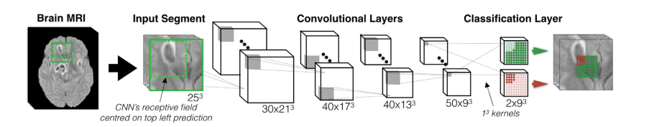

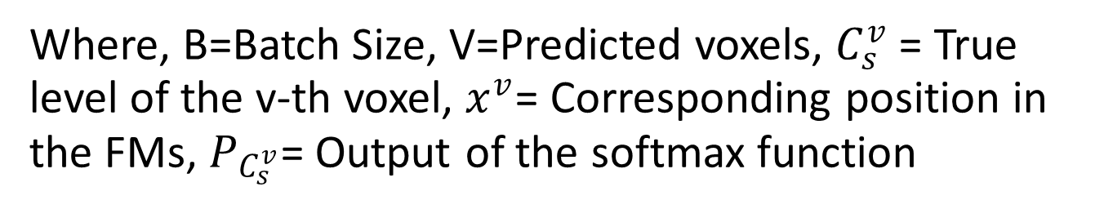
6.Dense Training
Dense Training
$$\frac{1}{B.V}\sum_{s=1}^{B}{\sum_{v=1}^{V}{\log{(P_{C_{s}^{v}}(x^{v}))}}}$$
Where, B=Batch Size, V=Predicted voxels, $C_{s}^{v}$= True level of the v-th voxel, $x^{v}$= Corresponding position in the FMs, $P_{C_{s}^{v}}$= Output of the softmax function
Fig. Baseline CNN
[K. Kamnitsas et al. 2017] Efficient multi-scale 3D CNN with fully connected CRF for
accurate brain lesion segmentation. Medical Image Analysis 36 (2017) 61–78
Notes:
Here in the figure shown the baseline model.
To Learn about any deep model implementation we need to learn and understand their input and training strategies .In Deepmadic a training strategy called Dense Training is used and analysis of its behavior in adapting to class imbalance of the segmentation problem was show. Usually training is done in patches which is the same size of the receptive field of the CNN. Here the segment is bigger than the receptive field. The idea is when using the patches you only predict on the center pixel. Using a segment able to get the prediction for the neighboring pixels as well. This idea and prediction about the neighboring pixels gives you an overview of the segment structure and able you to deal with the class imbalance problem. For the Dense training the cost function is computed as below:
$$\frac{1}{B.V}\sum_{s=1}^{B}{\sum_{v=1}^{V}{\log{(P_{C_{s}^{v}}(x^{v}))}}}$$
Where, B=Batch Size, V=Predicted voxels, $C_{s}^{v}$= True level of the v-th voxel, $x^{v}$= Corresponding position in the FMs, $P_{C_{s}^{v}}$= Output of the softmax function

Slide 15
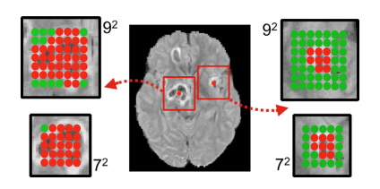
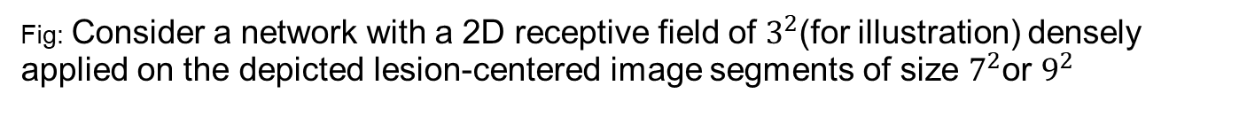
6.Dense Training
Segment based Sampling regulate class balance
Relatively more background (green) is captured by larger segments and around smaller lesions (Red)
Fig: Consider a network with a 2D receptive field of $3^{2}$(for illustration) densely applied on the depicted lesion-centered image segments of size $7^{2}$or $9^{2}$
[K. Kamnitsas et al. 2017] Efficient multi-scale 3D CNN with fully connected CRF for
accurate brain lesion segmentation. Medical Image Analysis 36 (2017) 61–78
Notes:
Now , In the figure above we can see two segments of different size 9x9 and 7x7. Relatively more background (green) is captured by larger segments and around smaller lesions. An appealing consequence of this scheme is that the sampling of input segments provides a flexible and automatic way to balance the distribution of training samples from different segmentation classes which is an important issue that directly impacts the segmentation accuracy.

Slide 16
7.Deeper Network
More layers, more power! More computation, more difficult to train
Use Smaller kernels
Use ReLu-Specific initialization
Solution
Use Batch Normalization
Notes:
Deeper networks have greater discriminative power due to the additional non-linearities and better quality of local optima (Choromanska et al., 2015). However, convolutions with 3D kernels are computationally expensive in comparison to the 2D variants, which hampers the addition of more layers. To design the deep network they adopt the state-of-art suggestions like, using smaller kernels, use batch normalization, ReLu Specific initialization.

Slide 17
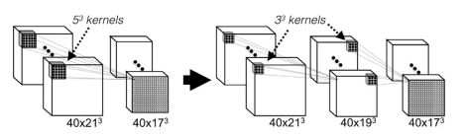

7.Deeper Network: Use Smaller Kernel
In order to build a deeper 3D architecture, They adopt the $3^{3}$ kernels that are faster to convolve with and contain less weights
[K. Kamnitsas et al. 2017] Efficient multi-scale 3D CNN with fully connected CRF for
accurate brain lesion segmentation. Medical Image Analysis 36 (2017) 61–78
Notes:
This design approach was previously found beneficial for classification of natural images (Simonyan and Zisserman,2014) but its effect is even more drastic on 3D networks. When compared to common kernel choices of $5^{3}$ (Zikic et al., 2014; Urban et al., 2014; Prasoon et al., 2013) and in baseline CNN, the smaller $3^{3}$ kernels reduce the element-wise multiplications by a factor of approximately $5^{3}$ /$3^{3}$ ≈ 4.6 while reducing the number of trainable parameters by the same factor.

Slide 18
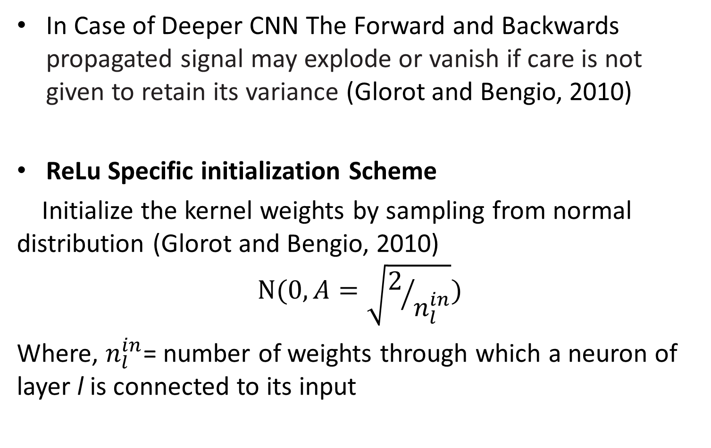
7.ReLu Specific initialization Scheme
In Case of Deeper CNN The Forward and Backwards propagated signal may explode or vanish if care is not given to retain its variance (Glorot and Bengio, 2010)
ReLu Specific initialization Scheme
Initialize the kernel weights by sampling from normal distribution (Glorot and Bengio, 2010)
$$N(0,A=\sqrt{2/{n_{l}^{in}}})$$
Where, $n_{l}^{in}$= number of weights through which a neuron of layer l is connected to its input
[K. Kamnitsas et al. 2017] Efficient multi-scale 3D CNN with fully connected CRF for
accurate brain lesion segmentation. Medical Image Analysis 36 (2017) 61–78
Notes:
Deeper networks are more difficult to train. It has been shown that the forward (neuron activations) and backwards (gradients) propagated signal may explode or vanish if care is not given to retain its variance (Glorot and Bengio, 2010). This occurs because at every successive layer l (letter L), the variance of the signal is multiplied by $n_{l}^{in}$ · var(W_), where nin l = Cl−1 i={x,y,z} κl(i) is the number of weights through which a neuron of layer l is connected to its input and var(Wl) is the variance of the layer’s weights. To better preserve the signal in the initial training stage They adopt a scheme recently derived for ReLu-based networks by He et al.(2015) and initialize the kernel weights of our system by sampling
from the normal distribution $N(0,A=\sqrt{2/{n_{l}^{in}}})$

Slide 19
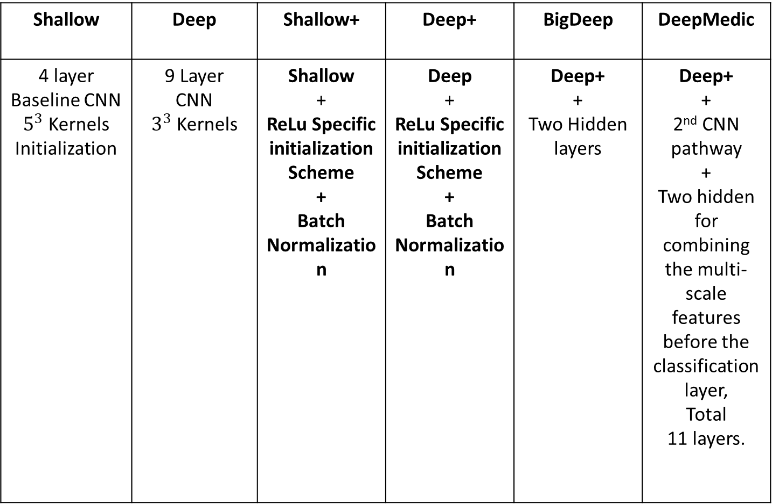
7.Building Deeper Model
Notes:
They Started with shallow network and Gradually expend the network and analyze their outcomes which will be discussed in coming slides.

Slide 20
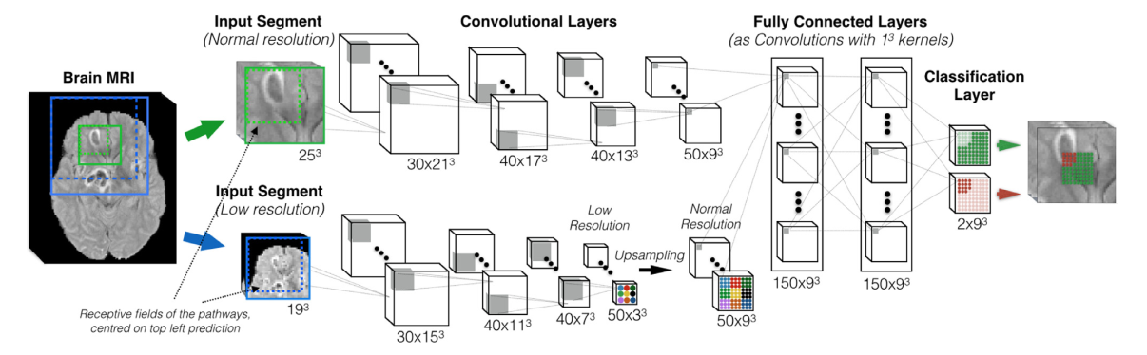
8.Multi-Scale Via Parallel Pathways
Fig: Multi-scale 3D CNN with two convolutional pathways
[K. Kamnitsas et al. 2017] Efficient multi-scale 3D CNN with fully connected CRF for
accurate brain lesion segmentation. Medical Image Analysis 36 (2017) 61–78
Notes:
Multi-scale 3D CNN with two convolutional pathways. The kernels of the two pathways are here of size $5^{2}$ (for illustration only to reduce the number of layers in the figure). The neurons of the last layers of the two pathways thus have receptive fields of size ${17}^{3}$ voxels. The inputs of the two pathways are centered at the same image location, but the second segment is extracted from a down-sampled version of the image by a factor of 3. The second pathway processes context in an actual area of size ${51}^{3}$ voxels. DeepMedic, proposed 11-layers architecture, results by replacing each layer of the depicted pathways with two that use $3^{3}$ kernels . Number of FMs and their size depicted as (Number × Size) .

Slide 21
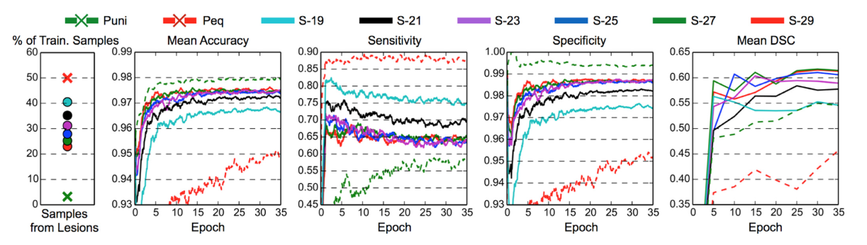
9.Model Analysis
Effect of Dense Training
[K. Kamnitsas et al. 2017] Efficient multi-scale 3D CNN with fully connected CRF for
accurate brain lesion segmentation. Medical Image Analysis 36 (2017) 61–78
Notes:
Comparison of the commonly used methods for training on patches uniformly sampled from the brain region (Puni) and equally sampled from lesion and background (Peq) against our proposed scheme (S-d) on cubic segments of side length d, also equally sampled from lesion and background. d the dimension of the segment was varied to observe its effect. From left to right: percentage of training samples extracted from the lesion class, mean accuracy, sensitivity, specificity calculated on uniformly sampled validation patches and, finally, mean DSC of the segmentation of the validation datasets. Progress throughout training is plotted. Because lesions are small, Puni achieves very high voxel-wise accuracy by being very specific but not sensitive, with the opposite being the case for Peq. Our method achieves an effective balance between the two, resulting in better segmentation as reflected by higher DSC

Slide 22
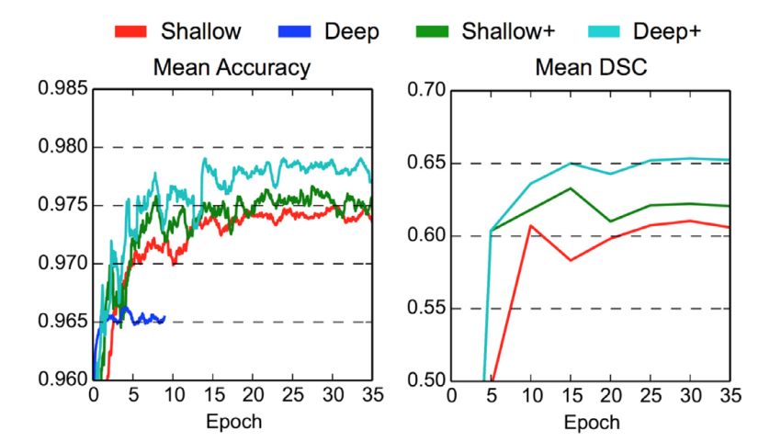
9.Model Analysis
Effect of Deeper Network
[K. Kamnitsas et al. 2017] Efficient multi-scale 3D CNN with fully connected CRF for
accurate brain lesion segmentation. Medical Image Analysis 36 (2017) 61–78
Notes:
Mean accuracy over validation samples and DSC for the segmentations of the validation images, as obtained from the “Shallow” baseline and “Deep” variant with smaller kernels. Training of the plain deeper model fails. This is overcome by adopting the initialization scheme of He et al. (2015), which further combined with Batch Normalization leads to the enhanced (+) variants. Deep+ performs significantly better than Shallow+ with similar computation time, thanks to the use of small kernels.

Slide 23
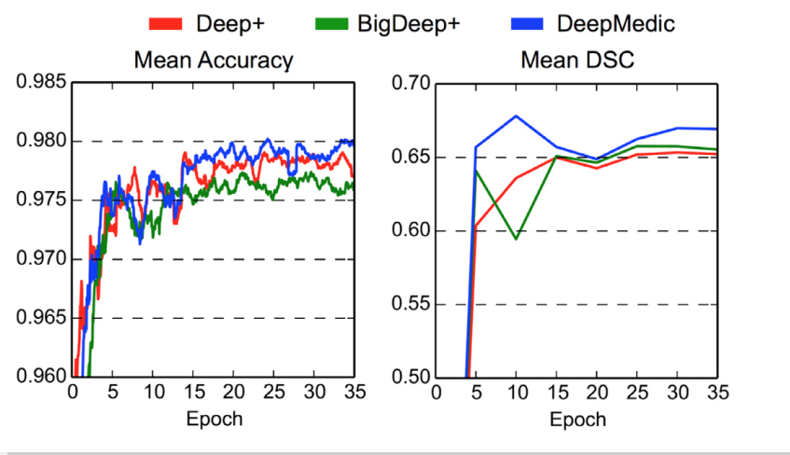
9.Model Analysis
Effect of Multi-Scale Pathways
[K. Kamnitsas et al. 2017] Efficient multi-scale 3D CNN with fully connected CRF for
accurate brain lesion segmentation. Medical Image Analysis 36 (2017) 61–78
Notes:
Mean accuracy over validation samples and DSC for the segmentation of the validation images, as obtained by a single-scale model (Deep+) and dual pathway architecture (DeepMedic). They also trained a single-scale model with larger capacity (BigDeep+), similar to the capacity of DeepMedic. DeepMedic yields best performance by capturing greater context, while BigDeep+ seems to suffer from over-fitting

Slide 24
10.BRATS 2015
Multimodal Brain Tumor Image Segmentation (BRATS) challenge . Link: https://sites.google.com/site/braintumorsegmentation/home/brats2015
Training Data 220 cases
Testing Data 110 cases
Multi-class problem
necrotic core
Edema
non-enhancing core
Enhancing core
Notes:
In order to gauge the current state-of-the-art in automated brain tumor segmentation and compare between different methods, They organized Multimodal Brain Tumor Image Segmentation (BRATS) challenges.

Slide 25
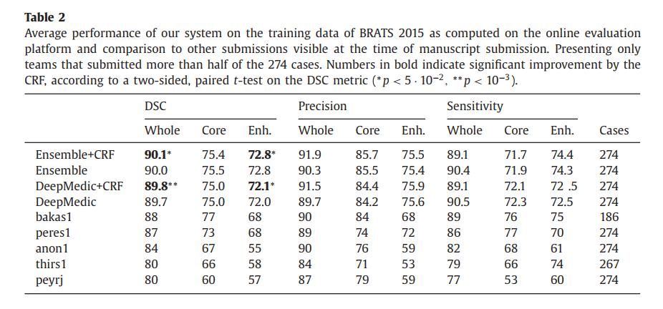
10.Results
BRATS 2015 training Result
[K. Kamnitsas et al. 2017] Efficient multi-scale 3D CNN with fully connected CRF for
accurate brain lesion segmentation. Medical Image Analysis 36 (2017) 61–78

Slide 26
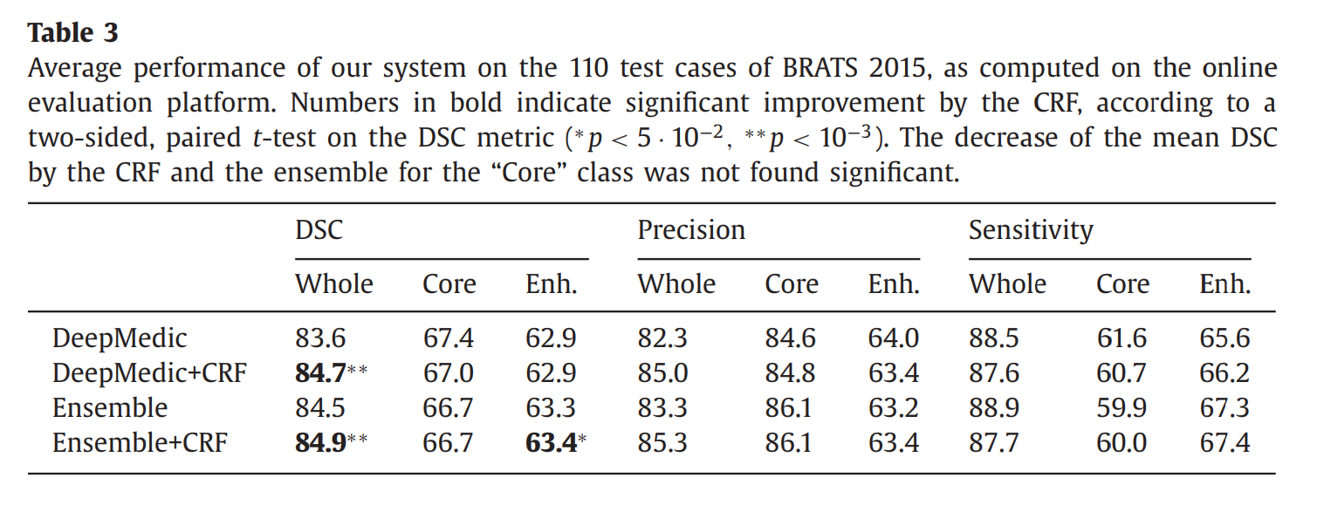
10.Results
BRATS 2015 test Result
[K. Kamnitsas et al. 2017] Efficient multi-scale 3D CNN with fully connected CRF for
accurate brain lesion segmentation. Medical Image Analysis 36 (2017) 61–78

Slide 27
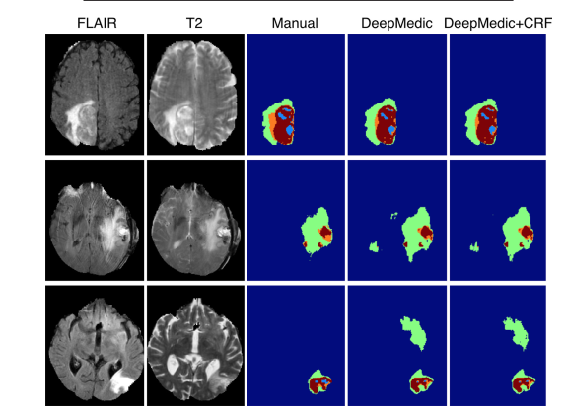
10.Results
Examples of DeepMedic’s segmentation from its evaluation on the training datasets of BRATS 2015.
Fig: cyan: necrotic core, green: oedema, orange: non-enhancing core, red: enhancing core. (top and middle) Satisfying segmentation of the tumour, regardless motion artefacts in certain sequences. (bottom) One of the worst cases of over-segmentation observed. False segmentation of FLAIR hyper-intensities as oedema constitutes the most common error of DeepMedic
[K. Kamnitsas et al. 2017] Efficient multi-scale 3D CNN with fully connected CRF for
accurate brain lesion segmentation. Medical Image Analysis 36 (2017) 61–78

Slide 28
11.Conclusion
Deep learning approaches Proven to be better than conventional approaches in comparison of results
Deeper network has more advantages where as it comes with more computation expenses and complexity
Dense training approaches using segments is proven to be better and using equal distribution of lesion and non lesion pixels over uniform distribution fails
Designing deeper network importance need to given to the initialization steps and parameters to be trained

Slide 29
To know more…
Konstantinos Kamnitsas, Christian Ledig, Virginia F.J. Newcombe, Joanna P. Simpson, Andrew D. Kane, David K. Menon, Daniel Rueckert, and Ben Glocker, “Efficient Multi-Scale 3D CNN with Fully Connected CRF for Accurate Brain Lesion Segmentation”, Medical Image Analysis, 2016.
GitHub: https://github.com/Kamnitsask/deepmedic
YouTube: [MISS 2016] Ben Glocker - Deep Learning for Brain Lesion Segmentation

Slide 30

Thank You

