Slide 1


Mass Detection in Breast Using Transfer Learning for Computer Aided Diagnosis

Slide 2
SUPERVISOR
Distributed Programming and Networking Projecct Defense 2O18June 7,
MAIA
Mario Molinara
Group Members
Fakrul Islam Tushar MAIA
Md. Kamrul Hasan MAIA
Lavsen Dahal MAIA

Slide 3
Contents of The Presentation
Breast Cancer diagnosis
Mass and Non-Mass
DCNN
Limitation of DCNN
Transfer Learning
Objective of the project
DNCC architecture
Preparing Dataset and Experimental setup
Training Configuration
Project Outcomes
Conclusion and Future Improvement
Reference

Slide 4
Why Breast cancer Diagnosis is important ??
Cancer
2nd leading cause of death worldwide [1]
Approximately, 70% Deaths of Cancer Occurs low and middle income countries[1]
Brest Cancer
Second leading Cause of Death for women.

Slide 5
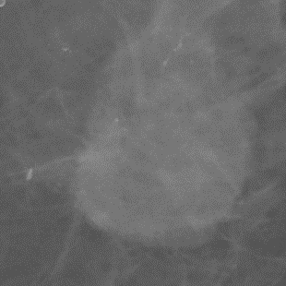

Mass and Non-mass
A tumor or mass is an uncontrolled growth of breast cells which are generally two types.
non-cancerous or ‘benign’, and
cancerous or malignant.
Fig.1: Mass Mammographic Image.
Fig.2: Non-Mass Mammographic Image.

Slide 6

Year
2012

Slide 7
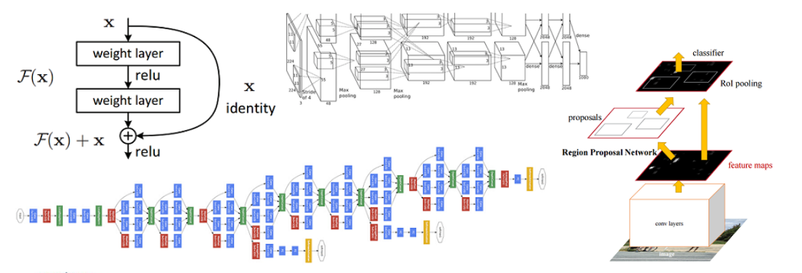
DCNN
DNCC Becomes obvious choice to the Computer vision societies
Alexnet
VGG
GoogLeNet
ResNet
Fig.3: DCNN models.

Slide 8
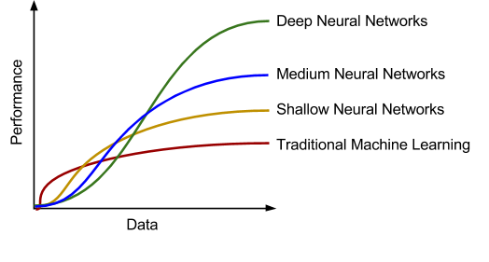
Limitation of DCNN for Medical Imaging ??
Deeper the CNN more data it needs.
Having huge amount of data is challenging for Medical Cases
Fig.4: Performance vs data .

Slide 9
Transfer Learning
Using a pretrained model and Fine tune it according to need
Fine Tuning Approach:
Remove the last layer use as Fixed Feature Extractor
Replace the last layer with new classifier
Trained the last Covn layer only and freeze others
Partially trained the model

Slide 10
Objective of the Project
VGG16
Transfer Learning
Mass and Non-mass
Detection
AlexNet
Training From Scratch
Mass and Non-mass
Detection

Slide 11
DCNN Architecture

Slide 12
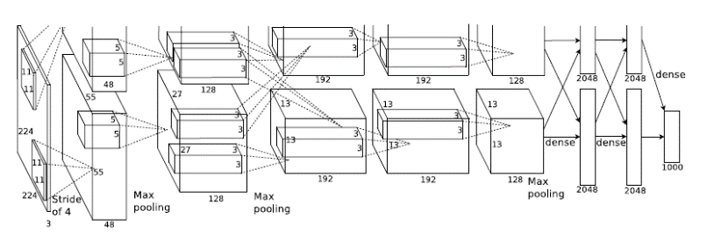
Alexnet ??
AlexNet used comparatively simple approach compared to modern DCNN model
5 conv layers,
Maxpolling layers,
Dropout layers and
3 fully connected layers.
ReLu Activation function
3 Different data Augmentation is been used :
Image translation, Patch extraction and Horizontal reflection.
Fig.5: Alexnet [2]

Slide 13
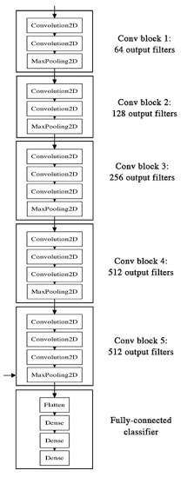
VGG16
Simplicity and Depth. Created in 2014 by Karen Simonyan and Andrew Zisserman of the University of Oxford
16 Weight Layers
3 fully Connected layer
Maxpooling layers after each covn block
Number of filter doubles after each maxpool layer.
Relu activation function used
Fig.6: VGG16 Architecture.

Slide 14
Preparing Dataset and Experimental Setup

Slide 15
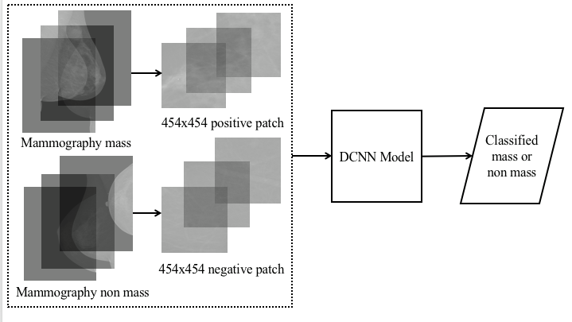
Preparing Dataset
Fig.7: Complexity Analysis Block Diagram.

Slide 16
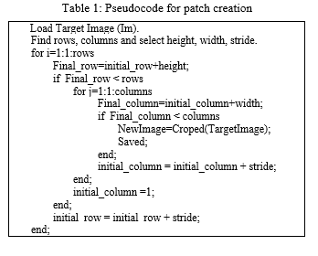
Preparing Dataset
Fig.8: Complexity Analysis Block Diagram.

Slide 17
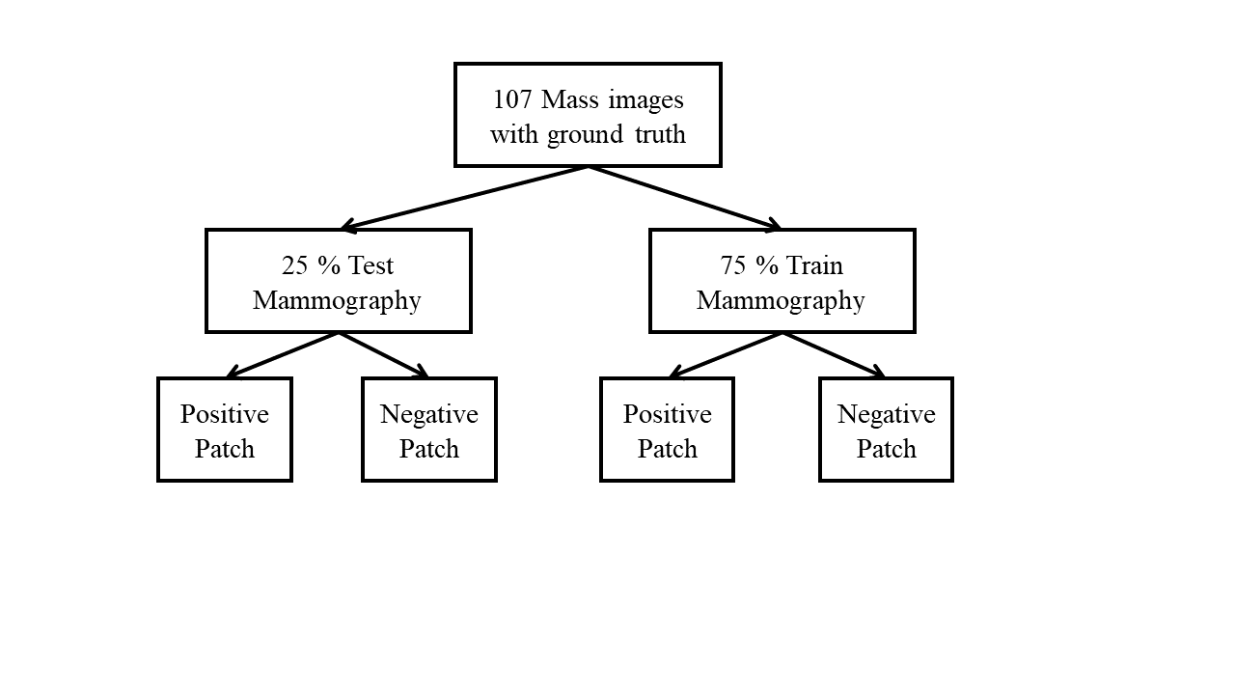
Training and Testing Dataset
Fig.9: Block diagram for manual Segmentation.

Slide 18
Training Configuration

Slide 19
Experimental Setup
 | CPU | RAM | GPU | CPU
Work station 1 | 1 (8 Hyper Threaded Core) | 256 GB | 2 TitanXP (12 GB onboard) | Work station 1
Work station 2 | 1 (4 Hyper Threaded Core) | 32 GB | 1 TitanXP (12 GB onboard) | Work station 2

Slide 20
Software Description
CUDA Version: 8.0
DL4J Framework Version: 1.0.0-alpha
JAVA SDK Version: 1.8
Maven: 4.0.0

Slide 21
Project Outcomes

Slide 22
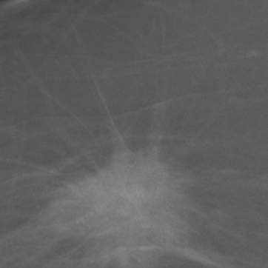
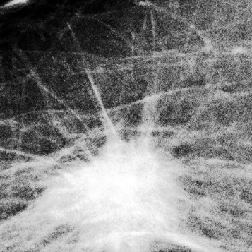
Possible Cases of Data Extractions
Case #. | Train (75%) | Test (25%)
Case-1 | P:750 and N:750 Inside mask No augmentation No pre-processing | P:250 and N:250 Inside mask No augmentation No pre-processing
Case-2 | P: 2250 and N:2250 Inside mask Two augmentations No pre-processing | P: 750 and N:750 Inside mask Two augmentations No pre-processing
Case-3 | P: 7500 and N:7500 Inside mask Nine augmentations No pre-processing | P: 2500 and N:2500 Inside mask Nine augmentations No pre-processing
Case-4 | P: 6750 and N:6750 Inside mask Eight augmentations No pre-processing | P: 2250 and N:2250 Inside mask Eight augmentations No pre-processing
Case-5 | P: 1800 and N:1800 Inside and around borders of mask Eight augmentations No pre-processing | P: 600 and N:600 Inside and around borders of mask Eight augmentations No pre-processing
Fig.10: VGG16 Architecture.
Fig.11: VGG16 Architecture.

Slide 23
Experimental Results for VGG16 (Edit Last Layer)
Train and Test from Case 1 | TP | 155
 | FP | 1
 | FN | 95
 | TN | 249
 | Accuracy | 0.8080
 | Precision | 0.8587
 | Recall | 0.8080
 | F1 score | 0.7635
Train and Test from Case 2 | TP | 729
 | FP | 89
 | FN | 21
 | TN | 661
 | Accuracy | 0.9267
 | Precision | 0.9302
 | Recall | 0.9267
 | F1 score | 0.9298
Train and Test from Case 3 | TP | 2403
 | FP | 223
 | FN | 97
 | TN | 2277
 | Accuracy | 0.9360
 | Precision | 0.9371
 | Recall | 0.9360
 | F1 score | 0.9376
Train from Case 3 and Test from Case 1 | TP | 211
 | FP | 39
 | FN | 39
 | TN | 211
 | Accuracy | 0.8440
 | Precision | 0.8440
 | Recall | 0.8440
 | F1 score | 0.8440

Slide 24
Experimental Results for VGG16 (Edit Last Layer)
Train and Test from Case 4 | TP | 2195
 | FP | 392
 | FN | 55
 | TN | 1858
 | Accuracy | 0.9007
 | Precision | 0.9099
 | Recall | 0.9007
 | F1 score | 0.9076

Slide 25
Experimental Results for AlexNet
Train and test both from case 1 No augmentations have been done on Train. Positive: 750, Negative:750 Epoch: 50, batch 20 and channel 1 | TP | 133
 | FP | 7
 | FN | 17
 | TN | 143
 | Accuracy | 0.9200
 | Precision | 0.9219
 | Recall | 0.9200
 | F1 score | 0.9172
Train and test both from case 1 2 augmentations have been done on Train. Positive: 1800, Negative:1800 Epoch: 50, batch 20 and channel 1 | TP | 145
 | FP | 17
 | FN | 5
 | TN | 133
 | Accuracy | 0.9267
 | Precision | 0.9294
 | Recall | 0.9267
 | F1 score | 0.9295
Train and test both from case 1 6 augmentations have been done on Train. Positive: 4200, Negative:4200 Epoch: 50, batch 20 and channel 1 | TP | 147
 | FP | 17
 | FN | 3
 | TN | 133
 | Accuracy | 0.9333
 | Precision | 0.9371
 | Recall | 0.9333
 | F1 score | 0.9363
Train and test both from case 1 10 augmentations have been done on Train. Positive: 4200, Negative:4200 Epoch: 50, batch 20 and channel 1 | TP | 136
 | FP | 2
 | FN | 14
 | TN | 148
 | Accuracy | 0.9467
 | Precision | 0.9495
 | Recall | 0.9467
 | F1 score | 0.9444

Slide 26
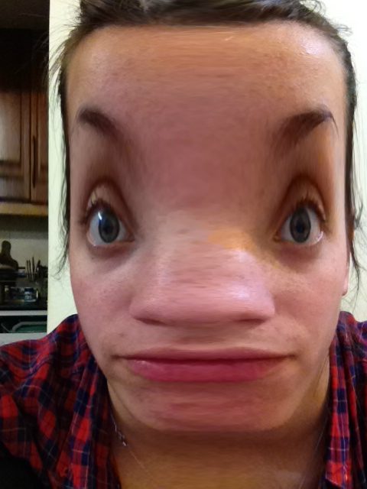
Experimental Results for AlexNet
Train and test both from case 1 2 augmentations (Warping and Flipping) have been done on Train. Positive: 1800, Negative:1800 Epoch: 50, batch 20 and channel 1 | TP | 149
 | FP | 43
 | FN | 1
 | TN | 107
 | Accuracy | 0.8533
 | Precision | 0.8834
 | Recall | 0.8533
 | F1 score | 0.8713
Fig.12: VGG16 Architecture.
Image warping is the process of digitally manipulating an image such that any shapes portrayed in the image have been significantly distorted.

Slide 27
Experimental Results for VGG16 (Bottleneck)
Train from case 3 and Test from Case 1 | TP | 82
 | FP | 23
 | FN | 168
 | TN | 227
 | Accuracy | 0.6180
 | Precision | 0.6778
 | Recall | 0.6180
 | F1 score | 0.4620
Train and Test from Case 3 | TP | 0
 | FP | 0
 | FN | 2500
 | TN | 2500
 | Accuracy | 0.5000
 | Precision | 0.5000
 | Recall | 0.5000
 | F1 score | 0.0000
Train and Test from Case 2 | TP | 0
 | FP | 0
 | FN | 750
 | TN | 750
 | Accuracy | 0.5000
 | Precision | 0.5000
 | Recall | 0.5000
 | F1 score | 0.0000

Slide 28
Conclusion and Future Work
Train from fc2 layer shows promising potential our mammography images.
The AlexNet model that trained from scratch also performed very well for more number of images in train.
Train VGG16 from the bottleneck layer does not have promising results.
To get promising results from bottleneck layer, more data must be used since its learning near about 100M parameters.
More experiments can be done to validate the results with our experimental set up.

Slide 29
Reference
[1] World Health Organization: Cancer. Access on: 01 June 2018. Available at: http://www.who.int/news-room/fact-sheets/detail/cancer
[2] A. Krizhevsky, I. Sutskever, and G. E. Hinton, “ImageNet Classification with Deep Convolutional Neural Networks,” Proceedings of the 25th International Conference on Neural Information Processing Systems, vol. 1, p.p. 1097-1105, 2012.
[3] K. Simonyan, and A. Zisserman, “Very Deep Convolutional Networks for Large-Scale Image Recognition,” arXiv:1409.1556.

Slide 30
Thank you !!!☺

Slide 31
ANY Question ???☺

