Slide 1


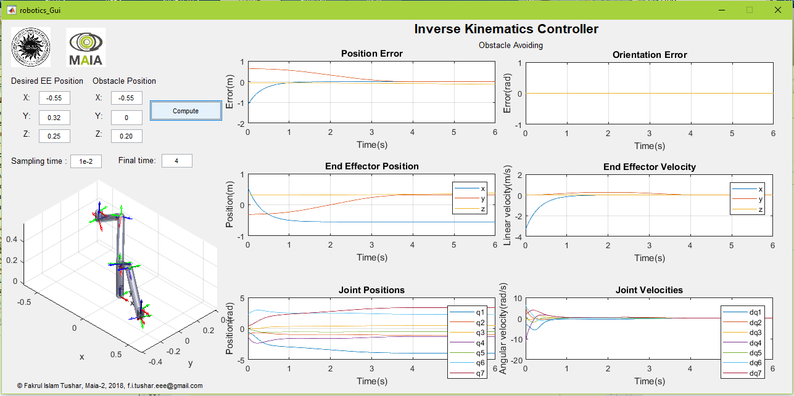
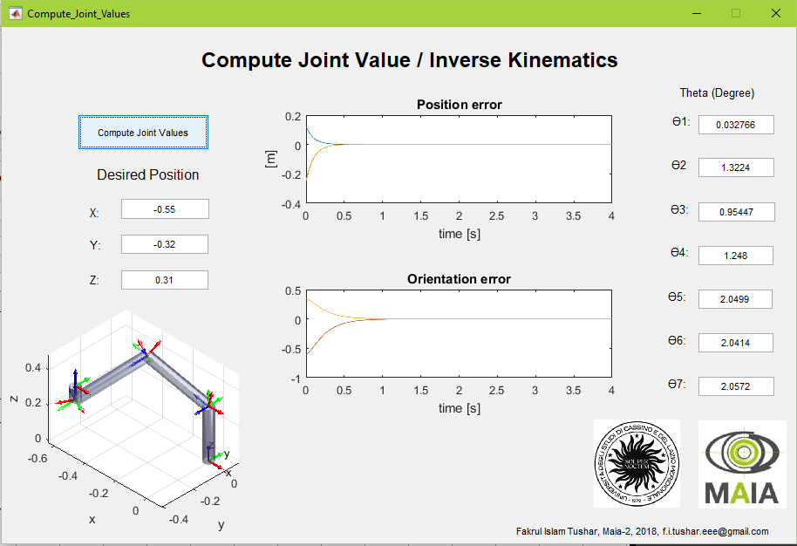
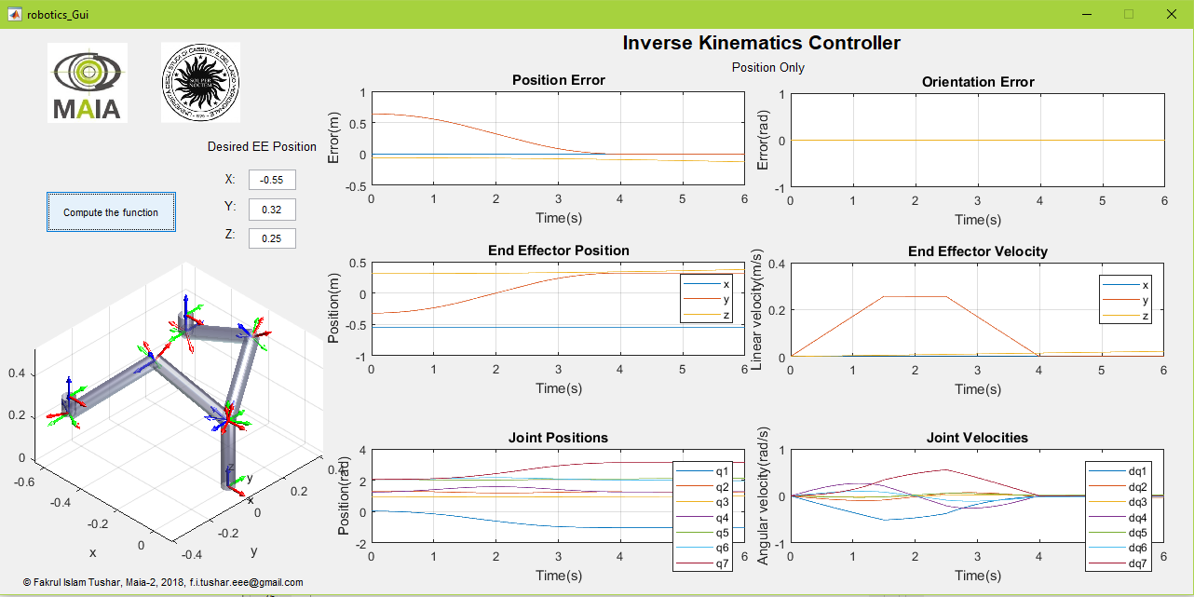
Project: Introduction To Robotics Professor: Gianluca Antonelli
Fakrul Islam Tushar
Medical Image Analysis and Applications (MAIA)
2nd Semester, University of Cassino.

Slide 2
Contents of The Presentation
Project Goal
Kinematics
DH Notations
Jaccobian
Finding Initial Joint Value
Inverse Kinematics Control Position only
Inverse Kinematics Control Position and Orientation
Inverse Kinematics Control Obstacle Avoiding
Results
Reference

Slide 3
Project Goal
Design an inverse kinematic controller to move end effector from position A to position B
1.Position Only
2.Position and Orientation
3.Obstacle Avoiding
Position and orientation Control

Slide 4
Kinematics
Kinematic model given the relation between the end-effector(EE) position and orientation and special position of the joint links
Direct kinematics
Joint Value EE Position
Joint Value EE Position
Inverse Kinematics

Slide 5
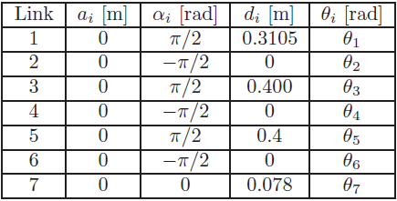
Denavit-Hartenberg (DH) Notation
Set of conventions used to represent a robot.
4 values required to describe a combination of joints:
Ө: Rotation along z axis
d: Translation along z axis
a: Translation along x axis
α: Rotation along x axis
Fig.1: DH table.

Slide 6
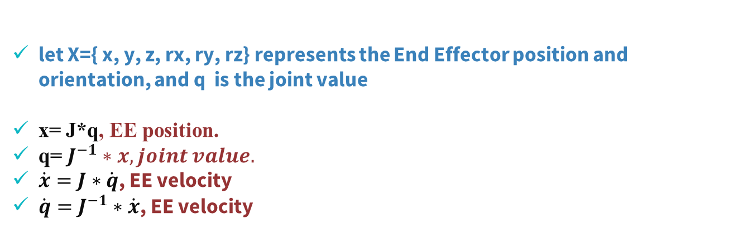
Jaccobian
Jaccobian is a function of joints values. J$=\frac{df}{dq}$
let X={ x, y, z, rx, ry, rz} represents the End Effector position and orientation, and q is the joint value
x= J*q, EE position.
q= $J^{−1}∗x, joint value.$
$\dot{x}=J∗$ $\dot{q}$, EE velocity
$\dot{q}=J^{−1}∗$ $\dot{x}$, EE velocity

Slide 7
Finding The Initial Joint Value for Initial Position

Slide 8
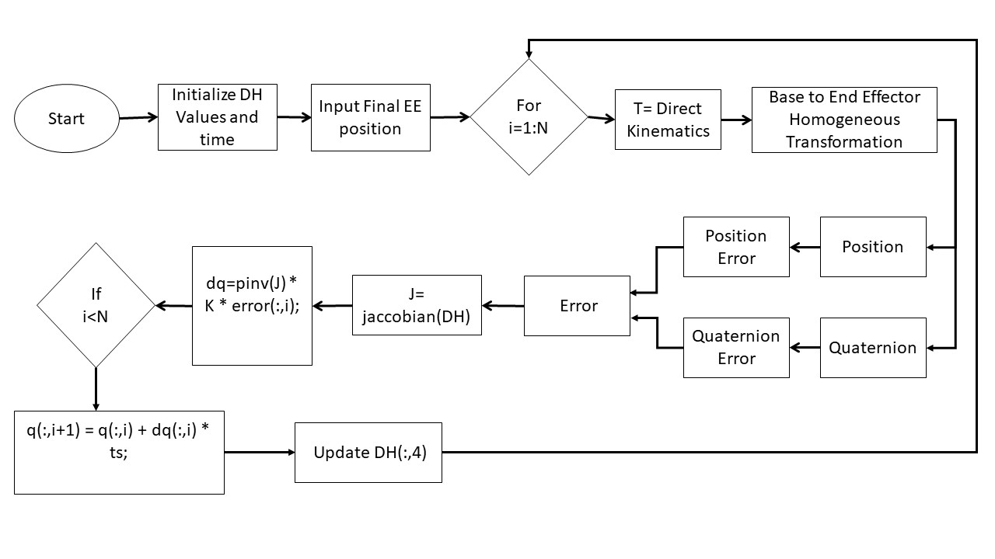
Finding Initial Joint values
Fig.2: Block Diagram of finding joint values.

Slide 9
Finding Initial Joint values
Fig.3: GUI for computing joint values.

Slide 10
Inverse Kinematics Controller Position Only

Slide 11
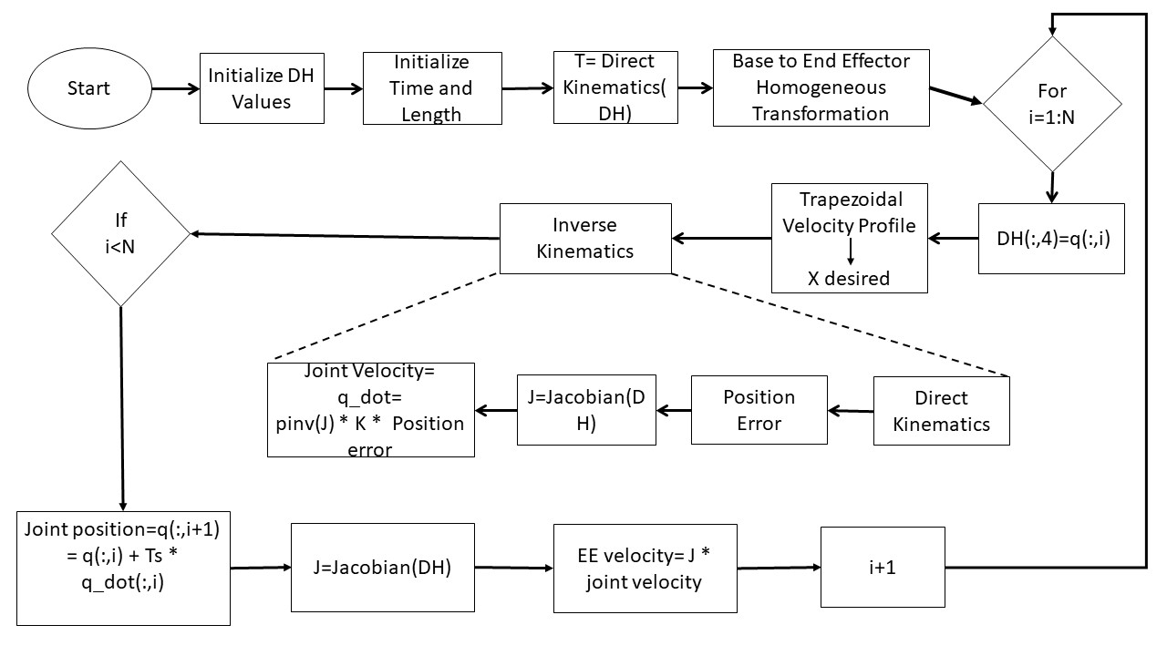
Position Control
Fig.4: Inverse Kinematics Controller (Position only).

Slide 12
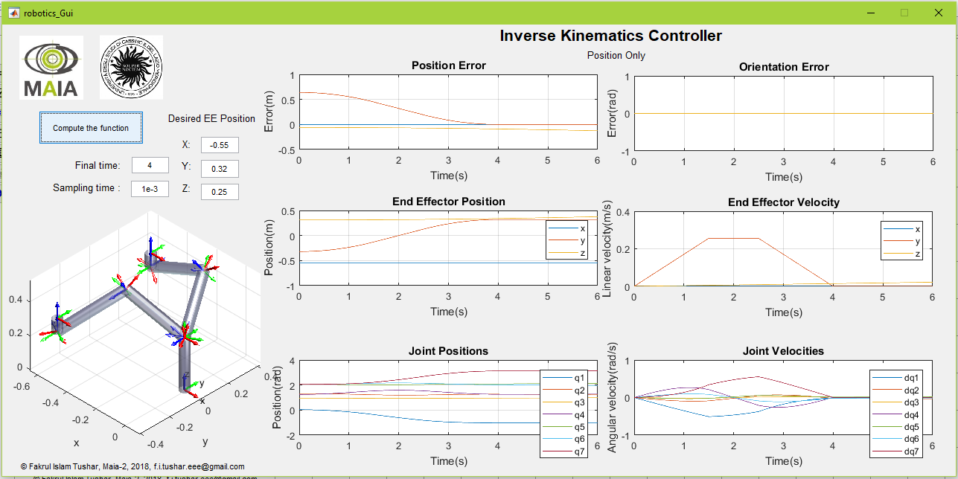
Position Control
Fig.5: Inverse Kinematics Controller (Position only).

Slide 13
Inverse Kinematics Controller Position and Orientation

Slide 14
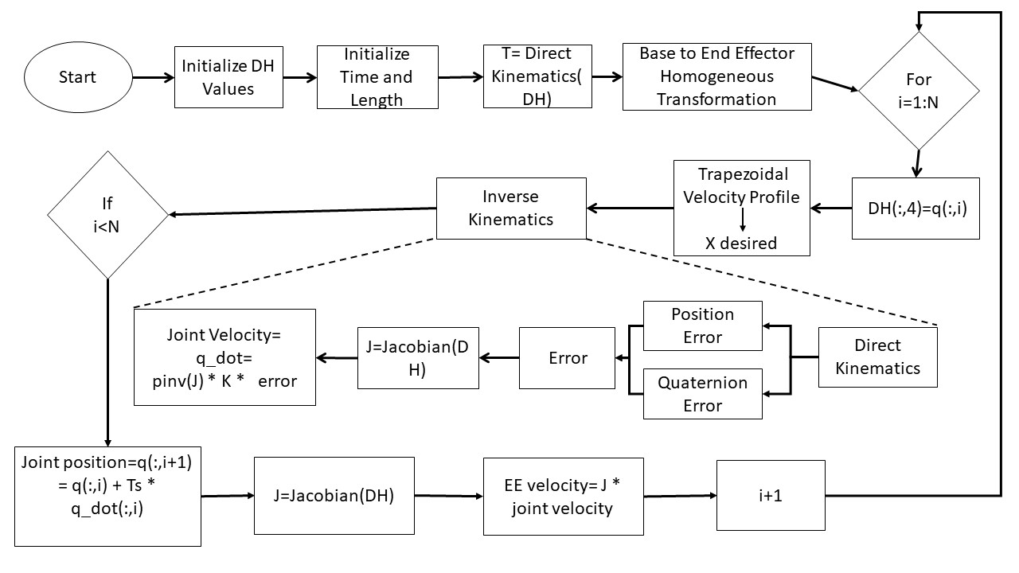
Position and Orientation Control
Fig.6: Inverse Kinematics Controller (Position and Orientation).

Slide 15
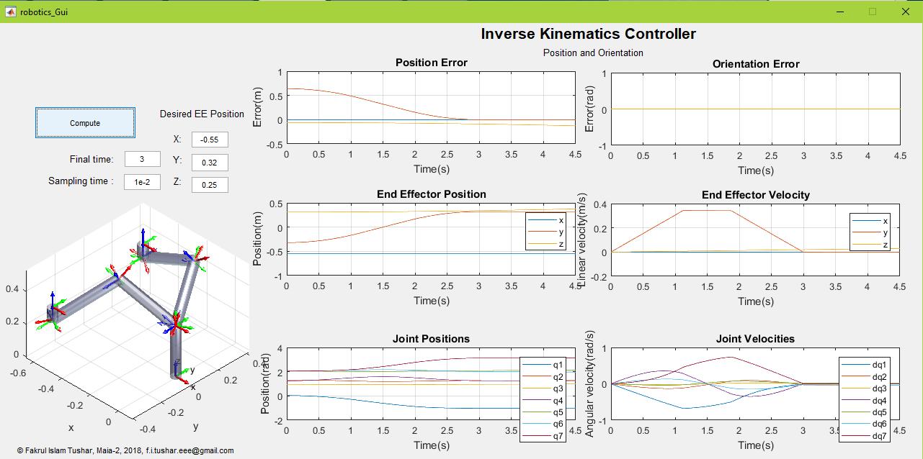
Position and Orientation Control
Fig.7: Inverse Kinematics Controller (Position and Orientation).

Slide 16
Inverse Kinematics Controller Obstacle Avoiding

Slide 17
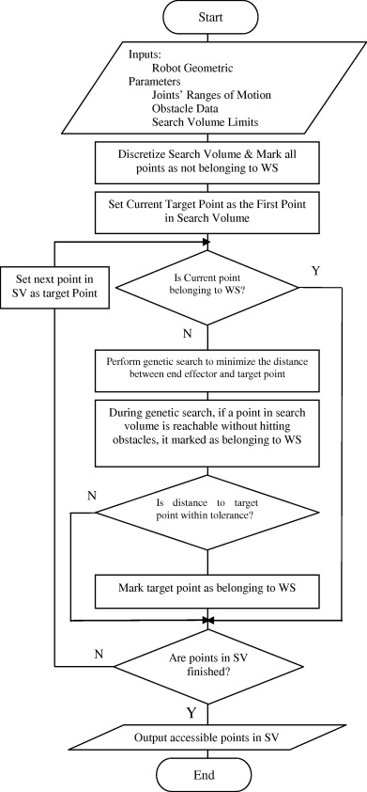
Obstacle Avoiding Control
the obstacle avoiding motion

Slide 18
Obstacle Avoiding Control
Fig.7: Inverse Kinematics Controller (Position and Orientation).

Slide 19
Results

Slide 20
Position only

Slide 21
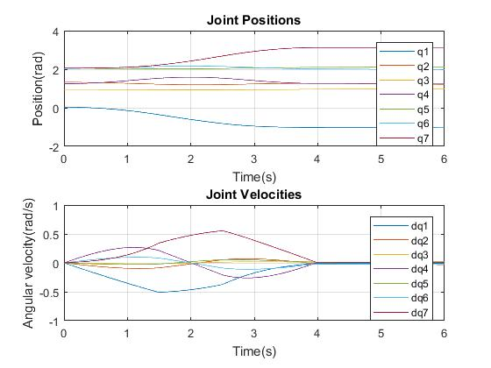
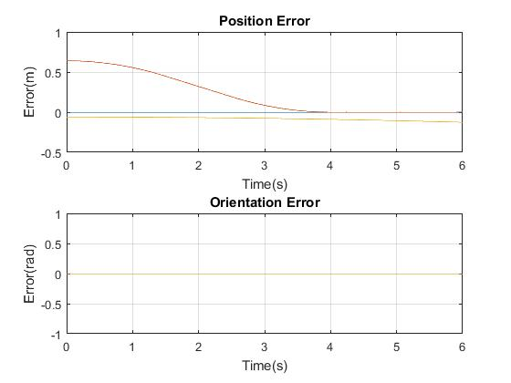
Position only
Fig.9: Block diagram for manual Segmentation.

Slide 22
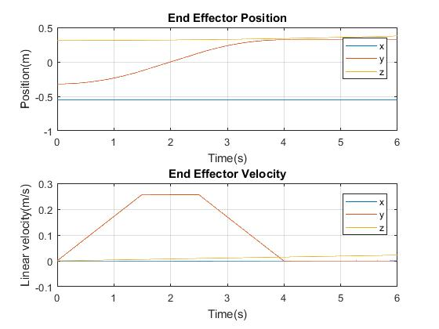
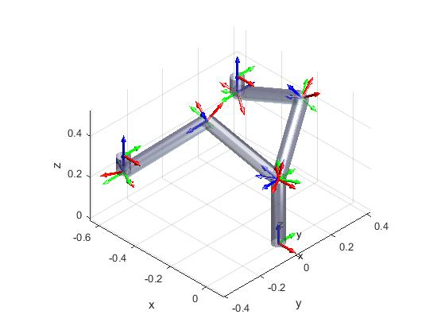
Position only
Fig.9: Block diagram for manual Segmentation.

Slide 23
Position and Orientation

Slide 24
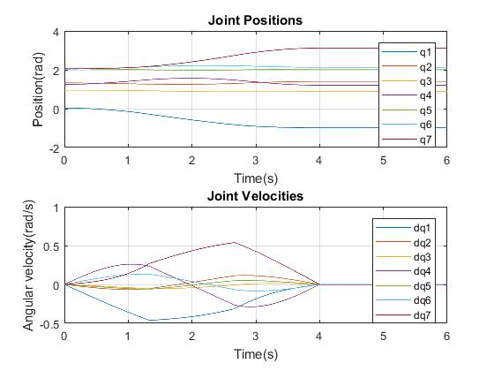
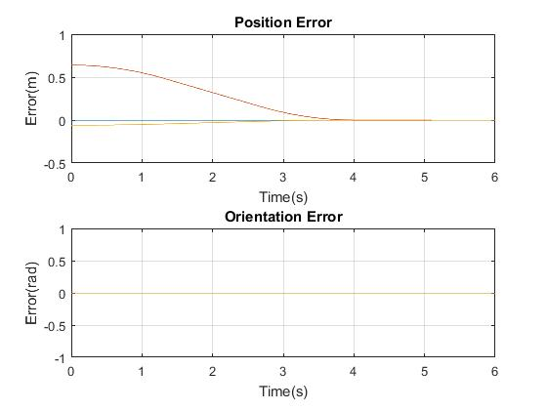
Position and Orientation
Fig.9: Block diagram for manual Segmentation.

Slide 25
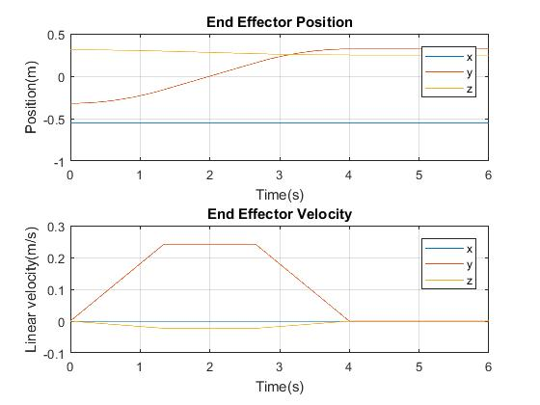
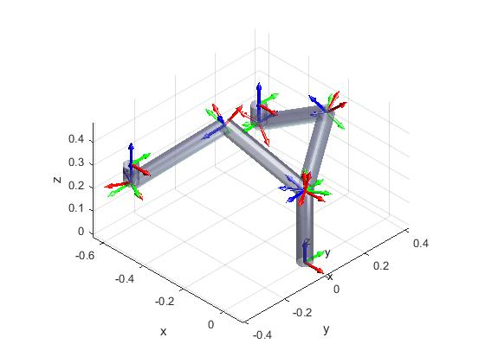
Position and Orientation
Fig.9: Block diagram for manual Segmentation.

Slide 26
Obstacle Avoiding

Slide 27
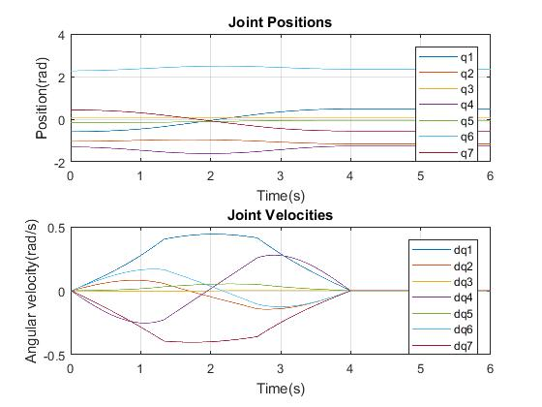
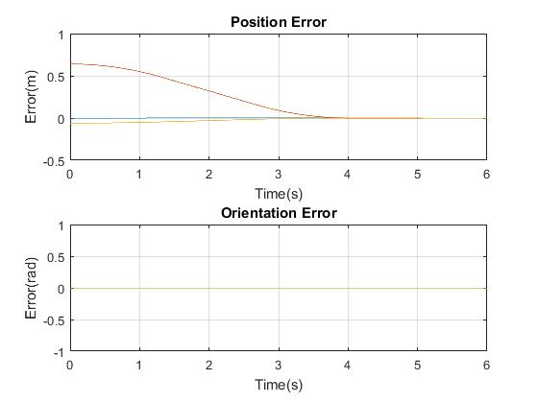
Obstacle Avoiding
Fig.9: Block diagram for manual Segmentation.

Slide 28
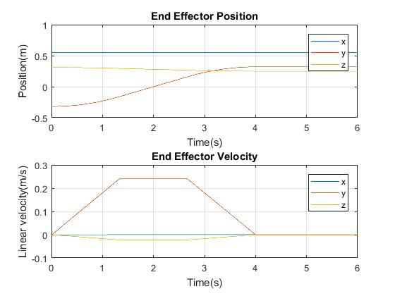
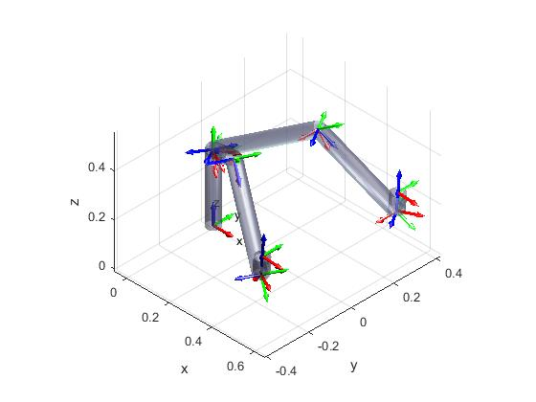
Obstacle Avoiding
Fig.9: Block diagram for manual Segmentation.

Slide 29
Project Outcomes

Slide 30
Reference
[1] Introduction to robotics Course Slides.
[2] Edx Introduction to Robotics Course [1-6 week]

Slide 31
Thank you !!!☺

Slide 32
ANY Question ???☺

