Slide 1
OptiFlow
AI-Driven Capital Investment Optimization
for Manufacturing Operations
Discrete Event Simulation · Optimization Agents · GenAI Orchestration
Ryan Fitzpatric | GE Digital Technology Experience | 2026

Slide 2
The Problem: Capital Decisions Are Slow and Analyst-Dependent
WEEKS
STATIC
GAP
Weeks, Not Minutes
Static Spreadsheets
Disconnected from Decisions
A VP making a $1M+ capital equipment decision waits weeks for a consultant analysis — by which time vendor quotes or market conditions may have changed.
Analysis arrives as a one-off spreadsheet. No scenario comparison. No audit trail. No way to interrogate assumptions behind the recommendation.
The people who run the analysis are not the people who make the call. Critical context gets lost in translation between analyst and executive.
The analysis cycle can collapse from weeks to minutes — but only if the interface is designed for the decision-maker, not the analyst.

Slide 3
The Insight: AI as the Interface Layer
Why Now
"The technology is table stakes.
The insight is the interface."
1
LLM Tool-Use APIs are production-ready
Structured tool calls with streaming make it viable to wire an LLM directly to a simulation engine.
2
AI eliminates the human cycle bottleneck
A VP does not want to configure a simulation.
They want to describe their situation
and get a recommendation they can act on.
Simulation existed. Optimization existed. What broke it: stale data, a queue of scenario requests, and a communication cycle so long the moment had passed before the answer arrived. AI gives the decision-maker the tool directly.
3
Domain models are the new moat
The bottleneck is no longer compute — it is the physics-accurate plant model and the interface that makes it accessible.

Slide 4
System Architecture: Three Layers
Each layer independently valuable; together they form a decision-support system
Layer 1
Layer 2
Layer 3
Simulation Engine
Optimization Agents
OptiFlow Interface
The Physics
The Solver
The Experience
Discrete event model: Availability, Performance, Quality (OEE)
Bottleneck-constrained throughput, compounding yield, profit delta
YAML plant model separates physical reality from market assumptions
Stochastic demand with configurable arrival variance
Three competing agents: Greedy ROI, Random Search, DQN
Action masking enforces budget and operational constraints
Agents surface non-obvious investment sequencing
Comparison reveals problem structure, not just answers
FastAPI backend + Claude tool-use API
Natural language to simulation to results — no forms
Chat · Configure · Results three-tab UI
Scenario library with rationale and side-by-side comparison

Slide 5
Layer 1: Simulation Engine
OEE as the lens — built on proven foundations, extended for dynamic scenario planning
The Foundation
What Had to Be Extended
Standard DES libraries model a fixed environment. Scenario planning requires the simulation to be dynamic — re-parameterizable on the fly.
Built on SimPy — Python discrete event simulation
Mature, well-validated DES library — same primitives used in AnyLogic, Arena, and academic simulation research
YAML plant model as mutable state
OEE mapping:
Separates physical parameters from market assumptions (vendor quotes, prices, dates). Re-runs against any scenario variant instantly — no rebuild.
Availability:
Step uptime and capacity — the throughput ceiling per step
In-flight investment state
Performance:
Approved but not yet operational upgrades tracked separately — visible in OEE projections but not consuming budget. Standard DES has no concept of this.
Throughput rate against nameplate — bottleneck-constrained across the line
Scenario-aware parameterization
Quality:
Each named scenario overrides a subset of plant model parameters as a diff. Enables fast side-by-side OEE comparison without duplicating the full model.
Yield per step, compounding — defects multiply through the process
OEE = A × P × Q:
Agent-compatible reward surface
The simulation models all three dimensions simultaneously, not in isolation
OEE-derived profit delta exposed as a callable function that optimization agents query after each proposed action.

Slide 6
Demo Scenario: Cascading Bottlenecks Across Parallel Lines
The obvious fix exposes what was hidden — supplier lead times make sequencing non-trivial
Line A — Component Machining · Supplier: Machine tool vendor
Compound
Fill A
Cap A
92%
86%
94%
BN 3
Shared Finishing
A:97% P:96% Q:99%
A:93% P:94% Q:98%
A:98% P:97% Q:99%
Label
Pack
87%
95%
Line B — Subassembly · Supplier: Automation vendor
BN 2
Mix
Fill B
Cap B
A:94% P:97% Q:96%
A:98% P:98% Q:99%
90%
59%
89%
BN 1
A:96% P:95% Q:99%
A:71% P:88% Q:95%
A:96% P:95% Q:98%
1
Fill B — OEE 59% (Obvious)
2
Label — OEE 87% (Was masked by BN1)
3
Fill A — OEE 86% (Emerges after BN2)
Availability 71% — unplanned downtime.
Refurbished cell: $180K, 16-wk lead
New unit: $240K, 6-wk lead
Both lines now fully feed Label — previously starved. In-flight upgrade approved, arrives week 10. Supplier lead time affects overlap.
Performance gap on Line A surfaces once Label resolves. Supplier sequencing from BN1 decision now constrains available budget window.

Slide 7
Layer 2: Optimization Agents — Three Competing Approaches
Intentional comparison: the contrast reveals problem structure
Baseline
Stochastic Baseline
Primary Agent
Greedy ROI
Random Search
DQN + Action Masking
Scores each available upgrade by marginal return on investment. Selects highest ROI action at each step. Fast and interpretable.
Samples N=500 random valid investment sequences within budget. Establishes stochastic lower and upper bounds on solution quality.
Deep Q-Network learns over sequences of investment decisions. Invalid actions (over-budget, max upgrades reached) masked to -inf before argmax.
+ Optimal for independent, single-step decisions
+ Provides confidence interval on solution quality
+ Discovers non-local reward sequences greedy misses
- Misses sequencing — invests in capacity before fixing yield
- No learning — pure exploration, no convergence guarantee
- Requires training; reward shaping critically important
Over-invests in Cap capacity before addressing yield
Shows non-greedy orderings can beat greedy by up to 18%
Learns yield-first ordering across diverse plant configs
Key finding: Yield-first sequencing outperforms capacity-first by 15-18% net profit across 50 benchmarked plant configs. This emerges from the compounding yield math — not from hyperparameter tuning.

Slide 8
Layer 3: The YAML-Centered Workflow
Conversation updates the model. Executive confirms. Then it runs.
1
Load Plant State
2
Converse & Update
3
Confirm the Model
4
Run
YAML source of truth
Scenario diff via chat
Visual generated for review
Simulation + optimization
Current OEE, capacity, vendor contracts, in-flight investments. Reality as-is — no setup required.
Executive: "Add Supplier B at 400 u/hr on Fill B. Budget $180K." Claude updates the YAML diff — costs, options, constraints.
SVG pipeline diagram regenerated from updated YAML. Executive reviews topology, costs, assumptions — and approves before anything runs.
One action. Simulation executes, optimizer finds best sequence, results streamed back into the conversation.
→
→
→
Tool Use Schema
load_plant_model
apply_scenario_change
generate_pipeline_svg
run_simulation
( plant_id )
( model, change_desc )
( scenario_model )
( confirmed_model )

Slide 9
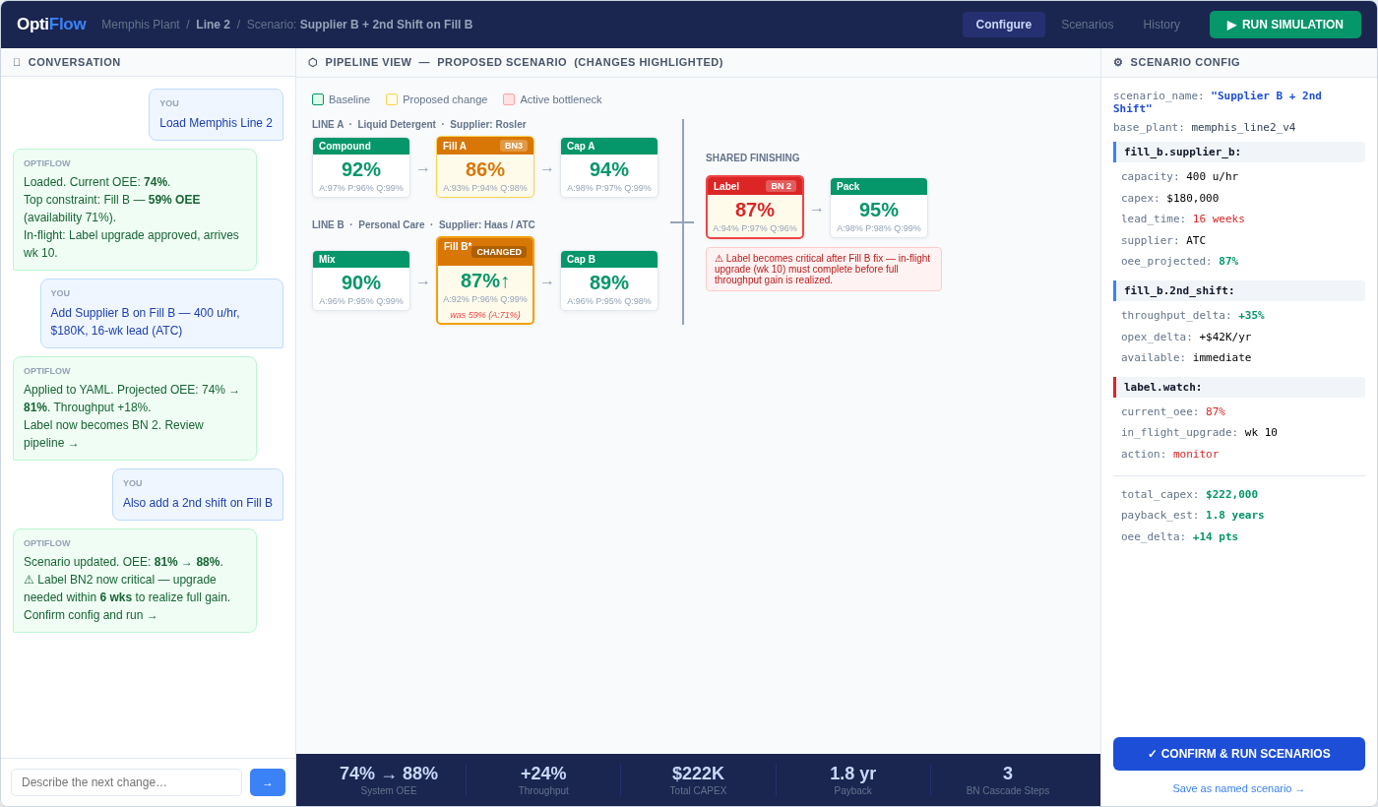
The Executive Interface: UI Prototype
Three-panel layout — conversation, live OEE pipeline, YAML scenario config

Slide 10
Scenario Planning: From Calculator to Decision-Support System
The institutional memory layer
Anatomy of a Scenario
What the Scenario Library Enables
name:
"Supplier Q1 Discount"
Named situations
"Supplier Q1 Discount" vs "Market Dip to $72" vs "Board $500K" — each with full rationale.
rationale:
"Machine tool vendor offering 18% discount through March"
tags:
["vendor-update", "q1-2026"]
In-flight investment tracking
->
Approved but not yet operational investments tracked separately — shown in projections, not consuming capital.
changes:
cap_upgrade_cost: $38K -> $31K
in_flight:
label_upgrade: approved, operational Q2
Side-by-side comparison
COO asks: show me the supplier discount scenario vs. baseline from six weeks ago. Instant answer.
created:
2026-01-14 | budget_remaining: $240K
Institutional memory
Rationale field preserves the why. Analysis is useful months later, not just the day it ran.

Slide 11
Simulation Validation: How We Know the Model Is Right
Accuracy of the simulation bounds the quality of every recommendation above it
Validation Approach
Model Integrity in Practice
Synthetic benchmarks with known optima
Vendor quote staleness
Plant configurations where the correct investment sequence is analytically derivable. Model output checked against ground truth before any live use. Covers single-bottleneck, multi-bottleneck, and near-equal constraint cases.
YAML validator flags quotes older than 60 days. Simulation runs with flagged assumptions show an uncertainty band — executive sees confidence, not false precision.
OEE component convergence testing
Availability, Performance, and Quality validated independently. N=100 → 500 → 1000 trial runs compared; results reported at N=500 where variance across all three components falls below 0.5%.
In-flight investment state
Approved but not yet operational upgrades are tracked separately in the YAML. They appear in projections without consuming budget — keeping the model honest about what's real vs. committed.
Bottleneck invariance check
Configs with one step deliberately set below all others — optimizer must identify the correct step 100% of the time. Failure here means the physics model is wrong, not the optimizer.
Scenario diff audit trail
Adversarial yield configurations
Every change to the plant model is logged as a diff with timestamp and rationale. Any scenario can be reconstructed or challenged — critical for capital approval processes.
Scenarios where greedy ROI is provably suboptimal by construction. Used to verify the optimizer learns sequencing rather than memorizing training patterns.
The simulation is only as good as the plant model. The YAML-centered design — with quote dates, in-flight tracking, and diff audit — is specifically built to keep that model honest.

Slide 12
Why Speed of Iteration Is the Actual Value
The math was never the bottleneck. The cycle was.
The Old Cycle — Plant 2, Line 2 scenario
With OptiFlow — Same scenario
Day 1
Plant manager identifies Fill B underperformance
0:00
Load Plant 2, Line 2 — model already current
Day 3
Request submitted to simulation team with context
0:45
Fill B identified as BN1. Supplier options loaded.
Day 8
Analyst builds model — Fill B only, no cascading view
1:30
Supplier B + 2nd shift scenario applied, run.
Day 11
Results returned. Manager asks: what about 2nd shift?
2:10
Label emerges as BN2. In-flight timing flagged.
Day 14
Supplier discount offer arrives. Cycle restarts.
3:00
Supplier discount arrives — YAML updated, re-run.
Day 21
Updated analysis returned. Discount window has closed.
3:45
3 scenarios saved, compared, rationale recorded.
Outcome: 3 weeks, 1 scenario explored, opportunity missed.
Outcome: Under 4 minutes, 3 scenarios explored, decision made.

Slide 13
What changed?
The plant manager now runs
the simulation.
No data engineer. No simulation expert. No analyst in the loop.
Load the plant, describe the change, confirm the model, run.
OEE-accurate simulation
Multi-agent optimization
GenAI as the interface
Scenario library
physics layer
solver layer
conversation layer
memory layer
Questions / Deep Dive / Live Configuration

Slide 14
Appendix
Technical Deep Dives for Q&A
A — Simulation Validation · B — Action Masking · C — Tool-Use Schema · D — Deployment Architecture

Slide 15
Appendix A: Simulation Validation Methodology
Synthetic benchmarks with known optima
Plant configurations where the analytically correct investment sequence can be derived by hand. Model output compared to ground truth before any live use.
Convergence testing
N=100, 500, 1000 trial runs compared. Results reported at N=500 where throughput and yield variance falls below 0.5%.
Bottleneck invariance check
Single-bottleneck configurations tested first — one step deliberately below all others. Optimizer must identify correct step 100% of the time.
Adversarial yield configurations
Scenarios where greedy ROI is provably suboptimal by construction — used to verify DQN learns sequencing rather than memorizing training configs.
Stale quote handling
YAML validator flags vendor quotes older than 60 days. Simulation runs with flagged assumptions show uncertainty band in results.

Slide 16
Appendix B: Action Masking — Implementation Detail
Why Action Masking?
Pseudocode
Without masking: agent wastes exploration budget on infeasible actions (over-budget, already max-upgraded), significantly slowing convergence.
def select_action(state, budget, q_net):
q_values = q_net(state)
# Build feasibility mask
mask = torch.full_like(q_values, -inf)
for a, action in enumerate(action_space):
if is_feasible(action, budget, state):
mask[a] = 0.0
# Apply mask before argmax
masked_q = q_values + mask
if random() < epsilon: # explore
return sample(feasible_actions)
return argmax(masked_q) # exploit
With masking: Q-values for invalid actions set to negative infinity before argmax. Agent selects only from the feasible action set at each step.
Result: faster convergence on feasible solution space; no penalty shaping required for constraint violations.
Action space: {upgrade_step_i_type_j} for all steps i and upgrade types j. Feasibility check: budget_remaining >= CAPEX_ij AND applications_i < max_applications.

Slide 17
Appendix C: Tool-Use API — Full Schema
// build_plant_model
{ name: "build_plant_model",
description: "Parse natural language into validated YAML. Ask clarifying questions when underspecified.",
input_schema: { steps: [{name, capacity_per_hr, yield_rate, opex_per_hr}],
upgrades: [{step, type, capex, opex_delta, performance_impact}],
budget: number, demand_rate?: number,
vendor_quotes?: [{item, cost, quote_date}] } }
// run_simulation
{ name: "run_simulation", input_schema: { plant_model: PlantModel, n_trials: number }
// returns: throughput_dist, bottleneck_step, yield_by_step, confidence_intervals }
// run_optimization
{ name: "run_optimization",
input_schema: { plant_model, agents: ["greedy","random","dqn"], budget }
// returns: ranked sequences per agent, profit_delta per sequence }
// compare_scenarios
{ name: "compare_scenarios",
input_schema: { scenario_a: ScenarioRef, scenario_b: ScenarioRef }
// returns: delta table (throughput, yield, profit, capex_exposure) }

Slide 18
Appendix D: Deployment Architecture & Latency Profile
FastAPI Backend
Claude Tool-Use API
Python 3.11. Async endpoints. SSE for streaming results. Handles concurrent simulation + LLM calls.
claude-sonnet model. Streaming tool_use blocks. Max 3 tool rounds per conversation turn.
Simulation Engine
DQN Agent
Pure Python DES. N=500 trials: ~1.2s on M2 Pro. Runs in-process for plant models < 1K steps.
PyTorch. Pre-trained on 50K synthetic configs. Inference-only at runtime: <50ms per optimization call.
Plant Model Store
Frontend
YAML files on disk (dev) / S3 (prod). Scenario library: SQLite (dev) / Postgres (prod). Sub-10ms reads.
React + Vite. SSE consumer for streaming. SVG pipeline rendered client-side from YAML. No iframe.
End-to-end latency: ~4s (LLM + sim + optimization). Streaming means first results appear in ~1.5s. Acceptable for executive decision cadence.

