Slide 1


Gini split vs Entropy: does the splitting criterion change interpretability of decision trees?
CS4437 EXPLAINABLE AI · GROUP 9 SUBMISSION 09/10/2026
Aaron McGuinness · Skye Fitzpatrick · Mark James Drohan · Mikey Fennelly

Slide 2
Presentation Overview
INTRODUCTION
BACKGROUND RESEARCH
DATASETS CHOSEN
DATASET FEATURES
ANALYSIS METHODS FOR INTERPRETABILITY
RESULTS TO DATE
CONCLUSION
QUESTIONS
REFERENCES

Slide 3
Two ways for a decision tree to choose its next split
INTRODUCTION
Gini
Entropy
1 − Σ p(k)² [2]
− Σ p(k) log₂ p(k) [2]
Chance of mislabelling · scikit-learn default [1]
Shannon uncertainty · information gain
Notes:
Gini split measure how the split reduces the chance of mislabelling (randomly assign a label using the node’s class)
Entropy split minimizes the weighted entropy of the child nodes

Slide 4
Does the choice of either Gini split or entropy split change the interpretability of a decision tree is?
RESEARCH QUESTION

Slide 5
Expected possible outcomes
INTRODUCTION
H0
No real difference
H1
Gini: simpler, less stable
H2
Entropy: more stable, deeper
H3
It depends on the dataset

Slide 6
Prior work measures agreement, not explanations
BACKGROUND RESEARCH
≤2%
Doesn't specify whether the trees are easier to interpret
of cases where the two criteria pick a different split [3]

Slide 7
BACKGROUND RESEARCH
Additional Info
CART (Classification and Regression Trees) is an algorithm that builds a tree from binary yes/no splits [6].
ID3 (Iterative Dichotomiser 3) is Quinlan’s algorithm that builds a tree from categorical attributes, giving each node one branch per value [7].
CART introduced Gini [6]; ID3 introduced information gain [7].
Trees with more leaves are harder to understand [8].
Small data changes can produce a different tree [9].

Slide 8
Datasets that we chose to use and why

Slide 9
Three medical datasets from UCI
DATASETS CHOSEN
Dataset | Patients | Features | Predicts
Breast Cancer Wisconsin | 569 | 30 | Malignant
Heart Disease (Cleveland) | 303 | 13 | Disease
Heart Failure Clinical Records | 299 | 12 | Death

Slide 10
Three cleaning decisions
DATASET FEATURES
Heart disease
Heart disease
Heart failure
Severity 0–4 → yes / no
6 missing values imputed
Dropped "time": it leaks the outcome

Slide 11
Analysis methods for interpretability and explainability

Slide 12
Structure & Complexity
ANALYSIS METHODS
Tree Depth
Deeper trees are less interpretable, and they require more splitting decision points.
Node / Leaf Count
More nodes or leaves on a tree means more possible paths for the model to reach a given outcome.
Features Used
Less features means less information you need to hold in your head to explain a model prediction.

Slide 13
Tree Stability
ANALYSIS METHODS
More stable splitting method means better interpretability
What does it mean for a splitting criterion to be “more stable”?
Does the structure stay roughly the same?
Are the most important features the same?
Tested by running the same split method against different train/test splits of the data!

Slide 14
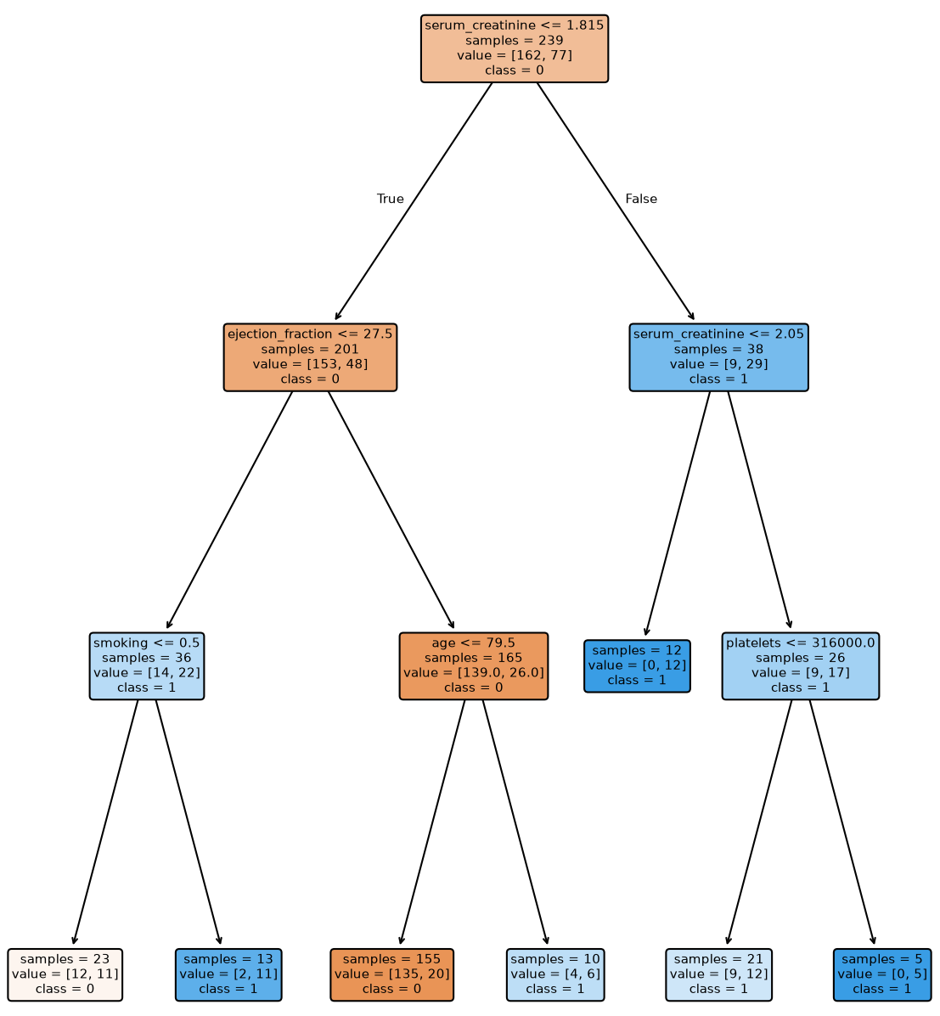
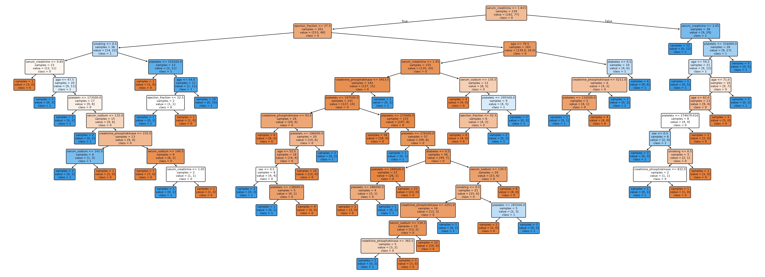
Accuracy vs Depth
ANALYSIS METHODS
Same dataset (heart_failure) split on entropy
Limited depth of 3 has only 7 leaves, 75% accuracy
Unlimited depth arrived at 14 with 50 leaves, 60% accuracy
Tree accuracy at fixed depths (3/5/7/10)
Accuracy at larger depth comes at the expense of explainability!
If one splitting criterion is more accurate at a set, shallow depth, then it provides more interpretability power per unit of complexity.

Slide 15

Full analysis pipeline, only the criterion changes
ANALYSIS METHODS
Download
Clean
Split
Train ×2
Compare
UCI by dataset id
Encode, impute
80/20, stratified
Gini, entropy
Top 3 levels
Metrics:
Tree structure and depth
Stability over 30 resamples
Accuracy at depth 3 / 5 / 7 / 10

Slide 16
Results

Slide 17
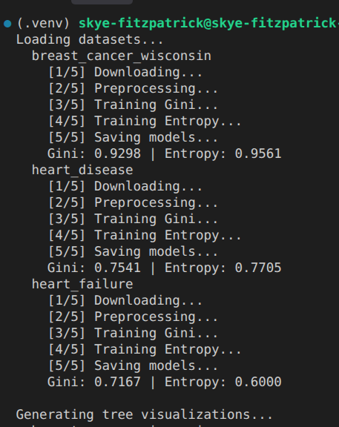
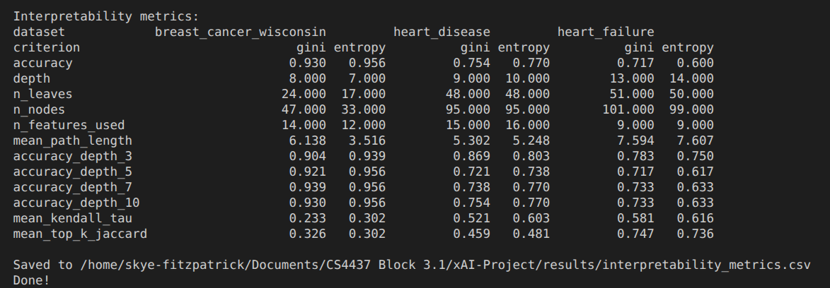
RESULTS

Slide 18
No criterion wins everywhere on accuracy alone
RESULTS
This backs up what we discovered in our initial research
Gini
Entropy
93.0%
Breast cancer
95.6%
75.4%
Heart disease
77.0%
71.7%
Heart failure
60.0%

Slide 19
Tree size only differed on one dataset
RESULTS
Breast cancer
Heart disease
Heart failure
47
33
95
95
101
99
Gini nodes
Entropy nodes
Gini nodes
Entropy nodes
Gini nodes
Entropy nodes
Entropy ~30% smaller
Same size
Near identical

Slide 20
Stability depends on the dataset, not the criterion
RESULTS
Gini
Entropy
Kendall's τ of feature rankings, higher = more stable
0.37
Breast cancer
0.31
0.54
Heart disease
0.55
0.64
Heart failure
0.62
≤ 0.06 gap between criteria
0.33 gap between datasets

Slide 21
Hypotheses: early verdict from only 3 datasets
RESULTS
H0
No real difference
H1
Gini: simpler, less stable
Leaning yes
Not supported
H2
Entropy: more stable, deeper
H3
It depends on the dataset
Not supported
Supported

Slide 22
1
No consistent winner between Gini and entropy.
2
The dataset shapes interpretability far more than the criterion.
3
Gini as the default looks safe for explanations.

Slide 23
Thank you
Questions?
AI DECLARATION
This presentation was generated with assistance from Claude.

Slide 24
REFERENCES (IEEE format)
[1] scikit-learn developers, “DecisionTreeClassifier,” scikit-learn, 2026. [Online]. Available: https://scikit-learn.org/stable/modules/generated/sklearn.tree.DecisionTreeClassifier.html. [Accessed: Oct. 9, 2026].
[2] MathWorks, “ClassificationTree,” MATLAB Help Center. [Online]. Available: https://www.mathworks.com/help/stats/classificationtree.html. [Accessed: Oct. 9, 2026].
[3] L. E. Raileanu and K. Stoffel, “Theoretical comparison between the Gini Index and Information Gain criteria,” Annals of Mathematics and Artificial Intelligence, vol. 41, no. 1, pp. 77-93, 2004.
[4] W. Wolberg, O. Mangasarian, N. Street, and W. Street, “Breast Cancer Wisconsin (Diagnostic),” UCI Machine Learning Repository, 1993. [Online]. Available: https://doi.org/10.24432/C5DW2B. [Accessed: Oct. 9, 2026].
[5] A. Janosi, W. Steinbrunn, M. Pfisterer, and R. Detrano, “Heart Disease,” UCI Machine Learning Repository, 1989. [Online]. Available: https://doi.org/10.24432/C52P4X. [Accessed: Oct. 9, 2026].
[6] L. Breiman, J. Friedman, R. Olshen, and C. J. Stone, Classification and Regression Trees. Chapman and Hall/CRC, 2017. [E-book] Available: https://doi.org/10.1201/9781315139470
[7] J. R. Quinlan, “Induction of decision trees,” Machine Learning, vol. 1, Mar., pp. 81-106, 1986.
[8] R. Piltaver, M. Luštrek, M. Gams, and S. Martinčić-Ipšić, “What makes classification trees comprehensible?,” Expert Systems with Applications, vol. 62, pp. 333-346, 2016.
[9] M. Last, O. Maimon, and E. Minkov, “Improving Stability of Decision Trees,” International Journal of Pattern Recognition and Artificial Intelligence, vol. 16, no. 2, Mar., pp. 145-159, 2002.

