Slide 1

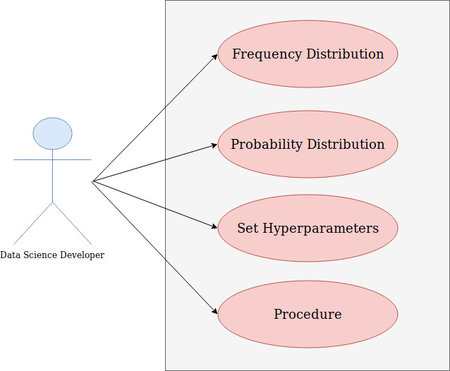
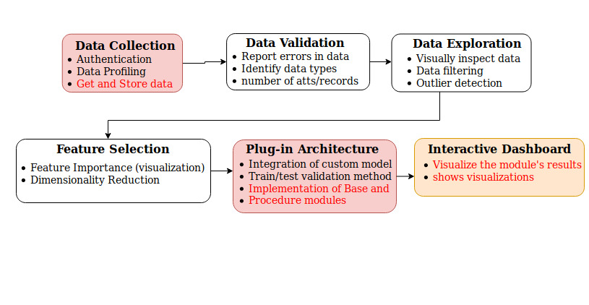
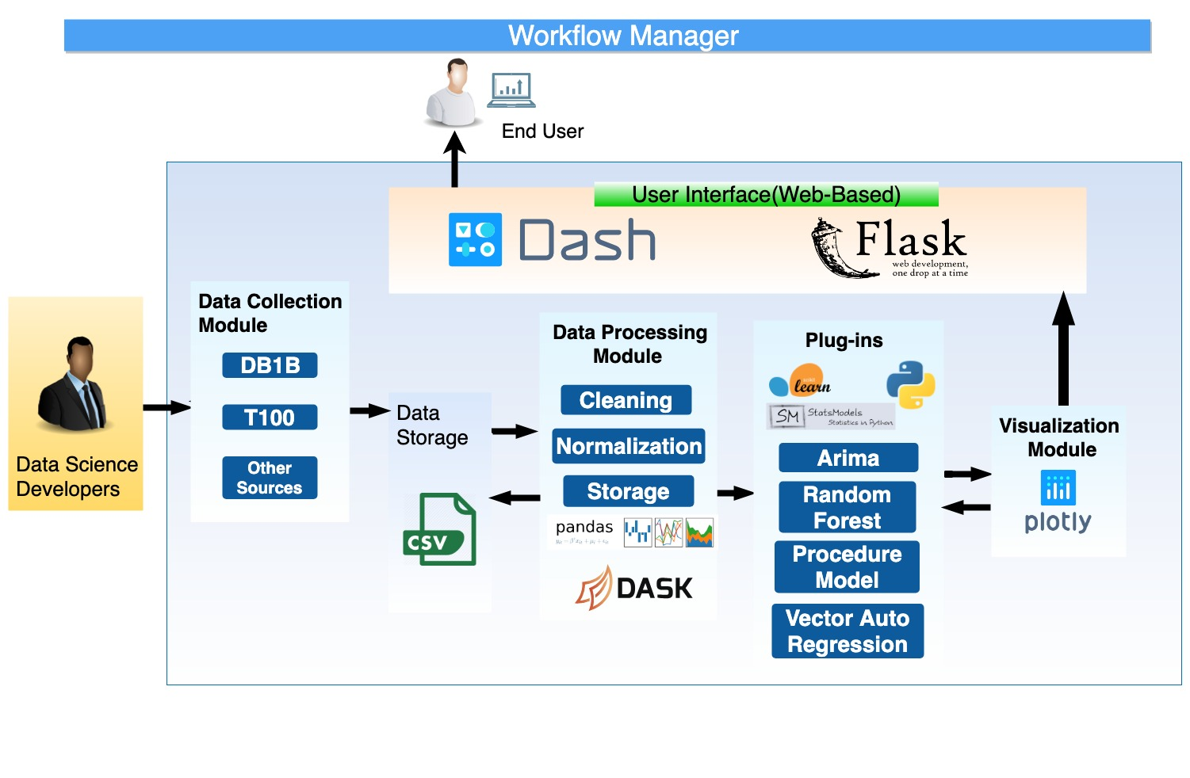
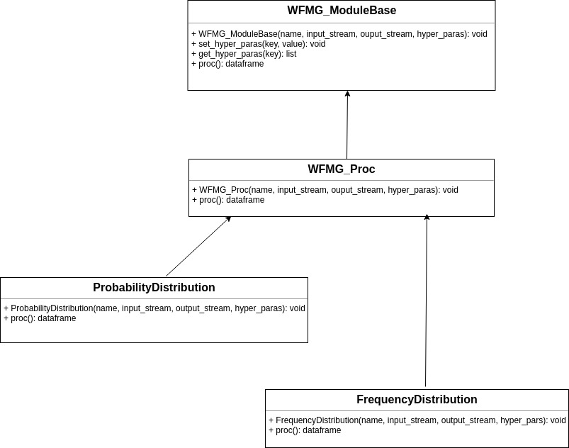
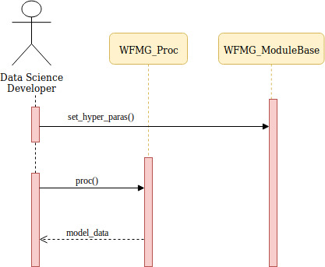
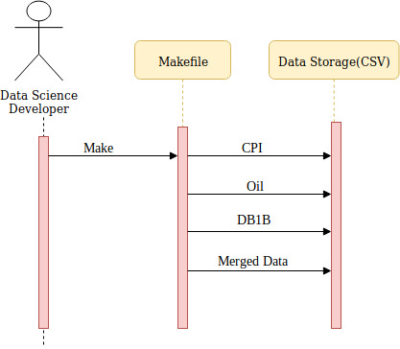
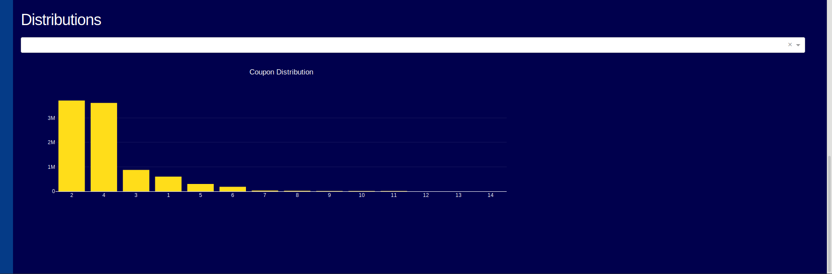
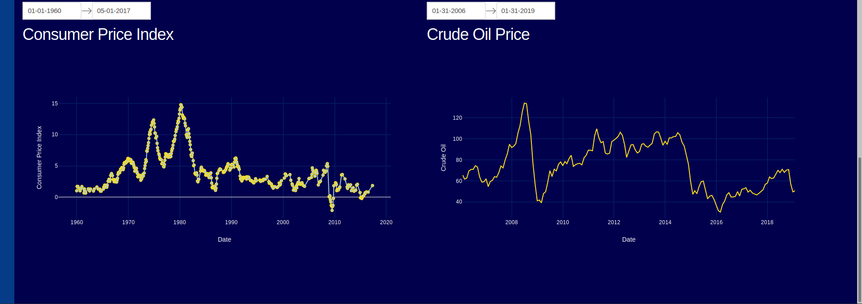
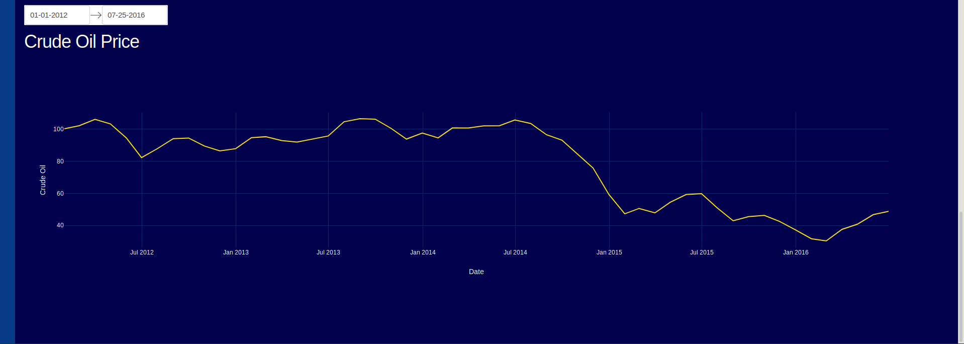
School of Computing & Information Sciences
Spring 2019 Senior Design Project
Data Science Workflow Manager
Students: Serge Metellus
Mentor: Steven Luis, Dr. Miguel Alonso, Florida International University
Instructor: Dr. Masoud Sadjadi, Florida International University
Problem
Current System
Requirements
The airline industry currently does not have
the capability to fully utilize the large
Amounts of data generated every day to
enhance customer experience, increase
the efficiency of operations or make better
data-driven decisions. Following the latest
data science tools and techniques, we can
leverage valuable insights from airline data.
Version 1.0 System:
      Users are able to see the visualizations of the
      data collected and processed from CPI and Oil.
      The different distributions can be selected from a
      drop down and the responding graph will be
      displayed.
      The graphs display data returned by the
      procedure method of each distribution class
The WFMG project requires the development of
A front-end that
displays visualizations
of data to the users
and allows the users
to filter and compare
data from different
sources
A WFMG Module,
shown in the diagram,
that returns the probability and frequency distributions of the various data
sources
Data processing scripts, one for each source,
automated by Make that processes and cleans
the data before visualizing
A back end web application that interfaces the
WFMG module, data processing scripts, and the
user interface.
System Design
An overview of the entire system architecture
highlighting the different modules in the system.
Object Design
Class Diagram depicting the WFMG Module base
class and the Procedure class. The distribution
sub-classes of WFMG_Proc returns the specified
distribution of the input Stream.
Implementation
WFMG Module
Base
Virtualization module that allows data science developers
To find the probability or frequency distribution of a
data set.
Data
Processing
Module
Make file that allows developers to process multiple
sources of data concurrently.
The processed data is then Imported by the
controller for visualization.
Verification
Integration and Unit Testing were used to verify the
System.
Screenshots
Test case ID: WFMG-24-UT
Purpose | Validate that the developer is able to instantiate the distribution classes and use the specified methods.
Precondition | The developer must have the WFMG module in the present working directory or imported from somewhere else.
Expected Results | The developer should be able to instantiate the Probability and Frequency sub classes.
Actual Results | The results are as expected, the models used to instantiate the distribution sub classes are able to use the methods from those classes and the inherited methods from the super-class
Status | Pass
Visualization of the Coupon Distribution from DB1B
Side by Side view of CPI and Crude Oil
Crude Oil Price for a specific date range
Summary
The goal of this project is to create a workflow manager
that allows developers working on a data science
project to introduce new models as plugins into
data processing to allow end users to visualize
and explore processed data and various data
distributions.
In this first iteration, we focused on the plugin
architecture and the interactive dashboard for
users interested in analyzing the different
data distributions.
Test case ID: WFMG-24-IT
Purpose | Validate that the visualizations in the graphs are able to use the methods from the WFMG module.
Precondition | The application (browser) must be installed and running.
Expected Results | The graph should use data from a data fame return by a call to the proc method.
Actual Results | The graph is visible from the dashboard with the expected style and arrangement and the data points come from a dataframe returned by the proc method.
Status | Passed
Acknowledgement
The material presented in this poster is based upon the work supported by FIU AIRLab and FareLogix . I am thankful for the help that I received from my group member Tomas Ortega

