Slide 1
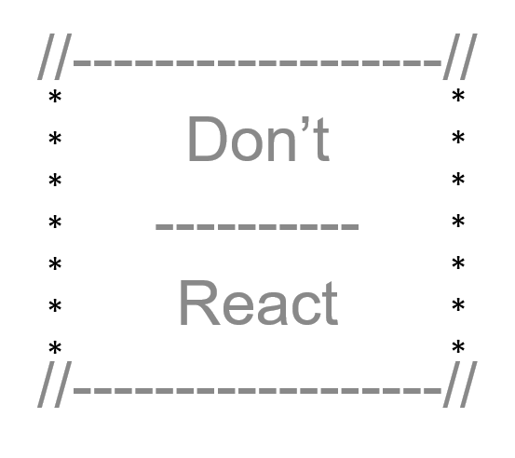
SocialQs Social cues for social misfits
2019

Slide 2

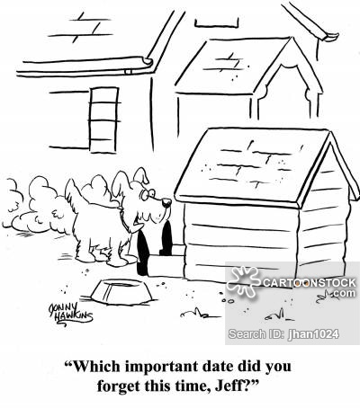
Are you a Social Misfit? Do you struggle with remembering important dates? Do you find time slipping by and realize you haven’t reached out to your family or friends in months? Have you ever picked up the phone to call someone and had a moment of panic realizing you have no idea what to say or you forgot their significant others name? If you answered yes to any of these questions, this is the site for you!

Slide 3
Why Social Q’s?
Social Q’s is Facebook without the noise.
It is A tool to help you connect with people you love without all the distractions that come with so many social media platforms.

Slide 4
What is Social Q’s?
Social Q’s is A Personal Relationship Manager
Allows you to keep track of your connections Even if they don’t’ even touch a computer.
Display a timeline of upcoming important events.
Gives you gentle reminders when an event important to you is coming up.
Allows you to set interval reminders to connect with someone.
All on your own terms

Slide 5
About SocialQs SocialQs for Social Misfits
Application Technologies
ReactJs
Deployed to Heroku
Node and Express Web Server
Mongo and Mongoose
Styled-components, Materialize, Bootstrap and/or CSS grid
Authentication tool is Passport – may consider OAuth
Competitive Analysis & Research
Monica (www.monicahq.com) – Personal records management - reminders for a fee
Hip (www.hip.com) – Planner & reminders – lacks personal records management - fees
iCalendar (https://icalendar.org) – Reminders – lacks the robust personal records management

Slide 6
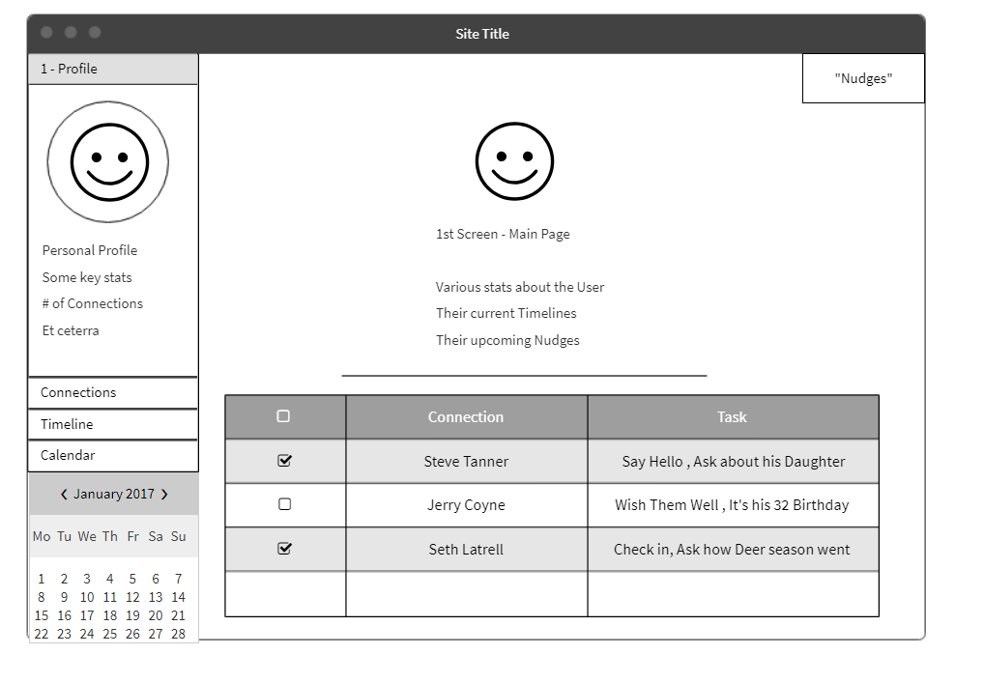
HomePage
Home Page – default to user profile
Contacts
Timeline
Calendar (stretch goal)

Slide 7
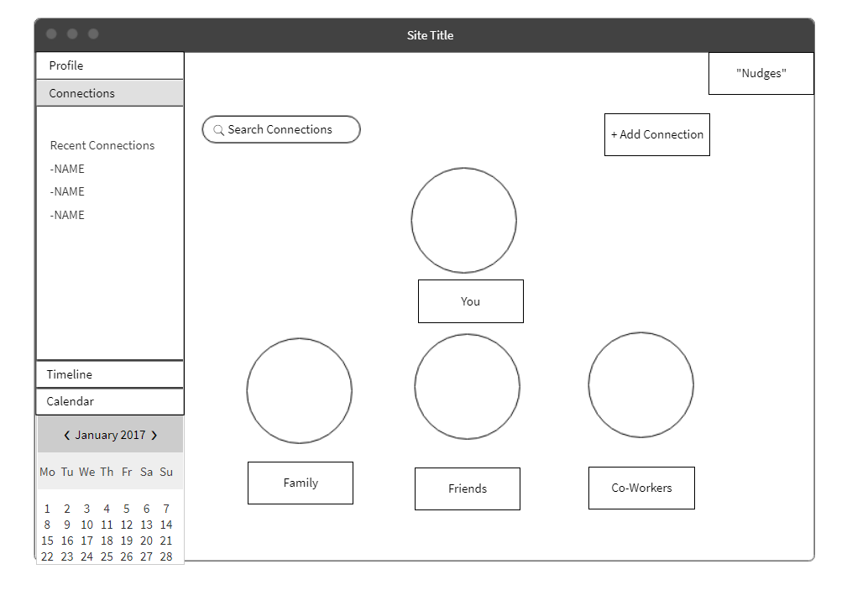
Contacts
Grouped by Relationship Type
Family / Friends / CoWorkers

Slide 8
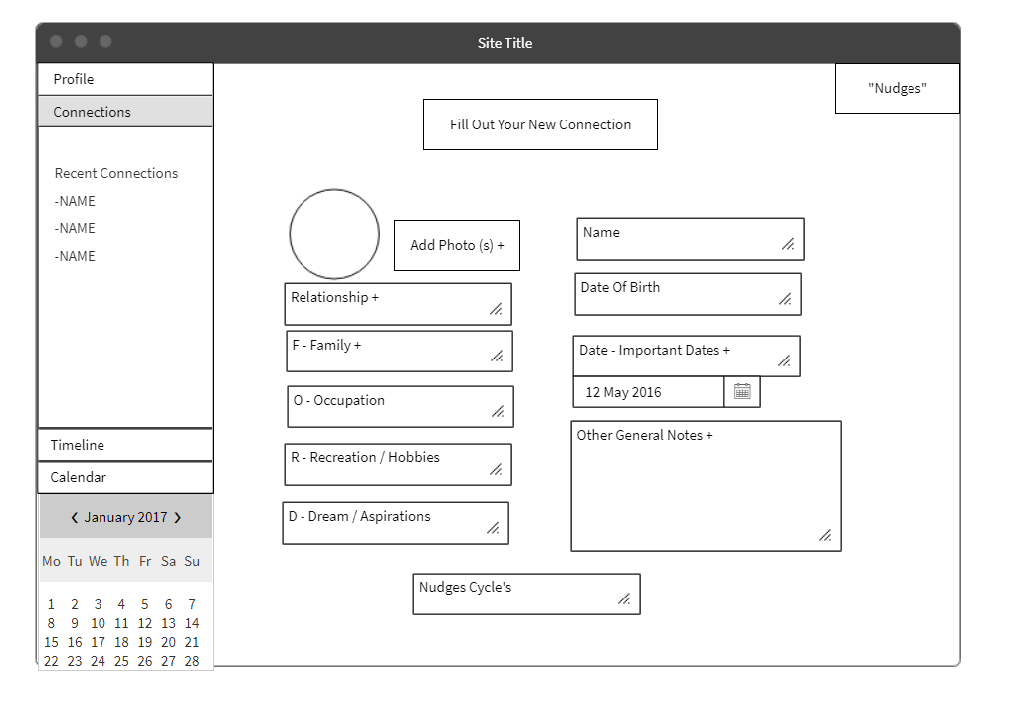
New Connection
Create, view, and edit contacts
In addition to a list of past and upcoming cues.

Slide 9
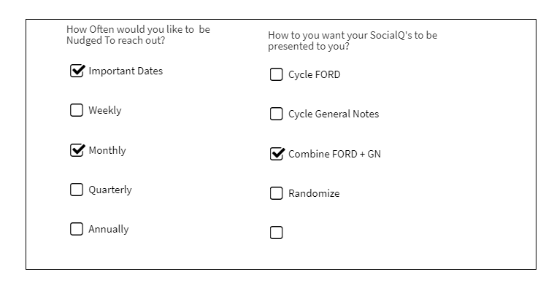
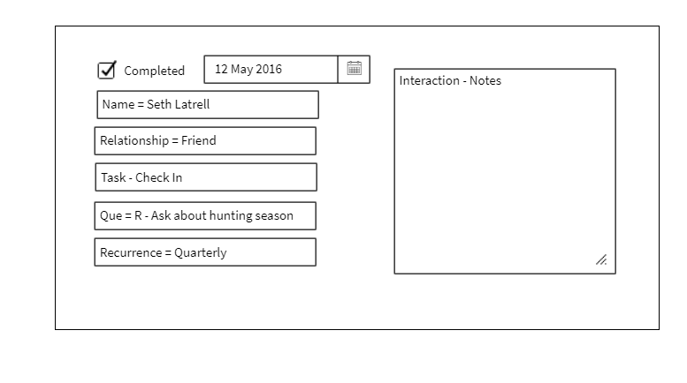
Cues
Determine what events you would like to be cued about
Set personalized recurring cues for each contact
Check a cue as completed and take notes for future connections.

Slide 10
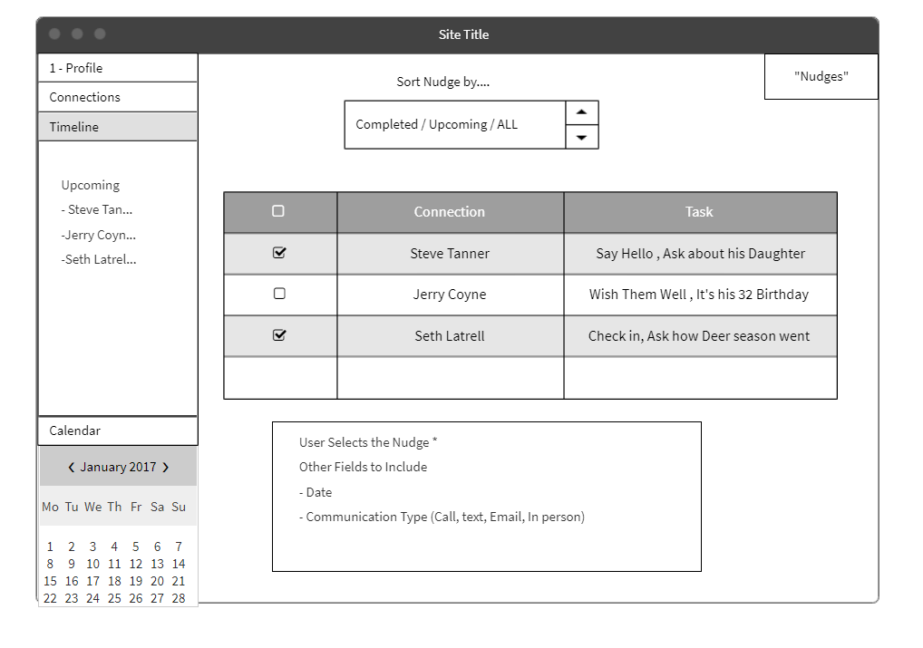
Timeline
Timeline of your upcoming events
Mark as completed or add a cue about an event

Slide 11
Initial Roles
Cheyra and Felicia - login and user profile CRUD
Laurie and Mark - user connections CRUD
Mike - setup, platform, database, events

Slide 12
Timeline
3/2 MVP
User can create, view, update, and delete a user profile.
User can create, view, update, and delete contact profiles and groups.
User can view and complete their upcoming events in a timeline.
3/9 Increased functionality
User can create a cue notification based on events in their timeline.
User can create a recurring cue notification to help them keep in touch with a specific contact.
Security and authentication
3/18 Finishing touches and stretch goals
User can view upcoming events in a calendar format and filter results.
User can view their past events and contact with contacts in a user log.

Slide 13
Project Board

Slide 14
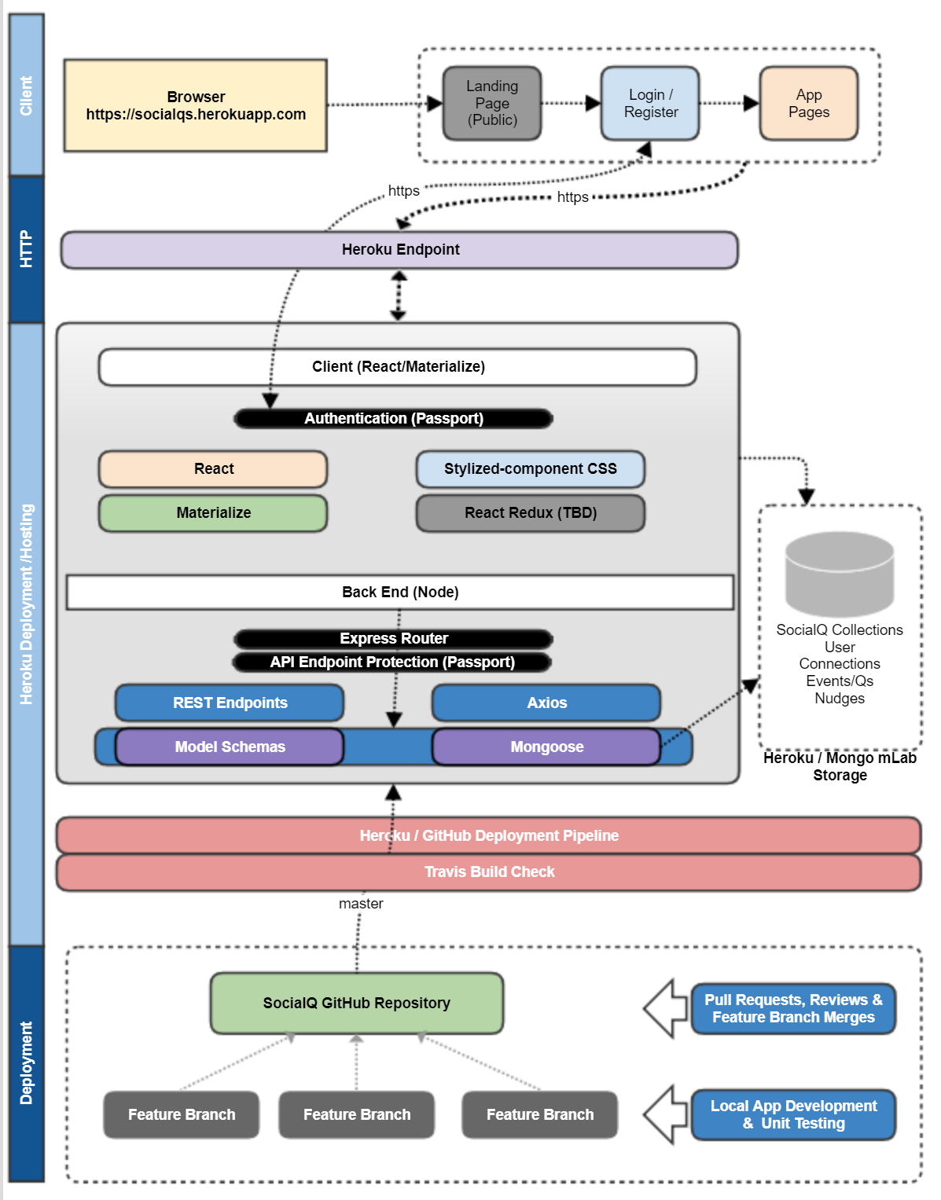
Technology Stack

Slide 15
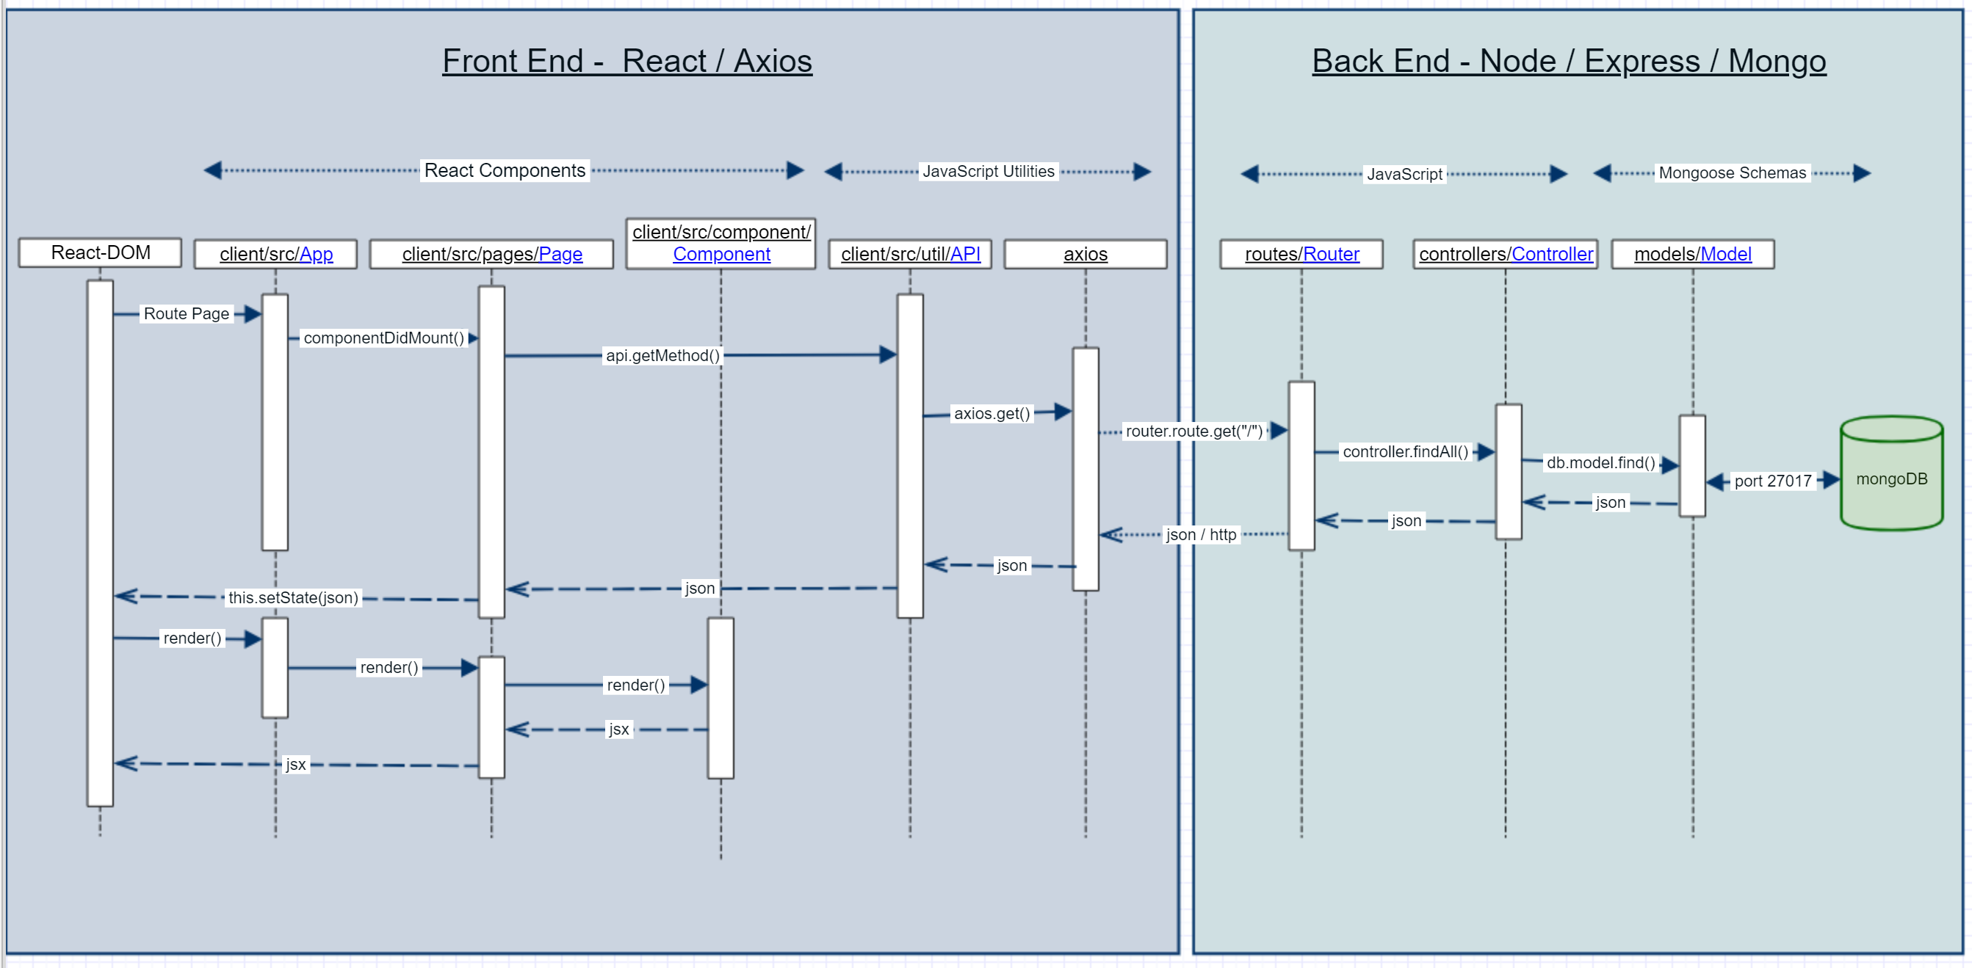
MVC Pattern – Round Trip Call Flow

