Slide 1
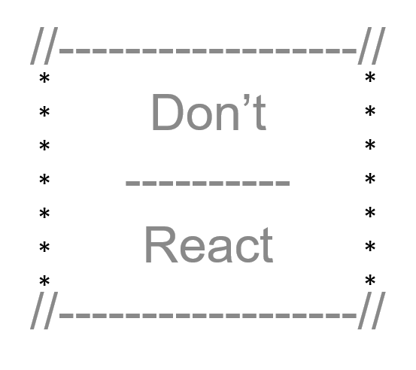
SocialQs Social cues for social misfits
2019

Slide 2

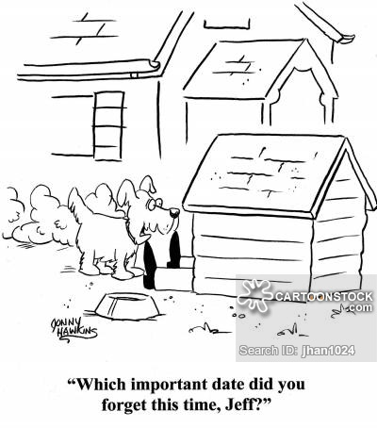
Are you a Social Misfit? Do you struggle with remembering important dates? Do you find time slipping by and realize you haven’t reached out to your family or friends in months? Have you ever picked up the phone to call someone and had a moment of panic realizing you have no idea what to say or you forgot their significant others name? If you answered yes to any of these questions, this is the site for you!

Slide 3
Why Social Q’s?
Social Q’s is Facebook without the noise.
It is A tool to help you connect with people you love without all the distractions that come with so many social media platforms.

Slide 4
What is Social Q’s?
Social Q’s is A Personal Relationship Manager
Allows you to keep track of your connections Even if they don’t’ even touch a computer.
Display a timeline of upcoming important events.
Gives you gentle reminders when an event important to you is coming up.
Allows you to set interval reminders to connect with someone.
All on your own terms

Slide 5
About SocialQs SocialQs for Social Misfits
Application Technologies
ReactJs
Deployed to Heroku
Node and Express Web Server
Mongo and Mongoose
Styled-components, Materialize, Bootstrap and/or CSS grid
Authentication tool is Passport – may consider OAuth
Competitive Analysis & Research
Monica (www.monicahq.com) – Personal records management - reminders for a fee
Hip (www.hip.com) – Planner & reminders – lacks personal records management - fees
iCalendar (https://icalendar.org) – Reminders – lacks the robust personal records management

Slide 6
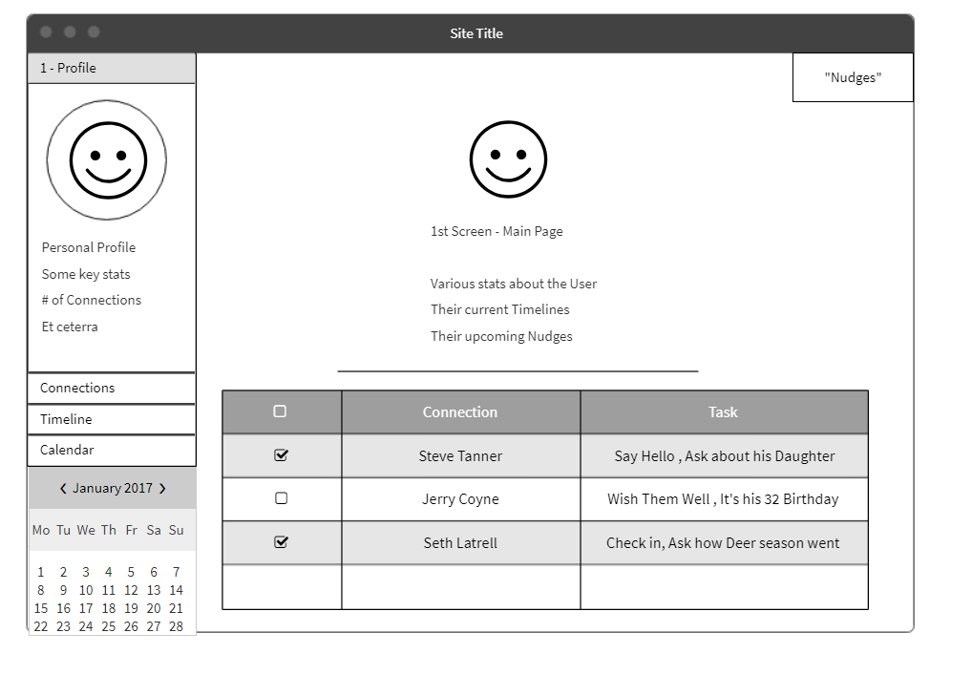
HomePage
Home page – default to Profile (User)
Connections
Timeline
Calendar (unlikely in MVP)

Slide 7
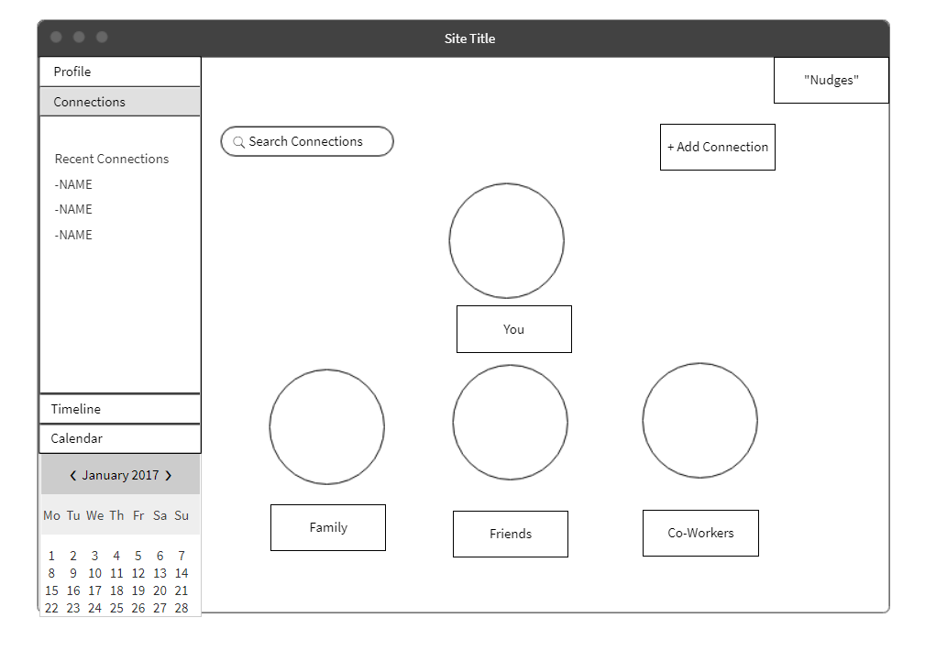
Connections
Grouped by Relationship Type
Family / Friends / CoWorkers
We can probably create other categories
College Friends / UNH programmers

Slide 8
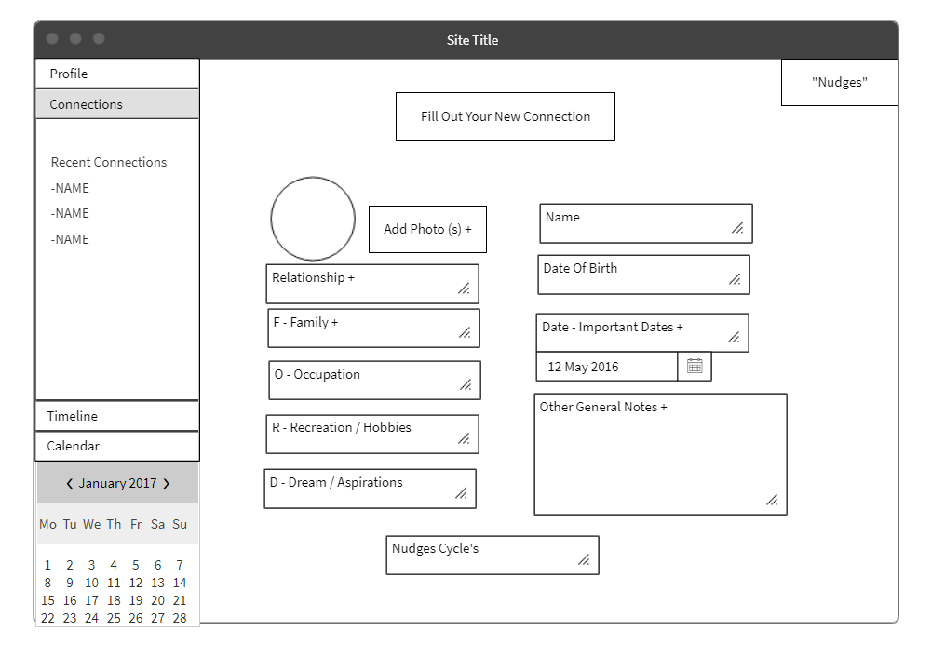
New Connection
Basic input from Laurie’s Outline
Completed Connection page has same info
In addition to List of past and upcoming “nudges”
Recurrence Cycle is 2 part based
The frequency of nudges
The Prompts cycle

Slide 9
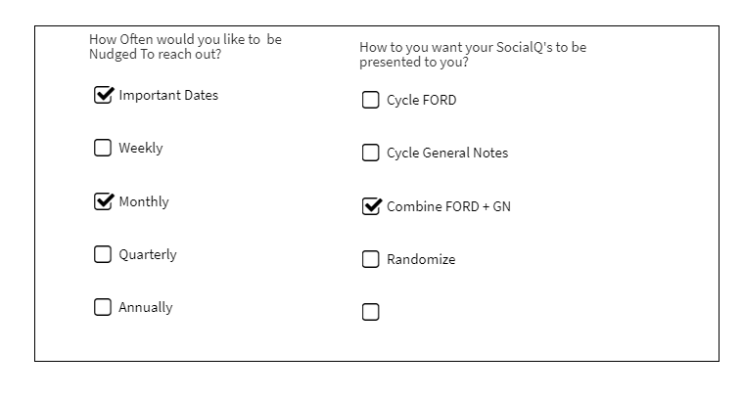
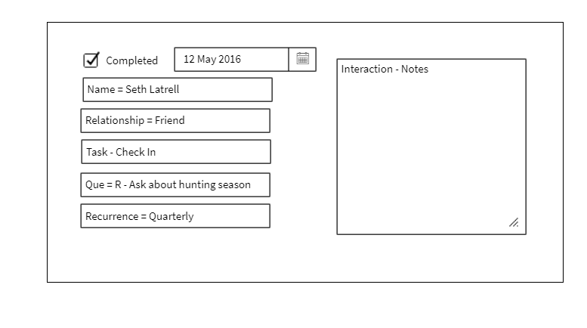
Cues
Similar to how Mike described Cigna example
User clicks line item
Form appears
User fills out the boxes

Slide 10
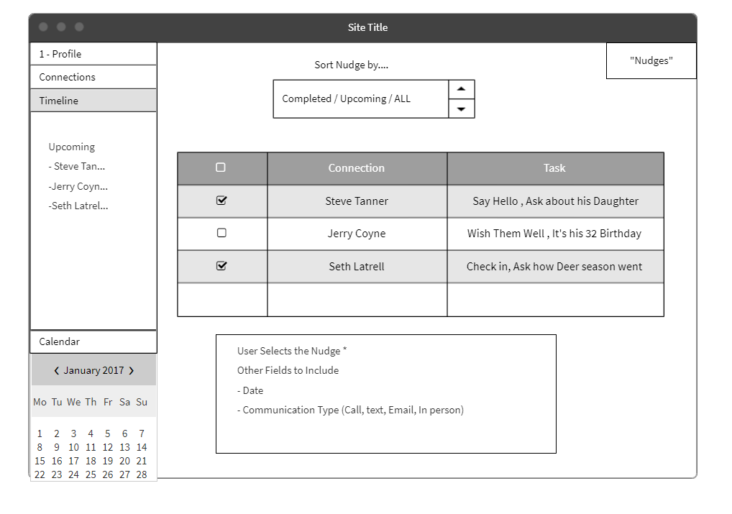
Timeline
Time line is “Nudge” focused
Lining up “nudges” based on selected criteria
Sort by Upcoming
Completed check

Slide 11
Initial Roles
Cheyra and Felicia - login and user profile CRUD
Laurie and Mark - user connections CRUD
Mike - setup, platform, database, events

Slide 12
Timeline
3/2 MVP
User can create, view, update, and delete a user profile.
User can create, view, update, and delete connection profiles and groups.
User can view and complete their upcoming events in a timeline.
3/9 Increased functionality
User can create a “Q” notification based on events in their timeline.
User can create a recurring “Q” notification to help them keep in touch with a specific connection.
Security and authentication
3/18 Finishing touches and stretch goals
User can view upcoming events in a calendar format and filter results.
User can view their past events and contact with connections in a user log.

Slide 13
Project Board

Slide 14
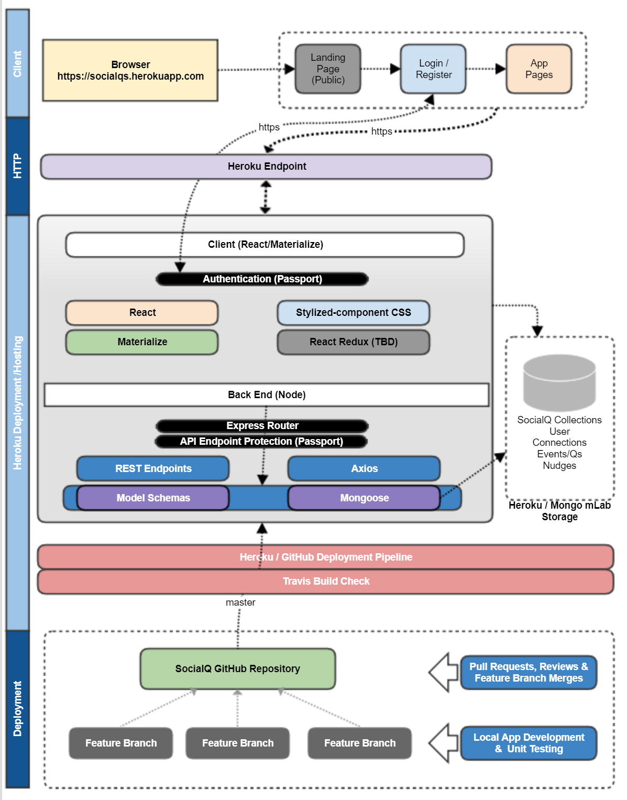
Technology Stack

Slide 15
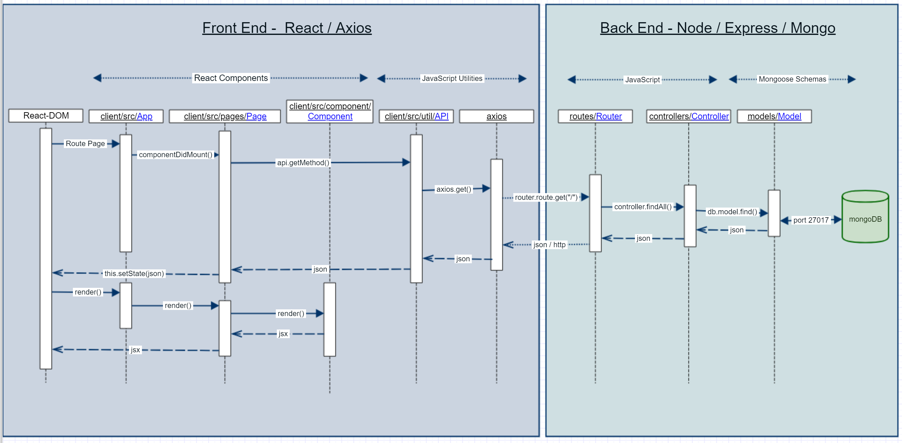
MVC Pattern – Round Trip Call Flow

