Slide 1
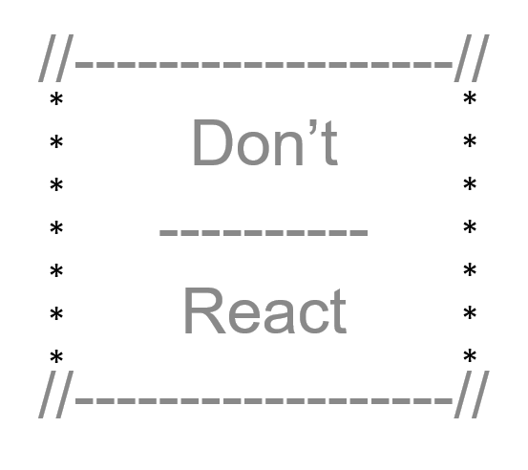
SocialQs Social cues for social misfits
2019

Slide 2

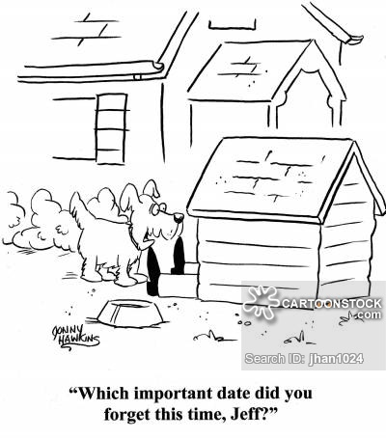
Purpose slide

Slide 3
About SocialQs SocialQs for Social Misfits
Application Technologies
ReactJs
Deployed to Heroku
Node and Express Web Server
Mongo and Mongoose
Styled-components, Materialize, Bootstrap and/or CSS grid
Authentication tool is Passport – may consider OAuth
Competitive Analysis & Research
Monica (www.monicahq.com) – Personal records management - reminders for a fee
Hip (www.hip.com) – Planner & reminders – lacks personal records management - fees
iCalendar (https://icalendar.org) – Reminders – lacks the robust personal records management

Slide 4
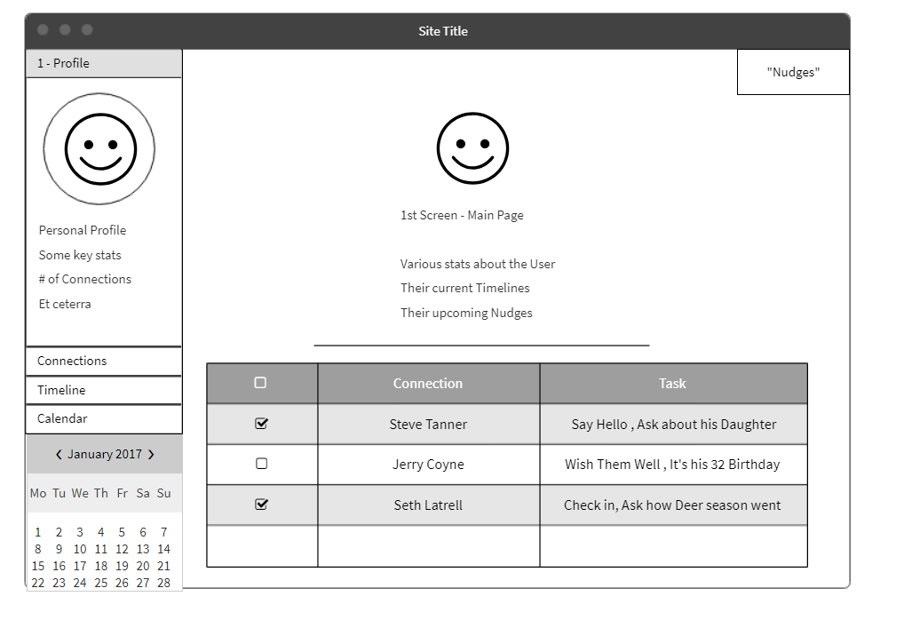
HomePage
Home page – default to Profile (User)
Connections
Timeline
Calendar (unlikely in MVP)

Slide 5
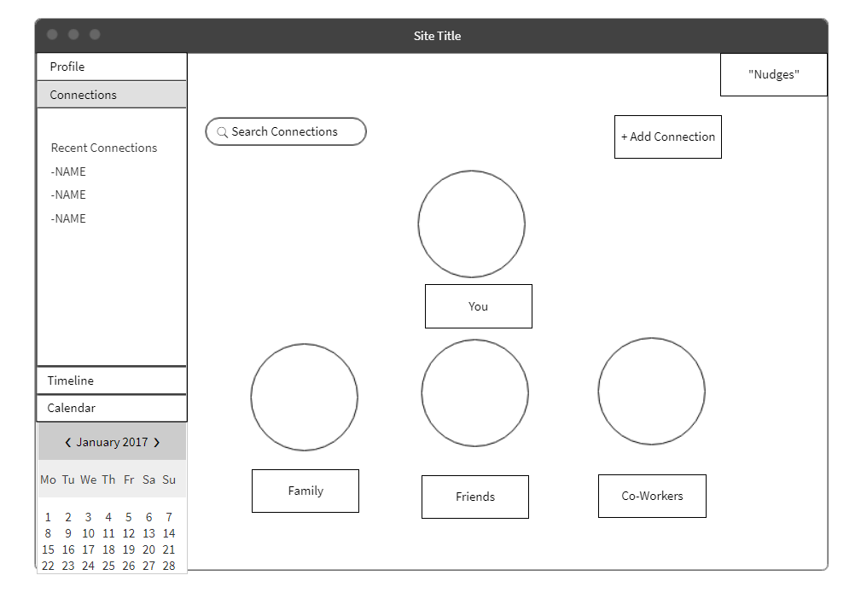
Connections
Grouped by Relationship Type
Family / Friends / CoWorkers
We can probably create other categories
College Friends / UNH programmers

Slide 6
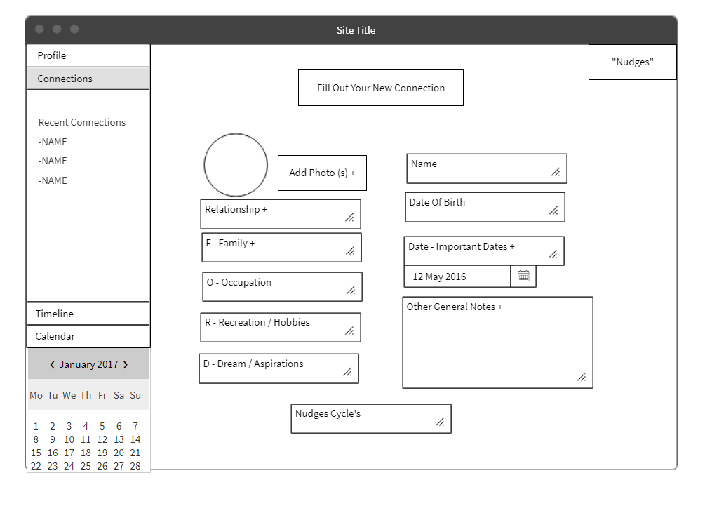
New Connection
Basic input from Laurie’s Outline
Completed Connection page has same info
In addition to List of past and upcoming “nudges”
Recurrence Cycle is 2 part based
The frequency of nudges
The Prompts cycle

Slide 7
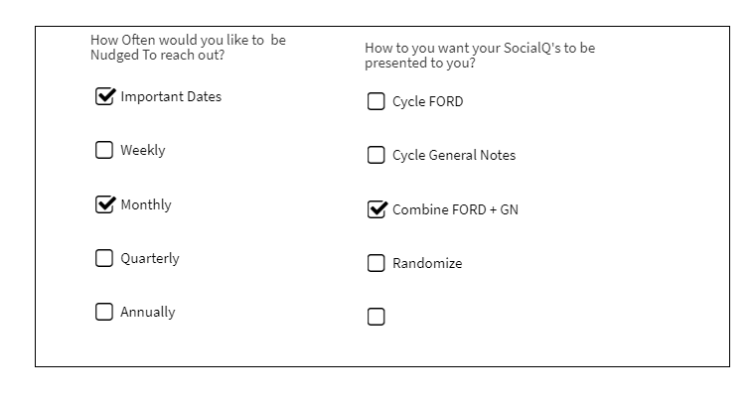
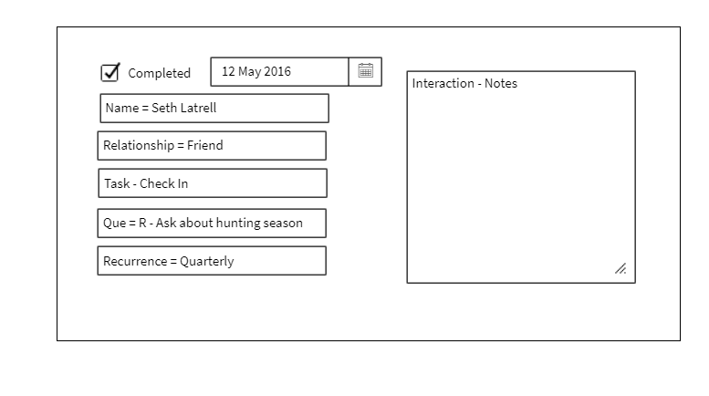
Cues
Similar to how Mike described Cigna example
User clicks line item
Form appears
User fills out the boxes

Slide 8
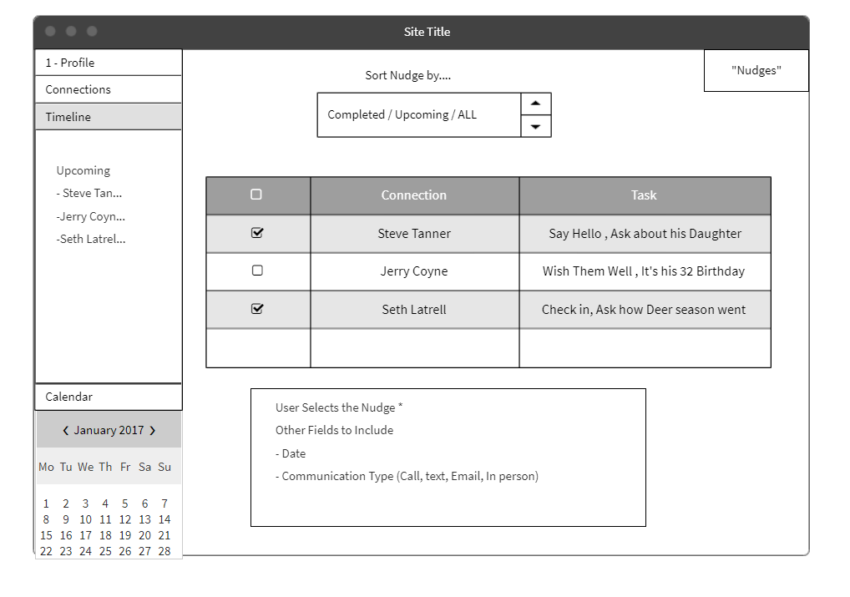
Timeline
Time line is “Nudge” focused
Lining up “nudges” based on selected criteria
Sort by Upcoming
Completed check

Slide 9
Initial Roles
Cheyra and Felicia - login and user profile CRUD
Laurie and Mark - user connections CRUD
Mike - setup, database,

Slide 10
Timeline
3/2 MVP
User can create, view, update, and delete a user profile.
User can create, view, update, and delete connection profiles and groups.
User can view and complete their upcoming events in a timeline.
3/9 Increased functionality
User can create a “Q” notification based on events in their timeline.
User can create a recurring “Q” notification to help them keep in touch with a specific connection.
Security and authentication
3/18 Finishing touches and stretch goals
User can view upcoming events in a calendar format and filter results.
User can view their past events and contact with connections in a user log.

Slide 11
Project Board

Slide 12
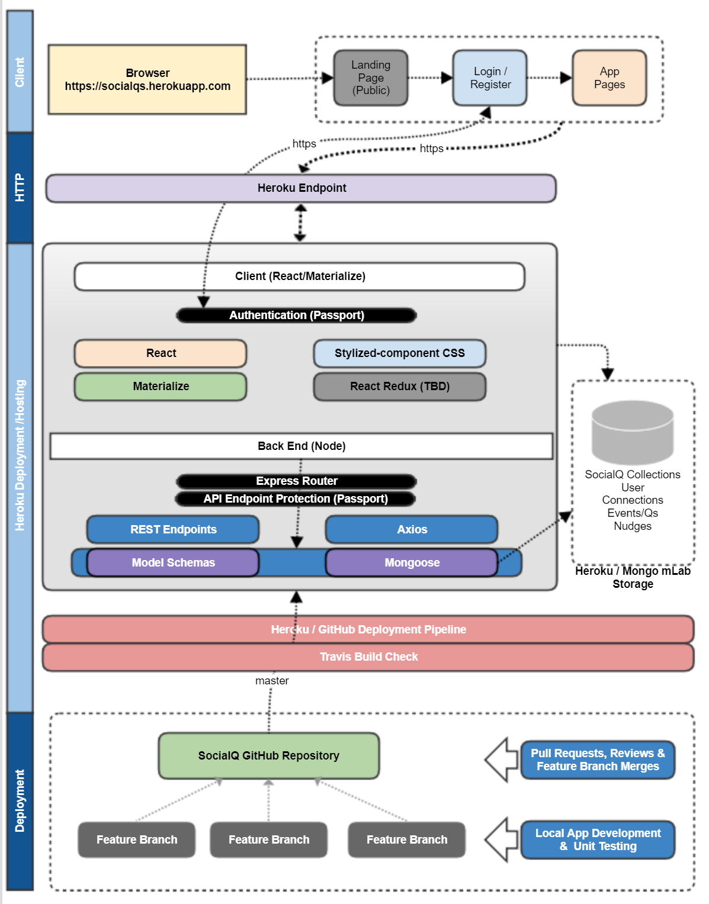
Technology Stack

