Slide 1
Identification of User Query on Stack Overflow Using Semantic Search
Problem Statement 2
Expectation : The solution should have a mechanism to identify relevant questions on stack overflow with tags and top k relevant answers that should be provided to user. So that he can understand the concept clearly and try to get his queries resolved more effectively and efficiently

Slide 2


TEAM DETAILS
(SKIT COLLEGE JAIPUR, RAJASTHAN, INDIA)
TEAM SIZE = 4
MOHIT SINGH CHOUHAN
KANAK SHARMA
TEAM LEADER,WATSON KNOWLEDGE STUDIO AND
BACK END DEVELOPER
DOMAIN EXPERT, IDEA ENTHUSIAST

Slide 3


TEAM DETAILS
(SKIT COLLEGE JAIPUR, RAJASTHAN, INDIA)
DEEPANKAR SHARMA
SHIWANSHU MANI
UI/UX Developer
Watson Assistant Integration DEVELOPER

Slide 4
Technologies/Platform
/API’s Used
WATSON KNOWLEDGE STUDIO
FOR TRAINING CUSTOM NLU MODEL TO CLASSIFY BETWEEN WORDS LIKE WHERE OF ENGLISH VS WHERE IN SQL
TO UNDERSTAND THE USER’S SEMANTIC BETTER
WATSON ASSISTANT
TO APPLY FUZZY LOGIC AND SPELLING CHECKING ON THE STACKOVERFLOW TAGS
WATSON NLU
PYTHON
STACKOVERFLOW API’S :
TAGS,RELEVANT TAGS,SEARCH
PANDAS
NLTK
SPACY (NATURAL LANGUAGE PROCESSING)
PYQT ( UI/UX DEVELOPMENT )

Slide 5
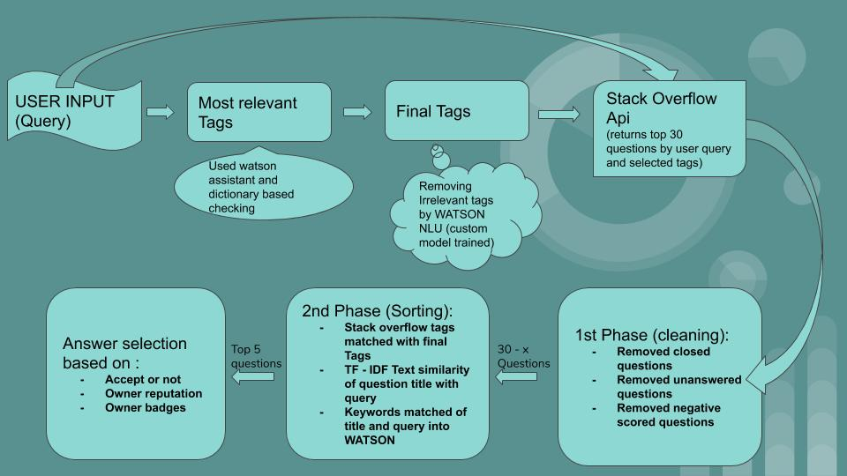
Flow diagram 1

Slide 6
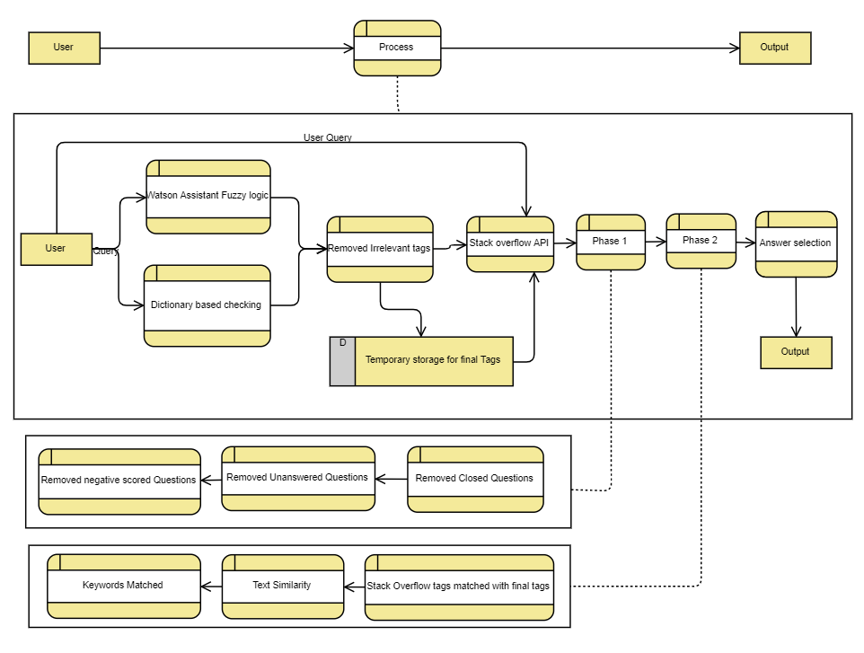
Flow diagram 2

Slide 7
UI/UX DESIGN - PYQT
Qt app development allows porting an application to multiple platforms through simple recompilation
The code is compiled to native binaries that run at full speed (no need to use a virtual machine)
Qt cross-platform software development makes it easy to create intuitive experiences for all users, no matter what system is used
Qt also has a very capable IDE in Qt Creator which works on all platforms and gives the same development environment wherever it’s used
Saves time, through one code deployed across all screens and platforms

