Slide 1

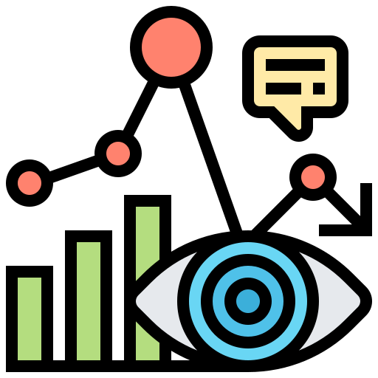
Play-Data: Tool to understand and Visualize Data
Submitted to: Nikhar Bhatnagar Mam
Submitted by: Mohit Singh Chouhan
ROLL NO: 16ESKIT059
Mentor: Mehul Mahrishi Sir

Slide 2
Problem Statement
Data Scientists, Machine Learning Engineers, Data Engineers, Researchers and Students need a tool to understand the data, do the pre-processing of the data and visualize the data.
There are a lot of libraries which provide data visualization but there is a need of automation in visualization.
Automation here should mean to do pre-processing of data types of the column of the data(if csv type) or attributes(if json files), pre-processing of statistical features like quartiles, standard deviation, skewness, mean , max, etc
Play Data is a tool which aids these people to do that and let them freely decide which algorithm can be applied to the data with the help of statistics and visualizations.

Slide 3
Idea of the Project
This Application will try to visualize the Data by deciding on it's own, which visualization is best suitable for the data depending on factors like ordinal or categorical and size of the data. Five Point Statistical Summary will be Provided along with the Box plot to mention and showcase the outliers in the data. Also SQL commands will also be accepted and piped to the graphs.
Other features would include the integration of API from the internet, so that people can work on time series data as well.
Statistical Summary will contain skewness, various quartiles, percentile,etc. Data will be accepted as input in JSON or CSV format. JSON format might require assisted understanding of data as nesting in json may not be understood very well by the algorithm itself as compared to tabular data in csv.

Slide 4
Technologies Used:
Python: This programming language is selected because of presence of various machine learning libraries like scikit learn, pandas, numpy, etc.
Dash by Plotly: This is a Python based framework, which is used to plot data in various kinds of graphs on the browser, with providing classes to handle the javascript,html and css without writing any code in them.
Flask/Django: A framework, to host web pages with Python in the Backend.
Various Machine learning libraries: Pandas, Numpy, Scikit-learn, etc

Slide 5
Working of the Project
Just drag and drop the file , you want to play with and tada..!!
You can integrate API from the internet by editing the api file and putting the API key and the URL.
There are various tabs which holds different functionality of viewing the statistics, and other to understand the data.

Slide 6
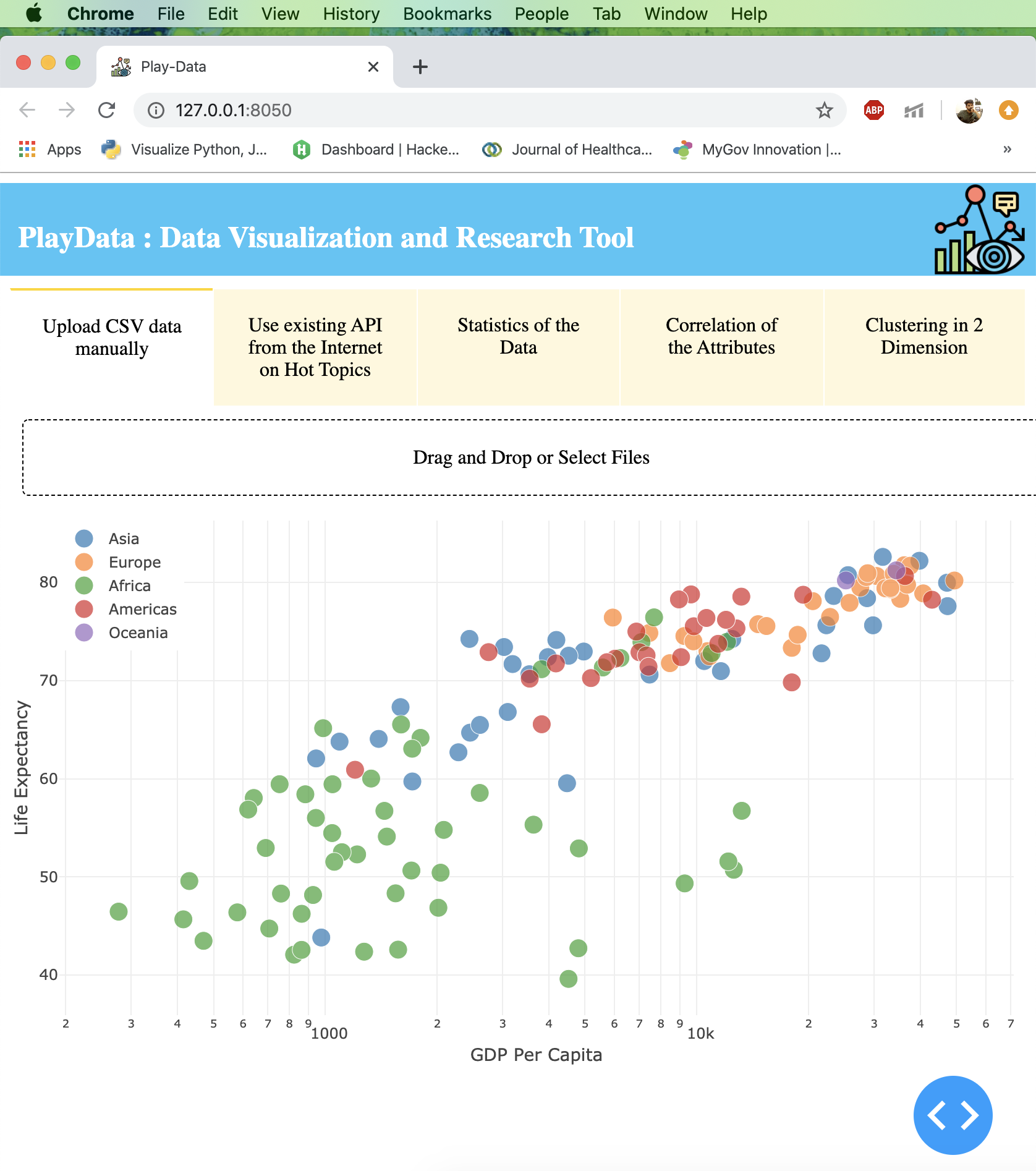
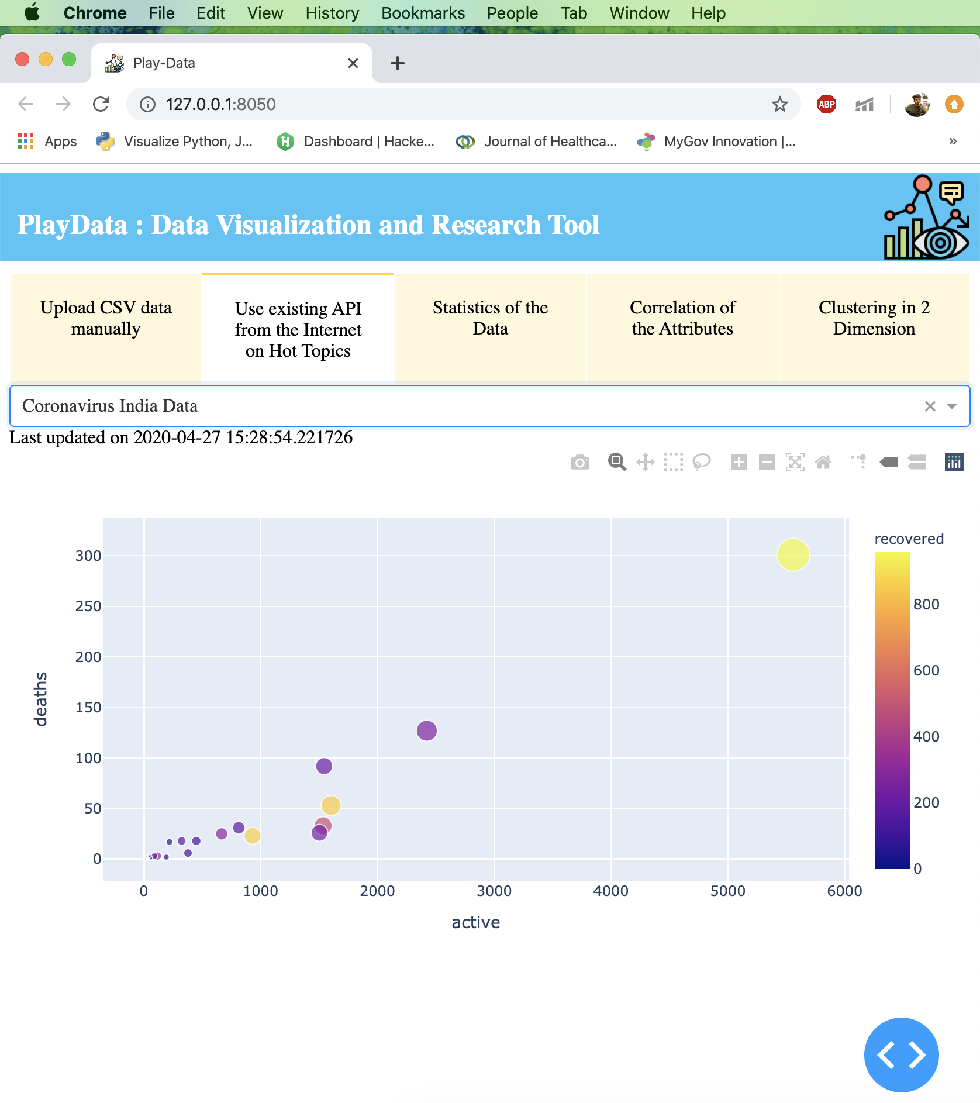
Screenshot of Few Test Cases:

Slide 7
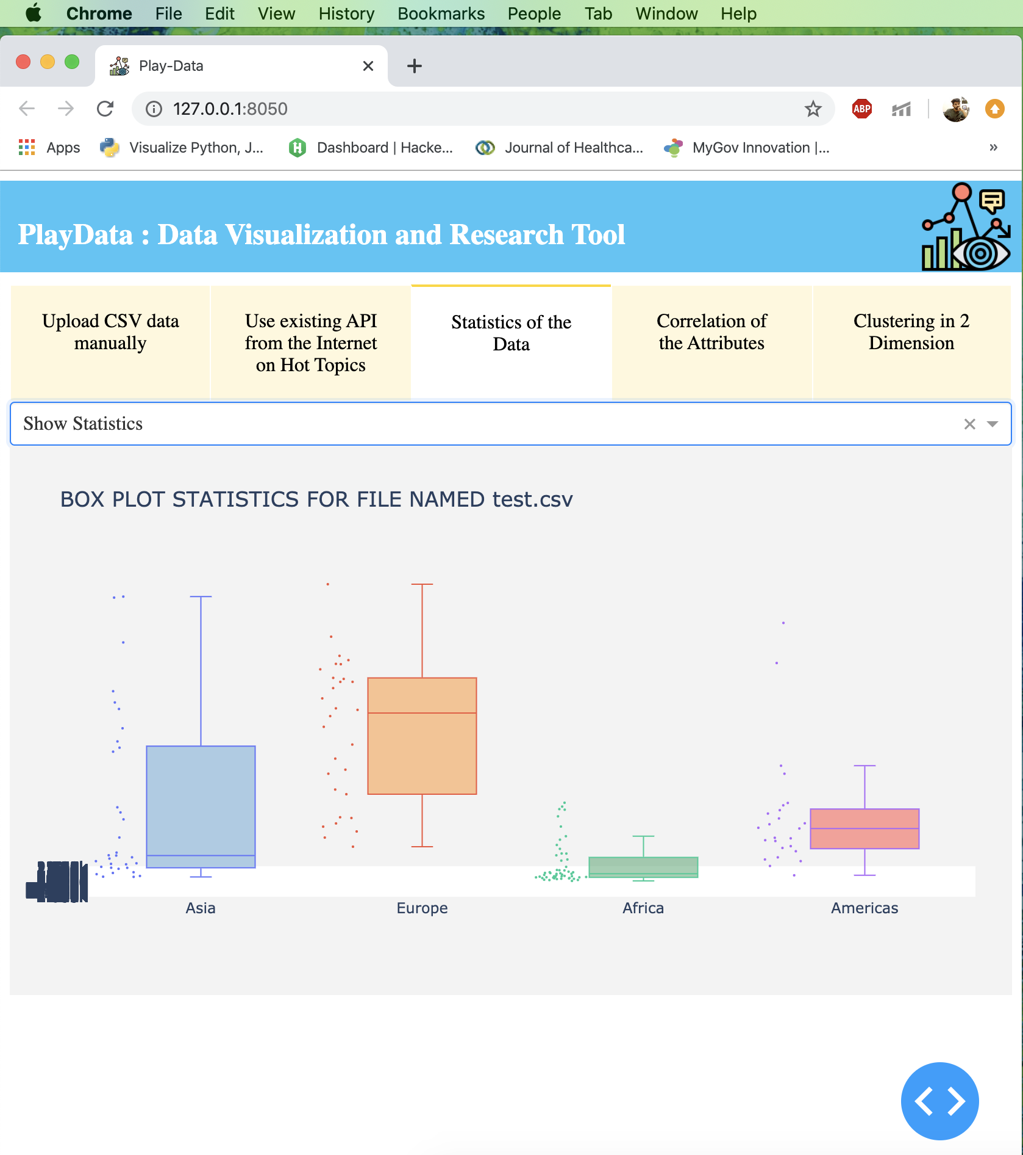
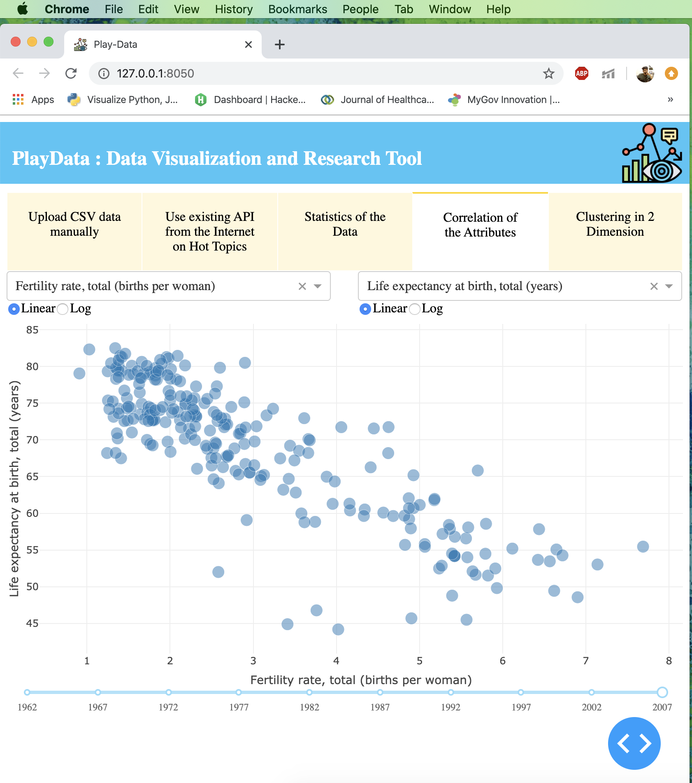

Slide 8
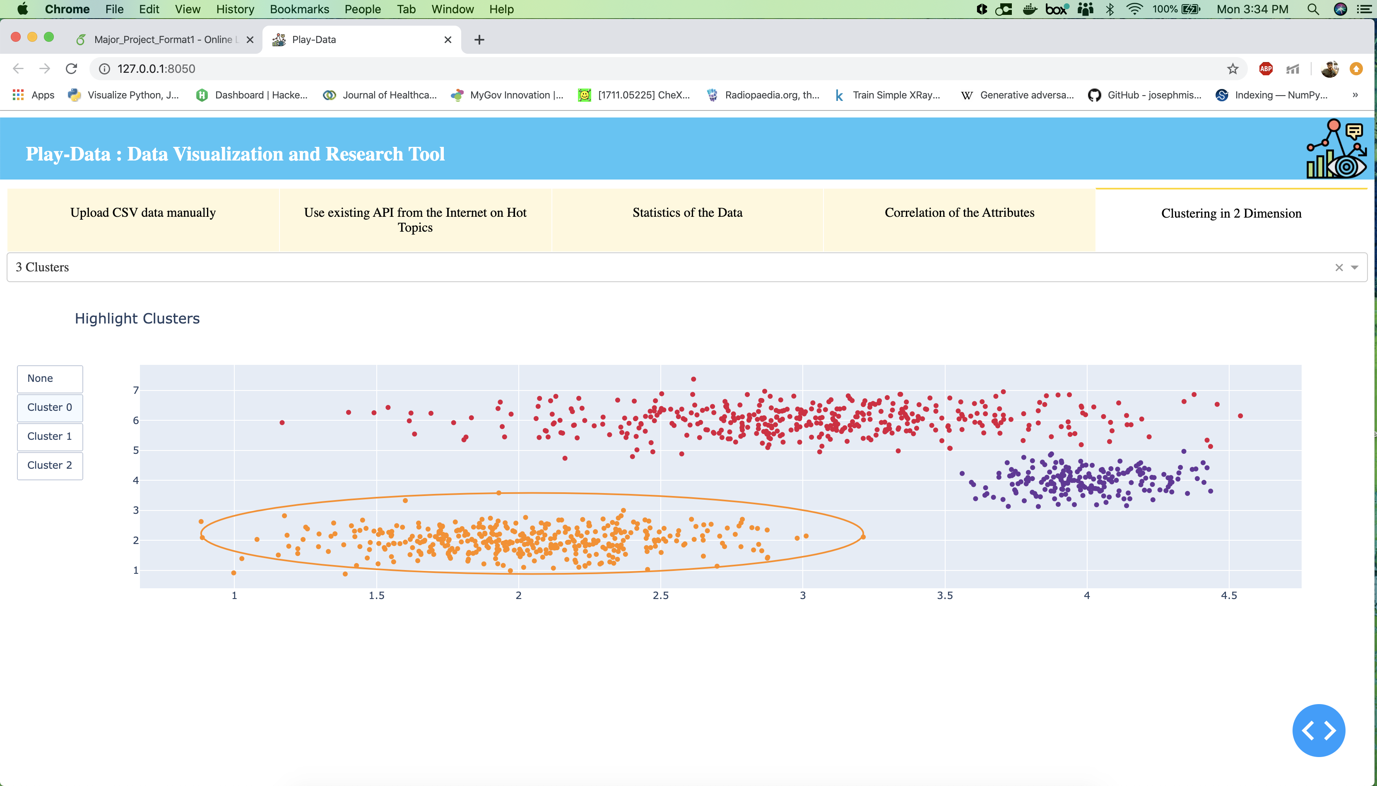

Slide 9
Future Scope:
This visualization and understanding feature can be made smarter by using more Machine learning algorithms to identify the data.
Providing the Play Data API to the users to integrate it with their own applications.
Scaling the application , so that it can take files with billion of rows, one way to achieve this is by using pandas with chunks feature.
Google, Facebook, etc. based authentication can be provided for sign up and sign in and than their uses can be counted and billed.

Slide 10


Thank You

Slide 11
Play-Data ER Diagram
File Info
Metadata
Data Storage
Attributes Data Types
File Type
Converts
Category
Features
Uses
Uses
Pre-Processing Models
ML Models
Visualization Models
Class of Algorithms
Window/Tabs
Name
Type
Dimensions
Name

Slide 12
Play-Data Use Case Diagram
Select ML Models
Uploads Data
Selects Workspace
Researcher/Scientist
Data Engineers
Selects Cluster Size
Uploads API Info
View Visualizations
Select Pre-Processing Steps

Slide 13
Play-Data Class Diagram
Data
+Name: String
+Type: String
+Date : Datetime
+File Type: String
+Preprocess
+Visualize +Delete
Visualize Models
ML Models
+Name: String
+Category: String
+Dimension: Tuple
+File Type: String
+Name: String
+Type: String
+Category: String
+File Type: String
+Apply
+Remove +Edit
+Show
+Apply
+Remove +Edit

Slide 14
Accountant Manager
Start
Login
Select Plan
Uploads Data
Select Pre-Processing Steps
Data Engineer
Play-Data Business Model
See Visualizations
Select ML Models and Apply
Researcher/
Data Scientist
End

Slide 15
Start
Play-Data Activity Diagram
Web login by user
Select Plan
Upload Data
Share Drive Link
Visualize Data
Select ML Models
Apply and Analyze Results
End

Slide 16
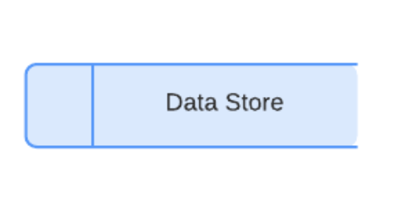
Data Engineer
Play-Data: Data Flow Diagram
Data Analyze
Define Visualization Models
Data Visualize
Define ML Models
Produce ML Outputs
Data Scientist

