Slide 1
Subscription Status Analysis
Free vs. Subscribed Users

Slide 2
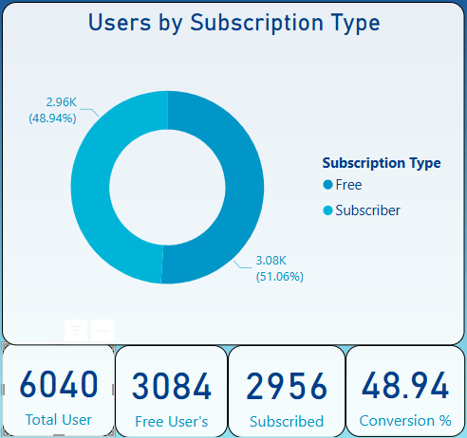
A nearly even split:- opportunity to convert Free users with targeted upsell campaigns.

Slide 3
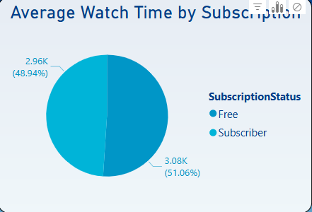
Watch time is almost identical across both groups. Content is engaging even in the free tier.

Slide 4
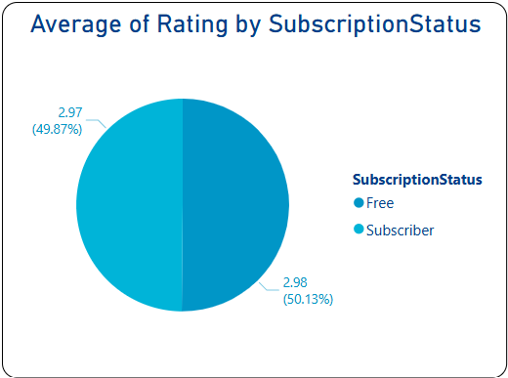
Users rate similarly regardless of subscription. Focus on maintaining quality over pricing.

Slide 5
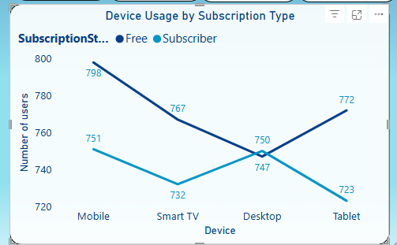
Mobile is the top device among Free users, a smart place to prompt subscription upgrades.

Slide 6
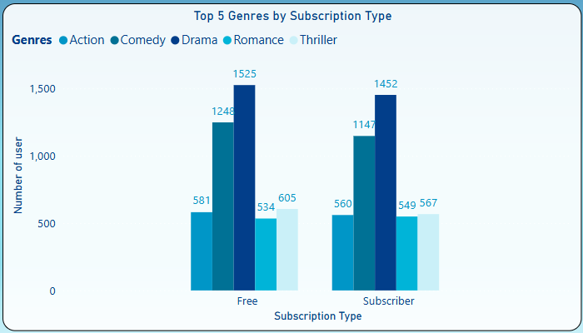
Drama and Comedy lead across both groups. Prioritise these in content and marketing placement.

Slide 7
Recommendations
Focus push notifications on mobile free users with premium previews.
Use Drama & Comedy content to promote subscriptions.
Since watch time and ratings are nearly equal, pricing nudges and exclusive features might convert better than content gating.

Slide 8
Subscription Analysis by Country
Comparing user behaviour and engagement across countries, by Subscription Status.

Slide 9
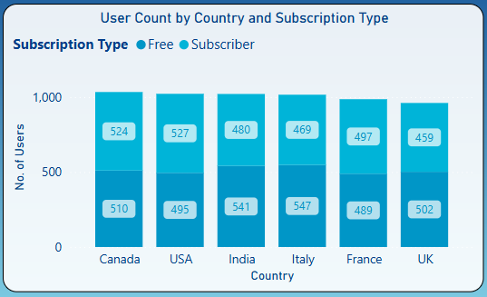
Canada, USA, and India lead in user count. High Free user base in India and Italy signals opportunity for growth.

Slide 10
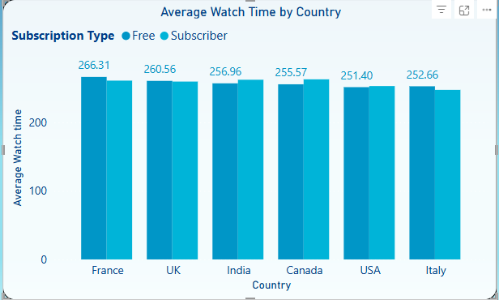
Free users in France show highest watch time. Watch time is fairly consistent across subscription tiers.

Slide 11
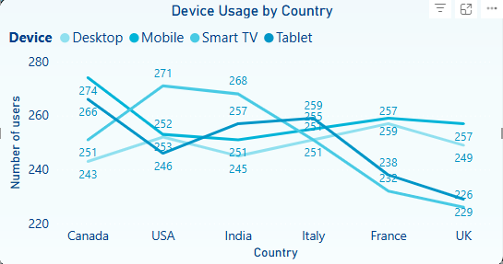
Mobile and tablet dominate across all countries. Tailor subscription prompts to device usage patterns.

Slide 12
Key Insights & Recommendations
Target France for Free-to-Subscriber conversion
Optimise UI for mobile-first countries subscriptions.
Reinforce value in high-subscription regions
Geo-personalised engagement

