Slide 1
Hotel Room Management System
Natapon Taecharoenchai 6037621
Phubodee Kongcharoensukying 6017637

Slide 2
Introduction
Hotel Room Management System which is allow the users to reserve the room from any hotel of their choice. A lot of people traditionally go to the website of the hotel and they contact via a phone which is probably Inconvenient and it is hard to know whether the room is vacant or not. So it is made to make the hotel reservation quite easy and convenient through application or a website.
The hotel management system staff are the main authority of the system who can help the user if he/she finds some problems and have complaints. Hence they can solve the problem to make him/her to be satisfied. Apart from that the user can review and give feedback about the hotel experiences.

Slide 3
Objectives
Our goal is to help the user to reserve the room from any hotel of his/her choice as they are finding it difficult to do so. The objectives of the system are:
- To help the user to reserve the hotel room.
- To provide any hotel which they want to reserve its room.
- After user reserves it the kinds of room will be provided
- To allow the user to give ratings, review and feedback based on their experience in order to improve the service.

Slide 4
User Requirement
User: The people that use this system to make the room reservation. Also user can give feedback to the system.
Manager: The people that take control in the system. They can provide help to user if they have problem to make reservation.

Slide 5
Scope
User:
- User can create their account and log-in to the system with email and password.
- User can book a room from any hotel.
- User can select types of room (e.g. Standard, Deluxe or Luxury)
Manager:
- Manager is allowed to log in with username and password
- Manager can help customers to provide the hotel room
- A manager can help customers if they are in a problem which can be addressed and solved.
- A manager’s duty is to update the customers about the availability of room.

Slide 6
Problems
- Difficulty in accessing the account: Many users find it hard to use the application or website as they do not have any experience about reserving the hotel.
- Misleading Information: For the hotel information, the users think that the room is free according to the website but later they realize the room is not available if they contact the hotel.
- Poor Hotel Experience: A lot of users complain to the hotel management about its poor services and perhaps sometimes they don’t take it seriously.

Slide 7
Limitations
The users who want to reserve a hotel room to stay in a hotel must do it via a website or an application and once doing it they have to contact the hotel management for confirmation.

Slide 8
Logical Design of the system
Firstly, we consider Data flow diagram(DFDs). We can divide into 2 primary DFD, which are Manager DFD and User DFD.

Slide 9
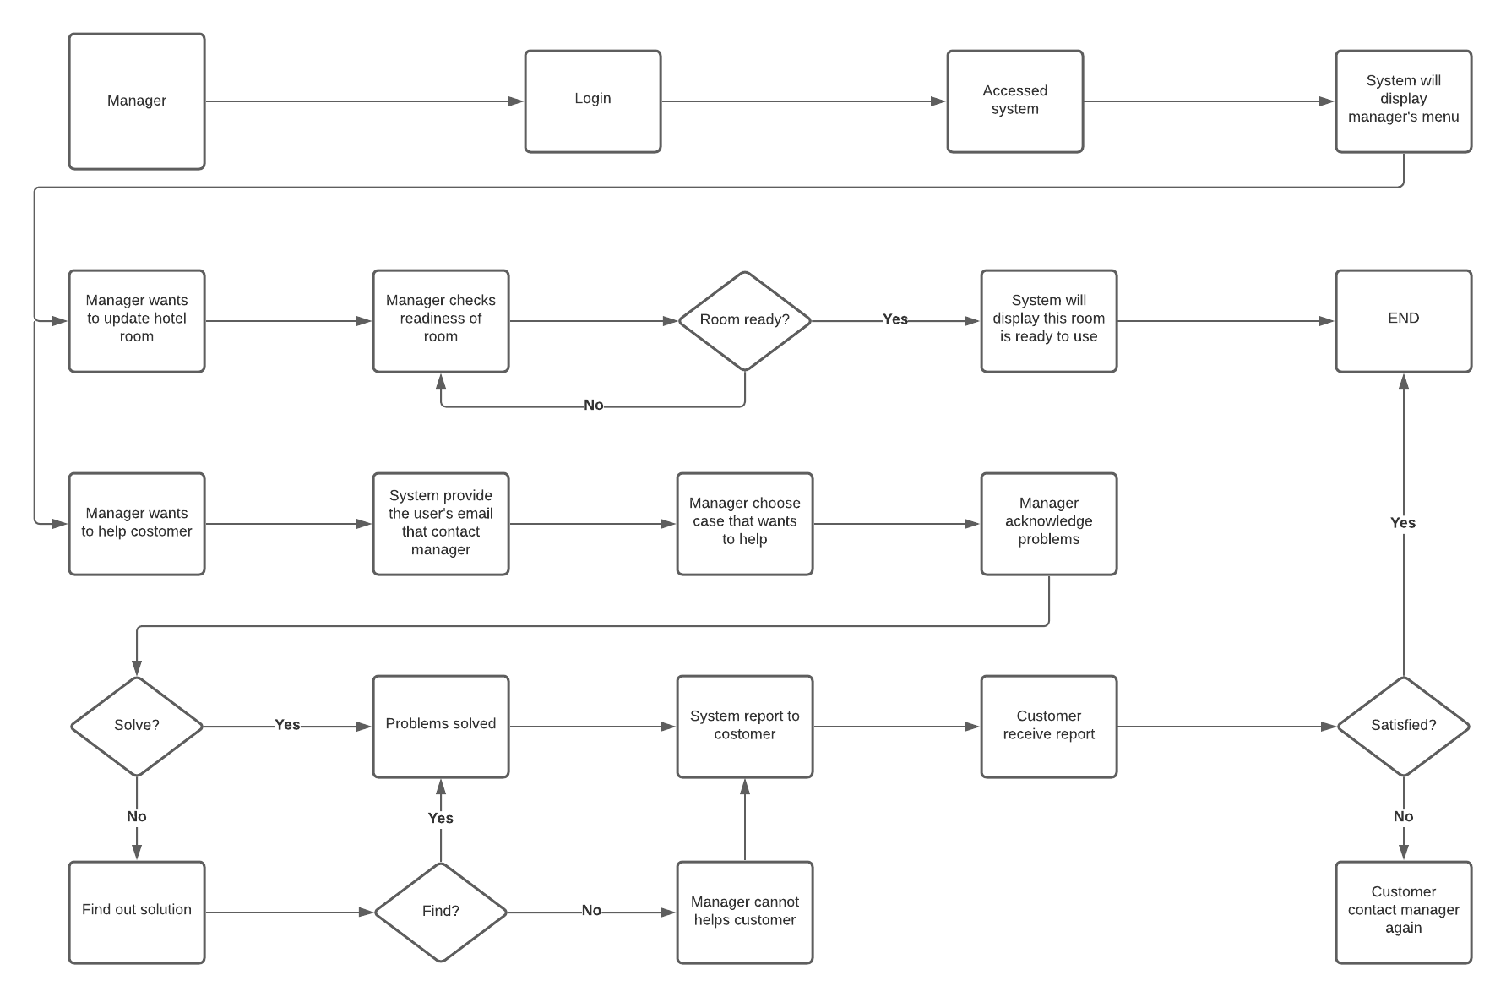
For Manager DFD :
Notes:
Start with manager dfd, manager already have access to the system. They have to login and system will displayed the manager menu. So that manager can choose 2 options, which are update and help customer.Lets focus on manager want to update the room first, they need to check the room if is it ready or not. The room needed to be clean and tidy before update into the system. So manager check readiness of the room if that ready or not. If the room ready, the system will display that room is ready. But if the room is not ready, manager is need to wait that room to be cleaned. At this step, the manager can choose to help the customer if they were contacted. The manager can choose the case that manager wants to help with. After manager choose case that manager prefer to help with, so manager acknowledge the problem of the customer. Manager need to solve the customer’s problem, if manager can solve the problem, the system will report back to the customer that problem solved. But if problem is not solve, manager needed to find out the solution for that problem. If this case is cannot fixed, the system will report back to customer that this problem is cannot be fixed.

Slide 10
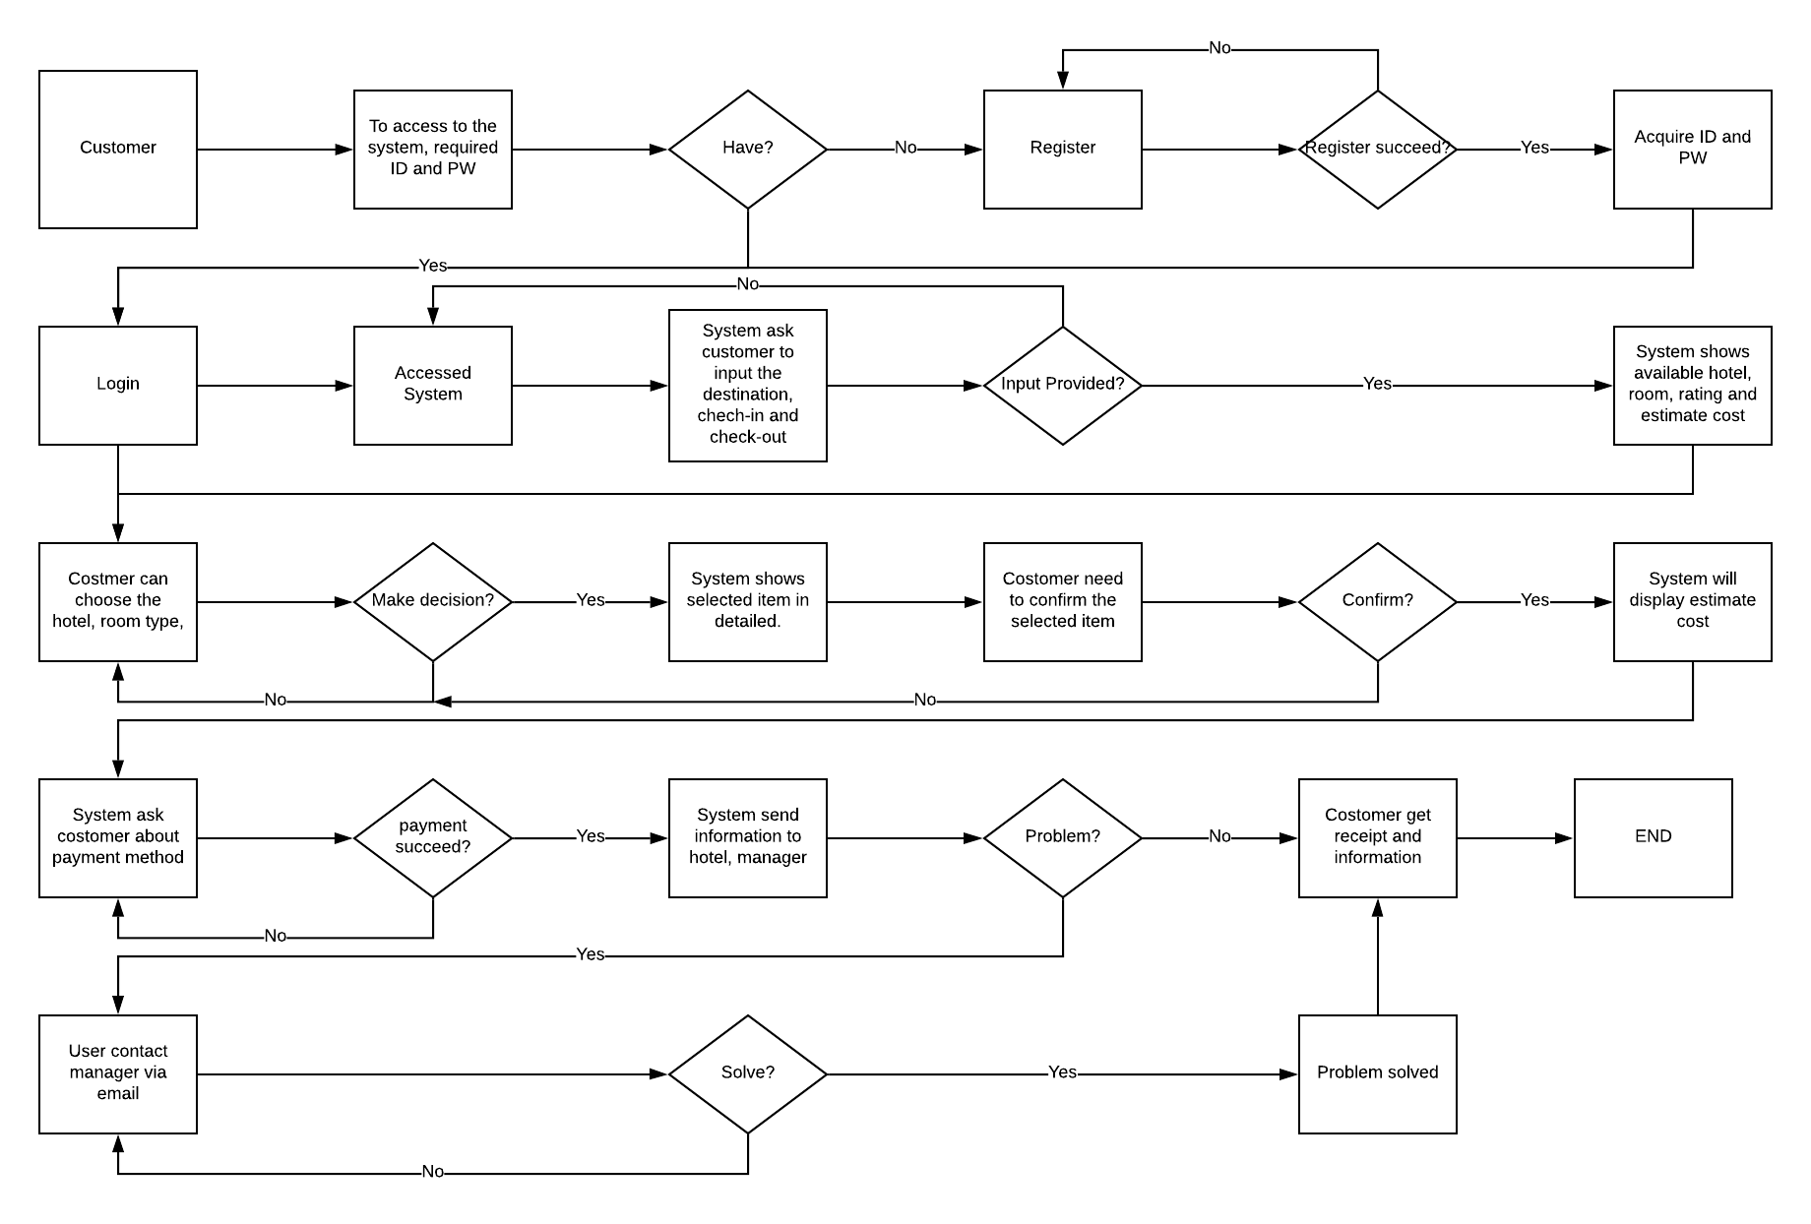
For User DFD
Notes:
For the user dfd, when customer wants to access to the system, they will need to register to identify that who are they. After they register, they will accessed to the system. The system will ask customer to input the destination and time. If the customer not provides input, the system will not show the result that customer needs. If customer inputs destination and checkin-checkout time, the system will display hotel, rating, and est.cost that customer can choose. Customer need to decide the item that customer prefer and proceed to next step. After the customer selected the item that customer choose, the system will show the hotel in detail.If customer do not sactisfy with their decision, they can go back and find another item to fulflilled their needs. If customer wants this hotel, they can click the confirm button to select this hotel. So the system will display the est. cost, and booking information and proceed to the payment options. If the customer completed the payment section, the system will display the receipt and sent information to the hotel. If customer have the problems with their booking information, they can contact manager to assist their problem.

Slide 11
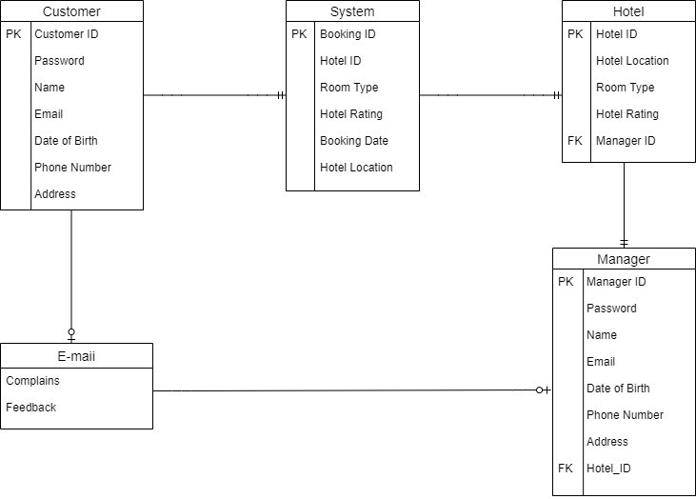
Secondly, we consider Entity-Relationship Diagram or ERD.
Notes:
This ER-diagram have 5 entity which are customer, system, hotel, e-mail and manager. Start with customer, it has customer id as primary key and personal information like name, phone number or address. Next is system entity have booking ID as primary key and also have hotel information. Hotel entity have Id as primary key and hotel information and have manager ID as foreign key. Manager entity have manager id as primary key and contain manager personal information. Lasty, email entity has complained and feedback.

Slide 12
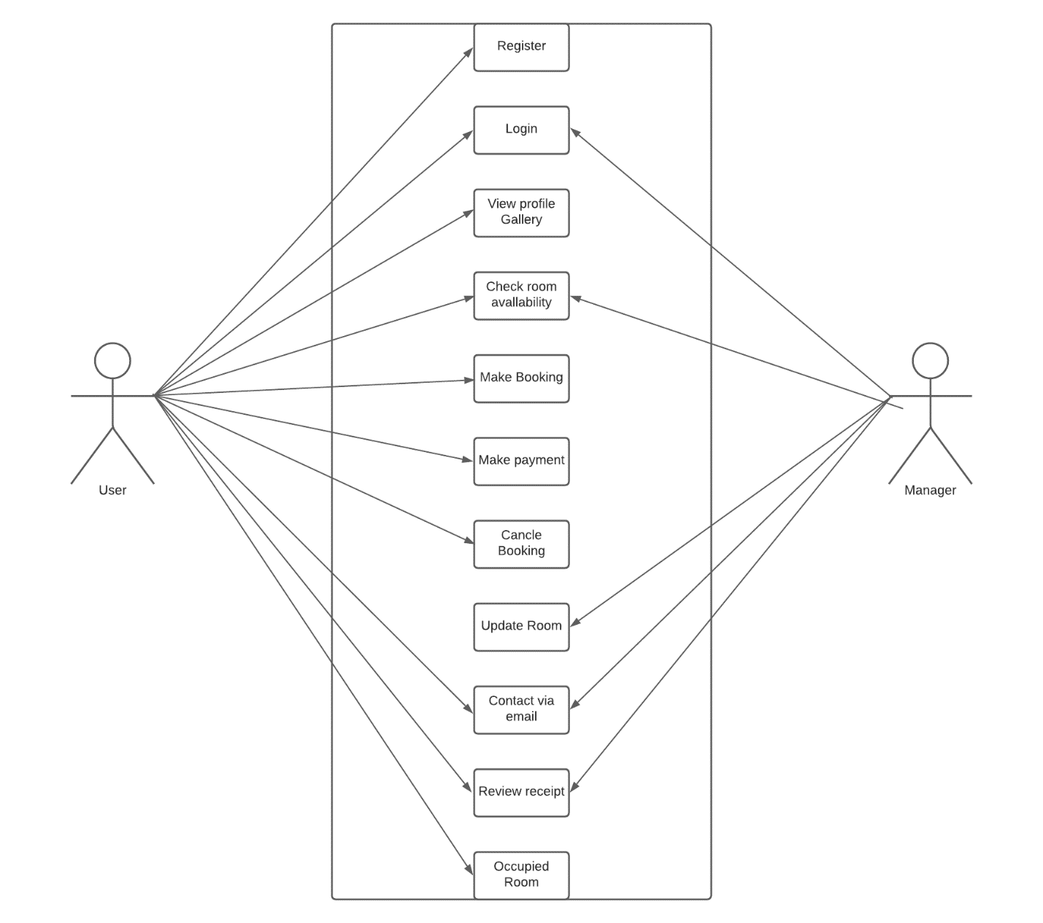
Use Case
Notes:
In this use case, there are 2 actors, user and manager.
- First of all, user needed to register in order to access the system. After user registered and login, user can view the picture of many room or view gallery that contain picture of room. Also, user can check the availability of room is that room is in used or not. After user decide which room that user wanted, user can make booking, make payment and cancel booking according to user decided. If user have problem with booking, they can contact the manager in order to help them via email. After user success booking, they can review the reservation. And lastly, they can use the room with no problem.
- Second, Manager already have account to access to system. After they login, they can check the room availability of room and update the room if the room is ready to be used. If user have problem with booking, they can help user to finish booking. And they can review reservation in order to check nothing is went wrong.

Slide 13
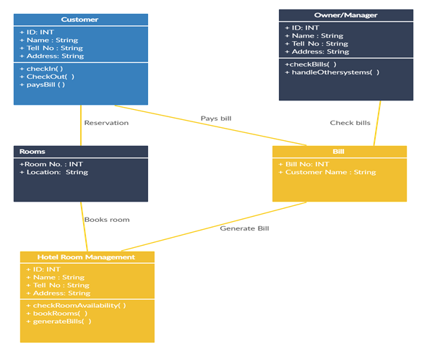
Class Diagram
Notes:
Class diagram for Hotel room management system contain 5 items. Hotel Room Management system class diagram describe the structure of Hotel Room Management system classes, their attributes, operations (or methods), and the relationships among objects. The main classes of the Hotel room management system are customer, Rooms, the system, bill and manager.

Slide 14
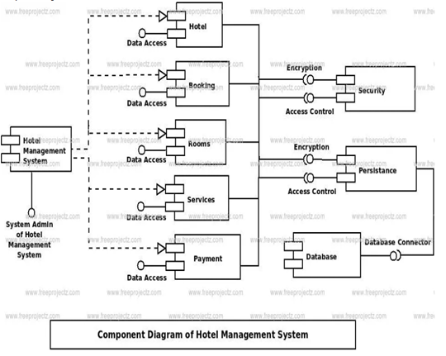
Component Diagram
Notes:
This is a component diagram of hotel management system which shows components, provided and required interface, ports, and relationships between the services, booking, rooms, hotel and customer. This type of diagram is used in component-based development to describe systems with service-oriented architecture. Hotel Management System UML component diagram, describe the organization and wiring of the physical components in a system.
Components of UML component diagram of hotel management system
- Service component
- Booking component
- Rooms component
- Hotel Component
- Customers component

Slide 15
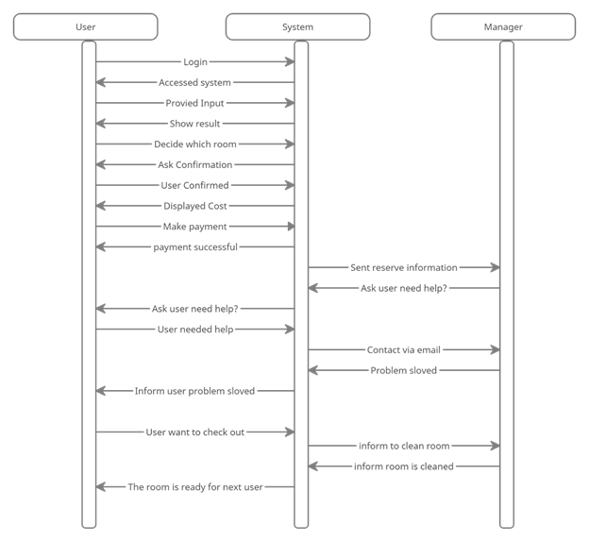
Sequence diagram
Notes:
This sequence diagram of Hotel Room Management System describes how user, manager and system have relationship with each other. It working like Data Flow Diagram.

Slide 16
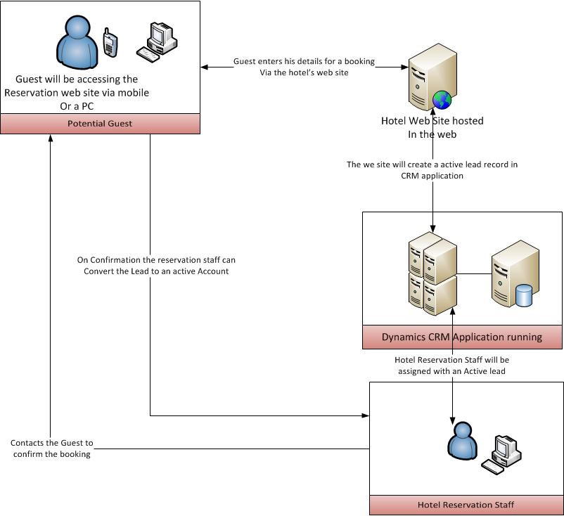
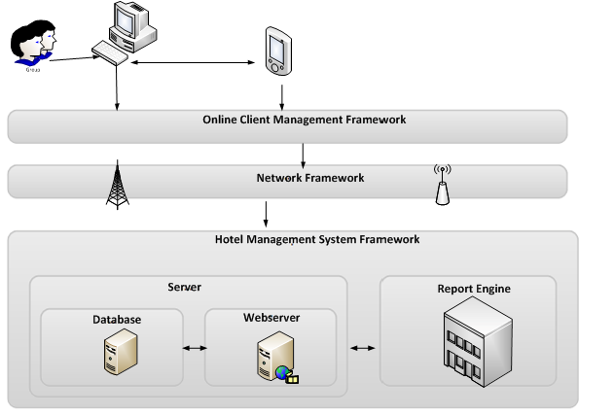
System Architecture
Notes:
This is the simple system architecture of Hotel Room Management System.
The system architecture of hotel room management show that user will be access the system via mobile or pc. So user enter their information detail for a booking via the hotel website that host by hotel owner. Then the site will create record reservation in CRM application. After that the manager will be assigned with an active record. And finally contacts to user to confirm the booking.

Slide 17
Thank You for your attention

