Slide 1
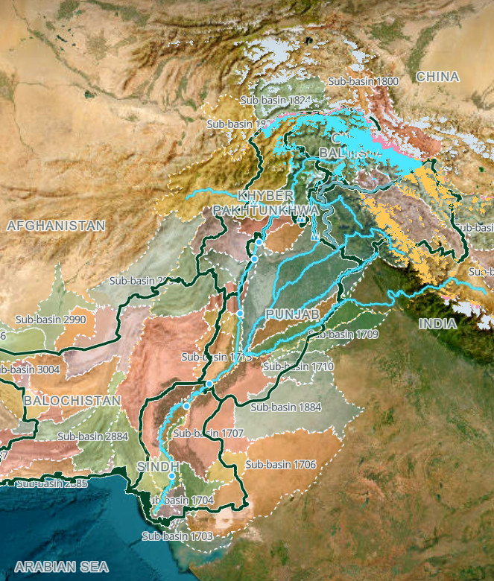
FloodGuard AI
PROJECT OVERVIEW · NOVEMBER 2026
Flood risk & disaster management platform: portal features, forecasting research and flood simulation
Faiza Muzaffar
11
36
7
portal views
forecast model configurations
published hydraulic results
Notes:
Introduce the platform: one integrated system for flood monitoring, risk screening, early warning, citizen reporting and incident response, backed by a data and forecasting research workspace and a flood simulation lab. The three numbers preview the three workstreams covered in this deck.

Slide 2



One platform, three workstreams
AT A GLANCE
FloodGuard AI portal
Data & forecasting
Flood simulation lab
disaster_management · React + FastAPI
flood_model · Flood Data Observatory
flood sim cursor · Scenario lab
Live river, rainfall and risk monitoring with GIS screening, forecasts, alerts, incidents and citizen reports.
Checksum-verified Marala river and rainfall records, and 36 forecasting configurations compared on flood days.
Upstream-first scenario preparation, HEC-RAS 2D and LISFLOOD-FP runs, playback, exposure and a 3D browser solver.
145
80%
385
districts screened on live weather
of high-flow days flagged 10 days ahead
hourly HEC-RAS frames published
Observe
FFD · GloFAS · weather
Verify
sources & checksums
Forecast
LSTM & hybrids
Simulate
HEC-RAS · LISFLOOD
Respond
alerts · incidents
Notes:
The three projects form one chain: FloodGuard observes and responds; the Flood Data Observatory verifies the data; the forecasting experiments predict river flow; the simulation lab turns flows into flood extents and exposure. Each card's number is explained later in its section.

Slide 3










FloodGuard AI: the operations portal
INSIDE THE PORTAL
01
Overview command map & KPIs
GIS Operations exposure & national map
Predictive Risk Views near-term & 10-year
Upstream Source Flood Watch upper basin
River Monitoring 22 river stations
Alerts crossings & approval
Incidents tracked response
An NDMA-style command screen for monitoring, screening, forecasting and response.
Citizen Reports two-way, geotagged
System Activity event timeline
Simulation scenarios & replays
Rainfall heatmap 1 h to 72 h rain
Notes:
Section one walks through the portal view by view, in the order of the sidebar. Every screenshot in this section was captured from the running app with live data on 10 November 2026.

Slide 4
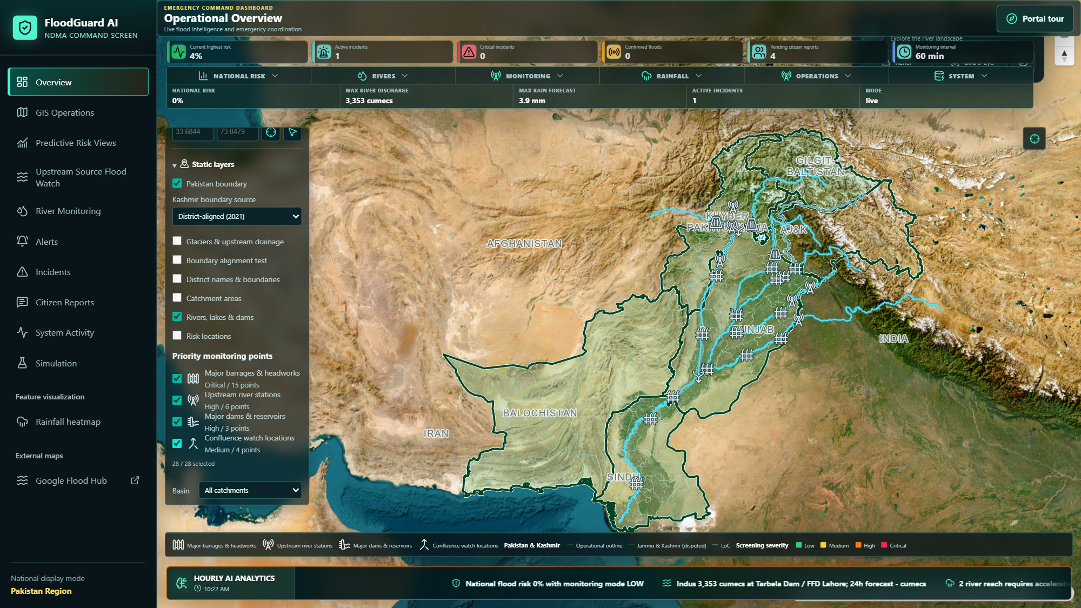
The command screen at a glance
FLOODGUARD AI · OVERVIEW
1
KPI strip
Highest risk, incidents, floods, reports, refresh interval.
1
2
3
2
Command HUD
Six drop-downs that open live tables over the map.
3
Map layers
Basemap, boundaries, glaciers, catchments, rivers, rainfall.
4
4
Priority monitoring points
28 sites in four categories, each toggled separately.
5
5
Hourly AI analytics
Rolling briefing on flow, rain, incidents and reports.
Notes:
The Overview is the default screen. The KPI strip and HUD summarise the national picture; the map carries every operational layer. Live inputs are Open-Meteo weather, GloFAS modeled discharge and FFD observed readings. The rainfall heatmap layer covers the last 1 hour through the next 72 hours.

Slide 5

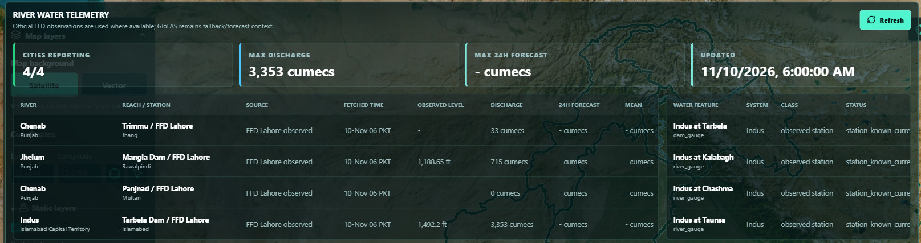

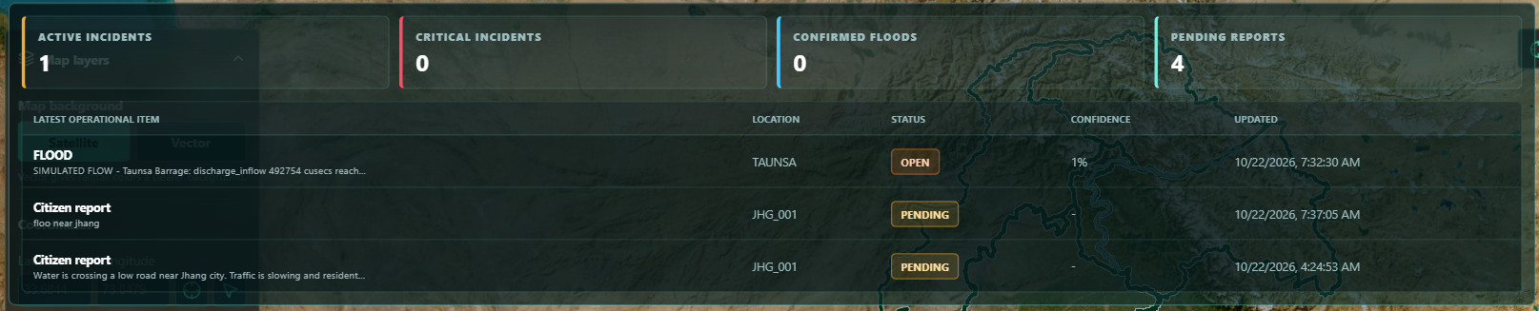


Drill down without leaving the map
FLOODGUARD AI · COMMAND HUD
RIVERS · River water telemetry
National risk
145 districts: severity, risk, rain and forecast.
Rivers
FFD telemetry: discharge, level, 24 h forecast.
Monitoring
22-station river table, 15-minute refresh.
Rainfall
Four cities: rain, forecast, temperature, soil.
OPERATIONS · Incidents and reports
Operations
Incidents, confirmed floods, pending reports.
System
Data mode, risk engine, feeds, backend health.
Notes:
Each HUD tab opens a live table over the map. Rivers shows official FFD observations where available, with GloFAS as fallback and forecast context. Operations lists open incidents and pending citizen reports. System confirms live data mode, the rule-based risk engine and backend health.

Slide 6
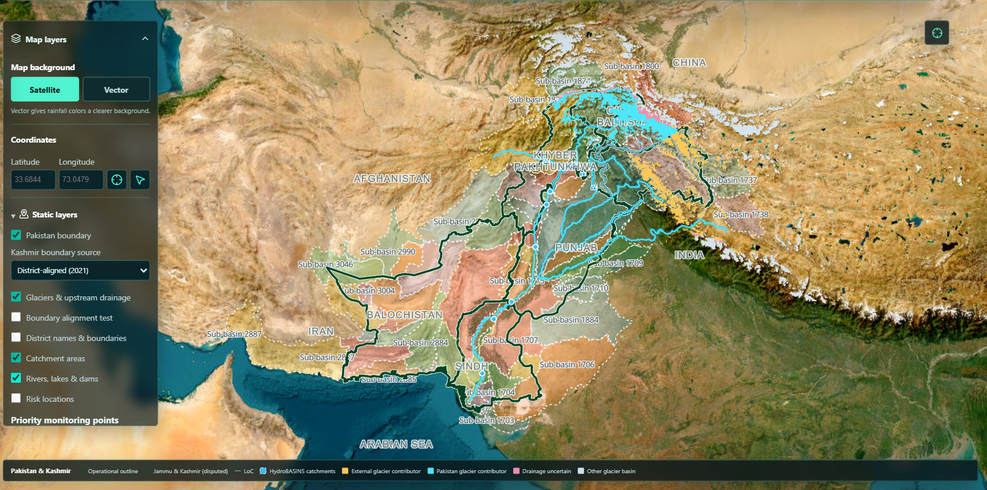
From glaciers to catchments
FLOODGUARD AI · MAP LAYERS
1
Glacier contributors
Glacier basins feeding Pakistan's rivers, by origin.
1
2
HydroBASINS catchments
Sub-basin outlines and IDs for catchment study.
4
3
3
Rivers, lakes & dams
Main river network, reservoirs and barrages.
2
4
Layer panel
Toggle layers; pick the Kashmir boundary source.
5
5
Live legend
Explains every visible layer and colour.
Notes:
Static geography loads as compressed, content-hashed files cached in the browser, so layers switch on instantly after the first visit. District names and borders come from their own source; display geography does not assign sovereignty or create risk estimates.

Slide 7
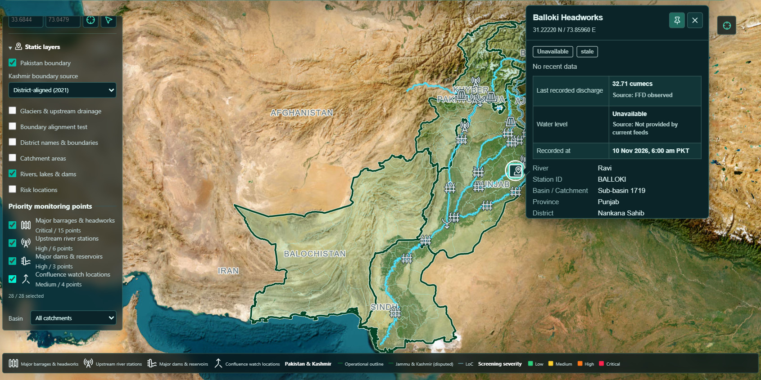
28 priority sites with live cards
FLOODGUARD AI · PRIORITY MONITORING
2
1
28 priority sites
15 barrages, 6 upstream stations, 3 dams, 4 confluences.
3
4
2
Hover, click or keyboard
Arrow keys move between points; Enter pins a card.
1
5
3
Freshness flags
Stale or missing data is flagged, never estimated.
4
Reading with its source
Last FFD discharge and the time it was recorded.
5
Location context
River, station ID, sub-basin, province, district.
Notes:
Hover cards show compact readings; pinning a card opens a 48-hour sparkline and 3 h / 24 h changes when stored observations exist. Missing thresholds or flood records are omitted, not estimated. Confluences are planning references without a live reading table.

Slide 8
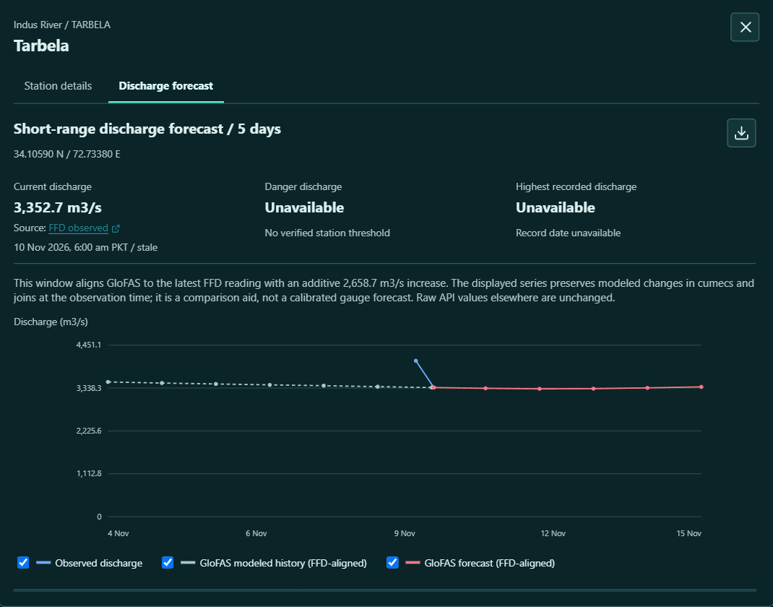
5-day discharge forecast per station
FLOODGUARD AI · STATION FORECAST
1
Latest gauge reading
FFD observed discharge, its time and a stale flag.
2
Verified thresholds only
Danger level and record appear only with a cited source.
5
1
2
3
GloFAS aligned to the gauge
Modeled flow is joined to the latest FFD reading and labelled as a comparison aid, not a calibrated forecast.
3
4
Five-day outlook
Observed, modeled history and forecast on one chart.
4
5
CSV export
Download the readings table for reports.
6
Toggle series
Show or hide each series and inspect any date.
6
Notes:
Opened from any station card or the terrain studio. Here, Tarbela on the Indus: the current FFD reading is 3,352.7 cubic metres per second. The window shows seven days of modeled history and five forecast days. Escape closes it.

Slide 9
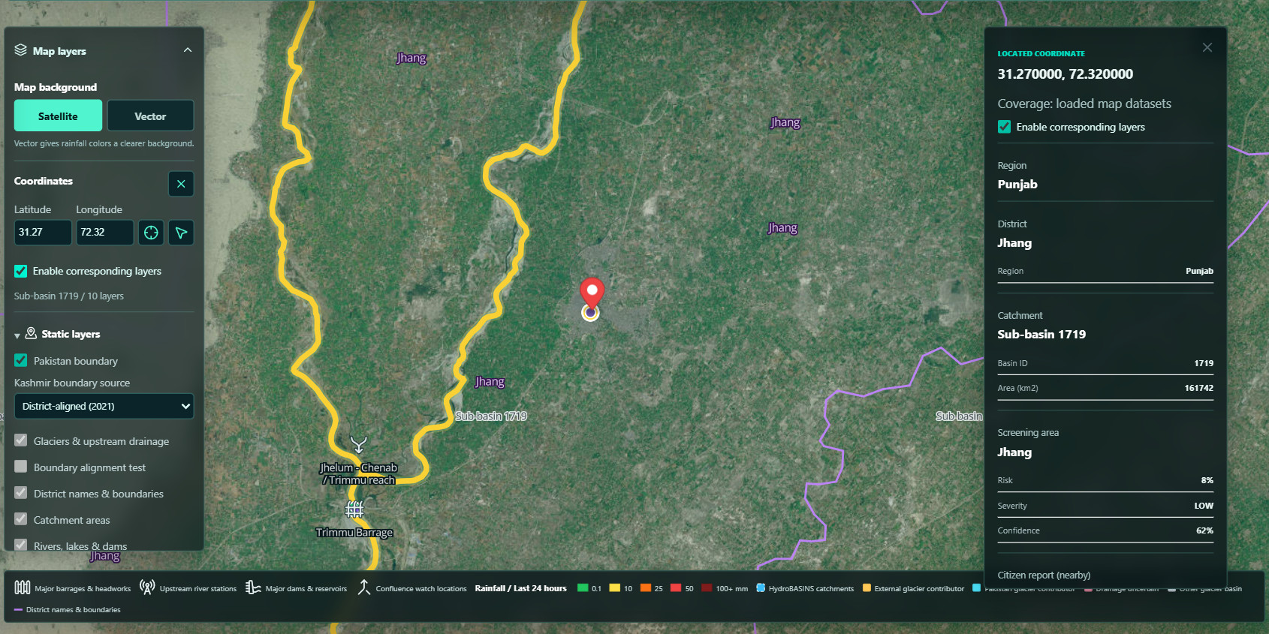
Pick a point, study its catchment
FLOODGUARD AI · LOCATION STUDY
1
Enter or pick coordinates
Type latitude/longitude or click the map.
2
Match layers to the point
Shows only the containing district and sub-basin.
1
3
2
4
3
Pinned location
The marker stays while you explore.
5
4
Location details
Region, district, catchment area, screening risk.
5
Clipped to the catchment
Rivers split at the boundary; outside points hidden.
Notes:
Example: 31.27 N, 72.32 E near Jhang falls in sub-basin 1719 (161,742 square kilometres). Trimmu Barrage and the Jhelum–Chenab confluence sit inside it. This selects a hydrological sub-basin; it is not a full upstream network or a site-specific risk estimate.

Slide 10
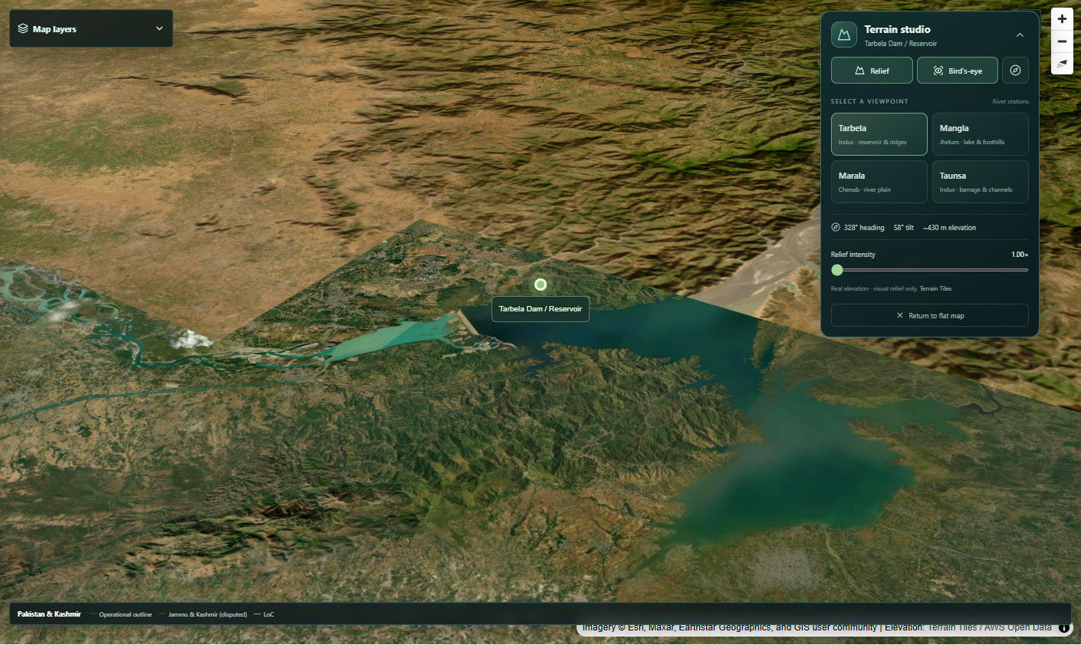
3D terrain for key river stations
FLOODGUARD AI · TERRAIN STUDIO
1
Relief & bird's-eye
3D terrain with tilt, rotation and north reset.
1
2
2
Four viewpoints
Tarbela, Mangla, Marala and Taunsa presets.
4
3
3
Live readouts
Heading, tilt, elevation and relief intensity.
5
4
Station on real terrain
Elevation from AWS Terrain Tiles; relief is visual.
5
Back to flat map
One click returns to the 2D operations map.
Notes:
Terrain studio sits on the GIS and rainfall maps. Choosing a viewpoint also opens that station's details and discharge forecast. Relief exaggeration is for visual context only; it does not change any measurement.

Slide 11
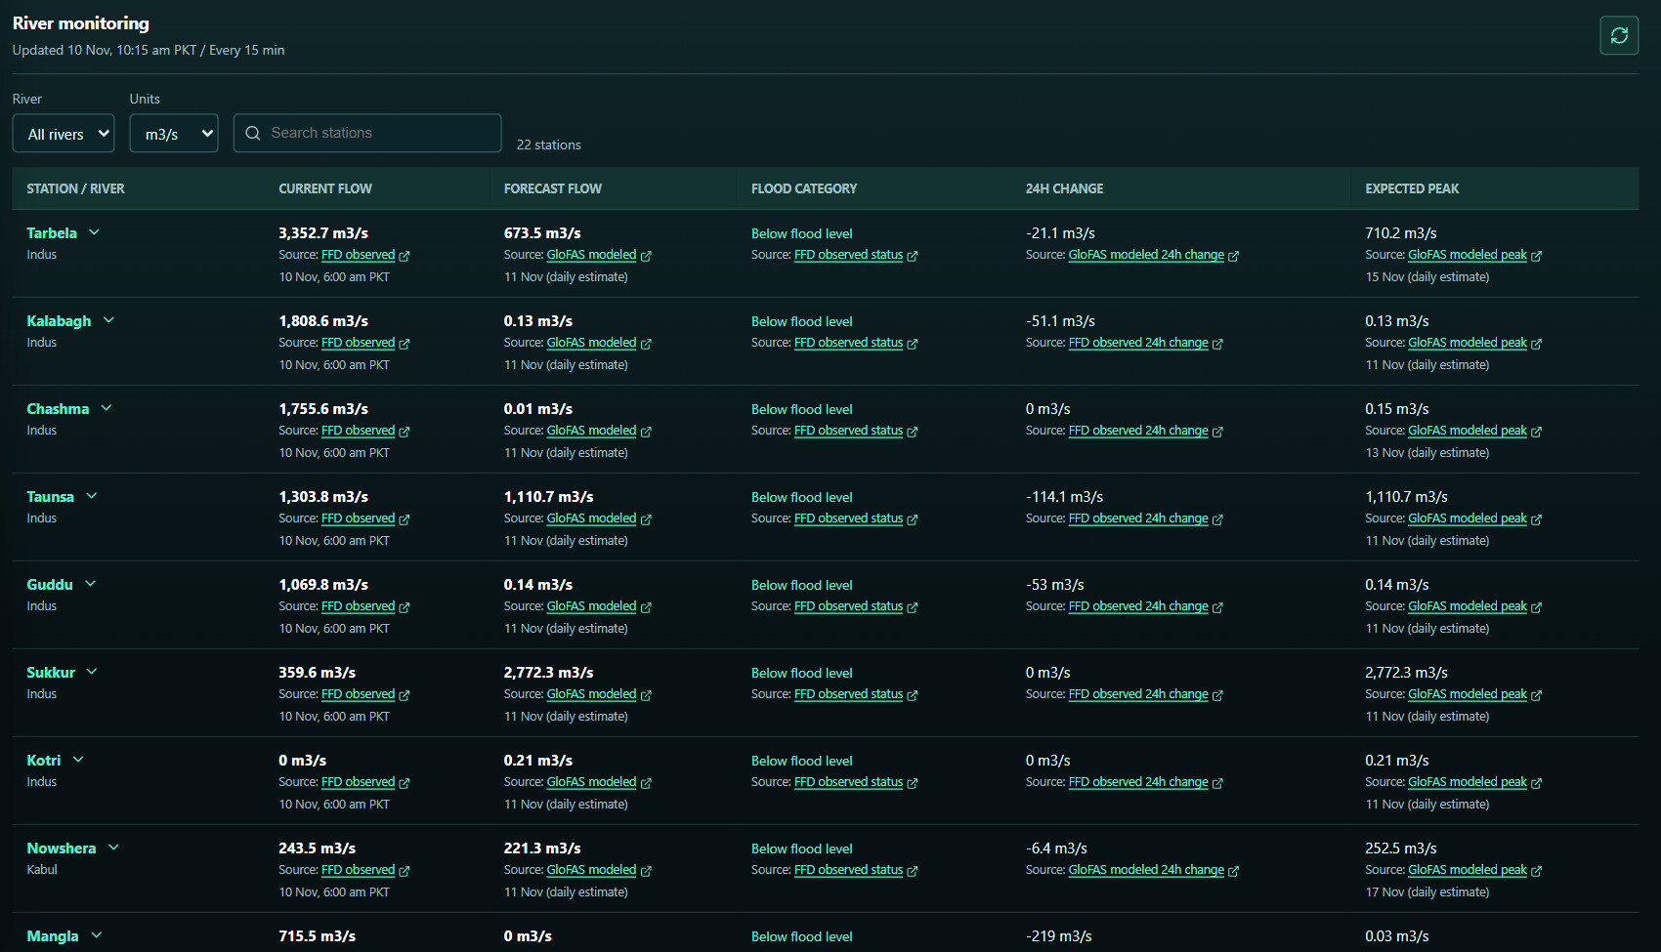

River monitoring across 22 stations
FLOODGUARD AI · RIVER MONITORING
1
Filter and convert
River filter, m³/s or cusecs, station search.
1
2
3
4
5
6
2
Current flow
FFD observed reading and its time.
3
Forecast flow
GloFAS modeled next-day estimate.
4
Flood category
FFD flood status for each station.
5
24 h change
Change since yesterday, with its source.
6
Expected peak
Modeled peak flow and its date.
Every value links to its source; the table refreshes every 15 minutes.
Notes:
22 barrages and headworks across the Indus, Kabul, Jhelum, Chenab, Ravi and Sutlej. Measured FFD values and GloFAS modeled values are always labelled separately; modeled discharge is never presented as a measured water level.

Slide 12
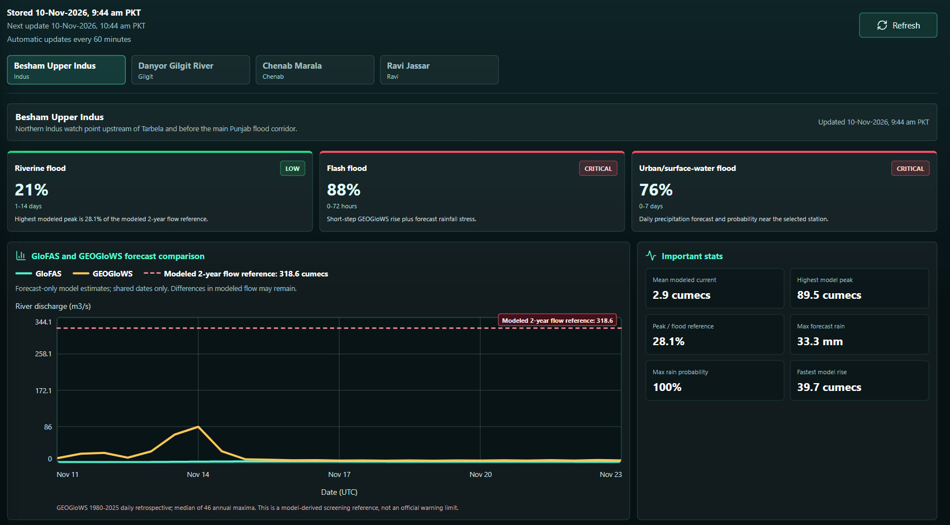
Watching the upper basin
FLOODGUARD AI · UPSTREAM SOURCE FLOOD WATCH
6
1
Four upstream watch points
Besham, Danyor, Marala and Jassar.
1
2
Three flood types
Riverine 1–14 days, flash 0–72 h, urban 0–7 days.
2
3
Two global models
GloFAS and GEOGloWS on shared forecast dates.
3
5
4
Flood reference line
Modeled 2-year flow from 46 annual maxima.
4
5
Key statistics
Mean flow, peak, rain and fastest rise.
6
Hourly snapshots
Stored hourly with next update and manual refresh.
Notes:
Upstream stations give the earliest signal before water reaches the Punjab flood corridor. The 2-year flow reference is model-derived from the GEOGloWS 1980–2025 retrospective; it is a screening reference, not an official warning limit.

Slide 13
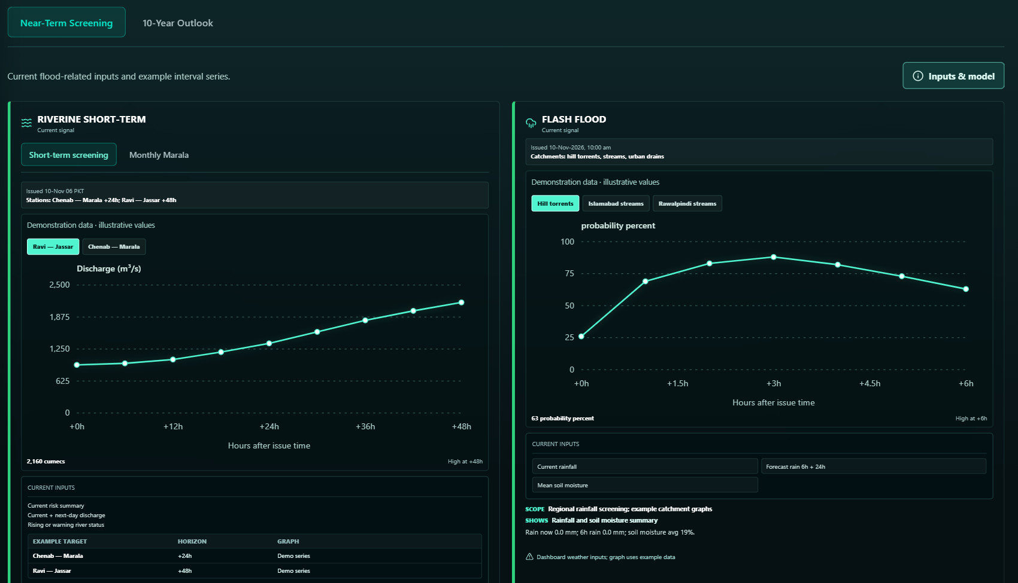

Near-term risk screening
FLOODGUARD AI · PREDICTIVE RISK VIEWS
1
Riverine short-term
Chenab–Marala +24 h and Ravi–Jassar +48 h discharge.
5
1
4
2
2
Monthly Marala
Daily history and seasonal discharge outlook.
3
3
Labelled demo series
Example curves stay marked until models connect.
4
Flash-flood probability
Hourly outlook for hill torrents, streams and urban drainage.
5
Inputs & model
Shows the live inputs behind each view.
Note: Charts here use clearly labelled demonstration series; the current inputs are live.
Notes:
This view is where the forecasting models from section two will plug in. The riverine baseline design is XGBoost for Trimmu +24 h and Balloki +48 h, with a Temporal Fusion Transformer comparison planned once data volume allows.

Slide 14
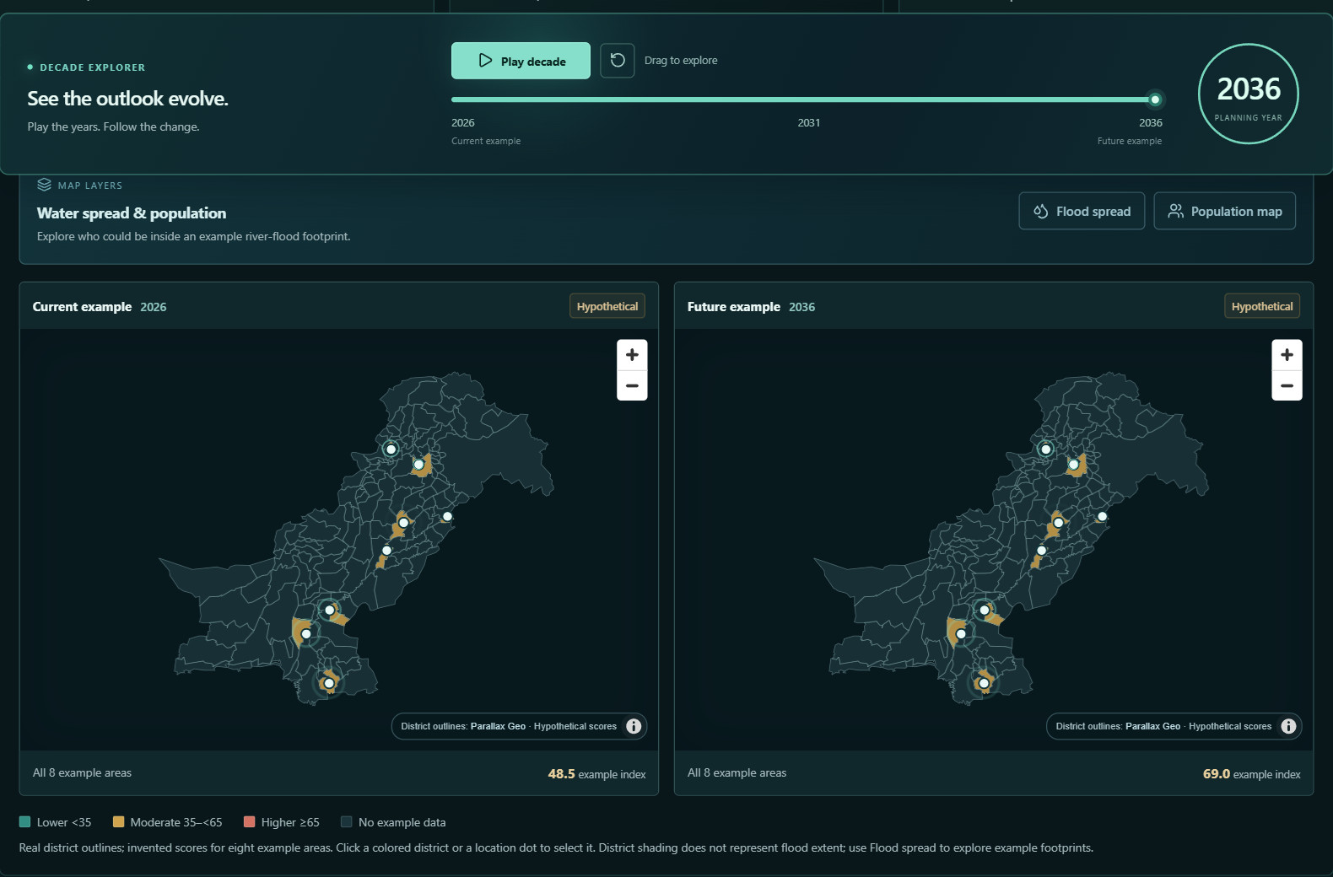
10-year flood-risk outlook
FLOODGUARD AI · LONG-RANGE PLANNING
1
Decade explorer
Play or drag through 2026–2036.
1
2
2
Flood spread & population
Example footprints with WorldPop 2025 people.
3
4
3
Current example
2026 example scores on real district outlines.
4
Future example
2036 under the chosen stress scenario.
5
5
Example index
Average of eight example areas: 48.5 → 69.0.
Note: Hypothetical preview. Scores and changes are examples, not validated predictions.
Notes:
This tab shows the planning experience we aim to build: compare locations, explore stress scenarios and see what drives change. Geography and the WorldPop population layer are real; the scores are illustrative.

Slide 15
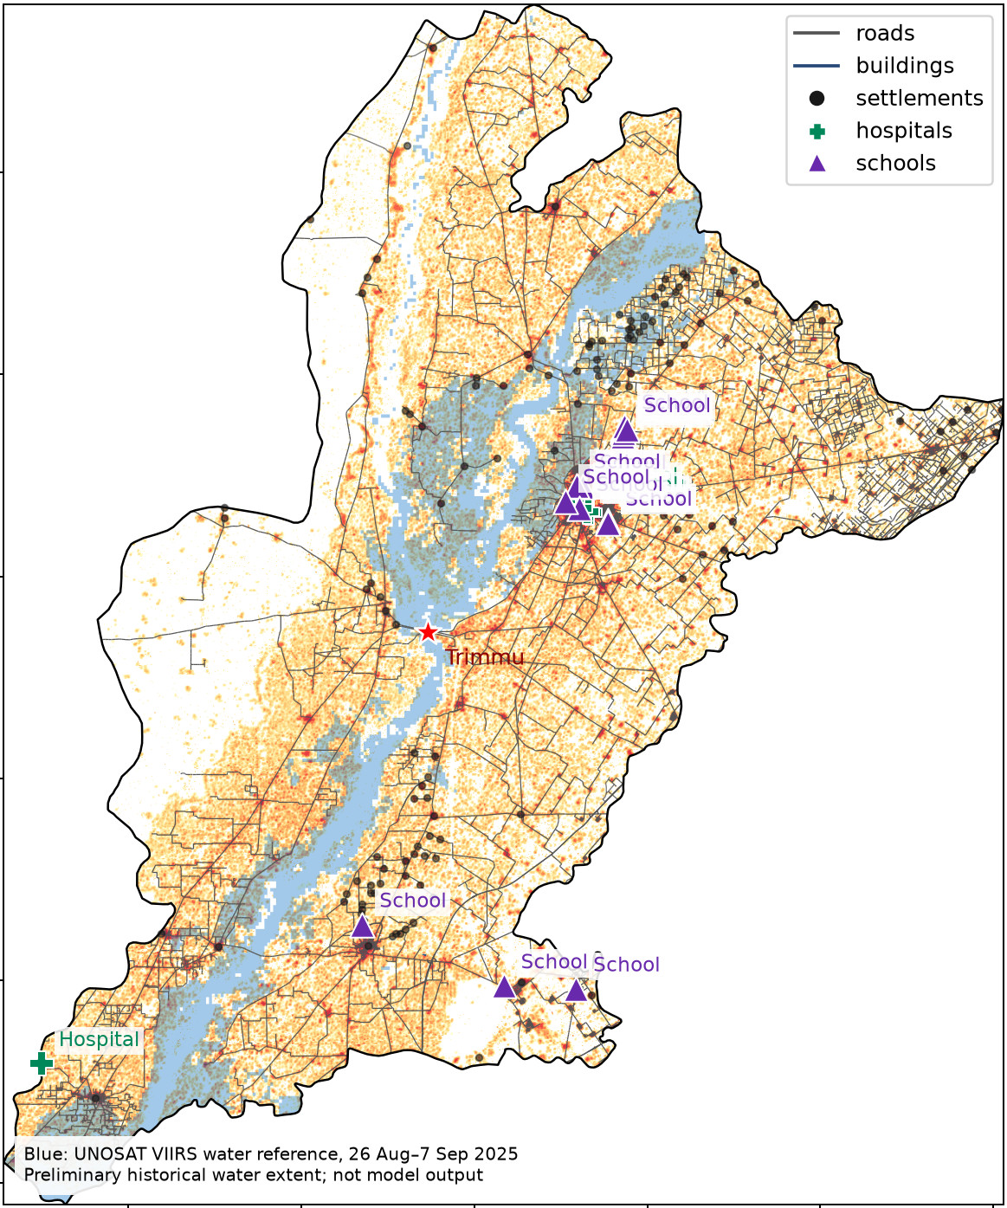
Who lives inside mapped flood water
FLOODGUARD AI · GIS OPERATIONS
313,436
9.7%
people estimated inside mapped flood water, Jhang district
of the known population in the Jhang study area
57.4%
16
of the water area has population data
mapped settlements inside the water
Method WorldPop population × fractional flooded cells, using the UNOSAT satellite water reference for 26 Aug – 7 Sep 2025. The Trimmu / Jhang datasets are prepared in the flood_model exposure module and read by the FloodGuard exposure engine.
Note: Partial coverage: this estimate is not a complete affected-person count.
WorldPop (CC BY 4.0) · © OpenStreetMap (ODbL) · UNOSAT
Notes:
GIS Operations calculates who lives inside a flood extent. For the Trimmu / Jhang pilot and the 2025 UNOSAT satellite water reference, about 313 thousand people live in mapped water cells. Unknown population cells stay unknown rather than zero. The map on the right is the exposure dataset preview from the flood_model project.

Slide 16
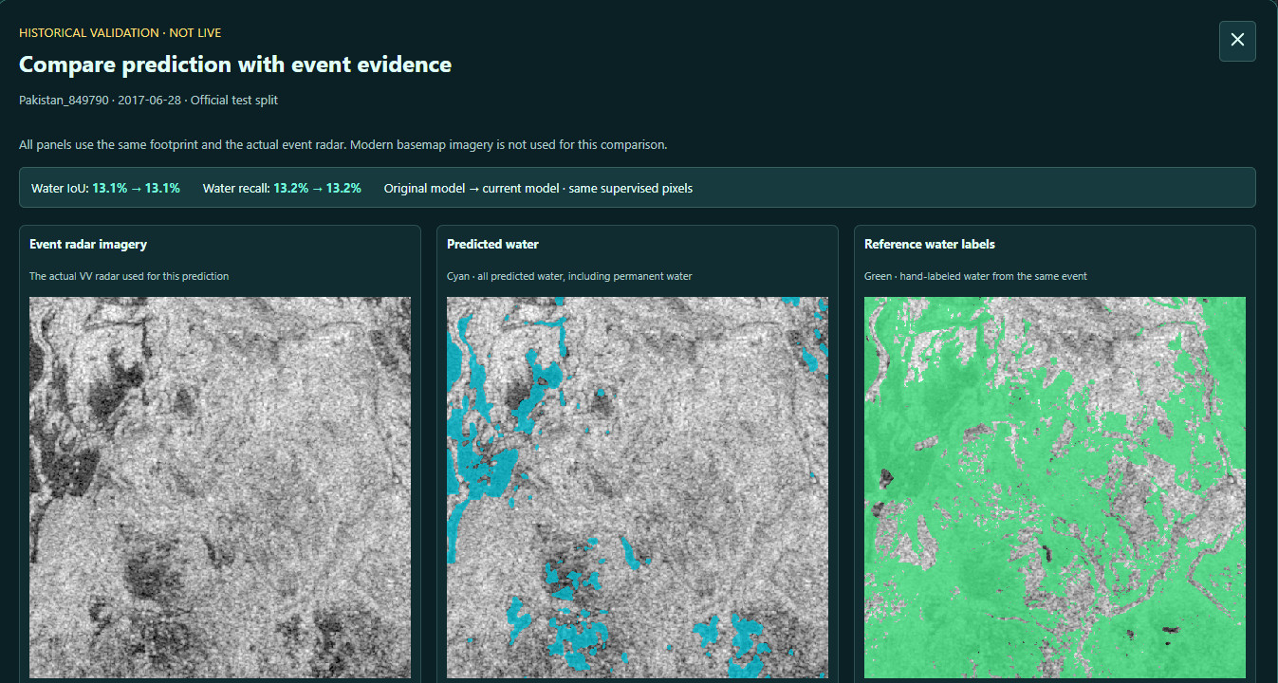
Satellite water mapping with radar
FLOODGUARD AI · SATELLITE WATER EXTENT
1
Radar sees through cloud
Sentinel-1 VV/VH passes for any selected location.
4
2
U-Net water mask
Predicted water overlay, including permanent water.
1
2
3
3
Checked against labels
Hand-labelled water from the same event.
4
Measured skill
Benchmark IoU 65.4%, Dice 79.1%; Pakistan chips 13.5%.
Note: Experimental mask, separate from the risk and alert models; validate before operational use.
Notes:
For a chosen point, the backend finds two recent Sentinel-1 passes, Copernicus DEM elevation and JRC permanent water, then runs a packaged U-Net and returns a dated map overlay. On the Sen1Floods11 test set it reaches 65.4% IoU, but only 13.5% on Pakistan chips, which is why it stays experimental.

Slide 17
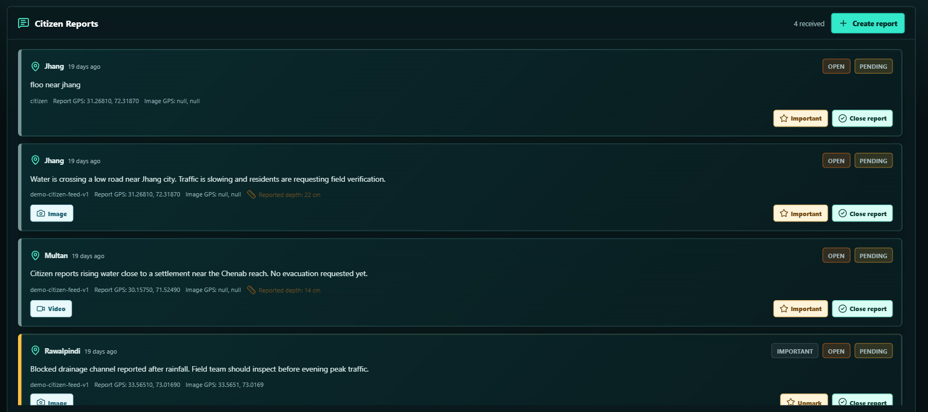
Two-way citizen reporting
FLOODGUARD AI · CITIZEN REPORTS
1
Create report
Text, map or GPS location, photo or video.
1
2
6
3
2
Report location
Place name and GPS coordinates on every report.
5
4
3
Photo geotag
EXIF location read if present; otherwise null.
4
Media evidence
Image or video, with reported water depth.
5
Important or close
Flag priority reports or close them in the database.
6
Status
Open or closed, pending authority verification.
Notes:
Reports are read from and written to the database, so the feed works in both directions. If a photo carries GPS tags its location is extracted; otherwise the user's location is used, and missing values are shown as null rather than guessed. Priority reports can feed the alert workflow on the next slide.

Slide 18


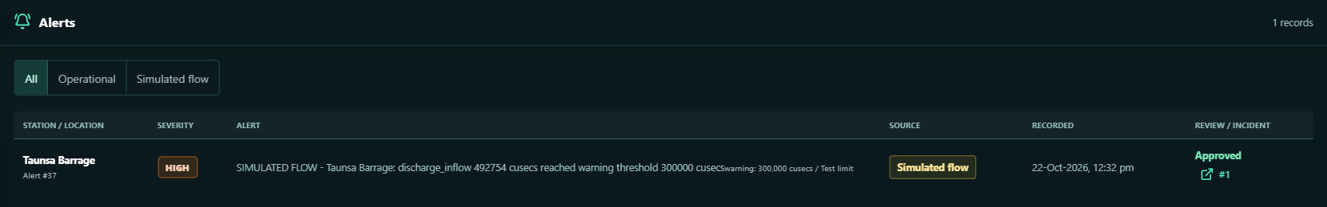
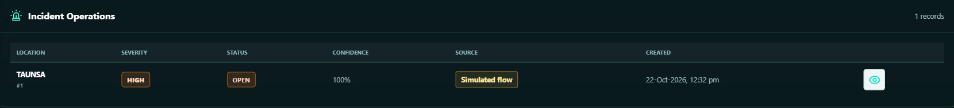
From alert to incident, with approval
FLOODGUARD AI · ALERTS & INCIDENTS
Signal
Threshold crossing or priority report
Alert
Reviewed and approved first
Incident
Opened, tracked, closed
Record
Logged in system activity
ALERTS Operational and simulated-flow alerts are filtered separately; approval links the alert to an incident.
INCIDENTS Each incident keeps severity, status, confidence, source and creation time.
Notes:
The example is end to end: a simulated discharge of 492,754 cusecs at Taunsa crossed the 300,000-cusec test warning threshold, raised a high-severity alert, was approved, and opened incident 1. Simulated-flow items are always labelled so they cannot be mistaken for operational alerts.

Slide 19
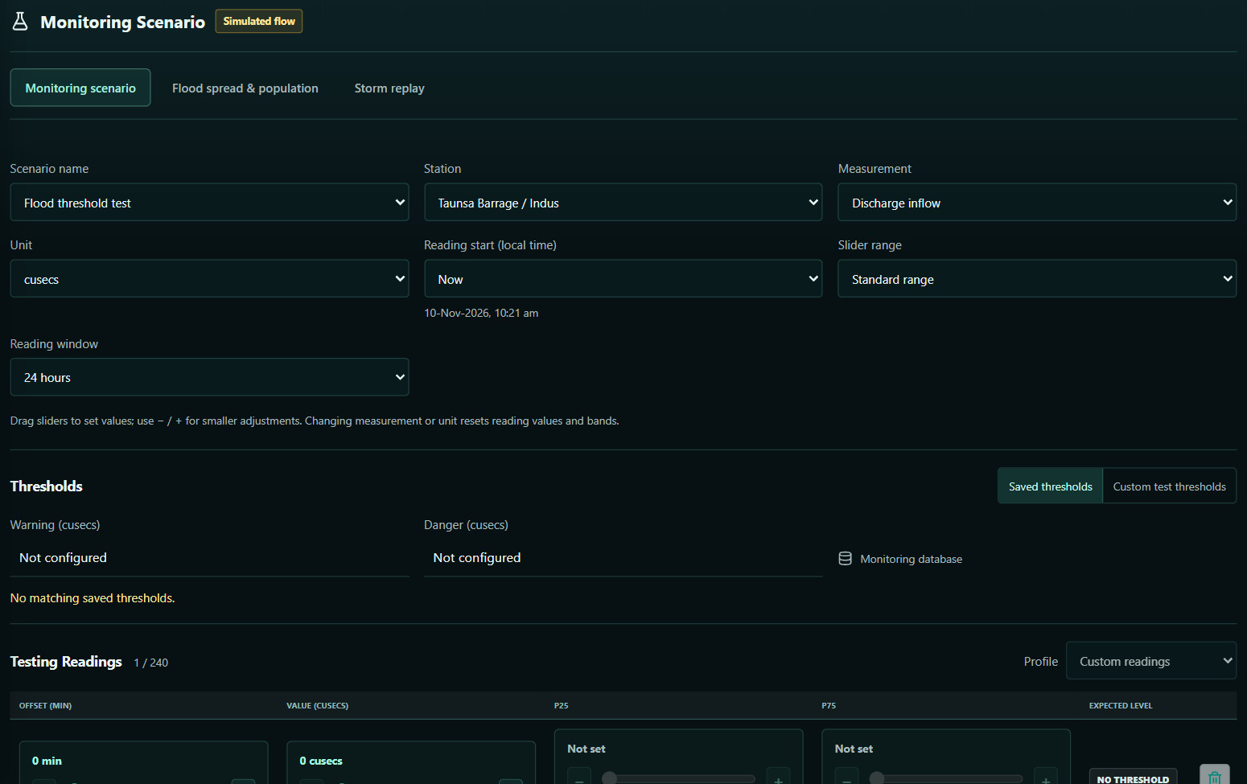
Test the warning chain safely
FLOODGUARD AI · SIMULATION
1
Three simulation tools
Monitoring scenario, flood spread, storm replay.
1
2
3
Scenario & station
Pick a barrage or gauge, e.g. Taunsa on the Indus.
2
3
Measurement & window
Discharge or level, cusecs or m³/s, 24 h window.
4
4
Thresholds
Saved station limits or custom test values.
5
5
Testing readings
Up to 240 readings; crossings raise simulated-flow alerts.
Notes:
The monitoring scenario lets operators rehearse the alert pipeline without touching real data. Readings that cross a threshold create clearly labelled simulated-flow alerts and incidents, like the Taunsa example on the previous slide.

Slide 20
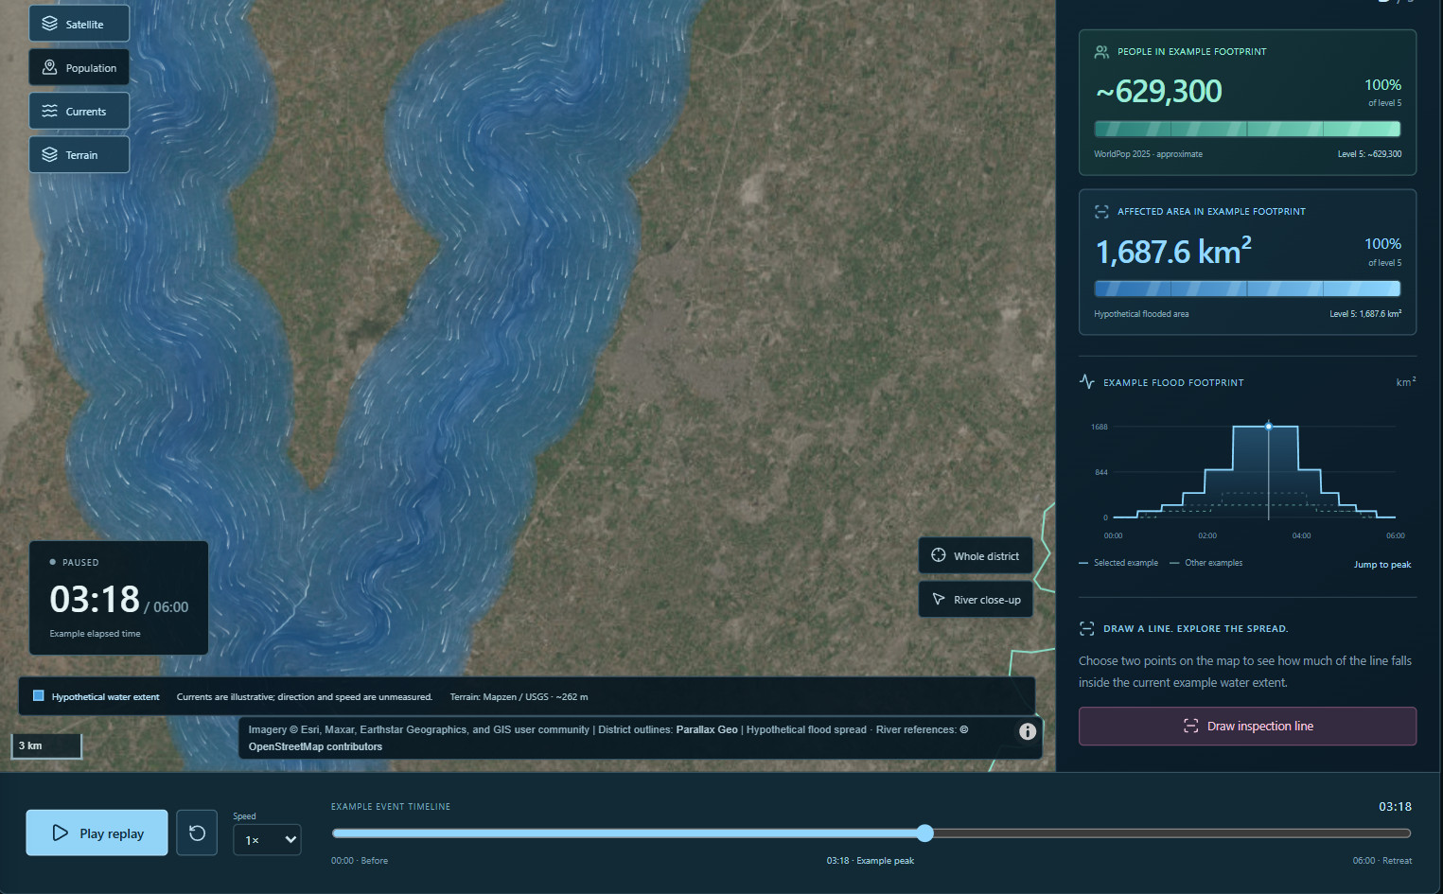
Storm replay with people affected
FLOODGUARD AI · SIMULATION
1
Map layers
Satellite, population, currents and terrain.
1
3
2
Replay clock
Play, pause, jump to the example peak.
4
3
People in footprint
≈629,300 at the example peak (WorldPop 2025).
5
4
Affected area
1,687.6 km² of hypothetical flooding.
2
5
Footprint over time
Area curve with the current frame marked.
6
6
Inspection line
Draw a line to measure how much is under water.
Note: Hypothetical level 0–5 sequence for Jhang, not a flood forecast.
Notes:
Storm replay animates an example flood rising and retreating over six hours. The Flood spread & population tab offers the same idea as 2D comparison maps and a cinematic 3D region view. Population comes from a fixed WorldPop 2025 baseline.

Slide 21
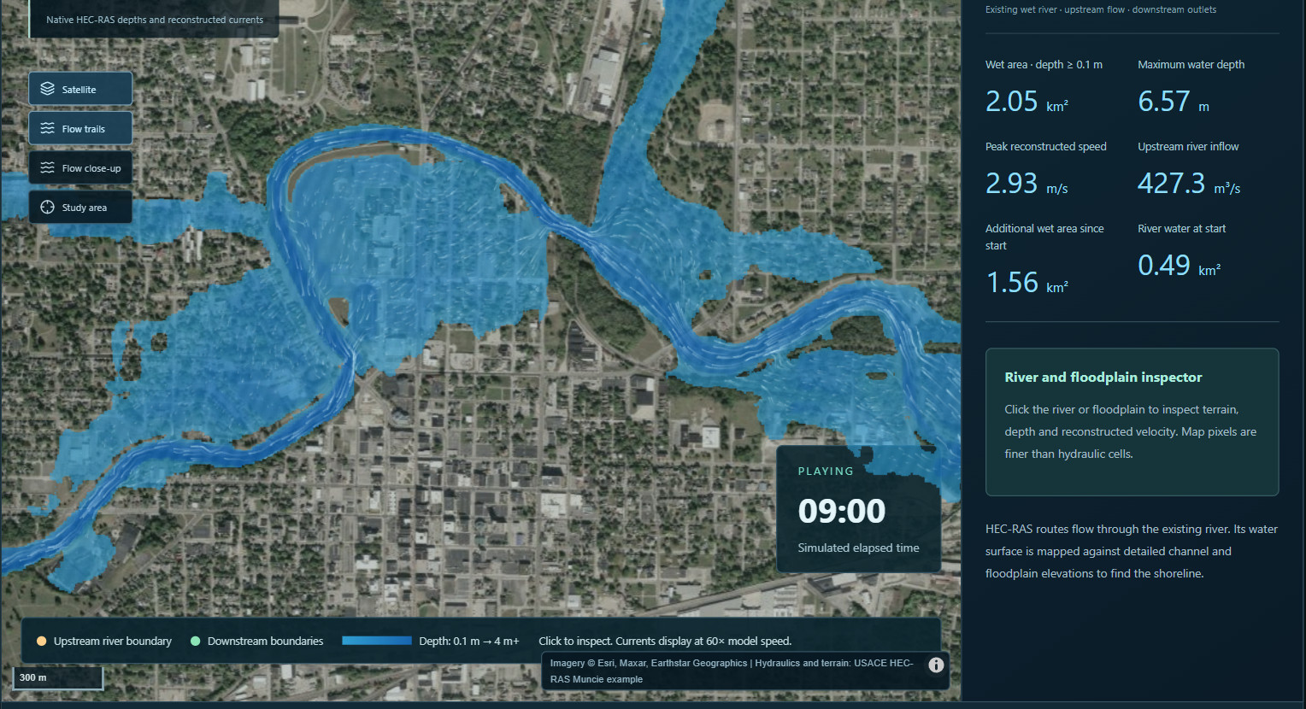
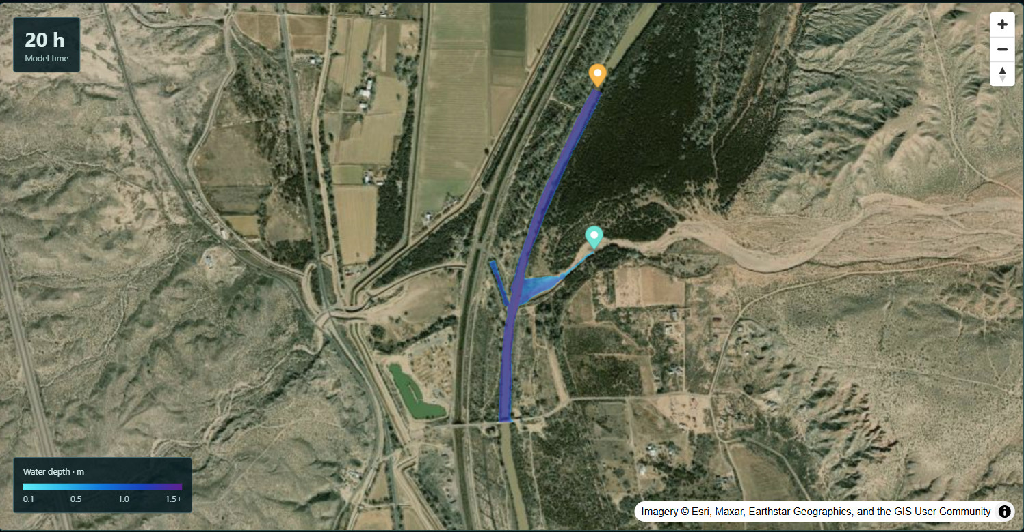
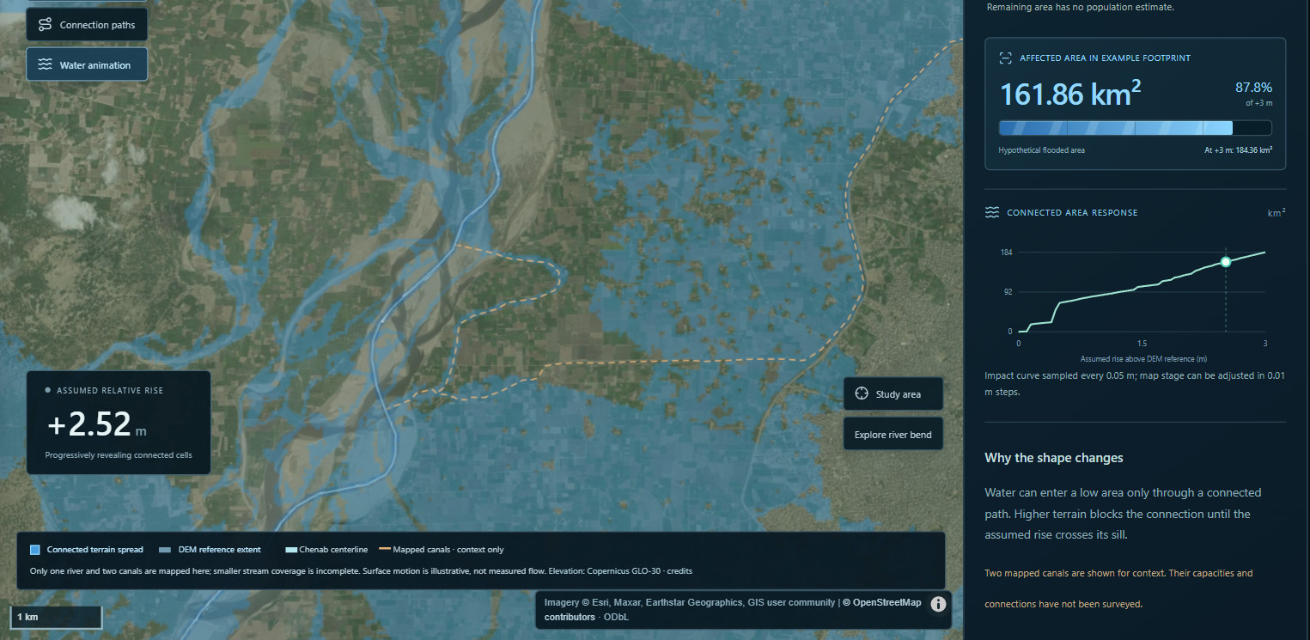
Hydraulic model replays
FLOODGUARD AI · SIMULATION
USACE confluence demo · HEC-RAS 2D
White River, USA · HEC-RAS 2D channel & floodplain
Jhang, Chenab · terrain prototype
Five replays in one workspace: district storm, Jhang terrain prototype, ANUGA 2D trial, HEC-RAS confluence and White River flow.
Note: USA cases are engine demonstrations, not Pakistan forecasts; the Jhang and ANUGA trials are uncalibrated.
Notes:
These replays make hydraulic model output understandable to non-specialists. The White River example uses 7,257 hydraulic cells on 1.5 m terrain. The Jhang prototype reveals which low ground connects to the Chenab as an assumed river level rises; it is a sensitivity display, not a measured depth.

Slide 22
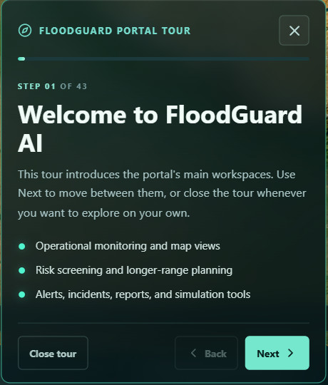
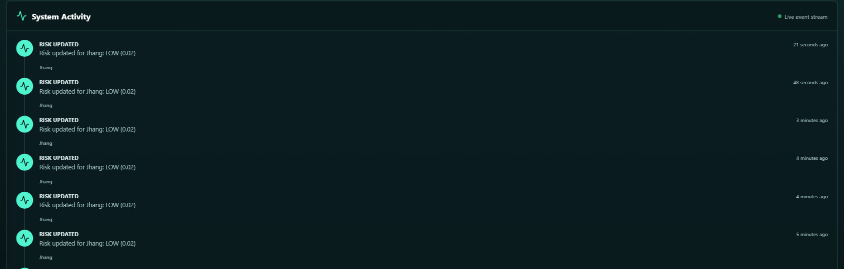

Guided tour, activity log, provenance
FLOODGUARD AI · HANDOVER & TRUST
43-step portal tour
Walks new users through every workspace; open it from any page.
System activity
Automated risk updates, monitoring changes and response events in one timeline.
Provenance on every view
Sources, observation times and 'simulated' labels travel with each value.
Notes:
The tour makes handover easy: anyone can learn the portal in a few minutes. The activity log records automated decisions, and every map lists its data sources, so a reviewer can trace any number back to where it came from.

Slide 23



Data & forecasting research
INSIDE FLOOD_MODEL
02
Flood Data Observatory
Sources, quality checks, catchment and rainfall explorer
Marala riverine dataset
Daily inflow 2016–2024, catchment rainfall 1990–2026
Forecasting experiments
36 configurations at 10, 15 and 30-day lead times
The flood_model workspace: verified river and rainfall data for the Chenab at Marala, and the models trained on it.
Flood-day evaluation
Skill measured separately on high-flow days
Exposure pilot
Trimmu / Jhang population, roads, buildings, facilities
Notes:
Section two covers the research workspace behind the forecasts: how the data are collected and checked, which models were tried, and how well they catch high-flow days.

Slide 24
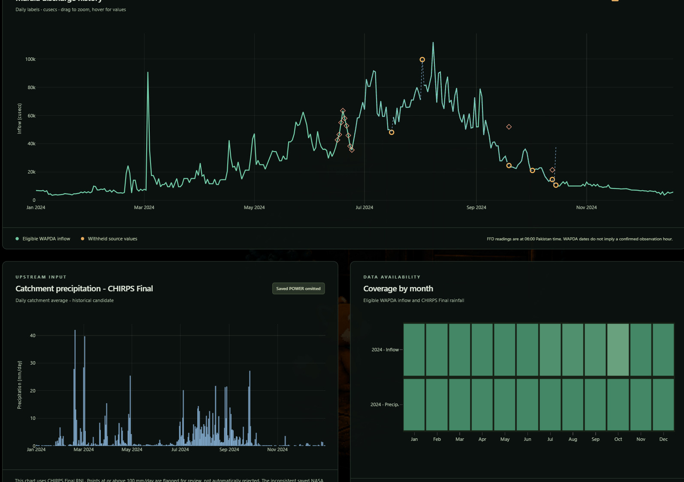
Every record traceable and checked
FLOOD_MODEL · FLOOD DATA OBSERVATORY
3,209
eligible daily Marala inflow values, 2016–2024 (WAPDA, IRSA-checked)
13,422
daily catchment rainfall values, 1990–2026 (CHIRPS v3)
828
source files re-hashed each snapshot; 0 checksum exceptions
7
questionable WAPDA dates withheld, never altered
Marala daily discharge (2024), CHIRPS catchment rainfall and the daily coverage calendar
Notes:
The observatory is a local portal over the research data. Each source keeps its licence and SHA-256 receipt; questionable values are withheld rather than edited, and modeled values are never mixed into observed tables. It rebuilds automatically when new source files arrive.

Slide 25
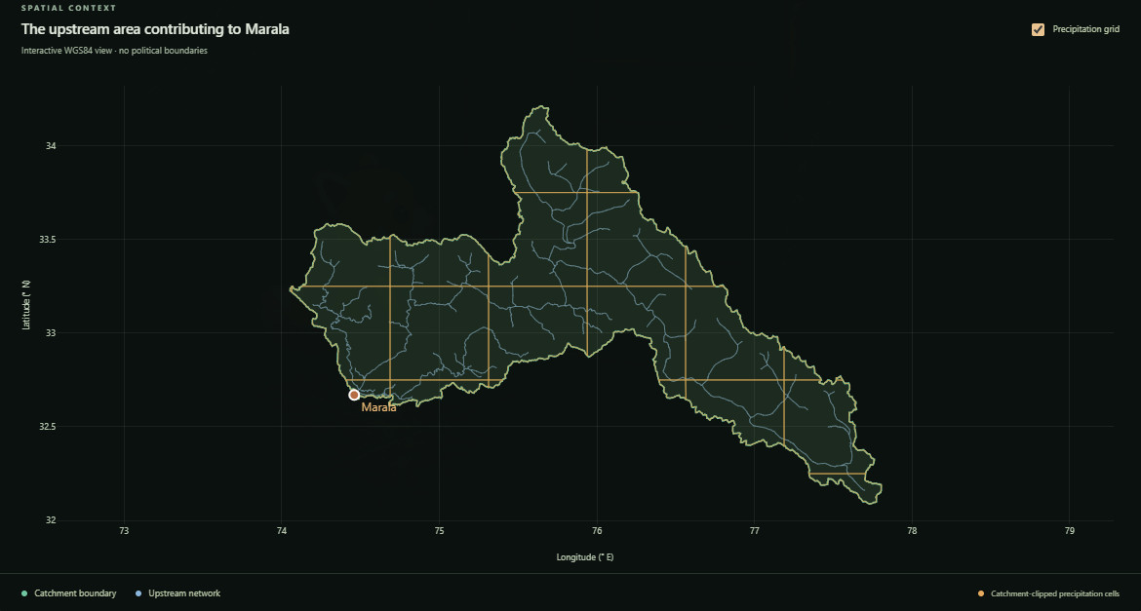

The catchment behind Marala
FLOOD_MODEL · CATCHMENT EXPLORER
28,781 km²
upstream catchment area (WGS84 geodesic)
Rainfall is averaged over 1,266 CHIRPS cells, each weighted by its area inside the boundary.
9 / 9 boundary checks passed
Valid polygon, no repair needed
Outlet listed in the JICA/PMD table
Station point inside the boundary
Area within 5% of PMD's 29,192 km²
Upstream area contributing to Marala, with the river network and catchment-clipped rainfall cells
IoU ≥ 0.99 with nearby outlet polygon
Note: Research delineation, not an agency-certified boundary.
Downstream Khanki excluded
Notes:
The Marala catchment was delineated from Global Watersheds / MERIT hydrography and checked against JICA and PMD evidence. Every rainfall value used by the models is a weighted catchment average, so cells only partly inside the boundary contribute only their inside area.

Slide 26




36 model configurations, one fair test
FLOOD_MODEL · RIVER-FLOW FORECASTING
36
LSTM networks
Hybrid physics + ML
Weather-only, past-discharge, encoder–decoder (seq2seq), elevation-band, 8-basin and global pretrained (Caravan, CAMELS-US).
HBV and differentiable δ-HBV, snow-bucket + LSTM, and HBV residual correction with LSTM or LightGBM.
model configurations compared
Train 2016–20 · validate 2021 · test 2022–24
8 daily inputs with a 365-day history
Other learners
Baselines
Lead times of 10, 15 and 30 days
N-HiTS, N-BEATSx, gradient boosting and LSTM + boosting ensembles.
Persistence and climatology: every model must beat these to be useful.
Scored on high-flow and normal days separately
Note: Weather inputs are ERA5-Land reanalysis with added noise standing in for forecasts.
Notes:
All models predict Marala daily inflow. The same split and inputs are used throughout so the comparison is fair. Because archived forecast weather was not yet available, reanalysis with noise stands in for future weather; true operational skill will be lower.

Slide 27
Best LSTMs flag ~3× more high-flow days
FLOOD_MODEL · RESULTS
80%
of high-flow days flagged 10 days ahead by the 15-day seq2seq LSTM (41 of 51)
27%
for persistence, the 'tomorrow equals today' baseline (14 of 51)
Trade-off about half of its alerts were false alarms (false-alarm ratio 0.52). Retrospective test, not live accuracy.
LSTM models
Other learners
Baselines
Hit rate at day 10, test 2022–2024. High-flow day = observed flow above the training 95th percentile (2,495 m³/s): 51 such days. Unadapted transfer diagnostics (0%) not shown.
Notes:
Hit rate answers: of the 51 high-flow days in 2022 to 2024, how many did each model flag 10 days ahead? The best LSTMs catch about three times as many as persistence. The cost is false alarms, so the balanced score (CSI) is closer: about 0.44 for the best LSTMs against 0.16 for persistence.

Slide 28
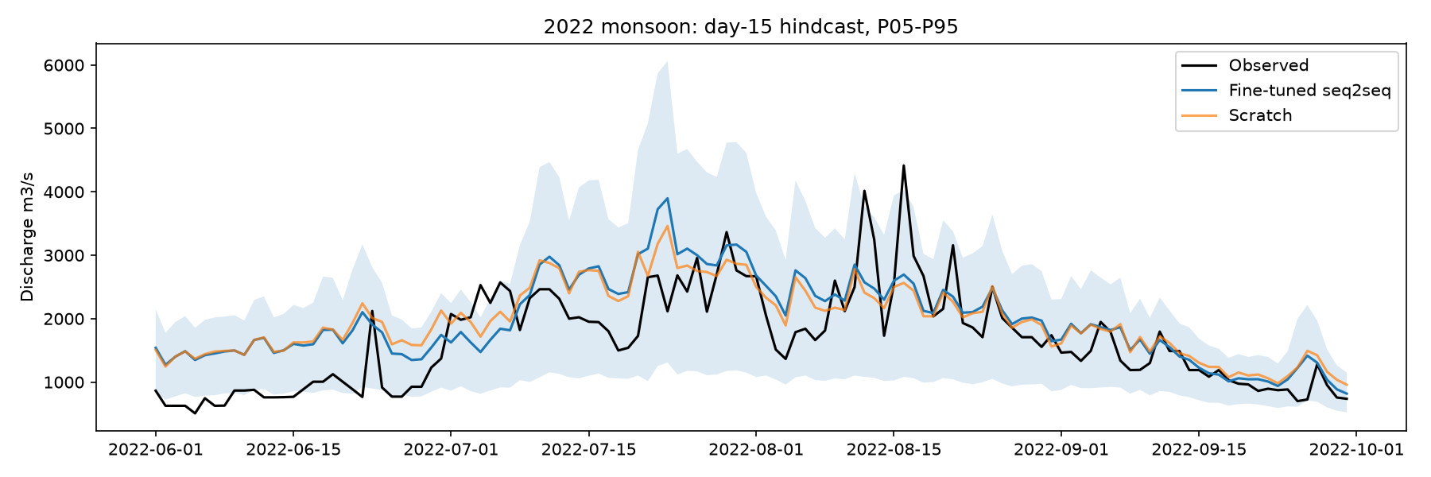

2022 monsoon, forecast 15 days ahead
FLOOD_MODEL · HINDCAST
Follows the monsoon rise and the September recession
Short peaks are smoothed: the mid-August spike is under-predicted
The shaded band shows the P05–P95 forecast range
Notes:
This is the encoder–decoder LSTM forecasting 15 days ahead through the 2022 monsoon. It tracks the season well and its uncertainty band is wide on flood days. Short spikes such as mid-August are under-predicted, which is why sub-daily gauge data are a priority.

Slide 29
Datasets behind the models
FLOOD_MODEL · DATASETS
Dataset | Source | Coverage | Used for
Marala daily inflow | WAPDA, cross-checked with IRSA | 2016–2024 · 3,209 days | Forecast target
Marala 06:00 gauge | FFD / PMD daily bulletins | 2024–2026 · 322 readings | Station forecast
Catchment rainfall | CHIRPS v3 + four comparison products | 1990–2026, daily | Model input
Weather & snow | ERA5-Land; MODIS snow cover | 1980–2024, daily | Model input
Flood events | Global Flood Database, DesInventar, PMD | 28 events · 10,097 records | Risk models
Pretraining basins | Caravan, CAMELS-US | Multi-basin, daily | Transfer learning
Satellite imagery | Sentinel-1, Copernicus DEM, JRC, Sen1Floods11 | On demand | Water mapping
Terrain & rivers | FABDEM, WorldCover, HydroRIVERS/BASINS, SoilGrids | Kabul / Nowshera | Simulation
Exposure | WorldPop, OpenStreetMap, OCHA, UNOSAT | Jhang district | Impact estimates
Live feeds | Open-Meteo, GloFAS, FFD | National, refreshed | Dashboard
Notes:
Every dataset keeps its source, licence and checksum. The forecasting work centres on the first four rows; the others feed risk screening, satellite water mapping, simulation and exposure.

Slide 30




Flood simulation lab
INSIDE THE SCENARIO LAB
03
Scenario lab
29-station catalog, upstream first, six-step workflow
Hydrology
HEC-HMS routing from upstream gauges to Nowshera
Hydraulics
HEC-RAS 2D and LISFLOOD-FP cases for four sites
Result review
Playback, A/B comparison, exposure, tributaries
The flood sim cursor workspace: from upstream gauges to georeferenced flood depth, people and facilities.
FloodSim 3D
Quick browser solver driven by FFD flood classes
Data & provenance
Every input registered with licence and SHA-256
Notes:
Section three covers the simulation lab. Nowshera on the Kabul River is the first hydraulic pilot, with Warsak upstream and the Kabul–Indus connection at Attock downstream.

Slide 31
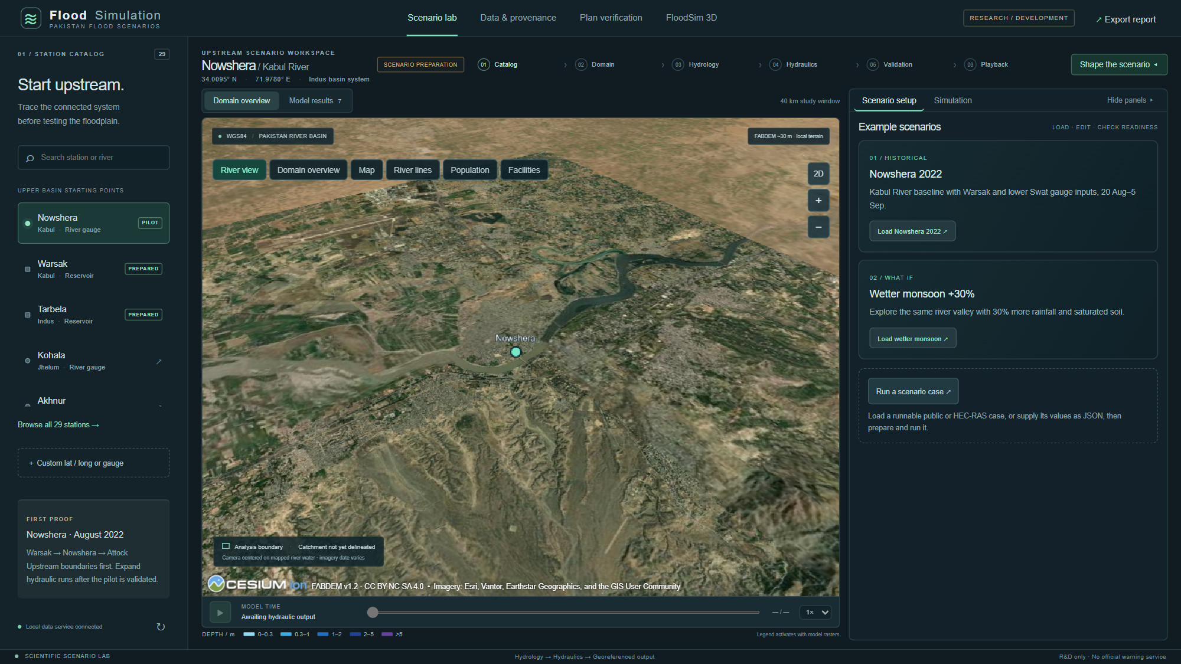
Scenario lab: start upstream
FLOOD SIM · SCENARIO LAB
1
29-station catalog
Nowshera pilot; Warsak, Tarbela, Marala prepared.
2
4
2
Six-step workflow
From station catalog to validated playback.
1
3
3
3D river view
FABDEM terrain, rivers, people, facilities.
5
4
Example scenarios
Nowshera 2022 and wetter monsoon +30%.
5
Run a scenario case
Load a case or JSON, check readiness, run.
6
6
Model-time playback
Timeline and depth legend for results.
Notes:
The lab prepares scenarios from upstream inputs first. Engines installed locally are HEC-RAS 6.6, HEC-HMS 4.14 and LISFLOOD-FP 8.0.3. A case that is missing required inputs is blocked before any compute job is submitted.

Slide 32
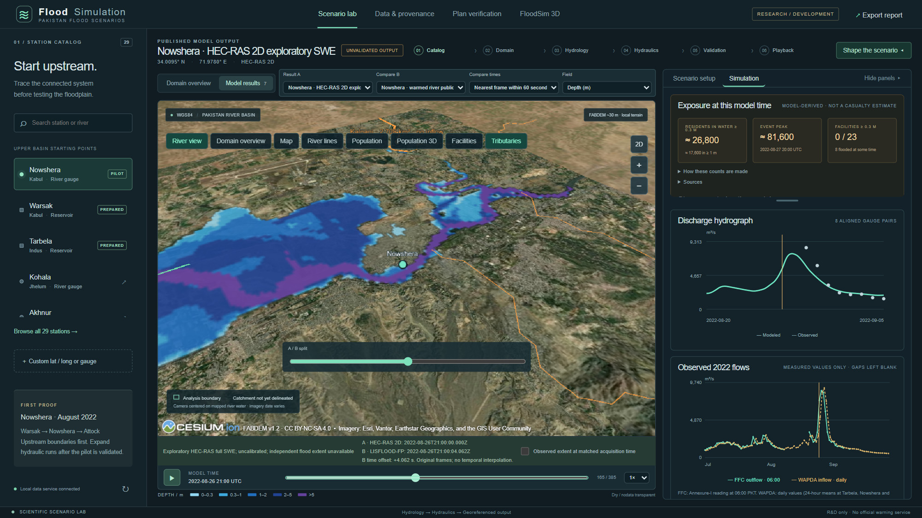
Replay results and compare engines
FLOOD SIM · MODEL RESULTS
1
Seven published results
HEC-RAS 2D and LISFLOOD-FP runs; pick A and B.
1
2
A/B split
Matched frames within 60 s; no interpolation.
3
3
Exposure at model time
≈26,800 residents in ≥0.3 m water in this frame.
4
4
Hydrograph check
Modeled flow against observed gauge points.
2
5
5
Observed 2022 flows
Daily FFC and WAPDA readings for 25 stations.
6
6
Hourly playback
385 frames at 1×, 4× or 16×; depth, level, speed.
Notes:
Shown: Nowshera, 26 August 2022 at 21:00 UTC, HEC-RAS on one side of the slider and LISFLOOD-FP on the other. The viewer only displays published rasters; it never computes water itself. Differences between the two cases also reflect mesh, roughness and boundaries, not only the engine.

Slide 33
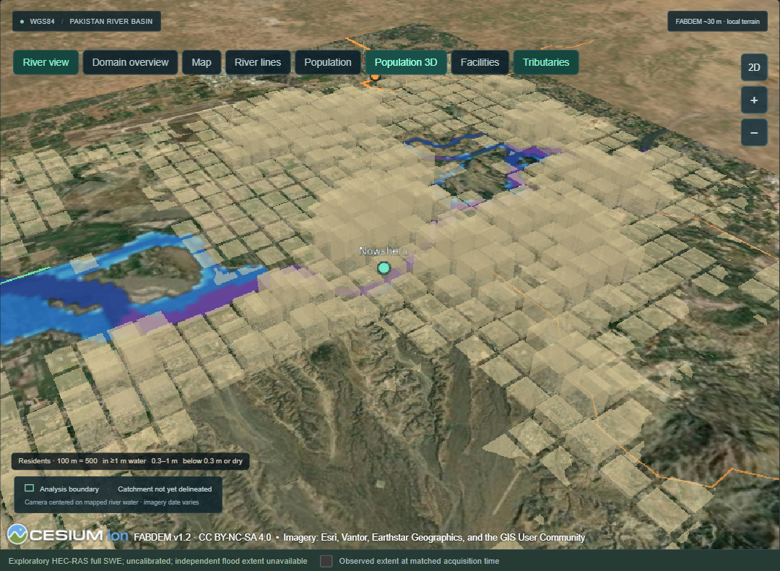
Who is in the water, frame by frame
FLOOD SIM · EXPOSURE
81,636
peak residents in ≥0.3 m of water, 27 Aug 2022 20:00 UTC (53,798 in ≥1 m)
477,091
residents inside the HEC-RAS model area (WorldPop 2022)
8 of 23
mapped health, school and emergency facilities flooded at some time
Tributary audit every stream crossing the model edge is listed with whether the model gives it water; the Kalpani tributary is not yet represented.
Population 3D: one column per ~500 m cell, filling red as residents go under water
Note: Model-derived counts, not casualty or displacement estimates.
Notes:
Exposure counts residents at 0.3 m and 1 m depth thresholds, matching the depth legend. Cells already wet in the first frame are excluded so the river itself is not counted as flooding. Facilities come from OpenStreetMap.

Slide 34
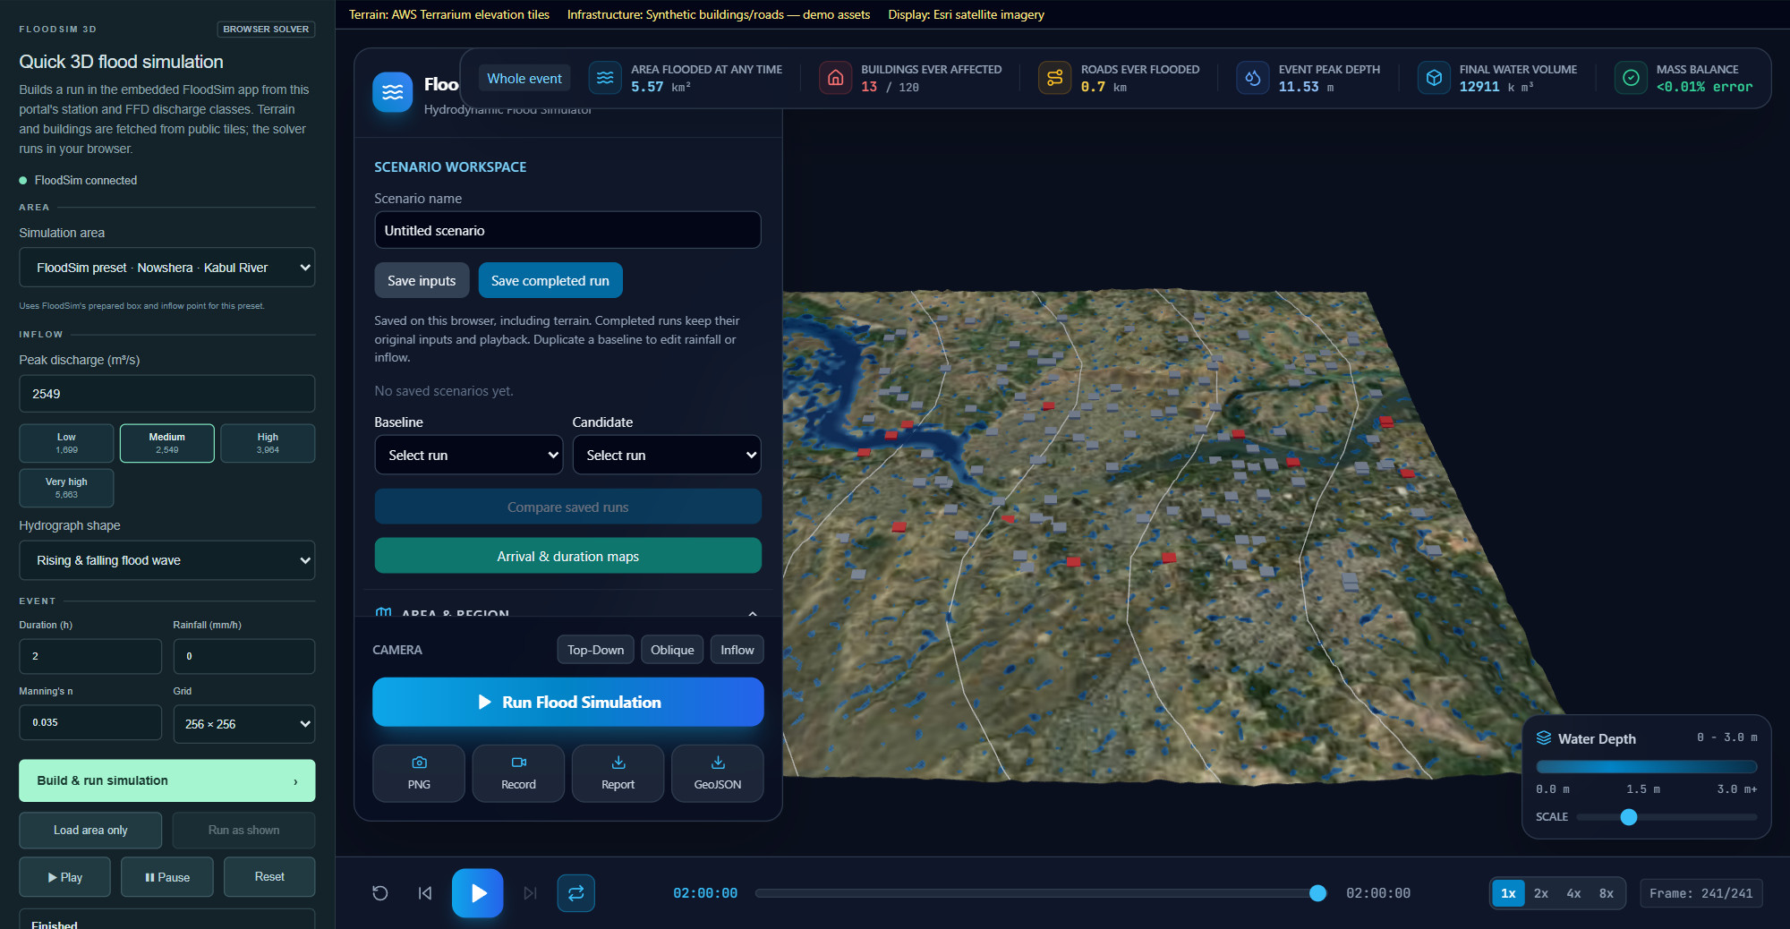
Quick 3D flood simulation
FLOOD SIM · FLOODSIM 3D
1
Area
A 4–20 km box around a station, or a preset.
4
2
FFD flood classes
Low 1,699 to very high 5,663 m³/s in one click.
1
5
3
Event settings
Hydrograph shape, duration, rain, roughness, grid.
2
4
Run statistics
5.57 km² flooded; mass-balance error under 0.01%.
3
6
5
3D depth on terrain
Water over public terrain, buildings and roads.
6
Exports
PNG, recording, report and GeoJSON extent.
Note: Screening only and uncalibrated; this run's buildings were synthetic placeholders.
Notes:
FloodSim is a separate browser app embedded in the portal. The portal sends area, inflow and event settings in one message, FloodSim fetches terrain and buildings and runs a local-inertial shallow-water solver, and the statistics come back to the portal. FFD classes are converted from lakh cusecs (1 lakh cusecs = 2,831.7 m³/s).

Slide 35
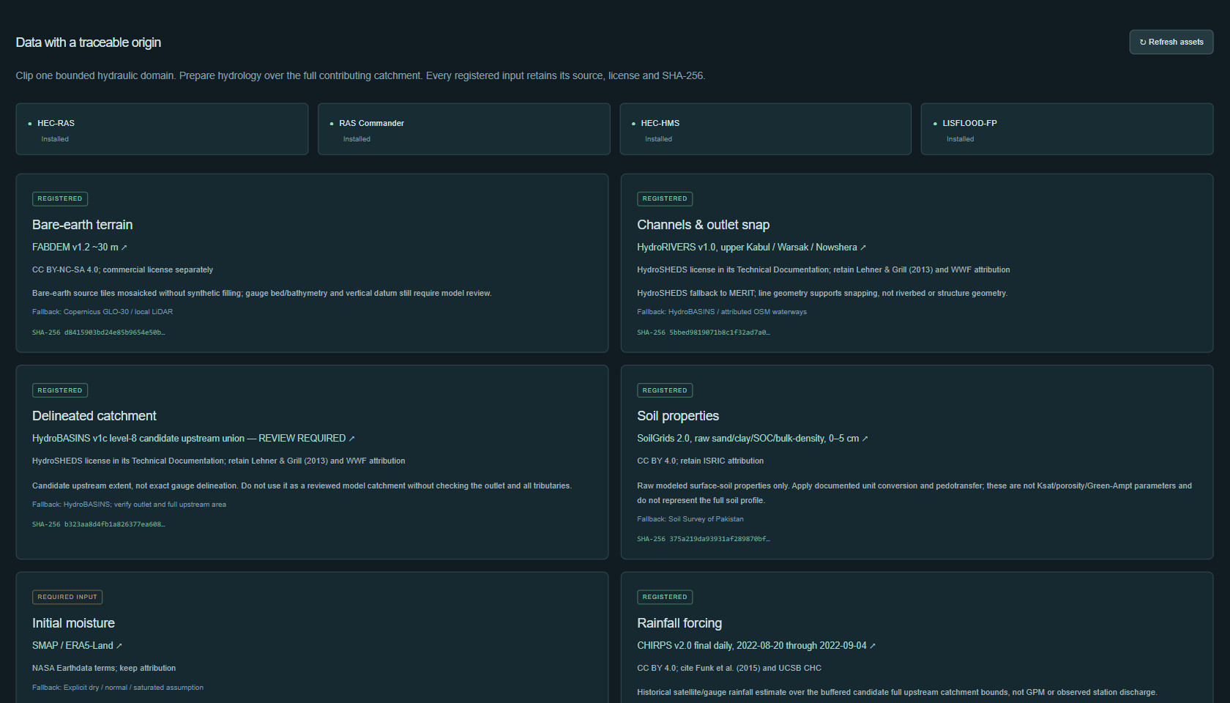
Traceable inputs, real engines
FLOOD SIM · DATA & PROVENANCE
1
Engines installed
HEC-RAS 6.6, HEC-HMS 4.14, LISFLOOD-FP 8.0.3.
1
2
Registered inputs
Terrain, rivers, catchment, soil, rainfall.
2
3
4
3
Named source product
e.g. FABDEM v1.2 (~30 m), linked to source.
5
4
Licence and fallback
Licence terms and a backup source.
5
SHA-256 fingerprint
Any change invalidates prepared domains.
6
6
Missing inputs block runs
Readiness checks stop compute early.
Notes:
Public inputs acquired so far include FABDEM terrain, WorldCover, HydroRIVERS, a candidate HydroBASINS catchment, SoilGrids, full-catchment CHIRPS rainfall and 17 official FFC reports. Initial soil moisture is still a required input, shown here as not yet registered.

Slide 36
Where the simulation models stand
FLOOD SIM · EVIDENCE
Study | Result | Target | Status
HEC-HMS routing to Nowshera (withheld period) | NSE 0.678 · KGE 0.462 | NSE ≥ 0.65 · KGE ≥ 0.60 | KGE not met
Same, plus 3 timed Warsak readings | KGE 0.469 | KGE ≥ 0.60 | Improved, not met
HEC-RAS 2D, zoned roughness (withheld) | KGE 0.558 | KGE ≥ 0.60 | Close, not met
Warsak LISFLOOD-FP vs Sentinel-1, river corridor | CSI 0.50–0.62 · detection 0.87 | CSI ≥ 0.5 | Met
Warsak floodplain only | CSI 0.17–0.21 | – | Limited by estimated bed
HEC-RAS 2D exploratory full SWE, Nowshera 2022 | 385 hourly frames, 200 m mesh | – | Uncalibrated
Main limit no surveyed river-bed geometry and sparse sub-daily gauge records. Roughness tuning barely moves the scores.
Notes:
Targets were declared before testing. Routing misses its KGE target, so it is kept as an exploratory model. Against Sentinel-1 water maps at Warsak the model meets the CSI target in the river corridor but not on the wider floodplain, where the estimated channel bed is the main limit. Detection is the probability of detection at the calibration flow.

Slide 37


What is operational, what is research
STATUS
Operational now
Research & preview
Held back on purpose
Live Open-Meteo weather and GloFAS discharge
FFD observed readings with sources
Rule-based risk engine on live inputs
145-district weather screening
Alerts, incidents and citizen reports in the database
LSTM river-flow forecasts (retrospective tests)
SAR U-Net satellite water mapping
10-year outlook and flood-spread previews
HEC-RAS, LISFLOOD-FP and FloodSim runs (uncalibrated)
Real-data XGBoost risk model: event ROC-AUC 0.59, spatial 0.38, below the 0.75 gate
Synthetic development models disabled in production
No invented water levels or placeholder facilities
Notes:
The platform is deliberately strict: production defaults disable simulation and rule-based fallbacks, and the real-data XGBoost model is not deployed because it failed its validation gate. Research outputs stay clearly labelled until they pass independent validation.

Slide 38



Data needed to make it operational
NEXT STEPS
PLATFORM NEXT
Official FFD station thresholds in metadata
Validated model to replace the development XGBoost
Forecast models wired into Predictive Risk Views
Early-warning report, approval and escalation
PostgreSQL for a shared deployment
Sub-daily gauge records
Surveyed channel geometry
Reviewed hourly or 3-hourly series to train and verify short flood peaks.
River-bed surveys to replace estimated channel depths in HEC-RAS and LISFLOOD-FP.
Archived forecast weather
Independent flood extents
TIGGE / GFS archives to measure true forecast skill instead of reanalysis.
Satellite or field-mapped extents to validate inundation maps.
Notes:
The software is ahead of the data. The four data items on the left are what would move the forecasts and simulations from research to operational use. The platform items on the right are already planned in the codebase.

Slide 39
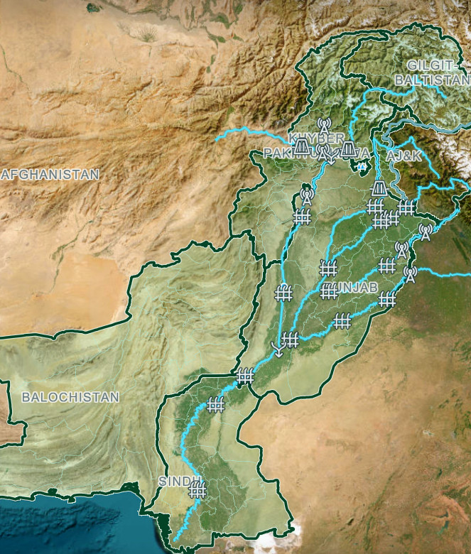
Thank you
QUESTIONS & DISCUSSION
FloodGuard AI portal · Flood Data Observatory · Flood Simulation lab
Faiza Muzaffar
55
34
48
API endpoints
backend test modules
UI check scripts
Notes:
Close with the engineering base: a FastAPI backend with 55 endpoints, 34 backend test modules and 48 front-end checks. Invite questions on priorities, especially the data requests on the previous slide.

