Slide 1
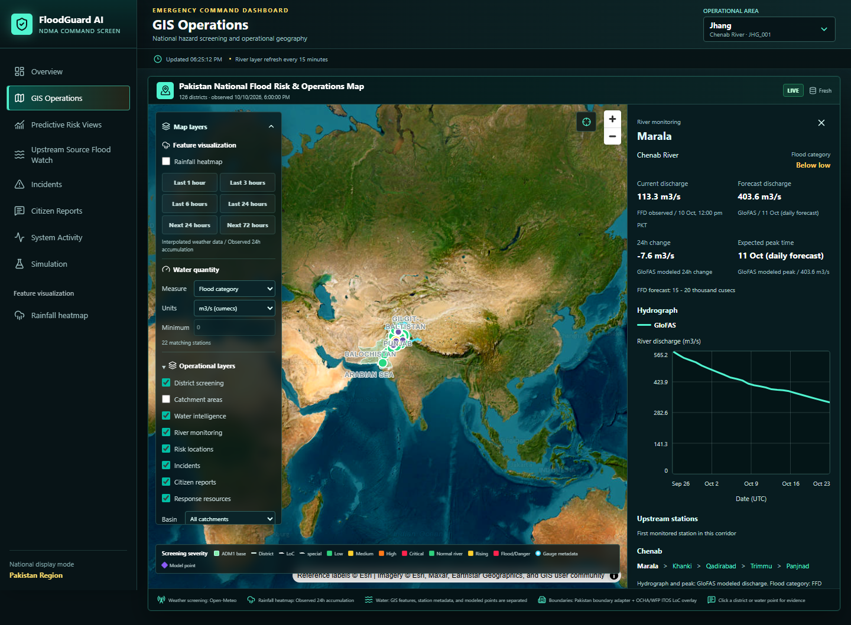
PORTAL FEATURE DECK
FloodGuard AI Disaster Management Portal
All current portal capabilities plus future scope and implementation roadmap
Prepared from the local disaster_management repository - 12 Oct 2026

Slide 2
EXECUTIVE SUMMARY
What the Portal Delivers Today
A command dashboard for flood intelligence, field reporting, simulation, and response coordination across Pakistan-focused operational geography.
MAIN VIEWS
PRIORITY SITES
REFRESH MODES
ADM2 SCREEN
10+
28
15m / 3m
126 districts
Operational awareness
GIS intelligence
Decision support
Overview map, KPIs, live weather and river context, hourly analytics, activity stream, alerts, and incidents.
District risk, rainfall raster, rivers, catchments, glaciers, Google Flood Hub points, reports, incidents, and resources.
Predictive models, upstream forecasts, monitoring simulation, citizen reports, population exposure, and automation context.
- Production defaults avoid silent mock fallbacks; simulation is isolated and clearly labeled.
- Backend APIs expose dashboard summaries, GIS layers, forecasts, reports, incidents, resources, and analysis artifacts.
- Frontend is built as a responsive authority dashboard with MapLibre-based operational layers.
FloodGuard AI Disaster Management Portal
02

Slide 3
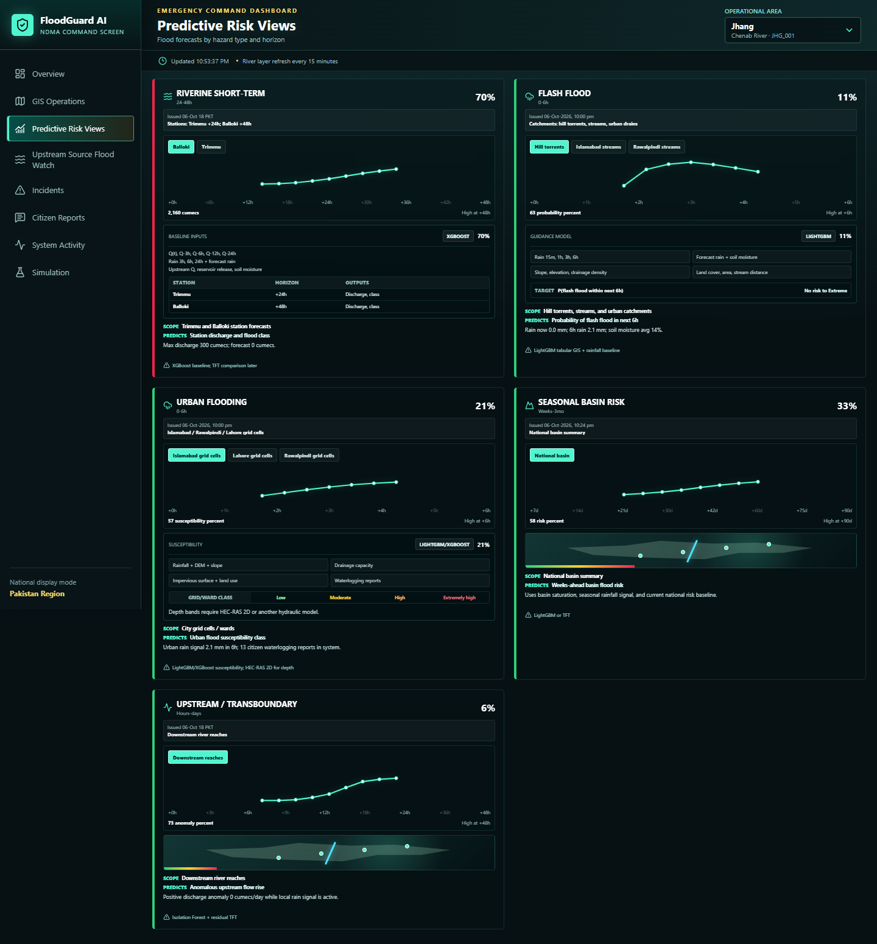
PORTAL STRUCTURE
Command Navigation and User Experience
- Sidebar sections cover Overview, GIS Operations, Predictive Risk, Upstream Watch, River Monitoring, Alerts, Incidents, Citizen Reports, Activity, Simulation, and Rainfall Heatmap.
- The top bar exposes operational location selection and current update status.
- Responsive screenshots exist for desktop and mobile views, and validation scripts check overflow and rendering.
- External Google Flood Hub access is available directly from navigation for official reference mapping.
Design intent
Operational state
Dense command surface for repeated operational use.
Live mode, simulation mode, backend errors, and refresh status stay visible.
FloodGuard AI Disaster Management Portal
03

Slide 4
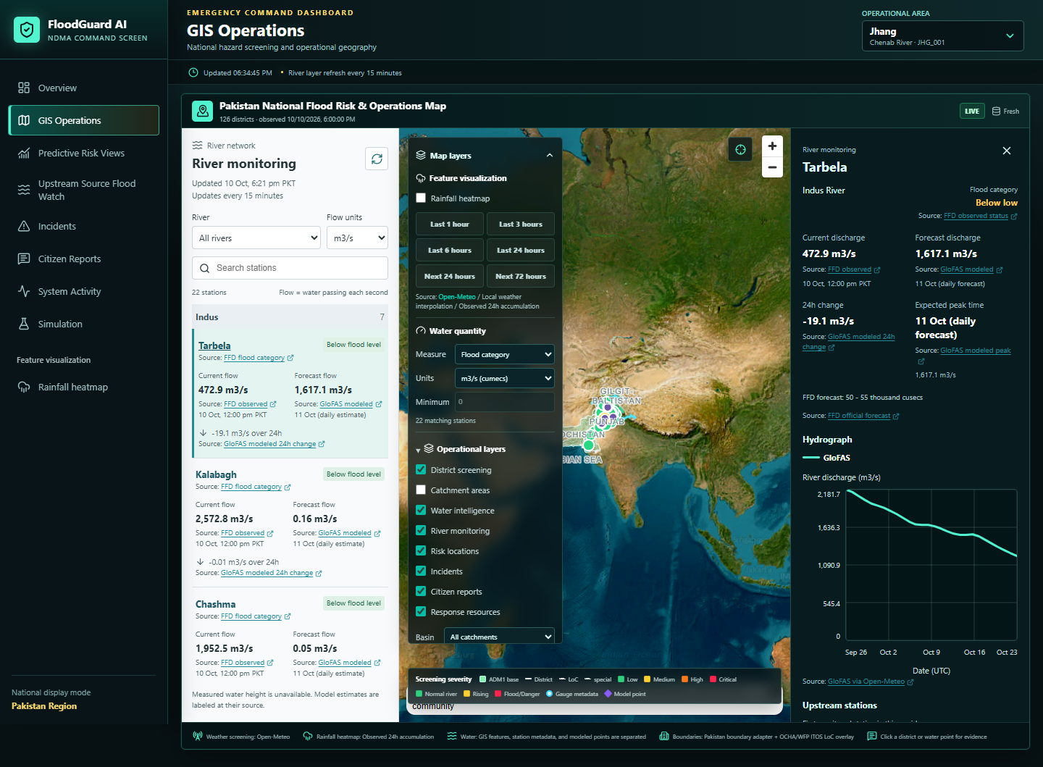
OPERATIONS
Operational Overview Dashboard
- National map canvas opens with Pakistan boundary context and overlays command KPIs.
- KPI deck summarizes risk, active incidents, reports, resources, monitoring interval, and command statistics.
- Hourly analytics ticker provides quick scanning across weather, river, risk, reports, and operational feeds.
- Mode banners warn when the system is in simulation or when a scenario is configured.
Live refresh
Flood cadence
Dashboard batches weather, river, risk, GIS, event, report, alert, incident, and resource requests.
River layer refreshes every 15 minutes normally and every 3 minutes during flood-like states.
FloodGuard AI Disaster Management Portal
04

Slide 5
GIS OPERATIONS
Layered Map Intelligence
- Static layers: Pakistan boundary, district names, catchments, glaciers, rivers, lakes, dams, and risk locations.
- Dynamic layers: district screening, river status, model forecast points, monitoring gauges, Flood Hub, reports, incidents, and response resources.
- Coordinate tools support lat/long entry, map picking, feature lookup, and study mode for corresponding catchment layers.
- Kashmir boundary source selector, LoC reference, and explicit display-geometry disclaimers avoid false boundary certainty.
Map engine
Study mode
MapLibre with compressed, cached GeoJSON assets.
Clips layers to selected HydroBASINS catchment.
FloodGuard AI Disaster Management Portal
05

Slide 6
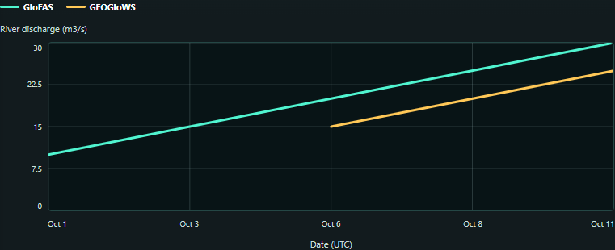
RAINFALL
Heatmap and Weather Context
- Rainfall heatmap supports last 1h, 3h, 6h, 24h and forecast 24h, 72h windows.
- Open-Meteo weather and regional rainfall samples feed the raster; local data is used when regional refresh is unavailable.
- Legend displays rainfall accumulation ranges from light precipitation through 100+ mm.
- Rainfall layer can be enabled directly from the rainfall view or as a GIS dynamic layer.
Source hygiene
Operational use
Cached regional rainfall can be shown when provider refresh fails.
Pairs precipitation signal with district risk, river status, and reports.
FloodGuard AI Disaster Management Portal
06

Slide 7
PREDICTIVE RISK
Multi-Hazard Forecast Views
- Riverine short-term: station discharge and flood class for Trimmu and Balloki horizons.
- Flash flood: 0-6 hour probability for hill torrents, streams, and urban catchments.
- Urban flooding: city grid or ward susceptibility using rainfall, DEM, slope, drainage, land use, and reports.
- Seasonal basin risk and upstream or transboundary anomaly detection give wider decision context.
- Stored forecast points are charted by model case and selectable target.
Model stance
Model families
Rule-based live baseline remains primary until validated ML artifacts meet deployment gates.
XGBoost, LightGBM, TFT comparison, and anomaly methods are represented.
FloodGuard AI Disaster Management Portal
07

Slide 8
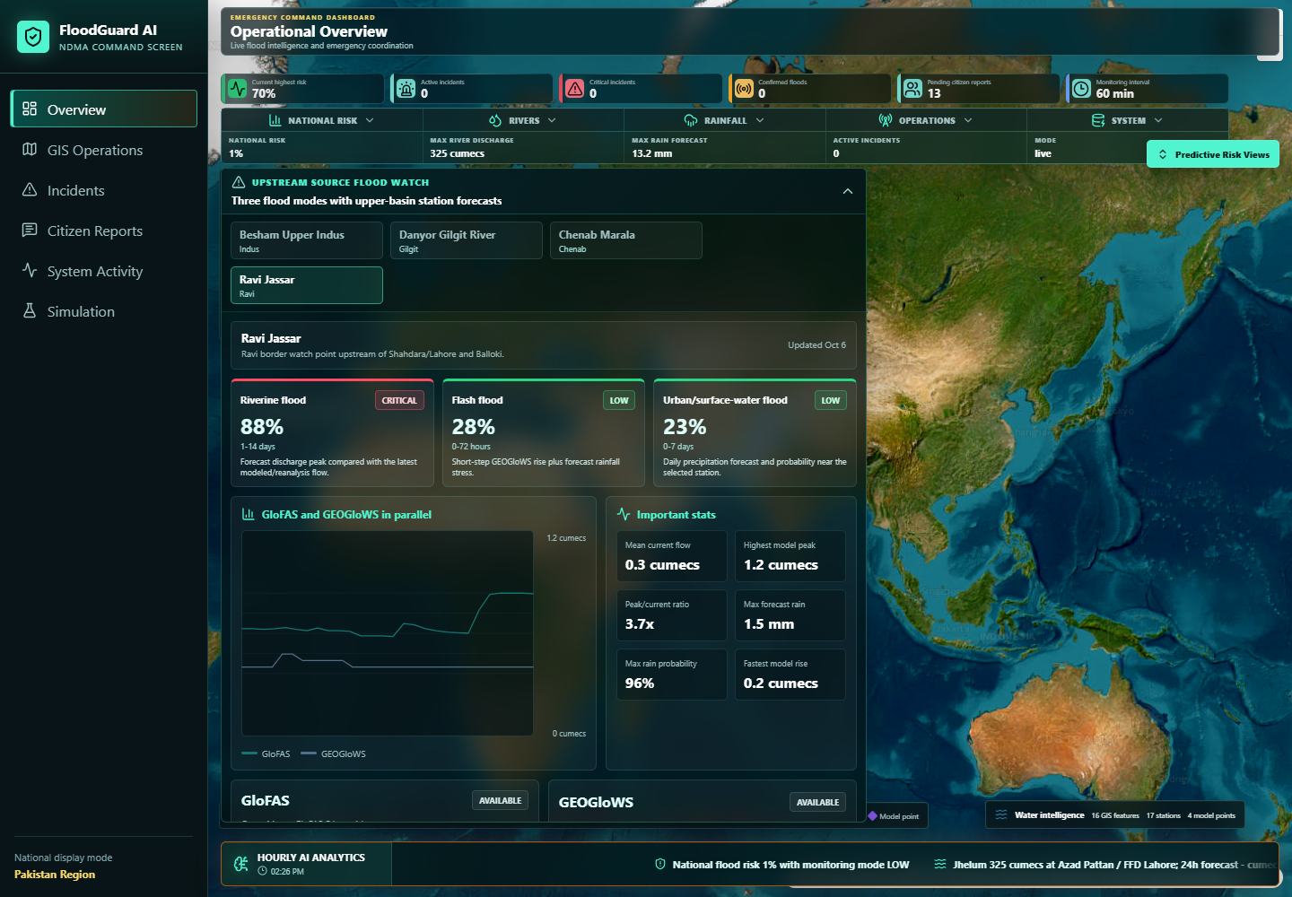
UPSTREAM WATCH
Source Flood Forecasting
- Station selector covers upstream source stations with river and basin metadata.
- GloFAS and GEOGloWS forecasts are shown in parallel with current flow, model peaks, peak timing, and provider notes.
- Trend strips summarize retrospective modeled history; rainfall context shows forecast totals and probabilities.
- Stored cache timestamp, next refresh time, automatic hourly update, and manual refresh button are exposed to users.
Lead time
Traceability
Hours to days for upstream and transboundary signals.
Forecast panel labels model source and stale or unavailable data.
FloodGuard AI Disaster Management Portal
08

Slide 9
RIVER MONITORING
Stations, Gauges, and Flow Status
- Detailed table filters by river, unit, station search, and selected station inspector.
- Shows current flow, forecast flow, flood category, 24h change, expected peak, and timestamps.
- Separates FFD observed status from GloFAS modeled values and labels measured versus modeled fields.
- Map river colors change based on current river status and refresh at operational cadence.
Units
Quality
m3/s and cusecs.
Observed water height is left unavailable if not published.
FloodGuard AI Disaster Management Portal
09

Slide 10
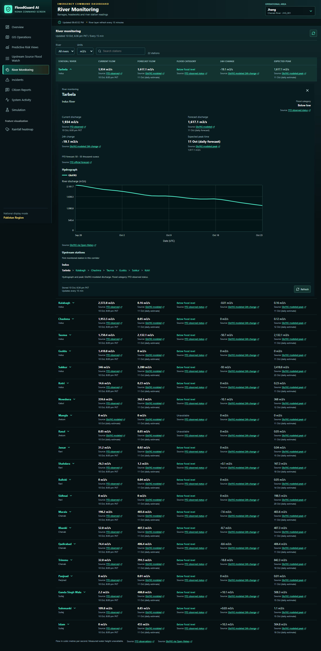
STATION DETAIL
Hydrograph, Hover Cards, and Forecast Windows
- Hover cards show compact station facts without triggering heavy fetches on every mouse move.
- Pinned station details retain original readings, hydrograph, and upstream network context.
- Discharge forecast tab adds a larger chart with observed history, modeled history, forecast days, selectable legend, table, and CSV download.
- Observed-history calls are abortable and cached; stale readings and missing thresholds are labeled rather than inferred.
Accessibility
Scale
Keyboard focus proxy, Enter to pin, Escape to dismiss.
Large networks use native MapLibre layers instead of DOM markers.
FloodGuard AI Disaster Management Portal
10

Slide 11
RESPONSE OPERATIONS
Alerts and Incident Management
- Alerts table filters all, operational, and simulated-flow alerts.
- Each alert records station or location, severity, message, source, timestamp, threshold metadata, and linked incident.
- Incident table tracks severity, status, confidence, source, creation time, and detail drawer.
- Activity timeline records risk updates, monitoring mode changes, incident creation, citizen reports, confirmations, and required alerts.
Alert -> Incident -> Activity Trail
1
2
3
4
Threshold or risk signal
Alert record
Linked incident
Timeline event
Auditability
Workflow base
Operational and simulated records are visually separated.
Current screens are ready for approval and escalation layers.
FloodGuard AI Disaster Management Portal
11

Slide 12
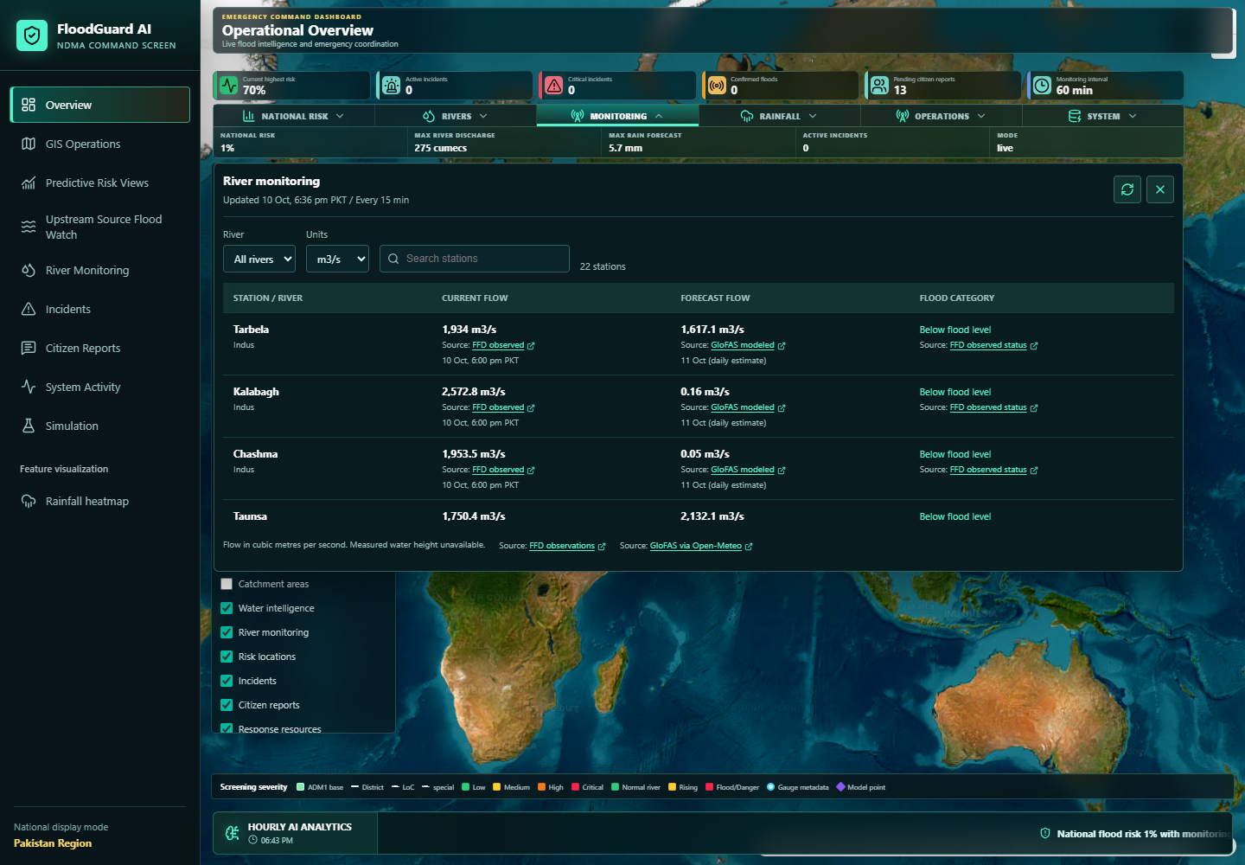
FIELD INPUT
Citizen Reports and Verification Queue
- Reports are fetched from the backend database and newly created reports are saved back through the API.
- Full report entry supports operational location, latitude, longitude, Google Maps link parsing, browser location, water depth, source, image URL, and video URL.
- Geotagged image upload reads EXIF GPS when present; otherwise image GPS fields remain visible as null.
- Reports stay highlighted as live for one minute, appear in a scrollable list, can be marked important, and can be closed in the database.
Validation
Map use
Required description and numeric coordinate/depth checks.
Google Maps search and coordinates help field localization.
FloodGuard AI Disaster Management Portal
12

Slide 13
EXPOSURE
Flood-Affected Population and Impact Analysis
- GIS Operations includes a population panel that loads latest analysis or starts a background calculation job.
- Sources include historical satellite water reference, user-provided flood GeoJSON, configured segmentation output, or explicit synthetic sample.
- Cards summarize exposed people, percentage of known population, mapped-water coverage with population data, and affected settlements.
- Map layers include flood extent, population density, administrative exposure, and affected settlements.
- Exposure API also supports roads, buildings, hospitals, schools, settlements, summary artifacts, audits, and layer downloads.
Trimmu / Jhang Pilot Reference
EXPOSED PEOPLE
KNOWN POP.
313,436
9.66%
WATER COVERAGE
SETTLEMENTS
57.44%
16
The deck keeps these values labeled as preliminary satellite reference analysis, not a live forecast or full affected-person count.
FloodGuard AI Disaster Management Portal
13

Slide 14
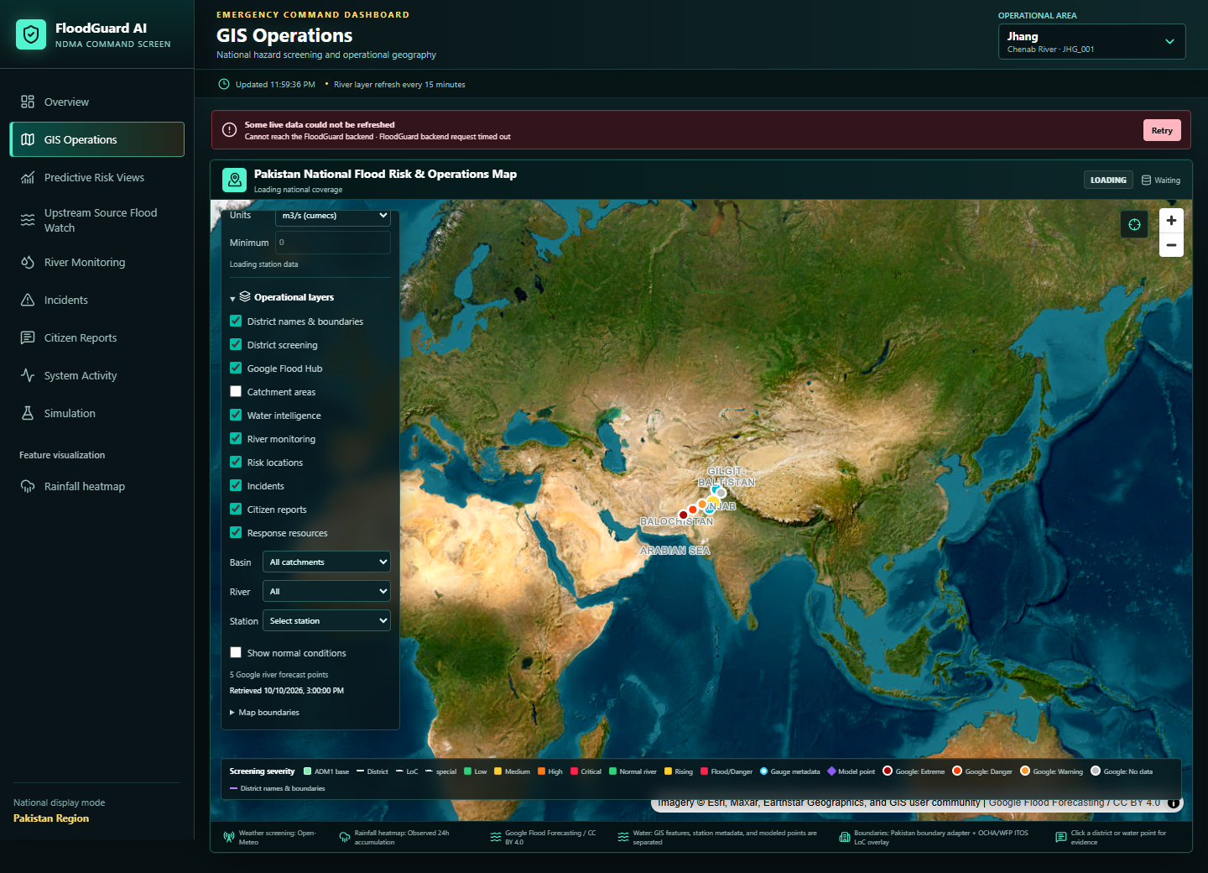
EXTERNAL INTELLIGENCE
Google Flood Hub, Water Layers, and Resources
- Google Flood Hub side navigation opens the official Flood Hub map in a new browser tab.
- GIS toggle displays official Flood Forecasting API river gauge points when credentials are configured.
- Markers use severity colors for extreme, danger, warning, normal, and no-data statuses with issue and forecast interval details.
- Response-resource layers can plot shelters, hospitals, and emergency contacts from authority-supplied data.
- Water intelligence separates GIS water features, station metadata, modeled forecast points, and observed gauge status.
No substitution
Attribution
Without Google credentials, no fake forecasts are shown.
Flood Forecasting API data is labeled with source links.
FloodGuard AI Disaster Management Portal
14

Slide 15
SIMULATION
Monitoring Scenario Testing
- Simulation page loads monitoring stations and lets users select station, measurement type, unit, start time, and gauge reference.
- Threshold source can be saved database thresholds or custom test thresholds.
- Testing readings support offsets, values, p25/p75 bands, expected level labels, profiles, and up to 240 rows.
- Play saves readings, creates alerts and incidents on threshold crossing, and pushes users to the generated records.
- Simulation mode is clearly stamped and separated from live operational data.
Scenario Flow
Configure
Add readings
Play
Review alerts
FloodGuard AI Disaster Management Portal
15

Slide 16
PLATFORM
Backend, Data, and Quality Foundation
- FastAPI backend exposes health, system status, weather, river, flood risk, GIS, exposure, population, reports, incidents, alerts, resources, automation, and simulation routes.
- SQLite is default for local development; PostgreSQL is supported through DATABASE_URL.
- Live providers include Open-Meteo weather and GloFAS modeled discharge; Google Flood API is optional and credential-gated.
- ML artifacts are versioned with model cards; underperforming research models are explicitly not deployed.
- Tests cover API behavior, GIS consistency, rainfall, river monitoring, model baselines, exposure, population, station history, simulation, and UI validations.
React + TypeScript + MapLibre
Authority dashboard and operational map
FastAPI + SQLAlchemy
APIs, persistence, simulations, events
Providers + cached assets
Weather, rivers, rainfall, Google, compressed GeoJSON
Risk + ML services
Rule-based live scoring and gated model artifacts
Tests + scripts
Backend, GIS, UI, exposure, and population validation
FloodGuard AI Disaster Management Portal
16

Slide 17
FUTURE SCOPE
High-Value Enhancements
Governance workflow
Warning dissemination
Advanced modeling
Role-based login, report verification queues, approval chain, escalation to higher authorities, and signed action logs.
SMS, WhatsApp, email, siren, CAP/alerting feeds, multilingual templates, and delivery confirmation.
Validated ensemble models, TFT sequence forecasts, hydraulic depth via HEC-RAS 2D, uncertainty bands, and model drift monitoring.
IoT and field feeds
Damage and exposure
Command operations
Gauge telemetry, low-cost rain stations, reservoir releases, rescue-team mobile updates, and offline-first data capture.
Near-real-time flood segmentation, infrastructure impact, evacuation routing, shelter capacity, and vulnerable-population overlays.
Tasking, resource dispatch, logistics stock, mutual-aid requests, post-event reports, and KPI dashboards for leadership.
Priority principle: strengthen trust, provenance, and operational accountability before expanding automated public warning.
FloodGuard AI Disaster Management Portal
17

Slide 18
ROADMAP
Suggested Implementation Path
0-3 months
3-6 months
6-12 months
12+ months
Harden current portal
Operational integrations
Model and exposure expansion
National command maturity
Auth and user roles
Report approval workflow
Alert templates and audit trail
Production deployment checklist
Authority resource database
Notification channels
Telemetry connectors
Incident tasking and dispatch
Validated ML deployment gate
Hydraulic depth studies
More regions for exposure
Automated quality dashboards
Multi-agency operations room
Mobile/offline field apps
Public warning publishing
After-action analytics
The portal already has a strong technical foundation. The next leap is workflow maturity: verified data, controlled approvals, reliable integrations, and trusted alerts.
FloodGuard AI Disaster Management Portal
18

