Slide 1
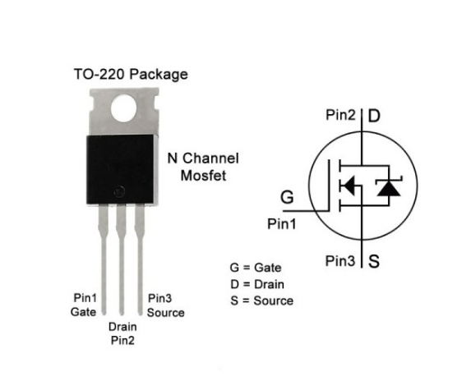

Slide 2
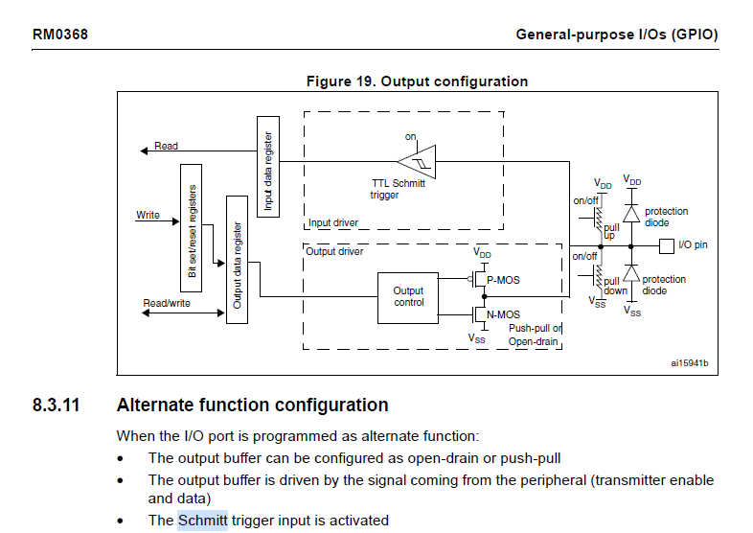


Slide 3
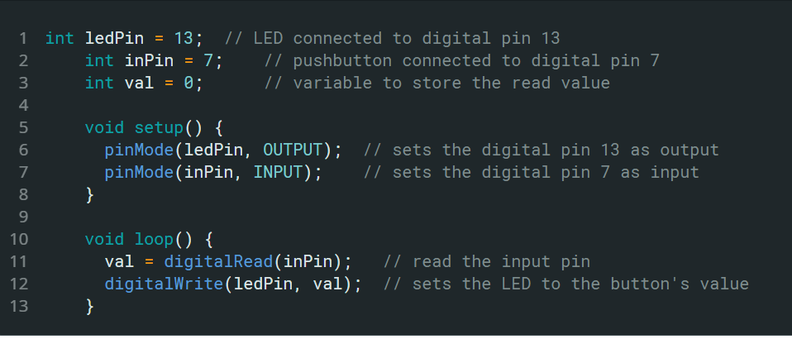

Slide 4
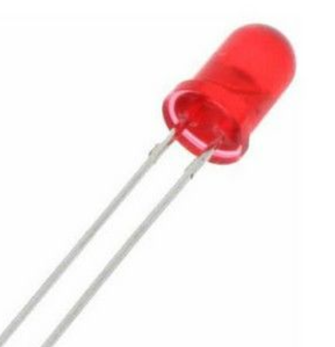




Slide 5
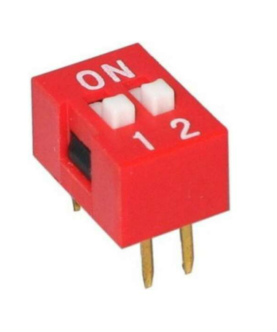




Slide 6








Slide 7
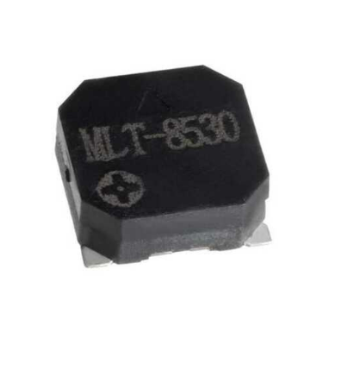
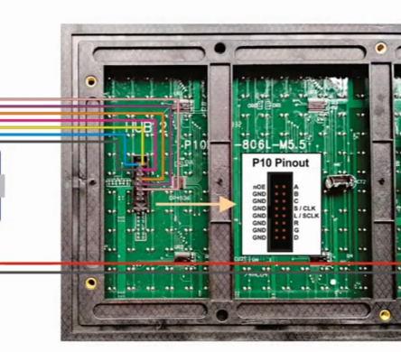





Slide 8
Batarya
3V
USB
5V

Slide 9
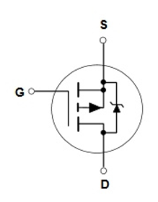
Batarya
3V
USB
5V

Slide 10

OFF Durumunda
Batarya
3V
USB
5V

Slide 11

ON Durumunda
Batarya
3V
USB
5V

