Slide 1
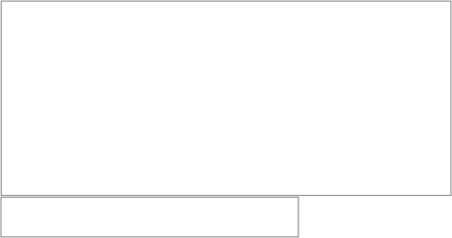
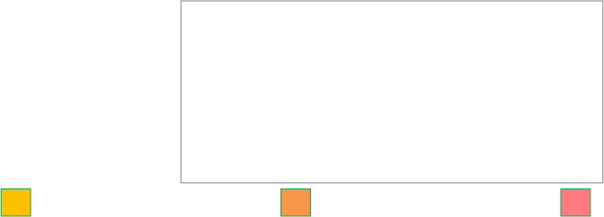
PROJECT NAME:FLYCOM
TEAM MEMBERS:POSTEUCA ANDREI-NICOLAE
LOZNEANU ANDI-FINEAS ,ALEXA TEODOR
IDEA IN SHORT:
Emergency communication system using app + mesh network + drones. Works without internet and delivers aid in crisis situations.
Hardcore Entrepreneur hackathon 6.0
1.PRODUCT - PROBLEM WE SOLVE 2. OUR TARGET GROUP & SDGs
Problem:
networks fail in crises
no coordination
people can’t ask for help
Solution:
communication without internet
mesh network
Relay drones (coverage)
Ally drones (delivery)
Target:
governments
NGOs
rescuers
civilians
SDGs:
3, 9, 11, 13
3. SMART OBJECTIVES
4. PRICE
5. PROMOTION
The 5 elements
Monetization
How and where we market
Specific: Emergency system (app + drones)
Measurable: 1000+ users, 10+ drones
Achievable: Based on existing tech
Relevant: Solves crisis communication
Time-bound: MVP 6 months, scale 3 years
5.
How:
hackathons
conferences
NGO partnerships
Where:
Europe
global crisis zones
government contracts
NGO partnerships
drone sales
software subscription

