Slide 1

Case Study

Slide 2
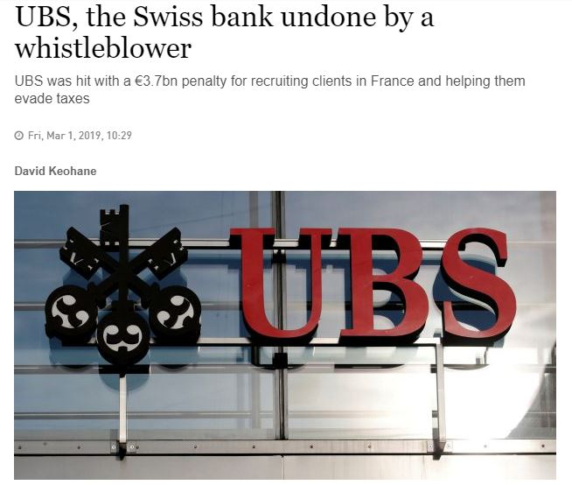
UBS Scandal

Slide 3
Issues
innovative ideas for policies
to employees and customers
Anti-Bribery & FCPA Advisory
Ethics & Compliance
Culture Change Training
Whistleblowing Hotlines
resolve mis reporting issues
Forensic Investigations
Ethical culture and business practise
Allocating and embedding
roles and responsibilities
around
the Ethics & Compliance programme
enhance the soft skills of my team members
e.g., stakeholder management, communications, etc.)
Enhancing
ethics within our business
Awareness about what similar
peer organisations are doing
for ethical trade / modern slavery
performance monitoring tools
for global sites/global operations
Continuing to conduct
our business with integrity
Risk reporting to Boards about
Environment, Health and Safety

Slide 4
Issues
Resource allocation and "doing more with less" - how innovation can help
how to ensure that whistleblowing cases are reviewed actively as part of the routine and not considered an add on
Code of Conduct compliance, Whistleblowing process, compliance training (inc. e-learning))
To encourage employee ownership of compliance and ethics within the organisation
To improve understanding of the
role ethics and compliance
will play in the transforming
nature of the workplace,
technology and innovation
Code of Conduct roll out and training

Slide 5
Features
Innovation Management
Open Innovation
Idea Management
- Innovation System of Record
- Collect & Identify
-Evaluate
- Agile Projects & experiments
-Connect & Engage
-Refine
- Ideas, Feedbacks & Suggestions
- Ideate & Collaborate
-Approve / Reject
-Evaluate & Prioritize
-Propose
- Develop & Launch
-Execute
-Submit
Employee Engagement
- Listen to ideas, Feedbacks & Suggestions
- Learn from review & research from feedback
- Craft solutions & implement new visions
- Prioritize changes & new initiatives
- Implement improvements
- Communicate values, ask questions

