Slide 1

Population: Effect on International Metrics
Project 1, Group 8
Rachel Le Grand, Arunkumar Sridharan, Steffi Yang, Jack Lowry, and Robert Bentz

Slide 2
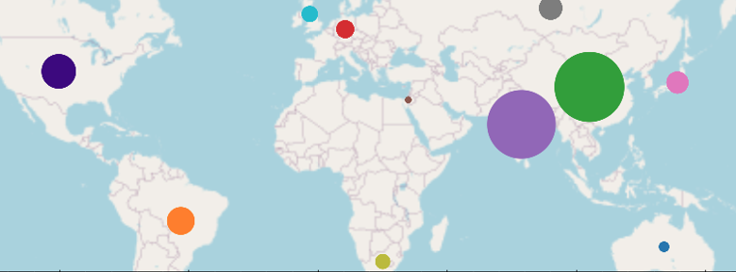
World Population, 11 Countries

Slide 3
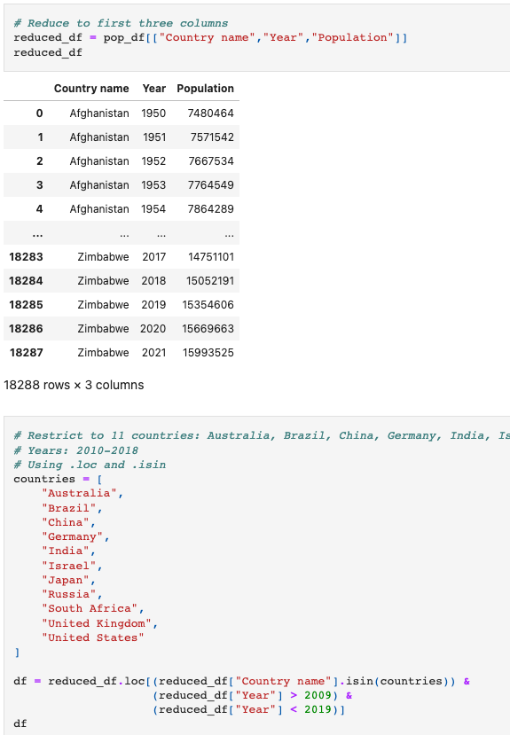
Introduction

Slide 4
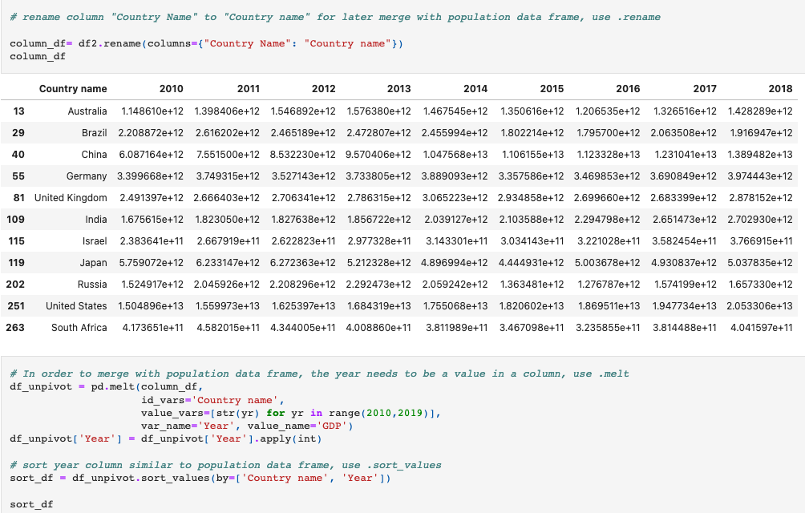
Cont. Introduction

Slide 5
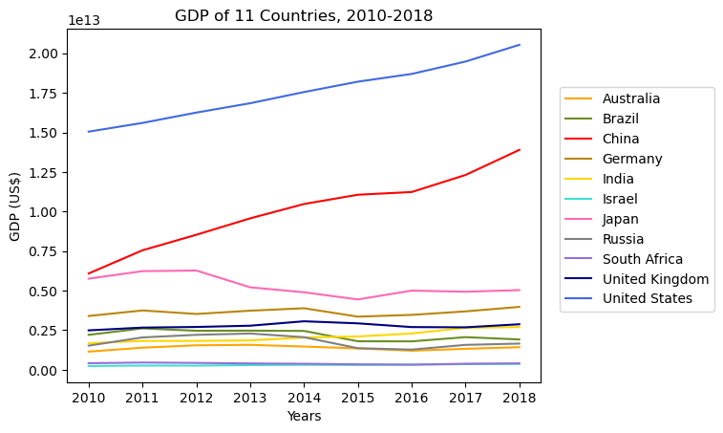
Gross Domestic Product (GDP)
Q: Why is GDP important when measuring a country’s growth and economy?
United States (US) leading the trend for the past 8 years
China follows in upward trend after United States
Represents how US and China are strongest economies
Japan shows decreasing trend from 2012-2016
Gross domestic product (GDP) is the total monetary or market value of all the finished goods and services produced within a country’s borders in a specific time period. As a broad measure of overall domestic production, it functions as a comprehensive scorecard of a given country’s economic health.

Slide 6
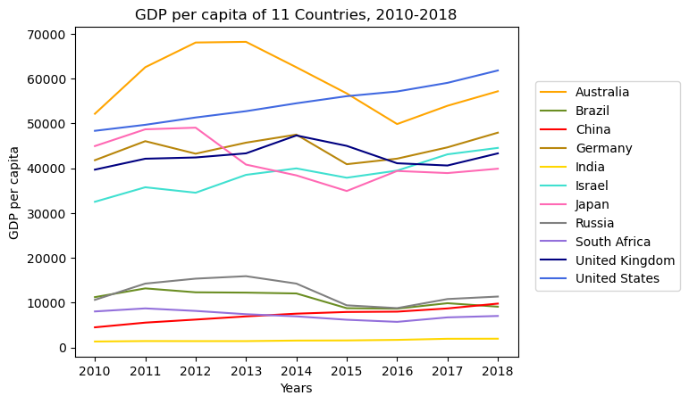
Gross Domestic Product Per Capita
Q: Why is GDP per capita important when measuring a country’s growth and economy?
Australia shows erratic trend with sharp increase and decrease.
US has stable increasing trend.
Japan shows declining trend in 2013.
GDP per capita measures the economic output of a nation per person. It seeks to determine the prosperity of a nation by economic growth per person in that nation. Per capita income measures the amount of money earned per person in a nation.

Slide 7
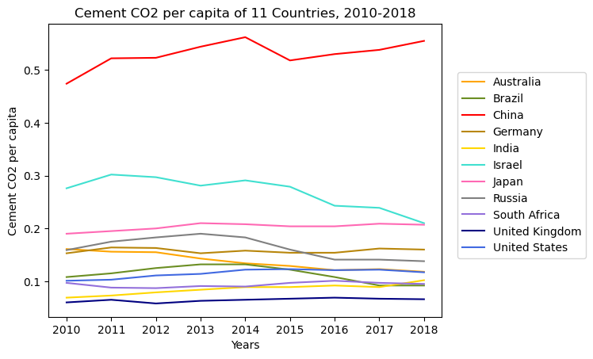
Impact of Cement CO2 Per Capita
Q: Question?
Source : https://ourworldindata.org/co2-emissions

Slide 8
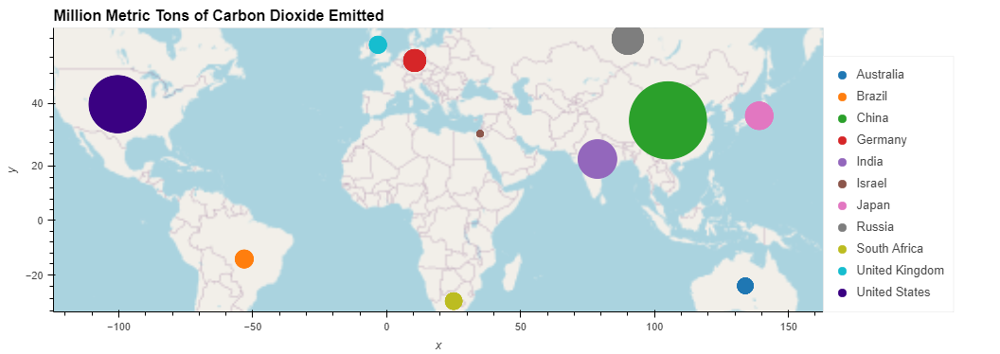
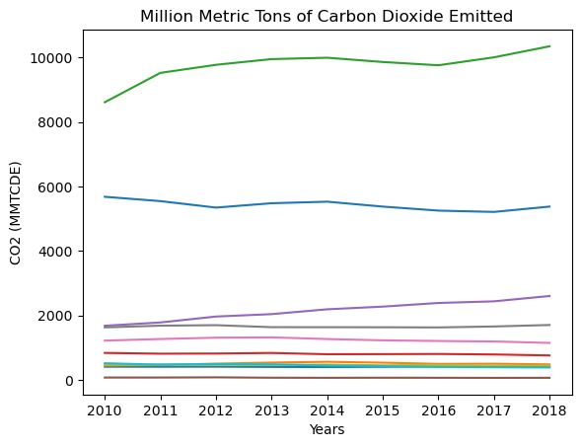
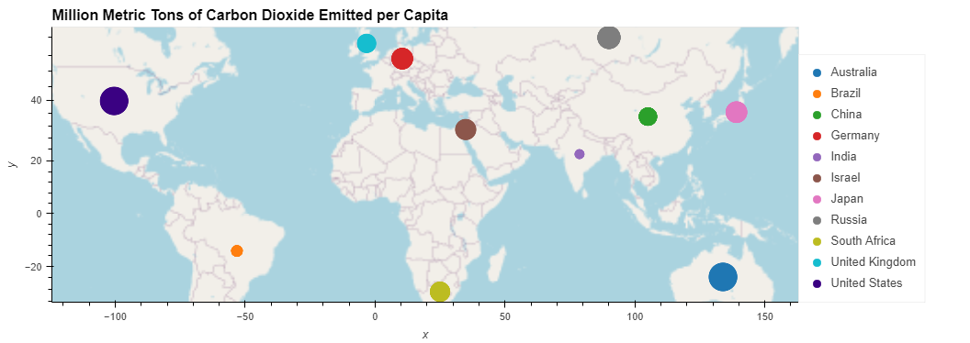
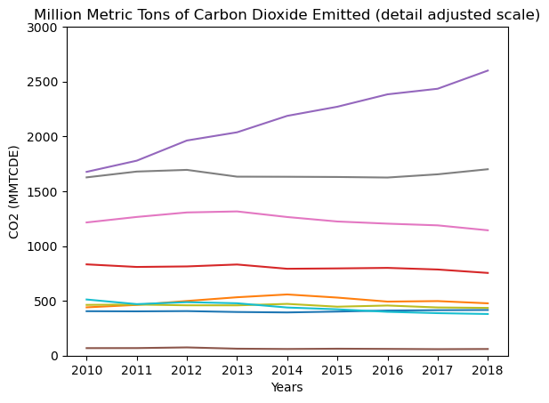
Comparing Carbon Dioxide Emissions Density Locations and Over time
Q: Does increasing population increase CO2 releases? Comparing CO2 releases per person, would emissions be the same everywhere?
Source : https://ourworldindata.org/co2-emissions

Slide 9
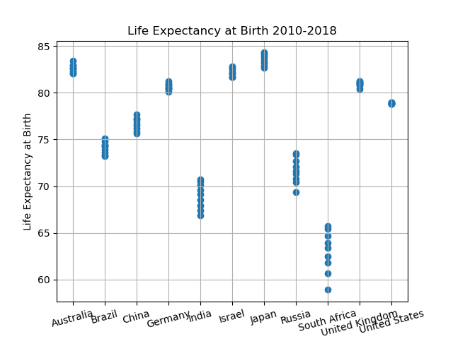
Life Expectancy at Birth
Q: Question?
Mean = 76.44 years
Min = 58.90 years
Max = 84.30 years
Lower Quartile= 71.72 years
Mid-Quartile = 78.90 years
Upper Quartile = 82.10 years
Source: https://ourworldindata.org/life-expectancy

Slide 10
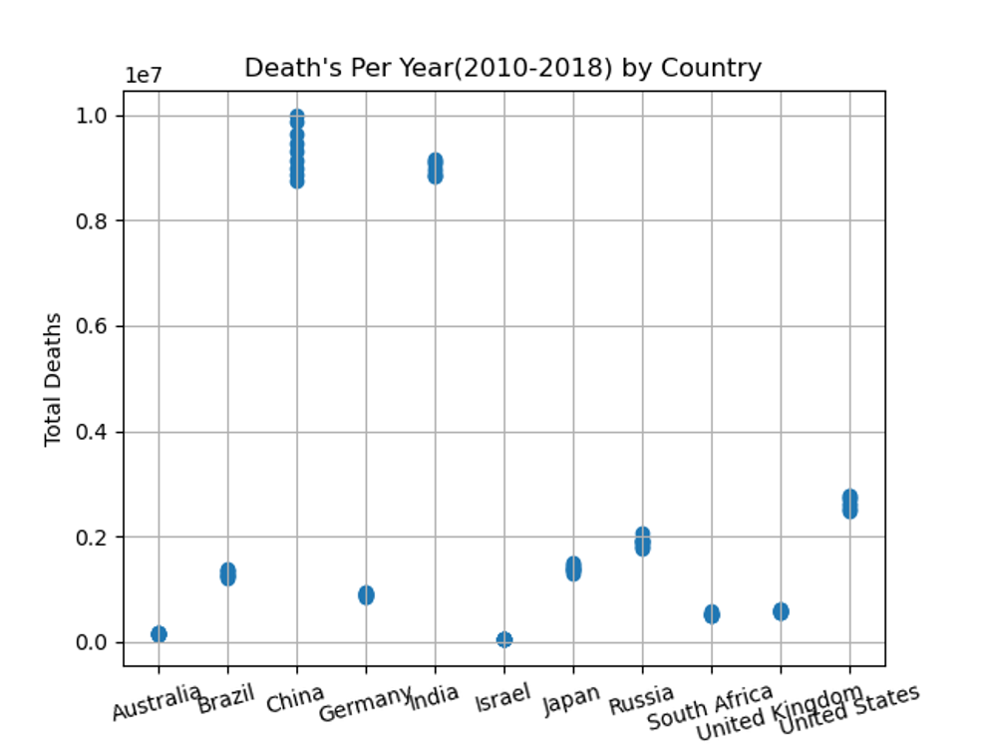
Annual Death Rate
Q: Question?
Mean = 2.52 million
Min = 3.91 million
Max = 9.98 million
Lower Quartile= 5.41 million
Mid-Quartile = 1.28 million
Upper Quartile = 2.53 million

Slide 11
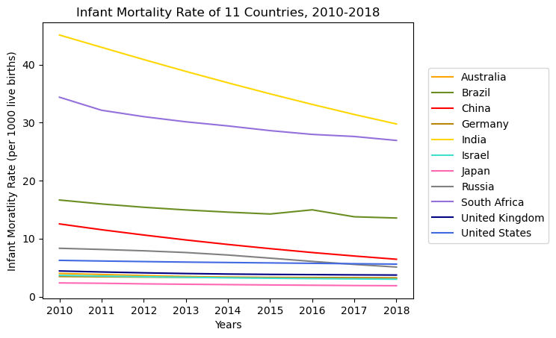
Infant Mortality Rate
Q: How healthy is each country?
4th in Infant Mortality Rate China: 12.53 in 2010 and 6.44 in 2018 (1st largest populated)
1st in Infant Mortality Rate India has the highest infant mortality rate : 45.09 in 2010 and 29.76 in 2018 (2nd largest populated)
South Africa: 34.37 in 2010 and 26.92 in 2018
Japan has the lowest infant mortality rate: 2.36 in 2010 and 1.88 in 2018
The infant mortality rate is the number of infant deaths for every 1,000 live births. In addition to giving us key information about maternal and infant health, the infant mortality rate is an important marker of the overall health of a society.
Source: https://www.who.int/data/gho/data/indicators/indicator-details/GHO/infant-mortality-rate-(probability-of-dying-between-birth-and-age-1-per-1000-live-births)

Slide 12
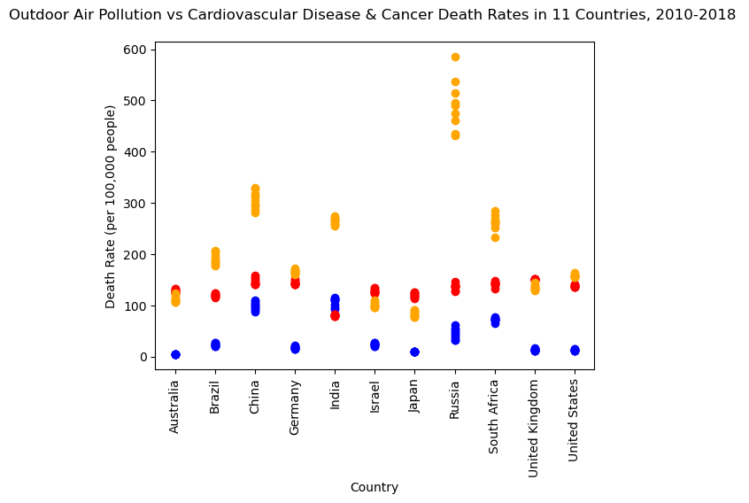
Impact of Outdoor Air Pollution
Q: What impact does outdoor air pollution have on the health of a population?
Russia ranking at the top for cardiovascular disease
China 2nd, South Africa 3rd
Japan least cardiovascular death rates
United Kingdom ranking at the top for cancer
India least cancer death rates
India ranking at the top for outdoor air pollution
Australia least outdoor air pollution death rates
Red cancer
Blue cardio
Orange air pollution
Outdoor air pollution is one of the world’s largest health and environmental problems – one that tends to worsen for countries as they industrialize and transition from low to middle incomes.
Source: https://ourworldindata.org/outdoor-air-pollution
Notes:
(Blue) Air Pollution
(Red) Cancer
(Orange) Cardiovascular

Slide 13
Cont . Impact of Outdoor Air Pollution
Country Name | Avg. Outdoor Air Pollution Death Rates | Avg. Cardiovascular Disease Death Rates | Avg. Cancer Death Rates
United States | 12.75 | 157.85 | 138.02
China | 99.38 | 305.56 | 147.08
India | 106.85 | 254.66 | 80.30
Brazil | 23.15 | 190.03 | 119.60
Russia | 44.58 | 491.88 | 136.46
Japan | 10.18 | 83.35 | 120.39
United Kingdom | 13.13 | 135.19 | 150.66
Germany | 17.38 | 165.68 | 144.03
South Africa | 72.05 | 262.24 | 141.82
Australia | 4.47 | 112.34 | 128.18
Israel | 23.87 | 101.27 | 128.30
Pearson Correlation Statistical Analysis: |  | r = 0.95 | r = 0.97
Source: https://ourworldindata.org/outdoor-air-pollution, https://ourworldindata.org/causes-of-death#cardiovascular-diseases, https://ourworldindata.org/causes-of-death#cancers
Notes:
China 2nd in all three categories w/ largest population
India has the lowest cancer rates but the highest air pollution rates
Smaller countries that are less densely populated are south Africa, uk, and Germany that rank among the top 3 countries for all 3 categories. Surprising was UK’s cancer death rates as they rank among the best countries with healthcare.

Slide 14
Analysis/Conclusion
Health Analysis
China is the largest densely populated country and 2nd leading country in death rates for outdoor air pollution, cardiovascular disease, and cancer
Likely correlated to population
South Africa exception
Differences likely due to healthcare costs and availability, nutrition/malnutrition, and economic status
Strong positive correlation between outdoor air pollution and cancer death rates as well as outdoor air pollution and cardiovascular disease death rates.
Findings vs Hypothesis?
Accuracy?
Relevant?
How can data be used?
What was learned?

Slide 15
Questions?

