Slide 1

Population: Effect on International Metrics
Project 1, Group 8
Rachel Le Grand, Arunkumar Sridharan, Steffi Yang, Jack Lowry, and Robert Bentz

Slide 2
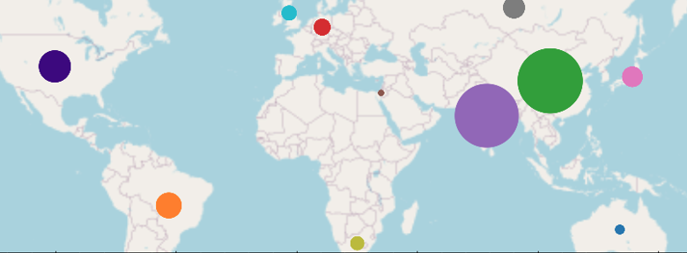
World Population, 11 Countries

Slide 3
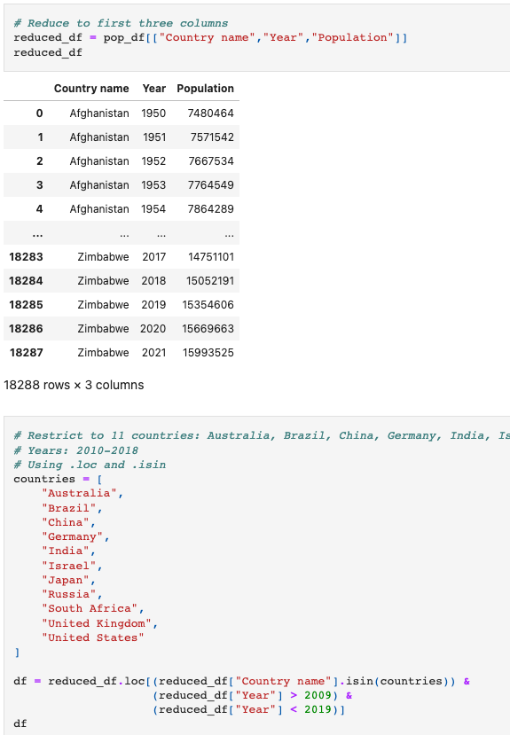
Pandas Function .isin()

Slide 4
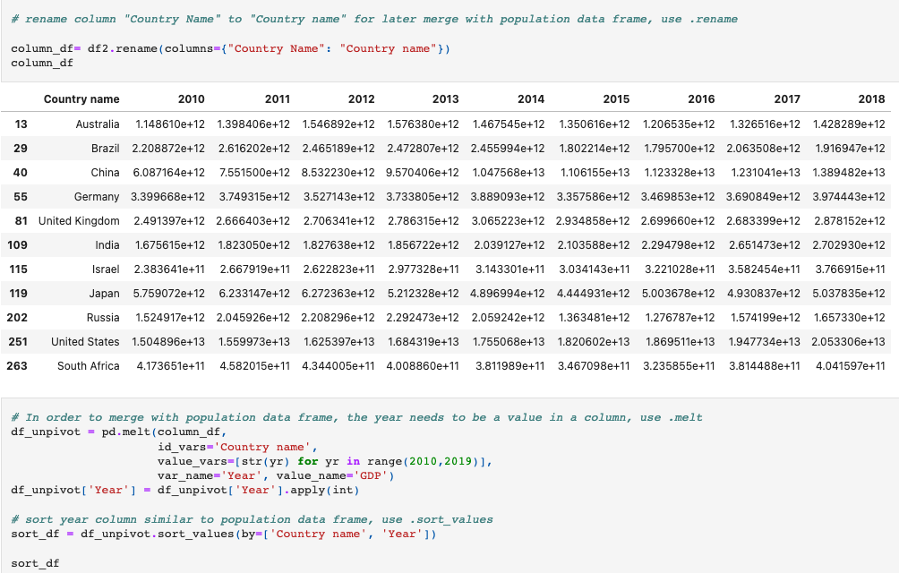
Pandas Function .melt()

Slide 5
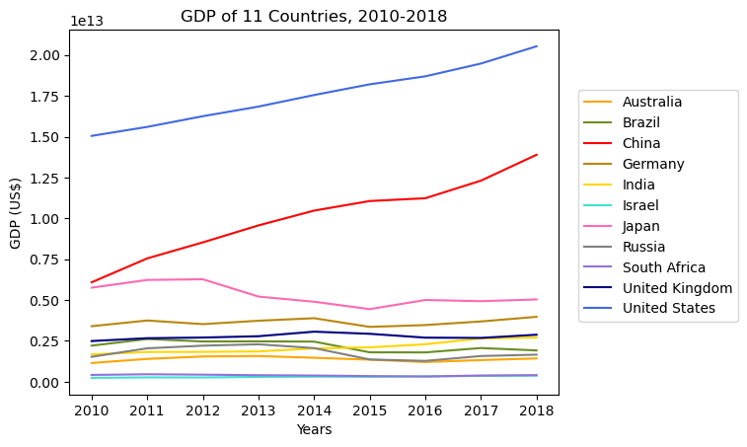
Gross Domestic Product (GDP)
Q: Why is GDP important when measuring a country’s growth and economy?
United States (US) leading the trend for the past 8 years
China follows in upward trend after United States
Represents how US and China are strongest economies
Japan shows decreasing trend from 2012-2016
Gross domestic product (GDP) is the total monetary or market value of all the finished goods and services produced within a country’s borders in a specific time period. As a broad measure of overall domestic production, it functions as a comprehensive scorecard of a given country’s economic health.

Slide 6
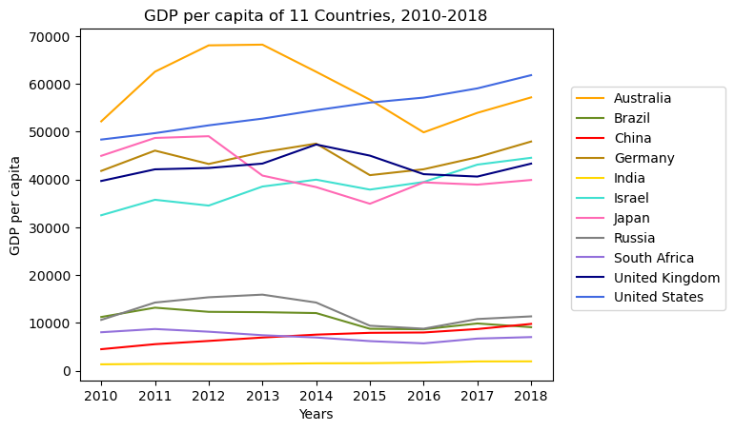
Gross Domestic Product Per Capita
Q: Why is GDP per capita important when measuring a country’s growth and economy?
Australia shows erratic trend with sharp increase and decrease.
US has stable increasing trend.
Japan shows declining trend in 2013.
GDP per capita measures the economic output of a nation per person. It seeks to determine the prosperity of a nation by economic growth per person in that nation. Per capita income measures the amount of money earned per person in a nation.

Slide 7
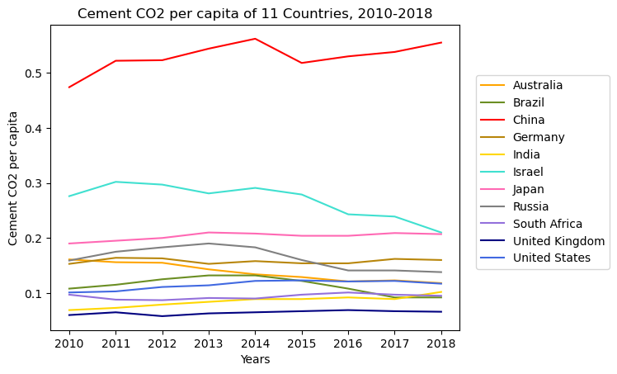
Cement Carbon Footprint
Q: Are the most populated countries the worst polluters?
China has the highest cement carbon footprint.
Israel has the 2nd highest cement carbon footprint.
Israel’s cement carbon footprint is decreasing
If it continues, it will go below Japan
Source : https://ourworldindata.org/co2-emissions

Slide 8
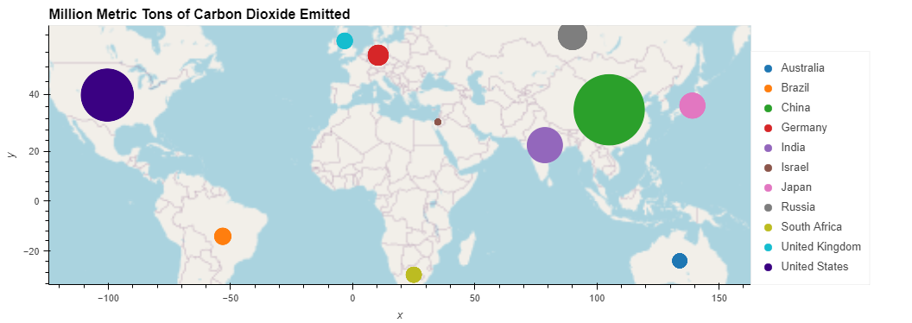
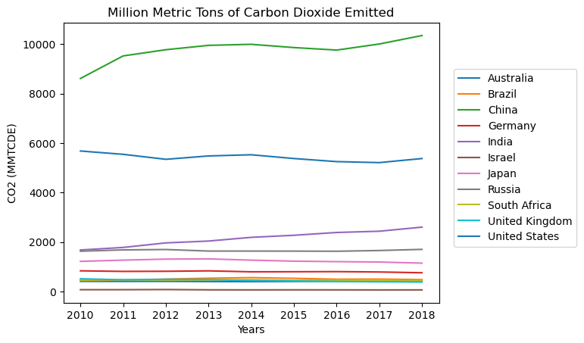
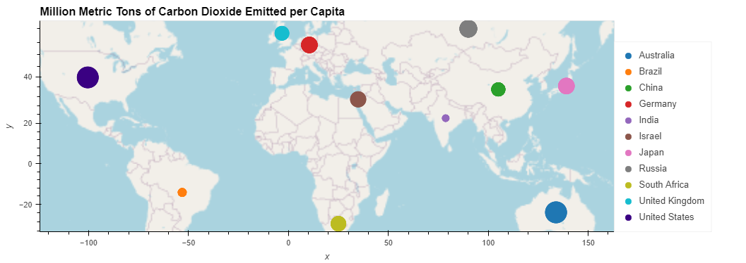
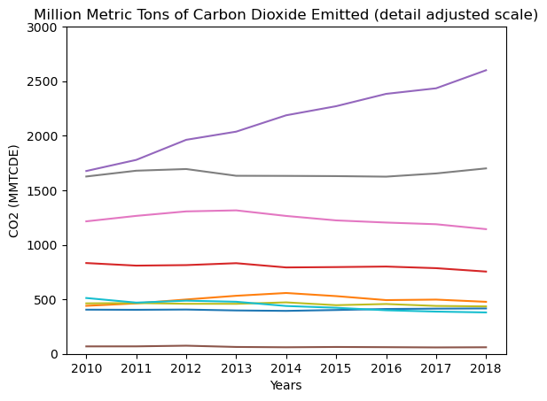
Comparing Carbon Dioxide Emissions Density Locations and Over Time
Q: Does increasing population increase CO2 releases? Comparing CO2 releases per person, would emissions be the same everywhere?
Source : https://ourworldindata.org/co2-emissions

Slide 9
Comparing Carbon Dioxide Emissions Density Locations and Over Time
Q: Does increasing population increase CO2 release?
While population increase does increase CO2 emissions, there are many factors to consider:
People and animals (farming)
Heating and cooling
Power generation
Industrial emissions
Q: Comparing carbon dioxide releases per person, would the emissions be the same everywhere?
Dividing the carbon dioxide emissions by population reveals similar densities on the geo map.
India and Brazil appear to be the outliers on the geo map.
India and Brazil have lower GDP, possibly indicating lower amounts of industry and resulting in population having a greater effect.
Source : https://ourworldindata.org/co2-emissions

Slide 10
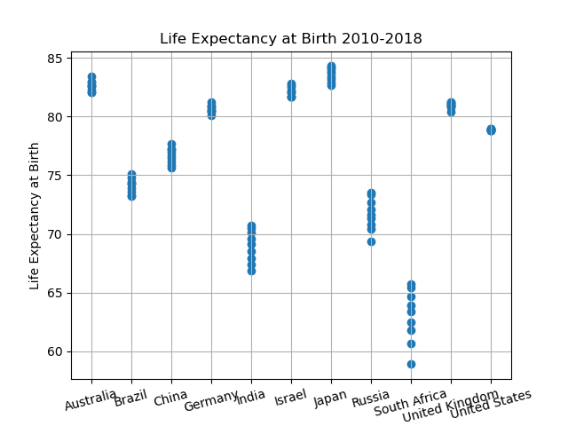
Life Expectancy at Birth
Q: Which countries have the highest and lowest life expectancy?
Top 3: Australia, Israel, and Japan
Bottom 3: India, Russia, South Africa
Mean = 76.44 years
Min = 58.90 years
Max = 84.30 years
Lower Quartile= 71.72 years
Mid-Quartile = 78.90 years
Upper Quartile = 82.10 years
Source: https://ourworldindata.org/life-expectancy

Slide 11
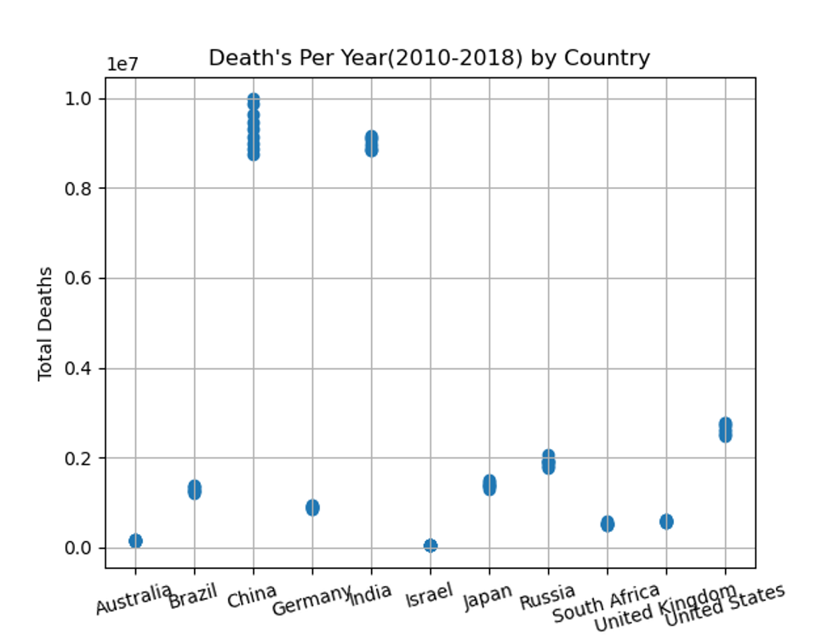
Annual Death Rate
Q: What do the annual death rates for each country equate to?
China & India have exceptionally higher annual death rates than the other 9 countries.
These can be attributed to their respective high population sizes in comparison, India’s #1 spot in Avg. Outdoor Air Pollution Deaths and China’s #2 spot in Avg. Outdoor Air Pollution Deaths.
Mean = 2.52 million
Min = 3.91 million
Max = 9.98 million
Lower Quartile= 5.41 million
Mid-Quartile = 1.28 million
Upper Quartile = 2.53 million
Source: https://ourworldindata.org/life-expectancy

Slide 12
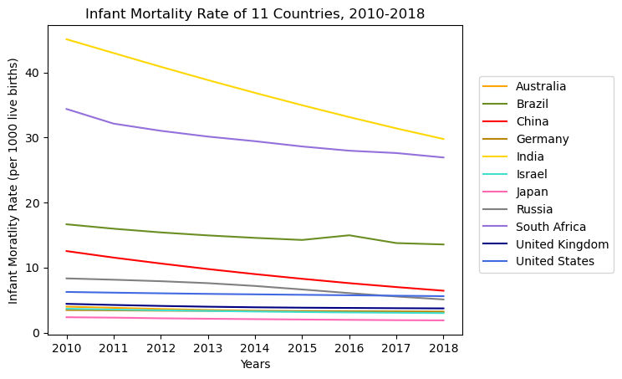
Infant Mortality Rate
Q: How healthy is each country?
Least Healthy Countries:
1st in Infant Mortality Rate India: 45.09 in 2010 and 29.76 in 2018 (2nd largest populated)
2nd in Infant Morality Rate South Africa: 34.37 in 2010 and 26.92 in 2018
3rd Brazil and 4th China
Most Healthy Countries:
Japan has the lowest infant mortality rate: 2.36 in 2010 and 1.88 in 2018
2nd: Israel, 3rd: Germany, 4th: Australia
The infant mortality rate is the number of infant deaths for every 1,000 live births. In addition to giving us key information about maternal and infant health, the infant mortality rate is an important marker of the overall health of a society.
Source: https://www.who.int/data/gho/data/indicators/indicator-details/GHO/infant-mortality-rate-(probability-of-dying-between-birth-and-age-1-per-1000-live-births)
Notes:
Another health indicator we decided to use was Infant Mortality Rate since it’s typically used to measure a country’s overall health. We wanted to know which countries were healthiest and whether population would be a factor.
According to the data, the least healthy countries were…
Japan is also among the top countries for having the best healthcare systems so that wasn’t very surprising.
But South Africa seemed like an anomaly because it’s among the least densely populated countries.

Slide 13
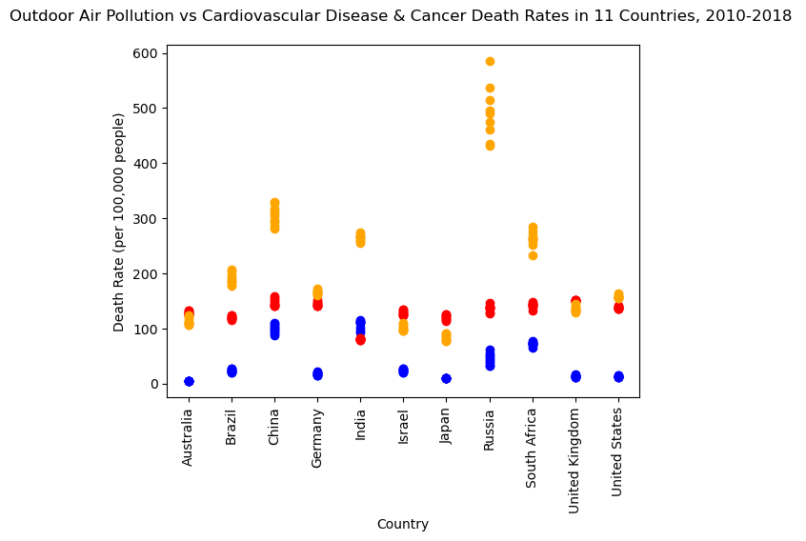
Impact of Outdoor Air Pollution
Q: What impact does outdoor air pollution have on the health of a population?
Russia ranking at the top for cardiovascular disease
2nd: China and 3rd: South Africa
Japan least cardiovascular death rates
United Kingdom ranking at the top for cancer
India least cancer death rates
India ranking at the top for outdoor air pollution
Australia least outdoor air pollution death rates
Red cancer
Blue cardio
Orange air pollution
Outdoor air pollution is one of the world’s largest health and environmental problems – one that tends to worsen for countries as they industrialize and transition from low to middle incomes.
Source: https://ourworldindata.org/outdoor-air-pollution
Notes:
-W/ that being said, we also wanted to measure the impact of outdoor air pollution, which is one of the world’s largest health and environmental problems. We measured that against cardiovascular disease and cancer which are the leading causes of death worldwide.
- According to the data, cardiovascular disease death rates indicated in orange dots was led by Russia. Cancer death rates in red was led by the United Kingdom and outdoor air pollution indicated in blue was led by India.
(Blue) Air Pollution
(Red) Cancer
(Orange) Cardiovascular

Slide 14
Cont . Impact of Outdoor Air Pollution
Country Name | Avg. Outdoor Air Pollution Death Rates | Avg. Cardiovascular Disease Death Rates | Avg. Cancer Death Rates
United States | 12.75 | 157.85 | 138.02
China | 99.38 | 305.56 | 147.08
India | 106.85 | 254.66 | 80.30
Brazil | 23.15 | 190.03 | 119.60
Russia | 44.58 | 491.88 | 136.46
Japan | 10.18 | 83.35 | 120.39
United Kingdom | 13.13 | 135.19 | 150.66
Germany | 17.38 | 165.68 | 144.03
South Africa | 72.05 | 262.24 | 141.82
Australia | 4.47 | 112.34 | 128.18
Israel | 23.87 | 101.27 | 128.30
Pearson Correlation Statistical Analysis: |  | r = 0.95 | r = 0.97
Source: https://ourworldindata.org/outdoor-air-pollution, https://ourworldindata.org/causes-of-death#cardiovascular-diseases, https://ourworldindata.org/causes-of-death#cancers
Notes:
-This chart summarizes all of the data as an average per country and represents a strong positive correlation between outdoor air pollution and cardiovascular disease death rates as well as outdoor air pollution and cancer death rates with r-values of .95 and .97.
-Countries highlighted in red have the highest values. Countries highlighted in orange have the 2nd highest rates and yellow have the 3rd highest. Countries highlighted in green have the lowest values.
-Some key takeaways from this chart are that China, being the largest densely populated country is also the 2nd leading country in all three categories.
-And a few of the smallest densely populated countries like the United Kingdom, Germany, and South Africa had some of the highest death rates compared to countries with higher populations.

Slide 15
Analysis/Conclusion
Environmental Analysis
CO2 emissions have not changed significantly over time, except for China
Assume most populated countries = worst polluters, but when looking at a country’s cement carbon footprint, Israel is in second place (China is first and Japan is third).
Predict future looking at the data and trends
Israel’s cement carbon footprint will continue to decrease (and go below Japan)
Health Analysis
Life expectancy top 3 countries: Australia, Israel, and Japan and bottom 3: India, Russia, South Africa
China and India have below average life expectancy and two highest for annual death rates
China is the largest densely populated country and 2nd leading country in all death rates for outdoor air pollution, cardiovascular disease, and cancer
Likely correlated to population
South Africa exception: differences likely due to healthcare costs and availability, nutrition/malnutrition, and economic status
Notes:
-To summarize, for the environmental aspect, (read slide)
-For the cement carbon footprint, we assumed that the most populated countries were the worst polluters, but that was not the case since Israel ranked 2nd.
-If we use the data and trends to predict the future, we can predict that Israel will fall well below Japan and no longer be held as the 2nd ranked country for cement CO2 emissions.
-In terms of the health aspect, the top 3 countries for life expectancy were (top: read slide) which made sense since they were also among the smallest densely populated countries. Again, South Africa essentially an outlier for the data.
-Since China and India have below average life expectancy rates and have the highest annual death rates, we can conclude that there is an inversely proportionate correlation between population and health outcomes which is understandable given the population density.
-And with China being the 2nd leading country in all death rates for outdoor air pollution, cardiovascular disease, and cancer, we can conclude that it is also correlated to its population density.
-With the exception of South Africa having high death rates for 2 out of the 3 categories and having the lowest life expectancy rate , we can likely attribute it to (read slide)

Slide 16
Questions?
Notes:
That concludes our presentation, are there any questions

