Slide 1


DECALCIFICATION
(TESTING FOR END POINT OF DECALCIFICATION)
MLS 334
(3 UNIT)
OSIAGWU DANIEL
CMUL

Slide 2
OBJECTIVE
The aim of the study is to ensure staining of hard bony lesions, so that the microscopic viewing and study of pathological lesions of the bone is possible.

Slide 3
HISTOLOGY OF BONE
STRUCTURE OF BONE
Bone consists of cells (osteocytes)
Bone is a living, growing tissue
They are organs of the skeletal system
Made mostly of collagen (90% of matrix are collagen molecules)
Collagen is a protein that provides a soft framework
Calcium phosphate is a mineral that adds strength and hardens the framework.
The combination of collagen and calcium makes bone strong and flexible enough to withstand stress
It is a specialized form of connective tissue characterized by a mineralized extracellular matrix.

Slide 4
Collagen (type I, VI) along with other matrix proteins
In the matrix calcium is in the form of hydroxyapatite crystals [Ca₁₀(PO₄)₆(OH)₂]
They are made of Minerals = calcium phosphate in the form of
        Hydroxyapatite crystals [Ca₁₀(PO₄)₆(OH)₂]
        Calcium Carbonate: CaCO3
        Magnesium Hydroxide: Mg(OH)2
        Fluoride and Sulphate
An individuals bone is formed by bone tissue and other CT like
        Cartilage
        Nerves
        Hematopoietic elements
        Fibrous tissue
        Fat
        Blood vessels

Slide 5
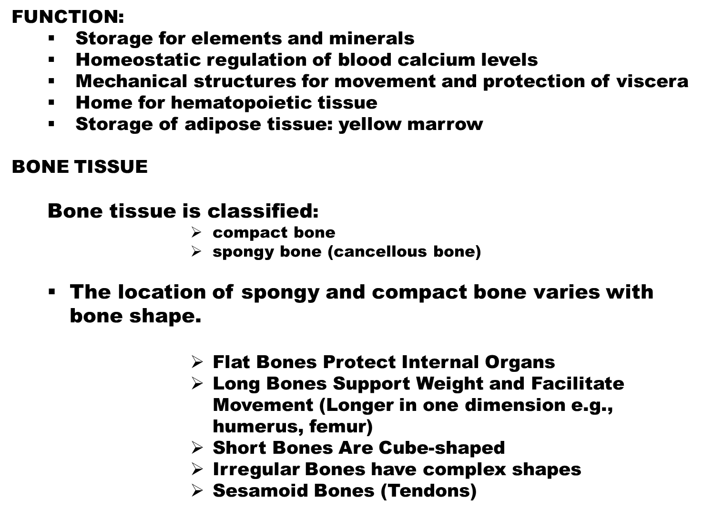

Slide 6
Short bones - nearly equal in length and diameter
Have
      compact
      spongy bone
      A marrow space on the inside
Thick compact bone with an intervening layer of spongy bone.
Irregular bones
e.g., vertebrae
hip bones
ethmoid bone
Flat bones - thin and plate-like
e.g., parietal bone
scapula
sternum
Articular surfaces are covered with hyaline cartilage
e.g., carpals
tarsals
patella

Slide 7
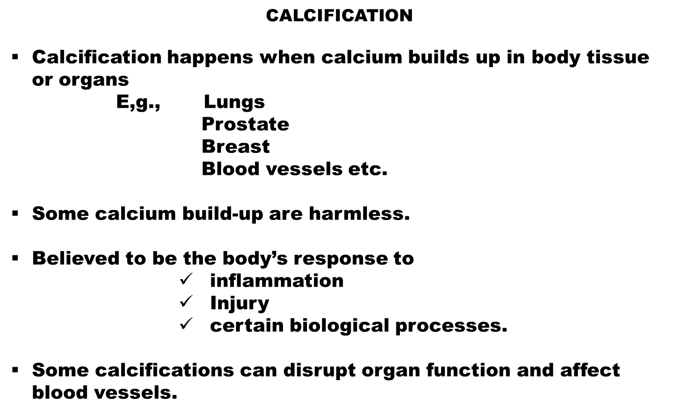

Slide 8
  This build-up can harden and disrupt the body’s normal processes.
  Calcium is transported through the bloodstream, It is also found in every cell.
Calcification of soft tissue
  Tissues like arteries, cartilage, heart valves, etc.) can be calcified as a result of vitamin K2 deficiency or by poor absorption calcium
Brain tissue can also calcify, and is known as cranial calcification

Slide 9
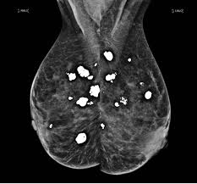
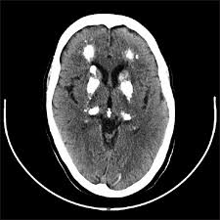
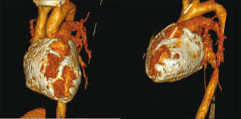
SOME BONE DISEASE
    Rickets
    Fracture
    Osteomyelitis
    Osteosarcoma
    Hip dysplasia
    Osteogenesis imperfecta (OI), A rare hereditary disease of connective
    tissue , characterized by brittle bones that fracture easily
    Metabolic bone disease
    Osteomalacia.

Slide 10
FACTORS FOUND TO PLAY A ROLE IN CALCIFICATION
These include:
  Infections
  Calcium metabolism disorders that cause hypercalcemia (too much calcium in the blood)
  Genetic or autoimmune disorders affecting skeletal system and connective tissues
  Persistent inflammation
  Calcium deposits are sometimes found in areas of cancer
Breast calcifications: macrocalcifications (large) and microcalcifications (small)

Slide 11
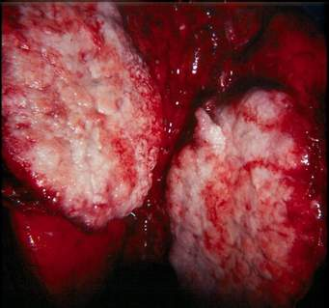
Image showing area of calcification in a Lung cancer tissue. Adapted from www.googleimages.com

Slide 12
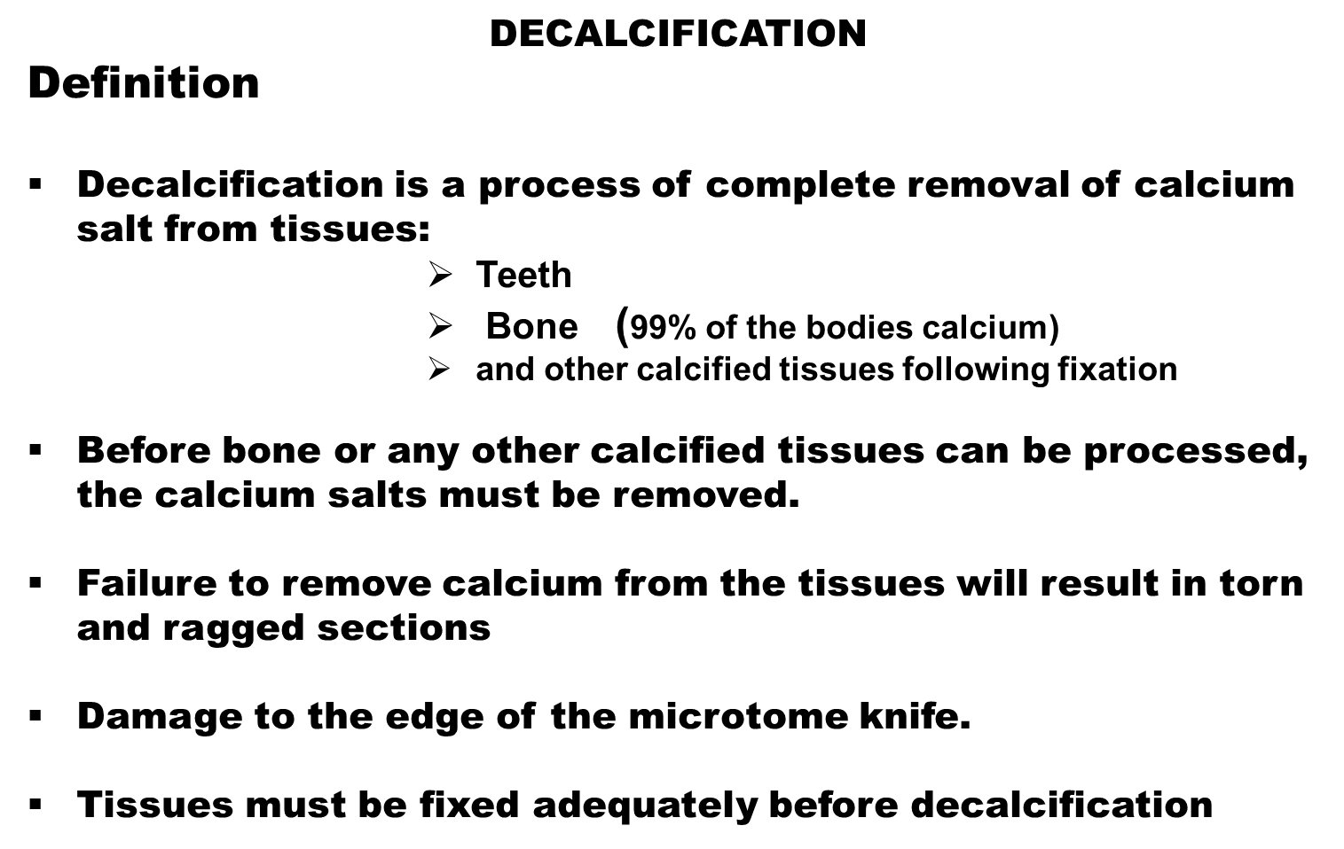

Slide 13
Tissues such as Lungs, breast, prostate etc., can become calcified after undergoing some pathological changes
Decalcification is done to assure that the specimen is soft enough to allow cutting with the microtome knife.
Unless the tissues is completely decalcified the sections will be torn and ragged and may damage the cutting edge of microtome knife.

Slide 14
FACTORS INFLUENCING THE RATE OF DECALCIFICATION
CONCENTRATION
    The concentration of active agent will affect the rate at which calcium is removed.
    Good formulation of decalcifying solutions strike a balance between speed and degree of tissue damage.
    Concentration of active agents depletes as it combines with calcium
    Use large volume of decalcifier and renew it several times during the decalcification process.
TEMPERATURE.
Increased temperature will speed up the decalcification rate but will also increase the rate of tissue damage so must be employed with great care.
AGITATION.
Gentle agitation may increase the rate decalcification slightly.
FLUID ACCESS.
As with fixation fresh decalcifier should have ready access to all surfaces of the specimen. This will enhance diffusion and penetration into the specimen and facilitate solution, ionization and removal of calcium.

Slide 15
STEPS TO PROPER DECALCIFICATION
To ensure complete removal of the calcium, it is important that the slices are 4-5 mm thick.
Some calcified tissue needs 2-3 hours only, for complete decalcification to be achieved.
Check decalcification after 2-3 hours.
Fixative of choice for bone or bone marrow
    Bouin's fluid
    Zenker’s fluid
NOTE:
Unfixed tissue tends to damage 4 times faster during decalcification than a properly fixed tissue.

Slide 16
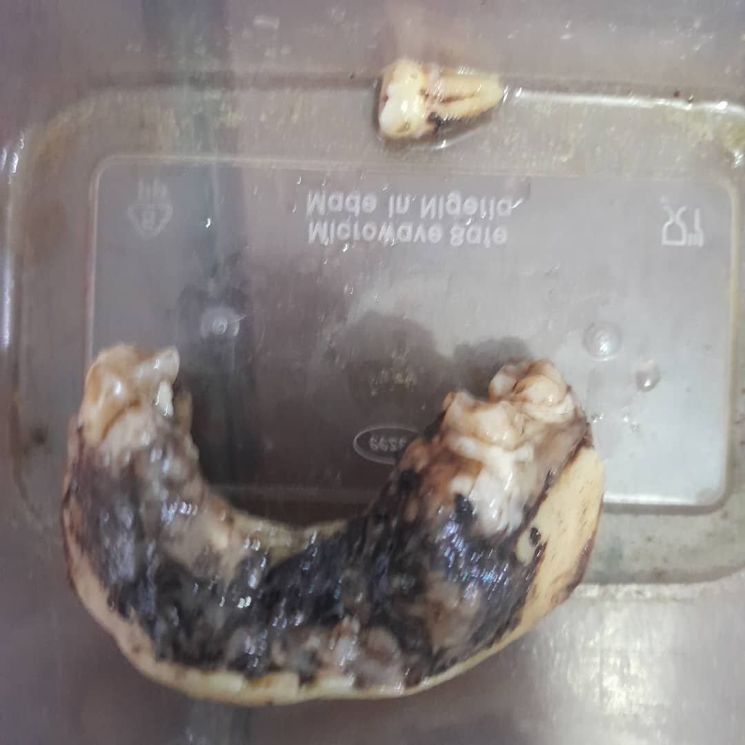

Slide 17
METHODS OF DECALCIFICATION
Mineral acid method
Chelating agent method
Ion exchange resin method
Electrolyte method
Mineral acids method
Acid decalcifiers are subdivided into 2 groups.
Strong acid
Weak acid

Slide 18
Strong acid
    Nitric
    Hydrochloric acid
    Perenyi’s fluid
    Von Ebner’s solution
Weak acid
    Formic acid "deactivate" prions Creutzfeldt-Jakob diseases(CJD)
    Acetic acid (GAA)
    Picric acid
    Evans and Krajian
    Gooding and Stewart
    Kristensen
A prion is a small infectious particle composed of abnormally folded protein that causes progressive neurodegenerative conditions.
These mis-folded proteins do not multiply in the host organism that they infect. Instead they affect the brain structure by acting as a template, inducing proteins with normal.

Slide 19
Procedure
1.Place calcified specimen in large quantities of nitric acid solution until decalcification is complete (change solution daily for best results).
2. Wash in running tap water for 30 minutes
3. Neutralize for a period of at least 1- 5 hours in 10% buffered formalin depending on size of the tissue.
4. process as desired.

Slide 20
Ion exchange resins method
Ion exchange resins in decalcifying fluids are used to remove calcium ion from the fluid.
Resins are ammoniated salts made of Sulfonated resin
Formic acid (with various conc.,)
They ensure rapid rate of solubility of calcium from tissue.
They reduce time of decalcification.
The resin is layered on the bottom of a container to a depth of = ½ inch, The specimen is allowed to rest on it.
NOTE:
After use, the resin may be regenerated by washing twice with dilute 10% HCL followed by three washes in distilled water.

Slide 21
Ion exchange resin has the following advantage:
Faster decalcification
Tissue preservation
Cellular details are better preserved
.
Chelating agents method
Chelating agents are organic compounds which have the power of binding certain metals.
    Ethylene-diamene-tetra-acetic acid(EDTA)
    Disodium salt called Versenate.
They have the power of capturing metallic ions. The process is slow, but has little or no effect on other tissue elements.
Some enzymes are still active after EDTA decalcification.

Slide 22
Electrolytic method
This is based on the principle of attracting calcium ions to a negative charged electrode in to the solution.
Decalcifying solution
      HCL (Conc.) 80ml
      Formic acid 90% 100 ml
      Distilled water 1000 ml.
Decalcify with electrolyte apparatus with the above mentioned decalcifying fluid.
This method has no added advantage over any other method.

Slide 23
NOTE:
Tissue must be removed from the decalcifying fluid as soon as decalcification is complete.
Neutralization :
Following immersion in mineral acids, tissues should be de-acidified or neutralized
Before washing, treat with an alkali.
    5% lithium sulphate
    sodium sulphate.
This may be effected by treatment over night
Washing
Thorough washing of the tissue before processing is essential to remove acid (or alkali if neutralization has been carried out)
washing out prevents interference with staining

Slide 24

“ LIFE IS THE MOST DIFFICULT EXAM, MANY PEOPLE FAIL BECAUSE THEY TRY TO COPY OTHERS, NOT REALIZING THAT EVERYONE HAS A DIFFERENT QUESTION PAPER”
THANK YOU.

Slide 25

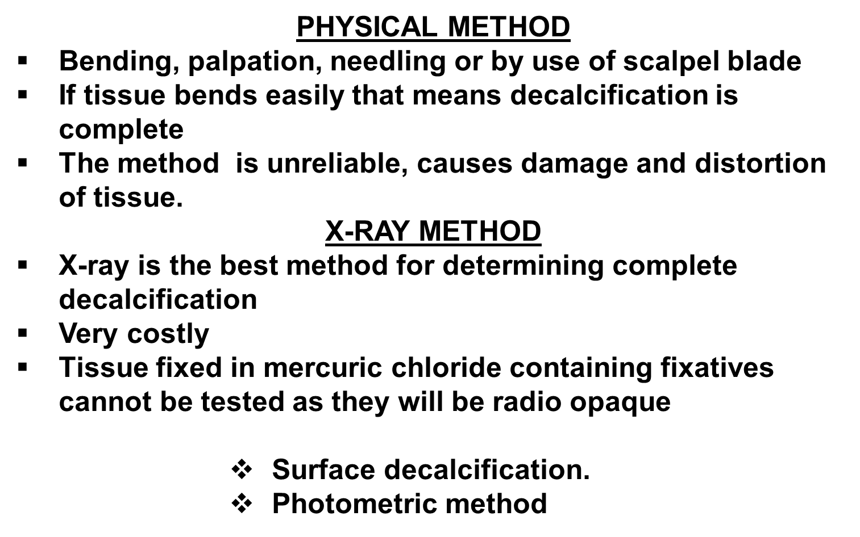

Slide 26

Pour 5mls of decalcifying fluid into a test tube.
2. Put a piece of litmus paper into the test tube to check pH..
3. Add conc. ammonia drop wise until litmus paper just turns blue. Red turns blue
4. Watch for turbidity of the decalcifying fluid
If solution remains clear, add 0.5ml of saturated ammonium oxalate
5. Leave for 10 – 30 minutes.

Slide 27
RESULT
If solution remains clear (no turbidity), end point of decalcification has been achieved.
Neutralize tissue by washing in running tap water or treat with 5% lithium sulphate
Process accordingly.
2. If solutions becomes turbid at step 3 or 5 end point of decalcification has not been achieved.
3. Replace fluid with a fresh decalcifying fluid and leave for a reasonable number of days before re-testing.
NOTE:
The size and nature of tissue will determine the length of time left for decalcification in the decalcifying fluid.

Slide 28
CONCLUSION
Decalcification is a straight forward process.
A careful preliminary assessment of the specimen
Thorough fixation
Preparation of slices of reasonable thickness for fixation
Proper processing
The choice of a suitable decalcifier with adequate volume, changed regularly
A careful determination of the endpoint.
Thorough processing using a suitable schedule.

Slide 29

Page KM. Bone. In Bancroft JD and Stevens A eds. Theory and Practice of Histological Techniques. New York: Churchill Livingstone, 1996.
Moore RJ. Bone. In Woods AE and Ellis RC eds. Laboratory histopathology. New York: Churchill Livingstone, 1994; 7.2-10.
Carson FL. Histotechnology. 2nd ed. Chicago: ASCP Press, 2007.
Vardaxis NJ. Pathology for the health sciences. Melbourne: Macmillan Australia Pty Ltd, 1997.
Young B, Heath JW. Wheater's Functional Histology. 4th ed. Edinburgh: Churchill Livingstone, 2000.
Clayden EC. Practical section cutting and staining. Edinburgh: Churchill Livingstone, 1971.
Skinner RA, Hickmon SG, Lumpkin CK, Aronson J, Nicholas RW. Decalcified Bone: Twenty Years of Successful Specimen Management. The Journal of Histotechnology 1997;20;267-277.

Slide 30

Try to be who you are, what God wants you to be and not what people want you to be.

Slide 31
THANK YOU
QUESTIONS ?

