Slide 1
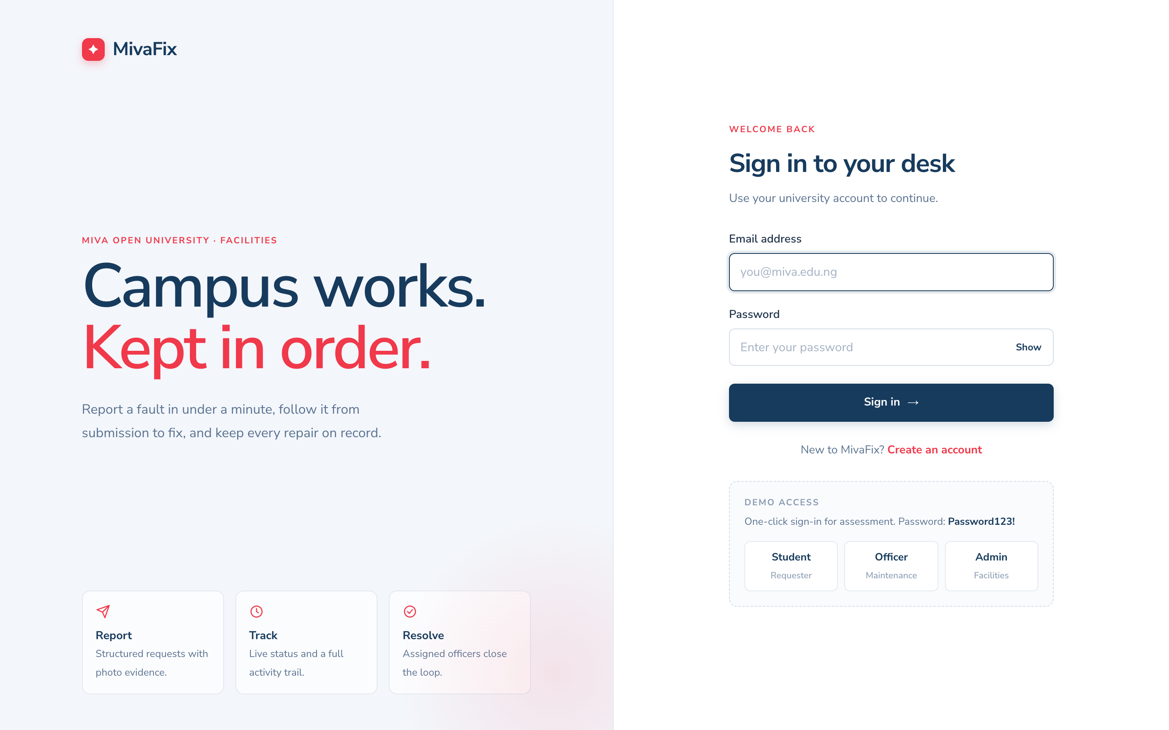
MivaFix
MIT 8333 · VIRTUAL LAB PROJECT
A digital maintenance service desk for Miva Open University
HTML/CSS/JS → PHP 8 API → MySQL
[Your name] · [Matric number]
Notes:
[0:00–0:30] MivaFix is a full-stack service desk built for the university’s maintenance workflow. It replaces scattered phone calls, paper forms, WhatsApp messages and office visits with one accountable digital record. In the next five minutes I will show the problem, the three user roles in action, the architecture, and how the system was tested and deployed.

Slide 2





Four channels, no single record
TODAY
WITH MIVAFIX
Phone calls
One trackable request queue
Paper forms
Delays
Requests reach the right officer immediately
Missing records
Every request stored with a ticket number
WhatsApp messages
Poor tracking
Live status and notifications for requesters
Office visits
No accountability
Audit trail of who did what, and when
Notes:
[0:30–1:05] Today, maintenance complaints arrive by phone, paper, WhatsApp and office visits. That causes delays, lost records, no way for the reporter to track progress, and no accountability for who handled a job. MivaFix replaces all four channels with one request queue: every fault gets a ticket number, goes to the right officer, and every change is recorded and announced.

Slide 3



Three roles, one workflow
Student / Staff
Maintenance Officer
Administrator
Report a fault with location, priority and a photo, then follow it to completion
Sees only assigned jobs and records progress with notes
Assigns officers, monitors the campus queue, manages users, exports reports
Submitted
Assigned
In progress
Completed
Notes:
MivaFix has three roles. Students and staff report faults and follow them. Maintenance officers only see jobs assigned to them. Administrators triage, assign and report. Every request moves through the same four stages: submitted, assigned, in progress and completed — and each move is logged.

Slide 4
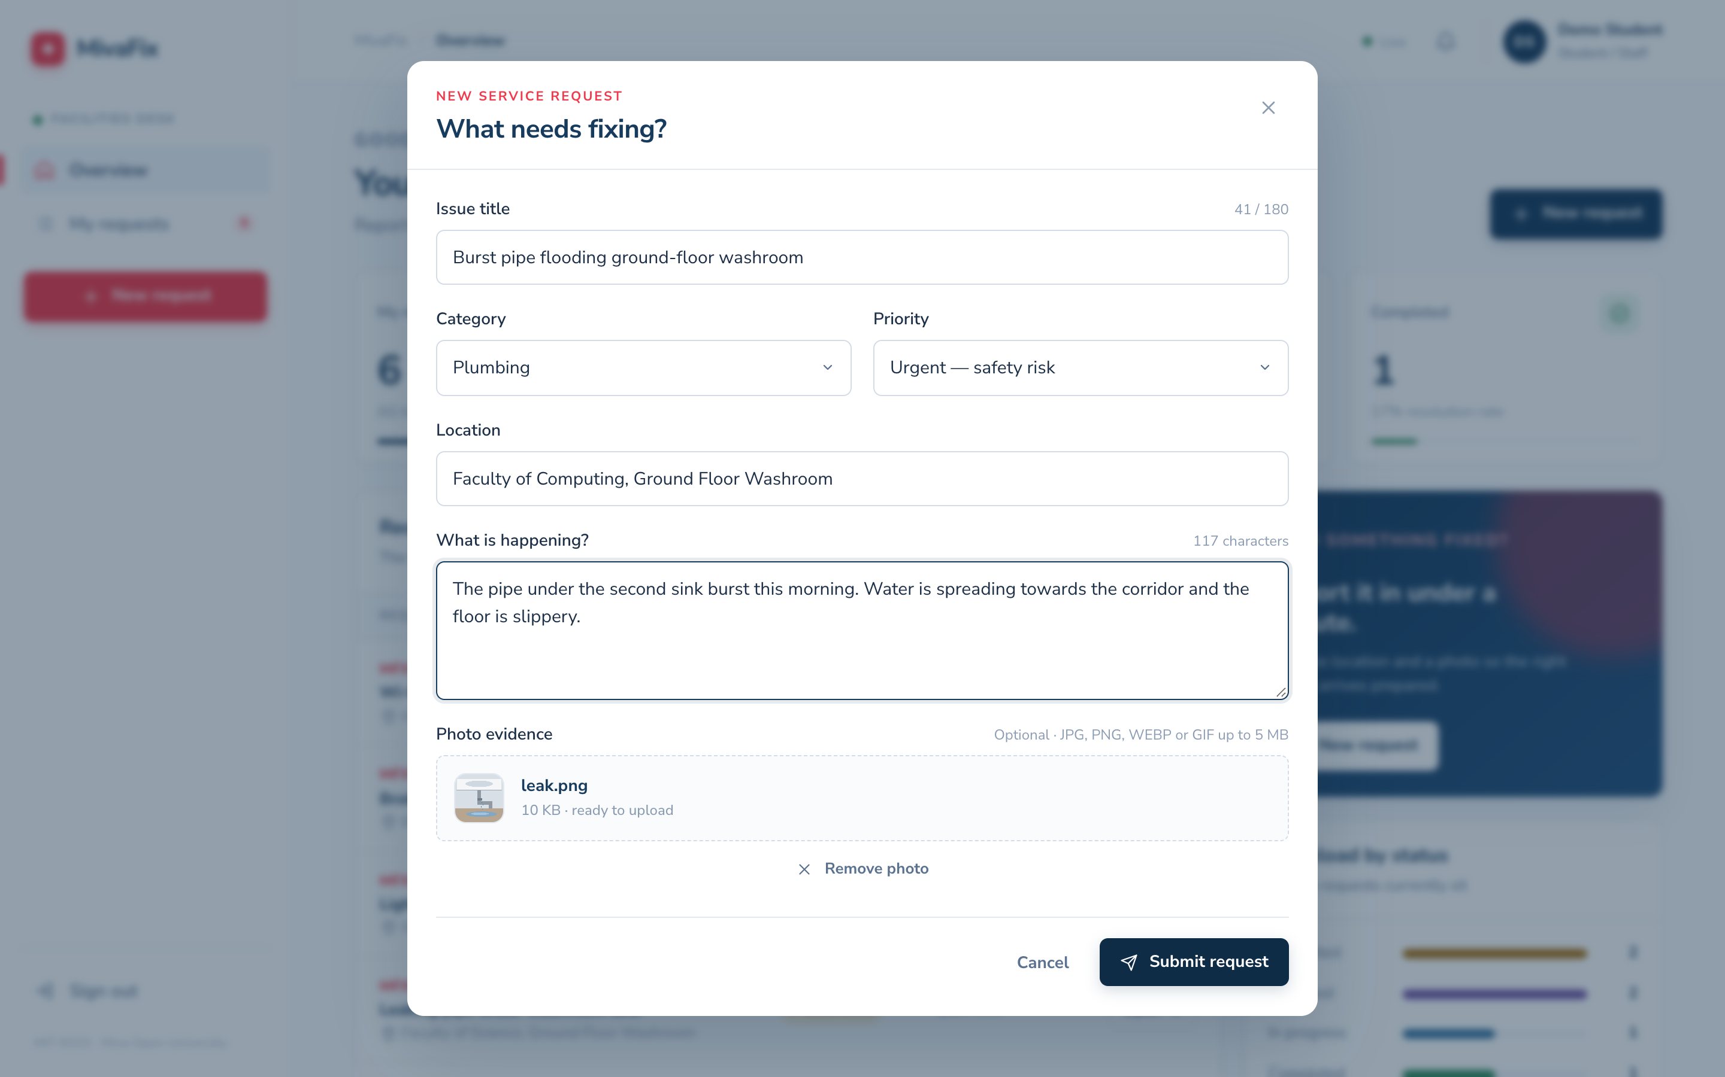
Students and staff report in under a minute
1
Sign in or register
Inline validation and password-strength check
2
Describe the fault
Category, location, priority, description and a photo
3
Track it live
Progress tracker, activity trail and notifications
Demo account: student@miva.test
Notes:
[1:05–1:55] DEMO: sign in as student@miva.test. The dashboard shows my requests and their status. I open New request, choose Plumbing, set Urgent, enter the location and description, and attach a photo of the leak — the form validates every field inline before it is sent. After submitting, I get a ticket number and can follow the request on the progress tracker and activity trail.

Slide 5
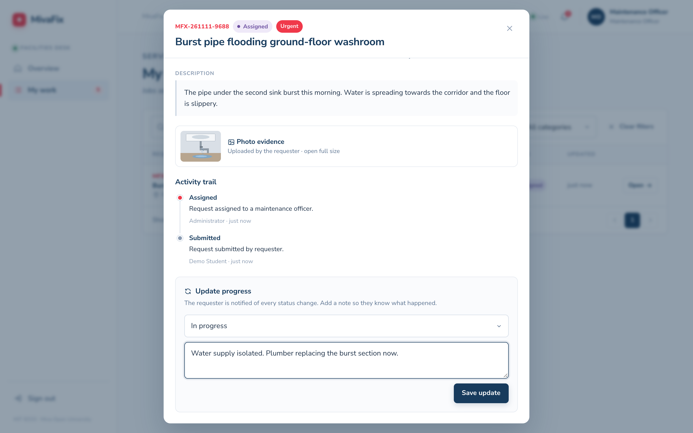



Officers see only their own jobs
Focused queue
“My work” lists only assigned jobs
Update with a note
Next status is pre-selected; the note tells the requester what happened
Everyone informed
Requester and admins are notified instantly
Demo account: officer@miva.test
Notes:
[1:55–2:40] DEMO: sign in as officer@miva.test. The officer’s dashboard and My work page show only jobs assigned to this officer. I open the burst-pipe request, the next status — In progress — is already selected, and I add a note: water supply isolated, plumber replacing the pipe. On save, the timeline updates and the student and administrators are notified. Later I mark it Completed the same way.

Slide 6
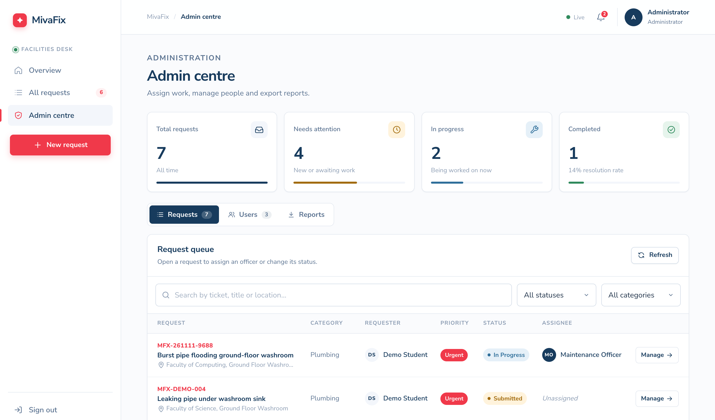
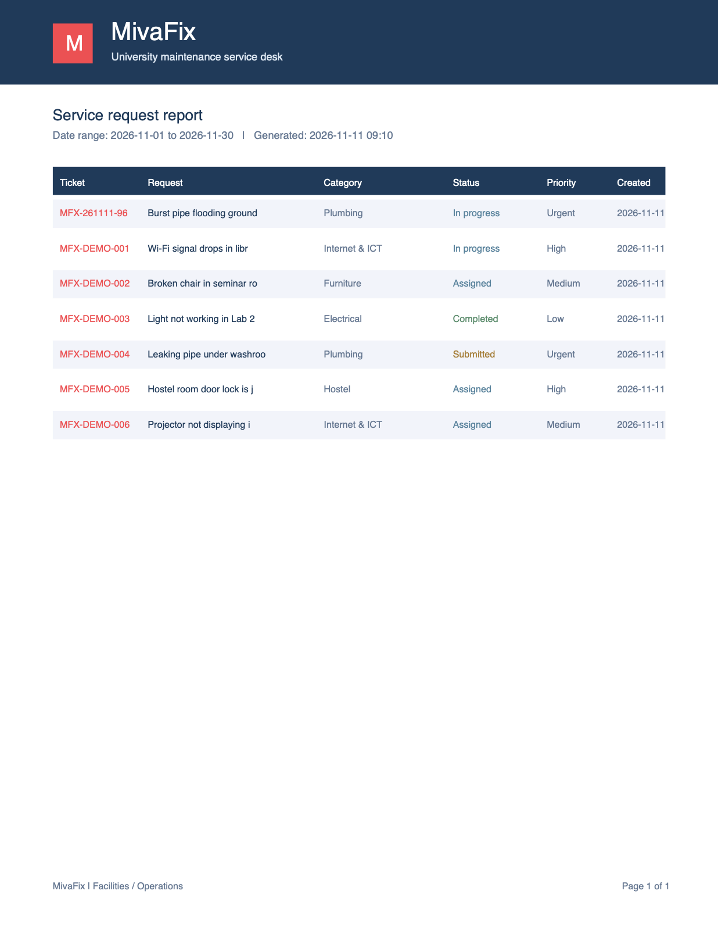
Administrators assign, monitor and report
Assign & reassign
Pick an officer; both parties are notified
Monitor the queue
Search, filter and paginate every request
Manage people
Directory filtered by role
Export reports
Date-range CSV and branded PDF
Demo account: admin@miva.test
Notes:
[2:40–3:30] DEMO: sign in as admin@miva.test and open the Admin centre. The metrics show campus-wide workload. I search the queue, open a submitted request and assign it to a maintenance officer — the officer and the requester are notified. The Users tab shows the people directory filtered by role, the notification bell shows in-app alerts, and the Reports tab exports a date-filtered CSV or a branded PDF.

Slide 7



Three-tier architecture
Frontend
PHP 8 API
MySQL
HTML5 and CSS3
Vanilla JavaScript
AJAX with fetch()
Responsive, accessible UI
OOP router and controllers
Sessions and RBAC
Validation, JSON errors
PDO prepared queries
7 related tables
Foreign keys and cascades
1:1, 1:N and M:N
utf8mb4, InnoDB
JSON over HTTP
SQL via PDO
DATABASE ENTITIES
roles
users
categories
service_requests
assignments
status_updates
notifications
Notes:
[3:30–4:15] The frontend is HTML, CSS and vanilla JavaScript; every call to the server is AJAX using fetch. It talks JSON to a PHP 8 REST API built with object-oriented classes — a router, request and response classes, an Auth class and four controllers. The API uses PDO prepared statements to reach a MySQL database of seven related tables: users, roles, service requests, categories, assignments, status updates and notifications, linked by foreign keys with one-to-one, one-to-many and many-to-many relationships.

Slide 8







All nine advanced features implemented
Session authentication
HttpOnly cookies, bcrypt passwords
Role-based access
Checked on every API route
Image evidence upload
Type and size checked, served securely
In-app notifications
On every assignment and status change
Search, filter, paginate
Ticket, title, location, status, category
Real-time updates
AJAX refresh every 10 seconds
Audit trail
Who did what, and when
API documentation
OpenAPI 3.0 at /api/docs
PDF and CSV export
Filtered by date range
Notes:
[4:15–4:45] The brief asked for at least four advanced features; MivaFix implements all nine: session authentication with hashed passwords, role-based access control, image evidence upload, in-app notifications, search, filter and pagination, real-time updates through AJAX polling, an audit trail, OpenAPI documentation, and PDF and CSV export.

Slide 9

Tested end to end and deployed online
42/42
25/25
9/9
API integration tests pass
PHP + cURL against a real database
Browser tests pass
Playwright driving Google Chrome
Advanced features
Brief required at least four
Live at [your live URL]
Apache + PHP 8 + MySQL · HTTPS · frontend and /api served from one domain
Demo password for all three roles: Password123!
Notes:
Both test suites run against the real API and a real MySQL database: 42 API integration tests cover authentication, access control, validation, uploads, the full assignment and status workflow, notifications and exports; 25 browser tests drive Chrome through every role’s journey, including mobile. All 67 pass. The application is deployed online on Apache, PHP and MySQL — [say your live URL].

Slide 10
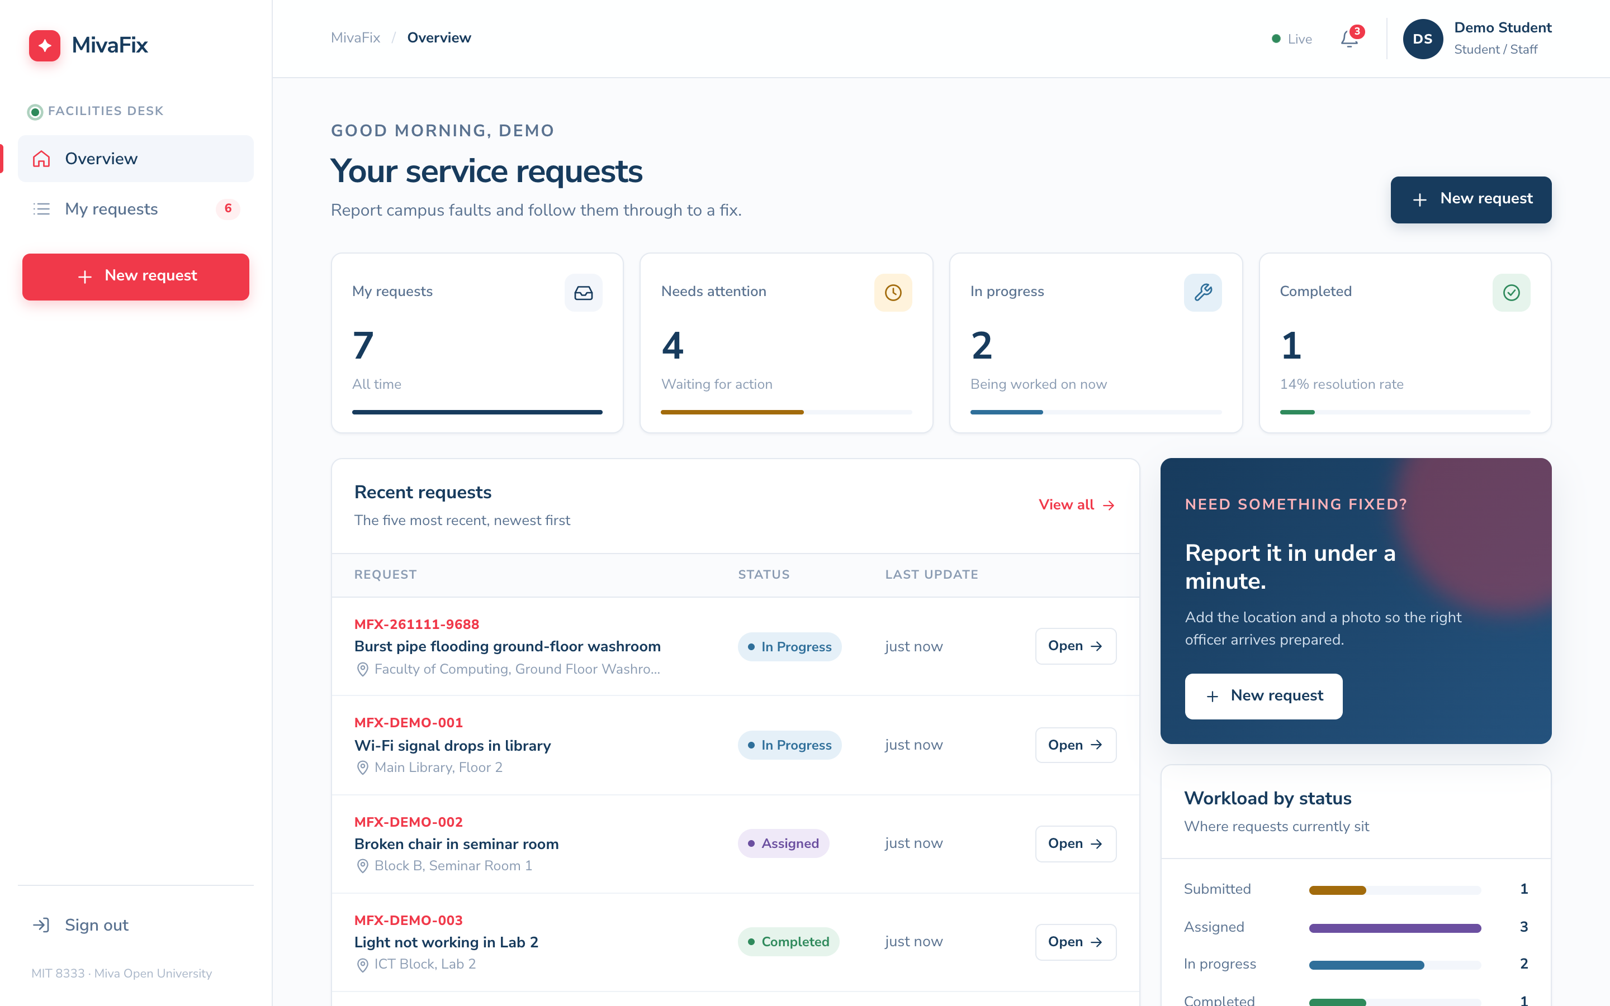
One source of truth
THANK YOU
for campus maintenance: faster response, full visibility and clear accountability.
Source code: [Google Drive link]
Live app: [your live URL]
Notes:
[4:45–5:00] MivaFix gives the university a single source of truth for campus maintenance. It improves response times, visibility and accountability, while keeping the architecture simple enough to maintain and extend. Thank you.

