Slide 1
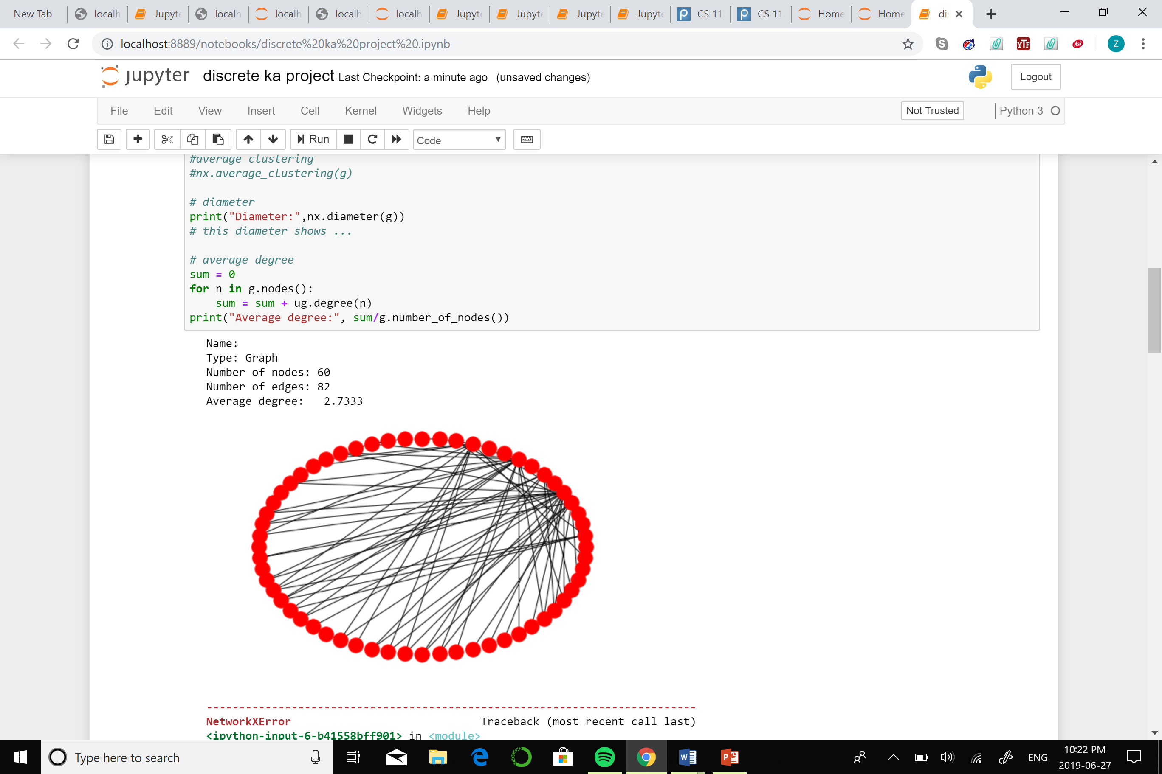
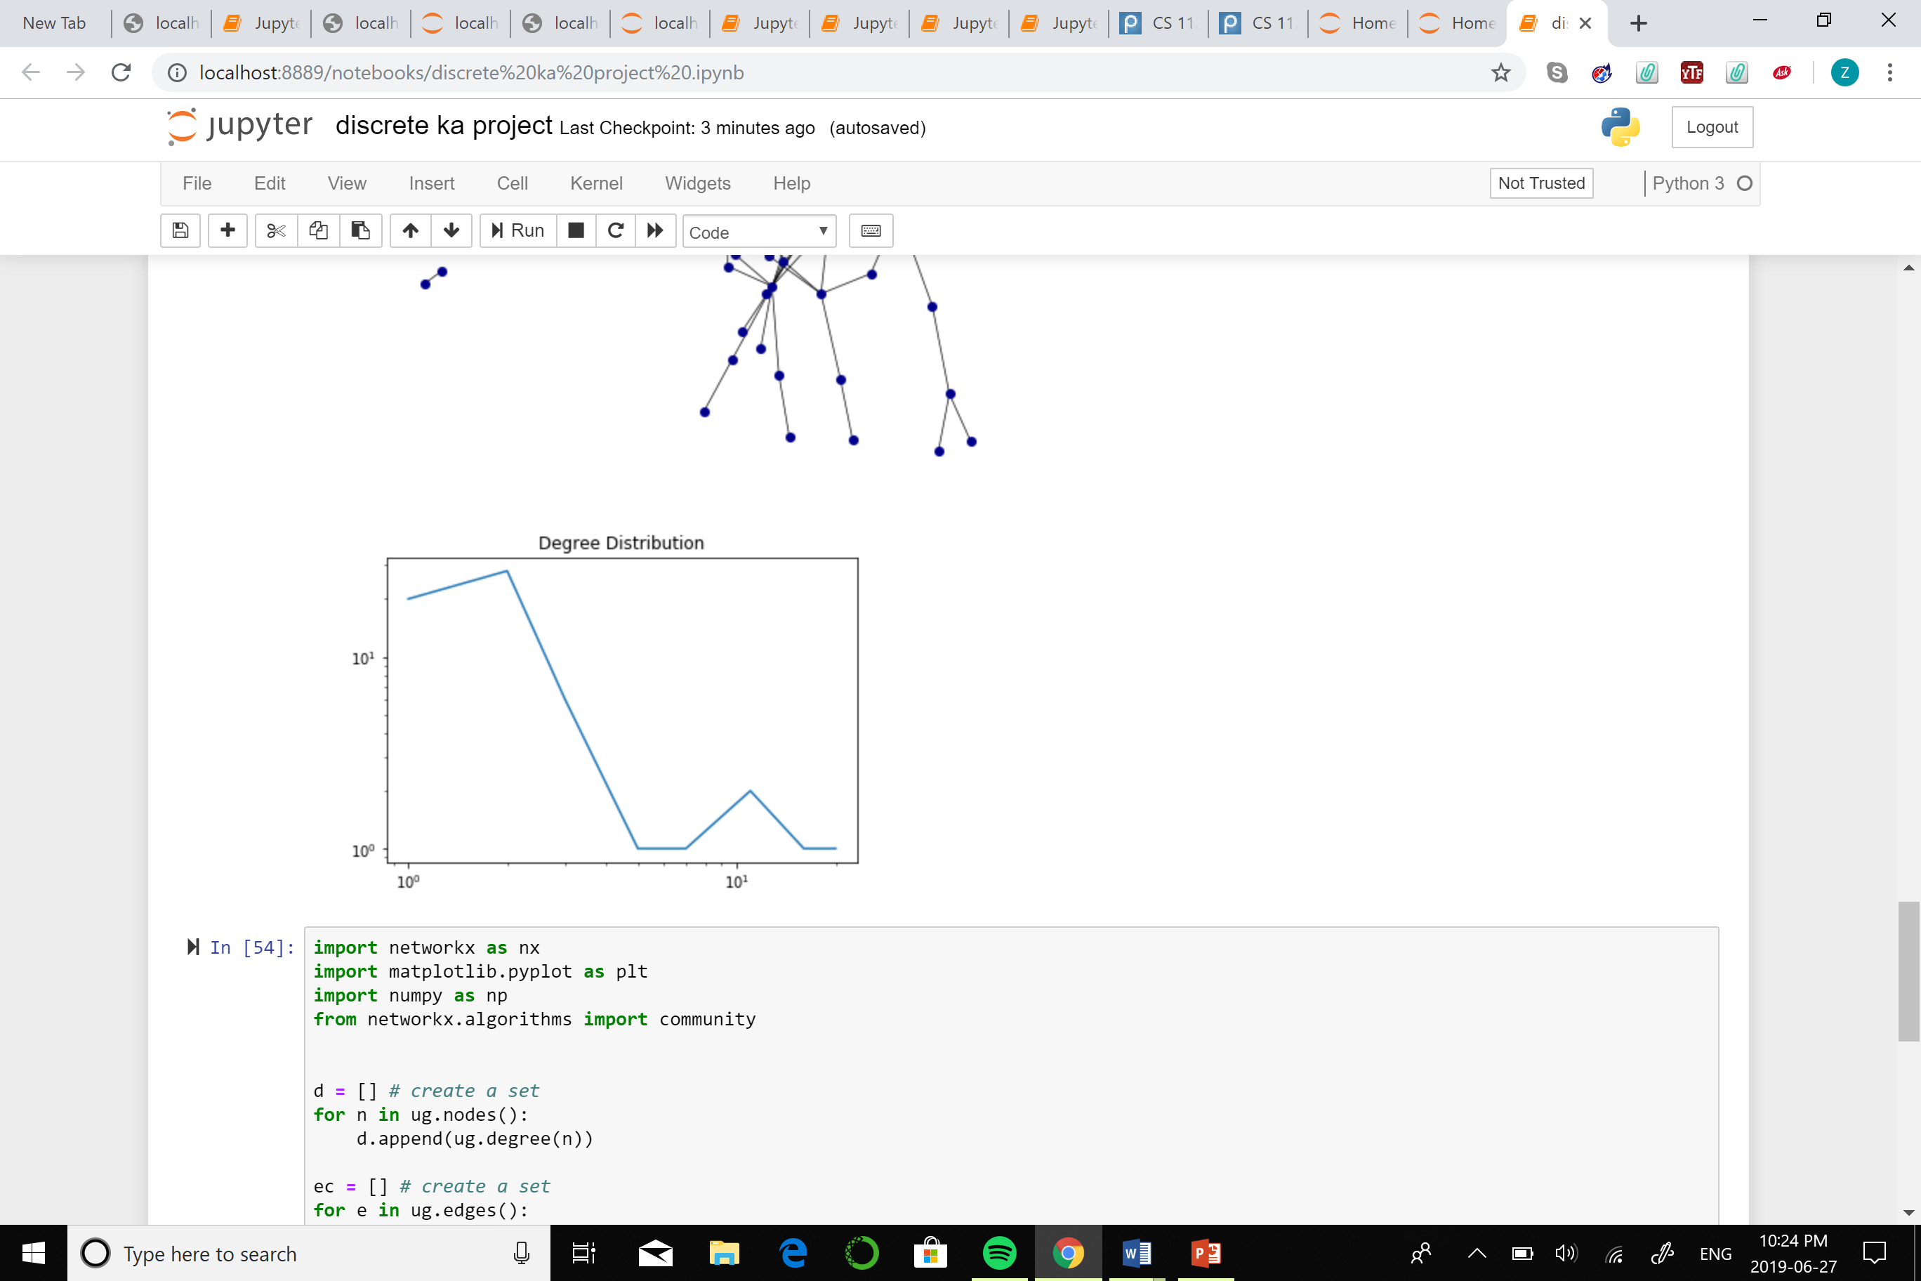
PAKISTANI MOVIES
INTRODUCTION
This project is based on genre of different Pakistani movies, where 60 nodes correspond to the movie name and genre and 82 edges correspond to the relation between movies and different genres.
NUMBER OF NODES: 60
NUMBER OF EDGES: 82
AVERAGE DEGREE: 2.733333334

