Slide 1
WEB APPLICATION FOR RENTAL SERVICES OF AGRICULTURAL TOOLS
PIP104 PROFESSIONAL PRACTICE-II
REVIEW - II
Batch Number: CSE-G106
Roll Number | Student Name
20201CSE0633 | FIZA JAVEED
20201CSE0602 | VARUN CHANDRAPPA
20201CSE0617 | RITIKA
20201CSE0627 | ROHIT BM
Under the Supervision of,
Mr. Md Zia Ur Rahman
Assistant Professor
School of Computer Science & Engineering
Presidency University Bangalore

Slide 2
Introduction
A web application that the farmers can use to hire tractors as well as other mechanizations at a nominal amount all using their mobile phones. This would not only help them avoid manual labor but can be also be considered as an important step to encourage this profession. By promoting efficient tool utilization, transparent transactions, and community collaboration, the project seeks to enhance productivity, reduce costs, and contribute to the sustainable development of agriculture. Through innovative features like secure authentication, a comprehensive tool catalog, and integrated payment solutions, the application aims to empower farmers and tool owners alike.

Slide 3


Literature Survey

Slide 4
A Mobile-Based Farm Machinery Hiring System Author: Sanjay Misra , JohnBosco Agbaegbu, Adio Akinwale , Ravin Ahuja
The aim of this research work is to design a mobile application for distributing or leasing agricultural machineries to farmers using locations-based services.
The design also took into consideration the configuration of the various topologies and other factors that could enhance the flexibility of a mobile application of this nature.
The user platform is categorized into three sections the presentation layer, the business layer and the data layer.

Slide 5
Design and Development of Mobile App for Farmers Author: Ms. Shubhangi G. Mane, Dr. Kulkarni R. V
Agriculture is the support of Indian economy so information sharing to the knowledge intensive agriculture area is upgraded by mobile-enabled information services.
This paper explores how Mobile Apps of agricultural services have impacted the farmers in their farming activities and which more innovative agriculture services will provide through Mobile App.

Slide 6
Tractor Hiring Application for Farmers Author: Krunal Bagaitkar, Khoshant, Anklesha Welekar3, Aman Yadav
This application named as tractor hiring application for farmers is a rental service in which the farmer arrives to request a hire of a rental unit.
To create an interface between farmers who want to hire and those who want to let out equipment.
It is more convenient than carrying the cost of owning and maintaining the unit.

Slide 7
Farm Mechanization in Indian Agriculture with Focus on Tractors Author: Ashok Gulati and Ritika Juneja
Farm mechanization in India, particularly tractors, has made significant progress, increasing farm power and replacing human and draught power.
India has become a major tractor producer, exporting around 900,000 units in 2019.
Inclusiveness is improving, with about 44% of small and marginal farmers using farm machinery.
Innovative models like CHCs and 'Uberization' aim to make machinery accessible on a 'pay per use' basis, potentially shaping the future of farm mechanization.

Slide 8
Research Gaps Identified
The existing literature on agricultural rental systems for tools and tractors exhibits several notable gaps. Firstly, there is a limited focus on the specific requirements and challenges unique to agricultural rental systems, often overshadowed by broader discussions on general rental systems or agricultural technology. Additionally, a research void exists in the integration of modern technologies like IoT, AI, and blockchain into web applications designed for tracking and managing agricultural tools and tractors. Furthermore, insufficient attention is given to user experience and interface design tailored to the diverse stakeholders, such as farmers and service providers. Issues related to data security and privacy, adoption factors, sustainability, interoperability with existing agricultural systems, business models, educational needs, and cross-cultural considerations remain underexplored in the context of web-based rental systems for agricultural tools and tractors. Closing these gaps is crucial for the development and successful implementation of effective and user-friendly agricultural rental solutions.

Slide 9
Proposed Method
The mobile application method involves market research, user-friendly development, secure payments, feedback systems, promotion, legal compliance, and continuous improvement.
It also includes machinery listing, data security, and user support to enhance the platform's usability and reliability.
Impact assessments are conducted to ensure the platform effectively serves farmers in hiring mechanized equipment.

Slide 10
Objectives
Objectives of the Mobile Application for Farm Mechanization:
1. Facilitate Mechanization Access: Enable farmers to easily access and hire tractors and machinery through a user-friendly mobile app.
2. Reduce Manual Labor: Alleviate the physical burden on farmers by providing efficient access to mechanized equipment for various agricultural tasks.
3. Promote Agricultural Profession: Encourage and sustain the farming profession by making it more efficient and attractive to new generations.
4. Enhance Affordability: Ensure that the hiring costs are nominal, making mechanization services financially accessible to a wide range of farmers.

Slide 11
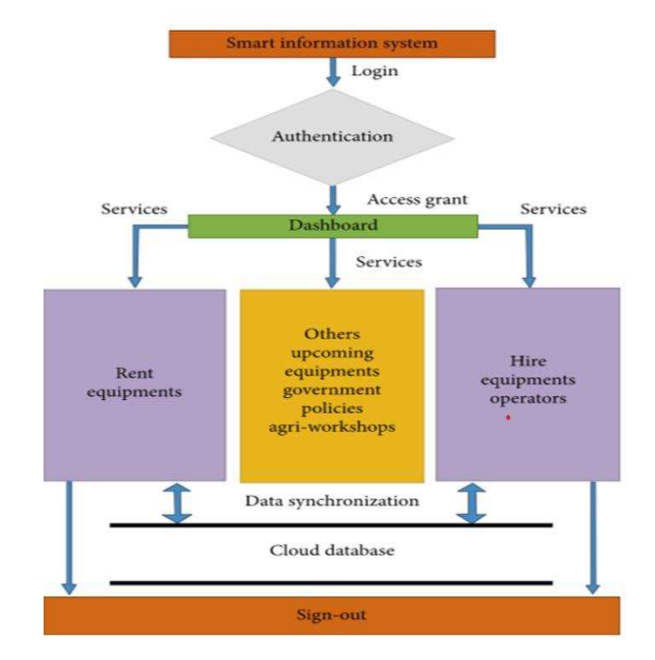
System Design & Implementation
Architecture: The architecture of a city information guide website encompasses several key components working cohesively. The front-end, responsible for the user interface's look and feel, employs contemporary web technologies like responsive design and interactive features to ensure an appealing user experience. The back-end, representing the server-side and database technologies, involves choosing appropriate databases and hosting solutions, often utilizing cloud-based systems. Data sources, including public records, government databases, and user-generated content, are integrated to provide accurate and current information. Application programming interfaces (APIs) facilitate seamless data interchange with various systems such as transport services, hotel booking sites, and social media networks. To enrich the content, photos from Flickr and maps from OpenStreetMap were manually entered into the database, contributing to the platform's comprehensive functionality.

Slide 12
Algorithm:
In developing a tractor hiring rental system web application, algorithmic choices play a pivotal role across various components. For user authentication and authorization, secure password hashing algorithms like bcrypt are utilized, alongside authorization algorithms for role-based access control. Search and recommendation functionalities employ algorithms such as binary search or advanced search algorithms, while recommendation algorithms like collaborative filtering suggest tractors based on user history. Booking and scheduling involve algorithms considering availability, location, and user preferences, and routing relies on optimal route algorithms for tractor delivery or pickup. The system employs location-based algorithms for real-time tracking and finding the nearest available tractor. Additional algorithms manage notifications, database operations, review analysis, security, and performance optimization, ensuring a secure, efficient, and user-friendly experience throughout the web application.

Slide 13
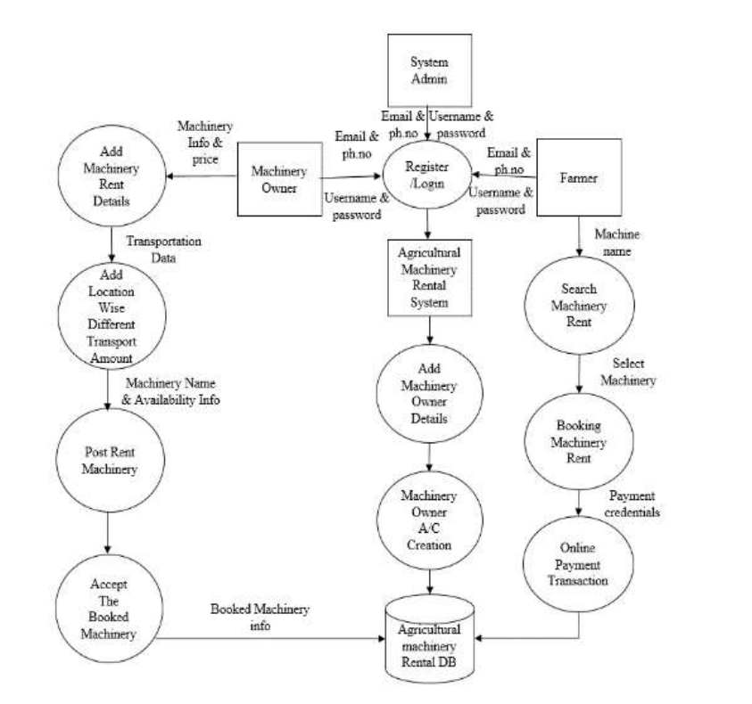
Flowchart:

Slide 14
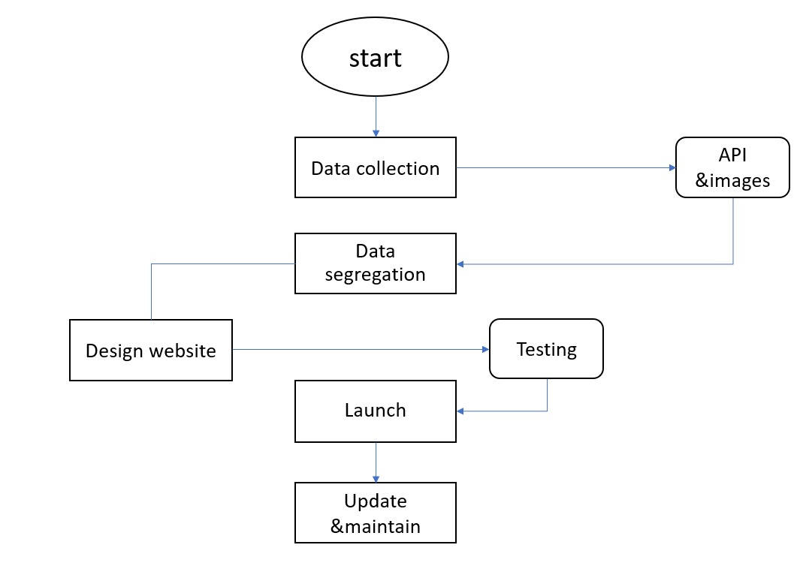
Development process:
Building a website using the MERN stack involves a systematic process. Initially, gathering APIs, images, libraries, designs, and information is crucial, followed by data segregation. Setting up the development environment involves installing MongoDB and Nodejs, initializing a Node.js project, configuring the connection, and creating a MongoDB database. Backend development utilizes Node.js and Express.js for server-side code, implementing routes and controllers for various city information categories. The use of MongoDB ORM or ODM like Mongoose facilitates data models, while CRUD operations communicate with the database. User authentication and authorization features are implemented using JSON Web Tokens or Passport.js. Frontend development utilizes Create React App to set up a React application, creating components for homepage, category listings, detailed information pages, and search capabilities. Integration of APIs and client-side routing with React Router enhances user interface elements, including interactive maps and search forms. Connecting backend and frontend involves sending API queries using Axios and managing data retrieval and display on the frontend to ensure a seamless user experience.

Slide 15
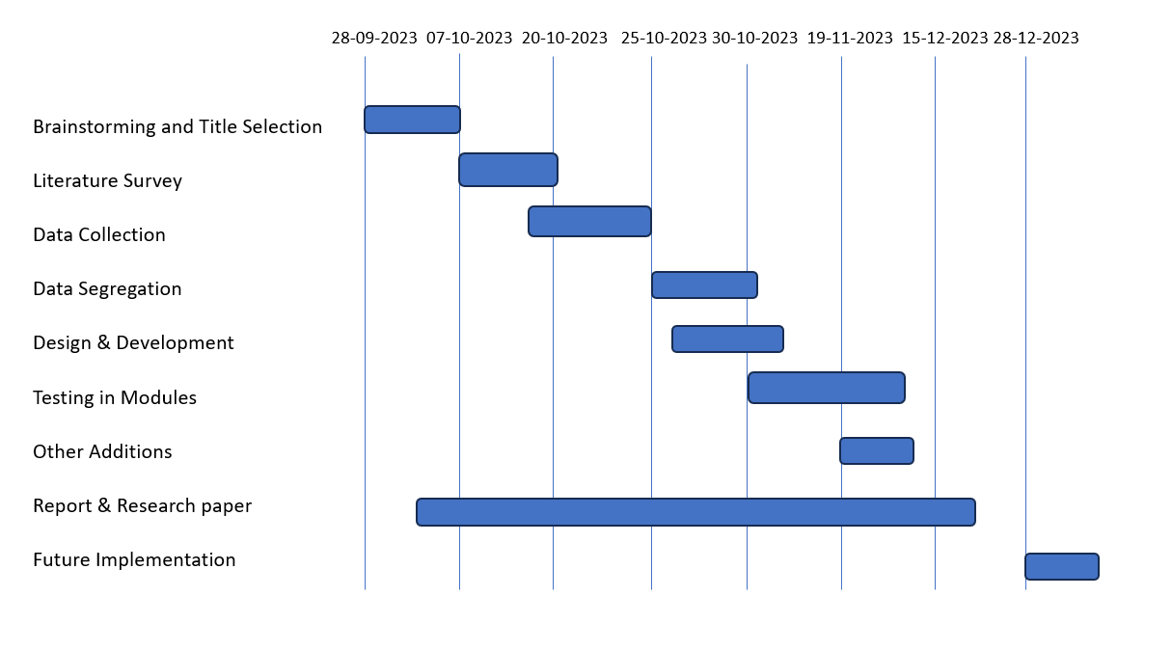
Timeline of Project

Slide 16
Outcomes / Results Obtained
Expected Outcomes of the web Application for Farm Mechanization:
Increased Mechanization: More farmers will access and utilize mechanized equipment, reducing their reliance on manual labor.
Higher Agricultural Efficiency: Improved access to tractors and machinery will lead to increased efficiency, resulting in higher crop yields and reduced labor costs.
Economic Empowerment: Farmers' income is likely to rise as mechanization helps optimize resources and increase agricultural productivity.
Sustainable Agriculture: The project's success will contribute to more sustainable and modernized agricultural practices, ultimately benefitting the entire agricultural ecosystem.

Slide 17
Conclusion
Our web application is a transformative tool designed to revolutionize modern agriculture, prioritizing user-friendly functionality and technological advancements. Focused on minimizing manual labor, the application enhances efficiency and productivity through intuitive interfaces and streamlined processes. It plays a crucial role in revitalizing farming by introducing a tech-savvy approach, making agriculture more accessible and appealing to both seasoned farmers and new enthusiasts. With a commitment to agricultural sustainability, the application employs data analytics and resource optimization tools to inform decision-making and empower farming communities economically. More than just a digital platform, our web application serves as a catalyst for positive change, harmonizing innovation and tradition to shape a thriving and sustainable agricultural landscape.

Slide 18
References
[1] AgroEcom: An Agricultural Equipment Rental Services for Smart Farming
https://ijrpr.com/uploads/V4ISSUE6/IJRPR14553.pdf
[2] AGRARYANS: Farm Equipment Rental System/Based on Agriculture https://www.irjet.net/archives/V9/i6/IRJET-V9I6152.pdf
[3] AGRICULTURE EQUIPEMENT’S RENTAL SYSTEM https://www.irjmets.com/uploadedfiles/paper/issue_3_march_2023/34591/final/fin_irjmets1 679567128.pdf
[4] Agri-Equipments Rental System https://www.ijsdr.org/papers/IJSDR1905050.pdf
[5] RfarmQuipment-Rental Farming Equipment Website https://www.tijer.org/papers/TIJER2304054.pdf

Slide 19
Publication Details

Slide 20

Thank You

