Slide 1
HabotConnect Project
Secure Staging, Automated Build Gates,
and Clean Data Validation
Fathima Fiza C P
fathimafiza1612@gmail.com
13 September 2026

Slide 2
AGENDA
What This Presentation Covers
1
The Scenario & Objective
What broke, and what the project needed to prove.
2
Task 1 — Secure Terraform Provisioning
GCS + BigQuery, encrypted, least-privilege, row-level security.
3
Task 2 — Poka-Yoke CI/CD Gate
A fail-closed pipeline that blocks bad commits automatically.
4
Task 3 — DCYN Schema Validation
A Django serializer that eliminates ambiguous data at the door.
5
Evidence & Live Demonstration
Screenshots of every task actually running successfully.
2

Slide 3
THE SCENARIO
Restoring System Integrity After a Staging Failure
What happened: A junior developer pushed unencrypted API credentials into raw application code, and triggered a database schema mismatch that broke downstream analytics.
The goal was not to patch the one bug — it was to build automated safeguards ("Poka-Yoke") so this class of mistake becomes structurally impossible to ship.
Task 1
Task 2
Task 3
Secure the infrastructure itself with Terraform
Automate the checkpoint that catches human error
Eliminate ambiguous data at the validation layer
3

Slide 4
ARCHITECTURE OVERVIEW
End-to-End Logic Flow
Student
Onboarding
Form (JSON)
→
Task 3
DRF Serializer
+ DCYN Validation
→
D0 Raw
Landing
(GCS Bucket)
→
D1 Staged /
Enforced
(BigQuery)
→
LSA Staff
(Row-Level
Security)
Every push through this pipeline first passes through Task 2's fail-closed CI/CD gate — lint, format, and secret-scan checks run automatically on every commit. Nothing insecure or malformed reaches the infrastructure above. This is the single control that ties Tasks 1, 2, and 3 together into one coherent, mistake-proof system.
4

Slide 5
TASK 1 — INFRASTRUCTURE AS CODE
Secure Staging Provisioning with Terraform
1
Customer-Managed Encryption (CMEK)
A dedicated KMS key encrypts the D0 raw landing bucket at rest — not relying on Google's default key.
2
Least-Privilege IAM
The ingestion service account can only create objects — it cannot list, read, or delete the bucket's contents.
3
Public Access Fully Blocked
uniform_bucket_level_access and public_access_prevention = enforced remove any path to accidental exposure.
4
Row-Level Security in BigQuery
LSA staff querying the students table only ever see rows where they are the assigned LSA — enforced at the database layer, not the application layer.
5

Slide 6
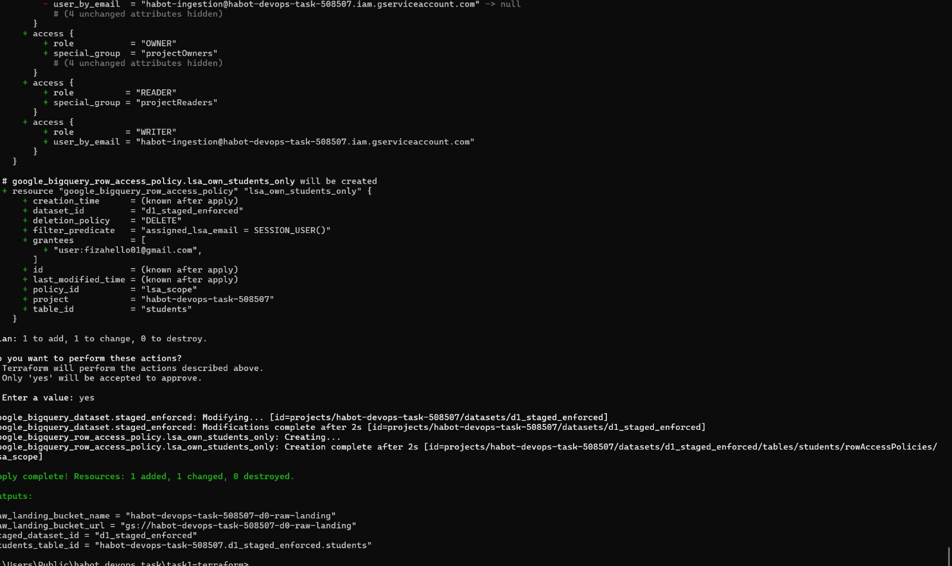
TASK 1 — EVIDENCE
Terraform Plan & Apply — Successful Deployment
6

Slide 7
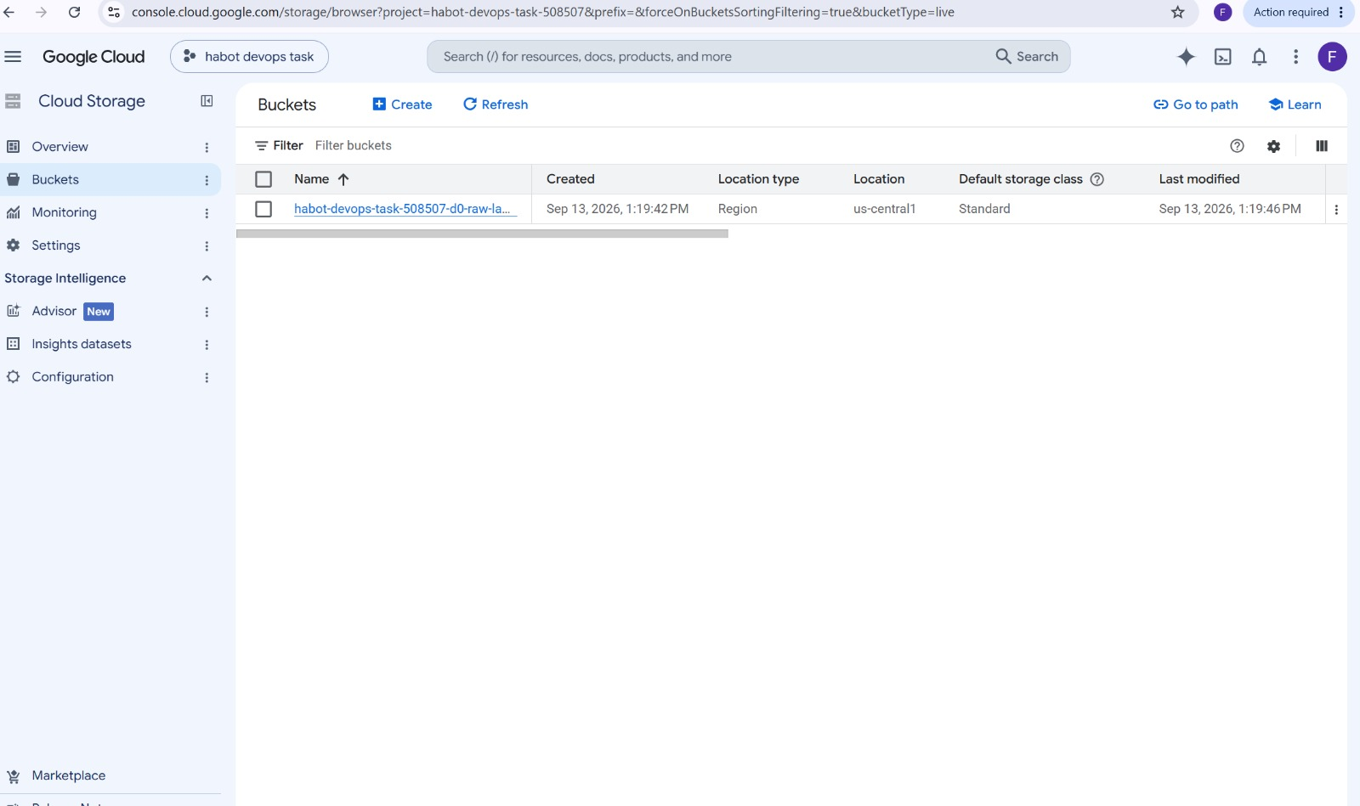
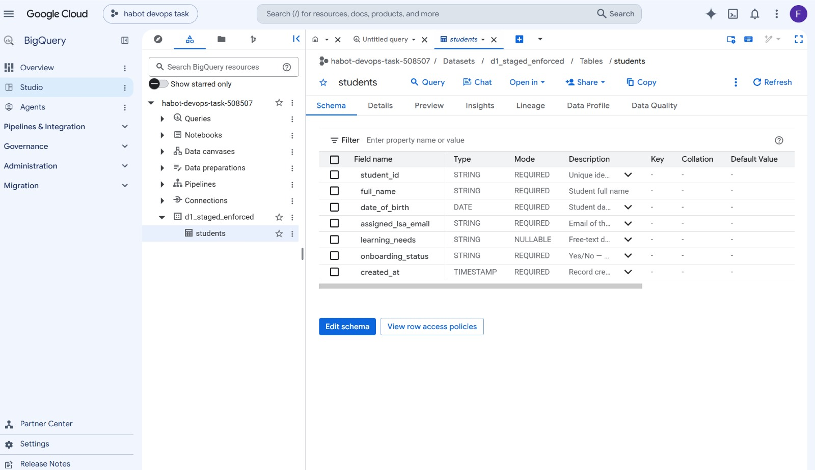
TASK 1 — EVIDENCE
Verified Live in the GCP Console
📷 Insert screenshot: GCS bucket in Cloud Storage console
📷 Insert screenshot: BigQuery dataset "d1_staged_enforced" and students table
7

Slide 8
TASK 2 — POKA-YOKE BUILD GATE
A Pipeline That Fails Closed, Not Open
1
Lint & Format Check
Black and Flake8 on Python code, terraform fmt and validate on infrastructure code.
2
Secret Scan (Gitleaks)
Custom rules detect hardcoded API keys and embedded service-account credentials — the exact failure in the scenario.
3
Quarantine on Any Failure
A dedicated job fires only when a gate fails, printing an explicit "QUARANTINED — blocked from deploying" message.
4
Deploy Only on a Clean Build
The deploy job requires both prior jobs to succeed — deployment is opt-in through success, never opt-out through absence of failure.
8

Slide 9
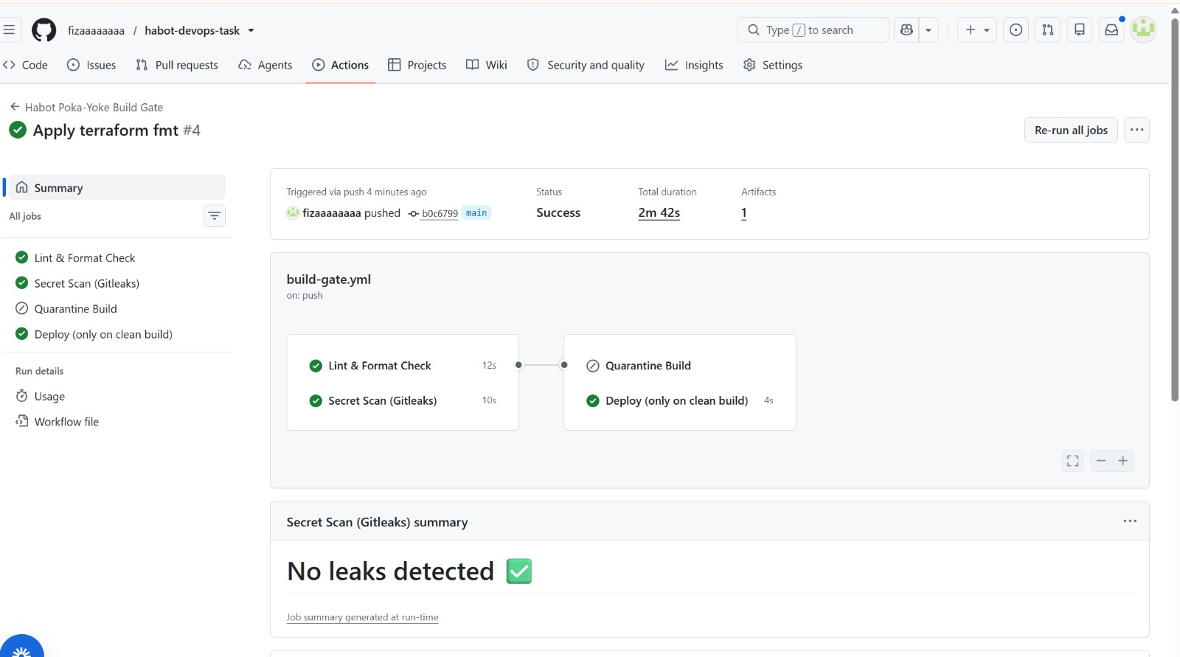
TASK 2 — EVIDENCE
Clean Commit: All Gates Pass
9

Slide 10
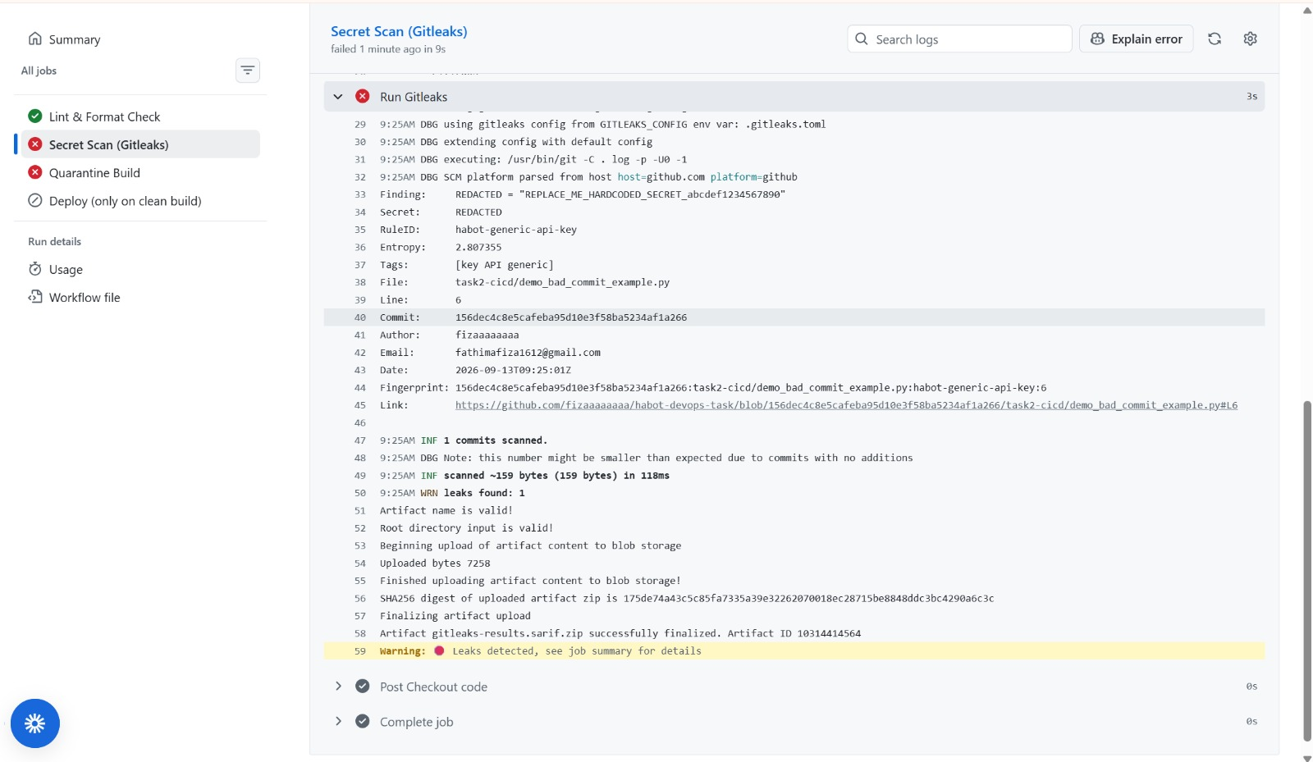
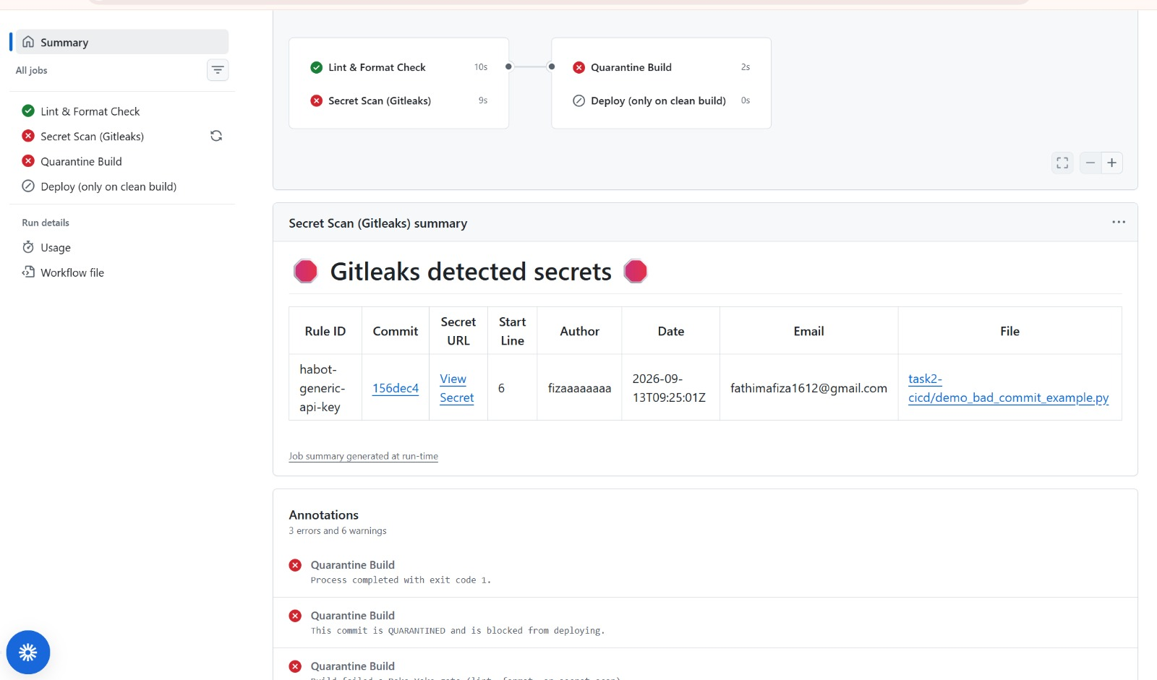
TASK 2 — EVIDENCE
Fail-Closed Demonstration: Bad Commit Blocked
📷 Insert screenshot: Gitleaks detecting the hardcoded secret (red / failed)
📷 Insert screenshot: Quarantine Build job — "This commit is QUARANTINED"
10

Slide 11
TASK 3 — SCHEMA MAPPING & DCYN
Eliminating Ambiguity, Not Guessing at It
1
DCYN: Deconstructed Yes/No Library
Every yes/no field is normalized to exactly "YES" or "NO" — anything ambiguous (blank, "maybe", partial values) is rejected outright.
2
Exact Field Validation Limits
student_id must match a strict pattern, date_of_birth must imply a real, currently-a-minor age — no vague "any string is fine."
3
Business Rules Enforced in Code
A record cannot be onboarded at all without guardian consent — this is not left to a human reviewer to catch.
4
Fails Closed, Same as Task 2
One ambiguous field rejects the entire record. No partial processing of a bad record.
11

Slide 12
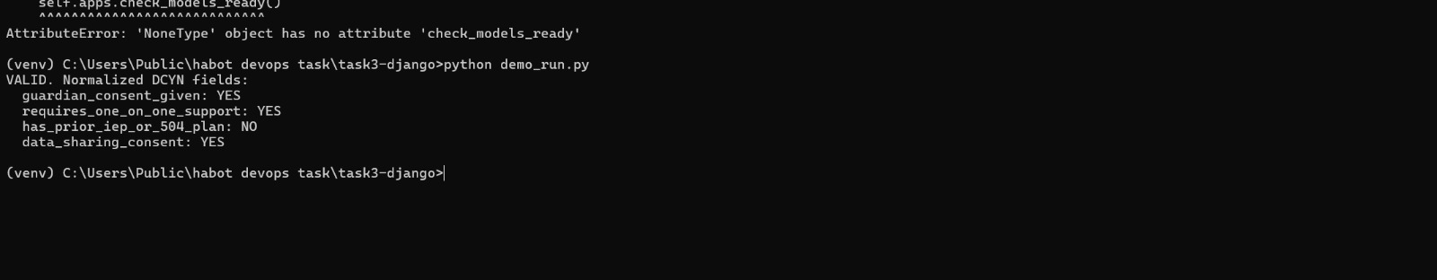
TASK 3 — EVIDENCE
demo_run.py — Three Scenarios
12

Slide 13
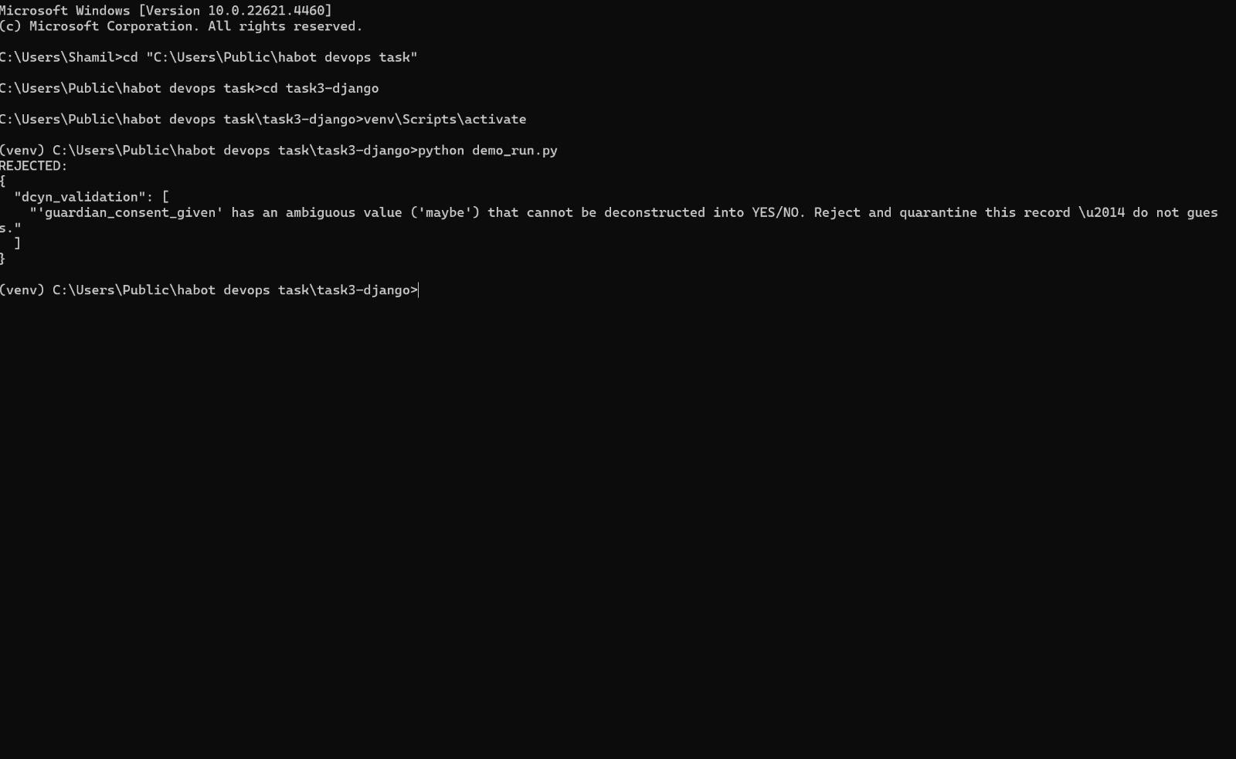
TASK 3 — EVIDENCE
demo_run.py — Three Scenarios
12

Slide 14
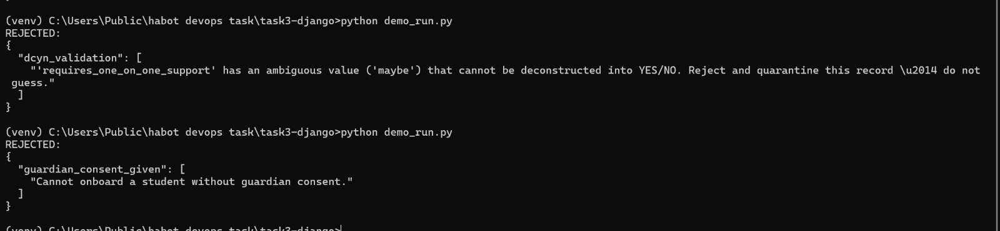
TASK 3 — EVIDENCE
demo_run.py — Three Scenarios
12

Slide 15
ENGINEERING JUDGMENT
Demo Constraints vs. Production Design
In This Demo
In Production at HabotConnect
• Personal Google account used as the Row-Level Security grantee and dataset owner
• projectOwners / projectReaders special groups stand in for a real Workspace domain
• Deploy job in the pipeline prints a placeholder message rather than pushing to a real environment
• lsa-staff@habot.io would be a real, managed Google Workspace group
• Terraform state would live in a remote GCS backend, not locally
• The deploy job would push to a real staging/production App Engine environment behind its own approval gate
13

Slide 16
Thank You
Full code, pipeline, and documentation available in the linked repository below.
Repository: https://github.com/fizaaaaaaaa/habot-devops-task
Fathima Fiza C P

