Slide 1
CUSTOMER CHURN PREDICTION
-By Fiza khan

Slide 2
CONTENT
1) PROBLEM STATEMENT AND OBJECTIVE
2) DATASET EXPLAINATION
3) METHODOLOGY
Data Collection
Data Analysis
Data Cleaning and Preprocessing
4) DATA VISUALIZATION
5) TRAINING AND TESTING THE MODEL
6) CONVERTING AND SPLITTNG THE DATA FOR TRAINING
7) ALGORITHMS USED IN THE DATASET
8) EVALUATING AND COMPARING THE ALGORITHMS
9) CONCLUSION

Slide 3
PROBLEM STATEMENT & OBJECTIVE
Problem Statement
Despite the bank’s efforts to offer competitive services and personalized solutions, there is a noticeable trend of increasing customer attrition. The bank lacks a robust mechanism to predict customer churn accurately and understand the underlying reasons behind it. The model will be used to identify high-risk customers, enabling the bank to proactively address issues and improve retention efforts.
.
Objective
The objective of Bank Churn Project is to predict which customers are likely to discontinue their services(churn) and to understand the factors influencing churn. This information is crucial for implementing target retention strategies to reduce customer attrition and improve overall customer lifetime value.

Slide 4
FLOWCHART
DATA COLLECTION
APPLYING ALGORITHMS IN DATASET
EVALUATING AND COMPARING THE ALGORITHMS
DATA CLEANING &
PREPROCESSING
SPLITING THE DATA FOR TRAINING AND TESTING
DATA VISUALISATION
TRAINING AND TESTING THE MODEL

Slide 5
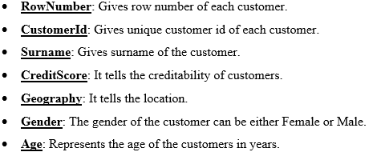
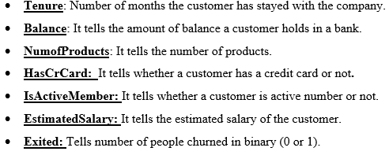
DATASET INFORMATION
This dataset contains 10,000 rows and 14 columns.
Attribute Information:

Slide 6
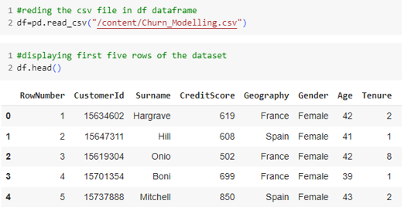
METHODOLOGY
DATA COLLECTION:
Gather bank customer churn data from financial institutions or public datasets, such as the Kaggle Bank Customer Churn Prediction dataset.
Dataset Link: https://www.kaggle.com/datasets/nikitkashyap/hospital-insurance-claim-fraud/data

Slide 7

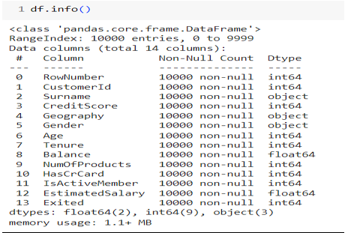
DATA ANALYSIS:
1) Using Shape: Shape displays the number of rows and columns of the dataset.
2) Using Info(): It provides a concise summary of the DataFrame, including the number of non-null entries, column data types, and memory usage.

Slide 8
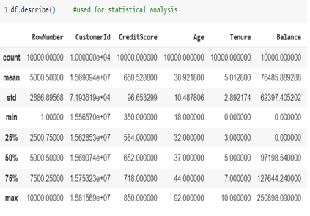
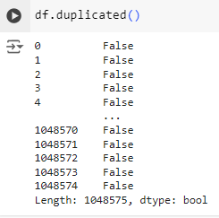
3) Using Describe(): The describe() function provides summary statistics of the DataFrame's numerical columns.
4) Using Duplicated(): Duplicate() finds duplicate entries if any.

Slide 9
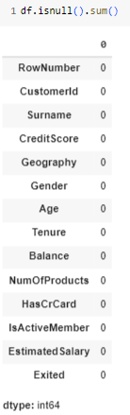
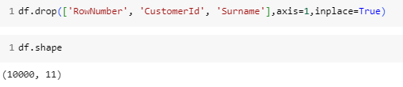
DATA CLEANING AND PREPROCESSING:
2) Dropping unnecessary columns :
3) Converting Column to Numeric :
Checking Null values:
Conclusion: There are no missing values

Slide 10
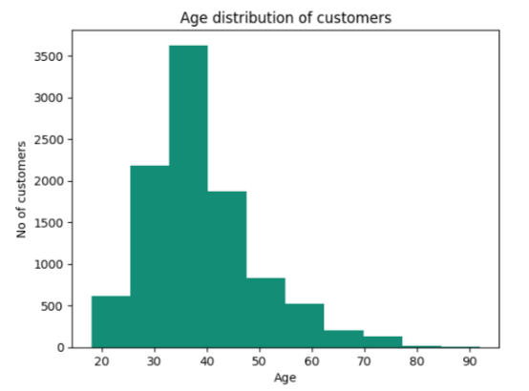
DATA VISUALIZATION
Age Distribution
Conclusion: Maximum People Belong To The Age Group b/w “30-40”

Slide 11
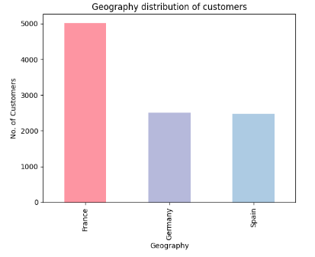
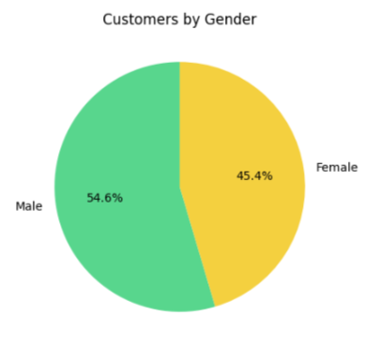
Geography Distribution of Customers
Gender Distribution
Conclusion : Most members are from France.
Conclusion : There Is A Majority Of Male Customers.

Slide 12
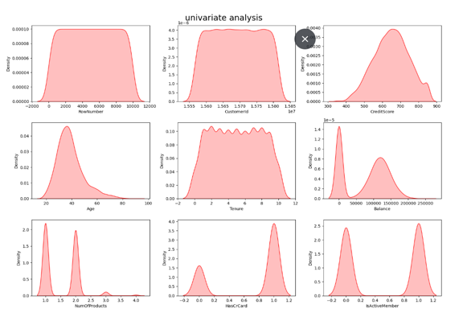

Slide 13
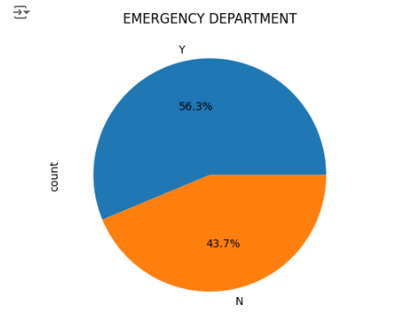
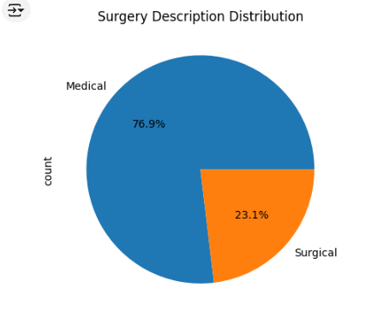
Emergency Department
Surgery Description Distribution
Conclusion : Majority Cases Belong To The Emergency Department
Conclusion : Illustrates The Distribution Of Surgery Descriptions, Showing The Proportion Of Each Surgery Type Within The Dataset.

Slide 14
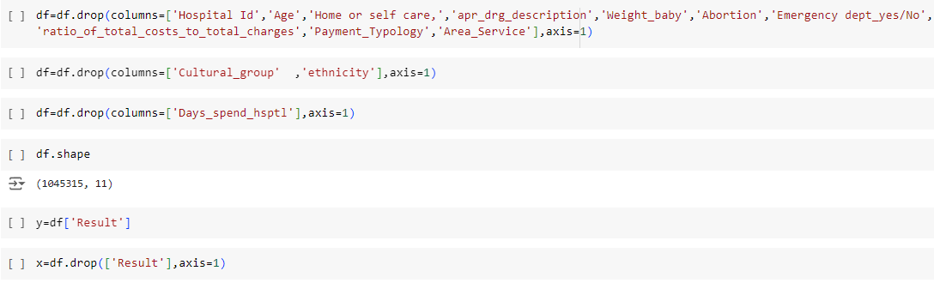
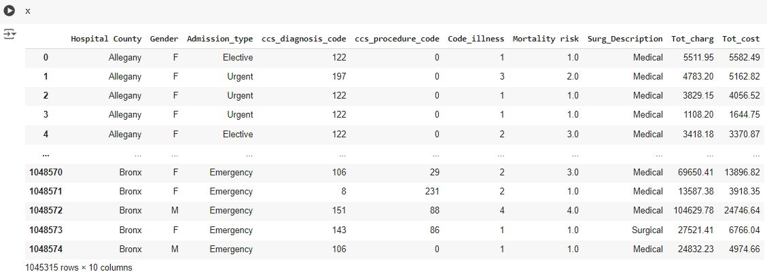
TRAINING AND TESTING THE MODEL

Slide 15
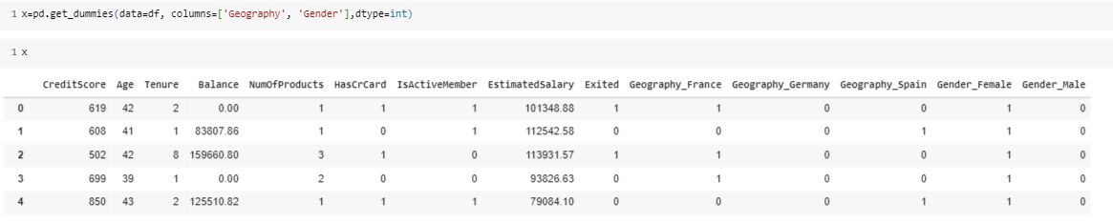
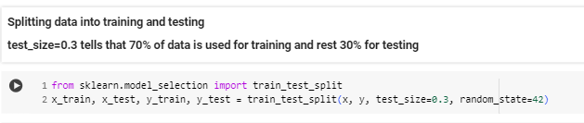
CONVERTING AND SPLITTING THE DATA FOR TRAINING
Converting categorical data into numerical:
Splitting the data for training:

Slide 16
ALGORITHMS USED IN DATASET
Logistic Regression: Logistic Regression is a simple yet effective algorithm for binary classification. It predicts the probability of a claim being churned based on input features, and works well when the relationship between the variables is linear.
Support Vector Machines(SVM): SVM is a versatile supervised learning algorithm capable of performing classification, regression and outlier detection tasks. It works by finding the optimal hyperplane that maximizes the margin b/w classes or fits the best line to separate different classes.
Random Forest: Random Forest is an ensemble method that combines multiple decision trees to improve accuracy and robustness. It reduces the risk of overfitting and performs well on large datasets with high dimensionality.

Slide 17
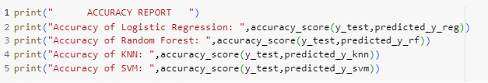
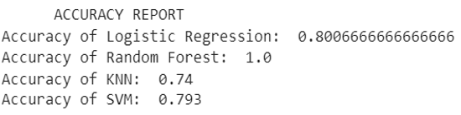
EVALUATING AND COMPARING THE ALGORITHMS
Accuracy: Accuracy measures how often the model correctly predicts churn and not churn out of all predictions made.

Slide 18

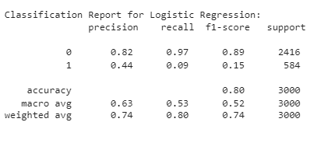
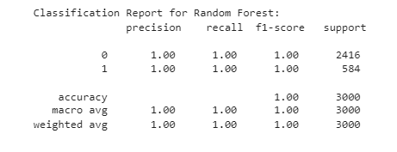
Classification Report: A classification report provides detailed metrics like precision, recall, and F1-score for each class (churn and not churn), helping to understand the model's performance in distinguishing between them.

Slide 19
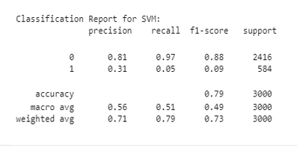
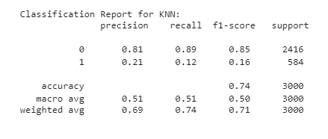

Slide 20
CONCLUSION
Best Overall Performance:
Random Forest is the best model for predicting whether a customer has churned or not. It has the highest accuracy, a good balance of precision and recall and the highest F1-score among the models evaluated.
Note:
SVM and KNN are distance based algorithms and therefore did not worked on our dataset which has more than 10lakh rows and 68 columns.

Slide 21


