Slide 1
Motion, Motions & Forces and Conservation of Energy
By : Fizah Al-Islam

Slide 2


Unit 1 : Motion
What is motion?
The dictionary definition is :
“The action or process of moving or being moved.”
But then you may ask, “What is an action or process?”
“An action or process is a thing that is done”
Notes:
- consider defining actions or process

Slide 3
Vectors VS Scalars – Part 1
Velocity is speed in a particular direction.
Momentum is a combination of mass and velocity.
Notes:
- a few more examples of displacement.
- consider splitting slide into section for vector and section for scalars

Slide 4
Vectors VS Scalars – Part 2
VECTORS
SCALARS
Vectors have both magnitude* and direction.
Forces are vectors, which is why they are shown on diagrams with arrows.
Displacement is the distance covered in a straight line, and it has a direction.
E.g. take a bathtub full of water, add more objects, the displacement increases north.
If you reduce the objects, the displacement is higher south
Scalars only have magnitude.
Examples of scalars are :
distance, speed, energy and time.
Distance is the length of the space between two points.
For example, if Bob cycles from point A to point B, the space between A and B is the distance.
Notes:
- *Magnitude = size

Slide 5
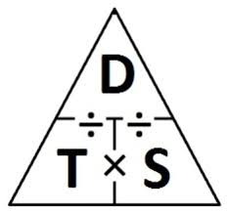
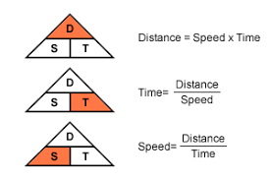
Distance/Time Graphs – Part 1
Speed can change during a journey, so the average speed is worked out.
Average speed is used to find the speed over the whole journey, but you can find the different speeds at different times of the journey in the graphs.
This equation is used to work out average speed :
average speed = distance (m)
(m/s) time taken (s)
This equation can also be rearranged to find the distance :
distance travelled = average speed x time
(m) (m/s) (s)
Notes:
- seperate between average (total journey) and speed between different parts of journey
-

Slide 6
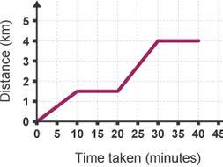
Distance/Time Graphs – Part 2
A journey can be shown on a distance/time graph. Since you use distance and time to work out speed, the graph gives infromation about the speed as well.
Facts about distance/time graphs:
If the line is horizontal, it means the object is stationary (not moving)
Straight, sloping lines means the object is travelling at a constant speed
The steeper the line, the faster the object is travelling
Speed is calculated from the gradient of the line.

Slide 7
Acceleration – Part 1
A change in velocity is called acceleration. Acceleration is a vector quantity, meaning it has both size and direction.
Acceleration tell you the change in velocity each second.
The following equation is used to calculate acceleration:
acceleration = change in velocity (m/s)
(m/s2) time taken (s)
It can also be written as :
a = v – u a = acceleration
t v = final velocity
u = initial velocity
t = time taken for change in velocity

Slide 8
Acceleration – Part 2
If an object is slowing down, the acceleration will have a negative value.
Acceleration can also be related to initial velocity.
(final velocity)2 - (initial velocity) = 2 x acceleration x distance
(m/s)2 (m/s)2 (m/s2) (m)
This can also be written as :
v2 – u2 = 2 x a x d
Deceleration occurs when v < u according to the previous equation
An object in free fall is moving downwards because of gravity.
If there are no other forces acting upon it (air resistance), the acceleration due to gravity is 9.8 m/s2.
Notes:
- deceleration occurs when v < u according to the previous eqtn
- make eqtn v2 – u2 = 2 x a x d

Slide 9
Velocity/Time Graphs – Part 1
The changing velocity of a dragster can be shown in a velocity/time graph·
Facts about a velocity/time graph :
A horizontal line means the object is moving at a constant speed.
A sloping line upwards means that an object is accelerating. The higher the gradient*, the higher the acceleration. If the line slopes down to the right, the object is decelerating.
You can find the acceleration of an object from the gradient of the line in a velocity/time graph.
Notes:
- *Gradient = steepness of the line

Slide 10
Key Concepts of Topic 1
Vectors have magnitude and direction, scalars only have magnitude.
Speed = distance x time
In a distance/time graph, the speed is the gradient of the line.
Acceleration is a change in velocity a specific time.
Acceleration = change in velocity
time taken
Acceleration is the gradient of the line on a velocity/time graph.

Slide 11
Unit 2 – Motion And Forces
Resultant Forces – Part 1
What is the resultant force?
A resultant force is a force equal to the sum of all forces acting on an object.
If 10N and another 10N are applied to the right, the resultant force is 20N. But if 40N is applied to the left, and 30N applied to the right, the resultant force is 10N left.
Why do this?
The rules of resultant forces are simple:
If the forces are acting in the same direction, add them
If they are acting in opposite direction, subtract the smaller force from the larger force.

Slide 12
Resultant Forces – Part 2
If the resultant of all forces are 0, the forces are called balanced. If there in a non-0 resultant force on the object, the object is now called non-balanced.

Slide 13

Newton’s First Law – Part 1
Newton’s first law is :
A moving object will continue to move at the same speed and direction unless an external force acts on it.
A stationary object will also remain stationary unless an external force acts upon it.
E.g. if you kick a ball, it will keep flying until another force acts upon it. This may sound weird, but there are other forces acting upon it the second you kick it.

Slide 14
Newton’s First Law – Part 2
What is circular motion?
An object that moves around in has a changing velocity, but the speed stays the same.
The resultant force that causes the change in direction is called the centripetal force, and that acts towards the centre of the circle.

Slide 15
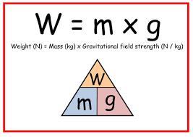
Mass & Weight
A lot of people get the definitions of mass and weight confused.
Mass = the quantity of matter there is in an object.
Weight = a measure of the pull of gravity on an object.
The unit for mass is Kg (kilograms), and because weight is a force, it can be measured in N (newtons).
On Earth, the gravitational field strength, is 9.8 newtons per kilogram (N/kg), but most scientists round it up to 10 N.
The weight of an object can be found using this equation:
weight = mass x gravitational field strength
(N) (Kg) (N/Kg)
This can also be written as :
W = m x g

Slide 16
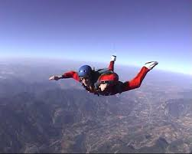
Mass & Weight – Part 2
Forces on falling bodies:
On Earth, a falling object has air resistance acting upon it too.
0.5 seconds after jumping.
speed = 5 m/s
3 seconds after jumping.
speed = 25 m/s
12 seconds after jumping.
speed = 55 m/s
Air resistance increases with speed, so the air resistance is smaller than her weight. The larger resultant force makes her accelerate downwards.
Her air resistance is larger, but her weight starys the same. The resultant force is still smaller, so she is still accelerating, but not as fast.
She is moving so fast that the air resistance balances her weight. She continues to fall at same speed.

Slide 17
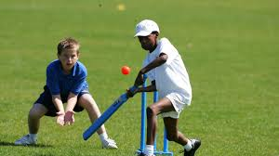
Newton’s Second Law – Part 1
What is Newton’s second law?
Newton's second law states that when you push an object with more force it will move faster and farther away.
E.g. hit a cricket ball lightly and it can travel 5m at 2 m/ph, but his it harder and it can travel 20m at 10 m/ph.

Slide 18
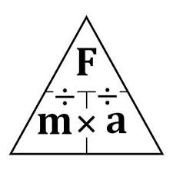
Newton’s Second Law – Part 2
The force needed to accelerate a particular object can be calculated with this equation:
force = mass x acceleration
(N) (Kg) (m/s2)
This can also be written as :
F = m x a
Inertial Mass:
The inertial mass of an object is the force on it divided by the by the acceleration the force produces.

Slide 19
Newton’s Third Law
What is Newton’s third law?

