Slide 1
UE22AM241B – Mathematics for Machine Learning
Course Project
Project Title :
HEART DISEASE PREDICTION USING GRAPH NEURAL NETWORK ON IMBALANCED DATASETS CHARACTERISED BY MISSING VALUES.
Team member 1 SRN and name: PES1UG22AM032 ARUNDHATI SITHARAM
Team member 2 SRN and name: PES1UG22AM043 BHUMIKA S MANDIKEL
Team member 3 SRN and name: PES1UG22AM047 CHANDANA S
Team member 4 SRN and name: PES1UG22AM059 FIZA HANEEN

Slide 2
Topic
Define your problem statement crisply
Graph Neural Network (GNN) approach, aiming to improve accuracy and robustness on imbalanced datasets characterized by missing values for heart disease prediction.

Slide 3
Uniqueness
Why you think this project is interesting or unique
Graph Neural Networks (GNNs):GNNs are one of the latest advancements in machine learning that excel at capturing the intricate relationships and dependencies between data points—a quality they often employ for healthcare applications like predicting heart disease. The project exemplifies the potential of GNNs in achieving accurate and robust predictive capabilities.
Tackling Imbalanced Datasets: Imbalanced datasets are a common theme found in most machine learning applications, especially in the field of healthcare where few patients may suffer from a rare disease. This project takes up the challenge of class imbalance by working out strategies within the GNN framework, contributing to the creation of more reliable and unbiased predictive models
Handling Missing Values: As most modern healthcare datasets often involve missing values, this is considered one of the primary challenges in machine learning; the current approaches to imputation may not be sufficient, leading to a loss of important data. By integrating GNNs, which can effectively capture from the incomplete data and retain structural information, this project offers a novel approach for handling missing values in heart disease prediction.

Slide 4
Uniqueness
Potential Impact on Healthcare:Heart disease is an important cause of mortality across the globe, and predictive models will help in early detection and intervention. By improving the accuracy and robustness of these models, this project can have a direct positive impact on the outcomes of patients and healthcare decision-making.
Interdisciplinary Collaboration:Combining the most recent trends in machine learning with healthcare and data preprocessing techniques, such as working on handling missing values and class imbalance, makes this project quite interesting and unique in the predictive modeling field of heart disease. This interdisciplinary approach can inspire cross-domain collaborations and innovations.

Slide 5
Dataset
Size: 2,50,000 instances (complete dataset)
Attributes:
HeartDiseaseorAttack,HighBP,HighChol,CholCheck,BMI,Smoker,Stroke,Diabetes,PhysActivity,Fruits,Veggies,HvyAlcoholConsump,AnyHealthcare,NoDocbcCost,GenHlth,MentHlth,PhysHlth,DiffWalk,Sex,Age,Education,Income.
Source: Kaggle Dataset(Heart-disease.csv)
We opted for heart disease prediction over sepsis prediction due to the absence of positive sepsis cases in the dataset,as indicated by a column entirely populated with zeros.

Slide 6
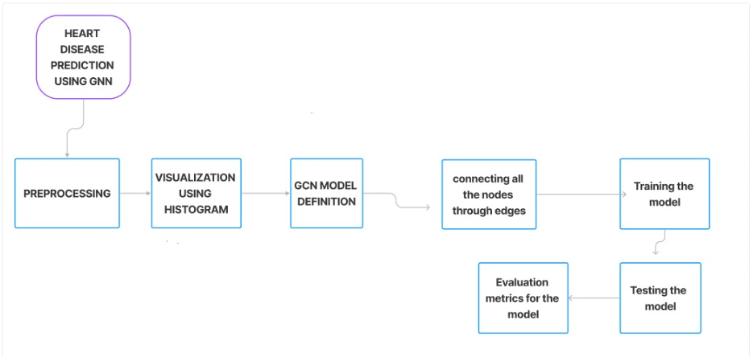
Overall design or approach in a diagram

Slide 7
Final results so far
EVALUATION METRICS :
Accuracy, Precision, Recall, F1-score, Support
Visualizations:
Histograms of Features:
Utilized histograms to visualize the distribution of features in the dataset.Analysed the histograms to gain insights into the data’s characteristics and potential impact
Key Findings:
The GNN model demonstrated strong predictive performance, with an accuracy of 0.91, indicating its ability to accurately classify heart disease cases.
Insights gained from feature histograms contributed to a better understanding of the dataset and potentially informed feature engineering or selection strategies for future iterations of the model.

Slide 8
Done vs Remaining to be done ?
No | Description | Done or To be done
1 | Preprocessing/Handling missing data | Done
2 | Visualization using histograms for analysis | Done
3 | GCN model definition | Done
4 | Handling Class Imbalance | To be done
5 | Training the model with the whole dataset | To Done
6 | Testing the model for test part of dataset | Done
7 | Evaluation metrics for the model | Done

Slide 9
Quantity and quality of work
no | Code functionality | % Complete | Runs without problem (Y/N) | If there are minor issues, indicate
1. | Plotting the bar chart for imbalanced data | 100% | Y | No
2. | Preprocessing | 100% | Y | No
3. | Handling the imbalanced data | 50% | Y | We have used only one approach ,we will use the other approaches later
4. | Printing data characteristics(for analysis) | 100% | Y | No
5. | Defining GCN model | 100% | Y | No
6. | Created a fully connected graph by connecting all the nodes through edges | 100% | Y | No
7. | Train the model with batches of data | 75% | Y | Due to memory limitations, we haven’t been able to create a node for each instance (we have 1000 nodes currently)
8. | Testing the model for test part of dataset | 100% | Y | No
9. | Evaluation metrics for the model | 100% | Y | No

Slide 10
Top few learning
Serial No | Top learning in this project
1. | Tackling Imbalanced dataset
2. | The project exemplifies the potential of GNNs in achieving accurate and robust predictive capabilities.
3. | Defining and understanding GNN models
4. | This project can have a direct positive impact on the outcomes of patients and healthcare decision-making.

Slide 11
Reference papers (optional)
No | Paper Title | Authors | Publication details Year, published where
1 | Predicting Heart attack through explainable Artificial Intelligence | Mehrdad Aghamohammadi,Mandvi Madan,Jung Ki Hong & Ian Watson | 2019,Switzerland AG
2 | Unveiling Key predictors for Early Heart attack detection using Machine Learning and Explainable AI Technique with LIME | Prakash Paudel Satish Kumar Karna Ruby Saud Loknath Regmi | 2023,Khulna,Bangladesh
3 | Heart Disease Prediction using Graph Neural Network | Rakhi Wajgi,Tushar Champaneria,Dipak Wajgi,Yogesh Suryawanshi,Dinesh Bhoyar,Ajinkya Nilawar | 2024,Maharashtra (India)

